Slide 1
Introduction to Community Health Workers in HIV Care

Slide 2
Objectives
Introduction to Community Health Workers in HIV Care
At the end of this unit participants will be able to:
Describe how CHWs can fit into the HIV care continuum, within the context of the national CHW movement
Identify CHW roles and tasks
Notes:
Review objectives.

Slide 3
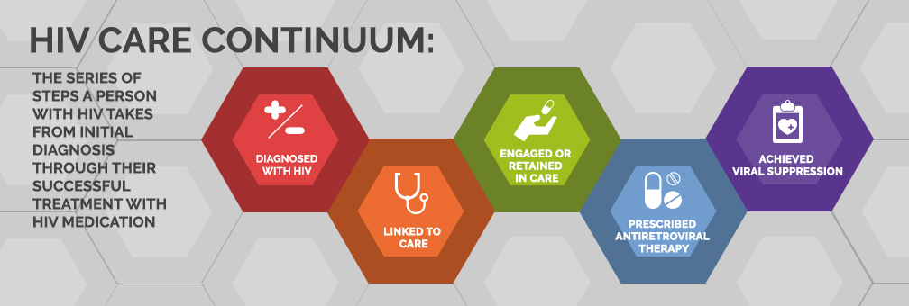
HIV Care Continuum
Introduction to Community Health Workers in HIV Care
Notes:
Review the diagram. The HIV care continuum follows a person from the time they are first diagnosed to achieving viral suppression (a very low level of HIV in the body). However researchers observed that in order for people living with HIV to benefit from the available treatment, a person must first know their diagnosis, engage in HIV medical care and see a prescribing health care provider regularly, and receive and adhere to antiretroviral therapy. Many people do not make it through all these stages due to several obstacles. Ask participants: “Why might people not complete the steps of the HIV Care Continuum?”
CHW can play a role in each step of the continuum and reduce the gaps in each stage of the continuum. For example, CHWs can provide health information, conduct testing, and refer clients to a health provider and other resources.

Slide 4
ACTIVITY: C3 ROLES
Notes:
Think-pair-share activity
Ask participants to review the handouts, paying particular attention to the C3 roles they might do as a community health worker.
Have participants pair up to discuss a concrete activity they could do with a person with HIV to improve outcomes at each stage. For example, what are things that you can do to help people learn their HIV status?
Ask participants to write on post-it notes 3-5 tasks that could improve HIV care continuum outcomes.
Ask volunteers to share their CHW roles and tasks to achieve the outcomes.
Discuss: Did we miss any key task?
Show the next slide and refer to C3 roles.

Slide 5
CHW Role in the HIV Care Continuum
Introduction to Community Health Workers in HIV Care
CHW Role (C3) | HIV Care Continuum
Conduct Outreach | Support Linkage & Engagement in Care: Identify, test & link newly diagnosed individual to HIV care Find PLWH who are out of care & build relationships
Care Coordination, Case Management, System Navigation | Support Linkage & Engagement in Care: Make referrals to health specialists or mental health services Provide appointment reminders Accompany to medical appointments
Providing Coaching & Social Support | Support Adherence to Treatment & Achieve Viral Suppression: Educate about HIV treatment Obtain medications Address side effects Understand labs
Implementation of Community & Individual Needs Assessment | Support Retention in Care: Collaborate with HIV medical case manager to develop a care plan to address patient goals
Notes:
Review CHW roles in the HIV care continuum listed on the slide.
Resume activity:
Have participants place their post-it notes on the appropriate stage on the care continuum poster.
Discussion:
Ask, “What are some one-on-one tasks that you could do with a person with HIV to achieve the goals of the care continuum?”
Ask, “What are some roles for you as CHW on the HIV care team in your agency, within the care continuum?”
Ask, “What are key roles for you as a CHW at the community level to impact the HIV care continuum?”
Ask, “How do roles and skills relate to the HIV care continuum in your region?”
Open discussion for other questions and answers.

Slide 6
Get Involved!
Introduction to Community Health Workers in HIV Care
Connect with a CHW Association in your state
Ryan White Programs
Link to Ryan White Planning councils and HIV Department at your State Health Department—Become a member!
Consumer advisory boards for Ryan White support clinics in your area.
Notes:
Share information about how CHWs can learn about HIV/AIDS services in their community by connecting to their State Health Department or local Ryan White Planning Council.

