Slide 1

end+disparities ECHO Collaborative:
An Overview of the Literature
Clemens Steinbock, MBA
clemens.steinbock@health.ny.gov
Updated January 19, 2017

Slide 2
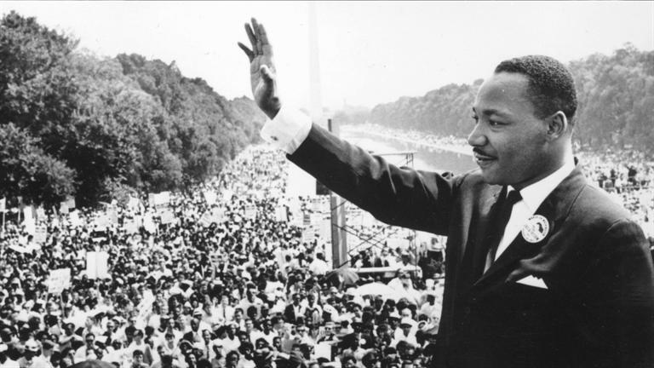
“Of all the forms of inequality, injustice in health care is the most shocking and inhumane.”
- Martin Luther King

Slide 3

What is the lifetime risk of HIV diagnosis for MSM?
1 in 6
1 in 12
1 in 18
CDC/NCHHSTP. 2016 conference on retroviruses and opportunistic infections--CROI graphics: lifetime risk of HIV diagnosis in the United States. Updated 2016 Feb 24. Available from http://www.cdc.gov/nchhstp/newsroom/2016/croi-2016.html
Notes:
Answer: A, 1 in 6

Slide 4
The lifetime risk of an HIV diagnosis for White MSM is 1 in 11. What is the risk for Black MSM?
1 in 2
1 in 4
1 in 6
CDC/NCHHSTP. 2016 conference on retroviruses and opportunistic infections--CROI graphics: lifetime risk of HIV diagnosis in the United States. Updated 2016 Feb 24. Available from http://www.cdc.gov/nchhstp/newsroom/2016/croi-2016.html
Notes:
Answer: A, 1 in 2

Slide 5
In the U.S., what percentage of new HIV diagnoses each year occur in African Americans?
24 percent
45 percent
64 percent
CDC. HIV/AIDS: HIV among African Americans. Updated 2017 Oct 26. Available from http://www.cdc.gov/hiv/group/racialethnic/africanamericans/
Notes:
Answer: B, 45%

Slide 6
What percentage of all HIV/AIDS-related deaths in 2014 occurred among African-Americans?
34 percent
44 percent
53 percent
CDC. HIV/AIDS: HIV among African Americans. Updated 2017 Oct 26. Available from http://www.cdc.gov/hiv/group/racialethnic/africanamericans/
Notes:
Answer: C, 54%

Slide 7
In the U.S., 1,400 white women were diagnosed with HIV in 2015. How many African American women were diagnosed?
1,000
3,000
4,500
CDC. HIV/AIDS: HIV among African Americans. Updated 2017 Oct 26. Available from http://www.cdc.gov/hiv/group/racialethnic/africanamericans/
Notes:
Answer: C, 4,500

Slide 8
The lifetime risk of an HIV diagnosis for White women is 1 in 880. What is the risk for African American women?
1 in 480
1 in 48
1 in 4.8
CDC/NCHHSTP. 2016 conference on retroviruses and opportunistic infections--CROI graphics: lifetime risk of HIV diagnosis in the United States. Updated 2016 Feb 24. Available from http://www.cdc.gov/nchhstp/newsroom/2016/croi-2016.html
Notes:
Answer: B, 1 in 48

Slide 9
In the U.S., what percentage of youth aged 13 to 24 with HIV are unaware of their infection?
24 percent
36 percent
51 percent
CDC. HIV/AIDS: HIV among youth. Updated 2017 Oct 26. Available from http://www.cdc.gov/hiv/group/age/youth/
Notes:
Answer: C, 51%

Slide 10
The overall HIV prevalence in the U.S. is estimated to be 0.5%. What is the estimated HIV prevalence among transgender women?
8 percent
18 percent
22 percent
UNAIDS. Data Sheet. HIV Prevalence . Accessed Nov 15 2017. Available from http://aidsinfo.unaids.org/
CDC. HIV/AIDS: HIV among transgender people. Updated 2017 Aug 3. Available from http://www.cdc.gov/hiv/group/gender/transgender/
Notes:
Answer: C, 22%

Slide 11
How many times more likely is it for a transgender woman to acquire HIV than all adults of reproductive age?
~5 times more likely
~15 times more likely
~50 times more likely
UNAIDS. The Gap Report 2014: transgender people. 2014 October 16. Available from http://www.unaids.org/en/resources/documents/2014/Transgenderpeople
Notes:
Answer: C, ~50 times more likely

Slide 12

"All human beings are born free and equal in dignity and rights."
- United Nations, Article 1 of the Universal Declaration of Human Rights

Slide 13
What is a Health Disparity?
“Differences in health outcomes or health determinants observed between populations” – Centers for Disease Control (CDC)

Slide 14
What is a Health Disparity?
“A population is a health disparity population if there is a significant disparity in the overall rate of disease incidence, prevalence, morbidity, mortality, or survival rates in the population as compared to the health status of the general population.”
– Minority Health and Health Disparities Research and Education Act, United States Public Law 106-525 (2000)

Slide 15
“It is time to refocus, reinforce, and repeat the message that health disparities exist and that health equity benefits everyone.”
- Former U.S. Secretary of Health and Human Services Kathleen Sebelius

Slide 16
Did you know?
Young people are 5 times more likely to have HIV than people older than 25
Black women are 20 times more likely to have HIV than white women
Men who have sex with men are 46 times more likely to have HIV than other men
Transgender women are 50 times more likely to get HIV than other adults
http://www.unaids.org/sites/default/files/media_asset/08_Transgenderpeople.pdf
http://www.cdc.gov/hiv/pdf/statistics_hssr_vol_17_no_4.pdf
http://www.aidsmap.com/HIV-positive-youth-are-less-likely-than-adults-to-achieve-viral-suppression-on-antiretroviral-treatment/page/2994025/
http://www.cdc.gov/mmwr/preview/mmwrhtml/su6203a19.htm?s_cid=su6203a19_w

Slide 17
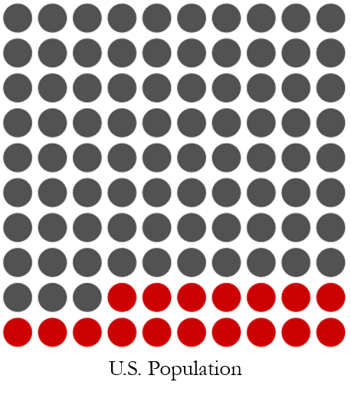
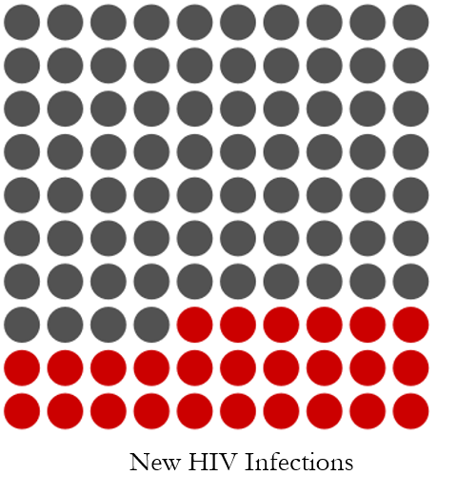
HIV Disparities at a Glance
17% of the U.S. population is aged 13 to 24
22% of new HIV infections in 2015 were among young persons (aged 13 to 24)
Reisner SL, Vetters R, White JM, Cohen EL, LeClerc M, Zaslow S, et al. Laboratory-confirmed HIV and sexually transmitted infection seropositivity and risk behavior among sexually active transgender patients at an adolescent and young adult urban community health center. 2015. AIDS Care. 2015;27(8):1031-1036
CDC. HIV/AIDS: HIV among youth. Updated 2017 Oct 26. Available from http://www.cdc.gov/hiv/group/age/youth/
.

Slide 18
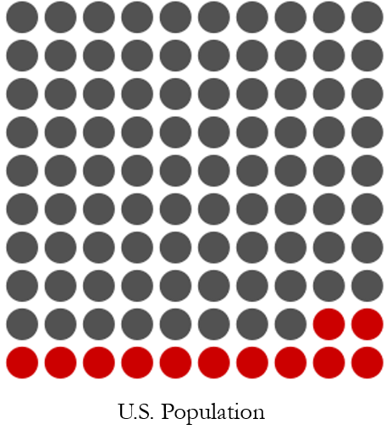
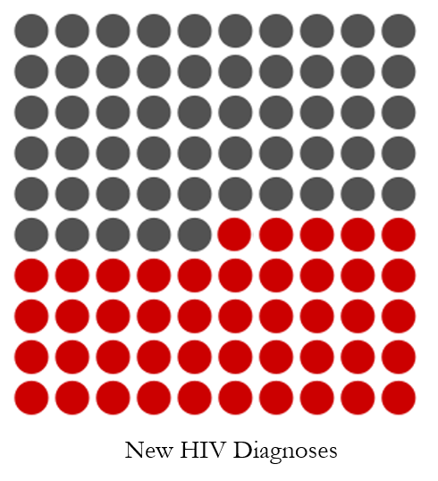
HIV Disparities at a Glance
12% of the U.S. population is African-American
45% of new HIV diagnoses in 2014 were among African-Americans
CDC. HIV/AIDS: HIV among African Americans. Updated 2016 Feb 4. Available from http://www.cdc.gov/hiv/group/racialethnic/africanamericans/

Slide 19

Black lives lost to HIV/AIDS in 2014…
…account for 53% of total deaths due to the disease.
3,591 lives
CDC. HIV/AIDS: HIV among African Americans. Updated 2016 Feb 4. Available from http://www.cdc.gov/hiv/group/racialethnic/africanamericans/

Slide 20
“The essence of global health equity is the idea that something so precious as health might be viewed as a right.”
- Paul Farmer

Slide 21
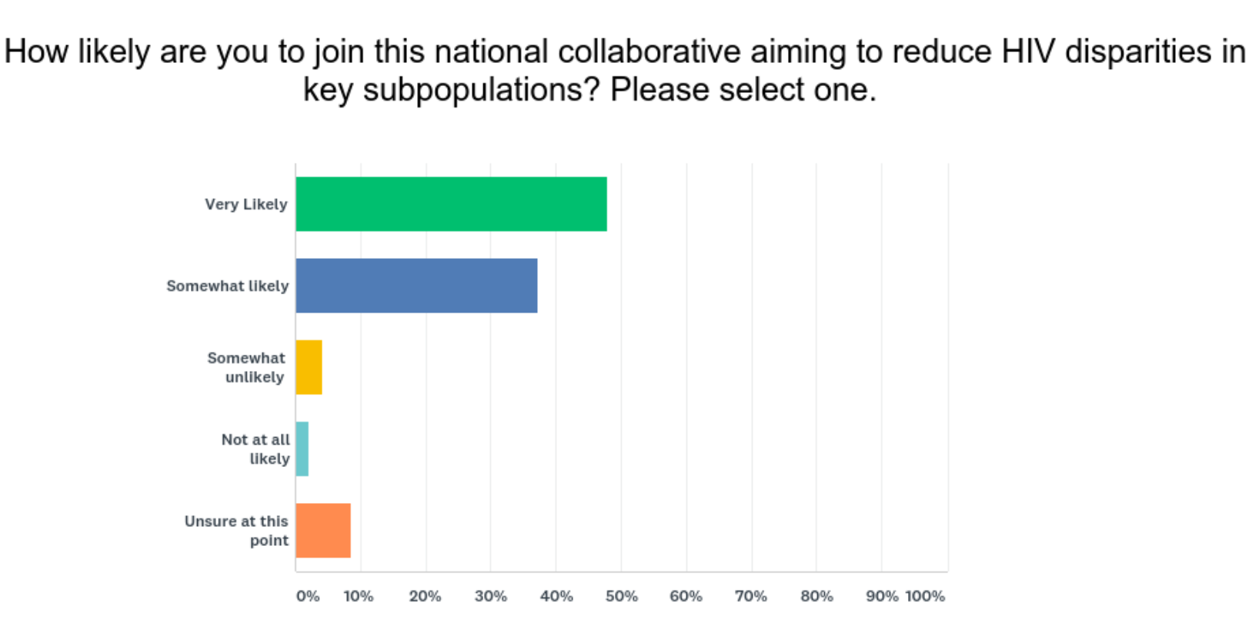
CQII Online Survey – Nov 2017
259 individual responses
[as of December 4, 2017]
97% of respondents stated that the focus of the Collaborative is in line with priorities of HIV providers (n=256)
85% of respondents reported that they were “Very Likely” (48%) or “Somewhat Likely” (37%) to join the initiative (n=163)
Online Needs Assessment Report, December 4, 2017
Notes:
Based on the suggestions in NHAS and from informant interviews, NQC decided to develop a new national initiative to address the need for quality improvement work in dealing with HIV disparities. This led to the creation of the end+disparities Learning Exchange.
Roughly one-quarter of all RWHAP recipients responded to this needs assessment.
In addition, 9 out of 10 respondents stated that they are willing to participate in a national improvement effort.
NQC interviewed 12 experts in the field, including HIV providers, consumers, QI experts, and other stakeholder; virtually every interviewee stated that the topic of reducing HIV-related disparities resonated with them.
What quality improvement domains have the lowest score using the NQC Organizational Assessment Tool? (n=192) The domain with the lowest scores (areas needing assistance) was in measuring disparities (mean 1.2; 24% scoring 3 or higher)

Slide 22
“We become not a melting pot but a beautiful mosaic. Different people, different beliefs, different yearnings, different hopes, different dreams.”
- Jimmy Carter

Slide 23




Disparity HIV Subpopulations
MSM of Color
African American and Latina Women
Youth
Transgender People

Slide 24

Disparities among MSM of Color
“When new infections among young black gay men increase by nearly 50% in 3 years, we need to do more to show them that their lives matter.”
- Former President Barack Obama
Notes:
Clemens
At the most recent 2016 conference on Retroviruses and Opportunistic Infections, the CDC released several statistics related to the life time risk for being diagnosed with HIV. A CDC study released in February 2016 provides the first-ever comprehensive national estimates of the lifetime risk of an HIV diagnosis for several key populations at risk and in every state.
Overall, the likelihood that an American will be diagnosed with HIV at any point during his or her life is now 1 in 99, an improvement from a previous study using 2004-2005 data that reported lifetime risk at 1 in 78. Despite overall progress, this study reveals stark disparities by race, risk group and geography.

Slide 25
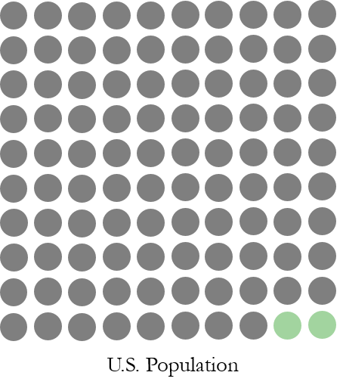
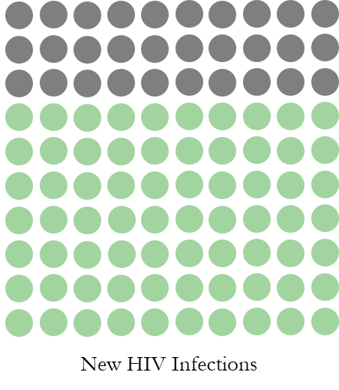
Disparities among MSM
2% of the U.S. population identify as MSM
70% of new HIV infections are among MSM
CDC. HIV/AIDS: HIV among gay and bisexual men. Updated 2017 Sept 27. Available from http://www.cdc.gov/hiv/group/msm/

Slide 26
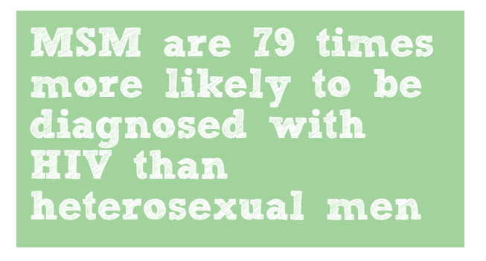
Disparities among MSM
CDC/NCHHSTP. 2016 conference on retroviruses and opportunistic infections--CROI graphics: lifetime risk of HIV diagnosis in the United States. Updated 2016 Feb 24. Available from http://www.cdc.gov/nchhstp/newsroom/2016/croi-2016.html
Notes:
1 in 6 lifetime risk for MSM
1 in 473 lifetime risk for heterosexual men
473/6=78.8

Slide 27


MSM of Color
1 in 11 White MSM will be diagnosed with HIV in his lifetime
1 in 4 Hispanic MSM will be diagnosed with HIV in his lifetime
1 in 2 African American MSM will be diagnosed with HIV in his lifetime
CDC/NCHHSTP. 2016 conference on retroviruses and opportunistic infections--CROI graphics: lifetime risk of HIV diagnosis in the United States. Updated 2016 Feb 24. Available from http://www.cdc.gov/nchhstp/newsroom/2016/croi-2016.html
Notes:
Clemens
This statistic is even more striking after considering the a study by Harawa indicating that the number of sexual partners by Black MSM is lower than for White MSM, as well as the occurrence of unprotected anal intercourse.

Slide 28
MSM of Color
The estimated rate of HIV infection among MSM over 18 years is a 46-fold difference compared with all other men
In 2015, young MSM (aged 13 to 24 years) accounted for 92% of new HIV infections among all youth, and 27% of new infections among all MSM
In 2015, 38% of all new diagnoses in black MSM were 13 to 24 years old.
Johnson AS, et al. CDC health disparities and inequalities report: HIV infection—United States, 2008 and 2010. MMWR. 2013;62(3);112-119.
CDC. HIV/AIDS: HIV among Gay and Bisexual Men.. Updated 2017 Sept 27. Available from https://www.cdc.gov/hiv/group/msm/index.html
CDC. HIV/AIDS: HIV among African American gay and bisexual men. Updated 2017 Sept 27. Accessed from http://www.cdc.gov/hiv/group/msm/bmsm.html

Slide 29
HIV Care Continuum (Black MSM vs. White MSM)
Black MSM are 47% less likely than White MSM to achieve viral suppression (16% vs 34%).
Rosenberg ES, Millett GA, Sullivan PS, del Rio C, and Curran JW. Understanding the HIV disparities between Black and White men who have sex with men in the USA using the HIV Care Continuum: a modelling study. Lancet HIV. 2014;1(3):e112-e118.

Slide 30
Viral Suppression in MSM diagnosed with HIV
47% of white MSM are virally suppressed
37% of Hispanic MSM are virally suppressed
28% of black MSM are virally suppressed

Slide 31
“It takes no compromise to give people their rights. It takes no money to respect the individual. It takes no political deal to give people freedom. It takes no survey to remove repression.”
- Harvey Milk

Slide 32
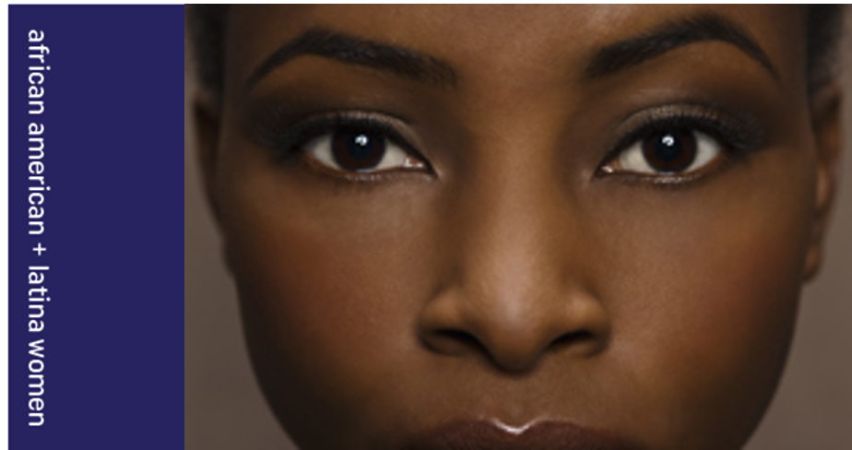
Disparities among African American and Latina Women
“Racial disparity and HIV rates in the United States is a major civil rights issue, and it is, in fact, a major human rights issue.“
- Dr. Adaora Adimora, University of North Carolina

Slide 33
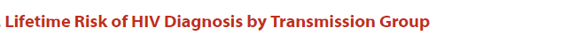
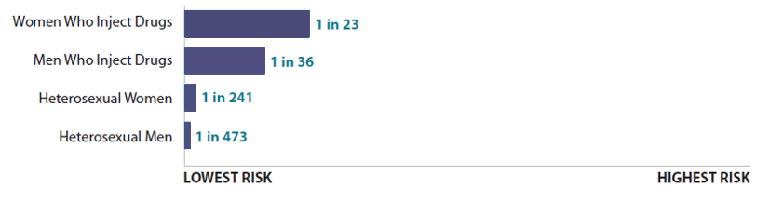
Disparities among Women vs Men
Heterosexual women are twice as likely to be diagnosed with HIV as heterosexual men. Women who inject drugs are also at a higher risk than men who inject drugs.
CDC/NCHHSTP. 2016 conference on retroviruses and opportunistic infections--CROI graphics: lifetime risk of HIV diagnosis in the United States. Updated 2016 Feb 24. Available from http://www.cdc.gov/nchhstp/newsroom/2016/croi-2016.html

Slide 34
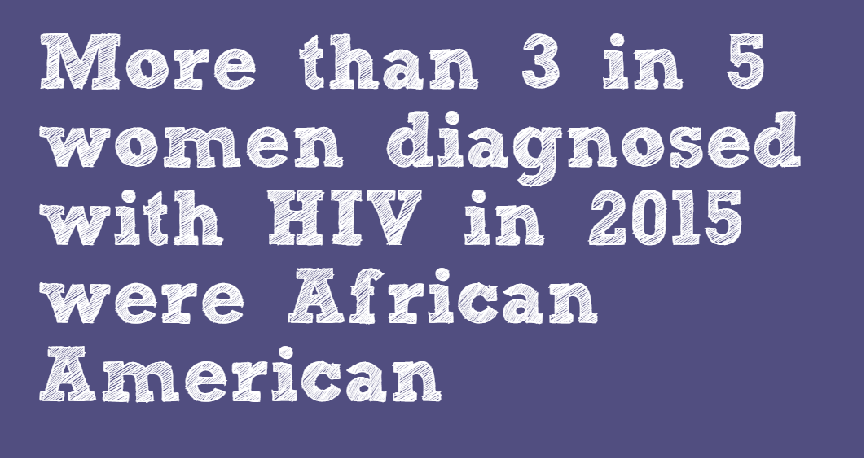
Disparities among Women
CDC. HIV/AIDS: HIV among women. Updated 2017 Mar 10. Available from http://www.cdc.gov/hiv/group/gender/women/

Slide 35
African American and Latina Women
13% of the U.S. female population are African American women
61% of new HIV infections among women occur among African American women
U.S. Female Population
New HIV Infections
CDC. HIV/AIDS Resource Library Slide Sets: HIV surveillance in women (through 2015). Updated 2017 July 27. Available from https://www.cdc.gov/hiv/pdf/library/slidesets/cdc-hiv-surveillance-women.pdf

Slide 36
African American and Latina Women
Of the total number of estimated new HIV infections among women, 61% were in African Americans (4,524), 19% were in white people (1,431), and 15% were in Latinas (1,131).
CDC. HIV/AIDS: HIV among women. Updated 2016 Mar 16. Available from http://www.cdc.gov/hiv/group/gender/women/

Slide 37
African American and Latina Women
1 in 880 white women will be diagnosed with HIV in her lifetime
African American women are 18 times more likely to be diagnosed with HIV than white women
Latina women are 4 times more likely to be diagnosed with HIV than white women
CDC/NCHHSTP. 2016 conference on retroviruses and opportunistic infections--CROI graphics: lifetime risk of HIV diagnosis in the United States. Updated 2016 Feb 24. Available from http://www.cdc.gov/nchhstp/newsroom/2016/croi-2016.html

Slide 38
“We all should know that diversity makes for a rich tapestry, and we must understand that all the threads of the tapestry are equal in value no matter what their color.”
- Maya Angelou

Slide 39

Disparities among Youth (13-24)
“Rather than letting my serostatus set my life ablaze, I allowed it
to set a fire under me.”
- Adrian, National Youth HIV & AIDS Awareness Day Ambassador

Slide 40
Youth (13-24)
One in five new HIV diagnoses in 2015 were among persons aged 13 to 24 years
CDC. HIV/AIDS: HIV among youth. Updated 2017 Oct 26. Available from http://www.cdc.gov/hiv/group/age/youth/

Slide 41
Youth (13-24)
Only 6% of youth are estimated to be virally suppressed, compared to an average rate of 30% across all age groups.
Zanoni BC and Mayer KH. The adolescent and young adult HIV cascade of care in the United States: exaggerated health disparities. AIDS Patient Care STDS. 2014;28(3):128-35. CDC, http://www.cdc.gov/hiv/pdf/library/factsheets/understanding-hiv-care-continnum.pdf

Slide 42
Youth (13-24)
Black youth ages 13 to 19 accounted for 63% of all new HIV infections among youth in 2014, though Blacks comprise only 14% of this population. Latino youth accounted for 20% of infections in this population; White youth accounted for 12%
In 2013, young Black women made up 64% of all women ages 13 to 24 living with a diagnosis of HIV
CDC. HIV/AIDS Resource Library Slide Sets: HIV surveillance in adolescents and young adults (through 2014). Updated 2016 Feb 26. Available from http://www.cdc.gov/hiv/library/slideSets/index.html

Slide 43
“For to be free is not merely to cast off one’s chains, but to live in a way that respects and enhances the freedom of others.”
- Nelson Mandela

Slide 44

Disparities among Transgender People
“Whether it’s a lack of access to quality and compassionate health care, or an out-of-date legal system that allows blatant discrimination, equality is too often out of reach for trans people.”
- Transgender Law Center

Slide 45
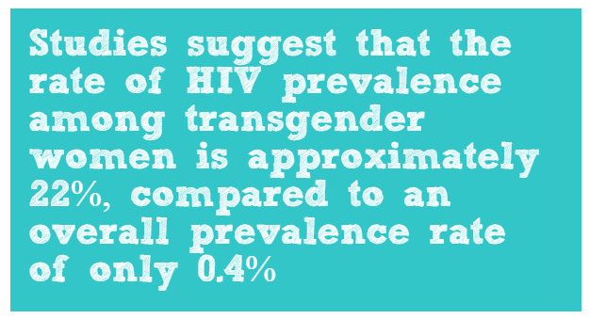
Transgender People
UNAIDS. Countries: United States of America—HIV and AIDS estimates (2012). Available from http://www.unaids.org/en/regionscountries/countries/unitedstatesofamerica Accessed June 16 2016
CDC. HIV/AIDS: HIV among transgender people. Updated 2017 Aug 3. Available from http://www.cdc.gov/hiv/group/gender/transgender/

Slide 46
Transgender People
1 in 250 odds of having HIV as an adult of reproductive age
1 in 5 odds of having HIV as a transgender woman
Transgender People are 49 times more likely to acquire HIV than all adults
UNAIDS. Countries: United States of America—HIV and AIDS estimates (2012); CDC. HIV/AIDS: HIV among transgender people. Updated 2016 Apr 18.
Baral SD et al. Worldwide burden of HIV in transgender women: a systematic review and metaanalysis. Lancet Infect Dis. 2013;13(3):214–222.

Slide 47
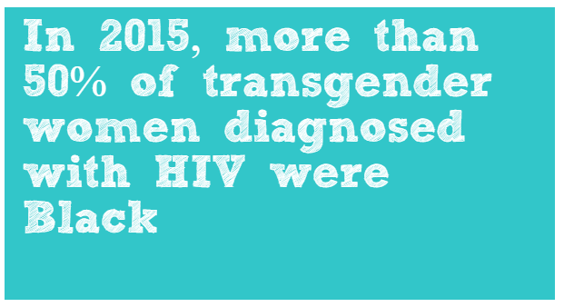
Transgender People
CDC. HIV/AIDS: HIV among transgender people. Updated 2016 Apr 18. Available from http://www.cdc.gov/hiv/group/gender/transgender/

Slide 48
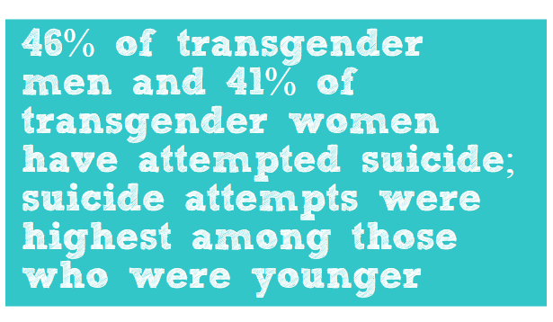
Transgender People
Haas AP, Rodgers PL, and Herman JL. Suicide attempts among transgender and gender non-conforming adults: findings of the national transgender discrimination survey. 2014 Jan.

Slide 49
Transgender People
Transgender women are less likely to receive ART treatment than non-transgender persons (59% are on ART vs 82% of a control group)
Percent of Transgender Women on ART
Melendez RM, Exner TA, Ehrhardt AA, Dodge B, Remien RH, Rotheram-Borus MJ, et al. Health and health care among male-to-female transgender persons who are HIV positive. Am J Public Health. 2006;96(6):1034-37

Slide 50
Transgender People
Estimates suggest that the transgender population could be roughly 0.6% of the total U.S. adult population
The unemployment rate for transgender people is twice the national unemployment rate; 97% of transgender people reported mistreatment, harassment and discrimination while working
HIV prevalence for transgender sex workers is 3 times higher than for male sex workers and 9 times higher than for female sex workers
Mizuno and colleagues found that transgender women have significantly lower ART dose adherence and durable viral suppression, even though they have similar rates in terms of receipt of care, treatment, and supportive services
Flores AR, Herman JL, Gates GJ, Brown TNT. How many adults identify as transgender in the United States? The Williams Institute. June 2015. Available from http://williamsinstitute.law.ucla.edu/wp-content/uploads/How-Many-Adults-Identify-as-Transgender-in-the-United-States.pdf
UNAIDS. The Gap Report 2014: transgender people. 2014 October 16.
Mizuno Y, Frazier EL, Huang P, and Skarbinski J. Characteristics of transgender women living with HIV receiving medical care in the United States. LGBT Health. 2015;2(3):228-234.

Slide 51
Ending disparities will end the HIV epidemic.

Slide 52


Learn More:
212-417-4730 (phone)
212-417-4684 (fax)
Info@CQII.org

