Slide 1



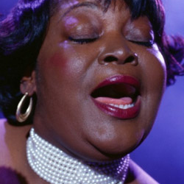



Guide to Oral Health Care for People Living with HIV/AIDS
Oral Diseases, Dental Emergencies and Patient Education
March 28, 2014
Notes:
Oral Health

Slide 2
Introduction
HRSA/HAB sponsored curriculum designed to assist primary care providers to recognize and manage oral health and disease for people living with HIV/AIDS.
Benefits of oral health integration in primary care:
  Improve earlier linkage to oral health care
  Reduce avoidable complications including oral-systemic
  Reduce burden/costs of preventable diseases
  Improve OH literacy of health care professionals and public
Webinar series
  Chapters 1-2: was conducted on March 7
  Chapters 3-5: March 28, 2-4 PM
Webcasts on TARGET Center: (https://careacttarget.org)

Slide 3
Housekeeping
Everyone is in listen only mode
Q&A will be taken during designated breaks through presentation
  Questions will be handled via chat pod or operator assistance
If you are viewing the webinar in a group, please provide the total number of people viewing the webinar in the appropriate pod.

Slide 4
Guide to Oral Health Care for People Living with HIV/AIDS
Chapter 3: Oral Diseases

Slide 5
Chapter 3:
Course Authors:
  Jeffery D. Hill, D.M.D.
  Carol M. Stewart, D.D.S., M.S.
Consultant:
  Vincent C. Marconi, M.D.
Series Editor:
  David A. Reznik, D.D.S.
HRSA, HIV/AIDS Bureau Consultant:
  Mahyar Mofidi, D.M.D., Ph.D.
Notes:
Acknowledgements:
Course Committee Authors:
Jeffery D. Hill, D.M.D.
Lauren L. Patton, D.D.S.
Therese G. Mayfield, D.M.D.
Consultants:
Vincent C. Marconi, MD
Series Editor:
David A. Reznik, D.D.S.
HRSA, HIV/AIDS Bureau Consultant:
Mahyar Mofidi, D.M.D., Ph.D.
Last Modified: February, 2014

Slide 6
Chapter 3: Learning Objectives
After viewing this presentation the learner should be able to:
  1. Be familiar with recognition and management of oral lesions commonly seen in HIV disease.
  2. Enhance ability of the medical team to recognize emergency dental needs vs. routine dental care.
  3. Discuss with patient key elements to maintain oral health.

Slide 7
Clinical Presentation
Categorizing lesions by clinical characteristics helps to focus the differential diagnosis
White lesions
Red lesions
Ulcerated lesions
Papillary lesions
Pigmented lesions
Notes:
Oral lesions can either be defined by the causative organism’s class, such as fungal, bacterial, viral, etc., or they can be grouped by general appearance. In this instance, we chose to use the descriptor to make differentiation of these oral conditions easier.

Slide 8
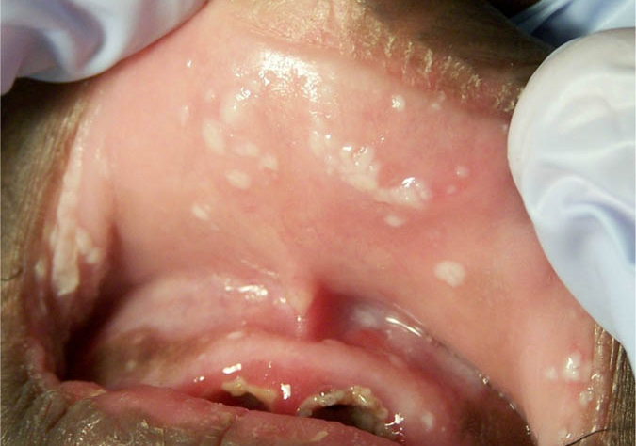
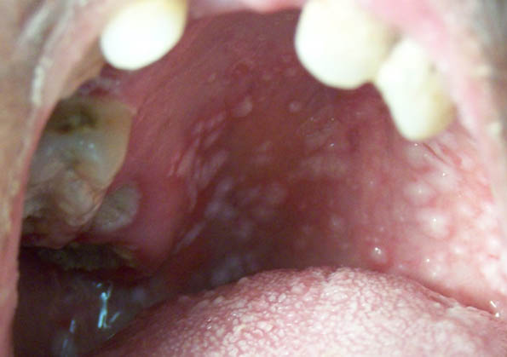
Pseudomembranous candidiasis
White Lesions
Clinical presentation
Signs: -multiple white plaques
-any mucosal surface
-can be scraped off
-red surface beneath
Symptoms: -burning sensation
-metallic taste
Etiology
  Candida albicans (most common)
  C. glabrata
Diagnosis
clinical appearance
cytological smear
Treatment (14 days)
topical anti-fungal
systemic anti-fungal
Notes:
Preferred therapy should be based on the extent of disease. Topical therapy may be considered for initial or mild-to-moderate episodes, including clotrimazole troches (10mg PO 5 times daily), nystatin suspension (4-6mL qid), or miconazole mucoadhesive tablet (1 PO daily)
For more extensive presentations, fluconazole 100mg is the medication of choice. Rx: dispense 15 tabs, take 2 PO stat, followed by one tab PO daily; it is convenient, well-tolerated and effective.
Source: Centers for Disease Control and Prevention. Guidelines for Prevention and Treatment of Opportunistic Infections in HIV-Infected Adults and Adolescents. MMWR 2009;58 (No. RR-4) April 10, 2009:45-8,155.

Slide 9
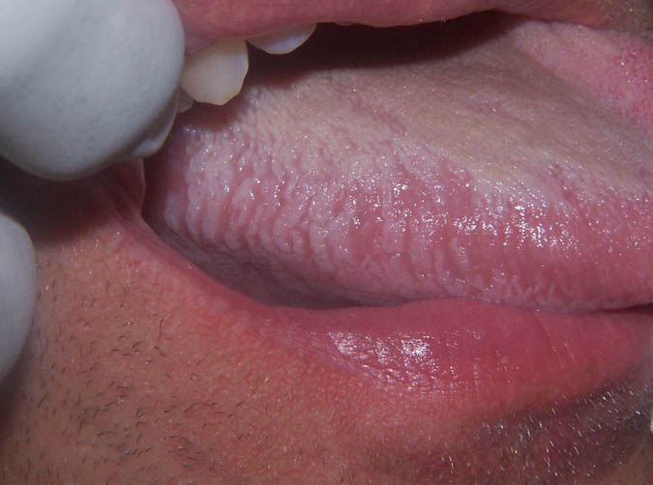
Oral hairy leukoplakia
White Lesions
Clinical presentation
Signs: -vertical corrugations
-lateral border of tongue -usually bilateral
-hairy or shaggy appearance
-cannot be wiped off
Symptoms: -painless
Etiology
  Epstein-Barr virus
Diagnosis
clinical appearance
Treatment
usually none required
high-dose anti-virals
Notes:
OHL is a common occurrence in persons with HIV that are either not on or are failing ART.
In moderate-to-severe cases, patients may desire treatment for cosmetic reasons.
Lesion resolution may be achieved via oral therapy with acyclovir 800mg PO 5 times per day for 14 days.
Recurrence is common several weeks after completion of antiviral therapy; however, lesions often spontaneously resolve or are eliminated with effective ART.
Source: Cherry-Peppers G, Daniels CO, Meeks V, Sanders CF, Reznik D. Oral manifestations in the era of HAART. J Natl Med Assoc. 2003 Feb;95(2 Suppl 2): 23S-25S.

Slide 10
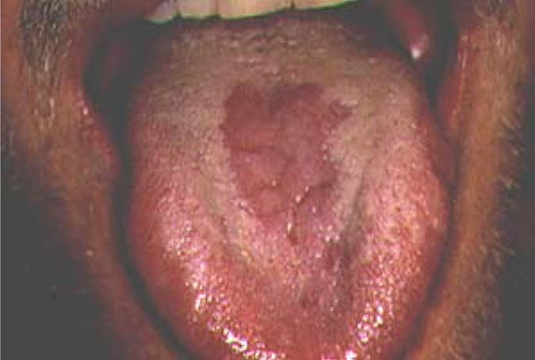
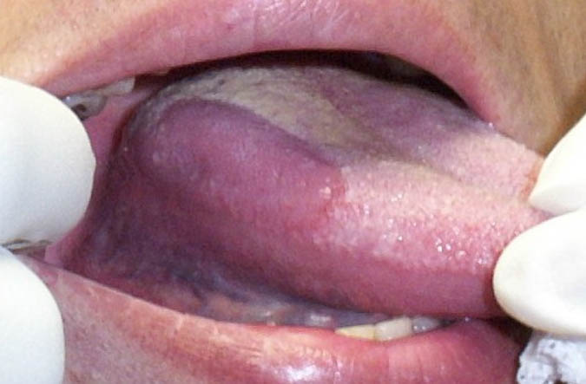
Erythematous candidiasis
Red Lesions
Clinical presentation
Signs: -macular, papillary atrophy
-dorsal tongue, hard palate
-edentulous ridge under denture or removable partial denture
Symptoms: -asymptomatic or
burning sensation
Etiology
  Candida albicans (most common)
  C. glabrata
Diagnosis
clinical appearance
cytological smear
Treatment
topical anti-fungal
Notes:
Erythematous candidiasis (EC) may be successfully treated with clotrimazole troches (10mg PO 5 times daily), nystatin suspension (4-6mL qid), or miconazole mucoadhesive tablet (1 PO daily).
For patients with dentures and removable partial dentures suffering from EC in the denture bearing areas, the dental appliance must be removed during application of the topical anti-fungal.
Dentures and partial dentures must be thoroughly cleaned and disinfected daily; complete dentures and non-metal partial dentures may be soaked for a few hours each day (or overnight) for 7-10 days in a mild bleach solution (approximately 1:10 dilution); partial dentures with metal plating should be soaked in 0.12% chlorhexidine gluconate.
Alternatively, ketoconazole 2% cream may be applied to the interior surfaces of the denture or partial denture (3-4 times a day for 7-10 days) to treat both the dental appliance and denture-bearing mucosa.

Slide 11
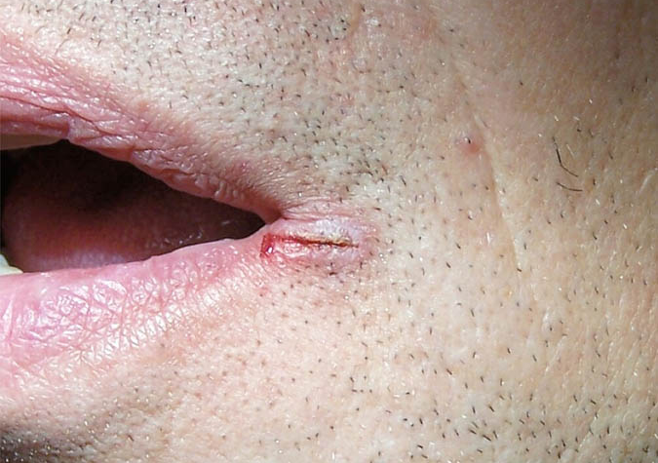
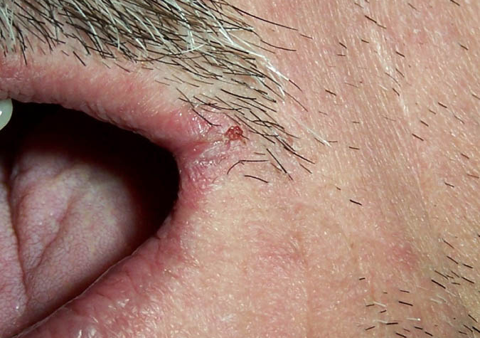
Angular cheilitis
Red Lesions
Clinical presentation
Signs: -labial commissure
-fissured, scaley patches
-unilateral or bilateral
Symptoms: -pain, bleeding
-burning sensation
Etiology
Candida albicans
Contributing factors:
nutritional deficiency
loss of vertical dimension
Diagnosis
clinical appearance
Treatment
topical anti-fungal
resolve contributing factors
Notes:
Loss of vertical dimension (a decrease in the distance between the tip of the nose and chin) occurs with ill-fitting or worn dentures, or the loss of or severe wear of the teeth; proper vertical dimension may be restored with fabrication of new dentures, partial dentures or through extensive dental treatment.
Deficiency in B vitamins 2,6 and 9 (riboflavin, pyridoxine and folic acid), as well as iron, may also contribute to conditions favorable for angular cheilitis.
Preferred topical anti-fungal therapy is ketoconazole 2% cream, applied to the affected area 3-4 times a day for 14 days; OTC clotrimazole and betamethasone combination may also be effective.
Source: Thomas DM, Mirowski GW. Nutrition and the Skin: Part I Nutrition and Oral Mucosal Diseases. Clinics in Dermatology. 2010 July; 28(4): 426-431.

Slide 12
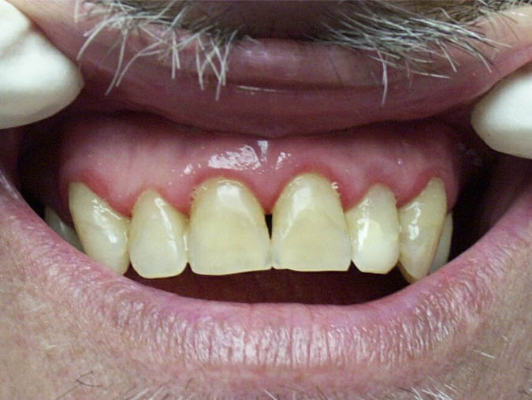
Linear gingival erythema
Red Lesions
Clinical presentation
Signs: -distinctive red band
-free gingival margin
-minimal edema
Symptoms: -minimal bleeding
-mild pain/tenderness
Etiology
  unknown
Diagnosis
clinical appearance
Treatment
thorough dental cleaning
chlorhexidine rinse
Notes:
Linear Gingival Erythema (LGE) may be associated with sub-gingival fungal colonization.
Primary providers may prescribe 0.12% chlorhexidine rinse (15mL for 30-45 seconds twice daily) if the patient cannot be seen immediately by a dental professional. Advise the patient not to drink or eat for 30 minutes following rinsing with 0.12% chlorhexidine gluconate.
Source: Cherry-Peppers G, Daniels CO, Meeks V, Sanders CF, Reznik D. Oral manifestations in the era of HAART. J Natl Med Assoc. 2003 Feb;95(2 Suppl 2): 23S-25S.

Slide 13
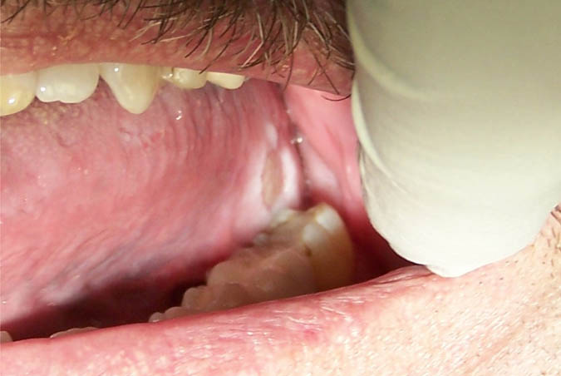
Aphthous ulcers
Ulcerated Lesions
Clinical presentation
Signs: -non-keratinized mucosa
-erythematous border
-yellowish-gray pseudomembrane
Symptoms: -very painful
Etiology
immunologic defect triggers
include physical trauma and stress
Diagnosis
clinical presentation
Treatment
often heal spontaneously
topical corticosteroids
systemic steroids
Notes:
Aphthous ulcers tend to present on non-keratinized mucosa, which includes the floor of the mouth, lateral border and ventral tongue, buccal mucosa and soft palate.
Minor aphthous ulcers (less than 1.0cm diameter) may be treated with triamcinolone dental paste; with a cotton swab or clean finger, dab or press (do not rub) a small amount to the lesion to form a film, 2-3 times a day after meals and at bedtime for 7-14 days; for hard to reach ulcers, dexamethasone elixir (0.5mg/5mL), swish 3 times a day with 5 mL for 1 minute, then expectorate; do not eat or drink for 30 minutes after topical treatments.
Major aphthous ulcers (greater than 1.0cm diameter) may require systemic steroid therapy, such as prednisone 40-60mg PO daily for 1 week, then taper; persistent major aphthous lesions may be responsive to thalidomide, 200mg PO daily for 2 weeks; thalidomide should not be used for women of childbearing potential.
Pain control medication and nutritional supplements may also be considered.
Source: Guide for HIV/AIDS Clinical Care. U.S. Department of Health and Human Services, Health Resources and Services Administration, HIV/AIDS Bureau. Jan 2011.

Slide 14
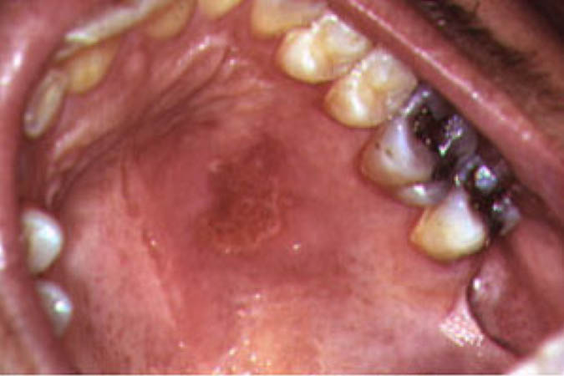
Recurrent intraoral herpes
Ulcerated Lesions
Clinical presentation
Signs: -keratinized mucosa
-whitish-yellow border
-red interior
Symptoms: -painful
Etiology
HSV-1
Diagnosis
clinical presentation
viral culture
Treatment
systemic anti-virals
Notes:
Recurrent intraoral herpes tends to present on keratinized or “fixed” tissues, which include the gingiva, hard palate and the dorsal tongue.
Preferred episodic therapy is valacyclovir 1g PO twice daily, famciclovir 500mg PO twice daily, or acyclovir 400mg PO tid; each treatment course is 5-10 days.
Suppressive therapy may be considered for patients with severe or frequent recurrences; valacyclovir 500mg PO bid, famciclovir 500mg PO bid, or acyclovir 400mg PO bid.
Many minor cases may be self-limiting and will resolve within 7-14 days without treatment.
Source: Centers for Disease Control and Prevention. Guidelines for Prevention and Treatment of Opportunistic Infections in HIV-Infected Adults and Adolescents. MMWR 2009;58 (No. RR-4) April 10, 2009:61-2,160.

Slide 15
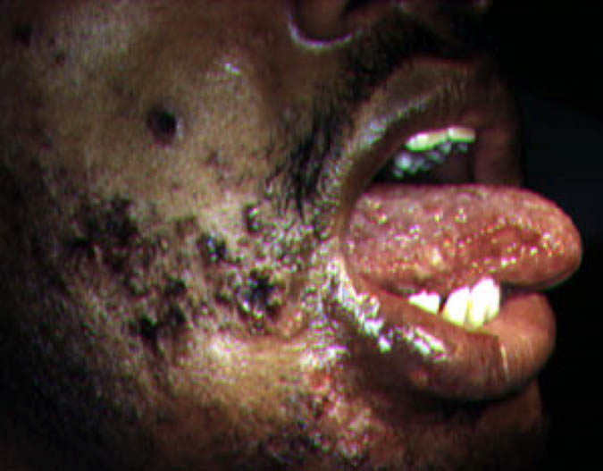
Herpes zoster
Ulcerated Lesions
Clinical presentation
Signs: -trigeminal nerve, v2 & v3
-unilateral clustered vesicles rupture & form small ulcers
Symptoms: -severe pain/paresthesia
Etiology
varicella-zoster virus
Diagnosis
clinical presentation
Treatment
antivirals
pain medications
Notes:
Antiviral therapy should be initiated as quickly as possible or any time before full crusting of lesions.
Preferred therapy is valacyclovir 1g tid, famciclovir 500mg tid, or acyclovir 800mg PO 5 times daily for 7-10 days.
Source: Centers for Disease Control and Prevention. Guidelines for Prevention and Treatment of Opportunistic Infections in HIV-Infected Adults and Adolescents. MMWR 2009;58 (No. RR-4) April 10, 2009:64-5,161.

Slide 16
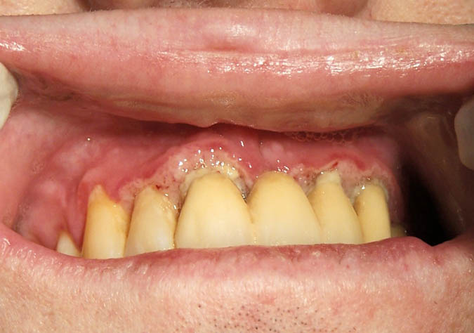
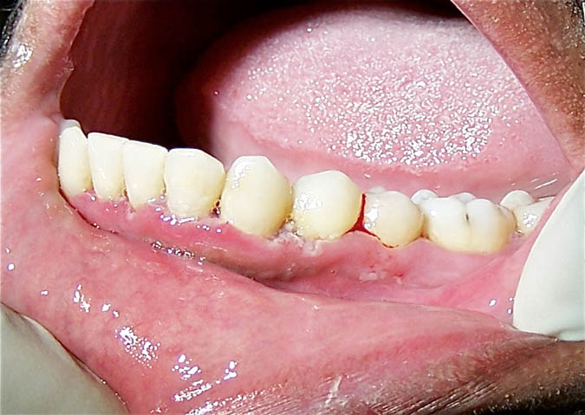
Necrotizing gingivitis
Ulcerated Lesions
Clinical presentation
Signs: -usually localized
-marginal necrosis
-papillary necrosis
Symptoms: -spontaneous bleeding
-very painful
Etiology
bacteria (gram-negative)
Diagnosis
clinical appearance
Treatment
debridement
antimicrobial rinse
antibiotics
Notes:
Necrotizing gingivitis is the rapid destruction of soft tissues around the teeth (gingiva, alveolar mucosa).
In addition to prompt referral to a dental professional, patients may be placed on antimicrobial rinse (0.12% chlorhexidine gluconate, twice daily) and antibiotics (metronidazole 500mg PO qid or Augmentin 875mg PO bid x 10 days).
Pain management and nutritional supplements should also be considered.

Slide 17
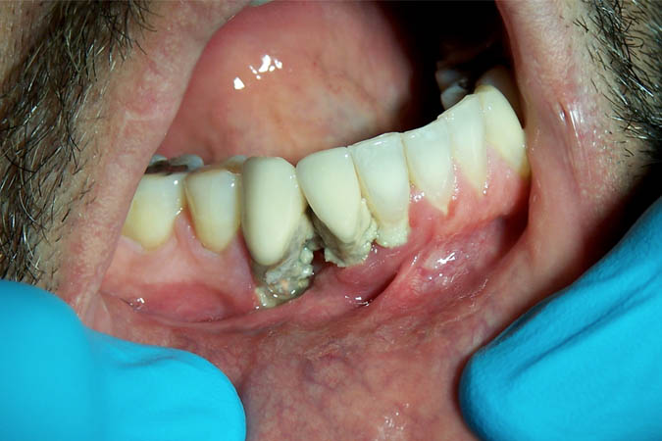
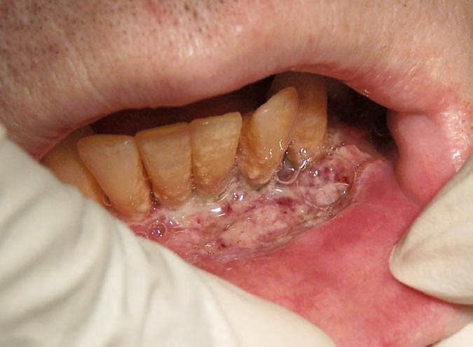
Necrotizing “ulcerative” periodontitis
Ulcerated Lesions
Clinical presentation
Signs: -localized or generalized
-soft tissue necrosis
-alveolar bone necrosis
Symptoms: -tooth mobility
-spontaneous bleeding
-fetid odor
-very painful (“deep-seated” jaw pain)
Etiology
bacteria (gram-negative)
Diagnosis
clinical appearance
Treatment
debridement
antimicrobial rinse
antibiotics
Notes:
Necrotizing periodontitis includes the rapid destruction of soft tissue as well as supporting hard tissue (alveolar bone) and periodontal attachment; It is considered a marker for severe immune deterioration.
Necrosis of periodontal tissues can quickly result in tooth loss; therefore, treatment should not be delayed.
In addition to prompt referral to a dental professional, patients may be placed on antimicrobial rinse (0.12% chlorhexidine gluconate, twice daily) and antibiotics (metronidazole 500mg PO qid or Augmentin 875mg PO bid x 10 days).
Pain management and nutritional supplements should also be considered due to severe pain, as well as the inability to eat properly.
Source: Glick M, Muzyka BC, Salon LM, Luric D. Necrotizing ulcerative periodontitis: a marker for severe immune deterioration. J Periodontol 1994;65:393-97.

Slide 18
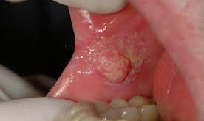
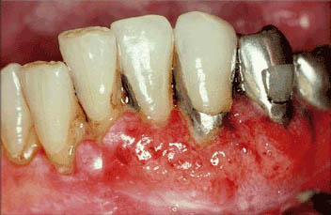
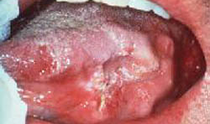
Squamous cell carcinoma
Ulcerated Lesions
Clinical presentation
Signs: *most common locations
-posterior lateral tongue
-floor of mouth
-ventral tongue
-soft palate
*highly variable appearance
-ulceration with raised, rolled margins
-red, velvety lesion with induration
-exophytic ulcerated mass
-mixed red/white lesion
-white plaque
Symptoms: sometimes painful
Notes:
Oral squamous cell carcinoma (OSCC) may present clinically in many different forms. Any non-healing lesion of 2-3 weeks duration suggestive of OSCC should be referred to ENT or Oral Surgery for biopsy.

Slide 19
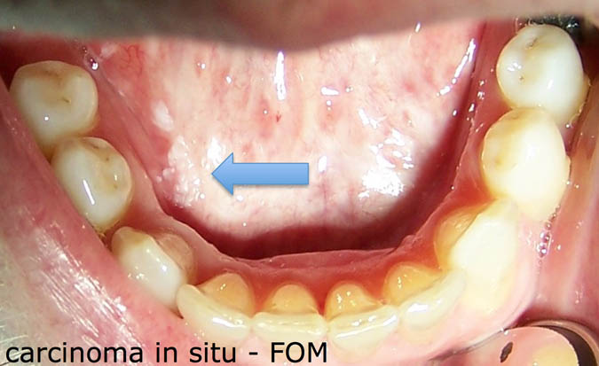
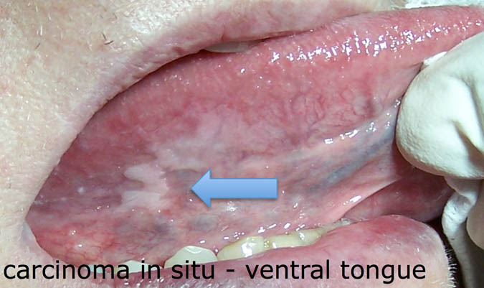
Squamous cell carcinoma
Ulcerated Lesions
Etiology/risk factors
etiology unknown
tobacco
alcohol
nutritional deficiencies
human papillomavirus
Diagnosis
incisional biopsy
Treatment
surgical excision
radiation therapy
chemotherapy
Pre- & Post- treatment
smoking cessation
alcohol cessation
aggressive oral health care
close follow-up & periodic re-evaluation
Notes:
An increase in HPV-associated (HPV 16) oropharyngeal cancers, most notably oropharyngeal squamous cell carcinoma of the base of the tongue & palatine tonsils, in white men less than 50 years old with no history of alcohol or tobacco use, has been recorded over the past several years.
Source: Marur S, D’Souza G, Westra WH, Forastiere AA. HPV-associated head and neck cancer: a virus-related cancer epidemic. Lancet Oncol. 2010 Aug;11(8):781-9.

Slide 20
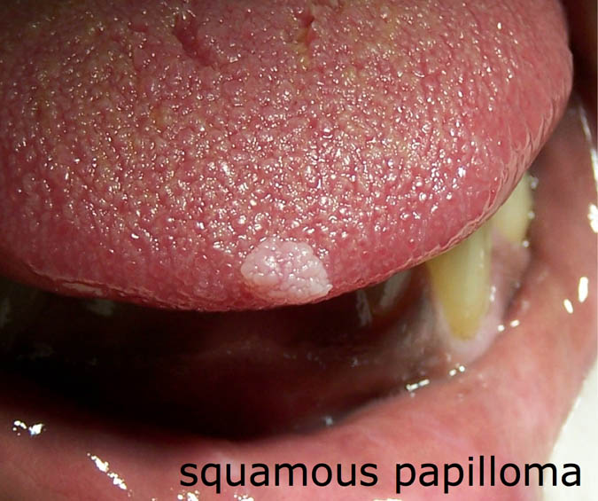
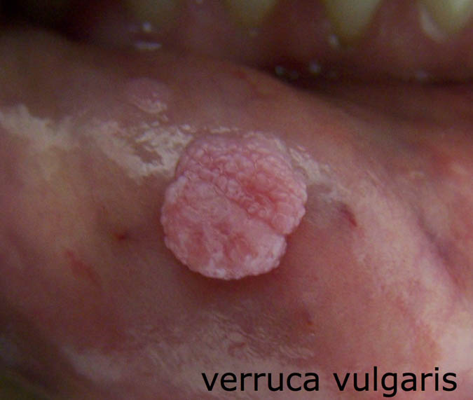
Squamous papilloma Verruca vulgaris
Papillary Lesions (oral warts)
Clinical presentation
Signs: -single or multiple
-any mucosal surface
-sessile or pedunculated
-small fingerlike projections
-rough, pebbled surface
-whitish or light pink
Symptoms: -non-painful
(unless traumatized)
Etiology
  human papillomavirus
Diagnosis
clinical appearance
Treatment
surgical excision
cryotherapy
Notes:
Oral warts are not uncommon in HIV-positive individuals, and studies suggest that the incidence has increased since the initiation of HAART; recurrence following treatment is high.
Although HPV infection is associated with oropharyngeal cancer, oral warts normally are not caused by the HPV types that are associated with oncogenic changes; however, close observation is important because the patient may also have been exposed to other HPV types, including HPV 16, the type most commonly associated with OSCC.
One recent multi-site cross-sectional study found the prevalence of oral HPV infection in HIV-positive persons to be as high as 34%, with 14% being infected with multiple HPV types; HPV 16 was the most common type detected (prevalence 5.7%).
(see sources next slide)

Slide 21
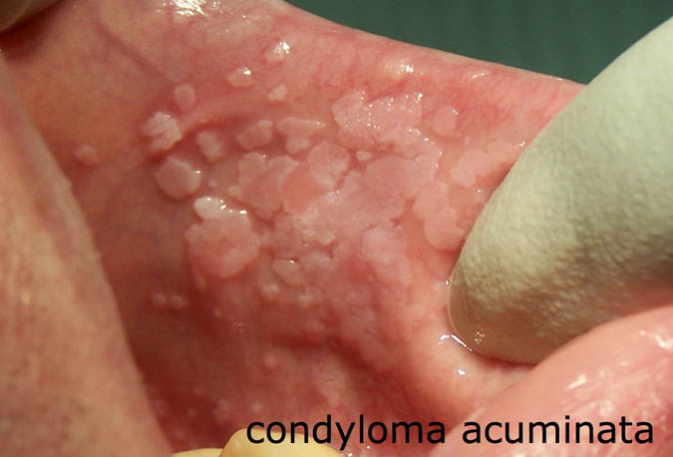
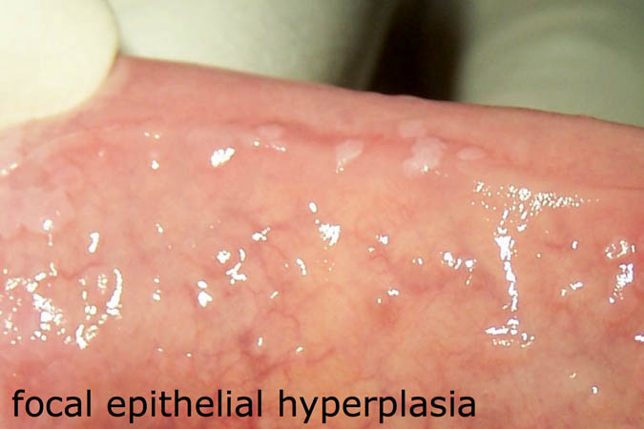
Condyloma acuminatum Focal epithelial hyperplasia
Papillary Lesions (oral warts)
Clinical presentation
Signs: -multiple/clustered
-any mucosal surface
-sessile
-slightly grainy surface
-whitish or light pink
Symptoms: non-painful
Etiology/risk factors
human papillomavirus
Diagnosis
clinical appearance
Treatment
surgical excision
cryotherapy
Notes:
Sources: King MD, Reznik DA, O’Daniels CM, Larsen NM, Osterholt DM, Blumberg HM. Human Papillomavirus-associated Oral Warts among HIV-seropositive Patients in the Era of Highly Active Antiretroviral Therapy: An Emerging Infection. Clin Infect Dis 2002 Mar;34(5):641-8.
Greenspan D, Canchola AJ, MacPhail LA, et al. Effect of highly active antiretroviral therapy on frequency of oral warts. Lancet. 2001 May;357(9266):1411-2.
Beachler DC, Weber KM, Margolick JB, Strickler HD, Cranston RD, et al. Risk factors for oral HPV infection among a high prevalence population of HIV-positive and at-risk HIV- negative adults. Cancer Epidemiol Biomarkers Prev. 2012 Jan; 21(1):122–133.

Slide 22
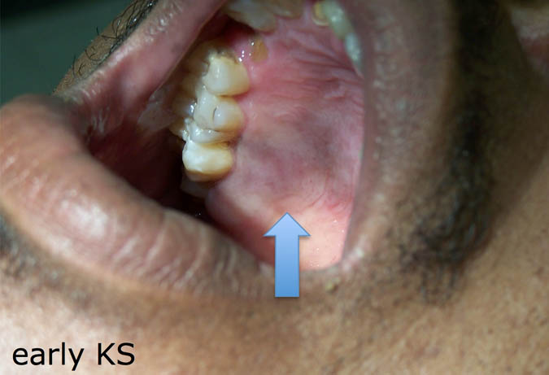
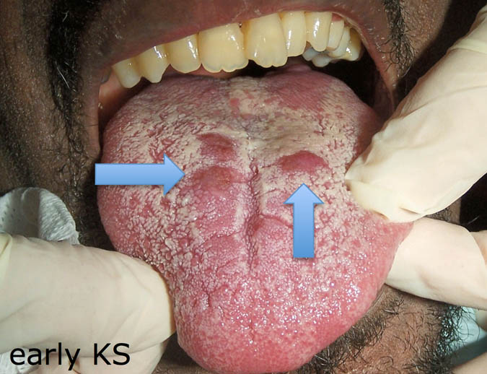
Kaposi Sarcoma - early
Pigmented Lesions
Clinical presentation - early
Signs: -lateral posterior hard palate or gingiva
-dorsal tongue
-slightly diffuse, macular
-purplish-brown
Symptoms: -non-painful
Etiology
  HHV-8 (KSHV)
Diagnosis
biopsy
Treatment
HAART (optimal)
chemotherapy
surgical excision
Notes:
KS can occur at any CD4+ cell count, but the risk of developing KS increases as the immune system declines, the greatest risk occurring when CD4 cell counts drop below 200.
KS is more common in men than women, and most common in MSM; oral lesions occur in approximately one third of all cases.
Early KS lesions may appear similar to normal physiologic pigmentation, so close examination of the lesion and review of patient medical history is necessary.
Biopsy is recommended to confirm diagnosis and to rule out bacillary angiomatosis, which can be clinically indistinguishable from KS.
Source: Centers for Disease Control and Prevention. Guidelines for Prevention and Treatment of Opportunistic Infections in HIV-Infected Adults and Adolescents. MMWR 2009;58 (No. RR-4) April 10, 2009:39,66-8.

Slide 23
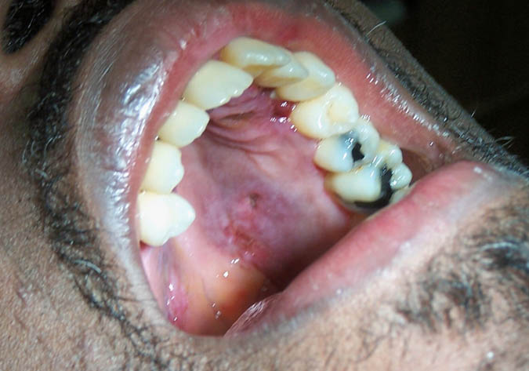
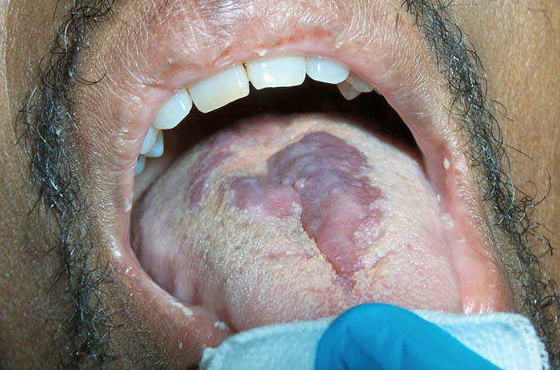
Kaposi Sarcoma – “mid-stage”
Pigmented Lesions
Clinical presentation –
“mid-stage”
Signs: -slightly raised
-more diffuse
-darker purple-brown
-ulcerations
Symptoms: -painful ulcerations, especially secondary to trauma
Notes:
As oral KS lesions progress, they are more likely to become painful secondary to trauma, and, in some cases, interfere with normal function such as eating and speaking.
Involvement of the gingiva is common, and meticulous oral hygiene is stressed to help prevent secondary fungal or bacterial infection.
Source: Cherry-Peppers G, Daniels CO, Meeks V, Sanders CF, Reznik D. Oral manifestations in the era of HAART. J Natl Med Assoc. 2003 Feb;95(2 Suppl 2): 23S-25S.

Slide 24
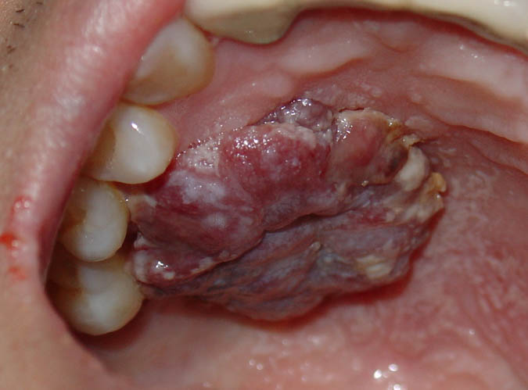
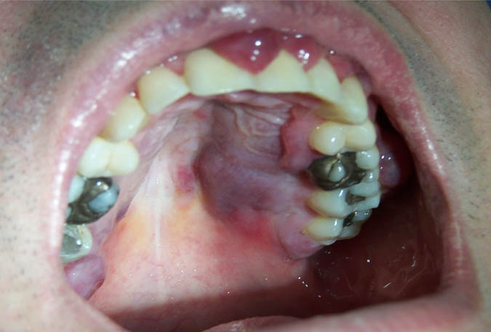
Kaposi Sarcoma - advanced
Pigmented Lesions
Clinical presentation –
advanced
Signs: -multiple sites or
solitary lesions
-nodular dark red or
purple-brown
Symptoms: -painful ulcerations
-bulky, interfere with function
-spontaneous bleeding
Notes:
Resource: The ACTG Staging Classification for AIDS-Associated Kaposi Sarcoma can be found at www.cancer.gov.

Slide 25


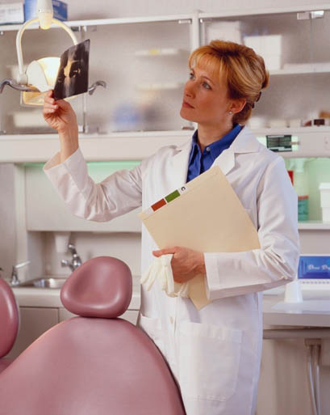
Questions?
Notes:
The end.

Slide 26
Guide to Oral Health Care for People Living with HIV/AIDS
Chapter 4: Diagnosis and Management of Dental Emergencies in the Medical Office

Slide 27
Chapter 4:
Course Author:
  Carol M. Stewart, D.D.S., M.S.
Consultant:
  Vincent C. Marconi, M.D.
Series Editor:
  David A. Reznik, D.D.S.
HRSA, HIV/AIDS Bureau Consultant:
  Mahyar Mofidi, D.M.D., Ph.D.
Notes:
Acknowledgements:
Course Committee Authors:
Jeffery D. Hill, D.M.D.
Lauren L. Patton, D.D.S.
Therese G. Mayfield, D.M.D.
Consultants:
Vincent C. Marconi, MD
Series Editor:
David A. Reznik, D.D.S.
HRSA, HIV/AIDS Bureau Consultant:
Mahyar Mofidi, D.M.D., Ph.D.
Last Modified: February, 2013

Slide 28
Chapter 4: Learning Objectives
For the medical team to recognize emergency dental needs vs. routine dental care
Be able to understand when and what dental care could be started in the medical office
Notes:
This module is designed to facilitate your diagnosis of dental problems as well as when to initiate treatment in the medical office and when to refer. The building of interdisciplinary teams is becoming more and more vital in HIV/AIDS care – and in overall health care as well.

Slide 29
Course Overview
Assessment of oral concerns presenting in any medical practice
Review of treatment options in the medical office
      Patient education
    Use of analgesics
    Use of antibiotics
    Referral
Discussion and case presentations of dental emergencies requiring rapid referral to an emergency room
Discussion and case presentations of dental emergencies requiring referral to a dentist and an appropriate time frame for that referral
Notes:
Dental disease is evident in all patient populations regardless of medical condition.
The majority of oral/dental pain presenting in your clinic will result from dental disease (caries and periodontal disease) so a significant portion of this presentation will focus on those disease processes.
The delivery of care in the medical office can be initiated prior to a dental referral, potentially allowing for improved patient care. As we progress through the module, treatment options which can be initiated in the medical office will be included in the case presentations.
Then we will look at those dental emergencies that require a rapid referral to an emergency room and which dental emergencies are best treated in the dental office and the most appropriate time frame for that referral. Each dental condition discussed will include medical office management and dental referral urgency.
A review of oral lesions more characteristic of HIV-infected individuals will be addressed in a separate module.

Slide 30
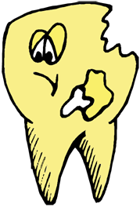
Introduction
Oral health care consistently ranks among the top unmet needs in Statewide Statement of HIV/AIDS Needs Surveys ⁽¹⁻⁴⁾
Dental disease often occurs from lack of routine care, which may be due to: ⁽⁵⁻⁷⁾
  lack of understanding regarding importance of oral health to overall health
  inadequate financial resources
  inadequate access to dental providers
  dental fear/anxiety
  fear of discrimination
  fear of breach of confidentiality
Notes:
Unmet needs for oral health care among PLWHIV are substantially higher than the unmet oral health needs in the general population (1) and are higher than unmet needs for medical care or other support services (2,3,4)
Dental disease can be attributed to several factors, but primarily is associated with a lack of routine care. The following concerns will contribute to this outcome.
1) Marcus M, Freed JR, Coulter ID, Der-Martirosian C, Cunningham W, Andersen R, Garcia I, Schneider DA, Maas WR, Bozzette SA, Shapiro MF. Perceived unmet need for oral treatment among a national population of HIV-positive medical patients: social and clinical correlates. Am J Public Health. 2000;90:1059-63.
2.)Heslin KC, Cunningham WE, Marcus M, Coulter I, Freed J, Der-Martirosian C, Bozzette SA, Shapiro MF, Morton SC, Andersen RM. A comparison of unmet needs for dental and medical care among persons with HIV infection receiving care in the United States. J Public Health Dent. 2001;61:14-21.
3.)Kenagy GP, Linsk NL, Bruce D, Warnecke R, Gordon A, Wagaw F, Densham A. Service utilization, service barriers, and gender among HIV-positive consumers in primary care. AIDS Patient Care STDS. 2003;17:235-44.
4.) Tobias C. Oral health care: The forgotten need for HIV-positive populations in the continuum of care. Washington, DC: American Association of Public Health Annual Meeting; 2007.
5.) U.S. Department of Health and Human Services. Oral health in America: A report of the surgeon general. Rockville, MD: National Institutes of Health; 2000. pp. 1-13.
6.) Sweet M, Damiano P, Rivera E, Kuthy R, Heller K. A comparison of dental services received by Medicaid and privately insured adult populations. J Am Dent Assoc. 2005;136:93-100.
7.) Patton LL, Strauss RP, McKaig RG, Porter DR, Eron JJ Jr. Perceived oral health status, unmet needs, and barriers to dental care among HIV/AIDS patients in a North Carolina cohort: impacts of race. J Public Health Dent. 2003;63:86-91.

Slide 31
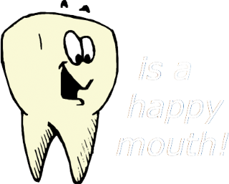
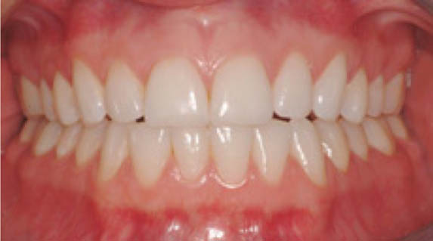
A Healthy Mouth
Gingiva – pink, firm, stippled, without pain, and without bleeding upon brushing
Teeth – lack of unrestored decay, without pain or sensitivity to sweets, hot or cold foods or beverages
Notes:
Before we discuss dental pathology, let’s take a quick look at a healthy mouth.
In this picture, no dental decay can be observed, and the gingiva “gums” are and healthy as well.
As we will note in subsequent slides, intact fillings or dental restorations, are a sign of routine care.

Slide 32
Triage Levels for Referrals
Routine (2-4 weeks)
Urgent (24-48 hours)
Emergency (Same day)
Notes:
The three triage levels that will be used in this module are routine, urgent, and emergency.
A more defined description of each will follow with clinical examples.

Slide 33
Routine Dental Referral (2-4 weeks)
Teeth:
Bothersome for several days, weeks, months
Discomfort is mild, not disruptive to routine
OTC meds will relieve pain
Pain is not spontaneous, may start after eating sweet foods, cold fluids; Does not persist
Gingiva/Periodontal:
Plaque, calculus
Mildly inflamed gingiva visible
Mild pain or discomfort
Notes:
Tooth associated pain does not always indicate the need for emergency referral.
Early dental decay that is mild in pain level, 1-3 months in duration, provoked by ingestion of sweet foods or cold fluids, would require dental care, but 2-4 weeks would be acceptable.
The same could be said for mild chronic gingivitis, due to lack of home care.

Slide 34
Urgent Referral 2 days (1)
Teeth:
  Pain is severe, disruptive to daily routine
  Pain is constant, sharp, spontaneous and may be localized to one or two teeth
  Inability to eat
  Extreme tenderness to palpation or tapping on the infected tooth
Notes:
Disruptive “tooth” pain which negatively impacts the patient’s ability to eat or perform routine activities, requires urgent referral.
Tapping on the tooth with a gloved finger or moving it back and forth will likely reproduce the pain and pinpoint the source.

Slide 35
Urgent Referral 2 days (2)
Gingiva/ Periodontal:
  Spontaneous and /or prolonged bleeding of gingiva
  Severely altered gingival architecture
  Fever, infection, purulence
Notes:
All of the above listed conditions should be addressed in a relatively short period of time and are considered urgent. Antibiotics such as metronidazole or clindamycin cane be used to address the infection. Pain management is important as is the need to ensure that the patient can intake food. Recommend softer, non-spicy foods such as soups, eggs, mashed potatoes, etc.

Slide 36
Emergency Referral (Same day)
Compromised airway, often presenting as difficulty breathing, altered voice, and trismus
Rapidly spreading infection
Infection/ swelling approaching eye
Fever, lymphadenopathy, weight loss, extreme fatigue or lethargy, dehydration
Spontaneous intraoral hemorrhage
Notes:
Any of these presentations could be life-threatening conditions and referral to an emergency department may be necessary.

Slide 37
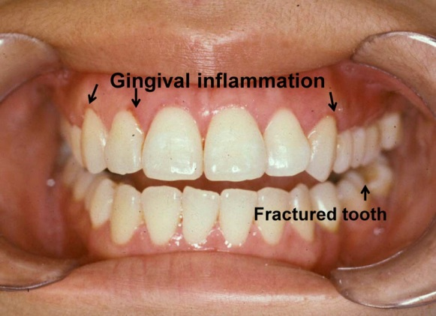
Case 1
History: A 24 year old female presents to the medical office for a routine follow-up evaluation. She has a non-detectable viral load and CD4 count of 550.
Chief concern: “Sore gums for 2 months”
Notes:
Note the gingival inflammation and fractured tooth pictured above.

Slide 38
Case 1 (Gingival concerns)
Finding: Gingival inflammation, which started a week after using a new toothpaste.
Diagnosis: Hypersensitivity
Irritation is due to irritation from abrasive agents in “tartar control” toothpastes, or hypersensitivity to agents.
Medical Office Management: Recommend a fluoride containing toothpaste with no abrasives, whiteners, or “tartar control” agents
Referral: Routine
Notes:
Gingival inflammation could also be due to
whitening agents in toothpaste, especially if not used
according to manufacturer's directions

Slide 39
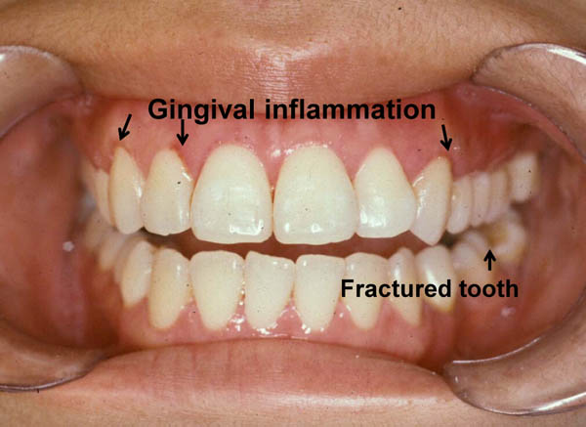
Case 1 (Tooth-related concerns)
Finding: Asymptomatic, long-standing fractured tooth in mandibular left posterior quadrant
Medical Office Management: No urgent care required for fractured tooth
Referral: Routine

Slide 40
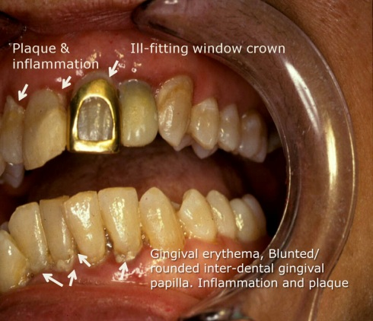
Case 2: “Gums hurt” “Bad breath & a nasty taste”
History: 42 yr. male presents for follow up medical appointment
Chief concern: “Gums hurt” “Bad breath & nasty taste” Pain is diffuse, intermittent, for 3 months
Clinical findings: Plaque and gingivitis
Notes:
The arrows denote soft plaque accumulations and adjacent red gingival. The toxins produced by the bacteria cause the gingival tissue to become inflamed.
This is noted by the redness and lack of adherence of gingiva to the teeth and the lack of pointed gingival architecture normally found in the interdental papillae area (tissue between the teeth). In case 2, this gingival change is especially apparent in the anterior teeth, both maxillary (upper) and mandibular (lower).
The original ‘healthy mouth’ is posted for comparison.

Slide 41
Case 2 – Treatment for gingivitits
Clinical Diagnosis: Chronic plaque-induced gingivitis
Medical Office Management:
Rx: 0.12% chlorhexidine gluconate rinse (Peridex or PerioGard)
Sig: Rinse with 15 mL and expectorate morning and at bedtime
Rx: Prevident Boost 5000 Toothpaste with Fluoride (1.1% NaF)
Sig: Use at bedtime every night according to manufacturer's directions
Dental Referral: Routine
Notes:
The oral bacterial infection from plaque induced gingivitis will contribute to halitosis (bad breath) and altered taste perception.
Start care in medical office while waiting on an appointment for a dental exam and debridement.
The antibacterial rinse, Rx: 0.12% chlorhexidine gluconate, which can be prescribed for used once or twice per day.
To reduce susceptibility to dental decay, Rx: Prevident Boost Toothpaste with Fluoride at bedtime every night
To enhance home care, provide a handout about the importance of oral health and oral hygiene.

Slide 42
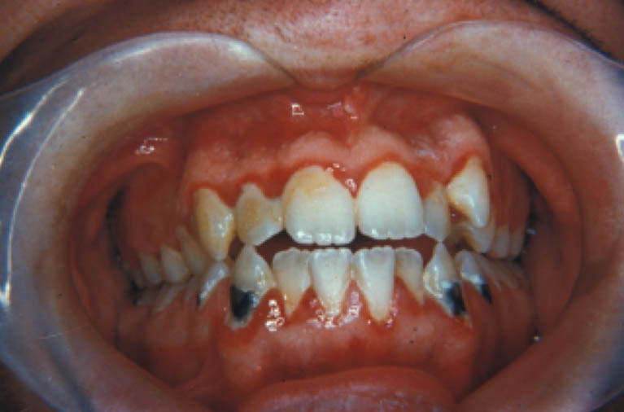
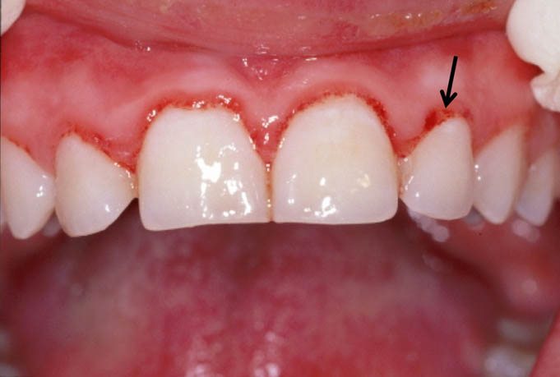
Case 3
History: A 22 year- old male complains of “red tender gums.” He has a history of injection drug use, which he discontinued 2 years ago when he was diagnosed with HIV infection. He is somewhat compliant with ART therapy. He brushes once per day.
Findings: Erythematous band-like gingival inflammation, especially prominent in the anterior teeth. If the gingival condition does not improve following a periodontal debridement and improved home care, Linear Gingival Erythema (LGE) may be considered.
Photo 2
Notes:
Case 3 oral condition could be a result of plaque induced gingivitis, a hypersensitivity to a food or flavoring such as cinnamon, reaction to a medication, and /or be exacerbated by mouth breathing.
Another consideration is Linear Gingival Erythema (LGE), which is somewhat common among HIV infected individuals. LGE is an erythematous, sometimes described as ‘fiery red’ band 2-4 mm in width along the marginal gingiva. (Marginal gingiva is the gingiva closes the teeth and follows the outline of the teeth.) LGE extends between adjacent papilla.
LGE may appear as in Photo 2 with petechiae (black arrow) within the gingiva erythema. (Photo 2 is from a different patient.)
The lesion does not completely respond to plaque control measures or root planing and scaling.
The lesion is also reported to be associated with oral candidiasis.¹ Antifungal agents may be prescribed in addition to plaque control measures.
1.) J Periodontol. 1995 Jan;66(1):30-7.
The relationship of candidiasis to linear gingival erythema in HIV-infected homosexual men and parenteral drug users.
Grbic JT, Mitchell-Lewis DA, Fine JB, Phelan JA, Bucklan RS, Zambon JJ, Lamster IB.
Division of Periodontics, Columbia University School of Dental and Oral Surgery, New York, NY, USA.
“A statistically-significant relationship was found between the presence of intraoral candidiasis and LGE in seropositive homosexual men: 42.9% of these subjects with candidiasis had LGE, while only 12.7% of the subjects without candidiasis had LGE (P < .05).”

Slide 43
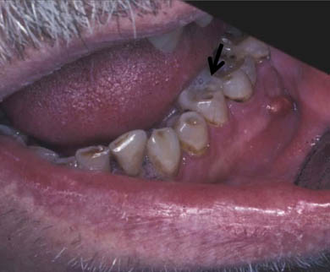
Case 4
Treatment: Endodontic procedure “root canal” or extraction. The accumulation of purulence eventually results in creating a tract through the bone and associated expansion of the gingival tissue. The pain often diminishes due to pressure being released when purulence breaks through the bone.
Medical Office Management: Recommend warm salt water rinses. Consider antibiotics for 7 days. Penicillin or Amoxicillin
Dental Referral: Within one week if possible. These may become acutely painful again within 1-2 weeks.
Notes:
If allergic to PCN, consider clindamycin.
Patient Education: Dental problems do NOT “cure themselves”
Treating the pain without treating the underlying cause only prolongs the problem

Slide 44
Antibiotics in Dentistry
If no penicillin allergy
  Penicillin VK (500mg)
  Two tablets stat, then one q 6 h for 7 days
  OR
  Amoxicillin 500 mg q 8 h for 7 days
If allergic to penicillin
  Clindamycin 300 mg q 8 h for 7 days
Notes:
Penicillin VK is very effective in treatment of in dental abscesses, in the non-penicillin-allergic patient.
Remember to encourage concurrent hot salt water mouth rinses.

Slide 45
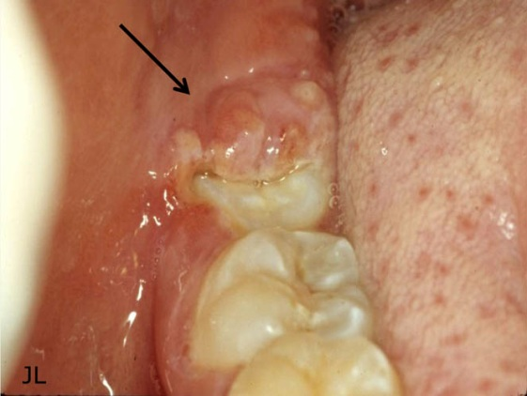
Case 5 – Pericornitis
Clinical: 19 year old male with CD4+ of 310 and Viral Load non-detectable. Compliant with ART.
CC: Moderate pain in lower right for one week
Observation: Inflamed flap of tissue over erupting third molar
Notes:
Inflamed soft tissue covering a partially erupted tooth. Suppuration may be observed.
Pain is often due to the upper wisdom tooth biting on the inflamed tissue overlying the bottom tooth
Suggests an infection in the posterior region of the mouth
More common in the mandible than maxilla
Can present with pain, swelling and trismus

Slide 46
Case 5 – Management of pericornitis
Clinical diagnosis: Pericornitis (bacterial infection)
Medical Office Management Considerations:
Warm salt water rinses bid
RX: Chlorhexidine 0.12% rinse bid until definitive dental management
Rx: If swelling and fever, consider po antibiotics i.e., penicillin (PCN) or amoxicillin, if no PCN allergy history
If PCN allergy, consider po clindamycin
Analgesics consistent with mild-moderate pain level (NSAIDS or Acetaminophen)
Referral: Appointment within 1 week.
* Patient should be instructed to call or return to clinic if pain, fever, or swelling increase before dental appointment can be scheduled, or report to ED
Notes:
Pain is often due to the upper tooth biting on the inflamed tissue overlying the lower wisdom tooth
This suggests an infection in the posterior region of the mouth
Rx: Penicillin 500 mg q 6 h or Amoxicillin 500 mg 1 q 8 h for 7-10 days
Clindamycin 300 mg q 6 h.
If there is more infection in tooth root/ bone that is suspected based on clinical observation, pain, swelling, fever, and/ or lymphadenopathy will increase and emergency referral will be needed.

Slide 47
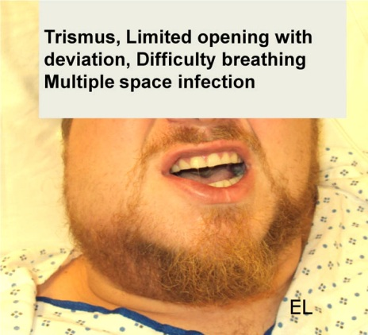
Case 6: Floor of mouth
History: 31 yr male with rapidly increasing right facial swelling; Poorly controlled diabetic.
Chief concern: “Toothache” started in right lower wisdom tooth, five days ago. Dentist provided penicillin, but it is not working.
  Clinical Findings: (as noted in photo)
Trismus indicates an infection in
the posterior mouth
Do not “force” the mouth open to
evaluate the area
The trismus will resolve once
the infection is resolved
Temp 101◦ F
Diagnosis: Abscess with multiple space infection
Management: Emergency referral to emergency department.
Notes:
Assessment: BP 155/91; HR 100; T 101◦F; Diabetic, poorly controlled. The reason for the lack of efficacy of the antibiotic is uncontrolled diabetes. Regaining diabetic control will enable the area to respond to routine therapies. However, since this case has progressed this far, a referral to the local emergency department is indicated.

Slide 48
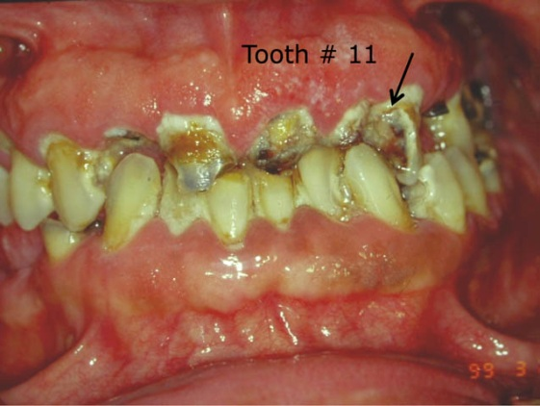
Case 7 – Oral disease secondary to methamphetamine use
History: 23 year male, diagnosed with HIV 1 yr ago. “All my teeth are crumbling, but the top left eye tooth is killing me”. “Also, my gums and the roof of my mouth burn.”
Findings: He has used methamphetamine for 1 year. He is rinsing with OTC
peroxide tid, and using OTC
topical benzocaine for pain
4-5 times per day.
Exam: Tapping on tooth
#11 with a finger elicited
sharp pain.
Notes:
Severe decay secondary to methamphetamine use and xerostomia. The pain on the roof of his mouth is secondary to rinsing with a non-diluted form of hydrogen peroxide. Please discourage this use as it will burn the soft tissues in the mouth. Diluted oral preparations of peroxide do exist (e.g. Peroxyl). It is also important to shy away from mouth rinses that have a high alcohol content as these can also burn the oral soft tissues in patient that have dry mouth.

Slide 49
Case 7 – Management of severe dental disease
Clinical diagnoses:
Acute pain from dental infection due to advanced decay on tooth #11 (Maxillary left cuspid)
Methamphetamine associated advanced generalized dental decay
Hyposalivation “dry mouth” from recreational drugs
Notes:
The urgent referral is to address the immediate problem – pain in tooth #11. Tit is important to stress follow up to this patient in order for him to obtain a comprehensive treatment plan to address the numerous other dental concerns.

Slide 50
Case 7 – Management of severe dental disease
Medical Management Considerations:
Instruct patient to discontinue use of OTC peroxide and excessive benzocaine
Pain management and nutritional supplementation are very important as a patient in this much discomfort will have trouble eating and taking medications
OTC Biotene rinse for oral dryness
Refer for rehabilitation counseling
Appropriate pain management
Nutritional counseling/supplementation
Referral:
Urgent referral oral and maxillofacial surgeon for extraction of tooth #11 and plan for extraction of non-restorable teeth.
Notes:
The urgent referral is to address the immediate problem – pain in tooth #11. Tit is important to stress follow up to this patient in order for him to obtain a comprehensive treatment plan to address the numerous other dental concerns.

Slide 51
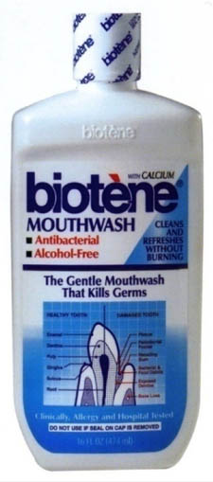
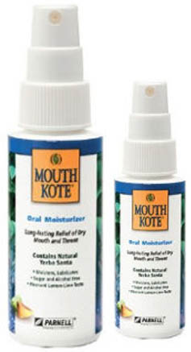
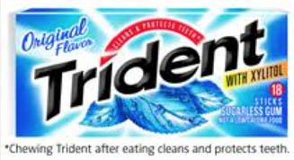
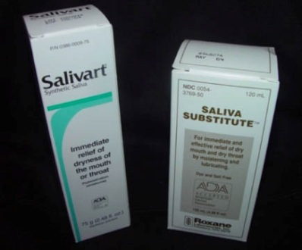
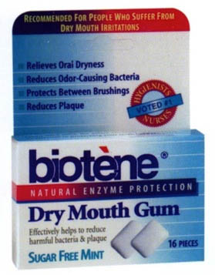
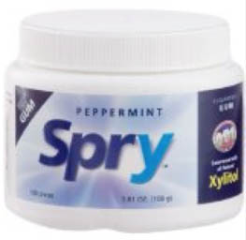
OTC agents for xerostomia or ‘dry mouth’
Mouthrinse
Biotene - Xylitol -sweetened, alcohol-free with helpful enzymes. Coating agent.
Artificial Saliva
Gum
Should be sugar-free,
recommend xylitol sweetened
Notes:
Xylitol is a sugar that does not promote dental decay, and may actually reduce activity.
Any recommended mouth rinse should be alcohol free.
Sugar free hard candy or gum will assist with salivary stimulation.
Nutritional counseling to limit sugar intake will be beneficial.

Slide 52


Minor Aphthous Ulcers
Etiology: An altered local immune response
Appearance: Round shallow ulcer, < 0.5 cm diameter, with grey/white covering membrane, and red halo
Usually found on lips, tongue, and soft palate
Notes:
Minor aphthous ulcers are a common complaint with a reported prevalence of roughly 20% in the general population.
Precipitating factors include stress, trauma, allergies, dietary components such as acidic foods, gluten, and food coloring or dyes. 1
1.) Clinician’s Guide to Treatment of Common Oral Conditions 6th Edition 2006. Siegal, Silverman, Sollecito.

Slide 53
Treatment of Aphthous Ulcers
Topical Corticosteroids:
  Triamcinolone Acetonide Dental Paste 0.1% (Kenalog and Orabase) Apply small amount with cotton swab to area after meals. Dexamethasone elixir 0.5mg/5mL. Disp: 100mL have patient rinse with 5 mL for one minite, then expectorate. Instruct patient not to eat or drink for at least 30 minutes
  0.05% fluocinonide ointment (Lidex) with 50:50 orabase. Apply small amount on a cotton swab to area after meals.¹
Notes:
Note: Prolonged use of topical corticosteroids may result in mucosal atrophy and secondary candidiasis, as well as potential for systemic absorption.
1.) Clinician’s Guide to Treatment of Common Oral Conditions 6th Edition 2006. Siegal, Silverman, Sollecito.

Slide 54
Antibacterial, Analgesic, and Coating Agents for Oral Ulcerations
Antibacterial:
  Chlorhexidine gluconate oral rinse 0.12%
    Rinse with 15 ml for 30 seconds and spit out bid for 7 days
Coating agent:
  Benadryl elixir (12.5 mg/ml of diphenhydramine) or (alcohol-free solution) and Maalox 50:50
    Swish with 5 ml and expectorate tid
Analgesic:
  2% viscous lidocaine
    Apply to ulcer with a Q-tip. (Do not swish due to possible loss of gag reflex.)
Notes:
Above is a short list of medications to address periodontal and soft tissue concerns. 0.12% chorhexidine gluconate mouth rinses are antimicrobial and impact both superficial bacterial and fungal infections. When using 2% viscous lidocaine to manage oral sores or ulcers, please be advised that this preparation will also “numb” the taste buds, discouraging nutritional intake. It is always important to stress proper nutrition when mouth pain is present.

Slide 55

Case 8
History: 23 yr male with extreme oral pain, “Loose teeth and bad breath for at least a month”.
Findings: Edematous, erythematous, gingiva that easily bleeds upon palpation. Note the loss of gingival architecture.
Differential diagnosis:
Necrotizing periodontitis
Uncontrolled insulin dependent diabetes
Blood dyscrasia such as leukemia
Drug induced immune suppression
Dental Referral: Urgent
Office Management:
Analgesics
Antibiotics that cover both gram⁺ bacteria
(Penicillin or Amoxicillin) plus
gram – bacteria (Metronidazole)
Chlorhexidine gluconate 0.12% rinse bid
Nutritional supplementation
Notes:
Alternative therapies: Augmentin 875mg disp. 14 tabs take one BID until gone.
For patients allergic to PCN or who cannot take metronidazole: Clindamycin 300mg disp 21 tabs, take one tab TID until gone.

Slide 56


Case 9
Clinical: 28 yr male presents as walk-in emergency to your office “mouth is bleeding”.
Findings: Intraoral spontaneous gingival bleeding and ecchymosis lateral tongue, lips and buccal mucosa. No skin ecchymosis was detected.
Medical Management is key here, there could be an issue with clotting factors or idiopathic thrombocytopenia purpura.
Diagnosis: Spontaneous bleeding due to inadequate clotting factors
Notes:
Fresh-frozen plasma and platelets were administered to raise the platelet count. Coordination between the medical and dental teams is vital to the successful management of this patient.

Slide 57
Summary
The enhanced ability of the medical team:
1. to screen and triage oral health concerns and
2. to provide education and initial therapy
is a critical step in improving outcomes for patients with HIV infection.

Slide 58
Questions?
Notes:
The end.

Slide 59
Guide to Oral Health Care for People Living with HIV/AIDS
Chapter 5: Patient Oral Health Education for Individuals Living with HIV/AIDS

Slide 60
Chapter 5:
Course Author:
  Jill A. York, D.D.S.
Consultant:
  Vincent C. Marconi, M.D.
Series Editor:
  David A. Reznik, D.D.S.
HRSA, HIV/AIDS Bureau Consultant:
  Mahyar Mofidi, D.M.D., Ph.D.
Notes:
Acknowledgements:
Course Committee Authors:
Jeffery D. Hill, D.M.D.
Lauren L. Patton, D.D.S.
Therese G. Mayfield, D.M.D.
Consultants:
Vincent C. Marconi, MD
Series Editor:
David A. Reznik, D.D.S.
HRSA, HIV/AIDS Bureau Consultant:
Mahyar Mofidi, D.M.D., Ph.D.
Last Modified: February, 2014

Slide 61
Chapter 5: Learning Objectives
Be familiar with proper oral hygiene instructions and home care
Understand the importance of nutrition on oral health for people living with HIV disease

Slide 62
Oral Hygiene Instructions

Slide 63
Good Dental Health
Health issues in the mouth can be one of the first signs of HIV infection and is a predictor of HIV progression probability.
A weakened immune system can be further stressed by poor dental health.
Soft tissue ulcers, gingival/periodontal disease, and decayed teeth can be portals that allow bacteria and other infectious organisms into the blood stream.
Identifying oral health concerns early allows for treatment before those concerns progress to other more serious infections.
Poor dental health including loose or painful teeth can severely impact the HIV positive patient’s ability to eat and take medications.
Notes:
Maintaining proper oral hygiene is one of the most important factors in dealing with HIV. It is a proven fact that poor oral hygiene in HIV patients is an indicator of what is happening throughout the body of the patient themselves.

Slide 64



Proper Brushing Technique
Tilt the brush at a 45° angle against the gumline and sweep or roll the brush away from the gumline.
Gently brush the outside, inside and chewing surface of each tooth using short back-and-forth strokes.
Gently brush your tongue to remove bacteria and freshen breath.
Notes:
Maintaining good oral hygiene is one of the most important things you can do for your teeth and gums. Healthy teeth not only enable you to look and feel good, they make it possible to eat and speak properly. Good oral health is important to your overall well-being. Daily preventive care, including proper brushing and flossing, will help stop concerns before they develop and is much less painful, expensive, and worrisome than treating conditions that have been allowed to progress.
Modified Bass Brushing Technique
Hold the toothbrush sideways against your teeth with some of the bristles touching your gums.
Tilt the brush so the bristles are pointing at your gum line.
Move the brush back and forth, using short strokes. The tips of the bristles should stay in one place, but the head of the brush should wiggle back and forth. You also can make tiny circles with the brush. This allows the bristles to slide gently under the gum. Do this for about 20 strokes or 20 circles. In healthy gums, this type of brushing should cause no pain. If it hurts, brush more gently.
Roll or flick the brush so that the bristles move out from under the gum toward the biting edge of the tooth. This helps move the plaque out from under the gum line.
Repeat for every tooth, on the insides and outsides.
On the insides of your front teeth, it can be hard to hold the brush sideways. So hold it vertically instead. Use the same gentle back-and-forth or circular brushing action. Finish with a roll or flick of the brush toward the biting edge.
To clean the biting or chewing surfaces of the teeth, hold the brush so the bristles are straight down on those surfaces.
Gently move the brush back and forth or in tiny circles to clean the entire surface. Move to a new tooth or area until all teeth are cleaned.
Rinse with water.
You can clear even more bacteria out of your mouth by brushing your tongue. Brush firmly but gently from back to front. Do not go so far back in your mouth that you gag. Rinse again.

Slide 65
Brushing Tips
Brush at least twice a day.
Brush for at least two minutes.
Have a standard routine for brushing.
Always use a toothbrush with soft- or extra-soft bristle.
Change your tooth brush regularly.
Choose a brush that has a seal of approval by the American Dental Association (ADA).
Electric is fine, but not always necessary.
Choose a toothpaste that contains fluoride and has the ADA seal of acceptance.
Notes:
Here are a few general pointers about brushing.
Brush at least twice a day. One of those times should be just before you go to bed. When you sleep, your mouth gets drier. This makes it easier for acids from bacteria to attack your teeth. Also try to brush in the morning, either before or after breakfast. After breakfast is better. That way, bits of food are removed. But if you eat in your car or at work, or skip breakfast, brush first thing in the morning. This will get rid of the plaque that built up overnight.
Brush for at least two minutes. Set a timer if you have to, but don't skimp on brushing time. Two minutes is the minimum time you need to clean all of your teeth. Many people brush for the length of a song on the radio. That acts as a good reminder to brush each tooth thoroughly.
Have a standard routine for brushing. Try to brush your teeth in the same order every day. This can help you cover every area of your mouth. If you do this routinely, it will become second nature. For example, you can brush the outer sides of your teeth from left to right across the top, then move to the inside and brush right to left. Then brush your chewing surfaces, too, from left to right. Repeat the pattern for your lower teeth.
Always use a toothbrush with soft or extra-soft bristle. Most dental professionals agree that a soft-bristled brush is best for removing plaque and debris from your teeth. The harder the brush, the greater the risk of harming your gums.
Change your toothbrush regularly. Throw away your old toothbrush after three months or when the bristles start to flare, whichever comes first. If your bristles flare much sooner than every three months, you may be brushing too hard. Try easing up.
Choose a brush that has a seal of approval by the American Dental Association (ADA). The type of brush you use isn't nearly as important as brushing the right way and doing it twice a day. Any approved brush will be a good tool, but you have to know how to use it.
Electric is fine, but not always necessary. Electric or power-assisted toothbrushes are a fine alternative to manual brushes. They are especially useful for people who don't always use proper brushing techniques. They also are a good choice for people with physical limitations that make brushing difficult. Use a powered toothbrush for at least two minutes, and don't press too hard.
Choose a toothpaste that contains fluoride and its box has the ADA seal of acceptance. So many different kinds of toothpaste are available today. There is a wide variety of toothpaste designed for many conditions, including cavities, gingivitis, tartar, stained teeth and sensitivity. Before choosing toothpaste, know the basics. The University of Mary Washington suggests switching to a sodium lauryl sulfate (SLS) -free toothpaste to reduce the risk of mouth sores or to minimize the associated pain and discomfort.

Slide 66



Proper Flossing Technique
Use about 18" of floss, leaving an inch or two to work with.
Hold the floss around the front and back of one tooth, making it into a “C” shape.
Gently follow the curves of your teeth.
Be sure to clean beneath the gumline, but avoid snapping the floss on the gums.
Notes:
Hold the floss in whatever way you prefer. The most common method is to wind the floss around your middle fingers. Then pull it tight and guide it with your index fingers. You also can wind it around your index fingers and guide it with your thumb and middle fingers. Some people just hold the ends of the floss, or use a floss-guiding tool. (If you have a fixed bridge, a bridge threader can help guide floss under the bridge for better cleaning.)
How you hold the floss is not as important as what you do with it. If you can't settle on a good method, ask your dentist or hygienist for suggestions.
Hold the floss so that a short segment is ready to work with.
Guide the floss gently between two teeth. If the fit is tight, use a back-and-forth motion to work the floss through the narrow spot. Do not snap the floss; you could cut your gums.
Hold the floss around the front and back of one tooth, making it into a “C” shape. This will wrap the floss around the side edge of that tooth.
Gently move the floss toward the base of the tooth and into the space between the tooth and gum.
Move the floss up and down with light to firm pressure to skim off plaque from the tooth. Do not press so hard that you injure the gum.
Repeat for all sides of the tooth, including the outermost side of the last tooth. Advance the floss to a clean segment for each tooth edge.

Slide 67
Flossing Tips
Floss once a day.
Take your time.
Choose your own time.
Don’t skimp on the floss.
Choose the type that works best for you.
  Waxed and unwaxed
  Flavored and unflavored
  Ribbon and threaded
Notes:
Antiretroviral drugs have been shown to have adverse side effects in the oral cavity and facial region. The primary care clinician should be aware of these and monitor the patient for their occurrence.
These may include:
Xerostomia.
Decreased saliva production and flow increases the risk of dental caries and candida infections.
Fat redistribution that can lead to facial fat wasting giving a cachectic appearance and parotid lipomatosis, leading to swelling and enlargement in the bilateral jaw area.
Taste disturbances of varying character
And oral and perioral paresthesias.
References:
Scully C, Diz Dios P. Orofacial effects for antiretroviral therapies. Oral Dis. 2001;7(4):205-10.
Diz Dios P, Scully C. Adverse effects of antiretroviral therapy: focus on orofacial effects. Expert Opin Drug Saf. 2002;1(4):307-17.

Slide 68
Oral Hygiene Products
Interdental Brushes
End-Tufted Brushes
Oral Irrigators
Interdental Tips
Mouthwashes and Rinses
  Fluoride rinses
  Antiseptic mouthwashes
  Combination mouthwashes
Tongue Scrapers
Notes:
The oral cavity is filled with thousands of microorganisms. Oral microbial infections can spread locally or distantly.
Bacteria (oral β streptococci, such as Strep mutans, and other species from dental abscesses or periodontal collections):
Can spread locally, regionally or distantly by extension causing:
Intraoral abscesses, sinusitis, facial and periorbital cellulitis,
submandibular and retropharyngeal abscess and airway compromise, or
brain abscesses
Can be inhaled causing aspiration pneumonia
Can become disseminated in the blood stream causing bacteremias and possible distant site infections, as in infective endocarditis
Candida can spread from oral cavity to esophagus, particularly in patients with severe immune suppression
HSV and HPV oral viral infections can be transmitted to genital and anal sites
References:
Wade WG. The oral microbiome in health and disease. Pharmacol Res. 2013;69(1):137-43.
Pace CC, McCullough GH. The association between oral microorganisms and aspiration pneumonia in the institutionalized elderly: review and recommendations. Dysphagia. 2010;25(4):307-22.
Parahitiyawa NB, Jin LJ, Leung WK, Yam WC, Samaranayake LP. Microbiology of odontogenic bacteremia: beyond endocarditis. Clin Microbiol Rev. 2009;22(1):46-64.

Slide 69

Denture Care
Remove and rinse dentures after eating.
Clean your mouth after removing your dentures.
Scrub your dentures at least daily.
Handle your dentures carefully.
Soak dentures overnight.
Rinse dentures before putting them
back in your mouth, especially if
using a denture-soaking solution.
Schedule regular dental checkups.
Do not use toothpaste or any household cleaning products.
Notes:
Removable partial or full dentures require proper denture care to keep them clean, free from stains and looking their best. For good denture care:
Remove and rinse dentures after eating. Run water over your dentures to remove food debris and other loose particles. You may want to place a towel on the counter or in the sink so that the dentures won’t break if you drop them.
Clean your mouth after removing your dentures. Use a soft-bristled toothbrush on natural teeth and gauze or a soft toothbrush to clean your tongue and palate.
Scrub your dentures at least daily. Gently scrub your dentures using a denture cleaner, mild soap or dishwashing liquid and a denture brush or soft toothbrush to remove food, plaque and other deposits. Avoid stiff-bristled brushes, strong cleansers and harsh toothpaste, as these are too abrasive and can damage your dentures. Toothpastes advertised as whitening pastes are especially abrasive and should be avoided with removable dentures.
Handle your dentures carefully. Be sure you don’t bend or damage the plastic or the clasps when cleaning.
Soak dentures overnight. Most types of dentures need to remain moist to keep their shape. Place the dentures in water or a mild denture-soaking solution overnight. Don’t soak dentures with metal attachments in solutions that contain chlorine because it can tarnish the metal. Check with your dentist about properly storing your dentures overnight.
Rinse dentures before putting them back in your mouth, especially if using a denture-soaking solution. These solutions can contain harmful chemicals that cause vomiting, pain or burns if swallowed.
Schedule regular dental checkups. Your dentist will advise you about how often to visit to have your dentures examined and professionally cleaned. Your dentist can help ensure a proper fit to prevent slippage and discomfort. See your dentist promptly if your dentures become loose. Loose dentures can cause irritation, sores and infection.
Do not use toothpaste. You can use a gel or paste specifically designed for dentures or a little soap or other mild, non-toxic cleansing agent. Don’t use any powdered or abrasive cleaners, including most regular toothpastes, because they are too abrasive and produce scratches on the denture surface.

Slide 70
Nutrition and Oral Health

Slide 71
HIV/AIDS and Nutrition
Treatment for HIV/AIDS:
Medications can have serious side effects including nausea, vomiting and diarrhea among others that can also affect nutritional status.
Antiretroviral Medication and Nutrition:
Medications can have many side effects that can negatively affect how the body absorbs and processes food.
Nutrition Implications:
Improving nutritional status in HIV/AIDS patients can improve clinical outcomes.
Notes:
Prevention of common oral diseases involves both mechanical and behavioral self care aspects.
These include:
Limiting intake and frequency of sugary, sticky food and drinks in the diet,
Avoiding tobacco products and limiting alcohol use,
Brushing all teeth thoroughly twice a day for 2 minutes with a soft bristle toothbrush. The brush can be manual or electric/rotary based on patient’s preference.
Brushing the top of the tongue may help those who complain of bad breath.
Ideally, flossing of teeth should be done once daily to remove dental plaque in the interproximal (between contacting teeth) areas where the toothbrush can not reach.
Use of a fluoride containing toothpaste will help prevent decay.
Soft bacterial plaque that is retained on teeth at the gum area and “fed” by sugars creates an acid (low pH) environment that breaks down tooth enamel causing tooth decay. It also irritates the gums causing inflammation and when left undisturbed will mineralize into hard calculus or tartar causing further progression of periodontal disease with recession and pocketing.
Excessively abrasive toothpastes should be avoided as they contribute to tooth sensitivity. At home tooth whitening may also lead to during treatment tooth and gum sensitivity and should be voided until oral health is established. However, home-based nightguard vital tooth bleaching with 10% carbamide peroxide has been shown to have limited long term side effects.
References:
Baelum V. Dentistry and population approaches for preventing dental diseases. J Dent. 2011;39 Suppl 2:S9-19.
Department of Health & British Association for the Study of Community Dentistry. Delivering Better Oral Health. An evidence-based toolkit for prevention. (2009) available from: http://www.dh.gov.uk/prod_consum_dh/groups/dh_digitalassets/documents/digitalasset/dh_102982.pdf accessed Feb. 10, 2013.
Chattopadhyay A, Patton LL. Smoking as a risk factor for oral candidiasis in HIV-infected adults. J Oral Pathol Med. 2012 Dec 4. doi: 10.1111/jop.12019. [Epub ahead of print]
Macdonald E, North A, Maggio B, Sufi F, Mason S, Moore C, et al. Clinical study investigating abrasive effects of three toothpastes and water in an in situ model. J Dent. 2010;38(6):509-516.
Boushell LW, Ritter AV, Garland GE, Tiwana KK, Smith LR, Broome A, et al. Nightguard vital bleaching: side effects and patient satisfaction 10 to 17 years post-treatment. J Esthet Restor Dent. 2012;24(3):211-219.

Slide 72
Nutrition Interventions
Good nutritional status
Weight regained or maintained; no macronutrient or micronutrient deficiencies
Nutritional needs met
Additional energy needs met; consumption of adequate diet with foods from all food groups; nutritional management of symptoms
Strengthened immune system
Improved ability to fight HIV and other infections
Reduce vulnerability to infections
Reduced frequency
and duration of opportunistic infections and possibly slower progression to AIDS

Slide 73
Healthy Eating
Adequate Calories: 35 to 40 calories per kilogram – or 16 to 18 calories per pound.
Adequate Proteins: 2 to 2.5 grams of protein per kilogram of body weight, or 0.9 to 1.1 grams per pound.
Fats: less than 30% of your daily calories.
Adequate Minerals: Selenium and zinc are important to your immune system.
Vitamins: B vitamins and vitamins A and C are essential in maintaining your immune system.
Notes:
Following a healthy diet can help keep your immune system strong, which helps your body to better fight the disease. The U.S. Food and Drug Administration defines a healthy diet as one that provides enough of each essential nutrient, contains a variety of foods from all of the basic food groups, provides adequate energy to maintain a healthy weight and does not contain excess fat, sugar, salt or alcohol. Persons with HIV should work with a registered dietitian to develop an eating strategy to ensure adequate consumption of essential nutrients to fight the virus.
Adequate Calories: Weight loss is a common problem that leads to malnutrition and decreased survival rates among those with HIV. Consuming an adequate number of calories is essential to maintaining weight and preventing weight loss in this population. According to Sylvia Escott-Stump, a dietitian and author, 35 to 40 calories per kilogram -- or 16 to 18 calories per pound -- of body weight are needed daily for those with HIV. This can be done by consuming a balanced diet of protein, fat, carbohydrates, fruits and vegetables through frequent meals and snacks.
Adequate Protein: Protein needs with HIV are much higher than for those in the general population. Eating adequate protein helps strengthen your immune system and prevents muscle breakdown and wasting. Consuming 2 to 2.5 grams of protein per kilogram of body weight, or 0.9 to 1.1 grams per pound, is recommended, according to Escott-Stump. High-protein foods include all animal sources such as meat, fish, poultry, eggs and dairy. Beans and nuts are rich sources of protein in addition to other essential nutrients that should be included in your diet. Nutrition and protein supplements are available to increase your intake if you are unable to consume adequate amounts through your diet.
Fats: Fats are essential for good nutrition and are high in calories, which help those with HIV maintain weight. It is recommended to consume less than 30 percent of your daily calories from fat, but certain medications needed with HIV can cause increased cholesterol and triglyceride levels. These are among the main causes of heart disease, so consuming only the appropriate fats is important, according to members of the nutrition and infection department at Tufts University Medical Center. According to Tufts' School of Medicine, saturated fats, which contribute to heart disease, should make up 7 percent of an HIV patient's calories per day; monounsaturated fats and polyunsaturated fats should both represent 10 percent of total calories. All percentages are consistent with the general heart-healthy guidelines for all adults. Saturated-fat sources to limit in your diet include full-fat dairy products, butter, fatty meats and foods fried in coconut or safflower oil. Polyunsaturated and monounsaturated fats, fats that prevent against heart disease, include fish, nuts, avocados and seeds and oils such as canola and olive oil.
Adequate Minerals: Adequate consumption of certain minerals is important to strengthening the immune systems of those infected with HIV. Iron, which is found in red meats, spinach and fortified grains, is important to prevent anemia. Selenium and zinc are important to your immune system. Selenium, which enhances immune function and response, can be found in whole-grain products, millet, milk, cheese, yogurt, meats, poultry, eggs, nuts and beans. Consuming adequate amounts of zinc protects against a zinc deficiency that can cause a poor appetite. Rich sources of zinc include animal proteins, whole-grain products, especially cereals, dried beans, nuts and dairy products.
Vitamins: Adequate vitamins are essential in maintaining your immune system, especially B vitamins and vitamins A and C. Deficiencies in these vitamins have been linked to the increased progression of HIV, according to the Journal of Clinical Nutrition. Rich sources of vitamin A include spinach, green peppers, carrots and mangoes. Foods high in vitamin C include oranges, strawberries, grapefruit, cabbage and potatoes. B vitamins can be found in meats, poultry eggs, whole-grain foods and legumes. Nutrients are absorbed through the gastrointestinal tract, which can become damaged with HIV, so additional supplementation may be needed if you are unable to consume adequate amounts.

Slide 74

Nutritional Recommendations
Fruits and Vegetables
High-Quality Protein
Whole Grains
Healthy Fats
Anti-Inflammatory Foods
Eliminate Non-nutritious Foods
Avoid Canned and Processed Foods
Notes:
A healthy, nutritious diet can enhance your immune system and help prevent HIV and AIDS complications, such as infections and unintentional weight loss.
Fruits and Vegetables: Fruits and vegetables are prime sources of vitamins, minerals and antioxidants, which support your body's ability to defend itself from infections and disease. Tufts University HIV/AIDS nutrition experts, Margo Woods and Emily Potts, as well as dietitian Joan Connors, recommend aiming for five to six servings, or roughly 3 cups, of fruits and vegetables per day. Choose fresh, colorful varieties, such as berries, citrus a fruit, apples, red grapes, cantaloupe, kiwi, tomatoes, leafy greens, bell peppers, broccoli and brussel sprouts for maximum antioxidant benefits.
High-Quality Protein: Protein provides amino acids---the building blocks of lean tissue. Protein-rich foods promote strong immune system function, cognitive abilities and tissue repair. The University of Maryland Medical Center recommends high-quality protein sources, such as organic eggs, lean meats, soy and dairy products, for improved muscle tissue and to prevent unintentional weight loss that may occur as a side effect of HIV/AIDS treatment. Examples of valuable protein-rich foods include baked skinless chicken or turkey breasts, grilled turkey burgers, egg and vegetable omelets, edamame, baked or grilled tofu, grilled fish fillets and low-fat milk, yogurt, cottage cheese and smoothies.
Whole Grains: Whole grains are rich sources of fiber and nutrients, such as iron---a nutrient important for HIV/AIDS patients. The University of Maryland Medical Center recommends replacing refined carbohydrate sources, such as enriched breads, pasta and snack foods, with complex sources, such as whole grains. For best results, incorporate a variety of whole grains, such as oats, quinoa, spelt, millet, bulgur, whole wheat, wild rice, brown rice, barley and popcorn, into your diet regularly. When purchasing whole grain foods, check packaging to ensure that whole grains are listed as main ingredients.
Healthy Fats: Dietary fats help your body absorb certain nutrients, such as vitamin K and E. They also enhance food texture, hair and skin health and brain function. Woods, Potts and Connors recommend eating at least one serving of nuts or seeds---healthy fat sources---per day. Choose healthy, unsaturated fat sources most often, which include olive oil, canola oil, flaxseed, pumpkin seeds, sunflower seeds, walnuts, almonds, Brazil nuts, pecans, avocados and fatty fish, such as salmon, tuna and sardines.
Anti-Inflammatory Foods: Inflammation is a process by which the body's immune system fights against invading pathogenic microorganisms such as bacteria and viruses. Occasionally, however, the immune system directs its actions against the body's own tissues and organs, leading to autoimmune disorders such as rheumatoid arthritis and tendinitis. An anti-inflammatory diet, consisting of foods that reduce inflammation, may be recommended to some patients. Oily fish and other foods high in omega-3 fatty acids and omega-6 fatty acids and alpha-linolenic acid, may play a crucial role in controlling inflammation by suppressing proteins that cause inflammation. Antioxidants help protect the body from the harmful effects of free radicals, and, according to an article published by Today Health, antioxidants may help slow down the progression of inflammation. Fruits and vegetables are rich sources of antioxidants such as vitamin C, beta-carotene, beta-cryptoxanthin, quercetin and anthocyanidins. Vitamin D can be obtained from foods such as dairy products, oysters and fish. Apart from causing weak bones and teeth, deficiency of vitamin D can also lead to an increased concentration of inflammatory proteins in the blood and can cause inflammatory responses in otherwise healthy women. The Linus Pauling Institute states that the amino acid arginine found in foods such as beef, poultry, eggs, fish, dairy products and peanuts is associated with low levels of inflammatory proteins in the blood and should therefore be included as part of an anti-inflammatory diet.
Eliminate Non-nutritious Foods: Water is also very important and you should drink at least 8 cups of filtered, distilled or spring water daily, even if you are not thirsty. Adequate fluid is necessary to flush out toxins from your body, says Balch. Eliminate cola, processed foods, anything with colorings or preservatives, saturated fats, salt, sugar, white flour and caffeine. These foods are nutrient devoid and will put an unnecessary strain on your body. Also, many people with HIV and AIDS lose their appetites, and consuming these foods may leave less room for the important, nutrient-dense whole foods.
Avoid Canned or Processed Foods: Most of the nutrients and nourishment in these types of food has already been destroyed through the artificial processing.

Slide 75
Major Nutrients for Oral Health
Vitamin D
Calcium and phosphorous absorption
Builds skeletal bones and teeth
Alveolar process support
Vitamin A
Forms oral epithelium
Enhances immune system
Wound healing
B-Complex Vitamins
Formation of new cells
Cofactor for nutrients
Protein
Supports growth of cells
Resist infection
Makes antibodies
Vitamin C
Supports collagen formation
Promotes capillary integrity
Enhances immune response
Iron, Zinc, Copper
Supports collagen formation
Wound healing
Regulates inflammation
Notes:
Dental caries is a dynamic process that involves a susceptible tooth, cariogenic bacteria in dental plaque, and a fermentable carbohydrate. Preventive factors from specific foods and diet sequencing may be utilized in order to reduce the destructive influence of fermentable carbohydrates. Fats and proteins consumed in a meal help coat the tooth surface to protect it from sugars. Consuming dairy products keeps the saliva rich in calcium and phospherus, offering benefits of remineralization by preventing the pH of the mouth falling below 5.5. Fluoride in both food and water will also help remineralize the enamel.
Diet and periodontal disease are not as clearly connected as diet and dental caries. Overall nutritional status can affect host susceptibility and influence disease progression. Good nutrition can be protective by helping increase resistance to periodontal infection and help minimize its severity while malnutrition can reduce resistance to periodontal infection. The physical consistency of food has a direct effect on periodontal health. Crunchy, fibrous foods increase salivary flow which offers antibacterial properties. All nutrients are needed to synthesis the oral tissues and structures, keep them healthy throughout life, enhance the immune system to fight infection.

Slide 76
Counseling Tips
To reduce cariogenicity of the diet, for adults suggest limiting eating events three times a day with no more than two between meal snacks and eliminating very sticky food rich in carbohydrates and sugars such as potato chips or sticky candies such as taffy.
For children who need the energy provided by between meal snacks, they should be healthy food choices low in cariogenic potential such as cheese, raw vegetables, meat roll-ups, and fresh fruit.
When oral hygiene does not follow a meal, suggest rinsing with water or chewing sugar-free gum.
Notes:
Reducing a patient’s caries rate is tied to home care and nutrition. Avoiding sticky foods rich in carbohydrates, such as potato chips and sticky candies, is an important step to take as is the reduction or elimination of sugary beverages. When circumstances do not allow for home care to take place 30 minutes after a meal, rinsing out with water or chewing sugar-free gum will assist until proper home care can take place.

Slide 77
Counseling Tips (continued)
To stimulate salivary flow, include cool, sour, or tart (sugar free) foods, increase water intake, and suck on sugar free mints.
Incorporate low-fat calcium rich foods in the diet, spaced throughout the day for the best absorption rate.
When reading a food label, don’t forget to look at the serving size and multiply accordingly.
Resources for patient education:
    http://www.ada.org/2392.aspx
    http://www.eatright.org/
Notes:
Conclusion: The HIV virus, or human immunodeficiency virus, strikes the immune system and can eventually lead to the disease AIDS. Nutritional management is integral to the care of all patients infected with human immunodeficiency virus, HIV infection results in complicated nutritional issues for patients, and there is growing evidence that nutritional interventions influence health outcomes in HIV-infected patients. People with HIV should take care to eat a nutritious diet full of healthy foods while avoiding foods that may be damaging to overall health. Malnutrition can cause poor oral health and poor oral health can indirectly cause malnutrition. Healthy eating, along with an overall healthy lifestyle that includes regular exercise, makes your body stronger and more able to fight off illness and may even slow the progression of HIV, according to FamilyDoctor.org.

Slide 78
Patient Education Handouts
Notes:
Handout 1: Patient Education – Nutrition and Oral Health
Handout 2: Patient Education – Oral Hygiene Instructions

Slide 79
Questions?
Notes:
The end.

