Slide 1
Using Surveillance and EHR Data in Case Conferencing for Improving Outcomes Along the Continuum of Care
FLORIDA
P4C
Mara Michniewicz, MPH
Prevention Program Manager
Florida Department of Health
National HIV Prevention Conference
December 7, 2015

Slide 2
Objectives
Understand
  Goals of case conferencing
  Case conferencing process
  Legal aspects of case conferencing and data exchange/sharing
Have knowledge of
  Client types (PLWH) covered by case conferencing
  Data systems used in case conferencing
  P4C DIS role

Slide 3
Case Conferencing
Goals
  Identify undiagnosed cases of HIV
  Link and re-engage out of care PLWH, into care
  Identify PLWH in need of Partner Services
  Lower individual and community viral load
Client types
  Newly diagnosed HIV +
  Previously diagnosed HIV+ and out of care
  In need of partner services
  Persistently high viral loads

Slide 4
Case Conferencing Flow
PLWHA actively engaged in continuum of care
HIV Client Case Sheet
PRISM/P4C Dashboard Reports/Data – to - Care
Case Conferencing with Care Team and DIS
Newly Diagnosed,
Never in Care
Develop Action Plan/Identify Responsible Party
(tailored to each area)
Monthly Case Conference Review
M&E
Out Of Care
In Need of Partner Services
Persistently High Viral Load

Slide 5
Case Conference Participants
P4C DIS
Health Center Care Team
  Provider
  Nurse
  Case Manager
  Others (linkage specialist, prevention counselors, eligibility specialists, etc.)

Slide 6
Legal Aspects
MOA between health centers and DOH
Client consent allowing bi-directional data exchange
  Electronic via P4C Dashboard
  Verbal via case conferencing

Slide 7
Data and Surveillance Systems Used
PRISM
Dashboard
  ELR - Health Center EHR
  CAREWare - CTL
  ADAP - Provide
eHARS

Slide 8
Data and Surveillance Matching Process
Three step process
  1. Health center data vs other surveillance systems
    Matching clients
    Non-matching clients
  2. Dashboard master list vs eHARS
    In system
    Not in system
  3. eHARS vs P4C List
    Zip code match

Slide 9
Development
Build relationships
Set protocols, procedures, and guidelines
Set up data exchange
  Health Center EHR capability
  SFTP set up
  Testing
Build dashboard and reports
PRISM
  Integrate P4C DIS activities into normal/traditional DIS flow/process
  Make changes in PRISM
Implement

Slide 10
PRISM and Case Conferencing
Case Assignment – Programming allows for automated case assignment, and for managers to sort by testing location and zip code
Linkage – Originally PRISM only set up for newly diagnosed cases and linkage to care. Created a workaround, and programming planned for people lost to care and re-engagement in care.
Partner Services – P4C DIS are assigned cases of people who are HIV positive, receiving care at the health center, and are needing partner services.

Slide 11
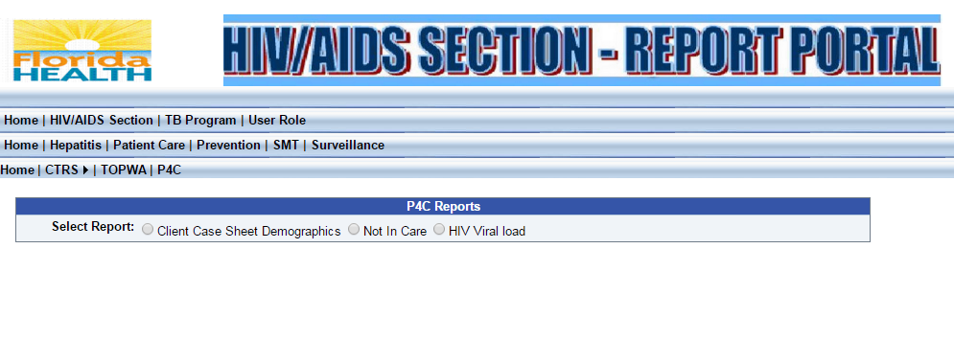
Florida P4C Dashboard
Client Type Reports
  Client Information Sheets
  Out Of Care Lists
  Persistently High Viral Load Lists

Slide 12
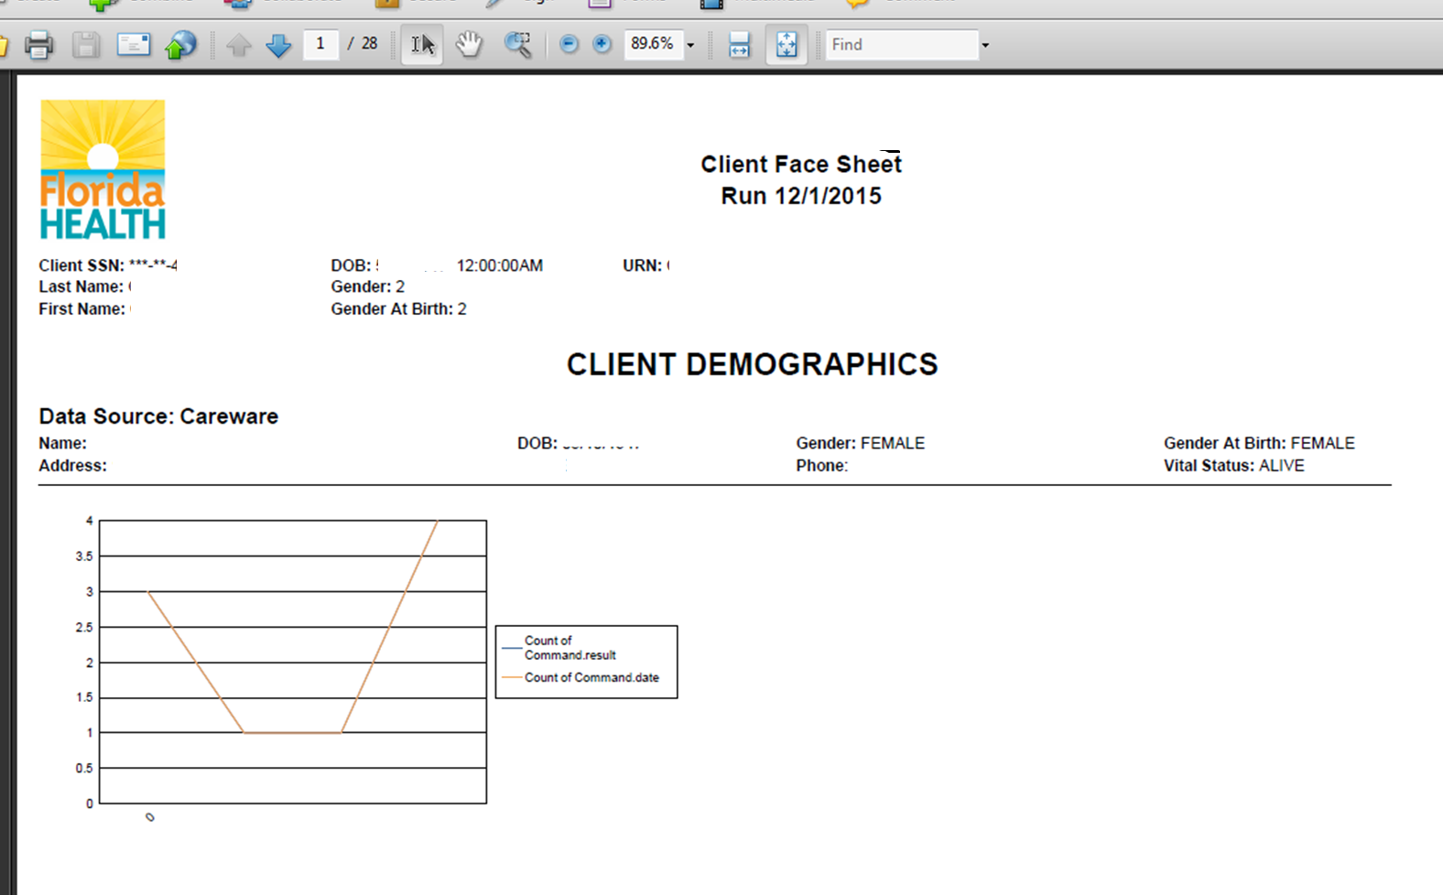
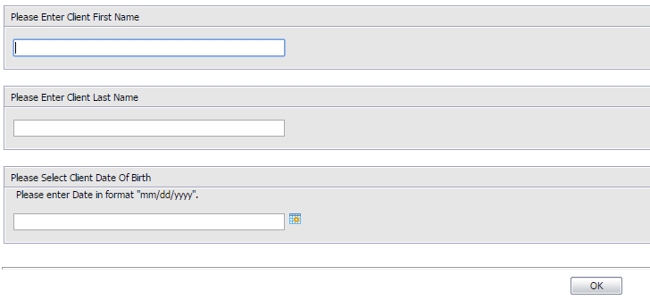
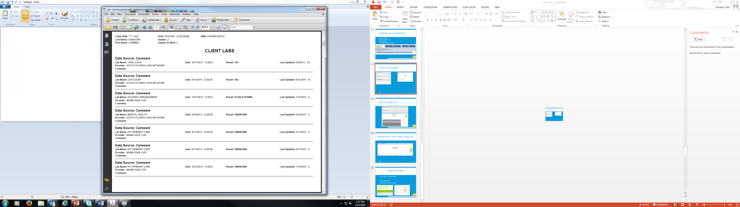
Client case sheet

Slide 13
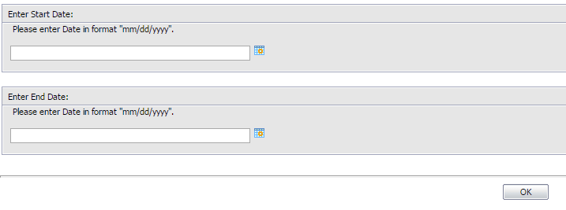
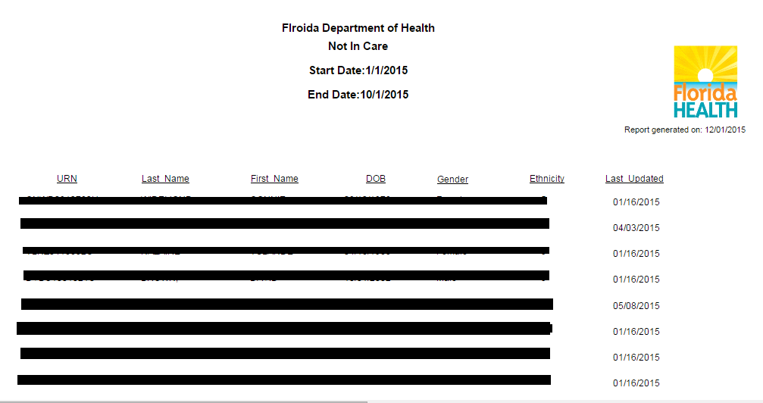
Not-in-care list
13

Slide 14
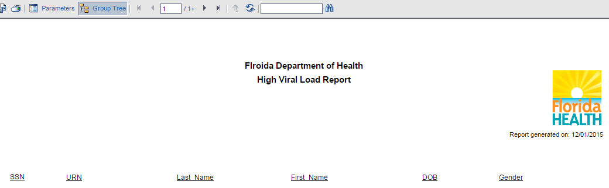
Persistently High Viral Load list

Slide 15
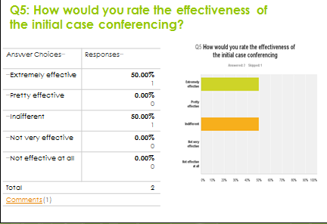
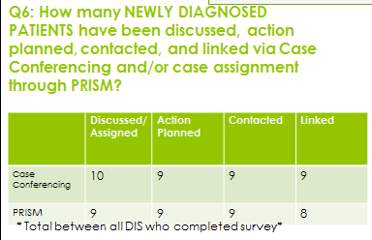
QI/QA and M&E
M&E for Development and Implementation stages
P4C monitoring tool
Case conference monthly survey
P4C monitoring tool
Monthly Reporting

Slide 16
Contact information
Mara Michniewicz, MPH, CHES
Prevention Program Manager
HIV/AIDS Section, Prevention Program
mara.michniewicz@flhealth.gov
Juan Vasquez
P4C Coordinator / Interventions Team Lead
HIV/AIDS Section, Prevention Program
Juan.Vasquez@flhealth.gov
Max Wilson, Ph.D
Disease Control Program Administrator / Statewide Evaluation Consultant
Area 4 AIDS Program Office, FDOH in Duval
Max.wilson@flhealth.gov
David Andress
P4C Care Consultant
Area 4 AIDS Program Office, FDOH in Duval
David.andress@flhealth.gov

