Slide 3
Panel Overview
Federal project overview (10 minutes)
Grantee presentations (70 minutes)
Questions & discussion (10 minutes)
For additional information
http://www.p4chivtac.com
The findings and conclusions in this report are those of the authors and do not necessarily represent the official position of the Centers for Disease Control and Prevention.

Slide 4
Federal Coordination and Funding
Multi-agency three-year project coordinated jointly at federal level
CDC/Division of HIV/AIDS Prevention (DHAP)
HRSA/Bureau of Primary Health Care (BPHC)
Other key federal partners
HHS/Office of HIV/AIDS and Infectious Disease Policy (OHAIDP)
HRSA/HIV/AIDS Bureau (HAB)
Funded by the Secretary’s Minority AIDS Initiative Fund (SMAIF)
& the Affordable Care Act

Slide 5
Overarching Goals
Strengthen partnerships
State departments of health
Community health centers
Identify promising new models for HIV service delivery
Improve identification of undiagnosed HIV infection
Establish new access points for care and treatment by integrating HIV services in primary care at health centers
Enhance the use of data for public health follow-up
Improve HIV outcomes along continuum of care, especially among racial/ethnic minority persons

Slide 6
Three Funding Mechanisms
CDC/DHAP
Supporting 4 state health departments (“HDs”)
Each HD identified up to 6 health center partners
HRSA/BPHC
Supplemental funding to 22 health center (“HCs”) grantees
Each with multiple service sites (86 total)
Supporting 1 contract for an HIV training and technical assistance collaboration center (“HIV TAC”)
Funding initiated FY14
HDs in July 2014
HCs & HIV TAC in September & December 2014

Slide 7
Grantee Eligibility
Health Departments
Burden of HIV: >5,000 HIV cases among African Americans and Latinos
Laboratory reporting: viral load and CD4 data at all levels
Not receiving CAPUS funding
Community Health Centers
Receive 330 Health Center Program Funds
Do not receive Ryan White HIV/AIDS Part C Program funding
Utilize an EHR system
At least 30% of patients representing racial/ethnic minority groups
Formal partnership agreement with a funded HD

Slide 8
P4C Grantees
Florida State Department of Health
6 health centers in Jacksonville, Orlando, West Palm Beach,
Fort Lauderdale & Miami
Maryland State Department of Health & Mental Hygiene
4 health centers in Baltimore City, Prince George’s & Montgomery Counties
Massachusetts Department of Public Health
6 health centers in Boston, Fall River, Lowell, and Salem
New York State Department of Health
6 health centers in New York City, Hudson Valley area,
Rochester and Buffalo

Slide 9
Health Department Activities
Data - Use HIV surveillance & health center patient data to improve health outcomes for PLWH (e.g., Data to Care and “case conferencing”)
Field Work - Expand partner services, linkage, retention, and re-engagement with care services for PLWH
Training/TA - Support training & TA activities for health centers to expand HIV testing, care & treatment, and prevention services for PLWH

Slide 10
Health Center Activities
Service Delivery – Provide routine HIV testing, basic HIV care, prevention services for PLWH, referrals, enabling services
Workforce Development – Establish and train multi-disciplinary HIV care team, train clinicians, staff and board
Infrastructure Enhancements – EHRs, 3rd party billing capabilities, develop and update formal referral agreements, care protocols, etc.

Slide 11
HIV TAC Activities
Serve primarily as a coordinator of training & technical assistance opportunities and resources
Leverage extensive network of federally-funded and other training programs and resources
Develop Health Center Toolkit

Slide 12
A Few Important Perspectives
Building partnerships & programs takes time
Staff hiring, training & turnover
D2C processes, data sharing policies & procedures, coordination of linkage and re-engagement processes complex
Enhancements to electronic health records not done overnight
Shifting to 3rd party billing can be difficult
Focus of Year 1
Programmatic Implementation, M&E
‘Perfection’ is a process – strong emphasis on quality improvement
Developed streamlined monitoring and evaluation plan
Outcome data reported on annual basis
Focus of Years 2 & 3

Slide 13
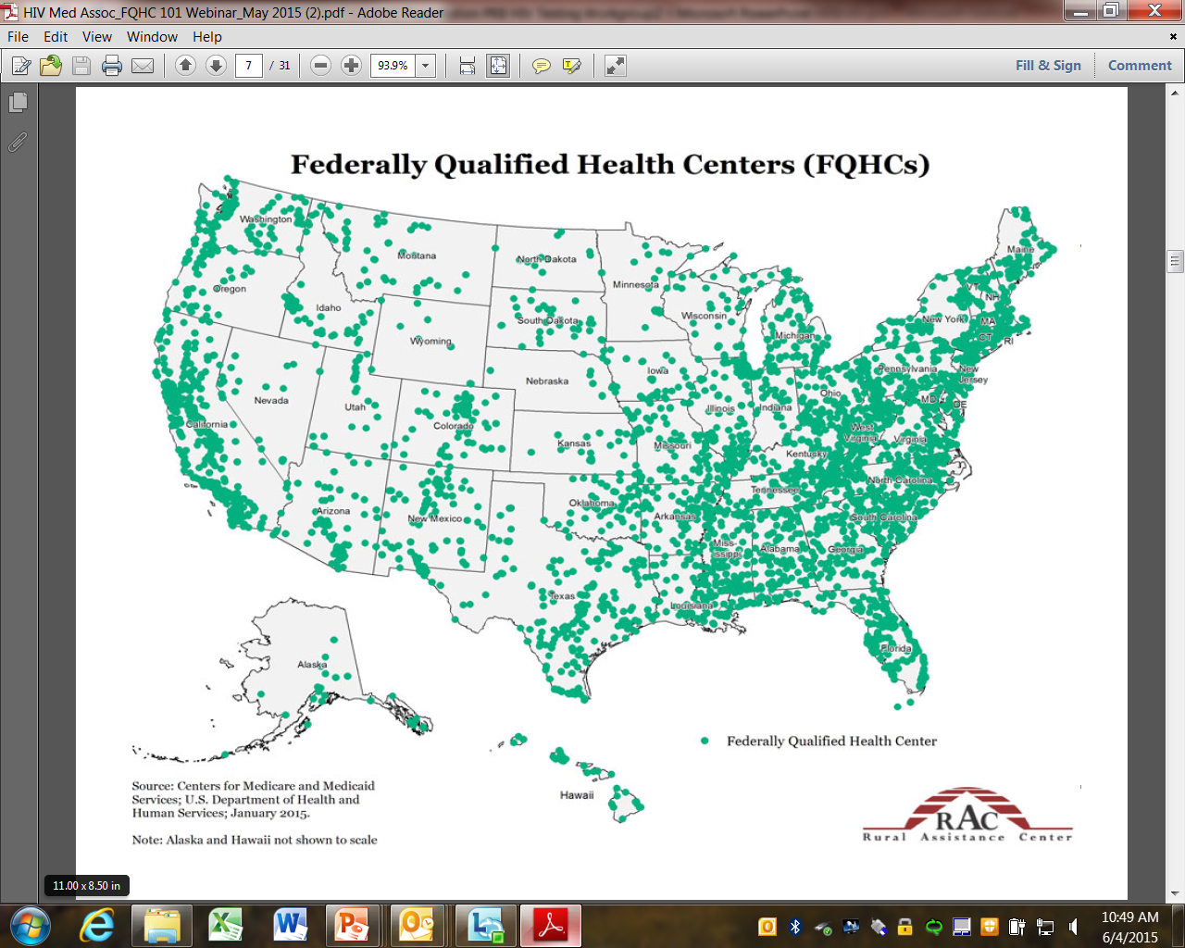
Anticipated Public Health Impact
Identify best practices & models of programmatic implementation
- Data to Care (D2C)
- routine HIV testing
- joining HIV services with primary care
Disseminate findings broadly to other health departments & FQHCs
Federal Health Center Program includes ~1,300 health centers and serves ~23 million people

Slide 14
Grantee Presentations
Presentation #1
Florida State Department of Health
Presentation #3
Massachusetts Department of Public Health
Presentation #2
New York State Department of Health
Presentation #4
Maryland State Department of Health and Mental Hygiene

Slide 15
Federal
CDC, Division of HIV/AIDS Prevention
HRSA, Bureau of Primary Health Care
HRSA, HIV/AIDS Bureau
HHS/Office of HIV/AIDS and Infectious
Disease Policy
Florida
Florida State Department of Health
Care Resource
Community Health South Florida, Inc.
Genesis Community Health, Inc.
Health Care Center for the Homeless, Inc.
I.M. Sulzbacher Center for the Homeless
Health Choice Network (HCCN)
Maryland
Maryland State Department of Health and
Mental Hygiene
Community Clinic, Inc.
Family Health Centers of Baltimore
Health Care for the Homeless, Inc.
Park West Health Systems Incorporated
Massachusetts
Massachusetts Department of Public Health
Codman Square Health Center, Inc.
Healthfirst Family Care Center, Inc. \ SSTAR
Lowell Community Health Center, Inc.
Mattapan Community Health Center, Inc.
North Shore Community Health Center, Inc.
Whittier Street Health Center
Massachusetts League of Community Health Centers
New York
New York State Department of Health
New York City Department of Health and Mental Hygiene
Anthony L Jordan Health Corp
Bedford Stuyvesant Family Health Center, Inc.
Betances Health Center
Community Health Center of Buffalo, Inc.
Damian Family Care Centers, Inc.
Greater Hudson Valley Family Health Center, Inc.
Training and Technical Assistance Contractor
MayaTech Corporation

