Slide 1
Building Leaders of Color
Session Two:
Stigma and Intersectionality
  Linda H. Scruggs, MHS
  Marissa Miller, SME
  Vanessa Miller, JD

Slide 2
Disclosures
Presenters have no financial interest to disclose.
This continuing education activity is managed and accredited by AffinityCE/Professional Education Services Group in cooperation with HRSA and LRG. PESG, HRSA, LRG and all accrediting organization do not support or endorse any product or service mentioned in this activity.
PESG, HRSA, and LRG staff as well as planners and reviewers have no relevant financial or nonfinancial interest to disclose.
Commercial Support was not received for this activity.

Slide 3
Learning Objectives
At the conclusion of this activity, the participant will be able to:
Define the impacts of stigma
Determine key elements of stigma
Explore how stigma impacts individuals living with HIV
Define intersectionality
Explain types of intersectionality

Slide 4
Obtaining CME/CE Credit
If you would like to receive continuing education credit for this activity, please visit:
http://ryanwhite.cds.pesgce.com

Slide 5

Stigma and Intersectionality
Building Leaders of Color (BLOC)
Training Workshop
This project is supported by the Health Resources and Services Administration (HRSA) through the Secretary's Minority AIDS Initiative Fund of the U.S. Department of Health and Human Services (HHS) under contract number U69HA304700100 as part of an award totaling approximately $2,750,000. The contents are those of the author(s) and do not necessarily represent the official views of, nor an endorsement, by HRSA, HHS or the U.S. Government.

Slide 6



Program Leadership:
The National Minority AIDS Council (NMAC) leads the BLOC Project.
The agency leads with race to urgently fight for health equity and racial justice to end the HIV epidemic in America.
Program Partners:
Positive Women’s Network-USA (PWN-USA)
United States People Living with HIV Caucus (HIV Caucus)
Transforming HIV Resentments into Victories Everlasting Support Services Incorporated
(THRIVE SS Inc.)
Notes:
Introduce NMAC’s role in BLOC and mission/vision of NMAC. Highlight NMACs historical and continued efforts to fight for health equity and racial justice to end the HIV epidemic in America.
Look at the proposal to explicitly state why people of color as leaders.

Slide 7
Rationale for BLOC
The purpose of BLOC is to contribute to the national HIV goals by ensuring people of color living with HIV, including transgender women of color, are equipped to provide meaningful input and guidance on achieving these goals via their participation on HIV planning bodies.
Notes:
BLOC is a program for people of color living with HIV of all ages [e.g. Black, Hispanic/Latino, American Indian/Alaskan Native (AI/AN), and Asian Pacific Islander (API)], including a special emphasis on transgender women of color living with HIV.
BLOC will contribute to a decrease in health disparities by developing leaders of color living with HIV who are emboldened to fully participate in RWHAP, planning bodies, and other leadership opportunities. Their participation will inform, educate, and support planning bodies and services providers to truly understand the needs of those who are most vulnerable. BLOC graduates will develop solutions that are built on the strengths and assets of these communities to create real solutions. BLOC trainings will give voice to those communities that are over represented in the number of new HIV cases, but under-represented in leadership opportunities.

Slide 8

Purpose of BLOC Program
To increase the number of Persons of Color Living with HIV who are actively serving in leadership roles or engaged in leadership activities related to HIV-related services at all levels of decision making

Slide 9

Our Guiding Principles
Where we begin
What we believe
How we operate
What we are creating
Notes:
See Handout: BLOC – Our Guiding Principles

Slide 10
Guiding Principles
The principle of Meaningful Involvement of People Living with HIV/AIDS (MIPA) demands that people living with HIV be substantively engaged in policy and programmatic decision-making activities that impact our lives, and fairly compensated for our participation.
The BLOC is based on the Denver Principles, a Bill of Rights / Declaration of Independence for the AIDS movement written in 1983. At its core, the Denver Principles demanded a set of rights and recommendations for people living with HIV.
Built on social justice movements building power for African Americans, Native Americans, Asian Americans, Latinos and Chicanos, women’s health and LGBT liberation.
Notes:
The Denver Principles began: “We condemn attempts to label us as ‘victims,’ a term which implies defeat, and we are only occasionally ‘patients,’ a term which implies passivity, helplessness, and dependence upon the care of others. We are ‘people with AIDS.’ This seminal moment in AIDS activism outlined 17 principles that covered everything from health care decisions to civil rights to sexual conduct. While the Denver Principles were written by members of the LGBTQ community who recognized their particular vulnerability to HIV and the social stigma attached to the disease, they built on community organizing practices that had been a vibrant part of the 1960s and 70s.
Together, the Denver Principles and MIPA make demands of our allies, our institutions, our government and our communities. They articulate our responsibilities as people living with HIV to engage each other and our representative institutions. They recognize the power of language to affirm or destroy and the potential to change social and cultural norms while reaching political goals. As the partner organizations behind the BLOC, we believe that, more than ever, the meaningful involvement of people of color living with HIV must guide policy and practice on the domestic epidemic today.

Slide 11



Our Aims as Leaders

Slide 12
Stigma & The Impact

Slide 13

The Stigma Tree

Slide 14
The Stigma Tree
Divide into small groups
Each group will conduct three brainstorms to identify how Persons of Color Living With HIV experience stigma to build their “Stigma Tree”
The three brainstorms should identify:
  The causes of stigma – the roots
  The forms of stigma – the trunk
  The effects of stigma – the branches
Transfer your brainstorm outcomes to Post-Its and place on your “Stigma Tree”

Slide 15
The Stigma Tree
Some examples to guide your brainstorm:
  Roots: Lack of Knowledge, Lack of Awareness, Fear, Stereotyping
  Forms: Physical Violence, Emotional Violence, Segregation
  Effects: Depression, Isolation, Fear
Be sure to place all your items on your “Stigma Tree” and select one group member to present your tree

Slide 16
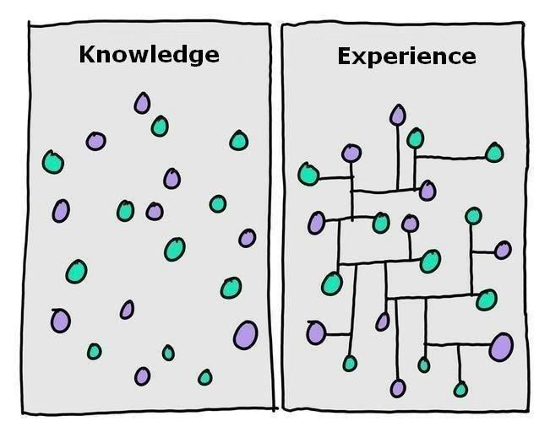
Stigma Tree Presentations

Slide 17

Stigma
Stigma is a social construction that involves at least two fundamental components:
the recognition of difference based on some distinguishing characteristic, or 'mark‘ and
a consequent devaluation of the person

Slide 18

Manifestations of Stigma
Public Stigma
Self-Stigma
Stigma by Association
Structural Stigma

Slide 19

Social Psychological Functions of Stigma
To keep people down
To make people conform
To keep people away
Notes:
To keep people down – stigmas help to legitimize and perpetuate social inequities (i.e., provide justification for the exploitation and dominance of lower status groups)
To make people conform - stigmas help to enforce social norms by serving as a punishment to those who choose non-conformity
To keep people away – stigmas trigger avoidance responses to a broad class of deviant human characteristics that potentially signal risk of infection

Slide 20

Discussion Question
Can anyone name some examples of these different types of stigma?
  Public
  Self-Stigma
  Stigma by Association
  Structural Stigma

Slide 21

How do people stigmatize?
Isolation and Rejection
Shaming and Blaming
Enacted Stigma (Discrimination)
Self-Stigma
Stigma by Association
Layered Stigma (Intersectionality)

Slide 22
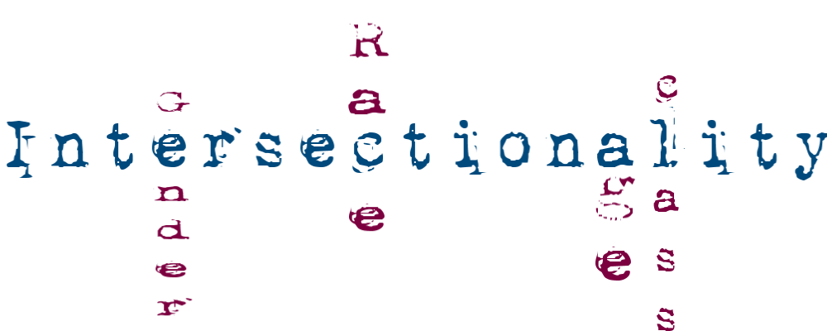
Intersectionality
Intersectionality is a term first coined in 1989 by American civil rights advocate, Kimberlé Williams Crenshaw, to describe what she saw as failures of the system in responding to domestic violence against poor Black women.

Slide 23
Intersectionality
Intersectionality promotes an understanding of human beings as shaped by the interaction of different social locations and identities.
These interactions occur within a context of connected systems and structures of power.
Through such processes, interdependent forms of privilege and oppression shaped by colonialism, imperialism, racism, homophobia, ableism and patriarchy are created.

Slide 24

Intersectionality
According to an intersectional perspective, inequities are never the result of single, distinct factors.

Slide 25

Intersectionality

Slide 26

Tenets of Intersectionality
People’s lives are multi-dimensional and complex
  Cannot be explained through single identities
Relationships and power dynamics between different identities and oppressions are linked.
  They can also change over time and space.
26

Slide 27
Tenets of Intersectionality
People can experience privilege and oppression simultaneously, based on context.
With social problems, the importance of any identity or structure cannot be predicted, but can be discovered through investigation.
27

Slide 28
Tenets of Intersectionality
Individual experiences must be linked to broader structures of oppression.
  Analysis must occur on multiple levels
Scholars, researchers, policy makers, and activists must consider their own social position and power.
  This “reflexivity,” should be in place before setting priorities and directions in research, policy work and activism.
28

Slide 29
Tenets of Intersectionality
Intersectionality is explicitly oriented towards transformation, building coalitions among different groups, and working towards social justice.
29

Slide 30

Activity: The Lenses

Slide 31

The Lenses
Race
Ethnicity
Gender
Sexual Orientation
Economic Class
Religious Affiliation
Education Level
Geography

Slide 32

The Lenses
For this activity, consider how you identify
Using the handout, fill in your lenses with these identities
Be prepared to share back with the larger group

Slide 33

Growth Mindset
Can anyone think of a time when they used a growth mindset to approach a challenge or set-back?

Slide 34

Report Back
What lenses do you view the world through?

Slide 35

Debrief
What identities align with one another?
What identities are in conflict with one another?
What makes them in conflict with one another?
How do/did you reconcile the two?
Have you ever experienced stigma as a result of your identities? What happened? How did you handle it?
Have you ever had to minimize or hide your identity because of the fear of be discriminated against?
Have you ever stigmatized or discriminated against someone? If so, what happened?

Slide 36

Questions and Comments

Slide 37


Slide 38


Learn more
Learn more about BLOC at:
http://www.blochiv.org/
And on TargetHIV
https://targethiv.org/ta-org/blochiv

Slide 39

Contact Us
Linda H. Scruggs, MHS, Consultant
(Pronouns: she, her, hers)
Acting Director, Leadership Pipeline
Cell 202-299-7832
lhscruggs@nmac.org
NMAC leads with race to urgently fight for health equity and racial justice to end the HIV epidemic in America
NMAC USCA
1000 Vermont NW
Suite 200
Washington, DC 20005
www.nmac.org
Charles Shazor Jr.
(Pronouns: he, him, his)
Program Coordinator
Leadership Pipeline
P: 202-302-7515
cshazor@nmac.org

