Slide 1
Perinatal HIV Prevention Cascade
Jessica Fridge, MSPH
Surveillance Manager, Louisiana Department of Health, STD/HIV/Viral Hepatitis Program

Slide 2
Perinatal HIV Exposure in Louisiana
Perinatal HIV Exposure and Transmission
Louisiana, 2007-2016

Slide 3
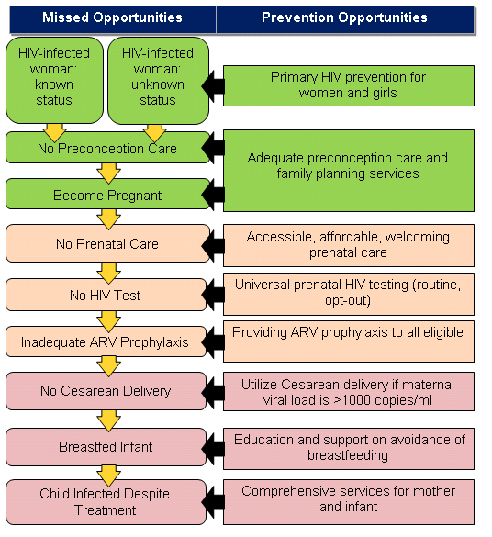
Perinatal HIV Prevention Cascade

Slide 4
Fetal Infant Mortality Review/HIV (FIMR/HIV)
The FIMR/HIV Prevention Methodology is an action-oriented community process that continually assesses, monitors, and works to improve service systems and community resources for women, infants, and families.
The goal of the FIMR/HIV Prevention Methodology is to improve perinatal HIV prevention systems by using the FIMR case review and community action process.
In 2009, the Louisiana STD/HIV Program and the Louisiana Bureau of Family Health partnered to carry out FIMR/HIV methodology in the New Orleans region.
The FIMR/HIV Methodology follows a five-step process for data collection, review, and community action:
Notes:
Cases reviewed to date include all cases of perinatal transmission of HIV from 2009 onward, as well as other cases with noted gaps in HIV or prenatal care. Louisiana is no longer funded specifically for FIMR/HIV, but continues to implement this methodology in the New Orleans and Baton Rouge regions with resources from the STD/HIV Program.

Slide 5
Louisiana – Estimated Percent Aware

Slide 6
Women Living with HIV Diagnosis Prior to Pregnancy

Slide 7
CDC Recommendations and Louisiana Legislation
Since 2006, the CDC has recommended repeat HIV testing during the third trimester for pregnant women in areas with high HIV incidence; Louisiana has high HIV incidence.
In 2007, the Louisiana Legislature passed RS 40:1091, a law that required offering both HIV and syphilis testing to all pregnant women at the first prenatal care visit.
Since the passage of this law, at least 40 women have been diagnosed annually with HIV during pregnancy and approximately 2,000 pregnant women have been diagnosed with syphilis.
HIV and syphilis are also reportable conditions during pregnancy per the Louisiana Sanitary Code.

Slide 8
Passage of Third-Trimester Testing Law
2011
1st Attempt: Proposed legislative bill to DHH
CDC conducted state-wide Epi-Aid and Rapid Ethnographic Assessment in Shreveport Region due to high rates of congenital syphilis and syphilis among women
2012
Expanded role of Perinatal Coordinator to include congenital syphilis
2nd Attempt: Proposed legislative bill to DHH
2013
FIMR/HIV CRT Recommendations for routine late pregnancy/3rd trimester testing
3rd Attempt: Proposed legislative bill to DHH (Success!)
2014
Act 459 became effective on June 4, 2014. Requires physicians to offer opt-out HIV and syphilis screening in the third trimester.

Slide 9
Prenatal Care Entry, Louisiana
Notes:
Over the past 5 years, between 70 and 75% of Louisiana women have received prenatal care beginning in the first trimester.
In 2016, about 5% of women entered care in the 3rd trimester (aka late entry) while and additional 3% received no prenatal care.

Slide 10
Prenatal Care Adequacy
Notes:
When we look at prenatal care adequacy, we again see little change over time – in the past 5 years that is. In 2016, 75% of Louisiana women received adequate or more prenatal care according to the Kotelchuck measure.
The or more means that you can be in the ‘adequate’ group or the ‘adequate plus’ group to be part of this 75%. (you guessed it – the adequate plus group received more visits than what would be expected for gestational age)
Sure – it is the ratio of expected to received visits for gestational age at delivery…
80-109% = Adequate; 110+% =Adequate Plus.
See https://www.mchlibrary.org/databases/HSNRCPDFs/Overview_APCUIndex.pdf for more detailed information.

Slide 11
HIV Continuum of Care Louisiana, 2017
83% of PLWH in care were virally suppressed
Notes:
Definitions:
Persons living with HIV: Number of persons living with HIV as of 12/31/2016 who were diagnosed by 12/31/2015, whose current address is in Louisiana (PLWH)
Engaged in HIV care: Number of PLWH who had at least 1 CD4 or VL test conducted in 2016
Retention in HIV care: Number of PLWH who had 2 or more CD4 or VL tests conducted in 2016 at least 90 days apart
Viral suppression: Number of PLWH whose most recent VL test in 2016 was <200 copies/mL

Slide 12
HIV Care Continuum by Sex at Birth Louisiana, 2017
81% of PLWH in care were virally suppressed
85% of PLWH in care were virally suppressed
Notes:
Definitions:
Persons living with HIV: Number of persons living with HIV as of 12/31/2017 who were diagnosed by 12/31/2016, whose current address is in Louisiana (PLWH)
Engaged in HIV care: Number of PLWH who had at least 1 CD4 or VL test conducted in 2017
Retention in HIV care: Number of PLWH who had 2 or more CD4 or VL tests conducted in 2017 at least 90 days apart
Viral suppression: Number of PLWH whose most recent VL test in 2017 was <200 copies/mL

Slide 13
Louisiana Links (LA Links)
Data-to-care strategy implemented across Louisiana since Oct 2013
Utilizes HIV surveillance data to identify people living with HIV (PLWH) who are:
Newly diagnosed and not linked to care
Previously diagnosed who need reengagement
In care, but experiencing high viral loads
Persons added to line lists based on time since last lab and/or viral suppression history
Linkage to care coordinators (LCCs) provide extensive services to address social barriers to care engagement and viral suppression maintenance
Pregnant women or new mothers, can be fast tracked into the LA Links database.

Slide 14
Lessons Learned – Barriers to Care
Need to make use of data collected on barriers to care
Clients still interacting with systems that may have previously failed them
Work with and help to change systems with policies rooted in:
Racism, Homophobia, Transphobia
How do social determinants affect linkage and maintenance in care and what can we do as Linkage to Care Coordinators and as an agency to address these issues?
Poverty
Stigma
Mental health issues
Substance abuse
Homelessness
Healthcare system policies
Insurance status – Medicaid expansion
Domestic abuse
Language access
Immigration status
Community violence

Slide 15
Questions?
Jessica Fridge, MSPH
STD/HIV/ Viral Hepatitis Surveillance Manager
Jessica.Fridge@la.gov

