Slide 1
Preventing Perinatal HIV Transmission Institute
Session 2: Addressing the Missed Opportunities
Thursday, December 13, 2018
HIV/AIDS Bureau (HAB)
Health Resources and Services Administration (HRSA)
Division of HIV/AIDS Prevention (DHAP)
Center for Disease Control (CDC)

Slide 2
Disclosures
Presenter(s) has no financial interest to disclose.
This continuing education activity is managed and accredited by AffinityCE/Professional Education Services Group in cooperation with HRSA and LRG. PESG, HRSA, LRG and all accrediting organization do not support or endorse any product or service mentioned in this activity.
PESG, HRSA, and LRG staff as well as planners and reviewers have no relevant financial or nonfinancial interest to disclose.
Commercial Support was not received for this activity.

Slide 3
Learning Objectives
At the conclusion of this activity, the participant will be able to:
Discuss missed opportunities in prevention of perinatal HIV
Share best practices from recipients across geographic areas most highly impacted
Identify areas of focus for programs including behavioral health

Slide 4
Obtaining CME/CE Credit
If you would like to receive continuing education credit for this activity, please visit:
http://ryanwhite.cds.pesgce.com

Slide 5
Health Resources and Services Administration (HRSA) Overview
Supports more than 90 programs that provide health care to people who are geographically isolated, economically or medically vulnerable through grants and cooperative agreements to more than 3,000 awardees, including community and faith-based organizations, colleges and universities, hospitals, state, local, and tribal governments, and private entities
Every year, HRSA programs serve tens of millions of people, including people living with HIV/AIDS, pregnant women, mothers and their families, and those otherwise unable to access quality health care

Slide 6
HIV/AIDS Bureau Vision and Mission
Vision
Optimal HIV/AIDS care and treatment for all.
Mission
Provide leadership and resources to assure access to and retention in high quality, integrated care, and treatment services for vulnerable people living with HIV/AIDS and their families.

Slide 7
Ryan White HIV/AIDS Program
Provides comprehensive system of HIV primary medical care, medications, and essential support services for low-income people living with HIV
    More than half of people living with diagnosed HIV in the United States – more than 550,000 people – receive care through the Ryan White HIV/AIDS Program
  Funds grants to states, cities/counties, and local community based organizations
  Recipients determine service delivery and funding priorities based on local needs and planning process
Payor of last resort statutory provision: RWHAP funds may not be used for services if another state or federal payer is available
84.9% of Ryan White HIV/AIDS Program clients were virally suppressed in 2016, exceeding national average of 55%
Source: HRSA. Ryan White HIV/AIDS Program Annual Client-Level Data Report 2016; CDC. HIV Surveillance Supplemental Report 2016;21(No. 4)

Slide 8

DATA Recap
HRSA HAB

Slide 9



Women, Pregnant Women and Infants Served by the RWHAP
10% of all RWHAP Clients
Women, 18-44 years old
.05% of all RWHAP Clients
Pregnant Women
<1% of all RWHAP Clients
Infants, < 1 year old
Source: HRSA. Ryan White HIV/AIDS Program Annual Client-Level Data Report 2016
Notes:
In 2016 approximately 57,000 women between the ages of 18- 44 received RWHAP services (10% of Total RWHAP Clients)
Approximately 2400 pregnant women received RWHAP services (these pregnant women are included in total # of women above)
.5% of all RWHAP clients
Approximately 1300 infant received RWHAP services .02% of all RWHAP Clients

Slide 10
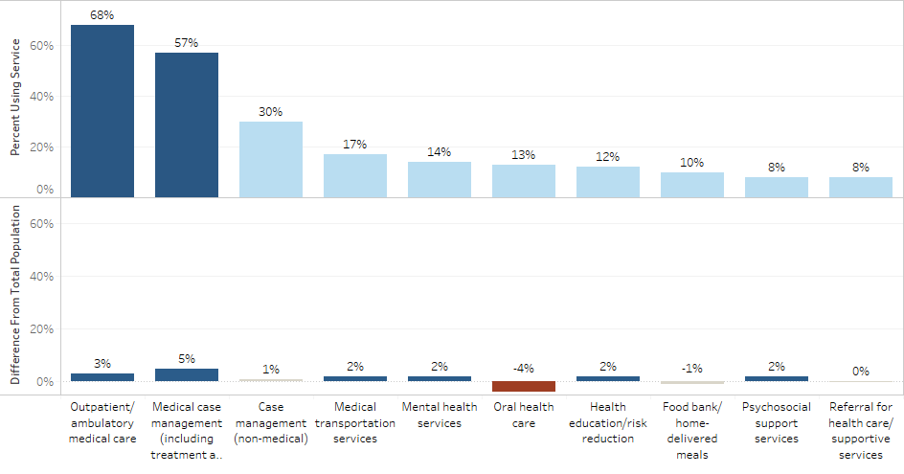
RWHAP Service Utilization Comparison with total clients
Top Service Categories, Women Age 18-44
Women, Ages 18-44 Service Mix: Difference from Total RWHAP Client population
Notes:
4. The use of these services actually isn’t that different from the rest of the population – slightly more medical case management and slightly lower oral health care.

Slide 11
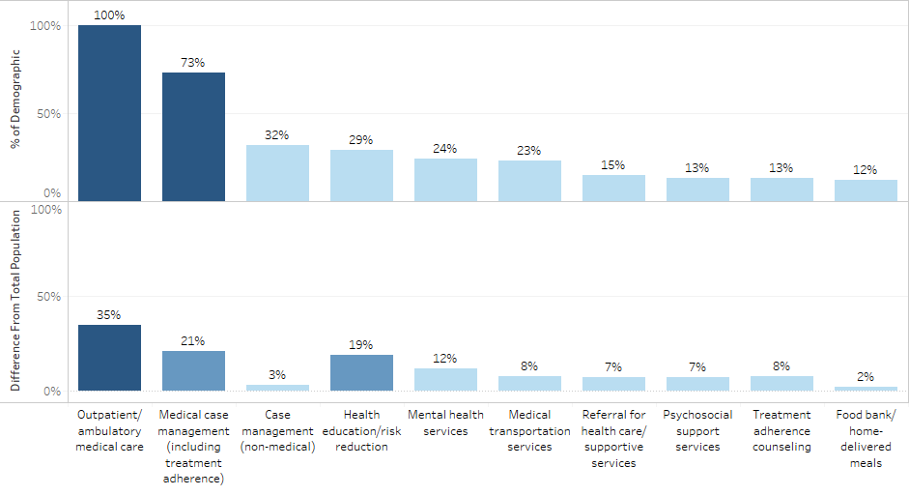
RWHAP Service Utilization Comparison Pregnant Women
Top Service Categories, Pregnant Women
Pregnant Women Service Mix: Difference from Total RWHAP Client Population
Notes:
6. Pregnant women utilize more services relative to the rest of the population.
.

Slide 12
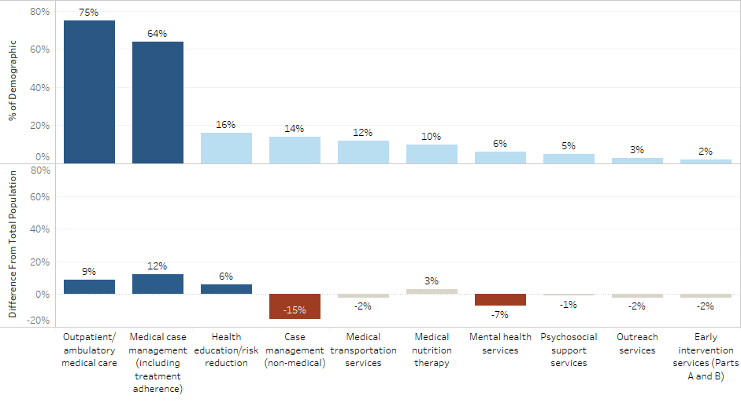
RWHAP Service Utilization by Infants
Top Service Categories: Infants
Infants Service Mix: Difference from Total RWHAP Client Population
Notes:
Infants tend to use WAY fewer services than the rest of the client population

Slide 13
DATA Recap
CDC DHAP

Slide 14
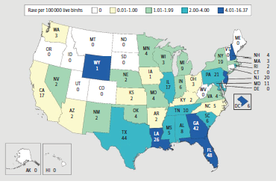
Estimated numbers and rates of perinatally acquired human immunodeficiency virus infections among children born in the United States and District of Columbia, 2010-2013
Taylor et al. JAMA Pediatrics May 2017
Notes:
Only since 2008 has CDC had nationwide estimates for the numbers of infants born with HIV in the United States. In this publication from 2017, among infants born with HIV in the United States during the four-year period 2010-2013, three states (TX, FL, and GA) accounted for nearly a third. The predominance of new infant infections occur now in the South, and there have been huge decreases in some of the northeastern states where there were once so many cases.

Slide 15
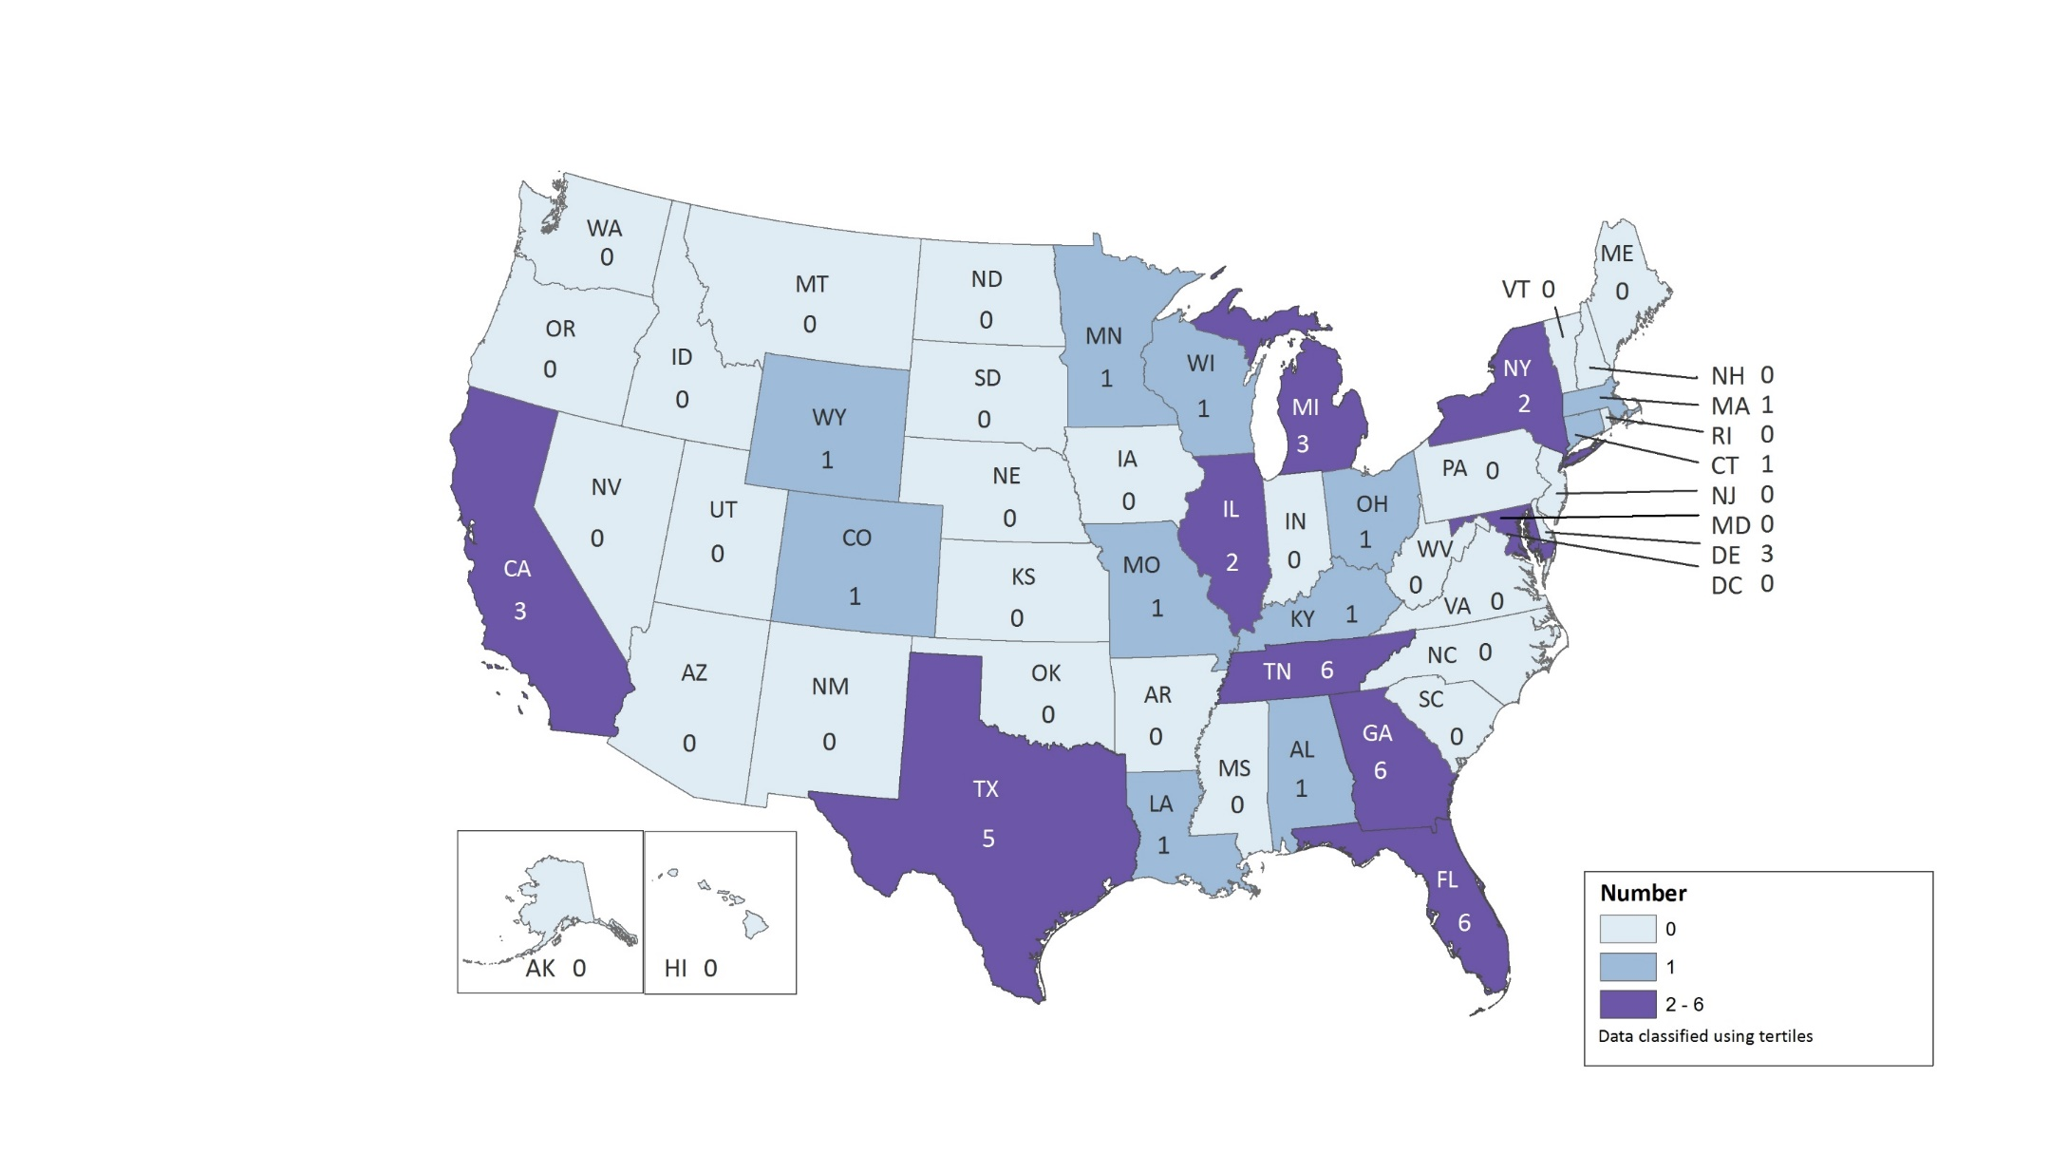
Diagnoses of Perinatally Acquired HIV Infection among Children Born During 2014, by Area of Residence—United States and Puerto Rico
N = 47
Puerto Rico
0
Notes:
This slide from CDC’s current slide set shows that 47 infants were born with HIV in the US. CDC’s Monitoring Report published in 2018 reports 53 infants born in 2015. Unlike the numbers on the previous slide, which were adjusted (known as “estimating”) to account for delays in diagnosis and reporting, starting in 2014 data the numbers will no longer be adjusted, meaning that the numbers are somewhat lower than when we used estimation.

Slide 16
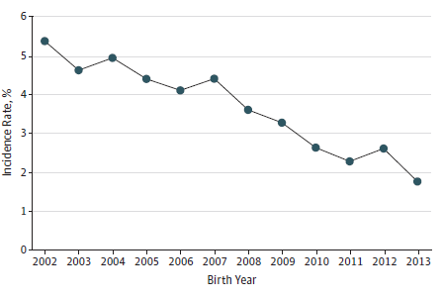
Estimated incidence rates of perinatally acquired human immunodeficiency virus infection in 50 US states and the District of Columbia, 2002-2013
Taylor AW et al, JAMA Pediatrics, May 2017
Rates are estimated diagnoses per 100,000 live births and were adjusted for delay in reporting from birth to diagnosis and from diagnosis to report
Notes:
The incidence (the number of cases per 100,000 live births) based on estimated numbers has decreased almost every year of this century, and in this year’s Monitoring Report (volume 23, number 4), the incidence with reported numbers was 1.3/100,000 in 2015; using those numbers, the incidence has been below 2/100,000 since 2008. Our national data always excludes the 2 most recent years in order to allow time for cases to be reported. CDC’s goal for eliminating perinatal HIV in the US is 1/100,000, so it is possible to speculate we have achieved our goal, assuming that numbers have continued to decrease. The implications of asserting that we have “eliminated” perinatal HIV will be explored more tomorrow by my colleague Margaret Lampe.

Slide 17
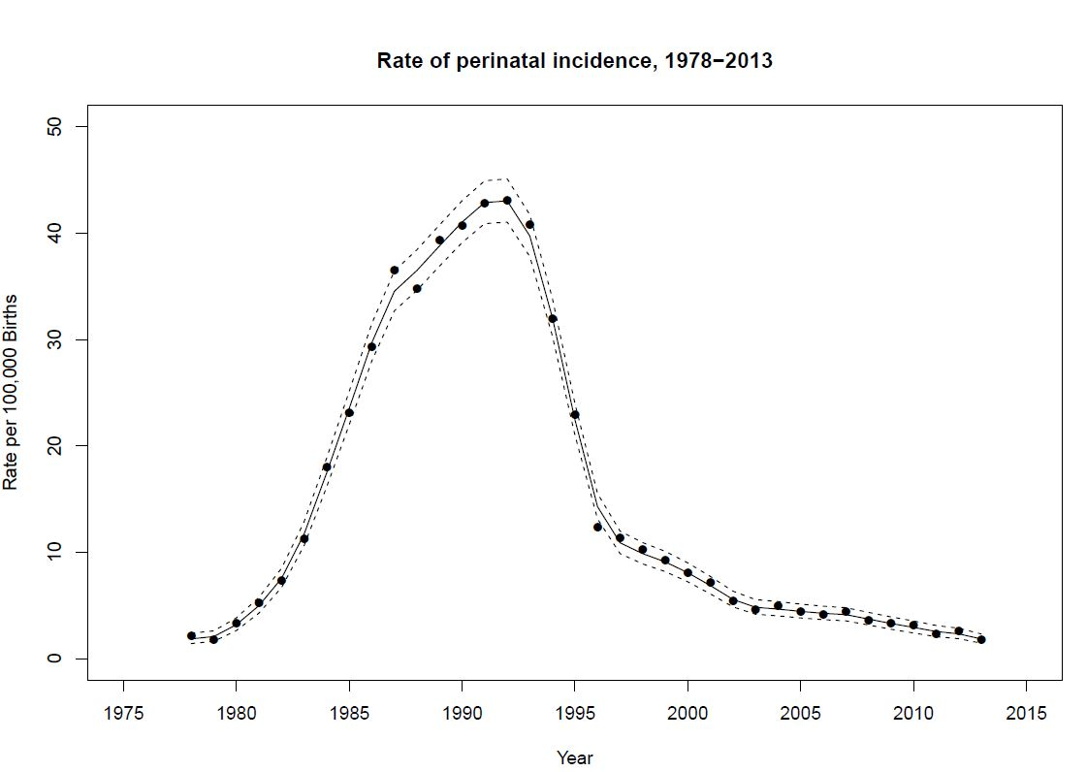
Incidence of Perinatally Acquired HIV Infection in the United States, 1978-2013
Nesheim SR, et al. J Acquir Immune Defic Syndr Volume 76, Number 5, December 15, 2017
Notes:
Consider this graphic presentation of the incidence of perinatally acquired HIV in the United States. As I said earlier, CDC did not have nationwide data for the numbers of infants born with HIV, but several different reports over the decades have estimated the number. From these estimates, we calculated the incidence of perinatally acquired HIV for every year back to 1978. Numbers for the earliest years were based on back-calculations based on diagnoses of AIDS and HIV.
This figure illustrates several things: the sudden, rapid increase in incidence through the 1980’s; the peak incidence at around 43/100,000 live-births in 1992, notably before the benefit of ARV prophylaxis had been demonstrated, much less introduced programmatically; incidence has decreased 96% from that peak (94% from the incidence at the time ARV prophylaxis was introduced); incidence decreased about 70% in the first several years following introduction of ARV prophylaxis; incidence appears to decrease at a more gradual rate during the years when triple-drug prophylaxis and elective cesarean section were introduced.

Slide 18
PANEL DISCUSSION
Addressing Missed Opportunities
Notes:
Moderated discussion in which four (4) recipients focus on practical and concrete ways to address missed opportunities.
HRAS HAB Team will develop 4-5 questions for the panel discussion and share these questions with leadership teams for approval.

Slide 19

Recognizing Missed Opportunities
Andrés Felipe Camacho-Gonzalez, MD
Assistant Professor
Director, Pediatric Infectious Disease Fellowship
Osler Society Advisor
Pediatric Infectious Diseases
Emory University
acamac2@emory.edu

Slide 20


Comprehensive HIV Clinical Care
Claire Farel, MD, MPH
University of North Carolina Chapel Hill
Medical Director, UNC Infectious Diseases Clinic
claire_farel@med.unc.edu

Slide 21


Integrated HIV Prevention and Care Services
JoNell Efantis Potter, PhD, APRN, FAAN
Professor, Department of OB/GYN & Pediatrics
Chief of Women’s HIV Service- Jackson Health System
University of Miami Miller School of Medicine

Slide 22


Behavioral Health Services, Addressing Stigma, and Linkage to Care
Kay Kinzie MSN, FNP-BC
Clinical Manager
Children's Hospital Immunodeficiency Program CHiP
kay.kinzie@childrenscolorado.org
24 hour Perinatal HIV Consult Line
303-281-9695

Slide 23
Missed Opportunities: Atlanta, GA
Andrés Felipe Camacho-Gonzalez, MD
Assistant Professor
Director, Pediatric Infectious Disease Fellowship
Osler Society Advisor
Pediatric Infectious Diseases
Emory University

Slide 24
Outline
Mother to Child Transmission in the US and Georgia
Missed opportunities for perinatal HIV Prevention in Georgia
Perinatal HIV Service Coordination Program
Multidisciplinary HIV/OB Team

Slide 25
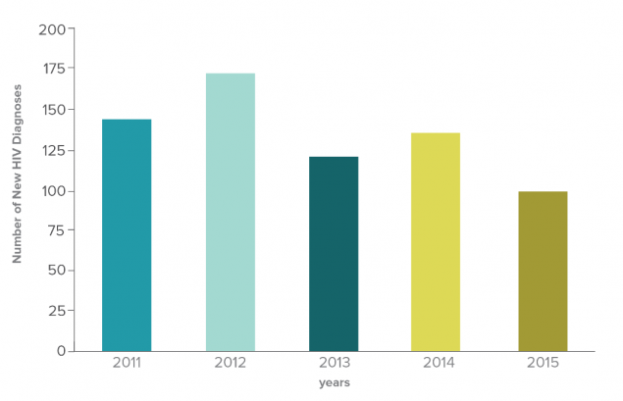
Diagnosis of Perinatal HIV in the US, 2011-2015
Source CDC. Diagnoses of HIV infection in the United States and dependent areas, 2016

Slide 26
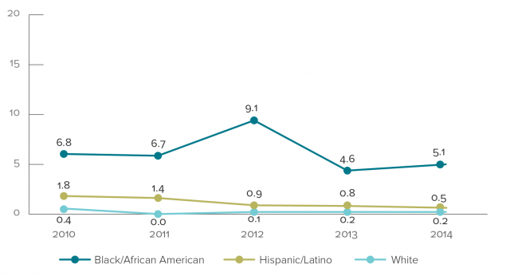
Rates of Perinatally Acquired HIV Infections by Year of Birth and Mother’s Race, 2010-2014
Source: Monitoring selected national HIV prevention and care objectives by using HIV surveillance data—United States and 6 dependent areas, 2015

Slide 27
Perinatal HIV: Where Does GA Currently Stand?
GA Ranked 1st in the nation for HIV Rates among adults and adolescents 31.8/100,000¹
GA ranked 5th highest in nation for overall total number new HIV infections (2016)²
Prevalence of HIV (2016)²
  13,447 females
  122 children < 13 years old (vast majority perinatally infected)
An estimated 191 HIV-positive women gave birth in 2016²
¹Centers for Disease Control and Prevention. HIV Surveillance Report, 2016;
²Georgia Department of Public Health, 2016 Surveillance Report

Slide 28
Perinatal HIV Infections by Year and Location of Birth
Georgia, 2009-2017
*
*Preliminary data
+Metro vs. non-metro category is determined by mother’s residence
Slide Courtesy of Pascale Wortley and Fay Stephens GDPH

Slide 29
Missed Opportunities for Prevention of MTCT in the United States: A Review of Cases from the State of Georgia, 2005–2012
Review of all cases at Ponce Infectious Disease Program: 27 infections
Demographics:
    89% of women were African American
    63% between 16-30 years of age
    74% (20) new their diagnosis prior to pregnancy
      Only 50% received prenatal care
        45% did not receive cART
        25% did not receive intrapartum AZT
HIV RNA was available at time of delivery in only 10/27 women and only 3 had undetectable levels
3 Infants acquired HIV infection in Utero
Camacho-Gonzalez et al. AIDS 2015

Slide 30
Risk Factors for MTCT Ponce Clinic 2005-2012
Risk Factor | Yes N (%) | No N (%) | Unknown N (%)
Maternal/Prepartum
Prenatal care | 12 (44) | 12 (44) | 3 (11)
Illicit Substance Use | 9 (33) | 10 (37) | 8 (30)
ARVs throughout pregnancy | 12 (44) | 14 (52) | 1 (4)
Delivery/Intrapartum
Rupture of membranes prior to delivery | 6 (22) | 3 (11) | 18 (67)
AZT at delivery | 14 (52) | 9 (33) | 4 (19)
Maternal undetectable HIV-1 RNA at time of delivery | 3 (11) | 7 (26) | 17 (63)
Maternal CD4 count <200 cells/µL | 2 (7) | 7 (26) | 18 (66)
Vaginal delivery | 8 (30) | 19 (70) | -
Infant/Postpartum
Neonatal ARV prophylaxis | 18 (67) | 7 (26) | 2 (7 )
Breastfeeding | 1 (4) | 19 (70) | 7 (26)
Camacho-Gonzalez et al. AIDS 2015

Slide 31
Missed Opportunities Identified
24/27 cases: Limitations in healthcare delivery or uptake.
  Linkage/Retention in care
  Vaginal delivery in 2 mothers who had detectable viral load
  Mothers not receiving intrapartum AZT
  Infant not receiving appropriate prophylaxis: only 67% received AZT
  Due to lack of initial diagnosis 1 patient was breastfed for 3 months.
Camacho-Gonzalez et al. AIDS 2015

Slide 32
Recommendations for Interventions
Development of Prevention Programs
Work directly with birth Hospitals
  Assess availability of rapid HIV testing in L&D units
  Assess providers PMTCT practices
Educate providers to increase adherence to national guidelines
Coordinate efforts within our system and with public health providers to improve linkage and retention in care

Slide 33



Perinatal HIV Services Coordination
Program (PHSC)
Program Goals | Intervention
Assess hospital for appropriate resources in terms of equipment, medication personnel and policies and procedures for PMTCT | Identity major delivery hospitals, establish connection, disseminate survey to multi-disciplinary team
Assist hospitals fill gaps in HIV prevention services where knowledge and resources for PMTCT are lacking | Provide on-site educational in-service training; provide ongoing support through continued communication and consultation; provide referral resources (patient follow-up, Emory Peds ID, IMPAACT studies)
Expand and improve surveillance of pediatric HIV by including HIV exposure notifcation | Develop and implement electronic perinatal HIV exposure notification system
Slide Courtesy of Somer Smith PharmD

Slide 34
PHSC Program
Forging Relationship With Hospitals and Providers
Identification of L&D Units
Initial Contact
Site Visit
Assessment and Hospital In-service with
Multi-disciplinary Team
Hospital Electronic Exposure Notification System Set-up
Report sent to DPH through SENDSS
Medical Record Review of Mom/Infant Pairs
Coordinate with Prevention for mom/baby follow-up
On-going communication about survey results, issues, recommendations for improvement
Provide referral resources (Grady IDP, Perinatal HIV Hotline)
Revise/edit protocols and policies
Provide update alerts of perinatal HIV guidelines
Slide Courtesy of Somer Smith PharmD
Notes:
Process of the program: initial set-up, ongoing communication, notification system, follow-up/linkage to care

Slide 35
Hospital Assessment Results: Measure for Care of HIV-Positive Pregnant Women
Hospital Type (n=11) | Annual Deliveries | # of HIV Positive Women Delivering (7/14-6/15)* | # of HIV Infected Babies Born (2005-2013)* | Policies and Procedures for PMTCT | Point-of-Care Testing at Delivery | HIV Testing Available in 1-2 hours | Opt-Out HIV Screening of Pregnant Women
University | 3,557 | 9 | 5 | Yes | No | Yes | Yes
University | 2,780 | 33 | 14 | Yes | Yes | Yes | Yes
Private | 3,307 | 3 | 2 | No | No | Yes | Yes
Private | 14,789 | 5 | 6 | Yes | No | No | No
Private | 3,223 | 6 | 2 | No | No | Yes | Yes
Private | 4,759 | 7 | 1 | No | No | Yes | No
Private | 5,101 | 3 | 1 | Yes | No | Yes | Yes
Private | 1,860 | 1 | 1 | Yes | No | Yes | No
Private | 5,280 | 5 | 2 | Yes | No | Yes | Yes
Private | 3,756 | 5 | 2 | Yes | No | Yes | Yes
Private | 485 | 0 | 1 | Yes | No | Yes | Yes
* These numbers were retrieved from birth certificate data
Slide Courtesy of Somer Smith PharmD

Slide 36
Hospital Assessment Results: Measures for Care of HIV Exposed Infant
Hospital Type | Annual Deliveries | # of HIV Positive Women Delivering (7/14-6/15)* | # of HIV Infected Babies Born (2005-2013)* | NAAT Testing of HIV-exposed Infants | Stocks Liquid AZT | Stocks Liquid NVP
University | 3,557 | 9 | 5 | Yes | Yes | Yes
University | 2,780 | 33 | 14 | Yes | Yes | Yes
Private | 3,307 | 3 | 2 | No | Yes | No
Private | 14,789 | 5 | 6 | Yes | Yes | Yes
Private | 3,223 | 6 | 2 | No | Yes | No
Private | 4,759 | 7 | 1 | No | Yes | No
Private | 5,101 | 3 | 1 | No | Yes | Yes
Private | 1,860 | 1 | 1 | No | Yes | No
Private | 5,280 | 5 | 2 | No | Yes | No
Private | 3,756 | 5 | 2 | No | Yes | No
Private | 485 | 0 | 1 | No | Yes | No
* These numbers were retrieved from birth certificate data
Slide Courtesy of Somer Smith PharmD

Slide 37
Viral suppression during pregnancy and PMTCT interventions among perinatal HIV exposed infants, by time of maternal HIV diagnosis and viral suppression pre-pregnancy, GA 2016
Dx and VS<200 Before Pregnancy
n = 75
Dx but Not VS (>200) Before Pregnancy
n = 69
Dx During Pregnancy
n = 46
Dx At or After Delivery
n = 5
Slide Courtesy of Pascale Wortley and Fay Stephens GDPH

Slide 38
Within Our Clinic: Multidisciplinary HIV/OB Team
Multidisciplinary HIV/OB Rounds
Care coordination and integration

Slide 39
Multidisciplinary HIV/OB Team
Monthly chart review of pregnant and postpartum women
Monthly meetings to review all pregnant and recently postpartum women seen in HIV/OB clinic
Review postpartum women who have not yet had an HIV primary care (IDP) visit
Collect and review data

Slide 40
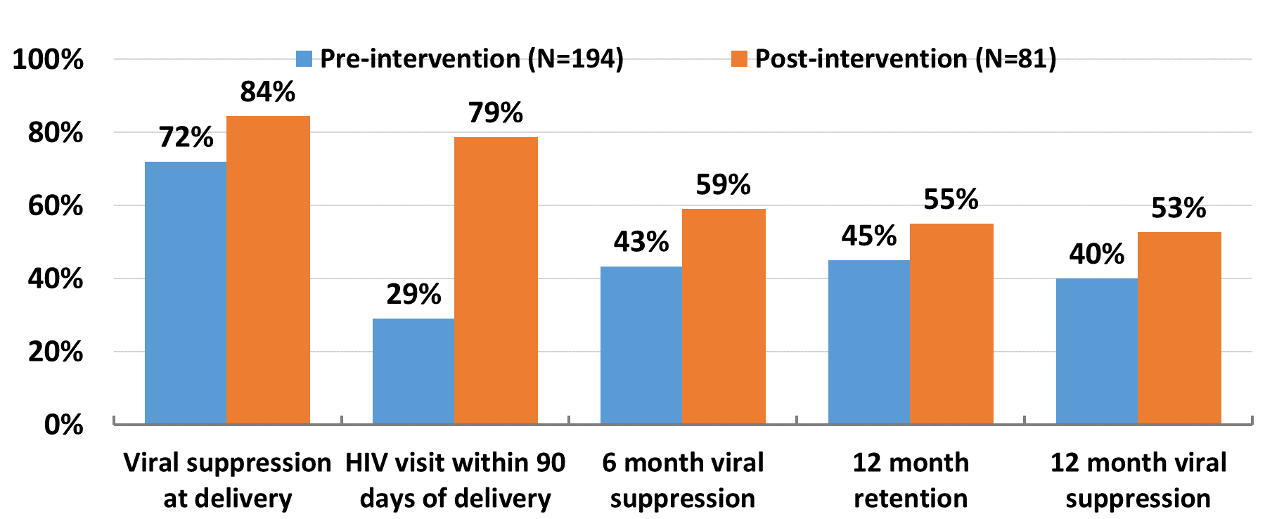
HIV Outcomes
Slide Courtesy of Anandi Sheth

Slide 41
Prevention during Labor & Delivery:
Prevention gaps remain
>75% of all HIV-exposed infants in 2016 were born to mothers virally suppressed at delivery
Among infants born to mothers with unsuppressed viral load at delivery:
  100% of infants received ZDV
  84% delivered by c-section
  77% received maternal IV-ZDV
  55% of infants received NVP
Gaps in some PMTCT interventions were more common among births in non-metro areas than in metro Atlanta

Slide 42
Conclusions
Prevention during Labor & Delivery:
Prevention gaps remain
>75% of all HIV-exposed infants in 2016 were born to mothers virally suppressed at delivery
Among infants born to mothers with unsuppressed viral load at delivery:
  100% of infants received ZDV
  84% delivered by c-section
  77% received maternal IV-ZDV
  55% of infants received NVP
Gaps in some PMTCT interventions were more common among births in non-metro areas than in metro Atlanta

Slide 43

Acknowledgments
Emory University
  Ann Chahroudi
  Martina Badell
  Anandi Sheth
Grady Health Systems
  Melissa Beaupierre
  Lisa Roland
  Lisa Curtin
  Jeronia Blue
DPH
  Pascale Wortley
  Fay Stephens
  Rhonda Harris
CDC
  Steve Nesheim
NICHD
  Rohan Hazra
NICHD IMPAACT Grant HHSN275701300003C

Slide 44
The HIV Care Continuum in Pregnancy and the Postpartum Period: The UNC Experience
Claire Farel, MD, MPH
University of North Carolina Chapel Hill
Medical Director, UNC Infectious Diseases Clinic

Slide 45
Learning Objectives
At the conclusion of this activity, the participant will be able to:
Describe trends in engagement in HIV care for pregnant and postpartum women in the Southeastern US
Describe challenges to retention in HIV care and HIV viral load suppression for postpartum women

Slide 46
The UNC Experience
The Southeastern US has high incidence and prevalence of HIV
UNC is an academic medical center serving a large urban, suburban, and rural catchment area
Leverage academic and Ryan White programmatic collaborations to optimize care for pregnant and postpartum HIV-positive women
  Co-located OB-GYN and peds ID services, GYN/ID trained nurse
  Case management for pregnant and postpartum women (social work and nursing)
  Collaboration with outreach programs across the state
University of North Carolina CFAR HIV Clinical Cohort (UCHCC) data
Notes:
For these analyses, we included all pregnancies with a live birth from January 1, 1996 through December 31, 2014 (n=141), to allow for at least 2 years of postpartum follow-up, and only included pregnancies that occurred after women initiated HIV care at our institution.
Primary outcome = engagement in care, secondary outcome = VL suppression

Slide 47
Conception to Delivery:
HIV Diagnosis, ART, and VL suppression
Chen, J.S. et al. AIDS, in press
Notes:
HIV diagnosis, antiretroviral therapy (ART) use, and virologic suppression (VL <400 copies/mL) from conception to delivery among women living with HIV, UCHCC 1996-2014.

Slide 48
Postpartum Engagement in Care and VL Suppression
Chen, J.S. et al. AIDS, in press
Notes:
Using the IOM criteria as a measure of HIV care retention, 70% and 48% of women were retained in care at 12 and 24 months postpartum, respectively. Overall, 38% were virologically suppressed during the first year postpartum and 25% in the second year postpartum. Among those with available HIV RNA measures, 52% and 42% were suppressed at 12 and 24 months postpartum, respectively. Postpartum retention in care did not vary across calendar years with little difference across the three calendar year intervals covering 1996 through 2014 (12 month retention P=0.42; 24 month retention P=0.24).

Slide 49
Next Steps
Recognition of the “4th Trimester” as at-risk period
Proactive approach to discussing fertility desire and intentions
Same-day access to family planning clinic
Educational video development addressing fertility desire
Development of remote visit options (e.g. telemedicine)
Development of “medical Lyft” transportation program to facilitate visit attendance

Slide 50

Acknowledgements
UNC ID Clinic staff and patients
UNC Ryan White Program staff
Jane Chen, MSPH
Brian Pence, PhD
Lisa Rahangdale, MD, MPH
Kristine Patterson, MD
Amy Durr, MSN, FNP
Amanda Antono, MS
Oksana Zakharova, MS
Joe Eron, MD
Sonia Napravnik, PhD

Slide 51
HIV Prevention Services for Discordant Couples including HIV Testing & PrEP
JoNell Efantis Potter, PhD, APRN, FAAN
Professor, Clinical Obstetrics & Gynecology
University of Miami Miller School of Medicine

Slide 52
Learning Objectives
At the conclusion of this activity, the participant will be able to:
Provide a description of the University of Miami – Miller School of Medicine Ryan White Part C & D Programs.
Discuss barriers & facilitators to HIV Testing & PrEP among HIV discordant couples.
Evaluate the findings from the PRIM Clinic Feasibility Study.
Propose potential strategies to increase HIV testing & treatment uptake among partners of pregnant women living with HIV.

Slide 53
The University of Miami-Miller School of Medicine
Ryan White Part C & D Program
Part D funded as one of the original sites for the Pediatric HIV Demonstration Projects in the late 1980’s.
Part C funded as one of the original RW Title III programs in the 1990s.
Evolved into a comprehensive program serving over 3300 adults, adolescents & children living with HIV annually.
Specialty services for women include Colposcopy; High Resolution Anoscopy; Preconception Counseling; Prenatal Care, including a Centering Pregnancy Pilot; & the WISH Clinic- a Primary Care Service designed specifically for Women.
Served over 3000 pregnant women living with HIV in the past 30 years.

Slide 54
Background
Heterosexual HIV discordant couples engage in unprotected sex to conceive, potentially placing the uninfected partner at risk.
For couples who do not have access to assisted reproductive services, pre-exposure prophylaxis (PrEP) may provide a safe option.
Promotion of PrEP for serodiscordant couples in the US remains largely neglected, despite implementation in other high risk groups.
US health care providers have endorsed the safety & efficacy of PrEP for negative individuals with sexual partners living with HIV.
Optimal methods or best practices for engaging & delivering PrEP services to serodiscordant couples are unclear.

Slide 55
Barriers & Facilitators to HIV Testing & PrEP
Barriers include no access to health care, HIV stigma, inaccurate perceived risk, and inaccurate knowledge or information.
Uptake has been associated with tailored outreach programs, rapid point of care HIV testing, as well as accurate information & education.
Facilitators include the utilization of patient navigators to facilitate access to testing & treatment.
Our team (Doblecki-Lewis, 2018) surveyed primarily heterosexual clinic patients living with HIV, of whom 86% reported they would have encouraged their partners to use PrEP if they had been educated about it.

Slide 56
The Ryan White Part D Prenatal Immunology (PRIM) Clinic in Miami, Florida
Approximately 100-125 pregnant women living with HIV receive prenatal care every year, 1/3 newly diagnosed during pregnancy.
In 2017, the median viral load at first prenatal visit was 5,000 copies per milliliter, indicating women were not aware of their HIV status or not adherent to treatment at or around the time of conception.
We conducted interviews among serodiscordant couples (Potter, 2016) – results highlighted low levels of knowledge on HIV transmission risk during conception, lack of health insurance & limited access to care among the seronegative male partners.

Slide 57
PRIM Feasibility Study
A survey was conducted to determine whether pregnant women living with HIV (PrWLH) knew their partner’s HIV status, if their partner was on PrEP (if negative) or in care and on treatment (if positive), and if their partners had health insurance.
60 PrWLH in PRIM completed surveys between Aug 2017 & Feb 2018.
The women were asked to respond to the survey questions about the partner (father) of their current pregnancy

Slide 58
PRIM Feasibility Study- RESULTS
About half (48%) reported their partners had tested negative.
Among the negative partners (n=29), 2 were on PrEP & 27 were not.
Most (approximately 80%) were uninsured & not accessing health care.
16 (of the 60) reported their partners had not ever been tested for HIV.
Among the 15 partners living with HIV, 12 were in care & on treatment; 3 were uninsured & not in care.

Slide 59
Discussion
Our results suggest the need for services for the male partners of pregnant women living with HIV.
Women living with HIV need assistance with strategies to safely disclose HIV to partners.
Male partners need access to HIV testing, referral to PrEP or HIV treatment & access to health care.
Models of Care are needed for pre-conception counseling.
Access to testing & treatment for partners during prenatal care should be considered.

Slide 60
Perinatal HIV Prevention in Colorado: Successes and Missed Opportunities
Kay Kinzie MSN, FNP-BC
Clinical Manager
Children's Hospital Immunodeficiency Program “CHiP”
University of Colorado/Childrens Hospital Colorado

Slide 61
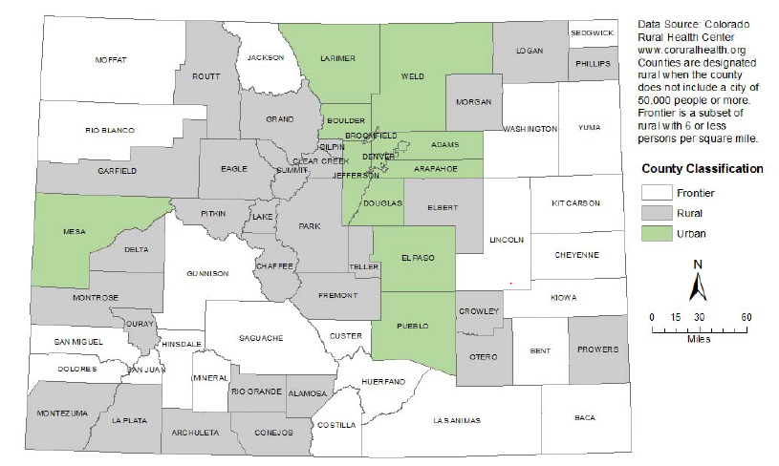
Colorado Population Distribution
Notes:
Colorado is defined as a rural state, 2015 population estimate of 5,456,599. Of 64 total counties, 93% of the estimated 5,456,599 population reside in 12 urban counties along the I-25 and I-70 corridors. Coloradoruralhealth.com
Live births in Colorado have averaged ~ 64,000 annually, with most populated counties also having higher birth numbers. CDPHE birth statistics

Slide 62
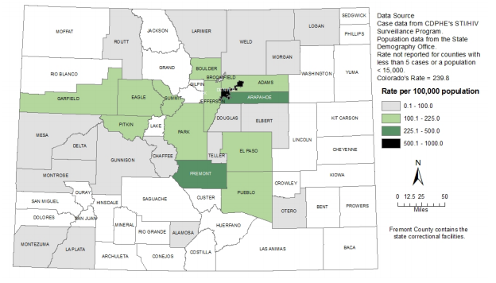
Colorado HIV Prevalence by County
Notes:
From Colorado Department of Health Integrated HIV/AIDS Epidemiology Annual Report Feb 2017. 13,052 PLWHA; 87.5% men, 12.5% women. Live births in Colorado ~ 64,000 annually

Slide 63
Childrens Hospital Immunodeficiency Program “CHiP”
Ryan White Part D, Part of University of Colorado, physically located at Childrens Hospital Colorado Pediatric Infectious Diseases
  Ryan White Part A, Part B
Began in 1992- Pediatric AIDS Clinical Trials Group (now International Maternal, Adolescent and Pediatric AIDS Clinical Trials/IMPAACT)
1995 Pregnancy program
1997 Youth care
2004 HOPE Reproductive Counseling, partnership with private reproductive endocrinologist for sperm washing and assisted reproduction
2009 Pediatric HIV AIDS Cohort Study (PHACS)
2011 Adolescent Trials Network
2015 Youth and Perinatal PreP
2016 Telehealth
2017 HIV Prevention Trials Network participation

Slide 64
CHiP Perinatal Services
Combined maternal and pediatric HIV care
  Coordinate with OB care provider
  Delivery site and nursery preparation and support, including medications
Support events
  HIV Positive childbirth class
  Infant care and soothing class
  Maternal postpartum event
Doulas- Ryan White psychosocial support, receive perinatal HIV specific training
Dedicated perinatal social worker
  Medical case management
  Financial assistance, housing, transportation, adherence, Part B Critical Events sponsor
Maternal substance and depression screening
  Adjacency of maternal postpartum depression services at University of Colorado and Childrens Child Health Clinic
Maternal transition support
Access to clinical trials: PHACS, IMPAACT
24 hour Perinatal HIV Consult Line

Slide 65
Local Tools Useful for Perinatal HIV Prevention
Same electronic medical record system is used by the largest medical care networks (access to maternal prenatal records)
  Denver Health and Denver Public Health
  University of Colorado (Denver Metro, Fort Collins, Northern and Southern Front Range)
  Kaiser Permanente (Nationwide)
  Sisters of Charity Leavenworth/SCL (Denver Metro)
  Adventist Health (Denver Metro)
Colorado statutes support maternal HIV testing
  HIV testing at first prenatal visit required (opt out)
  HIV testing required at labor and delivery if status unknown (opt out)

Slide 66
CHIP Perinatal Care Outcomes
Consult or direct HIV management of average of 32 OB clients/year since 2000 (22-43/yr): > 600 pregnancies
No infant HIV transmissions for mothers and receiving services at CHIP during this period
Utilization of enhanced infant prophylaxis for infants at higher HIV risk (mother with untreated or incomplete HIV viral suppression, other intrapartum risk factors) since 2002

Slide 67
Recent US-Born Children with Vertically Transmitted HIV Receiving Care at CHiP
Year | Child’s Age at Dx/Referral | Missed Opportunity
2012 | 2 yr old | No maternal prenatal HIV test. Child tested after maternal HIV status discovered with subsequent pregnancy with HIV screening. Later determined that mother had been dx’d with HIV during distant pregnancy, was currently in abusive relationship.
2013 | 3 yr old | Adopted, unknown HIV maternal status; Child presented with LIP
2014 | 3 month old | Mother refused to release prenatal records. Barrier of communication between initial delivery hospital (screen sent but pending at time of transfer to another facility transfer facility.
2016 | 3 month old | Incomplete maternal HIV viral suppression, maternal intrapartum Zidovudine, C section, and infant empiric therapy used. Infant 4 month HIV test positive
2017 | 1 year old | No available information. Child referred by community health clinic after parent disclosed child’s HIV status at visit.

Slide 68
Missed Opportunity 2018
Mother presented to metro area community hospital for labor check, reported no prenatal care. Labor ruled out, left when asked for urine sample
  Presented 2 days later in labor, disclosed HIV status, not on meds. Received IV zidovudine plus nevirapine, C section for breech presentation. Infant placed on empiric HIV therapy. Infant’s birth HIV NAT positive. Maternal and urine tox screens positive for multiple substances.
  Later review of EMR showed mother had been ruled out for labor during jail stay in 3rd trimester, did not report HIV. No HIV screening performed at time of care, records were not linked showing the mother’s medical history at other facilities.
  Mother had previously had received perinatal HIV care and had given birth to an uninfected child 8 years prior.

Slide 69
Discussion
Of the recent cases of perinatal HIV transmission being treated at CHIP, 67% demonstrated absence of maternal HIV screening for the pregnancy. Adherence to recommended HIV screening recommendations and requirements could have reduced transmission risk.
50% of cases demonstrated gaps/barriers in access to maternal health records that could have informed care providers to enact treatment to prevent perinatal transmission. In the era of shared EMRs, assuring that the full maternal record is visible can be an important tool in reducing perinatal HIV transmission.
The potential losses mothers may face related to discovery of substance use or partner learning her HIV status appear to be powerful motivators that oppose successful perinatal HIV transmission prevention.

Slide 70

QUESTIONS & ANSWERS

Slide 71
Contact Information
HIV/AIDS Bureau (HAB) Health Resources and Services Administration (HRSA) www.hab.hrsa.gov | Division of HIV/AIDS Programs (DHAPB) Center for Disease Control (CDC) www.cdc.gov/hiv/dhap
Tracey Gantt, DCHAP | Lauren Fitzharris, NCHHSTP, DHAP
Mindy Golatt, DCHAP | Kristen Gray, NCHHSTP,DHAP,HICSB
Letha Healey, OTCD | Margaret Lampe, NCHHSTP, DHAP
Katrina Jackson, DPD | Steve Nesheim, NCHHSTP, DHAP
Amelia Khalil, DPD
Makeva Rhoden, DCHAP
Madia Ricks, OTCD

Slide 72
Perinatal HIV Institute
Session 1 (12910): Where Are We Now?
Wednesday December 12, 2018 @ 1:30pm – 3:00pm
Session 2 (12871): Addressing the Missed Opportunities Thursday, December 13, 2018 @ 1:30pm – 3:00pm
Session 3 (12908): Getting to Zero
Friday, December 14, 2018 @ 10:15am – 11:45am

Slide 73






Connect with HRSA
To learn more about our agency, visit
www.HRSA.gov
Sign up for the HRSA eNews
FOLLOW US:

