Slide 1
CAREWare 6: Changes and Rollout Plan 2018 National Ryan White Conference on HIV Care and Treatment December 2018
John Milberg
Health Scientist
Division of Policy and Data
HIV/AIDS Bureau (HAB)
Health Resources and Services Administration (HRSA)

Slide 2
Disclosures
Presenter(s) has no financial interest to disclose.
This continuing education activity is managed and accredited by AffinityCE/Professional Education Services Group in cooperation with HRSA and LRG. PESG, HRSA, LRG and all accrediting organization do not support or endorse any product or service mentioned in this activity.
PESG, HRSA, and LRG staff as well as planners and reviewers have no relevant financial or nonfinancial interest to disclose.
Commercial Support was not received for this activity.

Slide 3
Learning Objectives
At the conclusion of this activity, the participant will be able to:
Understand steps required to make transition to CAREWare 6
Review data import and interoperability features in CAREWare 6
Review tools and reports to help monitor data quality and quality of HIV care

Slide 4
Health Resources and Services Administration (HRSA) Overview
Through grants and cooperative agreements, HRSA supports more than 90 programs that provide health care to people who are geographically isolated and economically or medically vulnerable. These programs assist more than 3,000 awardees, including community and faith-based organizations, colleges and universities, hospitals, state, local, and tribal governments, and private entities
Every year, HRSA programs serve tens of millions of people, including people living with HIV/AIDS, pregnant women, mothers and their families, and those otherwise unable to access quality health care

Slide 5
HRSA’s HIV/AIDS Bureau (HRSA HAB)
Vision
Optimal HIV/AIDS care and treatment for all.
Mission
Provide leadership and resources to assure access to and retention in high quality, integrated care, and treatment services for vulnerable people living with HIV/AIDS and their families.

Slide 6
HRSA’s Ryan White HIV/AIDS Program (RWHAP)
Provides comprehensive system of HIV primary medical care, medications, and essential support services for low-income people living with HIV
More than half of people living with diagnosed HIV in the United States – more than 550,000 people – receive care through the Ryan White HIV/AIDS Program
Funds grants to states, cities/counties, and local community based organizations
Recipients determine service delivery and funding priorities based on local needs and planning process
Payor of last resort statutory provision: RWHAP funds may not be used for services if another state or federal payer is available
84.9% of Ryan White HIV/AIDS Program clients were virally suppressed in 2016, exceeding national average of 59.8%
Source: HRSA. Ryan White HIV/AIDS Program Annual Client-Level Data Report 2016; CDC. HIV Surveillance Supplemental Report 2016;21(No. 4)

Slide 7
CAREWare Background: Development, Evolution, and Modernization
CAREWare (CW) software is in its 19th year of development
Released initially in 2000 as an MS-Access application to help recipients and providers track services, demographics and basic clinical information
Overhauled in 2004 in a modernized platform and with significant new reporting and quality management features
About 1,000 or 55% of recipients and subrecipients use CAREWare to produce the Ryan White HIV/AIDS Program Services Report (RSR) and nearly half of the RWHAP Part B AIDS Drug Assistance Program (ADAP) recipients to generate the ADAP Data Report (ADR)
Serves as one of the primary applications used to generate performance measures for the HIV Quality Management (HIVQM) initiative and is used regularly to monitor HIV care and services

Slide 8
Upgrade to CAREWare6: A New User Experience
User Interface
Rebuilt and redesigned to run in any internet browser such as Chrome, Firefox, Internet Explorer, Safari, etc.
Screens to enter data, run reports, etc.
Different from the current CAREWare version 5
Looks more familiar to navigating in a browser environment
Some critical components of CAREWare remain the same:
Database behind the scenes unchanged
Will ease the transition to the new version

Slide 9
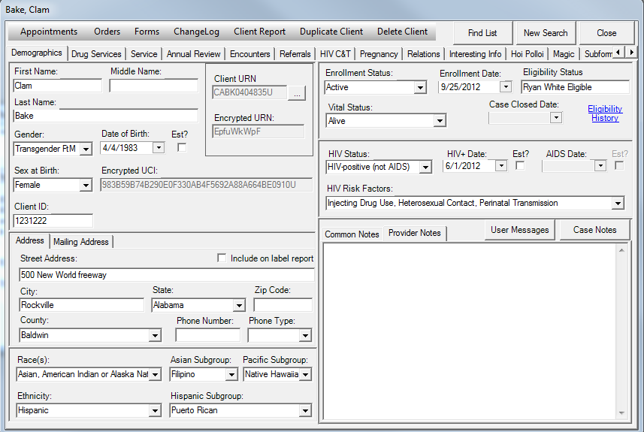
Client Demographics Tab in CAREWare Version 5

Slide 10
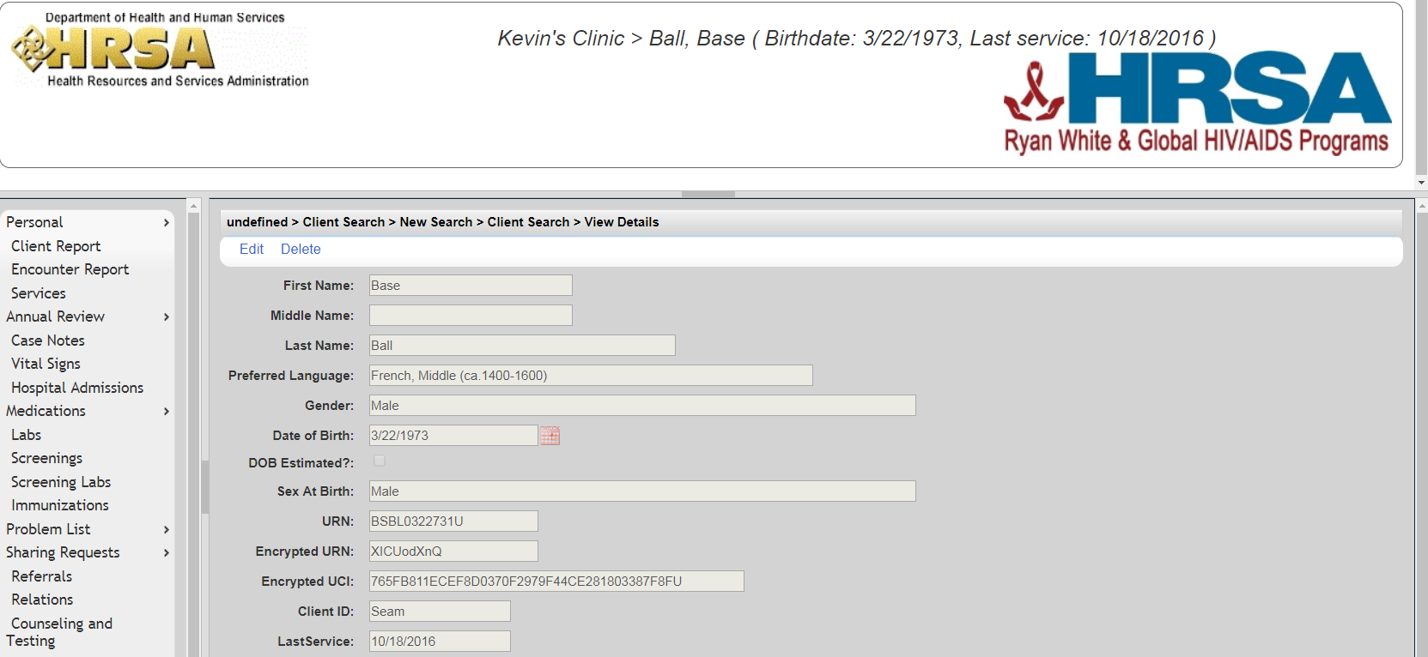
And in CAREWare Version 6 (CW6)…

Slide 11
Why Upgrade CW?
Existing interface built in a format called Windows Forms that will soon no longer be supported by Microsoft
Improved development and stabilization of browsers in the last decade which is the formation of choice for software developers and users
Increased sophistication of encryption technology and standards
Ability to authenticate both the site visiting and the specific user
Easier implementation of these security features through browsers
Easier ability to upgrade with the release of new builds of the software
Out of date style: new layout similar to the look and feel of other web applications
Notes:
The upgrade was essential for at least 5 important reasons:

Slide 12
Configuring CW6
Issues differ for stand alone users versus those who are part of a CAREWare network (internet facing)
To run with full encryption, a certificate of authentication from a certifying authority (CA) is required
Contains the secure “lock” that appears in your browser when you connect to a legitimate website (like your bank)

Slide 13
Two New Features in CW6
Centralized Eligibility
Establishing client eligibility for services through a central domain
Eliminate need for each provider to make this determination for each client
Calculating Personal Expenditures
Determining client cap on charges across a network of providers
A formal mechanism to calculate personal expenditures

Slide 14
Ongoing Support for CW6
Additional webinars as needed in the coming year
CAREWare helpdesk
2018 National Ryan White Conference on HIV Care and Treatment
Speak to your HRSA HAB Project Officer about the availability of additional technical assistance

Slide 15
CW6: Rollout and Implementation Timeline
Activity | When | Additional Info
Training webinars for users, both general review and technical issues | Fall/winter 2018 Throughout 2019 | Provided by : HRSA HAB and jProg
Official rollout-software made available on HAB website | December 2018 | Go to: https://hab.hrsa.gov/program-grants-management/careware
CAREWare 5 no longer supported | July 1, 2019 | The 2018 data submission will be the last year that CW5 can be used for RSR/ADR

Slide 16
Contact Information
John Milberg
DPD/Data Management and Analysis Branch
HIV/AIDS Bureau (HAB)
Health Resources and Services Administration (HRSA)
Email: jmilberg@hrsa.gov
Phone: 301.443.8729
Web: https://hab.hrsa.gov/program-grants-management/careware

Slide 17
Connect with HRSA
To learn more about our agency, visit
www.HRSA.gov
Sign up for the HRSA eNews
FOLLOW US:

Slide 18
Obtaining CME/CE Credit
If you would like to receive continuing education credit for this activity, please visit:
http://ryanwhite.cds.pesgce.com

