Slide 1
Sexually Transmitted Infections and the Ryan White HIV/AIDS Program
December 2018
Shanna Dell, MPH, RN, ACRN
Presidential Management Fellow | Nurse Consultant
Division of Policy and Data
HIV/AIDS Bureau (HAB)
Health Resources and Services Administration (HRSA)

Slide 2
Health Resources and Services Administration (HRSA) Overview
Supports more than 90 programs that provide health care to people who are geographically isolated, economically or medically vulnerable through grants and cooperative agreements to more than 3,000 awardees, including community and faith-based organizations, colleges and universities, hospitals, state, local, and tribal governments, and private entities
Every year, HRSA programs serve tens of millions of people, including people living with HIV/AIDS, pregnant women, mothers and their families, and those otherwise unable to access quality health care

Slide 3
HRSA’s HIV/AIDS Bureau (HAB)
Vision
Optimal HIV/AIDS care and treatment for all.
Mission
Provide leadership and resources to assure access to and retention in high quality, integrated care, and treatment services for vulnerable people living with HIV/AIDS and their families.

Slide 4
HRSA’s Ryan White HIV/AIDS Program (RWHAP)
Provides comprehensive system of HIV primary medical care, medications, and essential support services for low-income people living with HIV (PLWH)
    More than half of people living with diagnosed HIV in the United States – more than 550,000 people – receive care through the Ryan White HIV/AIDS Program
  Funds grants to states, cities/counties, and local community based organizations
  Recipients determine service delivery and funding priorities based on local needs and planning process
Payor of last resort statutory provision: RWHAP funds may not be used for services if another state or federal payer is available
84.9% of Ryan White HIV/AIDS Program clients were virally suppressed in 2016, exceeding national average of 59.8%
Source: HRSA. Ryan White HIV/AIDS Program Annual Client-Level Data Report 2016; CDC. HIV Surveillance Supplemental Report 2016;21(No. 4)

Slide 5
Sexually Transmitted Infection (STI) Testing in HRSA RWHAP Clinics
Syphilis screening: only STI variable currently required for Ryan White HIV/AIDS Program Services Report (RSR)
  “Has the client been screened for syphilis during this reporting period? (Yes/No/Not medically indicated)”
HRSA HAB STI performance measures include:
  Cervical cancer screening
  Chlamydia screening
  Gonorrhea screening
  Syphilis screening
Details for measures can be found at:
  https://hab.hrsa.gov/clinical-quality-management/performance-measure-portfolio

Slide 6
HRSA HAB Cooperative Agreement: Improving STI Screening and Treatment among People Living with or at Risk for HIV
Joint initiative between HRSA HAB, HRSA’s Bureau of Primary Health Care, and Centers for Disease Control and Prevention (CDC) Division of STD Prevention
Seeks to promote clinical service and systems-level interventions leading to an increase and/or improvements in the screening and treatment of STIs among low-income PLWH or at risk for HIV who are served by HRSA’s RWHAP and/or Health Center Program
Funded one organization to subcontract with three to five sites in three service jurisdictions
  One site in each jurisdiction serves as local convener to facilitate systems level change
Notes:
Will note funded by SPNS

Slide 7
François-Xavier Bagnoud Center
Rutgers School of Nursing
Newark, NJ
Washington, DC
Florida
Louisiana
Convener:
Howard University
Convener:
University of Florida
Convener:
Louisiana State University (LSU)
Howard University Hospital Comprehensive Clinic
Florida Department of Health (DOH), Orange County
Capitol City Family Health Center
Southwest Louisiana AIDS Coalition Comprehensive Care Center
Andromeda Transcultural Health
Florida DOH, Alachua County
Family and Medical Counseling
Services, Inc.
Florida DOH, Bay County
LSU Viral Disease Clinic

Slide 8
STI Interventions
Technical Expert Panel held in May, 2018 to identify interventions
Possible interventions selected:
  Clinical
    Training
    Testing (ALL to include multi-site extragenital testing)
      Express testing
      Self-testing
      Increased frequency for at-risk patients
      Home-testing/alternative testing locations
  Nonclinical
    Computer Assisted Self Interview (CASI)
    Clinical space improvements for patients and providers
  System-Level
    STI ECHO model
    Enhanced linkage services to state/local health department
Notes:
Would like to be able to update this slide as interventions are picked by CoAG

Slide 9
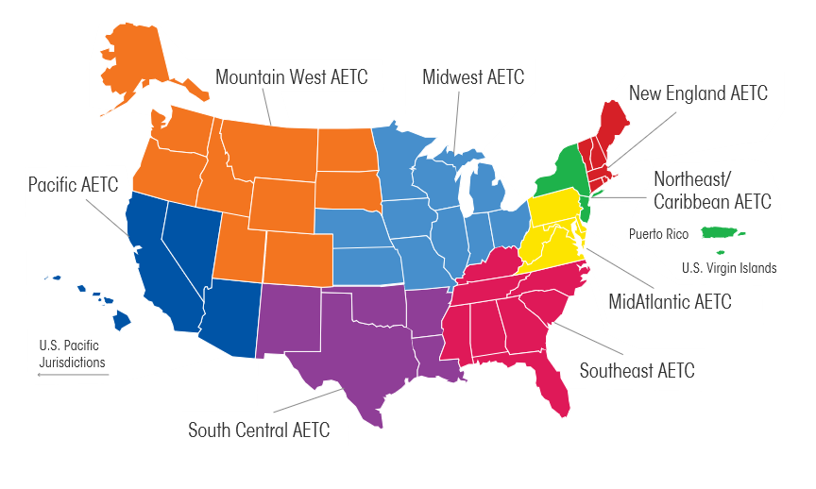
Other Resources:
HRSA RWHAP AIDS Education and Training Centers (AETC)
Mission: To improve the quality of life of persons living with or at-risk of HIV through the provision of high-quality professional education and training.
National Centers
  National Coordinating Resource Center:
    Rutgers University
    https://aidsetc.org/
  National Clinician Consultation Center:
    University of California, San Francisco
    http://nccc.ucsf.edu/
Regional Centers
Harborview Medical Center
University of Massachusetts
Columbia University
University of California, San Francisco
University of Pittsburgh
Vanderbilt Comprehensive Care Clinic
Parkland Health & Hospital System

Slide 10
Contact Information
Shanna Dell
Presidential Management Fellow | Nurse Consultant
Division of Policy and Data
HIV/AIDS Bureau (HAB)
Health Resources and Services Administration (HRSA)
Email: sdell@hrsa.gov
Phone: 301-443-3938
Web: hab.hrsa.gov

Slide 11






Connect with HRSA
To learn more about our agency, visit
www.HRSA.gov
Sign up for the HRSA eNews
FOLLOW US:

Slide 12
Increasing STI Testing and Treatment Across the Ryan White HIV/AIDS Program
Gail Bolan, MD
Director, Division of STD Prevention
Centers for Disease Control and Prevention
2018 National Ryan White Conference on HIV Care and Treatment
Oxon Hill, MD
December 2018

Slide 13







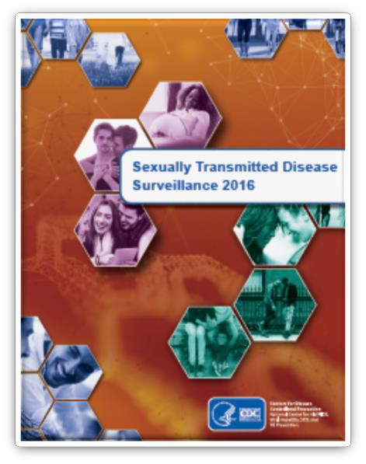







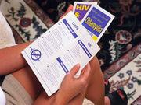








CDC: 3 sexually transmitted diseases hit record highs across U.S.
“Increases in STDs are a clear warning of a growing threat,” Jonathan Mermin, director of CDC’s National Center for HIV/AIDS, Viral Hepatitis, STD and TB Prevention, said in a news release. “STDs are a persistent enemy, growing in number, and outpacing our ability to respond.”
STD rates hit another record high, with California
near the top
C reports rise in
“Every baby born with syphilis represents a tragic systems failure,” Gail Bolan, director of CDC’s Division of STD Prevention, said in the news release. “All it takes
is a simple STD test and antibiotic treatment to prevent this enormous heartache and help assure a healthy start for the next generation of Americans.”
Ds in the United
America faces uncontrollable STD epidemic
tes
Syphilis, Gon First Time in
STDs Hit All-Time High in U.S.
USA – New STD cases “hit record high in US”
Sex disease with more th chlamydia, g
STD rates hit all-time highs for the third year in a row
STD rates reach record high in U.S., government says
STD Resurgence in the US
Annual report shows more than 2 million cases of chlamydia, gonorrhea and syphilis reported in 2016
There is now a gonorrhea superbug and we can't get rid of it
w STD cases hit a record high in
e US
Jim

Slide 14
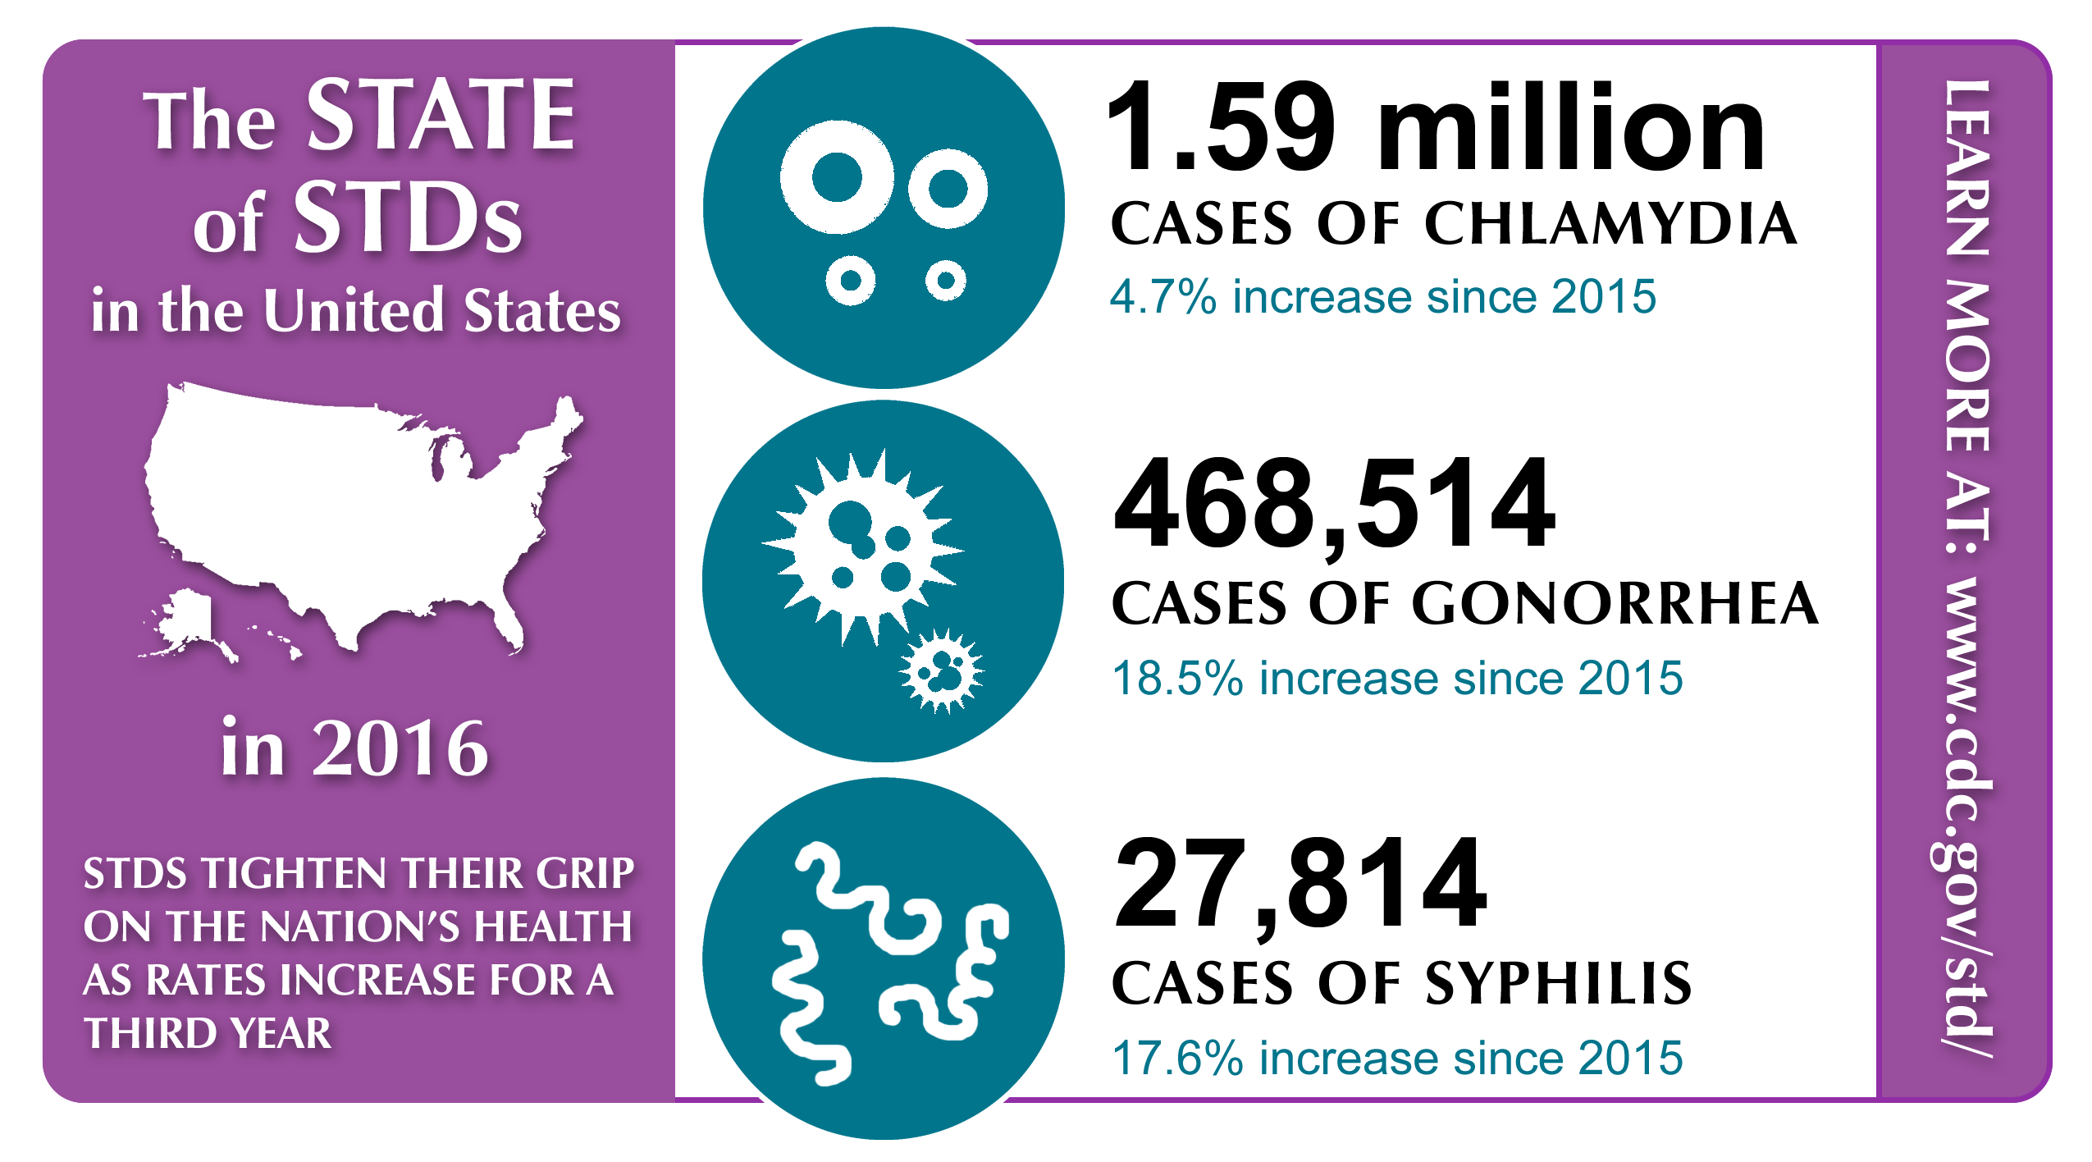
STIs are on the Rise in the United States
1.71 million
CASES OF CHLAMYDIA
7% increase since 2016
555,608
CASES OF GONORRHEA
19% increase since 2016
in 2017
101,567
CASES OF SYPHILIS
15% increase since 2016
918
44% ↑
Congenital Syphilis Cases in 2017
Notes:
As of April 12, 2018:
In 2017, there were 1,685,448 cases of chlamydia reported, an increase of 5.4% since 2016 (1,598,354 to 1,685,448 cases; 494.7 to 521.6 cases per 100,000 persons)
Rates of reported cases increased among both males and females:
the rate among males increased 9.0% (328.7 to 358.2 cases per 100,000 males)
the rate among females increased 3.6% (653.9 to 677.7 cases per 100,000 females)
In 2017, there were 548,678 cases of gonorrhea reported, an increase of 17.1% since 2016 (468,514 to 548,678 cases; 145.0 to 169.8 cases per 100,000 persons)
Rates of reported cases increased among both males and females:
the rate among males increased 17.9% (169.7 to 200.1 cases per 100,000 males)
the rate among females increased 16.1% (120.4 to 139.8 cases per 100,000 females)
In 2017, there were 98,437 cases of syphilis reported, an increase of 11.8% since 2016 (88,042 to 98,437 cases; 27.3 to 30.5 cases per 100,000 persons)
Rates of reported cases increased for both early latent and primary and secondary syphilis.
the rate of early latent syphilis increased 13.3% (9.0 to 10.2 cases per 100,000 persons)
the rate of primary and secondary syphilis increased 7.0% (8.6 to 9.2 cases per 100,000 persons)

Slide 15
Primary and Secondary Syphilis:
Reported Cases, U.S., 1941–2017
Primary and Secondary Syphilis Cases have increased 400% since 2001
Cases
Notes:
Syphilis is a sexually transmitted infection that can cause serious health problems if it is not treated, affect multiple organ systems, including the brain, nerves, eyes, heart, blood vessels, liver, bones, and joints. The impact on babies with syphilis can be especially heartbreaking.
Syphilis is divided into stages (primary, secondary, latent, and tertiary), and there are different symptoms associated with different stages. We talk about primary and secondary syphilis here, because these are the infectious stages of syphilis.
Historically, we have been successful in dramatically reducing syphilis cases since the advent of penicillin in the 1940s.
However after reaching an all time low in the early 2000s, the number of primary and secondary syphilis cases has increased 390% since 2001.
Additional Info:
In 2017, the rate of syphilis among men who have sex with men was 122 times the rate among men who have sex with only women

Slide 16
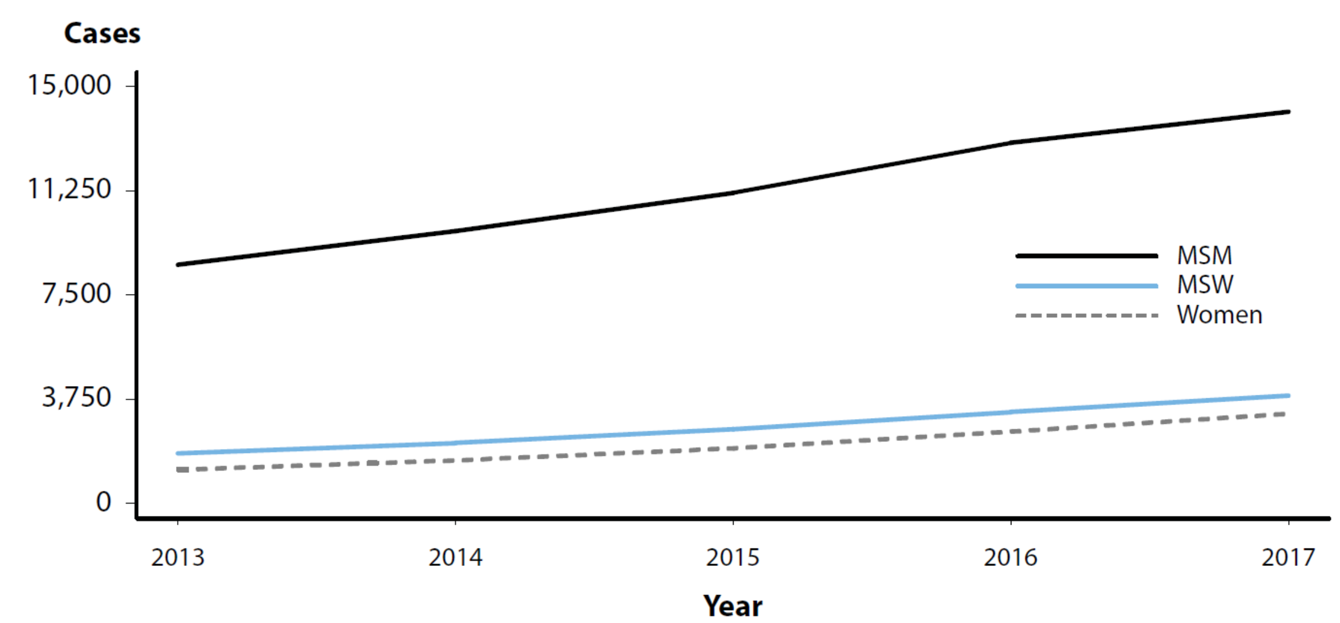
Primary and Secondary Syphilis — Reported Cases by Sex and Sexual Behavior, 37 States*, 2013–2017
* 37 states were able to classify ≥70% of reported cases of primary and secondary syphilis as either MSM, MSW, or women for each year during 2013–2017.
ACRONYMS: MSM = Gay, bisexual, and other men who have sex with men (collectively referred to as MSM); MSW = Men who have sex with women only.
Notes:
A total of 37 states were able to classify at least 70.0% of reported P&S syphilis cases as MSM, MSW, or women each year during 2013–2017.
In these states, during 2016–2017, the number of cases increased 8.6% among MSM, 17.8% among MSW, and 24.9% among women.

Slide 17
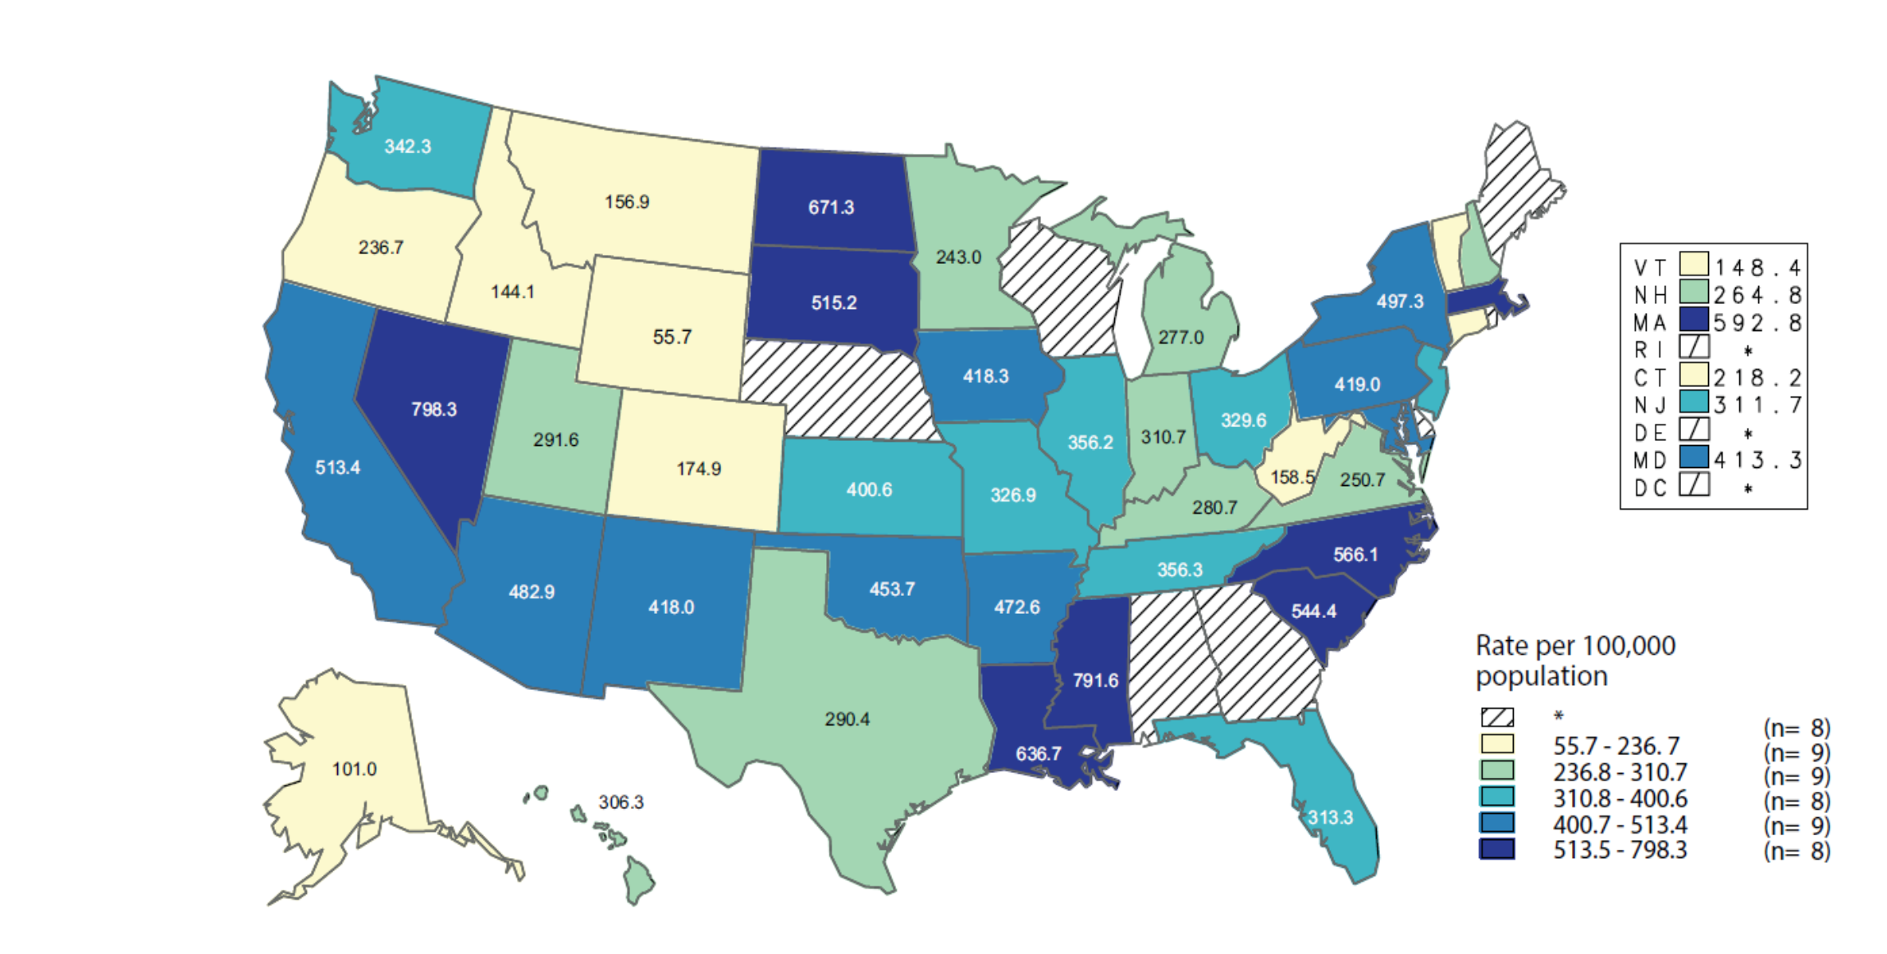
Primary and Secondary Syphilis — Estimated Rates of Reported Cases Among MSM by State, United States, 2017
* States reporting less than 70% of cases identified as MSM, MSW, or women in 2017 are suppressed.
NOTE: Estimates based on reported P&S syphilis cases among MSM in 2017 (numerator) and a published method of estimating the population size of MSM (denominator) by state. See Section A1.2 in the Appendix for information on estimating MSM population sizes for rate denominators.
ACRONYMS: MSM = Gay, bisexual, and other men who have sex with men (collectively referred to as MSM); MSW = Men who have sex with women only; P&S = Primary and secondary.
Notes:
In 2017, 43 states provided data to classify at least 70% of cases as MSM, MSW, or women.
Among these areas, estimated rates of P&S syphilis cases in MSM ranged from 55.7 cases per 100,000 MSM in Wyoming to 798.3 cases per 100,000 MSM in Nevada, with 27 states (63%) estimated to have rates between 200 and 500 cases per 100,000 MSM.

Slide 18
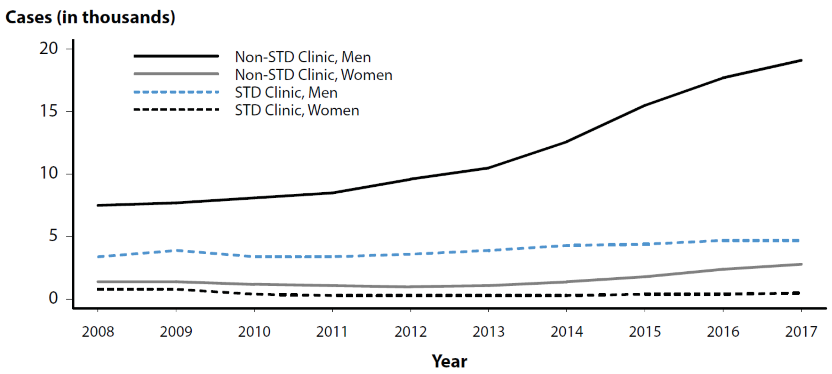
Primary and Secondary Syphilis — Reported Cases by Reporting Source and Sex, United States, 2008–2017
Notes:
During 2016–2017, the number of P&S syphilis cases reported by STD clinics and by non-STD clinic settings increased.
However, the proportion of P&S syphilis cases that were reported by STD clinics has declined over the last decade from 31.1% of cases in 2008 to 17.0% of cases in 2017.

Slide 19
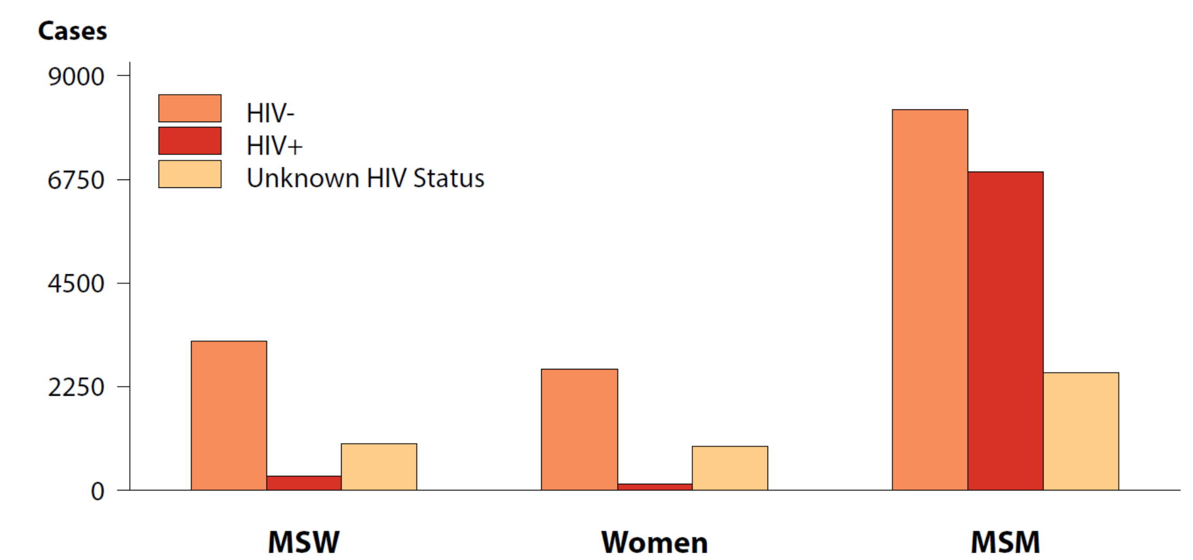
Primary and Secondary Syphilis — Reported Cases by Sex, Sexual Behavior, and HIV Status, United States, 2017
ACRONYMS: MSM = Gay, bisexual, and other men who have sex with men (collectively referred to as MSM); MSW = Men who have sex with women only.
Notes:
Reported cases of P&S syphilis continue to be characterized by a high rate of HIV co-infection, particularly among MSM.
Among 2017 P&S syphilis cases with known HIV status, 45.5% of cases among MSM were HIV-positive, compared with 8.8% of cases among MSW, and 4.5% of cases among women.

Slide 20
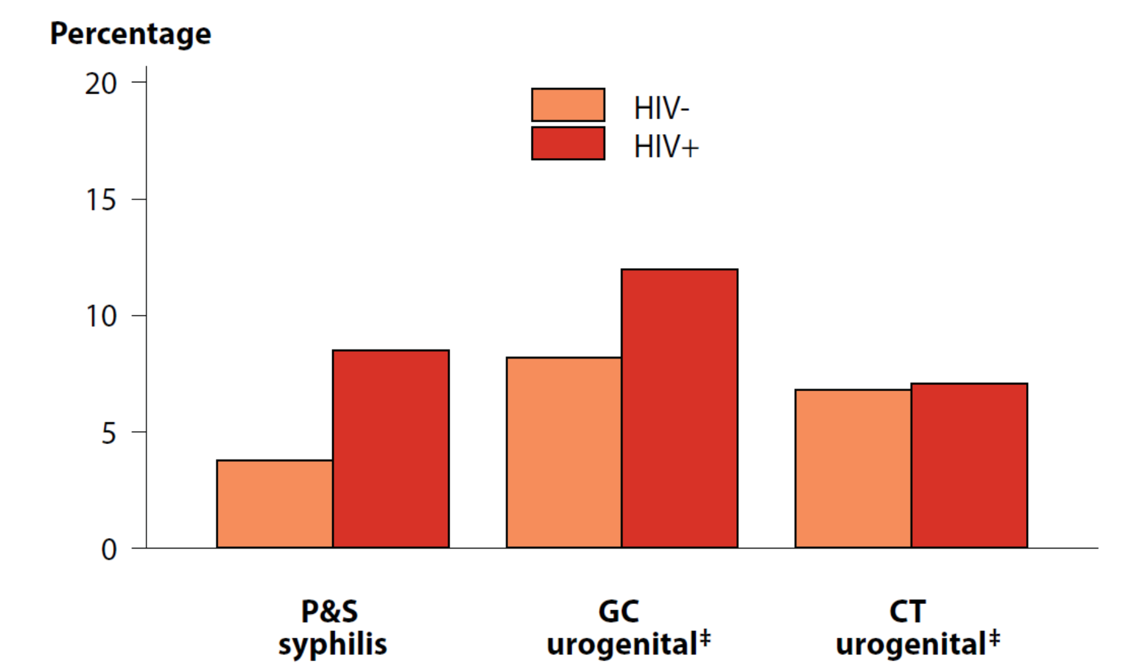
Proportion* of MSM Attending STD Clinics with Primary and Secondary Syphilis†, Urogenital‡ Gonorrhea, or Urogenital‡ Chlamydia by HIV Status§, STD Surveillance Network (SSuN), 2017
* Proportions represent the overall average of the mean proportions by jurisdiction.
† Includes SSuN jurisdictions that reported data on at least 20 patients with a diagnosis of primary and secondary syphilis in 2017.
‡ Includes results from both urethral and urine specimens.
§ Excludes all persons for whom there was no laboratory documentation or self-report of HIV status.
NOTE: See section A2.2 in the Appendix for SSuN methods.
ACRONYMS: MSM = Gay, bisexual, and other men who have sex with men (collectively referred to as MSM); P&S = Primary and secondary; GC = Gonorrhea; CT = Chlamydia.
Notes:
Among HIV-positive MSM visiting SSuN STD clinics in 2017, urogenital chlamydia positivity was 7.1% and urogenital gonorrhea positivity was 12.0% (compared to 6.8% and 8.2%, respectively, among HIV-negative MSM).
Among HIV-positive MSM, 8.5% were diagnosed with P&S syphilis compared to 3.8% of HIV-negative MSM.
Percentages represent the overall average of the mean value by jurisdiction.

Slide 21
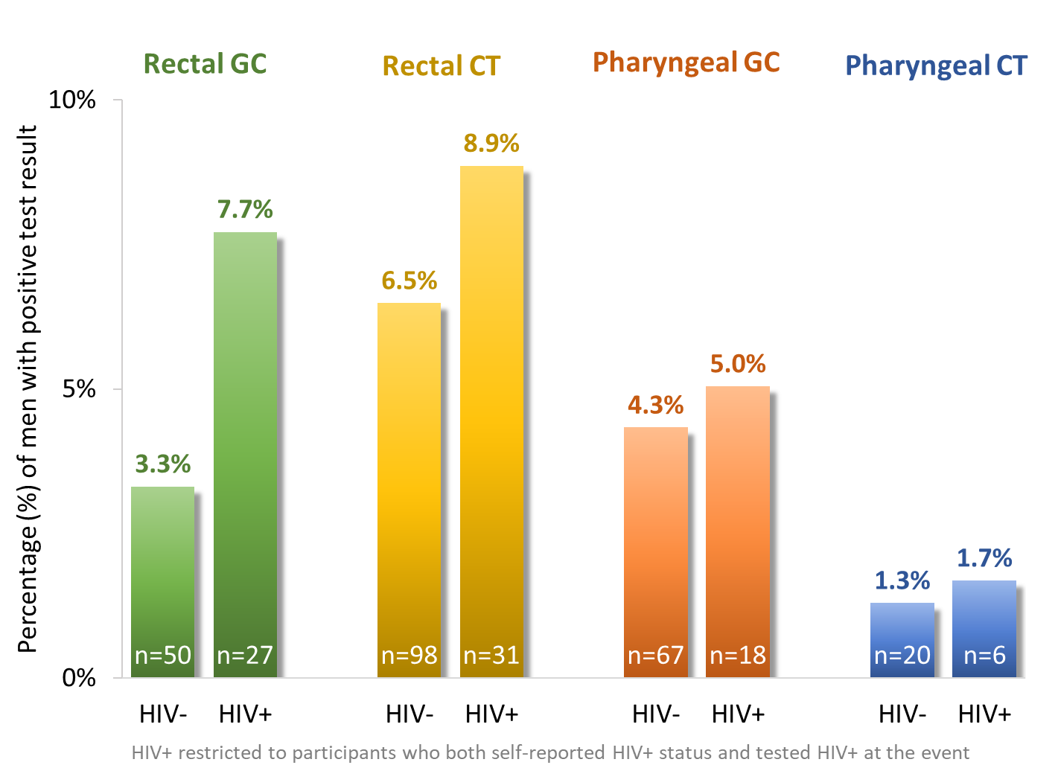
Prevalence of extragenital gonorrhea (GC) and chlamydia (CT) among venue-attending MSM by HIV status, NHBS, 2017
n=positives
Notes:
Here the results are stratified by HIV status. The left bar of each section represents the participants who tested HIV negative. The HIV+ bar on the right is limited to those who self-reported being HIV+, which was confirmed by an HIV.
In all instances, the group of men who were HIV+ had higher positivity than the HIV- group. The largest difference can be seen in the left-most group, rectal gonorrhea where 3.3% of HIV- participants compared to 7.7% of HIV+ participants had a positive rectal gonorrhea test.
Methods:
MSM cycle
Cross-sectional surveillance of MSM every 3 years
Venue-based sampling
Anonymous interview and HIV testing
22 participating sites
Inclusion criteria
Male, ≥18 years old, residing in participating city, able to complete survey in English or Spanish, ever had sex with a male
Analysis inclusion: ≥1 male sex partner in last 12 months
In 2017, STI testing was added to NHBS for the first time. The five participating cities were Houston, Miami, New York City, San Francisco, and Washington, D.C. In all, over 2,000 men participated in STI testing from these 5 sites.
Every participant was offered self-collected rectal and pharyngeal swabs that were then tested for gonorrhea and chlamydia. Since the recruiting and testing took place at venues, it meant that the participants swabbed themselves, which included getting a rectal swab, in…
--- change slides ---
Van or mobile units, in the venues, and even in pop-up changing tents on sidewalks

Slide 22
Proportion of Sexually Active HIV-Infected MSM in Medical Care Screened for Syphilis in the Prior 12 Months, Medical Monitoring Project 2009-2013
 | RW funded | Not-RW funded
2009 | 67% | 43%
2010 | 66% | 51%
2011 | 71% | 52%
2012 | 71% | 55%
2013 | 74% | 57%
Syphilis screening of MSM with HIV is slowly improving, but as of 2013, still under 70%
Test for trend p<0.01
Notes:
The Medical Monitoring Project allowed us to look at the proportion of MSM with HIV screened for syphilis, and we collected data for 2009 to 2013.
This slide gives us a good estimate of how well we are screening for syphilis among MSM with HIV.
As you can see, syphilis screening of MSM with HIV is slowly improving, but as of 2013, it was still under 70%, so there is still a lot of room for improvement here.

Slide 23
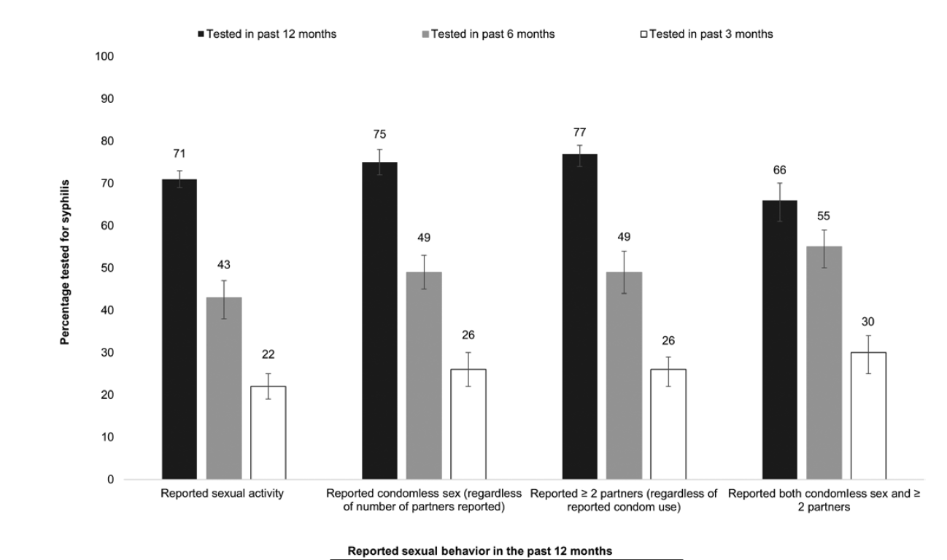
Percentage of Sexually Active, HIV-Infected MSM in Medical Care Screened for Syphilis in the Prior 12 Months—Medical monitoring Project, 2013-2014
All sexually active MSM, RW funded
 | n | Weighted row% | 95% CI | n | Weighted row% | 95% CI | n | Weighted row% | 95% CI
 |  | Tested in past 12 months |  |  | Tested in past 6 months |  |  | Tested in past 3 months
Reported sexual activity | 1667 | 77 | 73.2–80.6 | 1200 | 54 | 49.5–59.0 | 777 | 35 | 30.7–39.4
Reported condomless sex (regardless of No. of partners reported) | 815 | 80 | 76.7–84.0 | 605 | 59 | 54.1–63.6 | 408 | 40 | 34.7–44.4
Reported >=2 partners (regardless of reported condom use) | 1030 | 81 | 77.7–83.8 | 742 | 57 | 51.9–61.4 | 493 | 37 | 33.1–41.7
Reported both condomless sex and >= 2 partners | 591 | 84 | 80.3–87.4 | 431 | 60 | 55.1–65.6 | 297 | 41 | 36.5–46.2
All sexually active MSM, Non-RW funded
 | n | Weighted row% | 95% CI | n | Weighted row% | 95% CI | n | Weighted row% | 95% CI
 |  | Tested in past 12 months |  |  | Tested in past 6 months |  |  | Tested in past 3 months
Reported sexual activity | 528 | 59 | 54.5–63.8 | 378 | 43 | 37.0–48.1 | 239 | 26 | 22.0–30.9
Reported condomless sex (regardless of No. of partners reported) | 327 | 65 | 60.6–70.0 | 238 | 48 | 42.0–54.2 | 160 | 32 | 26.9–37.1
Reported >=2 partners (regardless of reported condom use) | 348 | 67 | 62.2–72.3 | 255 | 49 | 42.6–56.0 | 167 | 31 | 25.9–36.6
Reported both condomless sex and >= 2 partners | 242 | 70 | 64.6–75.1 | 179 | 52 | 45.1–59.0 | 121 | 35 | 28.9–41.1
Tested in past 6 months
Tested in past 12 months
Tested in past 3 months
RW Funded:
Tested in past 6 months
Tested in past 12 months
Tested in past 3 months
Non-RW Funded:
% tested for syphilis
Reported sexual activity
Reported condomless sex (regardless of No. of partners reported)
Reported > 2 partners (regardless of reported condom use)
Reported both condomless sex and > 2 partners
Reported sexual behavior in past 12 months

Slide 24
CDC: 3 sexually transmitted diseases hit record highs across U.S.
“Increases in STDs are a clear warning of a growing threat,” Jonathan Mermin, director of CDC’s National Center for HIV/AIDS, Viral Hepatitis, STD and TB Prevention, said in a news release. “STDs are a persistent enemy, growing in number, and outpacing our ability to respond.”
STD rates hit another record high, with California
near the top
C reports rise in
“Every baby born with syphilis represents a tragic systems failure,” Gail Bolan, director of CDC’s Division of STD Prevention, said in the news release. “All it takes
is a simple STD test and antibiotic treatment to prevent this enormous heartache and help assure a healthy start for the next generation of Americans.”
Ds in the United
America faces uncontrollable STD epidemic
tes
Syphilis, Gon First Time in
STDs Hit All-Time High in U.S.
USA – New STD cases “hit record high in US”
Sex disease with more th chlamydia, g
STD PCHD
STD rates hit all-time highs for the third year in a row
STD rates reach record high in U.S., government says
Annual report shows more than 2 million cases of chlamydia, gonorrhea and syphilis reported in 2016
There is now a gonorrhea superbug and we can't get rid of it
w STD cases hit a record high in
e US
Jim

Slide 25

Strengthening STD Prevention and Control for Health Departments (STD PCHD) Priorities
Project Period: January 1, 2019 – December 31, 2023
Purpose: Implement and strengthen STD prevention and control of three major STDs (chlamydia, gonorrhea, and primary & secondary syphilis) in state, local and territorial health departments
59 Eligible Applicants: Same as currently funded in STD AAPPS
  50 state public health agencies
  Los Angeles, CA
  San Francisco, CA
  District of Columbia
  Chicago, IL
  Baltimore, MD
  New York City, NY
  Philadelphia, PA
  Puerto Rico
  US Virgin Islands

Slide 26
Overview
Priorities
Eliminate congenital syphilis
Prevent primary and secondary syphilis
Prevent antimicrobial resistant GC
Prevent STD-related PID, ectopic pregnancy, and infertility
Address STD-related outbreaks
Reduce STD-related health disparities
Target Populations
Adolescents and young adults
Men who sex with men (MSM)
Pregnant women

Slide 27
Overview
Cross-cutting strategies
  STD-related HIV prevention
  Creating, maintaining, leveraging partnerships
5 Strategy Areas
  STD
  Promotion of CDC-Recommended Screening, Diagnosis, & Treatment
  Disease Investigation & Intervention
  Promotion of STD Prevention & Policy
  Data Use for Program Improvement
  Surveillance

Slide 28
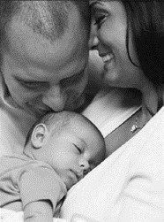

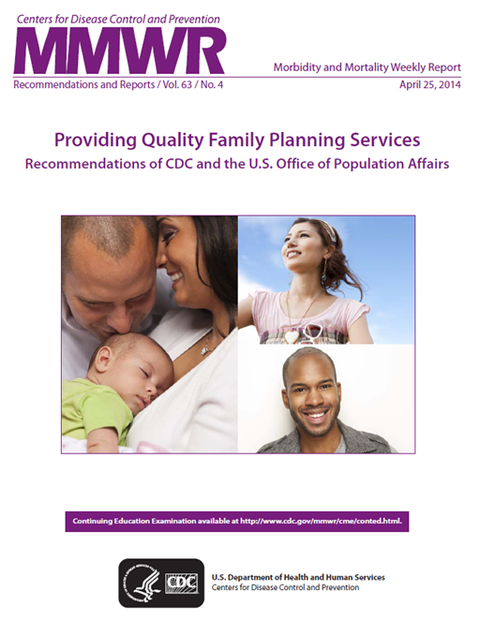

Providing Quality STD Clinical Services Recommendations

Slide 29
Levels of Care: Basic & Specialized Settings
Basic STD Care
Recommended risk assessment
Screening and treatment of those identified with asymptomatic infection
Diagnosis and treatment of patients with common symptomatic infection
Specialized STD Care
Comprehensive, confidential STD clinical services
  Basic STD Care
  Same day diagnostic and treatment services

Slide 30

Provision of Quality STD Clinical Services *
Sexual History and Physical Examination
Prevention
Partner Services
Screening
Evaluation of STD-related Conditions
Laboratory Tests
Treatments
* These guidelines outline what services should be available in the clinical setting. The CDC STD Treatment Guidelines offer guidance on what services an individual patient should receive.

Slide 31
Prevention
Basic and Specialized STD Care
The following prevention services should be available: Brief single STD/HIV prevention counseling (up to 30 minutes) PrEP and nPEP assessment and referral On-site emergency contraceptive pills or by prescription Brief contraceptive counseling or referral Referral/linkage for co-occurring conditions On-site hepatitis B vaccination On-site HPV vaccination
Specialized STD Care
The following prevention services should be available as a specialized STD service: On-site condom provision On-site hepatitis A vaccination PrEP and nPEP provision (either on-site or through linkage) The following prevention services could be available as a specialized STD service: High intensity STD behavioral counseling ( > 2 hours)
Preliminary as of August 2018, may be subject to change

Slide 32
Laboratory Tests – At the time of the patient visit
Basic and Specialized STD Care
The following tests and equipment should be available at the time of the patient visit: Thermometer pH paper
Specialized STD Care
The following tests should be available as a specialized STD service with results available during the patient visit: Phlebotomy Gram, methylene blue or gentian violet stain for urethritis On-site qualitative non-treponemal serologic test for syphilis Test for trichomoniasis Test for bacterial vaginosis Test for vulvovaginal candidiasis Urine dipstick Urinalysis with microscopy Test for pregnancy The following tests could be available onsite as a specialized STD service with results available during the patient visit: Dark field microscopy for syphilis Test for HIV
Preliminary as of August 2018, may be subject to change

Slide 33
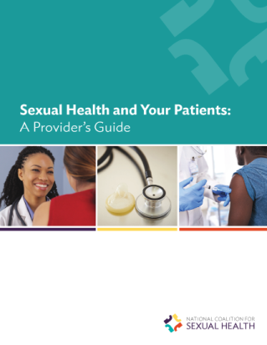

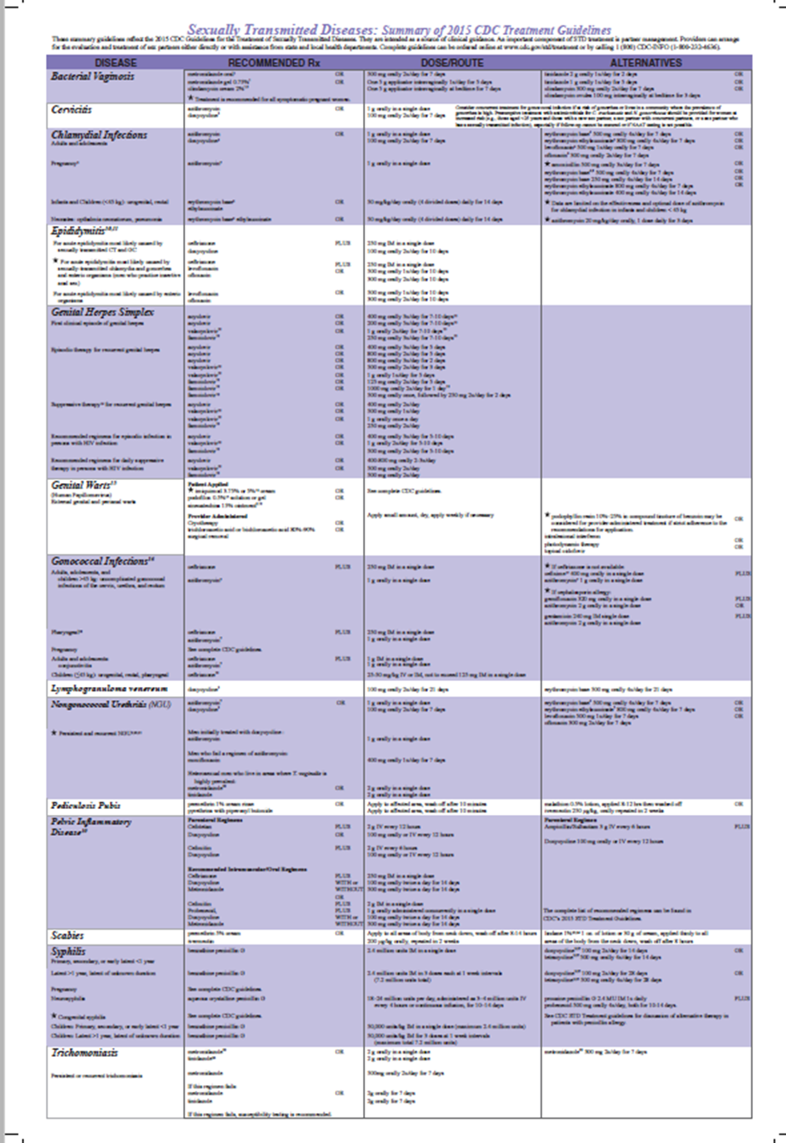
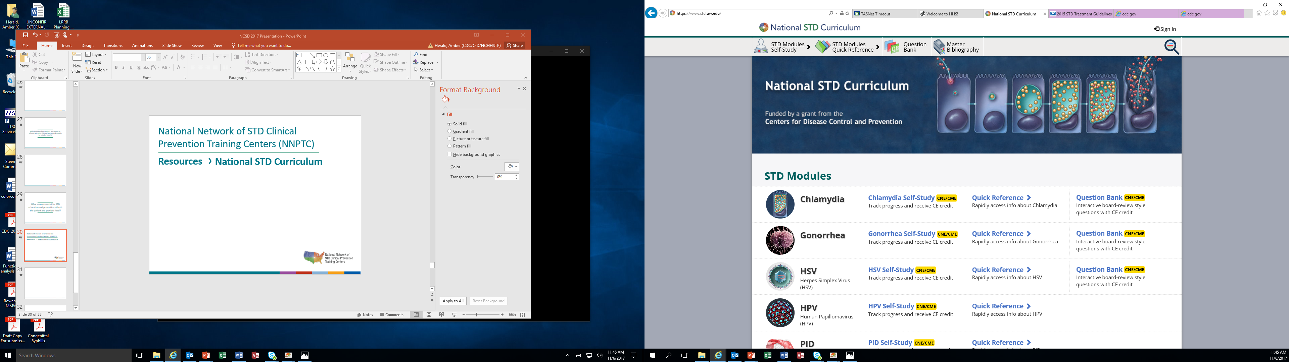
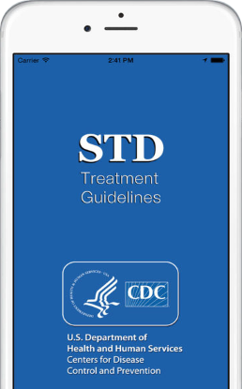
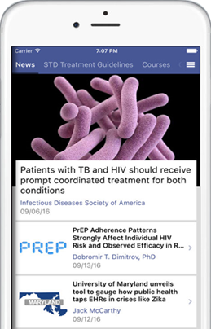
STD Resources
CDC: cdc.gov/std/default.htm
STD Treatment Guidelines: www.cdc.gov/std/tg2015 /default.htm
NNPTCs:
www.nnptc.org www.STDCCN.org
National Coalition for Sexual Health: www.ncshguide.org/providers www.ncshguide.org

Slide 34
National Network of STD Clinical Prevention Training Centers (NNPTC)
Resource: www.nnptc.org │ www.STDCCN.org
University of Washington
Denver Public Health
Massachusetts Department of Public Health
Columbia University
Johns Hopkins University
Offering STD treatment resources
University of California, San Francisco
Washington University in St. Louis
University of Alabama at Birmingham

Slide 35

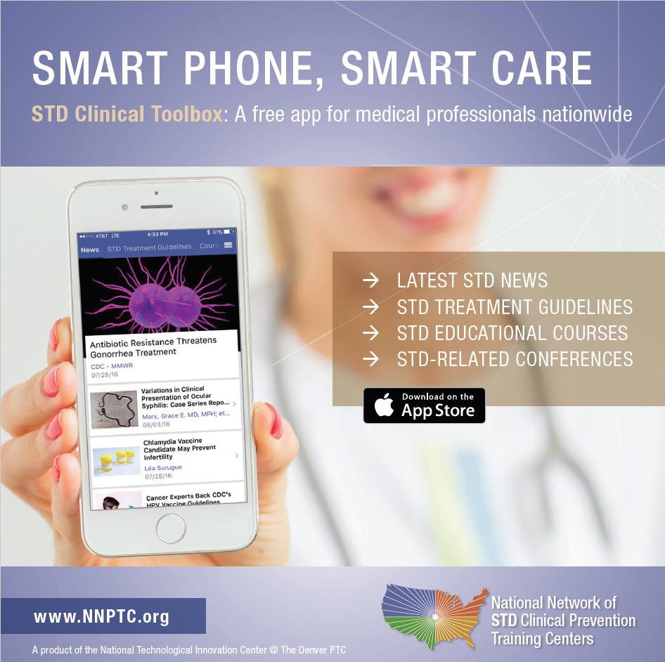

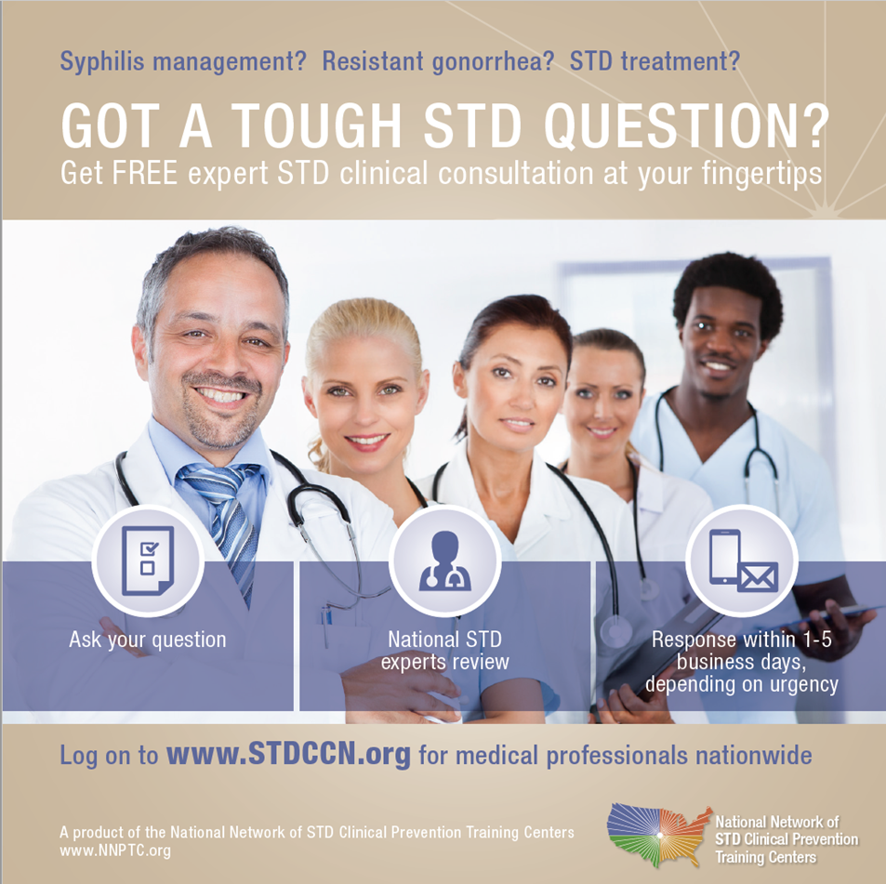
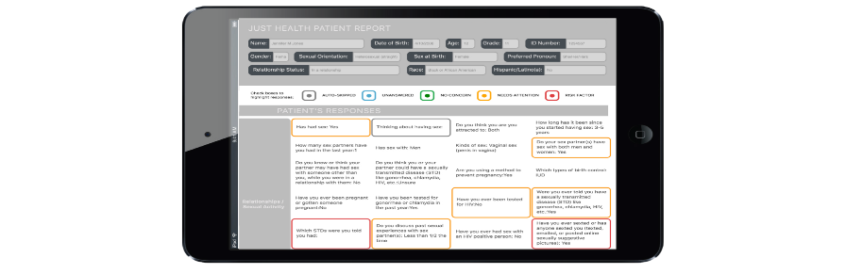



Sexual History App
Just Health’s algorithms help navigate the tough questions about sexual health. Just Health improves education, prevention, early diagnosis, and treatment. Features include:
More communication. Less stigma.
EHR interoperable
Clinical guidance
Counseling messages
Just Health is built on CDC sexual history guidelines, which cover:
User-friendly interface with skip logic
Individual & population-level reports
Cross-platform
Partners Prevention of Pregnancy Protection from STDs Practices Past History of STDs
www.justhealth.org
Just Health isn't a substitute for the conversation - it's a bridge to it.

Slide 36
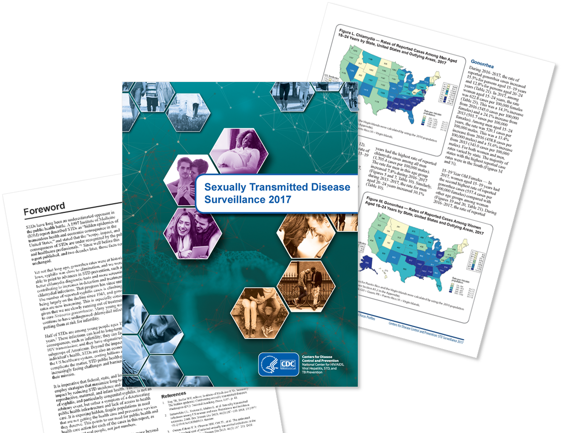
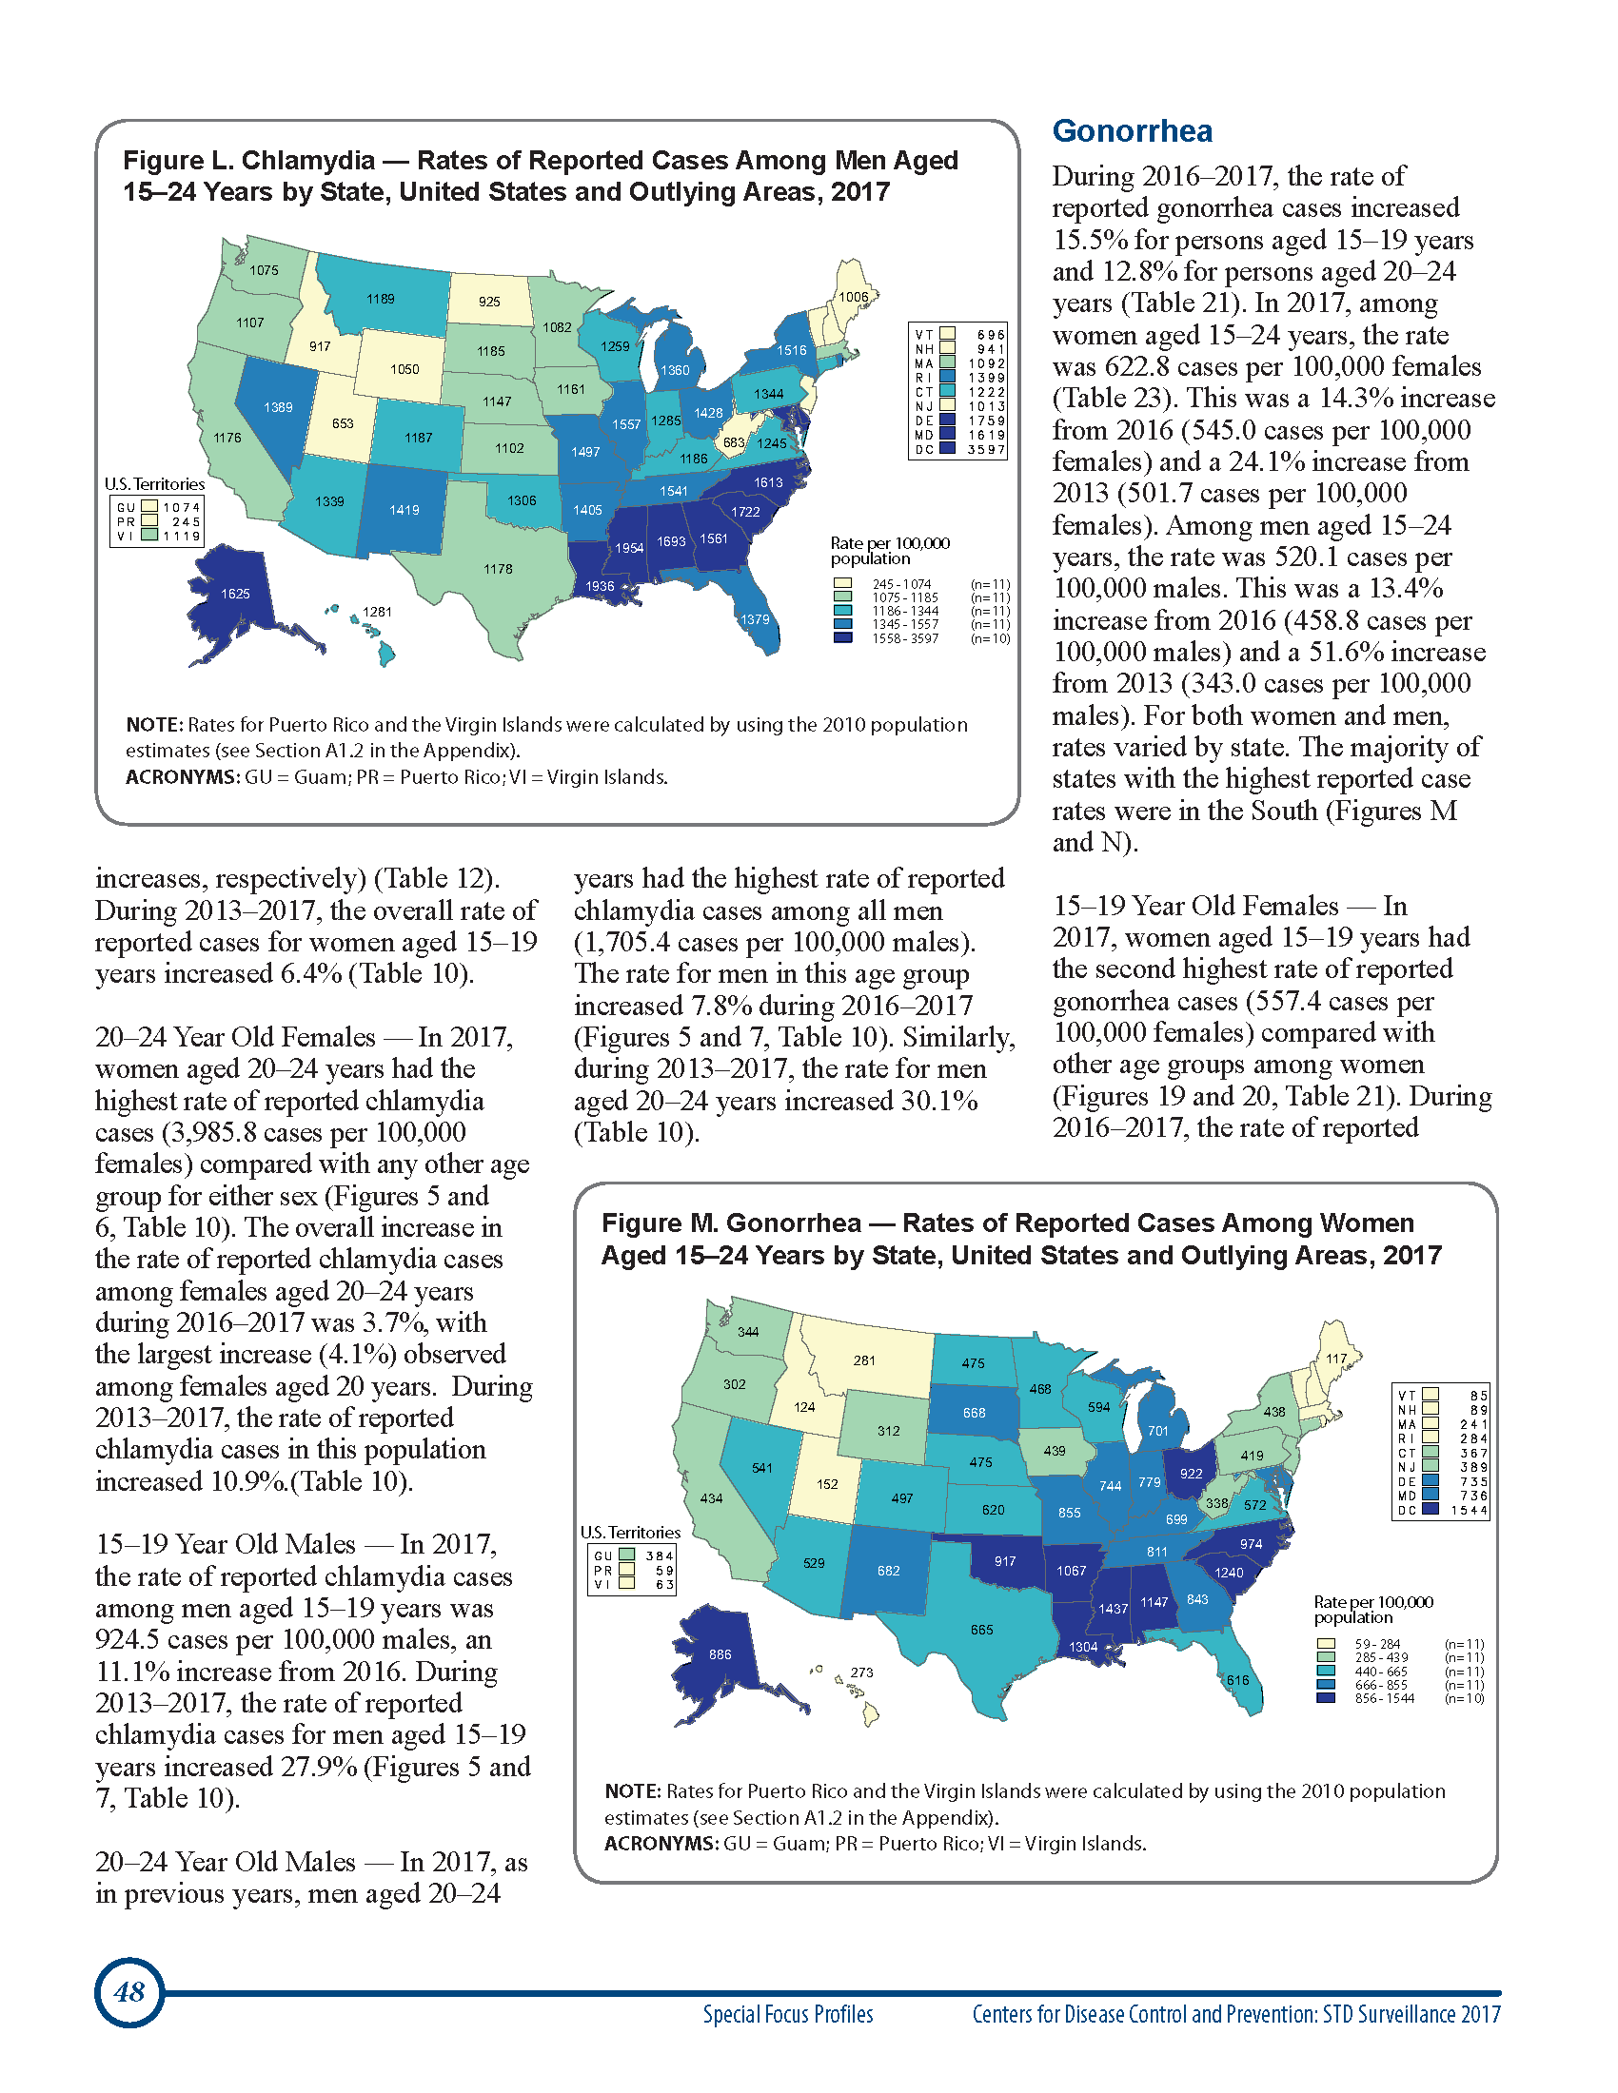
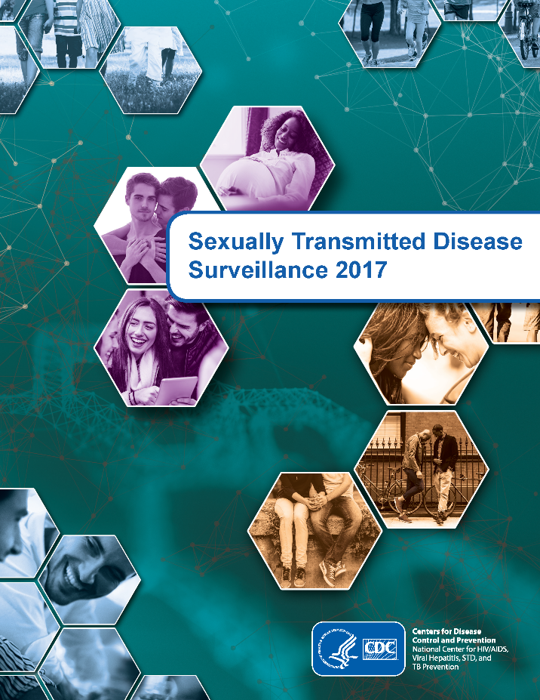
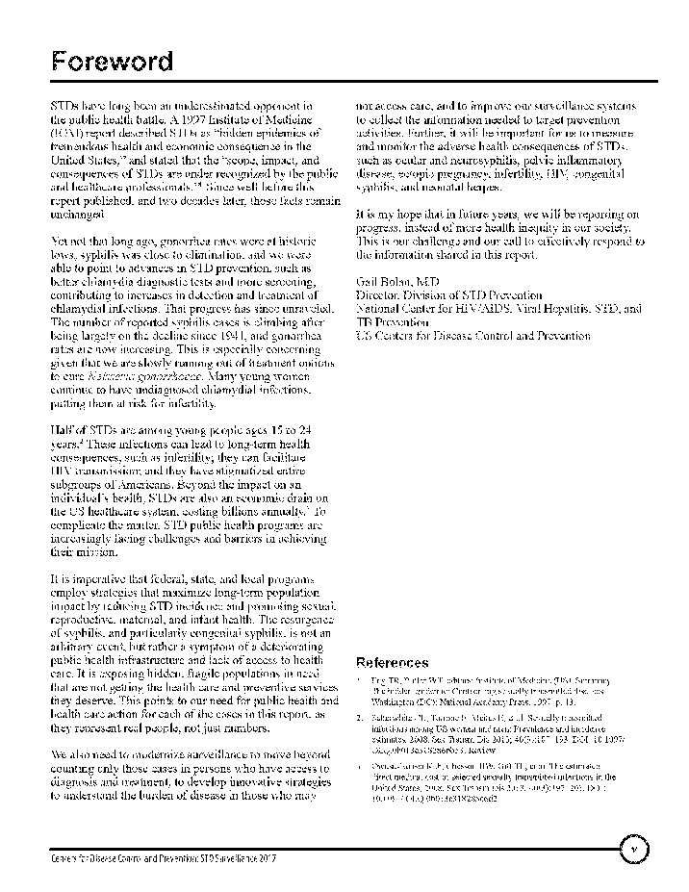
Centers for Disease Control and Prevention
Resources: 2017 STD Surveillance Report
Released September 2018
Documents 4th year of increases in 3 major notifiable STDs
Slide-decks available
Visit: https://www.cdc.gov/std /stats17/default.htm

Slide 37

Thank you
Questions?
gyb2@cdc.gov
For more information, contact CDC
1-800-CDC-INFO (232-4636)
TTY: 1-888-232-6348 www.cdc.gov
The findings and conclusions in this report are those of the authors and do not necessarily represent the official position of the Centers for Disease Control and Prevention.

Slide 38
Overview of National HIV Curriculum and National STD Curriculum
David Spach, MD
Professor of Medicine
Division of Infectious Diseases
University of Washington, Seattle

Slide 39


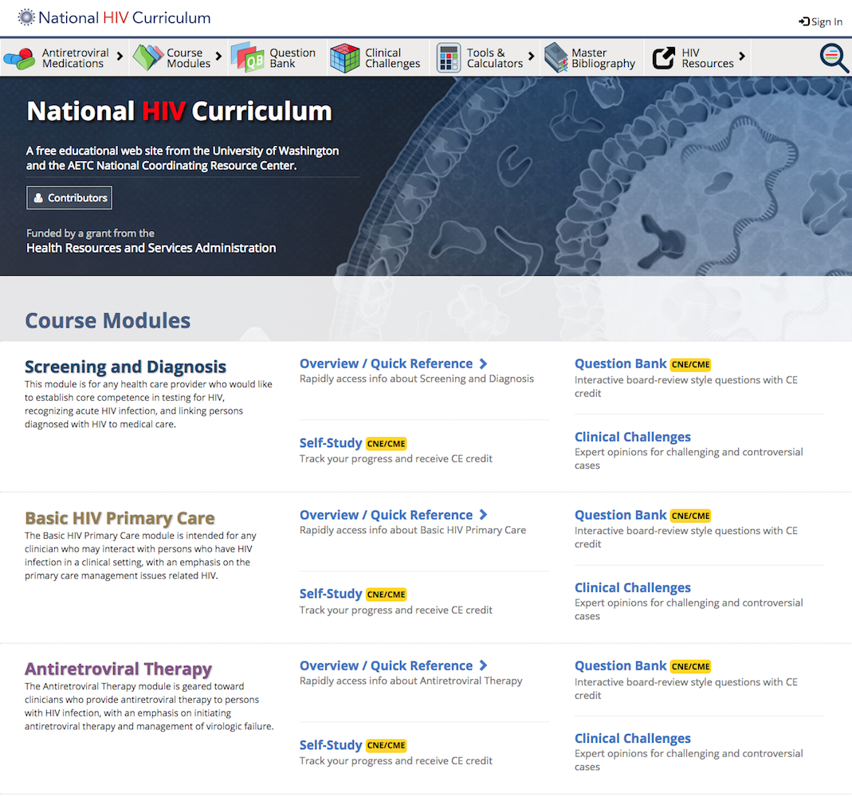
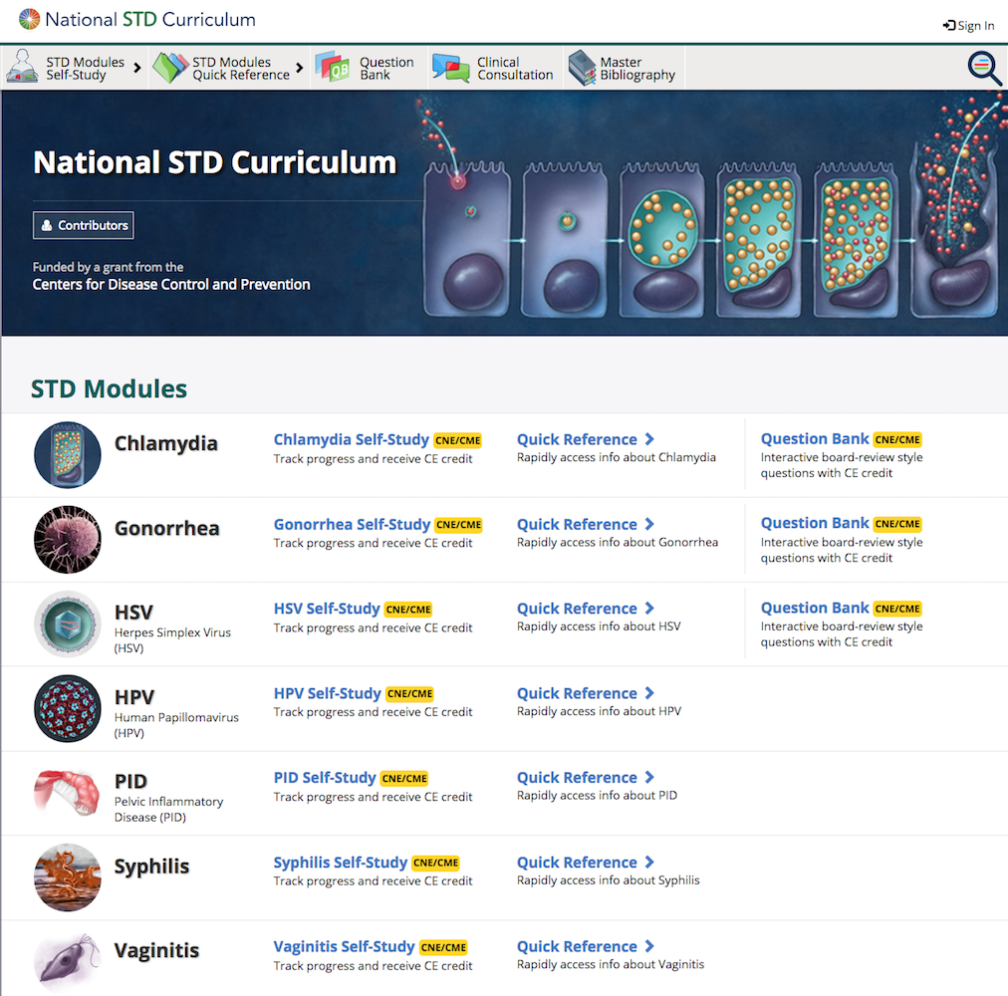
National HIV Curriculum (www.hiv.uw.edu)
National STD Curriculum (www.std.uw.edu)

Slide 40
Funded by:
Health Resources & Services Administration
Funded by:
Centers for Disease Control and Prevention

Slide 41
Key Curriculum Features
Comprehensive up-to-date material
Dual functionality: quick access and modular step-by-step function
Content tightly correlated with U.S. federal guidelines
Free CME and CNE
Board review-style Question Bank
Progress tracking and group functionality

Slide 42
Self-Study Modules: Dual Functionality
Self-Study
Sequential (Step-by-Step)
Flexible modular options
Certificate program
Ideal for training programs
Quick Reference
Highly organized interface
Quick search
On demand topics
Ideal for staying updated

Slide 43
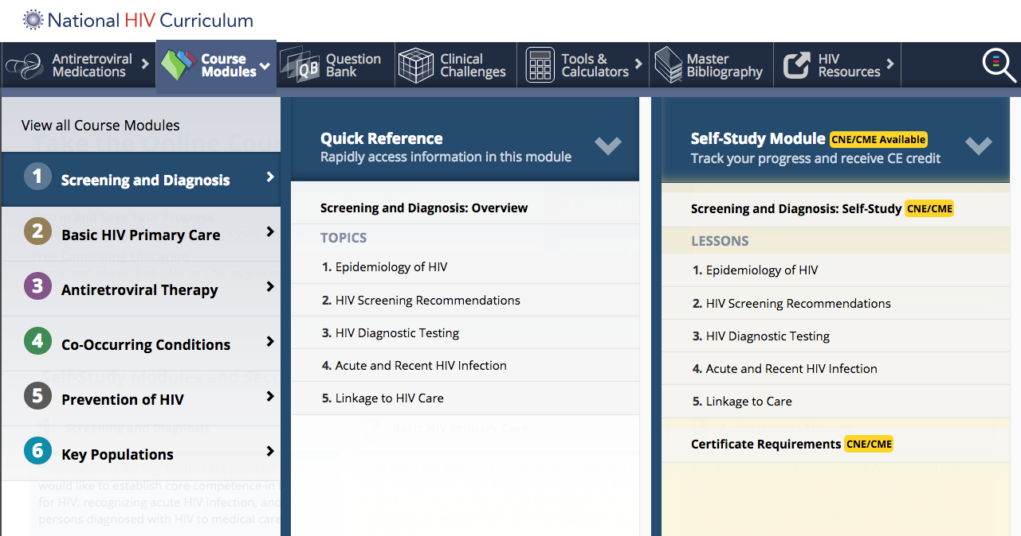
2 Options:
(1) Directly view content via Quick Reference
(2) Sign in to Self-Study Module and work through step-by-step

Slide 44
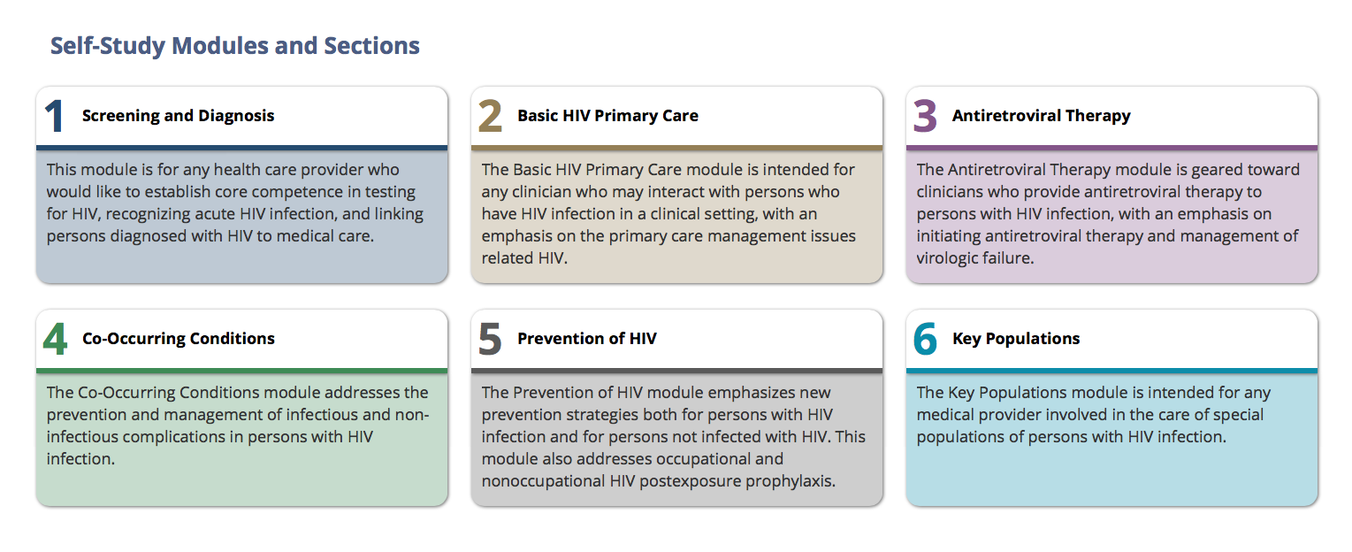
National HIV Curriculum: Modules

Slide 45
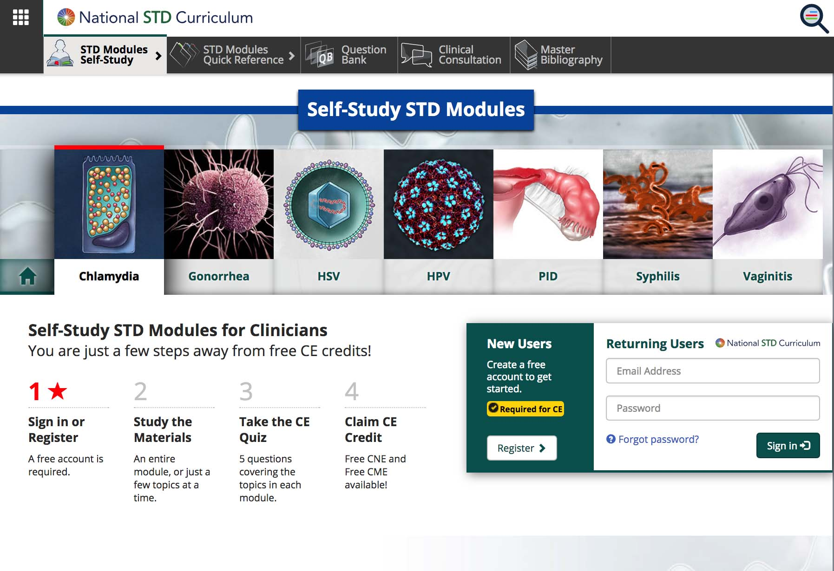
Self-Study STD Modules

Slide 46
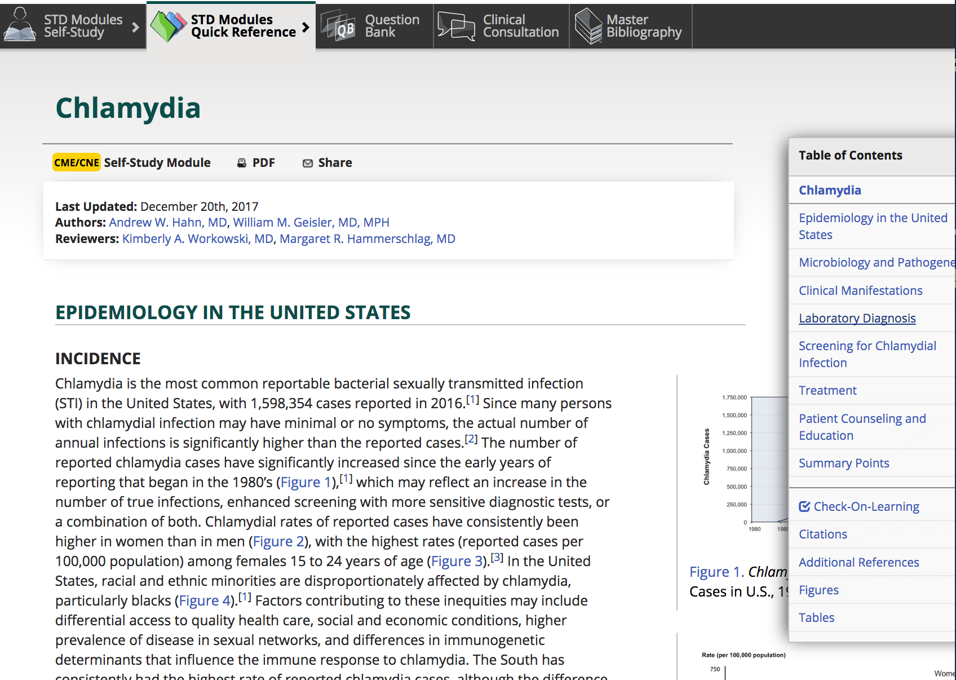
National STD Curriculum: Quick Reference

Slide 47
National HIV Curriculum
Antiretroviral Medication Section
Editor’s Summary
Prescribing Information
Clinical Trials
Slide Deck/Teaching References

Slide 48
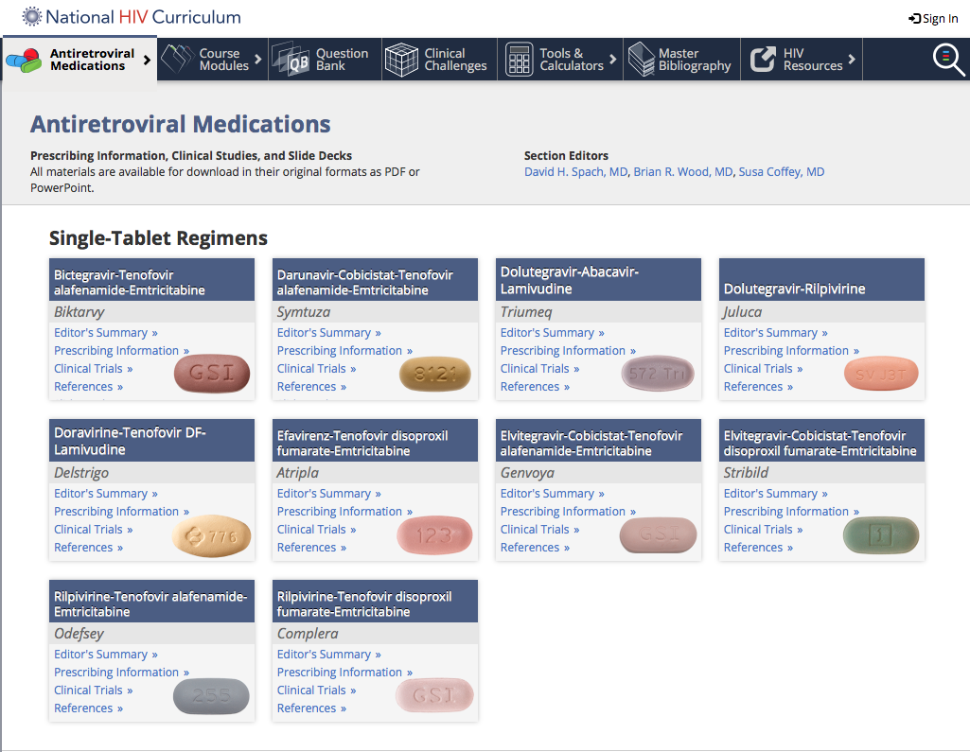
National HIV Curriculum: Antiretroviral Medication Section

Slide 49

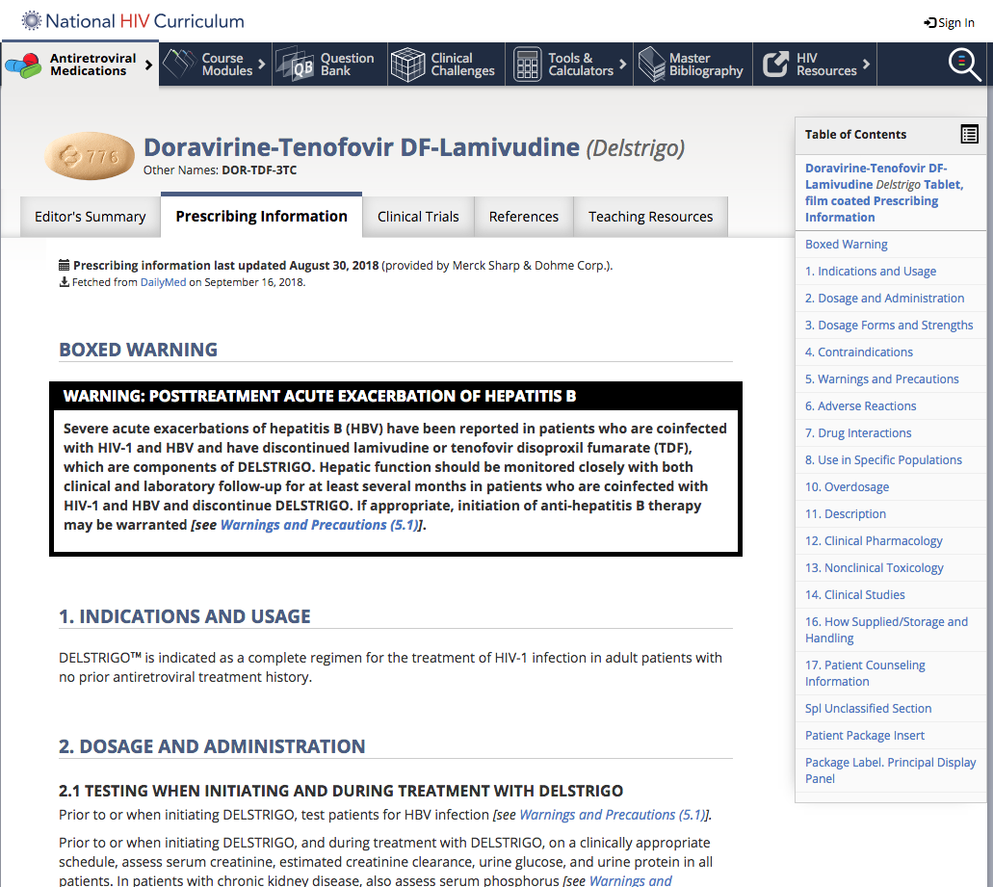
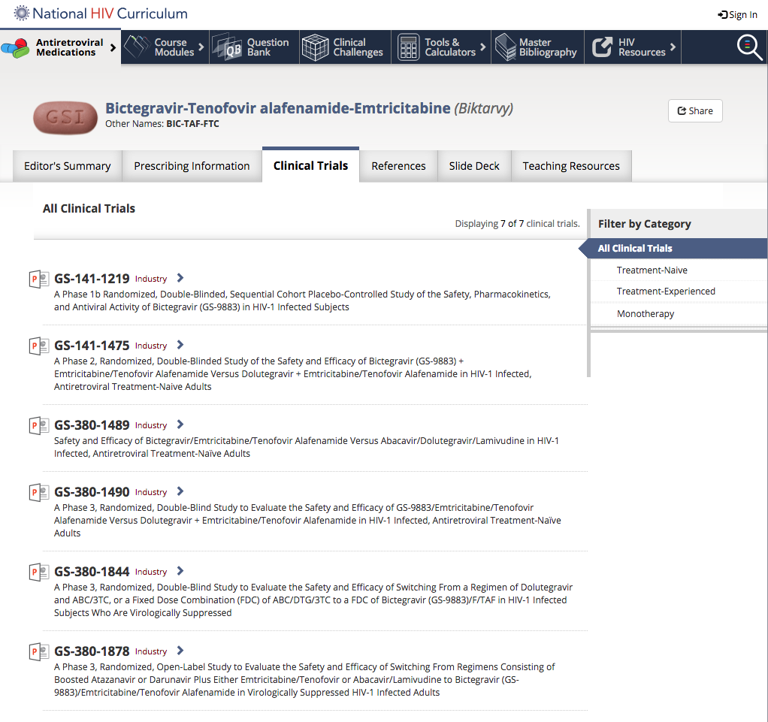
Prescribing Information
Clinical Trials

Slide 50
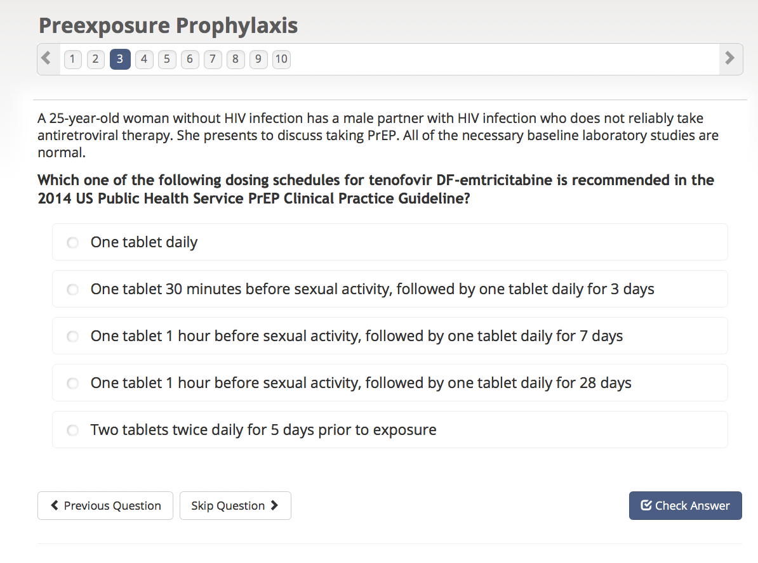
HIV Question Bank
Board Review Style
Feedback summaries
450+ Questions
Emphasis on guidelines

Slide 51
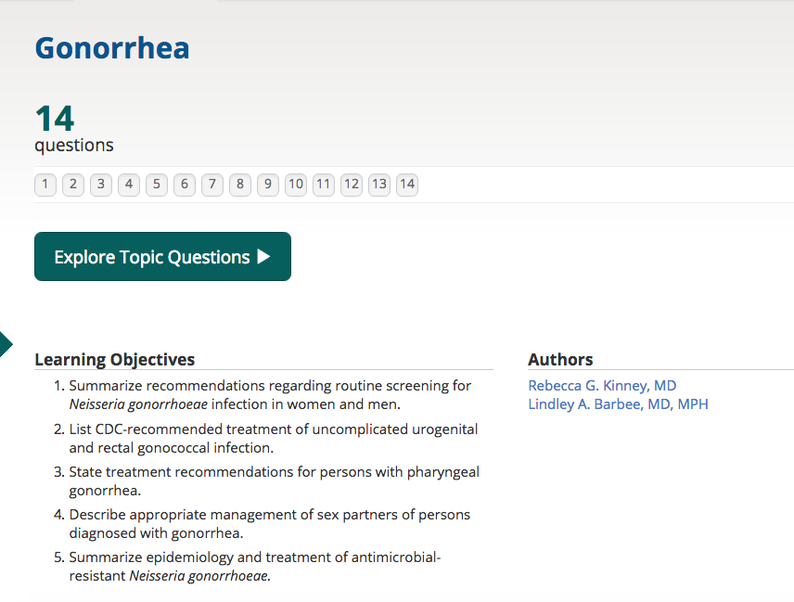
STD Question Bank
Board Review Style
Feedback summaries
100+ Questions
Parallel to CDC STD Guidelines

Slide 52
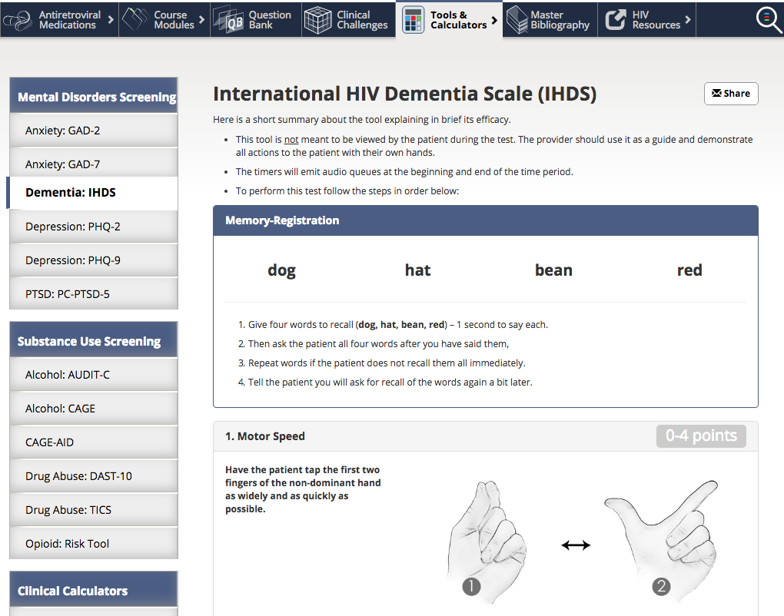
Tools & Calculators
National HIV Curriculum

Slide 53
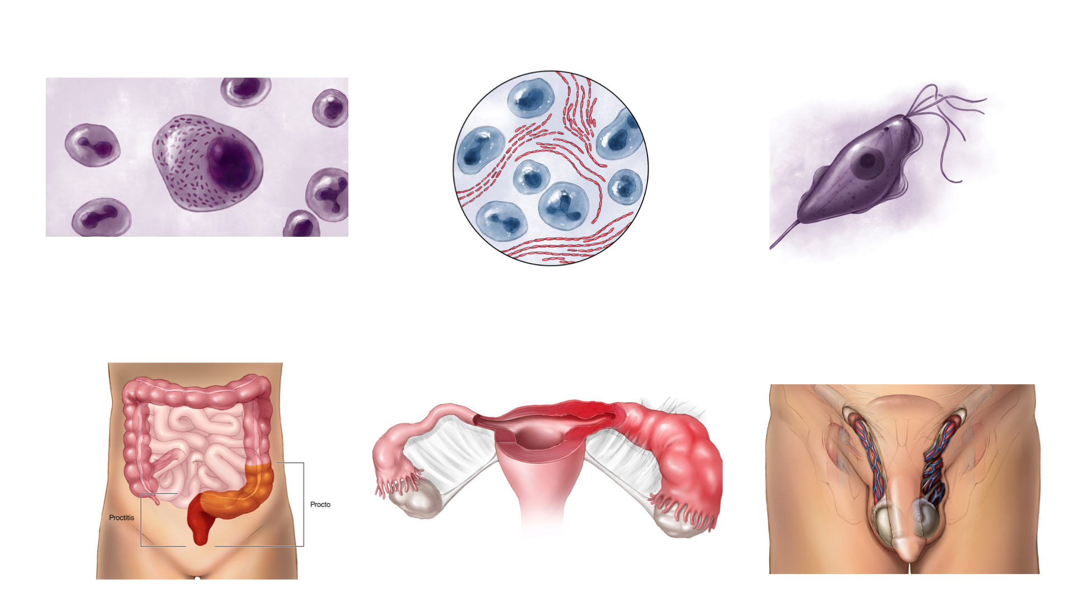
National STD Curriculum: Sample Illustrations

Slide 54


Group Functionality: Invite, Organize, and Track Progress

Slide 55
Use of National HIV Curriculum in Ryan White Clinics
Free resource for comprehensive HIV training
Ability to use curriculum as formal training tool
Comprehensive updated resource

Slide 56
Use of National STD Curriculum in Ryan White Clinics
Free resource for STD training
Ability to use curriculum as formal training tool
Establish groups in RW clinic for STD core competency training

Slide 57
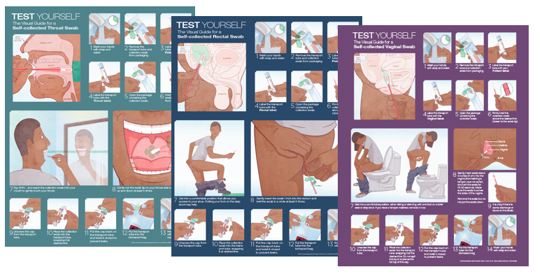
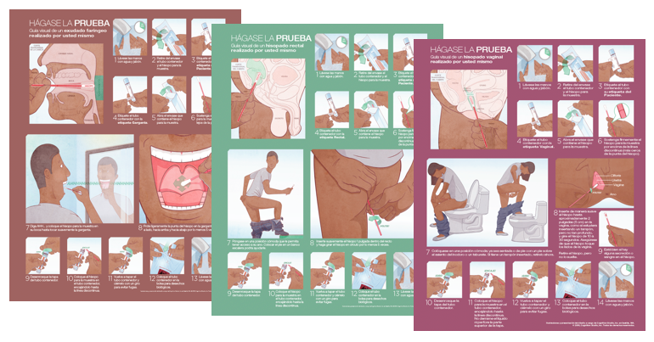
University of Washington STD Prevention Training Center
STD Self-Testing Visual Aids and Posters
STD Self Testing Visual Aids: English
www.uwptc.org
STD Self Testing Visual Aids: Spanish
www.uwptc.org

Slide 58
Acknowledgements
University of Washington Team
Andrew Karpenko
Kenton Unruh
Bruce Maeder
Julia Freimund
Karin Bauer
Mary Annese
Editors, Authors, Reviewers
John Nelson and NCRC
HRSA (support and funding)
CDC (support and funding)

Slide 59
STI Services for PLWH in a Community Health Center Setting
Ami Multani, MD
Alex Gonzalez, MD MPH
Infectious Disease Director
Fenway Health
Medical Director
Fenway Health

Slide 60
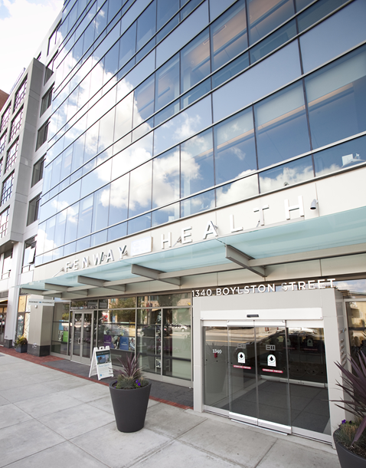

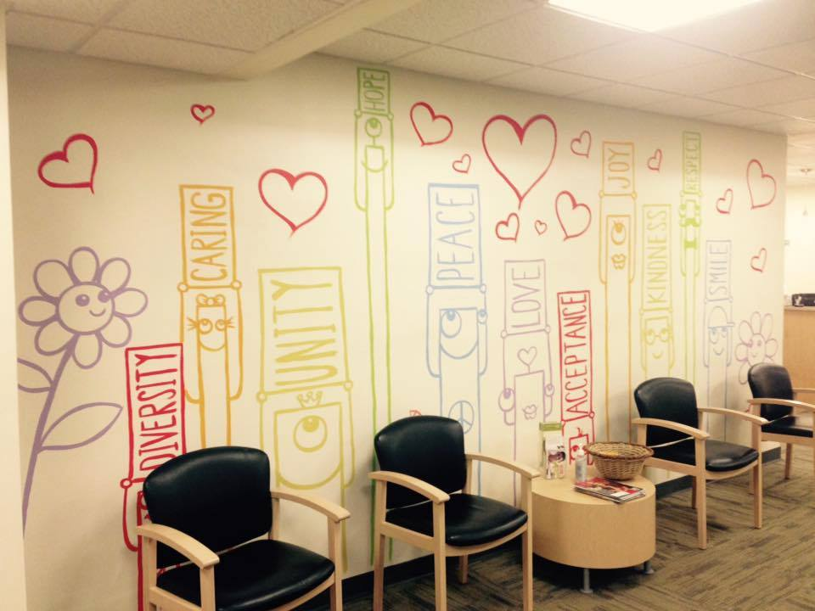
Fenway Health
Federally qualified health center with 3 clinic sites in Boston, MA
Established in 1971
34,000 patients / 122,000+ total visits in 2017
  50% are LGBTQ
  2200+ are PLWH
  4000 are transgender
NCQA Level 3 Prime Patient Centered Medical Home

Slide 61
Fenway Health
Ryan White Part C grantee
2238 clients – largest HIV clinic in Massachusetts
94% male and MSM risk factor
33% people of color
46% at or below 200% FPL
37% Publicly Insured
8% Uninsured
Notes:
Over 2200 HIV patients – largest HIV clinic in Massachusetts
About a third of our HIV patients are people of color
Most are MSM, half are at or below 200% of FPL, Most are commercially insured and very few are uninsured thanks to health care reform in Massachusetts
Small percentage of our HIV patients are trans but that’s still 70 trans patients – only about 5 of whom are trans masculine
We are very close to achieving the WHO 90/90/90/90 care continuum goal, and this goal is part of our overall quality plan for the health center
Race/Ethnicity: 66.4% White, 16.4% Hispanic/Latinx, 13.4% Black, 3.5% Asian
Gender: 93.6% Male, 3.4% Female, 3% Transgender (MTF>FTM)
SES: 46% at or below 200% FPL
HIV Risk Factor: 93.1% MSM, 4.2% Heterosexual contact, 3.8% IDU
Insurance: 56% Commercial, 36.5% Public, 7.9% Uninsured
ART: 97.5% on ART, 86% on ART have a VL<200 copies

Slide 62
Fenway Health – HIV Care Continuum
Linkage to Care 100%
On ART 97.5%
On ART + VL<200 86%

Slide 63
Fenway Health
Multispecialty integrated team based care model
Primary Care: including HIV Care, Transgender Care, Women’s Health Care, Pediatrics, Adolescent Care, and Team Nursing & Case Management
Medical Specialties: Dermatology, Endocrinology, High Resolution Anoscopy, Infectious Disease, Medication Assisted Treatment, Nephrology, Nutrition, Podiatry, Pulmonology
Complementary Therapies: Acupuncture, Massage, Osteopathic Manipulative Therapy
Behavioral Health: Therapy, Psychiatry, Integrated SBIRT
Other: Dentistry, Optometry, Pharmacy, X-ray & BMD

Slide 64
Fenway Health – STI Screening Rates Among PLWH
In last 12 months…
73% screened for syphilis
42% screened for chlamydia
44% screened for gonorrhea

Slide 65
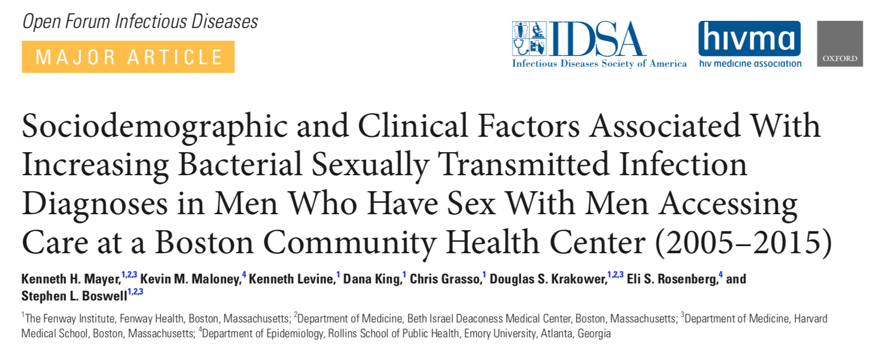
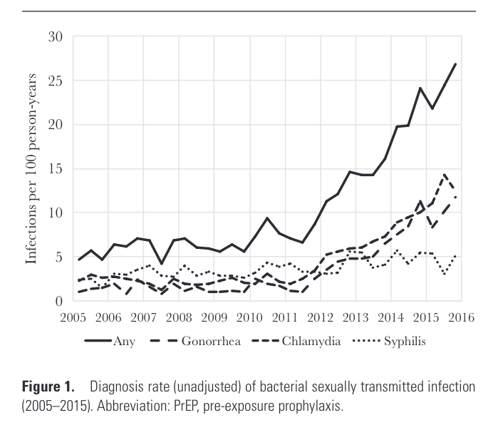
BSTI Cases Increasing
Notes:
Consistent with the findings shared by the previous presentations, we have seen a significant increase in the number of bacterial STI’s diagnosed - both among HIV positive and HIV negative MSM’s - at Fenway Health. Our colleague Ken Mayer at the Fenway Institute published these findings in OFID earlier this year and we will review some of the data with you now.
In this slide here, you can see that this more than 8 fold increase in the rate of bacterial STI’s is driven mainly by upticks in the number of chlamydia and gonorrhea infections, specifically over the last 7 years.
In 2015, the last measurement year of this study, 23% of the BSTI’s detected in our clinic were among people living with HIV, even though HIV patients only comprised about 15% of the patient population. In fact, in multivariable analysis, being HIV+ was independently associated with receiving a BSTI diagnosis.

Slide 66
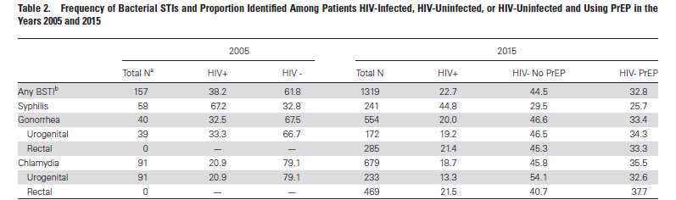
BSTI Cases Increasing
Mayer KH, Maloney KM, Levine, K et al; Open Forum Infect Dis. 2017 Oct 8; 4 (4)
Notes:
Again you can see in this slide how we have seen a dramatic increase in the # of BSTI’s diagnosed at Fenway. PLWH comprised a smaller percentage of the total # of infections at our clinic in 2015 than in 2005, mainly because we have had such a growth in our overall patient population (we have tripled in size during this time). But HIV patients are still making up a disproportionate share of the BSTI diagnoses. (15% of overall population but 23% of BSTI’s)

Slide 67
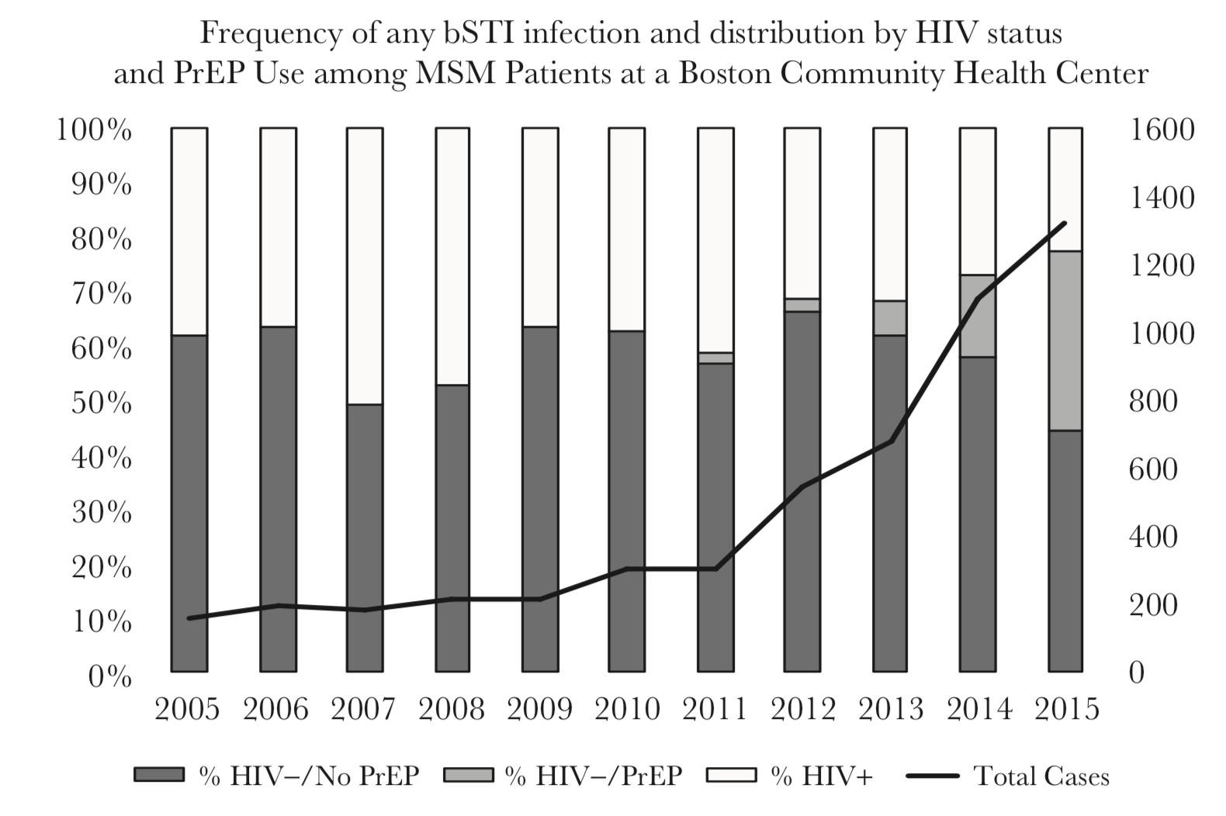
BSTI Cases Increasing
Mayer KH, Maloney KM, Levine, K et al; Open Forum Infect Dis. 2017 Oct 8; 4 (4)
Notes:
Again you can see in this slide how we have seen a dramatic increase in the # of BSTI’s diagnosed at Fenway. PLWH comprised a smaller percentage of the total # of infections at our clinic in 2015 than in 2005, mainly because we have had such a growth in our overall patient population (we have tripled in size during this time). But HIV patients are still making up a disproportionate share of the BSTI diagnoses. (15% of overall population but 23% of BSTI’s)

Slide 68
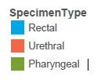
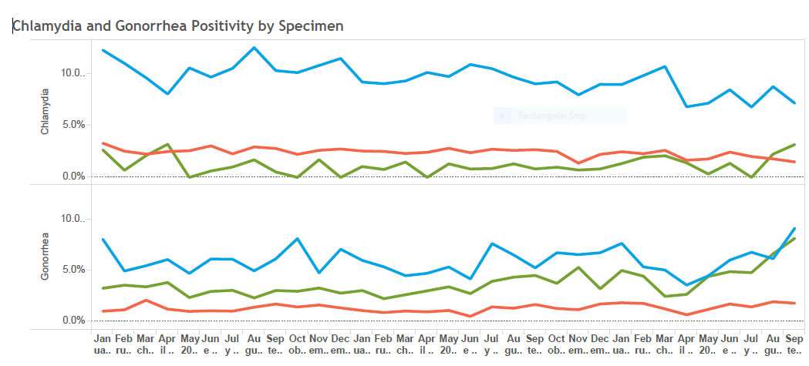
BSTI Cases Increasing
Notes:
We asked our data team at Fenway to take a closer look at gonorrhea and chlamydia infections among our HIV+ patients over the past two years, and here’s what they were able to show us. As you can see, our current state is that about 10% of all rectal chlamydia specimens are turning up positive, and the same goes for rectal and pharyngeal gonorrhea specimens.

Slide 69
Fenway Health and STI Care
We are actually 3 organizations in one...
FQHC
Medical
Behavioral Health
Optometry
Dentistry
Pharmacy
Lab
The Fenway Institute
Advocacy
Research
Training/Education
AIDS Action Committee
Community Outreach Programs
Public Health Programs
Housing & Legal Case Management for PLWH
STI services integrated into primary care
STI Data Collection/Analysis
STI Clinical Training
STI services as part of research studies
STI Policy Recommendations
STI services as part of…
Standalone STI Clinics w/DPH
Programs in nonclinical settings
STI Community Outreach/Education
Notes:
In order to explain Fenway Health’s approach to STI care, we first have to explain that Fenway Health is actually 3 different organizations merged into one entity.
We’ve already described the health center component itself – this is where we have STI services integrated right into primary care, and we’ll talk a little bit more in subsequent slides about tools we have in place to make that integration successful.
The Fenway Institute is our research/advocacy/training arm. STI screenings take place within the institute as part of research studies. This is also where our Data Team sits – they collect and analyze information about STI care from across the 3 organizations. That National LGBT Health Education Center is housed in the institute too, and this center serves as the main source of technical assistance to health centers around the country regarding LGBT health including STI care.
Lastly, we have an AIDS Service Organization called AIDS Action Committee, which is the home of among other things our public health programs – many of which involve STI screening and care. These tend to be standalone programs that are collaborations with the Massachusetts Dept of Public Health, such as several on-site STI clinics and two nurse-based off-site programs that focus on at-risk adolescents and transgender women.

Slide 70
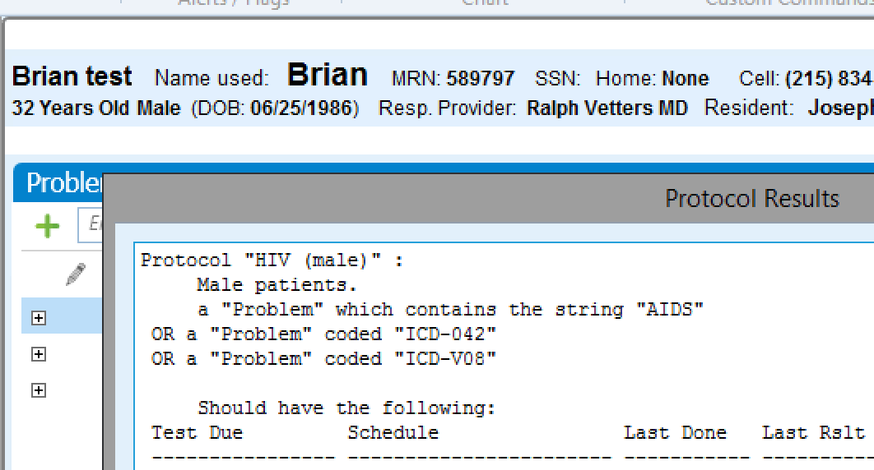
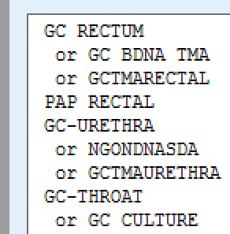

STI Services at Fenway Health: Integration into HIV Care
Notes:
Most of our HIV positive patients are screened for STI’s as part of their regular HIV care with their primary care provider. Our EMR is called Centricity Practice Solutions and it contains a customizable decision support function. On the top of the slide you can see how a condition based protocol is set up so that every HIV patient’s clinical care gaps are visble to the clinical team. These same gaps print out on the chart summary that we give to each provider prior to the start of these visits.

Slide 71
STI Services at Fenway Health: Standalone STI CLINIC
HIV/STI public health clinics funded by grants from Massachusetts Department of Public Health
Specifically serves MSM and transgender clients and their partners, irrespective of their HIV status
Most services are provided by RN’s using standing orders, with NP backup
Services offered:
  HIV counseling and testing and linkage to care
  Hepatitis C counseling and testing and linkage to care
  BSTI testing and treatment: syphilis, gonorrhea, chlamydia
  Insurance enrollment
All services documented in clinic EMR

Slide 72


STI Services at Fenway Health: Programs in Nonclinical Settings
Youth on Fire
Drop in center for homeless and street involved youth in Cambridge
Boston GLASS
Drop in center for LGBTQ youth of color in Boston
Services provided onsite
HIV/HCV counseling & testing & linkage to care
BSTI screening & linkage to care
Positive screens referred to Fenway adolescent clinic

Slide 73

NEXT STEPS: DASH clinic
Innovative approach to on-demand STI screening of asymptomatic individuals
Based on Dean Street Express Clinic model by NHS in United Kingdom

Slide 74

NEXT STEPS: DASH clinic
High impact / low threshold storefront sexual health facility that will offer fast, reliable and confidential sexual health screening (BSTI, HCV, and HIV testing) and linkage to care/treatment
  Allows increased access to rapid screening and same day results + linkage to care/treatment
  Hope to divert 75% of Fenway Health’s asymptomatic STI screening visits there

Slide 75


NEXT STEPS: DASH clinic
Model will…
  Increase BSTI screening rates for both HIV+ and HIV- existing Fenway patients (lower barrier to obtaining appointment in a timely manner)
  Decrease BSTI transmission by increasing likelihood of testing and treating asymptomatic patient on the same day (currently only providing same day treatment to symptomatic clients and clients with known BSTI+ contacts)

Slide 76
Acknowledgements
Dr. Kenneth Mayer – The Fenway Institute
Chris Grasso, MPH – The Fenway Institute
Marcy Gelman, NP MPH – The Fenway Institute
Kenneth Levine – The Fenway Institute

Slide 77
Implementing on demand STI testing in an HIV clinic
Hilary Reno, MD, PhD
Assistant Professor, Infectious Diseases, Washington University in St. Louis
Medical Director, St. Louis County Sexual Health Clinic
Director, St. Louis STI Regional Response Coalition (www.stlstirr.org)
St. Louis STD/ HIV Prevention Training Center
Medical Consultant, CDC, Division of STD Prevention

Slide 78

Washington University HIV clinic
Ryan White Part C grantee
In 2017: 1939 patients, 70% cis gender men, 28% cis gender women, 2% transgender women
80% MSM, 2% use IV drugs
Patients with undetectable virologic controls are seen every 3-6 months.
Notes:
The Washington University HIV clinic. Descriptors.
Our clinic has an active QI team and we recognized that STI testing and follow-up components were not having a maximized benefit for our patients. Over the past few years, a multi stage QI plan was implemented as well as clinic patient flow changes to address these issues. I will describe these today.

Slide 79

Sept 25, 2017
134%
35%
80%
217%
Notes:
First, let’s look at the scope of the problem:
Regional rates of STIs are High and increasing with the greatest increases in gonorrhea and syphilis. These infections impact our patients and contributed to our desire to address STI care in our HIV patients.

Slide 80
Incident STI rates are higher for Transgender Women (TW) and MSM while retesting rates are poor in all groups
MS in prep.
Notes:
The scope of the problem.
Based on my interest as a transgender health provider and the interest of our case managers, we embarked on a retrospective case control study that in part, collected data on incident STIs in our patients. We know that the incidence of STIs is high is our transgender women and cisgender MSM. And that there are some concerns with quality of care with transgender women having lower rates of follow up testing than cisgender MSM.

Slide 81
STI location is similar between Transgender Women and MSM with TW having a lower proportion of genital infections.
MS in prep.
Notes:
In addition, our clinic data indicates other areas for improvement and focus. STI data indicate that for our transgender women, oral and rectal STIs are more common than genital infections and therefore, case managers were interested in revising their prevention interventions.
So with high regional rates of STIs and high rates of iSTIs in our patients, the QI team first took on improving testing rates in the clinic.

Slide 82
Notes:
This is a graph of Qual performance measures. Please note the red line that is triple testing in our MSM and transgender women. Initially rates of annual testing were just over 30%. This was in 2014, 2-3 years after the recommendation on extragenital testing was made. A year long QI project was implements and screening rates improved. The intervention

Slide 83

Quality Improvement plan: Provider education

Slide 84

Quality Improvement plan:
Patient education
Notes:
We worked to educate patients on triple testing.

Slide 85
Pt arrives for IOV or ROV
--Insurance verified at check-in
MA places pt in exam room
Provider identifies what screenings are needed at visit
Provider requests labels from MA as needed
Provider performs assessment in exam room
Self-Administered
STI Triple Screen
Process Map
Provider performs throat swab & shows pt what to do w/ rectal swab
Provider puts labels on containers
Provider writes date, site, and initials on labels
Pt elects to screen
Provider educates client about need for screening at all 3 sites and documents refusal
YES
NO
Urine ONLY
Provider gives pt option for rectal swab:
1) Provider completes * 2) Self-Collection – provider can leave room or turn back
Pt or Provider collects rectal swab
Throat swab and rectal swab placed in specimen bag by provider
Provider places specimen bag in bin in the MA/RN station to the right of the sink
Exam Completed
Revised 8/10/15
Notes:
Patient flow was discussed in great detail and explored to help staff and provider acceptance/ buy in. We also layed the ground work for self collected samples to improve patient and provider buy in. Self collected samples for STI testing have been shown in many studies to be at least as sensitive as provider samples and have be acceptable to patients and providers.

Slide 86
Key successes/ Next steps
Improved extragenital testing rates
Self testing protocols were in place and successful
Recognition that STI rates are increasing = provider buy in.
Belief that care could be improved.
That evidence based methods of improvement exist (self-collection, express visits).

Slide 87
Walk in STI care
Provider to see and evaluate
Staff to facilitate NAATs x 3, RPR
Patient calls with
STI concern
Patient given appointment—encouraged to be same day
Symptoms
No symptoms
Walk in testing/ nurse visit:
Self collected GC/ Ct NAAT(urine, oral, rectal), RPR
Physical exam: empirically treat if signs noted.
If patient has rectal symptoms, consider treating with ceftriaxone 250 mg IM x 1 PLUS doxy 100 mg PO BID x 7 days
All patients with +NAATs need rescreening in 3 months/ next visit
If patient reports exposure, but no symptoms:
If syphilis exposure, needs exam, plus bicillin
If GC, Ct exposure, needs empiric treatment + walk in testing.
Notify PCP, follow up test results

Slide 88
Walk in STI care
The plan was discussed at the clinical faculty meeting and implemented last year.
Walk in STI care continues to be accepted and used by our providers and patients.
It has been especially successful for the PrEP clinic.
Notes:
So with this solid base, we needed to tackle how to get patients tested when they called with an exposure, concern, or symptoms. Waiting was not an option. So we moved to a model inspired by STD clinics: walk in STD Care.

Slide 89
Future efforts
Case management is updating their prevention messaging to ensure gender neutral and sex positive language.
A QI subgroup is focused on disparities for our Transgender patients.
Follow up testing is still a targeted improvement project.

Slide 90
Acknowledgements
Washington University In St. Louis HIV Clinic staff, case managers, and patients.
Our QI team especially Julia Schlueter, MPH

