Slide 1
Re-envisioning Indiana’s Service Delivery System: Strategies Implemented and Lessons Learned
Lori DeLorenzo, RN, MSN-Owner, Organizational Ideas
Mark Schwering, BS- Ryan White Part B Program Director, Indiana State Department of Health
Brittany Sichting, MA- HIV Services Associate Program Director, Indiana State Department of Health
Notes:
Lori: Slides 1-3

Slide 2
Disclosures
Presenter(s) has no financial interest to disclose.
This continuing education activity is managed and accredited by AffinityCE/Professional Education Services Group in cooperation with HRSA and LRG. PESG, HRSA, LRG and all accrediting organization do not support or endorse any product or service mentioned in this activity.
PESG, HRSA, and LRG staff as well as planners and reviewers have no relevant financial or nonfinancial interest to disclose.
Commercial Support was not received for this activity.

Slide 3
Learning Objectives
At the conclusion of this activity, the participant will be able to:
Be able to articulate one of more lessons learned that can be applies to improving the services delivery system in their respective setting;
Identify one or more strategies to implement related to programmatic, fiscal, data and/or quality management change that can enhance and/or support for the service delivery system; and
Recognize ways to implement system level change that will foster reaching the National Priorities.

Slide 4
Notes:
Mark: Slides 4-27
Care Coordination map of Indiana
Explain the difference between CC and agencies funded by RWHAP
Identify those agencies funded by Part B/ADAP, which is more than what is listed on this slide

Slide 5
The Continuum of HIV Care, Indiana, as of December 2017
87% Aware of HIV Status
69%
58%
58%
Notes:
HIV-Newly Diagnosed: annual newly reported cases
HIV-Prevalence: all Persons Living with HIV/AIDS
Linked to Care: based on CD4/VL within 3 months of diagnosis
Retained to Care: based on having an annual CD4/VL
Suppressed VL: based on most recent CD4/VL
Unmet Need: based on no reported annual CD4/VL

Slide 6
Indiana HIV Demographic Breakdown as of December 2017 – Gender
*CDC. Estimated HIV incidence and prevalence in the United States, 2010-2015. HIV Surveillance Supplemental Report 2018;23(1).

Slide 7
Indiana HIV Demographic Breakdown as of December 2017 – Race
*CDC. Estimated HIV incidence and prevalence in the United States, 2010-2015. HIV Surveillance Supplemental Report 2018;23(1).

Slide 8
Indiana HIV Demographic Breakdown as of December 2017 – Risk Factor
*CDC. Estimated HIV incidence and prevalence in the United States, 2010-2015. HIV Surveillance Supplemental Report 2018;23(1).

Slide 9
Indiana PLWH Demographic Breakdown as of December 2017 – Program Enrollment

Slide 10
PLWH Served in Indiana – December 2017
4,735 PLWH enrolled in Care Coordination
2,832 of these enrolled in Part B/ADAP services

Slide 11
Service Categories Prior to Funding
Indiana primarily funded TWO service categories prior to being awarded the Ryan White Supplemental Funds!
Those were:
AIDS Drug Assistance Program (ADAP) Treatments
Health Insurance Premium and Cost Sharing Assistance for Low-Income Individuals
Notes:
A very small amount of medical services was funded to uninsured PLWH in the past.

Slide 12
Funding Prior To Supplemental
Ryan White Care Act X07 Base Funds -- $14.7 million
State Funds (Tobacco Settlement) -- $2 million
Rebate Funds (340B) – Average $24 million

Slide 13
How It All Began
Nov. 7, 2016 First day as Indiana Ryan White Part B Director – ISDH
March 2017 Project Officer mentioned Supplemental Funds on a Monitoring Call $219 million
March/April 2017 Developed a plan and wrote the application
May 12, 2017 Submitted the application
June – Aug 2017 Began laying foundation if we received the award
Conversations with current agencies
Conversations with Meals on Wheels, Indiana Housing and Community Development Authority, Family Social Services Administration, Mental Health Providers
Developed a RFP Process

Slide 14
Target Areas in Grant Application
Expand HIV Medical Case Management and non-Medical Case Management Services
Expand Linkage to Care program across the State of Indiana
Build additional mental health and substance abuse capacity for HIV positive clients including funding Psychiatric Nurse Practitioners and Mental Health/Substance Abuse Counselors
Further develop outpatient substance abuse treatment services for HIV clients
Develop a network of substance abuse recovery coaches
Increase system-level workforce capacity by developing and implementing workforce models including Care Coordination, Client Navigation, Linkage to Care and Enrollment Specialists
Expand housing services offered throughout the State of Indiana
Create additional food bank/home delivered meal resources and Medical Nutrition Therapy
Address the Hepatitis C epidemic by treating HIV co-infected individuals

Slide 15
Notice of Award and Beyond
Photo of me August 30, 2017
August 31, 2017 we received notice we were receiving award
It changed our world at ISDH

Slide 16
What did we do after award notification
Identified RFP recipients – including ASOs, Meals on Wheels, Local HDs, Mental Health Providers
September 15, 2017 – sent RFP to designated recipients
September 25, 2017 – deadline for Letters of Intent
September 27, 2017 – discussion with a group named Organizational Ideas
October 1, 2017 – hired first of three local consultants
October 16, 2017 – RFP due to ISDH
October 20 – November 3, 2017 – evaluated proposals
November 8, 2017 – notified award recipients and began working on contracts
December 18, 2017 – Kick off meeting with OI
January 2, 2018 – Beginning of contracts and two additional local consultants

Slide 17
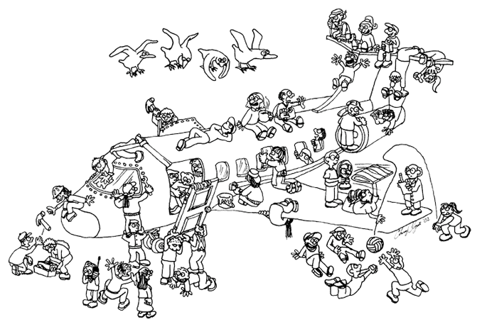
The Process…
“Building the Plane While Flying It”
Notes:
Before moving on, stop to see if there are any questions from index cards that are related to the information covered to this point

Slide 18
RFP Process and Original Awards
Originally funded 18 contracts – ASOs, Meals on Wheels
Added Volunteers of America, Local Health Departments, Linkage to Care
Eventually funded 26 different venues
Identified and reclassified Ryan White Service Categories – 11 originally and expanded to additional 4 (6 Core Medical Services, 9 Supportive Services) for a total of 17 RW Service Categories

Slide 19
Funding After Supplemental
Ryan White Care Act X07 Base Funds -- $14.7 million
State Funds (Tobacco Settlement) -- $2 million
Rebate Funds (340B) – Average $24 million
Supplemental Award- $26 million

Slide 20
Service Categories After Funding
Core Medical Services
AIDS Drug Assistance Program Treatments
Early Intervention Services (EIS)
Health Insurance Premium and Cost Sharing Assistance for Low-Income Individuals
Medical Case Management
Medical Nutrition Therapy
Mental Health Services
Outpatient/Ambulatory Health Services
Substance Abuse Outpatient Care
Supportive Services
Emergency Financial Assistance
Food Bank/Home Delivered Meals
Health Education/Risk Reduction
Housing
Medical Transportation
Non-Medical Case Management Services Psychosocial Support Services Substance Abuse Services (residential)
Outreach

Slide 21
OI and Local Consultants
Organizational Ideas National Consultants
Administrative
Programmatic
Fiscal
Data
Quality Management
Local Consultants
Agency capacity building and infrastructure
Program, Reporting and Monitoring
Executive capacity and leadership development

Slide 22
Building the Knowledge
Internal
Weekly meetings with OI team and Local Consultants
Continuous communication with Local Consultants
Multiple internal manager and staff meetings
External
Monthly TA Webinars with all subrecipients
Frequently Asked Questions via e-mail and now on website
Individual Site Check-in with all subrecipients – Local Consultant and ISDH
Hundreds of e-mails answered by ISDH, Local Consultants and OI team
Subrecipient meeting near end of grant cycle

Slide 23
PLWH Served in Indiana – December 2017 vs October 2018
Notes:
in December 2017, 2,538 clients were receiving primarily ADAP/Health insurance, and by October 2018, after building infrastructure, 2,832 clients were receiving ADAP/Health Insurance/some additional funded services.
ACAPS clients included in Care Coordination and in Ryan White Part B/ADAP Services columns. Anyone served by Care Coordination is in the Care Coordination section, and anyone served by ACAPS is in the group on the right.

Slide 24
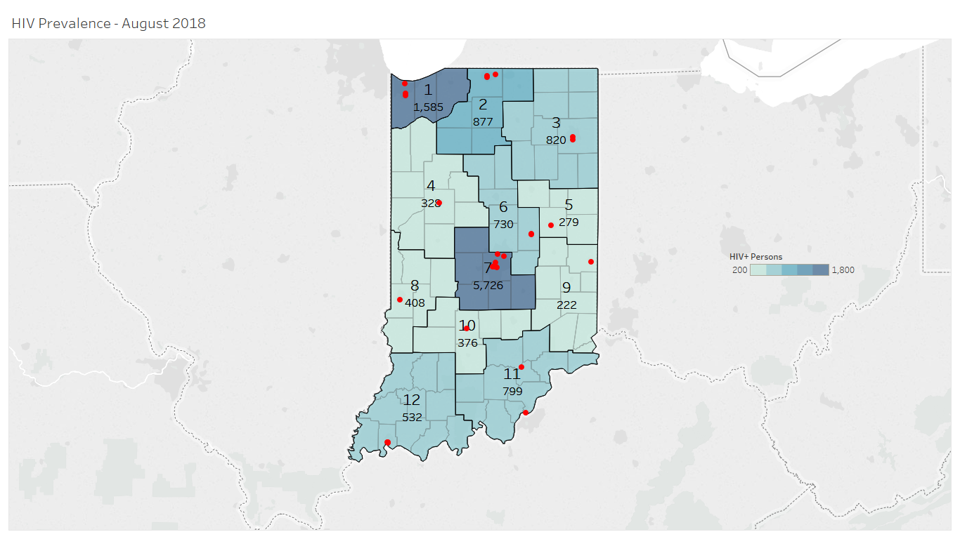
HIV Prevalence by Care Coordination Region – August 2018
Ryan White-funded
Agencies
Notes:
This is our HIV prevalence map, which simply shows where Indiana’s HIV positive people are living. You can also see the red dots, where we have care coordination sites. We often look at these to try to assess whether we are giving enough assistance, based on the patient load that each region has.

Slide 25
Programmatic Successes
Notes:
Before moving on, stop to see if there are any questions from index cards that are related to the information covered to this point

Slide 26
Infrastructure Development
Prior to Supplemental Award
3 Managers and 5.5 Staff
Lost 2 Managers in January and February, Quality Manager and Administrative Assistant positions open
After Supplemental Award
Filled one manager position and Administrative Assistant position early
Throughout summer added 12 positions
Revised reporting structure
Key positions – Associate Services Program Director, Ryan White Services Program Manager, Ryan White Services Specialist, Contract and Rebates Manager, Fiscal Field Analyst

Slide 28
Eligibility Crisis
Upon award, we were very excited to begin serving clients
There was just one thing- we didn’t have an eligibility policy or data tracking system in place
Leveraged existing eligibility process for Agency Claims Administration and Processing System (ACAPS) for use with Part B supplemental services
HIVe was born in March 2018 to enhance system for eligibility
Includes all required RSR demographic data elements
Discussions initiated with Part A/C recipient for CAREWare shared server
Notes:
Brittany: Slides 28-53

Slide 29
Indiana’s Eligibility Standards
Care Coordinator are the ones that enter the data an collect the initial eligibility documents
ISDH staff then take the information input into HIVe and issue an approval or denial based on supplied documents
At or below 300% of poverty level
HIV Positive
Indiana Resident
Must prove payer of last resort and Medicaid if eligible for services

Slide 30
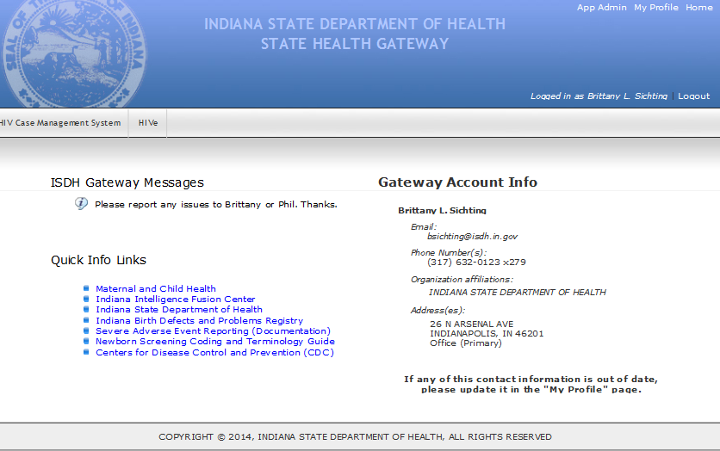

Slide 31
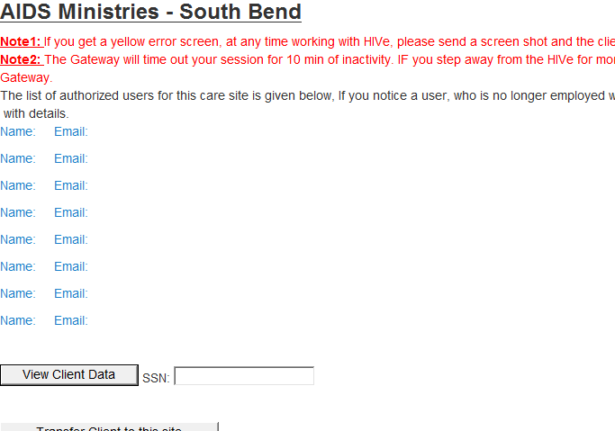

Slide 32
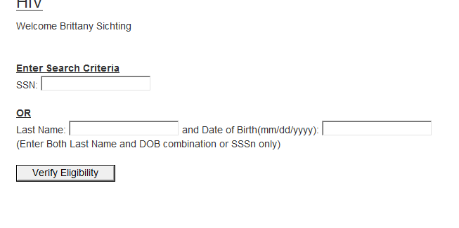

Slide 33
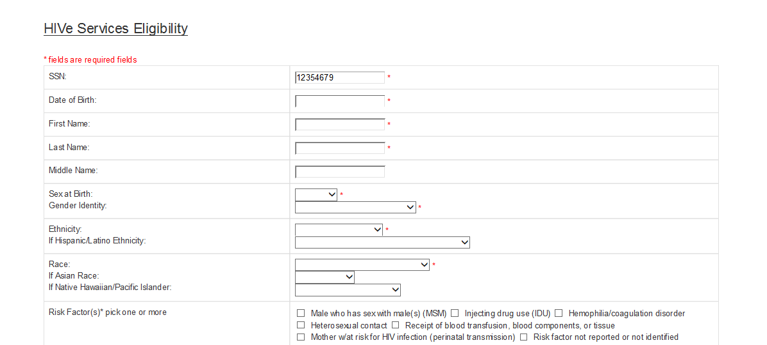

Slide 34
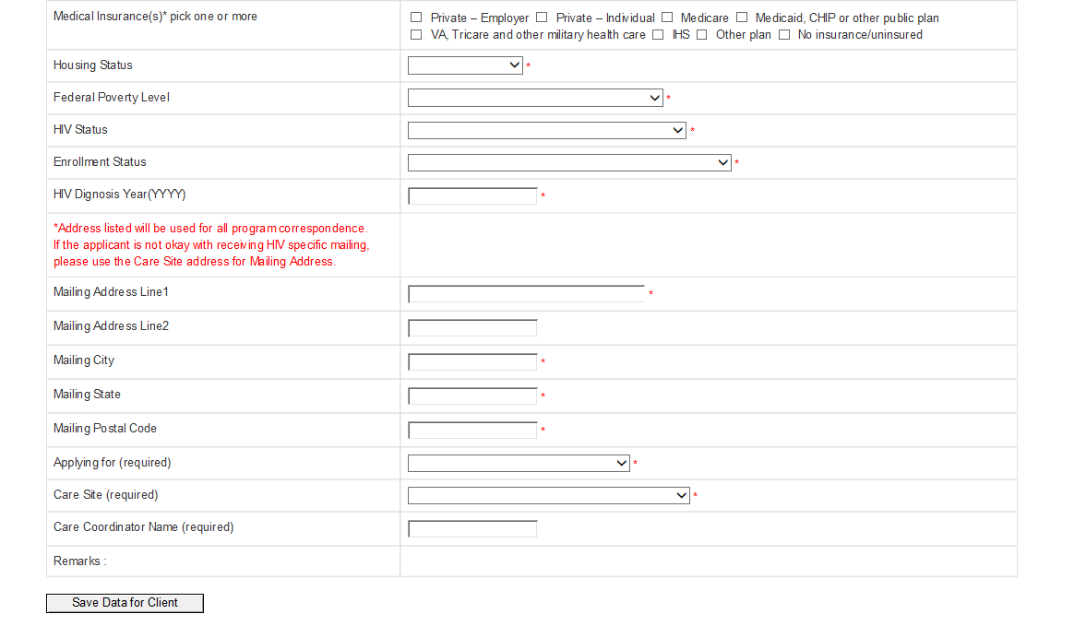

Slide 36
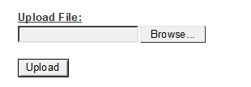

Slide 37
Policies & Procedures
Many policies & procedures had to be developed
Approximately 30 are now in place
Range of topics and issues are addressed, such as:
Client Eligibility Determination & Recertification
Allowable Use of Funds
Invoicing
Annual Subrecipient Monitoring
Notes:
Refer participants to the handout that provides the comprehensive list

Slide 38
Subrecipient Monitoring
We knew that with the standard of monitoring for Ryan White being so high, we would need to do an overhaul compared to what our care sites were used to.
We developed a schedule for three monitoring site visits over the course of two months.
We decided to break the visits down by small, medium, and large categories based on size, location, and funded services per agency.

Slide 39
What we Knew…
We had to:
Conduct one annual on-site Programmatic/ Administrative and Fiscal visit to providers (sub-recipients)
Monitor the sub-recipient program and uses of funding to check for compliance with federal requirements
Provide technical assistance and strengthen collaborative relationships with sub-recipients
Write a report of the visit and implement a corrective action plan if necessary

Slide 40
Goals to Relay to Subrecipients
It’s a Federal Requirement!
ISDH has a mandate to understand and check on the award monies that we give to our sub-recipients
ISDH must monitor to assure compliance with federal requirements and program objective
This process happens for EACH funded service category
Technical Assistance
Any findings in a monitoring site visit allow ISDH to provide on site assistance to help bring recipients into compliance.
Understanding Services
Funded services are great on paper, but we like to see them in action!
Monitoring allows programs to have showcase of new and innovative ideas that are working to serve HIV+ clients across the state.
Partnership Power!
There is power in understanding services being done across the state
Collaboration and Trust

Slide 41
Steps to the Visit: Step One
At least four weeks before the visit, we let them know who is coming onsite, the proposed dates of the visit, the list of documents needed, and our monitoring tool
There is a pre-screening tool used by ISDH staff to determine need and risk per site.
Two weeks before the visit, a call is set up
This call is to establish:
The purpose of visit
The site visit agenda
Determine if multiple sites need to be visits (satellite sites, administrative offices, etc.)
Discuss entrance/exit conferences and determine who should be present
Answer questions about requested documents
Confirm meeting with consumers (if this is something that is needed)
Review process for selecting client charts and making them available

Slide 42
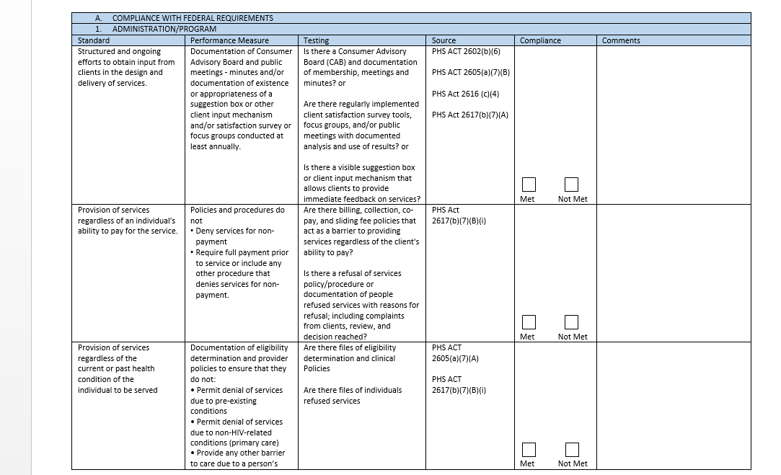

Slide 43
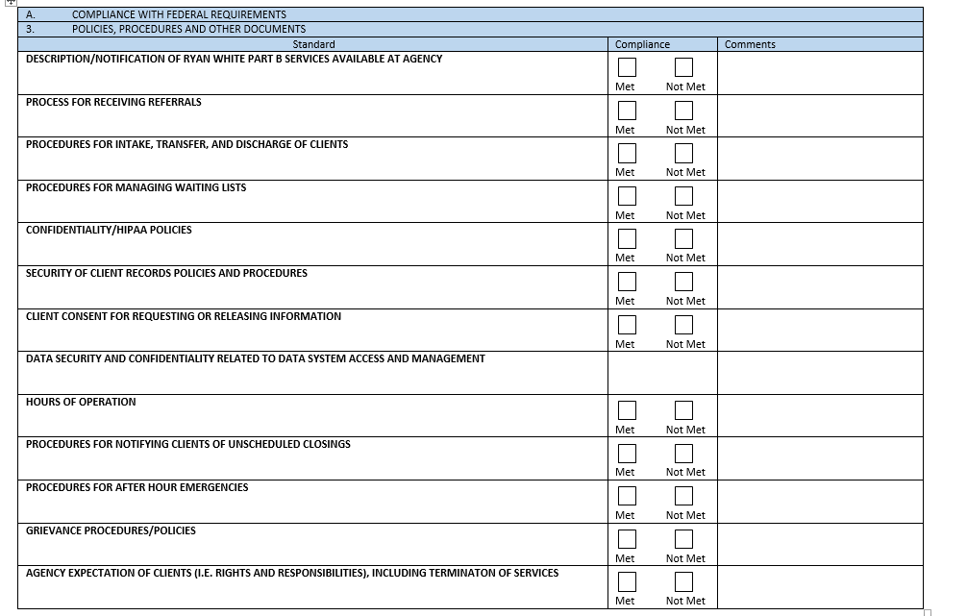

Slide 44
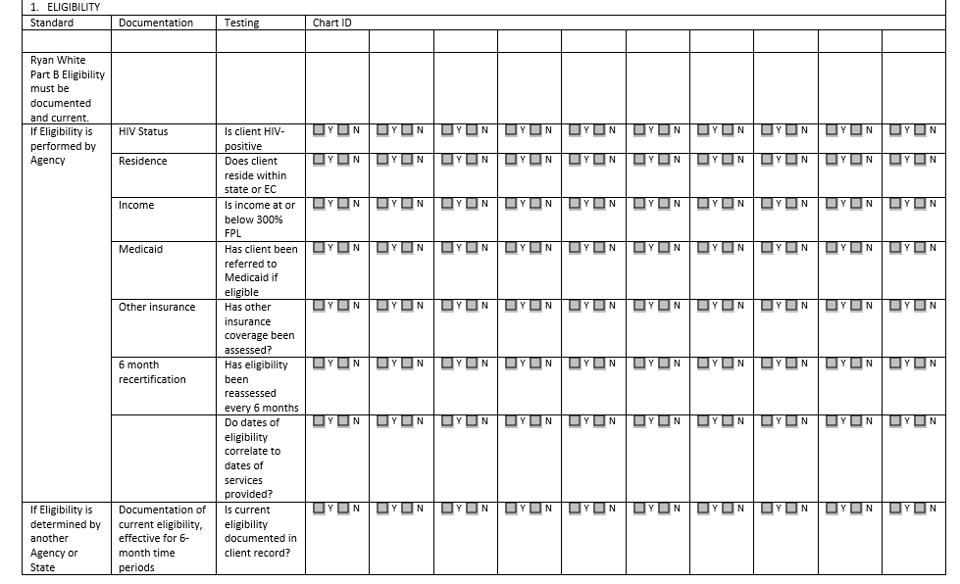

Slide 45
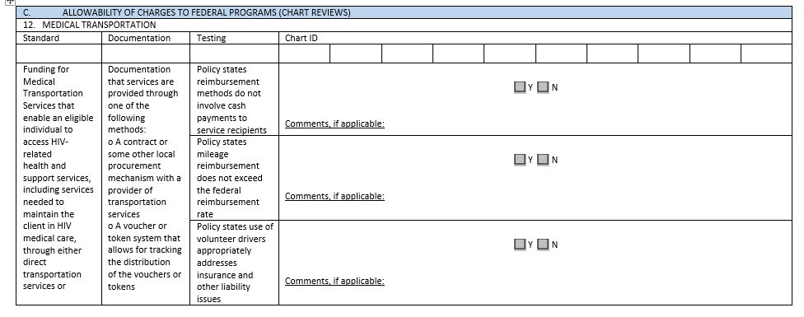

Slide 46
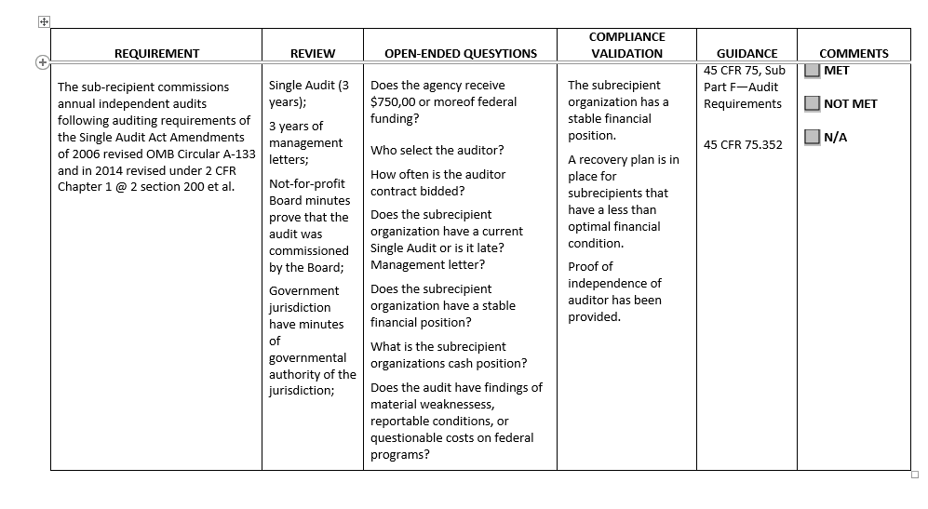

Slide 47
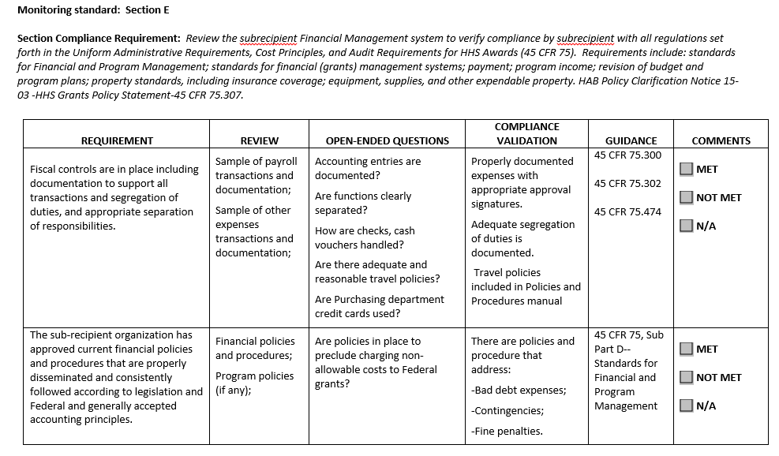

Slide 48
Steps to the Visit: Step Two
Entrance Meeting
ISDH reviews purpose of visit
Sub-recipient presents
1-hour agency overview
How Part B services have been implemented
Successes and challenges of the program
Monitoring Activities
Use review tools
Staff discussion and document review
Exit Meeting
Inform sub-recipient of compliance issues and opportunities for improvement
Make every effort to communicate findings that will be reflected in report – no surprises!

Slide 49
Day 1:
Entrance Conference ISDH: Introductions Purpose of the visit. Sub recipient: Provide an overview of the program, describing how Part B services have been implemented and any successes/challenges of the program. A short slide presentation is welcomed, but not necessary. | Recipient Staff: | ISDH HSP Site Visit Team:
10:00 AM – 10:30 AM | Tour of the Facility
10:30 AM – 12:00 PM Room Location: North Room, 1st floor | Concurrent Activities: Staff interviews and document reviews. For the purposes of this Pilot Phase Site Visit, the entire team will be involved with the Administrative and Fiscal review process. A typical site visit would have Administrative review and Fiscal review occurring in two separate rooms. Recommend we begin with Administrative/Programmatic Review, then to Fiscal Review, then to Chart Reviews over the course of the visit.

Slide 50
Steps to the Visit: Step Three
There is a blended discussion along with document review
We make note if there is a need for Technical Assistance
Compliance is checked with “Met”, “Not Met”, “Yes”, “No”
Partial compliance is noncompliance!
Client files will be requested for review
There is also a strong chance that we will want to sit with a group of clients
This focus group will allow clients to give their feedback on services, unmet needs, and any barriers they have

Slide 51
After the Visit
Monitoring reports will be compiled by ISDH
ISDH has 45 days from the last day of the visit to deliver the final report to the sub-recipient
These reports are generated and approved by ISDH leadership
Corrective Action Plan
To address findings in the monitoring reports sub-recipient will submit a CAP within 10 working days
ISDH approves/modifies the CAP within 7 working days and returns the plan to the sub-recipient
ISDH monitors resolution of corrective actions
Follow-up Visits
Site Visit Evaluation

Slide 52
What Have We Learned?
We all have a learning curve!
Ryan White funding has a lot of pieces, we need to work together to maintain
Our sub-recipients are very open to learn the process and very willing to help develop our monitoring process
We have a way to go yet.
We have completed three site visits so far, but ISDH’s training wheels are officially off!
We will begin to implement our system as we roll out the next sites to be monitored.

Slide 53
Next Steps
ISDH is developing a policy and site visit schedule
We are waiting for approval about a site visit exemption
Quality management is an upcoming development that will be reflected on monitoring site visits
ISDH will be in contact with each sub-recipient to give them their monitoring timeline

Slide 54
Accomplishments
Notes:
Before moving on, stop to see if there are any questions from index cards that are related to the information covered to this point
Mark: Slide 54-61

Slide 55
ISDH
Allocated more than $13M to expand and create services
Across 17 service categories and 25 agencies
Created a data system to improve information exchange between recipient, subrecipients and Care Coordinators
Increased staffing level
Created a technical assistance team of national experts and state consultants
Enhanced knowledge, training and trusting relationships with subrecipients
Initiated service integration with Prevention and STD Operations

Slide 56
Administrative
Developed key policies and procedures
Established weekly team calls
ISDH, OI and state consultants
Updated subrecipient contracts to ensure federal compliance
Implemented monthly subrecipient progress reports

Slide 57
Programmatic
Developed eligibility determination process for services
Created internal tools to track contracts and allocations
Mapped funded subrecipient activities to RWHAP Service Categories

Slide 58
Fiscal
Developed key policies and procedures
Established a subrecipient risk assessment tool
Established subrecipient invoicing and reimbursement process
Developed internal tools to track subrecipient budgets

Slide 59
Data Management
Provided high level review of data reporting requirements
Conducted provider assessment regarding data collection reporting activities
Developed interim data collection process & tool
Foundational work for establishing ISDH-approved data system
Consulted with other states regarding approaches to data collection
Initiated discussions with Marion County about possible collaboration
Engaged ISDH IT, Data Security and legal representation into review of potential data systems
Conducted meetings with vendors to discuss data system implementation
Developed subservices and service units for use in data system

Slide 60
Monitoring and Reporting Requirements
CAREWare Implementation
Shared ISDH/Marion County data collection system
Data will be required to be entered by the 15th of the month following the provision of services.
Includes all required data elements (see your handout for details)
Training will be provided
Estimated implementation is early-mid 2019
Monthly Subrecipient Webinars will continue and are a great place to stay up-to-date about requirements

Slide 61
Quality Management
Developed IN Statewide QM plan
Outlines structure for CQM in Indiana across Division Programs
Delineates infrastructure, performance measurement and quality improvement
Established Subcommittee of the Indiana HIV/STD Advisory Committee
Developed performance measures
Notes:
Lori: 61-69
QM plan:
Lays out the structure for CQM in Indiana across Division Programs
Internal activities (Internal QM team, capacity building, etc.)
External (QM committee, capacity building, etc.)
Brings subrecipient expectations to life through narratives and tables
Infrastructure
Performance Measurement
Quality Improvement
QM Cmte
Established Subcommittee of the Indiana HIV/STD Advisory Committee
Created in August 2018
Made up of subrecipients, consumers, and other stakeholders
Includes participants from all regions, all Division Programs, and is demographically diverse

Slide 62
Quality Milestones
CQM Element | Fall 2017 | Fall 2018
Statewide QM Plan |  | REVIEW
Internal QM Team
Statewide QM Committee
Statewide QM Performance Measurement |  | CAREWare
Statewide QI Projects |  | PRE-PLANNING
Staff Training in QM |  | MORE TO COME!
Subrecipient Training in QM |  | MORE TO COME!
Consumer Involvement in QM
Cross-Part Involvement in QM

Slide 63
Website Development
Notes:
Review these slides quickly. Focus is on the more general categories of information rather than specific items.

Slide 64
Before and After
Our old website had two purposes:
To show where you could get HIV testing and care
To update you on the services you could get once an HIV+ diagnoses was delivered
The new website does the following:
It is still a guidebook for services, but there are very detailed services listed and where to find them
There are resources for our sub recipients including the monitoring tool, polices, procedures, and TA resources
We have access to our live FAQ document currently up to 16 pages
We also have access to our subrecipient manual online

Slide 66
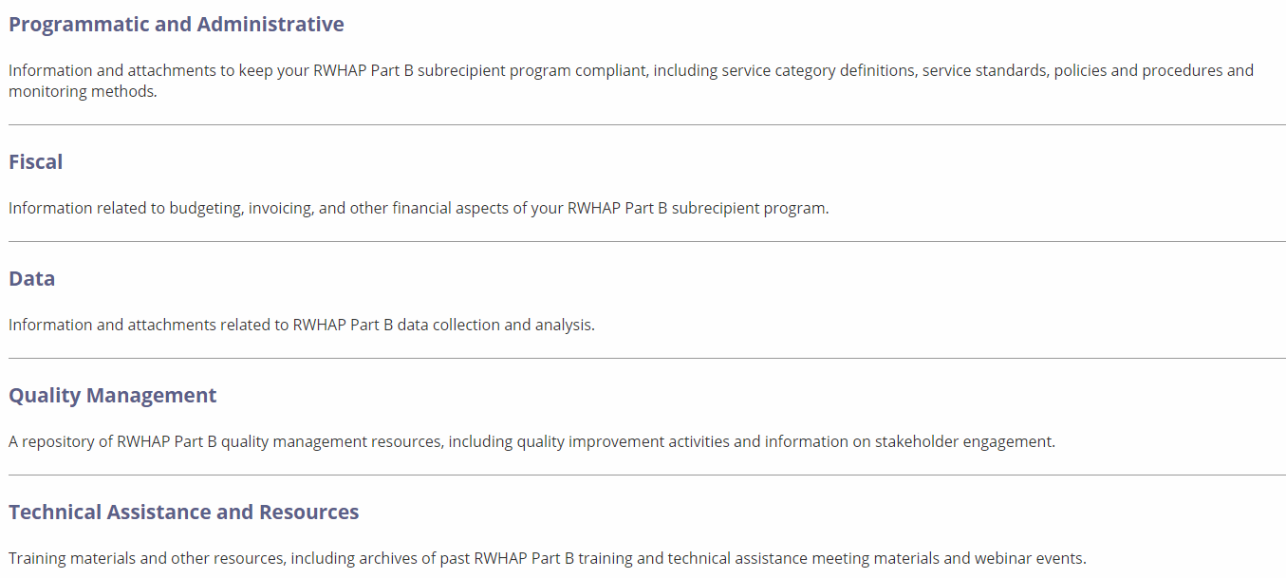

Slide 68
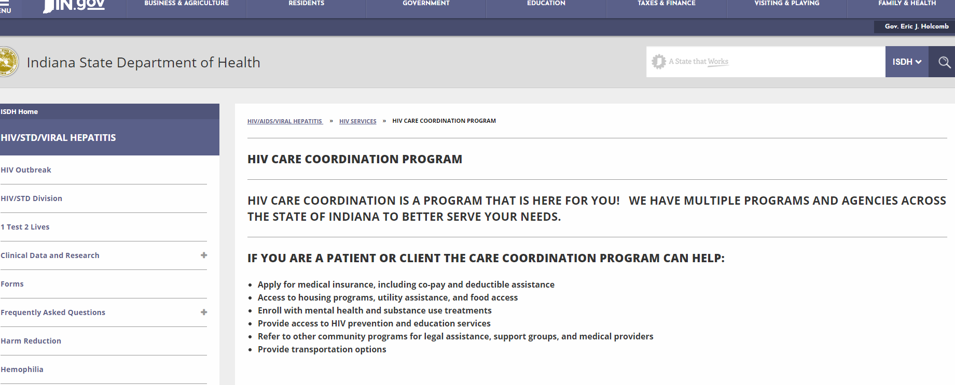

Slide 69
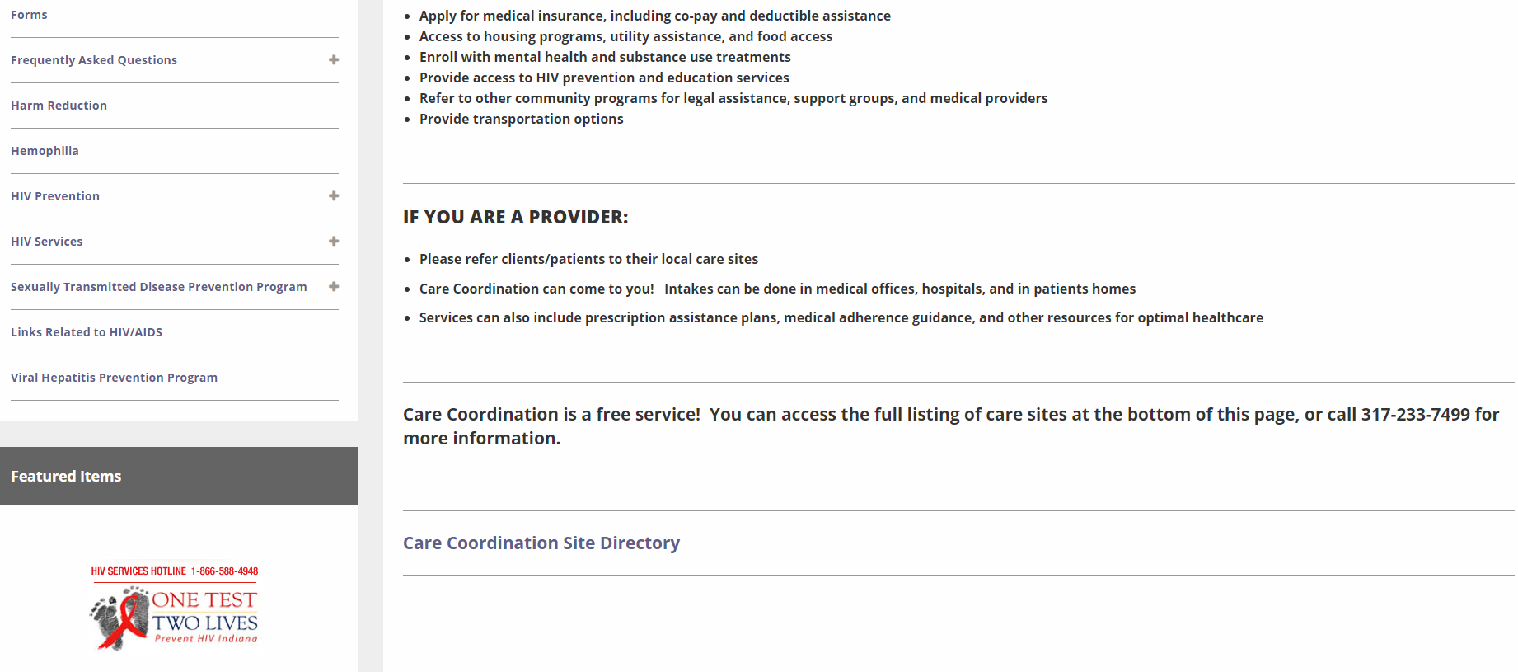

Slide 70
Cross Cutting Accomplishments
Notes:
Brittany: 70-71

Slide 71
Annual Subrecipient Monitoring
Developed Monitoring Procedure and Templates
Developed Administrative and Fiscal Monitoring Tools
Piloted Subrecipient Monitoring
Selected a “small”, “medium” and “large” subrecipient
OI led initial visits, transitioning to ISDH facilitating the process
Further strengthened collaborative approach with and support of subrecipients
Emphasized visits as TA visits as well as compliance visits

Slide 72
Subrecipient Training and Relationships
Subrecipient Training
Monthly subrecipient webinars
Training topics included QM, RWHAP concepts, compliance requirements
Videoconferencing (Zoom)
Recipient Training
OI led training for all ISDH staff in “kickoff” meeting
RWHAP basics for Prevention and STD staff and subrecipients
QM training
Fiscal and accounting concepts
Technical assistance “on demand” to recipient staff
Notes:
Brittany & Lori: Slides 72-73

Slide 73
Information Dissemination
Subrecipient Manual
Website
Primary source of guidance, resources and information
Frequently Asked Questions (FAQs)
Included questions raised directly by subrecipients
Statewide Subrecipient Meeting

Slide 74
Future Opportunities
Notes:
Mark: Slides 74-80

Slide 75
Keeping Up With the Rapid Growth
ISDH capacity
Staff skills and training
Staff recruitment and retention
Changing Organizational Chart and Staff Roles
Data systems, reporting and management
Contract Management
Subrecipient capacity
Fiscal systems
Managing multiple funding streams
Administrative infrastructure
Provider recruitment and training

Slide 76
Division-Wide Integration
Integrating processes and expectations
HIV services, ADAP, HIV Prevention, STD Operations
Subrecipient monitoring
Annual and ongoing
Subrecipient contracts
Quality Management Plan and participation
Statewide eligibility process
Service Standards

Slide 77
Statewide Collaboration and Integration
All RWHAP Parts Eligibility
All RWHAP Parts Quality Management
Service Standards
Data systems
Statewide service and program planning

Slide 78
Next Steps
Continue building collaboration across agencies
Regional Continuum of Care Committees
Create Service Standards
Continue building “One Stop Shop” service model
New service categories are being considered
Legal, Linguistics and Medical Transportation
Notes:
Mark

Slide 79
Next Steps
Provide financial, accounting and budgeting TA to agencies
Continue utilizing consultants for further TA and capacity building
Add “best practices” area to ISDH website
Continue TA webinars
Create virtual forums to develop collaboration & networking among agencies
Quarterly subrecipient meetings
Notes:
Mark

Slide 80
Next Steps
Continue development of Quality Management Program
Establish subrecipient monitoring visit schedule
Utilize Advisory Council for needs & feedback
Develop ideas and plans for an “End the Epidemic” Campaign
Develop a program to identify and eliminate HepC in co-infected PLWH
Notes:
Mark

Slide 81
How We Survived
Keep in mind, the majority of this work was accomplished in 9 months and services have only been actively in place for 4 or 5 months…
How did we do it?
Commitment and dedication of staff
Support from within ISDH to execute contracts and expand staff
Combined efforts of consultants with national expertise and local consultants who understand nuances and providers of HIV Care in Indiana
Weekly planning calls
Ryan White subrecipient interest, engagement, patience and dedication
HRSA/HAB support (encouragement, clarification and FUNDING)
Notes:
All: Slide 81

Slide 82
Program Lessons Learned
Be realistic about capacity
Ask for help when needed – value experience
Terminology matters
Network and collaborate locally, state-wide and nationally
Utilize the experience and advice of your Project Officer
Think outside the box
Don’t lose sight of the big picture
Allot time for yourself
Notes:
Mark & Brittany: Slide 82

Slide 83
The Continuum of HIV Care, Indiana, Dec. 2017 and Aug. 2018
87% Aware of HIV Status
69%
70%
65%
60%
58%
58%
Notes:
Mark: Slide 83
HIV-Newly Diagnosed: annual newly reported cases
HIV-Prevalence: all Persons Living with HIV/AIDS
Linked to Care: based on CD4/VL within 3 months of diagnosis
Retained to Care: based on having an annual CD4/VL
Suppressed VL: based on most recent CD4/VL
Unmet Need: based on no reported annual CD4/VL

Slide 84
Notes:
Lori: Slides 84-86

Slide 85
Mark Schwering Brittany Sichting Lori DeLorenzo, RN, MSN
Mschwering@isdh.IN.gov Bsichting@isdh.IN.gov loridelorenzo@comcast.net

Slide 86
Obtaining CME/CE Credit
If you would like to receive continuing education credit for this activity, please visit:
http://ryanwhite.cds.pesgce.com

