Slide 1


Slide 2
Ending the Epidemic: Maximizing Communication between
Program and Evaluation to Strengthen the Care Continuum

Slide 3
Learning Objectives
Highlight communication approaches for evaluation-to-program feedback that will inform program service delivery and ensure mutual investment in the quality of data reporting.
Learn new approaches to encourage providers of HIV medical and support services to help PLWH engage in care and initiate and adhere to ART to achieve viral load suppression.
Identify the potential (and specific roles/responsibilities) of providers from a range of different HIV service settings for supporting viral load suppression among PLWH.

Slide 4
The Undetectable Framework: Using Quality Improvement to Achieve 90-90-90 Targets
Jacinthe Thomas, MPH and Graham Harriman, MA, Jennifer Carmona, MPH, and Mary Irvine, DrPh, MPH
Care and Treatment Program, NYC Department of Health and Mental Hygiene

Slide 5
Outline
EtE Blueprint and Strategy
  Brief background information
NYC DOHMH Efforts to End the Epidemic
NYC Ryan White Part A Undetectable Framework
  Treatment Status Report (TSR)
  Agency Viral Load suppression Report (AVSR)
Steps in Strengthening the Care Continuum

Slide 6

Ending the Epidemic
On June 29, 2014, Governor Andrew M. Cuomo announced a three-point plan to end the AIDS epidemic in New York State
Designed by a task force that included a significant number of community and government leaders from NYC
Goals/pillars of the plan
  Identify persons with HIV who remain undiagnosed and link them to health care;
  Link and retain persons diagnosed with HIV to health care and get them on anti-retroviral therapy to maximize HIV virus suppression so they remain healthy and prevent further transmission; and
  Facilitate access to Pre-Exposure Prophylaxis (PrEP) and non-occupational post-exposure prophylaxis (n-PEP) for high-risk persons to keep them HIV-negative

Slide 7
New York City EtE Plan
  Transform STD clinics
      Make STD clinics “Destination Clinics” for Sexual Health Services
      Make Sexual Health Clinics Efficient Hubs for HIV Treatment and Prevention
  Launch PrEP and Repair the nPEP Delivery System
  Support Priority Populations Using Novel Strategies
  Take NYC Viral Suppression from Good to Excellent
  Make NYC Status Neutral

Slide 8
Bureau of HIV and AIDS Prevention and Control
Care and Treatment Program - Undetectable efforts
Branding and Social Marketing
Be , Play, and Stay HIV Sure campaigns, U=U
Engagement of Clinical Providers
Managing and Sharing Data
Use Primary Care Status Measures (PCSM) data to ensure all PLWH have opportunity for ART Initiation and VLS
Use Care Continuum Dashboards (CCDs) to report to providers on success and opportunities for improvement
Using Data for Quality Improvement
Help providers better manage and use data

Slide 9


“

Slide 10
The Undetectable Framework for Ryan White Part A Programs
NYC DOHMH Care and Treatment Program
Technical Assistance
Service Standards
Treatment Status Report
Agency VL Suppression Report
Ryan White Part A Funded Agencies
Improved Core and Support Services
Undetectable Viral Load

Slide 11
Ryan White Part A Contractor Role
Leverage Each Opportunity to Optimize Individual and Community Health
  Collect Primary Care Status data (Care appointments, Viral Load, CD4, ART status, ART adherence, every 120 days)
  Talk with clients about Viral Load Suppression and ART adherence
  Identify barriers to ART adherence and VLS and provide support and/or refer clients
  Follow-up to ensure success

Slide 12
Treatment Status Report (TSR)
A line-level dashboard that flags clients:
  who are overdue for a viral load test result update in eSHARE; or
  who were not virally suppressed as of their last viral load test results update
For flagged clients, the report displays whether or not the client has been prescribed ART, and if not, the reason
Data are filterable by service category, agency, and client ID
Data in the dashboard refresh automatically on a monthly basis
Dashboard is available to all Ryan White Part A quality management specialists and is sent to providers on a quarterly basis

Slide 13
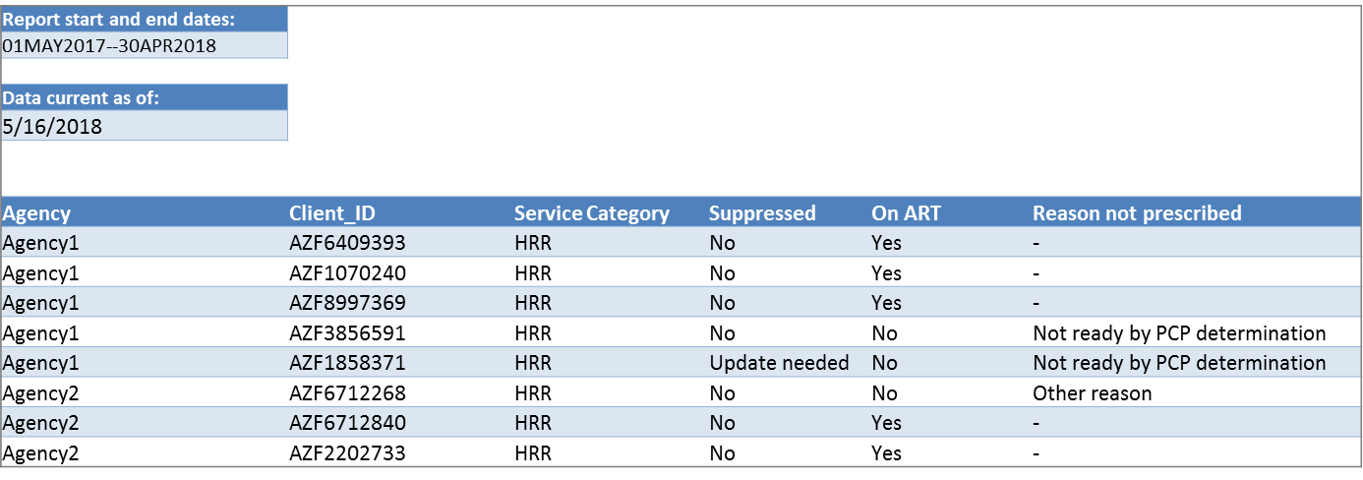
TSR Screenshot

Slide 14
Description of TSR Variables
Variable | Description | Categories
Clientsysid | Client system ID | N/A
Target Met? | Is client virally suppressed (VL ≤ 200 copies/mL)? | No = client does not have VL ≤ 200 copies/mL at most recent documented test Update Needed = client did not have any VL value documented within the past year
On Meds? | Has the client been prescribed ARVs? | Yes = client has been prescribed ARV at most recent assessment No = client has not been prescribed ARV at most recent assessment Update Needed = client did not have an ARV status update in the past year
Reason Not On? | Why has the client not been prescribed ARVs? | Not medically indicated Not ready – by PCP determination Intolerance/side effects/toxicity Payment/insurance/cost issue Client refused Other reason Unknown

Slide 15
Agency Viral Load Suppression Report
(AVSR) - Rationale
RWPA-funded programs contribute to helping PLWH remain engaged in care and adherent to treatment, in order to achieve viral suppression and better health.
Some services address this more directly than others, but all play an important role.
The AVSR is intended as a surveillance-based “snapshot” to help providers understand the viral suppression of their RWPA client population, and compare results between years and/or between their RWPA client population and a larger RWPA population.

Slide 16
What is covered on the ASVR?
Proportion of virally suppressed RWPA clients per calendar year within agency
Proportion of virally suppressed RWPA clients per calendar year across NYC

Slide 17
Where does the VL data come from?
Viral load (VL) data obtained from the NYC HIV surveillance registry
NYC HIV Surveillance Registry
  Named reports of all persons diagnosed with HIV and/or AIDS in NYC
  All HIV-related laboratory tests ordered by NYC providers including (but not limited to):
    CD4 T cell counts
    HIV viral load quantities

Slide 18
AVSR: Definitions
Eligible clients (for each calendar year)
  RWPA-Wide
    Enrolled in at least one RWPA-funded program for at least one day
    Received at least one service
  Agency-specific
    Enrolled in at least one RWPA-funded program for at least one day at that agency
    Received at least one service at that agency
Virally suppressed
  Latest viral load lab test result within the calendar year was ≤200 copies/mL

Slide 19
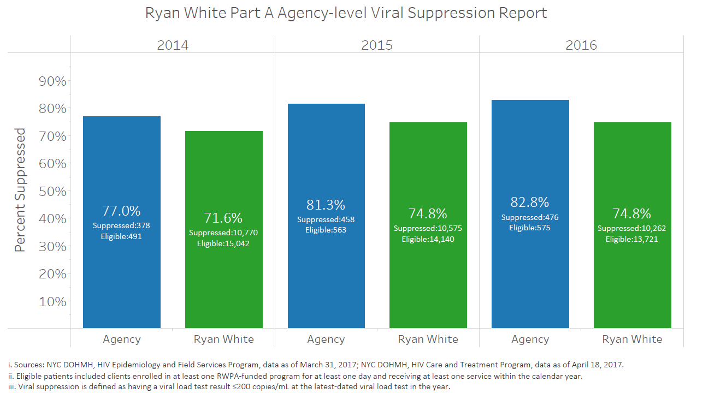
AVSR Screenshot

Slide 20
Interpretations and Limitations of AVSR
Many factors can contribute to an individual’s viral suppression status (beyond their involvement in program X at agency Y)
Viral suppression levels may be low for clients at agencies focused on reaching the most vulnerable individuals, and especially those bringing in a high volume of new clients
The report may be most useful in terms of reviewing trends over time, and comparing agency to RWPA overall trends

Slide 21
Next Steps in Strengthening the Care Continuum
Extensions of the AVSR to expand its utility
  Sub-reports on VL suppression among new versus established clients
  Breakouts of VL suppression by client demographics
Continued communication with programs about using the reports to facilitate coordination among RWPA service providers, clinicians and clients to support desired treatment outcomes

Slide 22

Acknowledgements
NY Eligible Metropolitan Area Ryan White Part A service providers and clients
Kizzi Belfon, MPH
Stephen Hile,
Sarah Braunstein, PhD, MPH

Slide 23

Questions or Other Suggestions?

Slide 25
Using the HIV Care Continuum: Implementing Standardized Health Outcome Measurements in a Social Service Organization
Alexa Kreisberg, MPH
Director, Monitoring & Evaluation
Gay Men’s Health Crisis (GMHC)
New York City, New York

Slide 26

GMHC
Mid-size AIDS service organization
Founded in 1982
Serves over 13,000 individuals living with or affected by HIV/AIDS
Programs include mental health, substance use, care coordination, legal services, housing, meals & nutritional services, HIV/STI testing, etc.
Notes:
GMHC, or Gay Men’s Health Crisis, was founded in 1982 and we are a mid-size AIDS service organization with a little over 250 employees. We serve over 13,000 individuals living with or affected by HIV/AIDS. We have mental health, substance use, care coordination, HIV testing, housing, amongst a lot of other programs.

Slide 27
Background
2016 – GMHC began a viral suppression campaign called Target Zero
Primary Care Status Measures (PCSM) are collected from clients every six months
  Last Primary Care Visit
  ARV Status
  Viral Load & CD4 Count
Unsuppressed and out care clients are referred to medical care and service providers coordinate warm handoffs
GMHC uses the HIV Care Continuum to identify gaps in services as well as a data QA tool
Notes:
At the end of 2016, GMHC began engaging in an initiative called Target Zero with the goal of increasing the number of clients who have undetectable viral loads.
In this initiative, care providers ask clients for their “primary care status measures,” which are markers for each level of the cascade, every six months.
If clients are not engaged in care or facing barriers to care, providers give referrals and coordinate warm handoffs to other services.
The HIV care continuum is often used to identify gaps in services, but GMHC is also using it as a tool to QA the initiative implementation. This allows us to identify gaps in data collection and to monitor the validity and reliability of the data that we report.

Slide 28

Implementation
Brainstorming with clients and staff
Data entry training for staff & volunteers
Determining Inclusion/Exclusion Criteria
Semi-annual (or more frequent) data collection & entry
Marketing
Quarterly monitoring
Referrals

Slide 29
Logic Model
Inputs
Sense of community around ending the epidemic
Clients feel empowered to take control of their health
GMHC will be able to talk about impact
Increased engagement in care
Undetectable viral loads
Increased adherence
Increased linkage to care
Clients know their HIV-related health information
Outcomes
Referrals to PCP, coordinated care, support services
Quarterly reporting
Data entry into EHR
Outputs
Trainings for Volunteers (HIPAA, EHR, health literacy)
Quarterly monitoring
Marketing
Referrals
Consultation Sessions
Semi-annual (or more frequent) data collection & entry
Activities
Volunteers
Target Zero App
Standard Forms
Computer Lab
EHR
Staff
Notes:
We are currently using a volunteer to assist clients in accessing their medical information, navigating patient portals, talking with their doctors and discussing any barriers to care.
In order to monitor progress, GMHC created an agency specific HIV care cascade. This data was collected for the end of 2016 as baseline data and is collected quarterly moving forward.

Slide 30
Baseline

Slide 31
Quality Improvement Activities
Changes to electronic health record to better capture data
Data entry training
HIV Care Continuum education for all staff
Standardized Form
Client lists for outreach
Referral training

Slide 32
Where We Are Now

Slide 33
Challenges
Data Quality
Competing Priorities & Staff Time
Resistant Participants
Non-clinical program working with clinical information
Inclusion/Exclusion Criteria

Slide 34
Seamless Evaluation: How to Integrate Evaluation in Program Activities to Enhance the Client Experience
Dr. John Guidry, PhD
Lead SPNS Evaluator
Gay Men’s Health Crisis (GMHC)
New York City, New York

Slide 35

Background & Purpose
Project HEALTH is a comprehensive care coordination program to improve HIV health outcomes.
Project HEALTH aims to mitigate structural, clinical, and individual factors that prevent engagement in care, participation in the workforce, housing stability, and viral suppression.
Project HEALTH is funded through HRSA's Special Projects of National Significance (SPNS), therefore, has a significant evaluation component.

Slide 36
Evaluation Goals
Ensure clients are fully aware of program activities and what is required of their participation
Ensure that clients are aware that the program is a special program that is part of a national cross-site evaluation
Ensure that clients understand that their involvement in the program may contribute to developing and refining new programs
Provide program staff and evaluation staff with a common and transparent process for bringing clients into the program, welcoming them, and helping them to understand the program

Slide 37
Strategy
Ensure that all enrollees provide contact information and alternate contact information that will be crucial to their retention in the program.
Create a method of collecting and transmitting program data between program and evaluation that is transparent and comprehensive, with built-in redundancies that ensure no information will be lost in the course of program implementation.
Construct a program enrollment and consent process that supports and complies with the cross-site evaluation protocols provided by the ETAP.
Evaluation will maintain a program tickler with dates for enrollment, consent, HIPAA release, date of first service, date of baseline survey, and projected dates and windows for all follow-up surveys (at 3, 6, 12, and 18 months).

Slide 38
Challenges
Client no shows
Staff turn-over
Balance between program and evaluation staff
  Limited research staff to consent and survey
Gathering medical information
  Major hospitals recognizing HIPAAs
  Medical providers slow to provide medical information to social service providers

Slide 39
Next Steps
Hiring research assistants
Expanding evaluation staff availability for consent and surveys
Coordinating with medical providers
Evaluation team will develop a plan to provide evaluation findings to program staff in timely manner, so that findings are used to strengthen and improve implementation
  Qualitative interviews will provide quicker and more useful feedback for program improvement

