Slide 1

Expediting Specialty Referrals to
Reduce Disparities in HIV Outcomes:
The Patient Navigator Role
Vanesa Lauradin, Patient Navigator, BA
Notes:
I will be focusing on how patient navigators can help improve health outcomes with non-HIV illnesses and how PN treat patients holistically when expediting specialty appointments

Slide 2
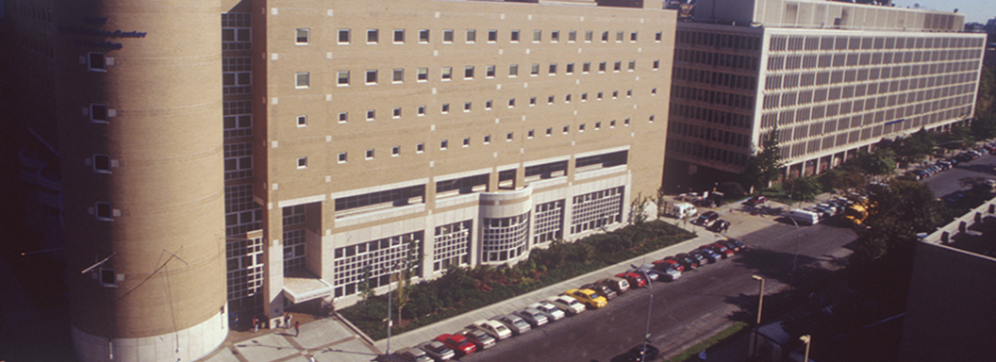
STAR Program
Achieve Health Equity through
  Quality Care
  Education and Research
  Community Empowerment
Notes:
1991- STAR Program was establish with the overall goal of integrating HIV-related care, research and clinical education.

Slide 3
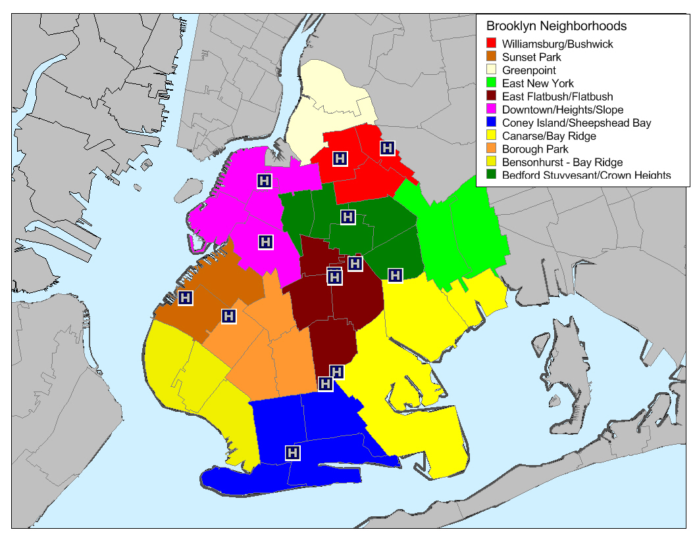
Brooklyn Communities
Greenpoint
Williamsburg/
Bushwick
Downtown/
Heights/Slope
Bedford Stuyvesant
East New York
Sunset Park
East Flatbush/
Flatbush
Canarsie
Borough Park
Bensonhurst
Bay Ridge
Coney Island/
Sheepshead Bay
Source: United Hospital Fund

Slide 4

Community Setting
Notes:
High immigrant urban community including many people of Caribbean descent; low socioeconomic status

Slide 5
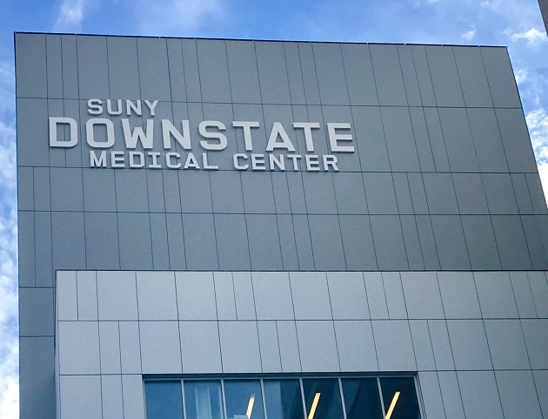
STAR Health Center
Primary care
HIV treatment
PEP/PrEP
HCV screening/ treatment
Behavioral Health
Nutrition
LGBTQ Health Initiative
Notes:
Clinic patient population—currently 50% of our HIV population in STAR is 50years or older (600pts)
--Clinical Pharmacist—we have clinical pharmacist in clinic 5 days a week to address complicated medication profiles
--All MDs are boarded in IM/ID—familiar with complex cases
--Psychiatrist specializes in consult liaison psychiatry and neuropsychiatric conditions
--Neuropsych testing is available in SUNY
--SUNY also has Geriatric specific resources such as Alzheimers unit, and wheelchair clinic
--Wide array of supportive services: case management, MH counseling, patient navigation, clinical pharmacist, nutrition, psychiatric, phlebotomy, HCV, Prep-PEP, --all co-located; and within Downstate—radiology, and medical/surgical subspecialties

Slide 6

RW-A Care Coordination
Notes:
STAR Patient Navigators, belonging to our Ryan White Part A Care Coordination Program HIV medical case management program.
The STAR Program at University Hospital Brooklyn utilizes Patient Navigators to join with PLWHAs to enhance self-management of HIV disease and closely monitor completion of specialty referrals.
Patient navigation ensures linkage to and engagement in needed medical or specialty care, mental health, harm reduction/substance use services, and social services. An important part of patient navigation is assessing social services and benefits needs.
Housing instability, food insecurity, lack of transportation, lack of medical insurance, and other barriers may impact a patient’s ability to manage their own care. Moreover, accompaniment to scheduled medical and social support service appointments has been shown to reduce mortality and depression while improving retention in care, viral suppression, and mental health.

Slide 7
Eligibility Criteria For Care Coordination
Newly diagnosed with HIV within past 12 months
Unsuppressed viral load within past 12 months
New to HIV care
Out of care for at least 9 months
Pregnant
Change in ART regimen
Other high risk for falling out of care

Slide 8
Clinical issue
Non-AIDS medical conditions occur more often and are associated with a greater risk of death than AIDS
Close coordination of specialty referrals is imperative to reduce disparities in morbidity and mortality

Slide 9
Co-Morbidities In HIV Patients
Higher rates with PLWHIV
  Cardiovascular disease
  Kidney disease
  Osteoporosis and fractures
Similar rates with HIV-negative people
  Hypertension
  High Cholesterol
  Endocrine disease
    Diabetes
Notes:
http://www.aidsmap.com/Co-morbidities-are-common-and-rising-among-people-with-HIV-in-the-US/page/3105593/
Hsue P et al (Song X presenting). A longitudinal analysis of comorbidities among human immunodeficiency virus (HIV) patients and matched non-HIV controls in the USA. IDWeek, New Orleans, abstract 950, 2016.

Slide 10
“I am HIV Positive, Now What?”
Why don’t patients go to their specialty appointments?
How are they at risk to falling out of care?
Notes:
Lack of understanding
Believe one doctor should be able to treat everything
Too ill to go to specialty appointments.

Slide 11
Patient Barriers
Lack of health literacy
Low socioeconomic status
Fear or/and overwhelmed by new diagnosis
Lack of time/ Inconvenient hours
Transportation issues
Unstable living situation-i.e. homelessness
No working phone
Out-of-network providers
Notes:
No telephone

Slide 12
Patient Barriers
Immigration status
Drug addiction
Mental health issues
Cultural barrier
Language barrier
Specialty provider not LGBTQ friendly
Lack of social support
Mistrust of health care system

Slide 13
Provider Barriers
Pt is uninsured/ lack Insurance coverage
Medicaid & Medicare
Long wait time for specialty appointments
Lack of communication with providers within hospital systems
Notes:
Pt SS-Needs to go a movement clinic, next available appointment is 4 months from now

Slide 14
Role of Patient Navigator
Facilitate Team-Based Care
Assessment of patients
  Needs
  Ability
Logistics
Closely monitor completion of specialty referrals

Slide 15
How PNs Expedite Specialty Referrals: Holistic Approach
Remind patients of the purpose of the appointments via Health Promotion Sessions
Listen to patients reasons behind their resistance
Inform PCP of any other symptoms patients are experiencing
Connect to resources & social support
Accompanying patients to the specialty
Advocate for patients
Notes:
PN are a vital component in amplifying the patient’s voice throughout the referral process, and in addressing barriers to successful completion and follow up.
Engaging pt in their own care

Slide 16
PN Attributes in Expediting Specialty Appointments
Being patient
Ability multi-tasking and retain information about pt’s medical & social history
Effective communication skills
  Building relationships
Culturally Competence
Motivational Interviewing
Notes:
When working with multiple specialties, navigators must develop these characteristics

Slide 17

Honoring Autonomy…
Notes:
Motivational Interviewing Values: Autonomy, Relatedness and Competence
A Navigator will describe how facilitating patient autonomy is critical to improving retention in care and reducing health disparities in morbidity and mortality.

Slide 18
Case Study: Patient W
65 year-old African American woman
HIV+ for 20 years from heterosexual contact
Dialysis for 17 years
Non-adherent to ART treatment
Medical issues include
  kidney failure, Non-obstructive coronary artery disease, COPD/asthma, high cholesterol, gastro-esophageal reflux disease, osteoarthritis
Notes:
What is the patient main priority in terms of her health?
Which medical issue does the patient navigator start with?
Does Patient W have social support ?
How does a PN evaluate strengths of a patient?
What can she do on her own?
What is willing to do on her own?
How does PN develop relationship with patient W?

Slide 19
Challenges
Medical Challenges
  Dialysis
    Limited appointment time
  Cancer and Surgeries
  Mental Health
Social Barriers
  HIV status revealed by family
    Lack of Trust
  Isolated

Slide 20
Patient W’s Strengths
Willing to go to specialty appointments when motivated
    Memorial Sloan Kettering
Asks a lot of questions
Can provide some of her medical history to providers on her own.
Can learn to trust providers when she develops rapport with those involved in her care.

Slide 21
Patient Navigator’s Role
PN built rapport with patient
PN stressed the importance of going to specialty appointments
Linked how her HIV management could affect the outcomes of other medical issues
Logistics
  Transportation & Insurance
Bridging communication between medical providers and case workers involved in her care
Notes:
Patient Navigator built rapport
frequent home visit, Direct-observable therapy (DOT), accompaniments and phone calls
PN stressed the importance of going to specialty appointments
Provided medical information in simple terms to increase health literacy

Slide 22
Patient Navigator’s Role
Contacted patient’s daughter for more active involvement in mother’s care.
Active listening
  Providing PCP about pt’s symptoms that may lead to specialty referral

Slide 23
Outcome: One Year Later
Patient W started to go to specialty appointments more regularly
Completed one of the two surgeries she needs.
  PN was able help pt seek 2nd option
  Obtained pre-surgical clearances
Patient W recovered from surgery at rehab center.

Slide 24
QI PROJECT-Incomplete Cardiology Referrals:
1 in 5 CC pts
Notes:
How do we know navigators are effective in expediting specialty appointments?
We completed a needs assessment

Slide 25
Interventions Implemented
Case presentations by Patient Navigators
Education re: HIV and chronic disease management
Improved Appointment Monitoring
Exploring Structural Causes of Medical Mistrust

Slide 26
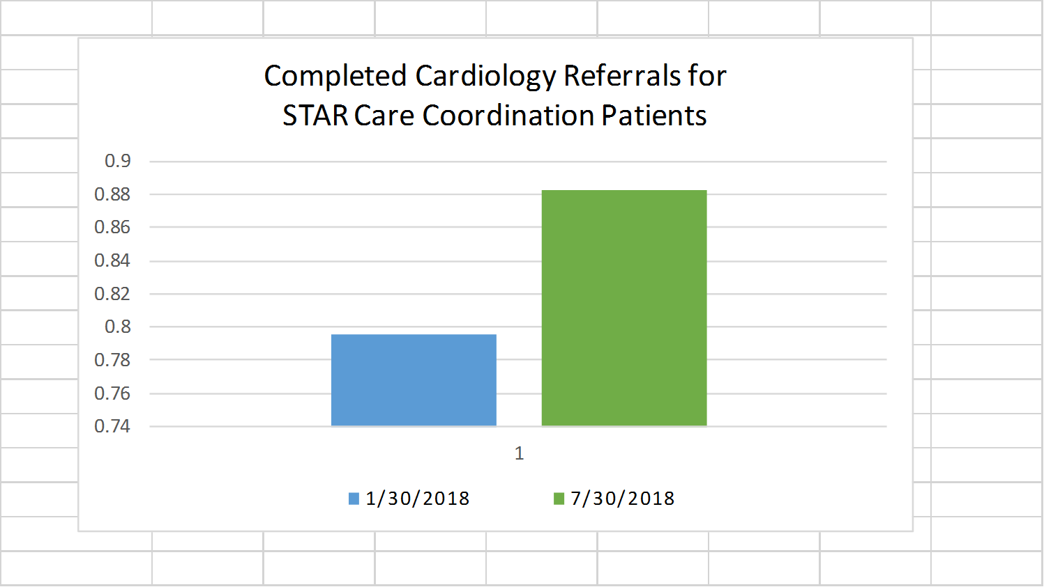
Follow Up Data

Slide 27
Lessons Learned
Expediting specialty appointments involves team-based care.
The health care system is confusing.
PN must evaluate patients’ abilities and needs
PN can help pt’s empower themselves in managing own care
Consistent communication between medical provider improve patients’ continuity of care.

Slide 28


Slide 29
References
Boccara, F., Lang, S., Meuleman, C., Ederhy, S., Mary-Krause, M., Costagliola, D. & Cohen, A. (2013). HIV and coronary heart disease: time for a better understanding. Journal of the American College of Cardiology, 61(5), 511-523
Freeman, R., Gwadz, M. V., Silverman, E., Kutnick, A., Leonard, N. R., Ritchie, A. S., & Martinez (2017). Critical race theory as a tool for understanding poor engagement along the HIV care continuum among African American/Black and Hispanic persons living with HIV in the United States: a qualitative exploration. International journal for equity in health, 16(1), 54.
Macias, S; Carmona, J; Estem, K. CARE COORDINATION PROGRAM IMPLEMENTATION MANUAL, NYC DOHMH (2018) Bureau of HIV/AIDS Prevention and Control
Mehrotra, A., Forrest, C. B., & Lin, C. Y. (2011). Dropping the baton: specialty referrals in the United States. The Milbank quarterly, 89(1), 39-68.
Neuhaus, Jacqueline, et al. Risk of all-cause mortality associated with non-fatal AIDS and serious non-AIDS events among adults infected with HIV. AIDS (London, England) 24.5 (2010): 69

