Slide 1
HIV/AIDS Bureau
The Grantee Toolbox
Debbie Isenberg
Elisa Peet

Slide 2
Disclosures
This continuing education is managed and accredited by Professional Education Service Group. The information presented in this activity represents the opinion of the author(s) or faculty. Neither PESG, nor any accrediting organization endorses any commercial products displayed or mentioned in conjunction with this activity.
Commercial support was not received for this activity.

Slide 3
Disclosures
Debbie Isenberg, MPH, CHES
Has no financial interest or relationships to disclose.
Elisa Peet
Has no financial interest or relationships to disclose

Slide 4
Learning Objectives
Upon completion of this presentation, you should be able to:
Locate and understand the reports available to Grantees in the RSR.
Locate and understand the reports available to Providers in the RSR.

Slide 5
Reports Available to Grantees
RSR Grantee Report
RSR Client Data Completeness Report – by Data Element
RSR Client Data Completeness Report – by Provider (available to both grantees and providers)

Slide 6
Grantee Report
PDF version of the online grantee report
To download this report
Search for the grantee report and download from the Print Package
Click “Print” inside the grantee report under the left-side menu

Slide 7
Client Data Completeness Report
Provides feedback to grantees and providers on data quality, not quality of care.
Two report options:
By provider
By data element.
Available in PDF or Excel format.
To download this report
Search for the grantee report and download from the Print Package

Slide 8
Client Data Completeness Report (continued)
For each data element, the Completeness Report contains:
Number of clients for whom you reported the data element
Number of clients for whom the element was required
Number of client records for which the element was required but missing
Number of client records for which the element was required and was reported as “Unknown”

Slide 9
Reports Available to Providers
RSR Provider Report
RSR Provider Report Validation
RSR Client Upload Confirmation Report
RSR Client Data Completeness Report (available to both grantees and providers)
RSR Services Crosswalk Report – by Service or by Contract
RSR Provider Report Comments
RSR Provider Report Workflow History

Slide 10
Reports Available to Providers
Provider reports can be accessed in two ways:
Search for the provider report using the “Search Provider Reports” link under the left-side menu in the Workflow Inbox
Print the report from within the actual provider report.
Client Data Completeness Report can only be accessed through the search function

Slide 11
Provider Report
PDF version of the online provider report
Doesn’t include client-level data
Useful in seeing the other grantees that fund your provider and the services they fund them for

Slide 12
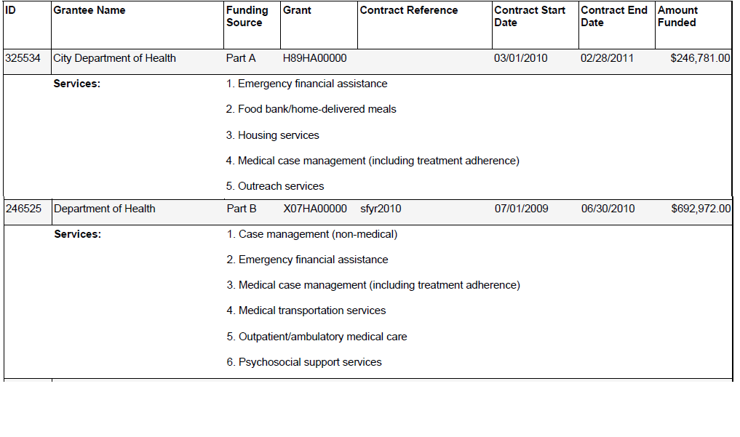
Provider Report

Slide 13
Provider Report Validation
Generated in HTML format
Displays all the validation messages for the provider report
Errors must be fixed in order to submit the provider report
Warnings will not prevent users from submitting, but if they can’t be resolved, a warning comment is required
Alerts will not prevent users from submitting, and no comment is required

Slide 14
Client Upload Confirmation Report
Generated in a PDF version
Shows the aggregate client data that are in the system associated with a provider’s report
Can be used to cross-check the numbers you expected based on your XML upload
Displays number of clients by gender, race, ethnicity, service visits by category, etc.
Only available once the client-level data has been uploaded to the provider report

Slide 15
Services Crosswalk Report
Available in HTML format
Compares the services selected as funded, services selected as delivered, services included in the XML upload, and whether a validation message is triggered
Generated by Services or by Contracts.

Slide 16
Services Crosswalk Report

Slide 17
Provider Report Comments
Generated in HTML format
Displays
the date a comment was entered
the name of the user that entered the comment
the comment title
the actual comment in a table
Because comments can be read by other organizations associated with the provider report or HRSA staff, please be clear.

Slide 18
Provider Report Workflow History
Generated in HTML format.
Provider Report Workflow History shows
the description of an action
the user that took the action
when the action occurred
Examples of actions are
A report is started
CLD is uploaded or cleared
A report is submitted
A report is accepted/returned for changes, etc.

Slide 19
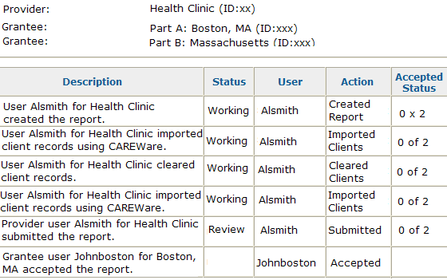
Exercise
Review
1 of 2

Slide 20
Key Points to Take Home
There are many reports available for grantees which can show you different view of the information in your online reports.
There are many reports available for providers which can show you different view of the information in your online reports.
These reports are the tools available to you to review your providers’ data.
HAB expects you to use these reports.

Slide 21
How to Use the Tools in the RSR System (Part 2)

Slide 22
Learning Objectives
Upon completion of this presentation, you should be able to:
Identify ways you can use the reports during RSR reporting.
Identify ways that the reports can help you plan for RSR reporting.

Slide 23
Recourses
Ryan White HIV/AIDS Program Data Support
888.640.9356: M-F 9 am to 5:30 pm ET
ryanwhitedatasupport.wrma@csrincorporated.com
TARGET Center website
www.careacttarget.org/category/topics/data-reporting
DART Team
Data.TA@CAIglobal.org
HRSA Call Center
877.464.4772: M-F 9 am to 5:30 pm ET
CallCenter@HRSA.gov.

Slide 24
Obtaining CME/CE Credit
If you would like to receive continuing education credit for this activity, please visit
http://www.pesgce.com/RyanWhite2012

Slide 25
Questions?

