Slide 1
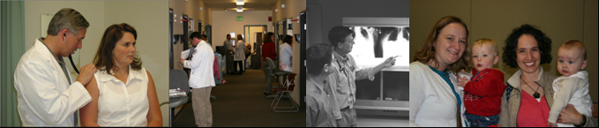



Family Medicine Residency of Idaho
HIV Training Track

Slide 2
FMRI Program Background
Established 1975
16-11-11, 43 family medicine residents total
ACGME accredited
Strong emphasis in medicine, obstetrics, pediatrics, emergency medicine, and surgical procedures
5 clinic sites
2 rural training tracks

Slide 3
Wellness Center
Ryan White Title C
~550 patients from Idaho, Oregon, Nevada
Multidisciplinary care provider team
FQHC, 340b pharmacy
Comprehensive HIV-positive primary care, case management, behavioral health services
Outreach clinic in Twin Falls, ID
Physician team manage all inpatient admissions
HIV Primary Care Fellowship
FMRI = Ryan White Grantee

Slide 4
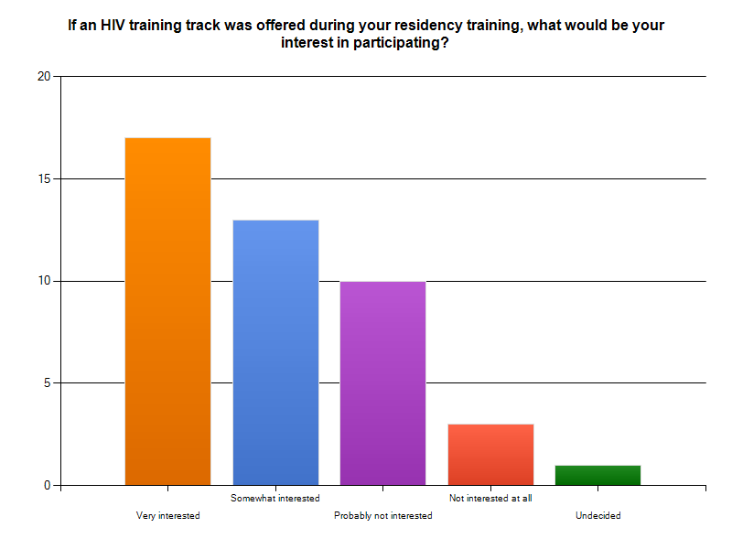
39.5%
ALL Residents 2011-12
30.2%
23.3%
7.0%
2.3%

Slide 5
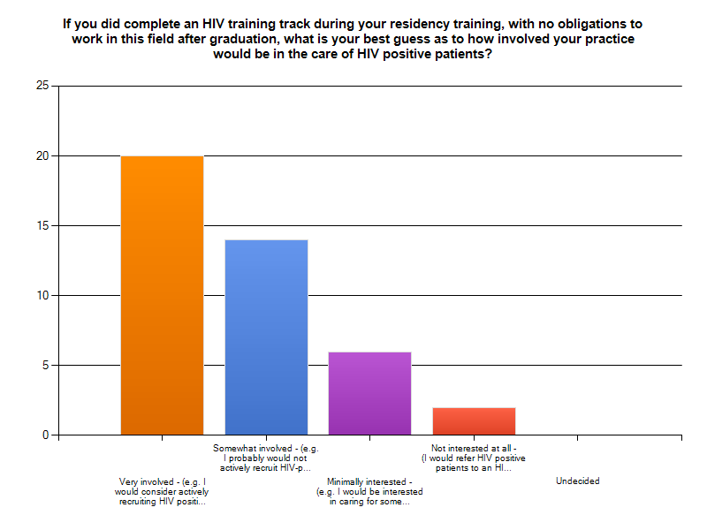
ALL Residents 2011-12
47.6%
33.3%
14.3%
4.8%

Slide 6
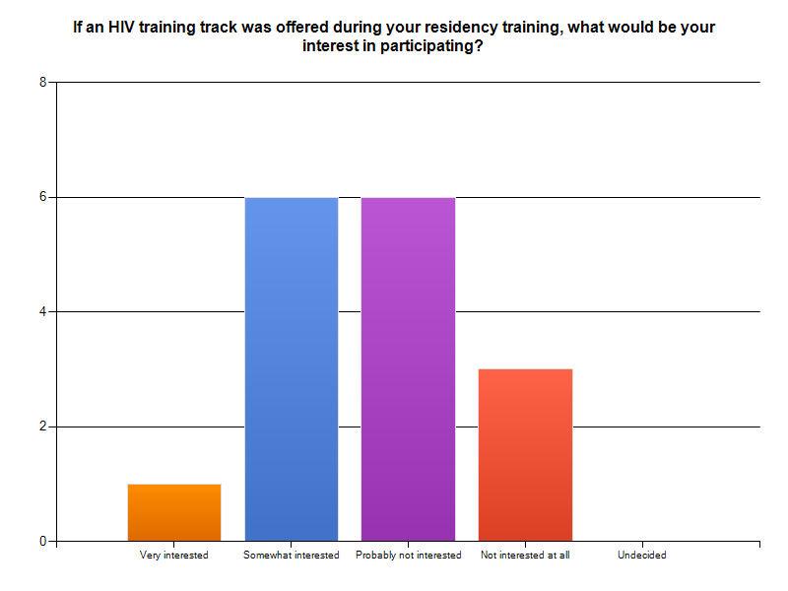
R1s 2012
37.5%
37.5%
18.8%
6.3%

Slide 7
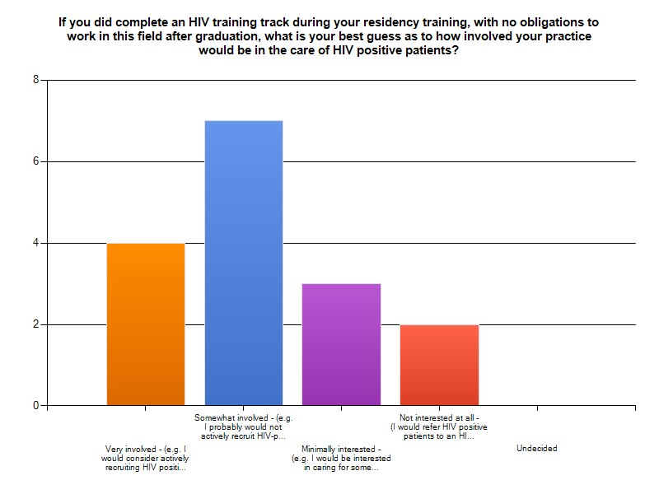
43.8%
R1s 2012
25.0%
18.8%
12.5%

Slide 8
HIV Training Track : Program Development
Family Medicine Residency of Idaho (FMRI)
Goals and Objectives
Comprehensive, web-based HIV curriculum, being developed in collaboration with NW AETC and University of Washington SOM
Inpatient core HIV competencies
Continuous HIV didactic schedule
Structured patient care – HIV-positive patients are empanelled in FM resident continuity clinic
Regular clinical preceptoring by FM, HIV and ID faculty
Local web-based HIV learning community website
Participation in weekly HIV ECHO teleconference project

Slide 9
FMRI HIV Training Track : Goals and Objectives
Goals:
  Provide systematic clinical and didactic training in HIV primary prevention, secondary prevention, post and pre exposure prophylaxis, HIV diagnosis and management both in the inpatient and outpatient setting.
  Provide training in updated, state of the art HIV-positive primary care.
  Cultivate the experience of collaborating with a multidisciplinary team involving social work, nutrition, behavioral health specialists, pharmacists and infectious disease and HIV specialists in order to provide comprehensive health care uniquely essential to the HIV population.
Objectives (display competency in the following):
  Testing, lab monitoring, and transmission of HIV infection
  Pathophysiology and natural history of HIV infection
  Management of comprehensive anti-retroviral therapy
  Management of OIs
  HIV disease progression, suppression
  Evaluation of ARV resistance
  Adverse reactions to medications, and drug interactions
  Issues of confidentiality
  Social and financial issues related to HIV infected individuals
  Metabolic complications of HIV infection/treatment
  HIV-positive behavioral health
  PMTCT, HIV-positive women’s health
  HIV-positive pediatric care, etc.

Slide 10
FMRI HIV Training Track :
Web-based Curriculum
  5 Modules
    various topics covered in lessons
    core concepts
    activities
    reference links
  Post lesson quizzes
  Post module assessment
  Progress tracker function

Slide 11
FMRI HIV Training Track : Web-based Curriculum Example
MODULE B: Basic HIV Clinical Care
  Lesson 1. Initial Evaluation and Routine Lab Monitoring
  Lesson 2. Virology, Pathogenesis, and Natural History
  Lesson 2. CDC Case Definition
  Lesson 3. Recognizing Common Clinical Manifestations
  Lesson 4. Prevention of Opportunistic Infections (Basic)
  Lesson 5. Immunizations
  Lesson 6. Initiating Antiretroviral Therapy
  Lesson 7. Primary Care Issues, Common Syndromic Presentations with HIV
  Lesson 8. Management of Sexually Transmitted Diseases
  Lesson 9. Retention in Care

Slide 12
FMRI HIV Training Track :
Local web-based learning community
  Links to online educational resources
  Announcements
  Recent scientific journal article web-board
  Local HIV events calendar
  HIV-positive patient tracking tool

Slide 13
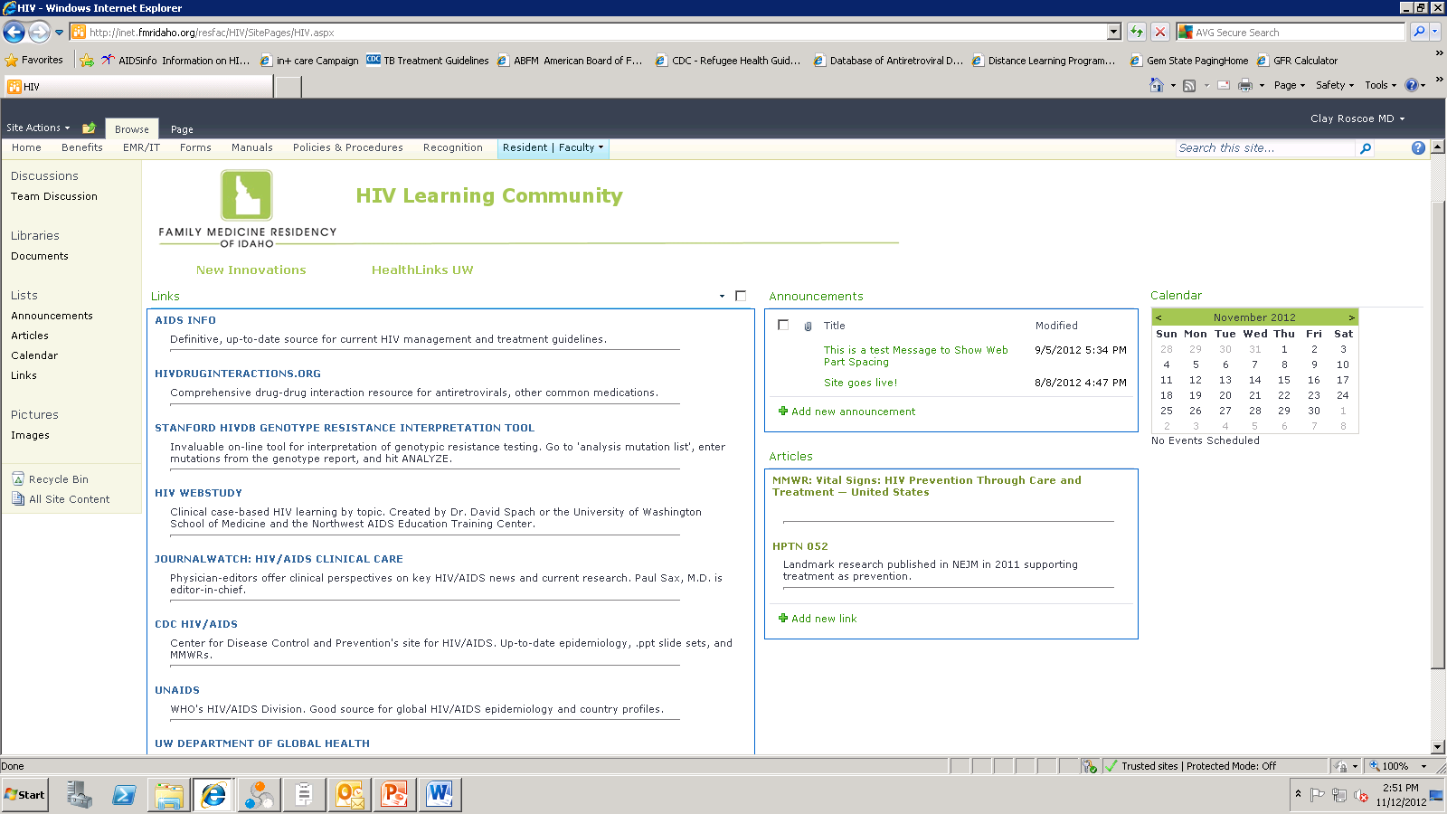
Screenshot
HIV Learning Community

Slide 14
FMRI HIV Training Track :
Curriculum Development, Additional Elements
Inpatient core competencies for HIV+ admissions
Didactic schedule
  Weekly ECHO teleconference participation (mini-topic, cases)
  Monthly journal club led by HIV primary care fellow
  Three annual HIV quarter-day conferences
  Mini library, reading list
Patient care
  10 patients empanelled in each training track resident FM continuity clinic x2 years
Routine clinic preceptoring by HIV, FM and ID faculty
Rotate with local pediatric ID physicians

Slide 15
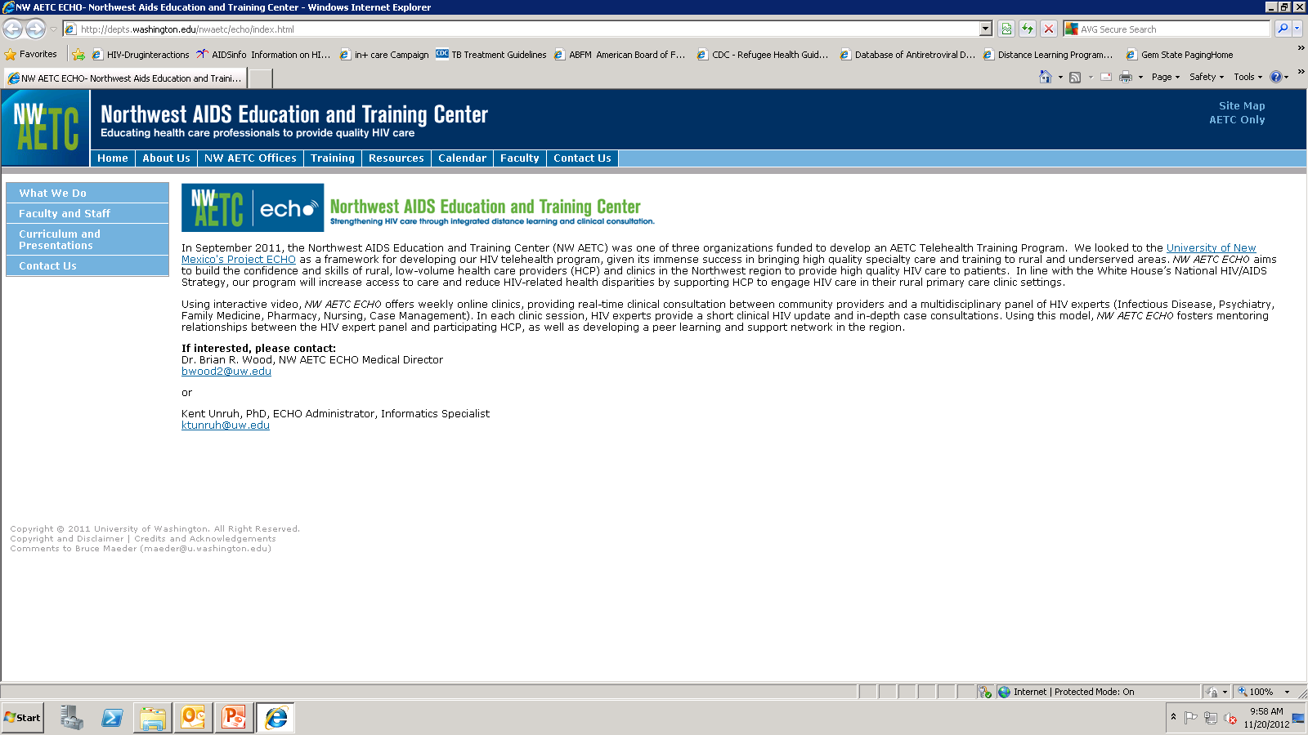

Slide 16
FMRI HIV Training Track : Evaluation
Immediate preceptor feedback is given on each patient presentation by FM/HIV faculty.
Clinical and inpatient core competencies reviewed, learned, demonstrated, and checked off.
Continuous tracking of step-wise completion of HIV curriculum modules.
Bi-annual evaluations by the HIV training Track Director and HIV care team (nurses, pharmacists, social workers).

