Slide 1
“Access and Retention: County Jails and State Prisons Releasing HIV Positive Ex-offenders to HRSA Grantees”
Ryan White All Titles Meeting
November 27th – 29th, 2012
Washington DC
Howell I. Strauss, DMD, Ann Ferguson, MSN and Fungisai Nota, PhD.
AIDS Care Group
Chester, PA

Slide 2
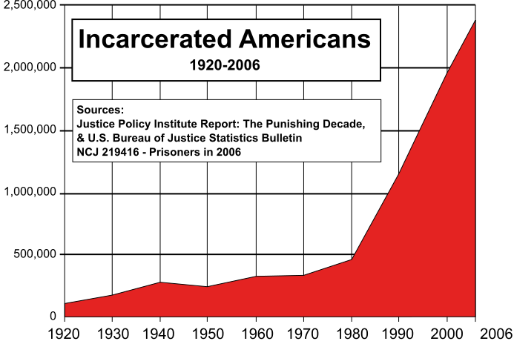
Context of the problem
The US general population increased by 2.8 times from 1920 to 2006. In the same time period the prison population increased 24 times.

Slide 3
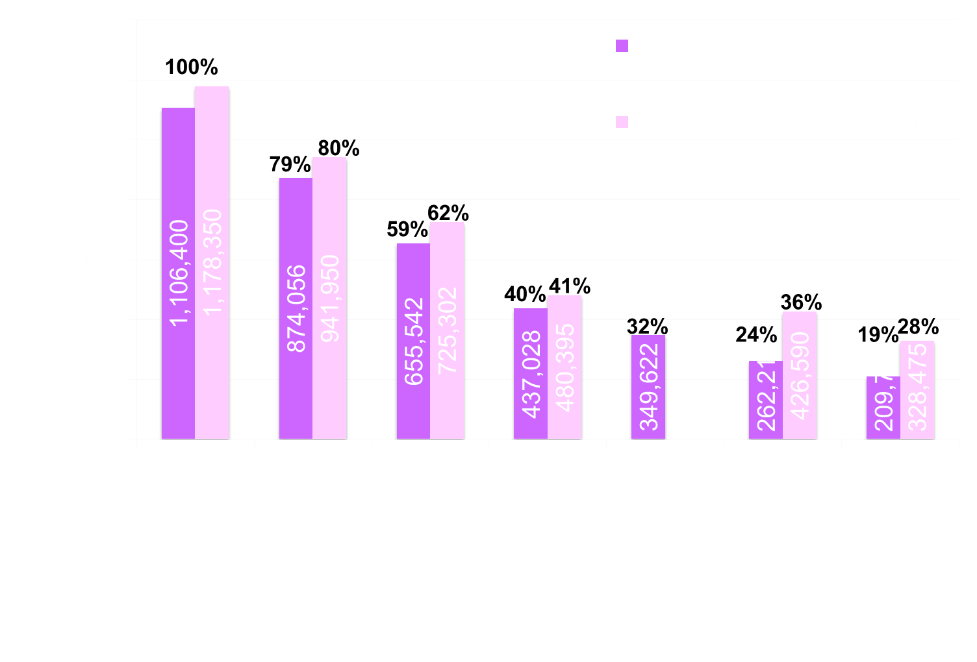
Major DECLINE in the Implementation Cascade

Slide 4

Counties in PA

Slide 5
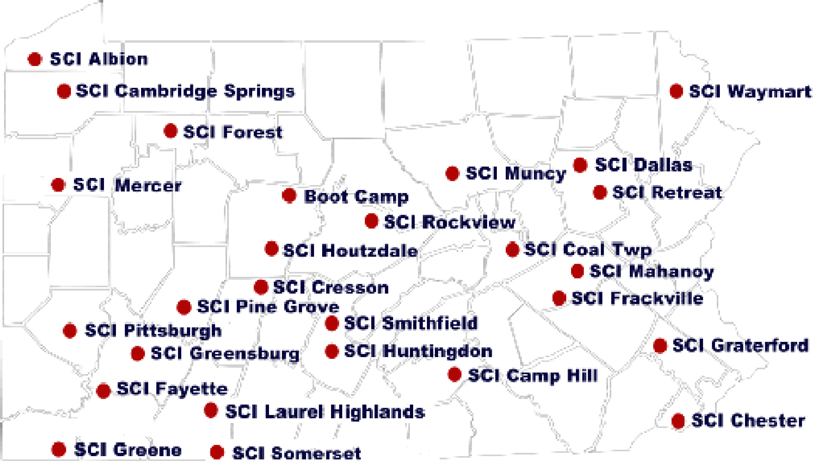

Slide 6
“Discharge to the Streets: Re-integrating the HIV+ Prisoner”
Into places no one should go, but to which over 100,000 persons reside; the Pennsylvania county and state jail and prison systems contain populations living with and at-risk for HIV disease.
The State prison system has over 700 persons living with HIV/AIDS.
The 67 county and municipal jails hold as many living with HIV/AIDS.
90% are discharged. For those who are uninsured, this is where we come in.

Slide 7
If, the ultimate goals of working with recently-released ex-offenders living with HIV are timely linkage to health care and improved health outcomes in PLWHA;
Then, any and all factors (including medical and non-medical or social issues) that are barriers to the achievement of goals should all get equal weight and attention.

Slide 8
From the new National HIV/AIDS Strategy:
The United States will become a place where new HIV infections are rare and when they do occur, every person, regardless of age, gender, race/ethnicity, sexual orientation, gender identity or socio-economic circumstance, will have unfettered access to high quality, life-extending care, free from stigma and discrimination.

Slide 9
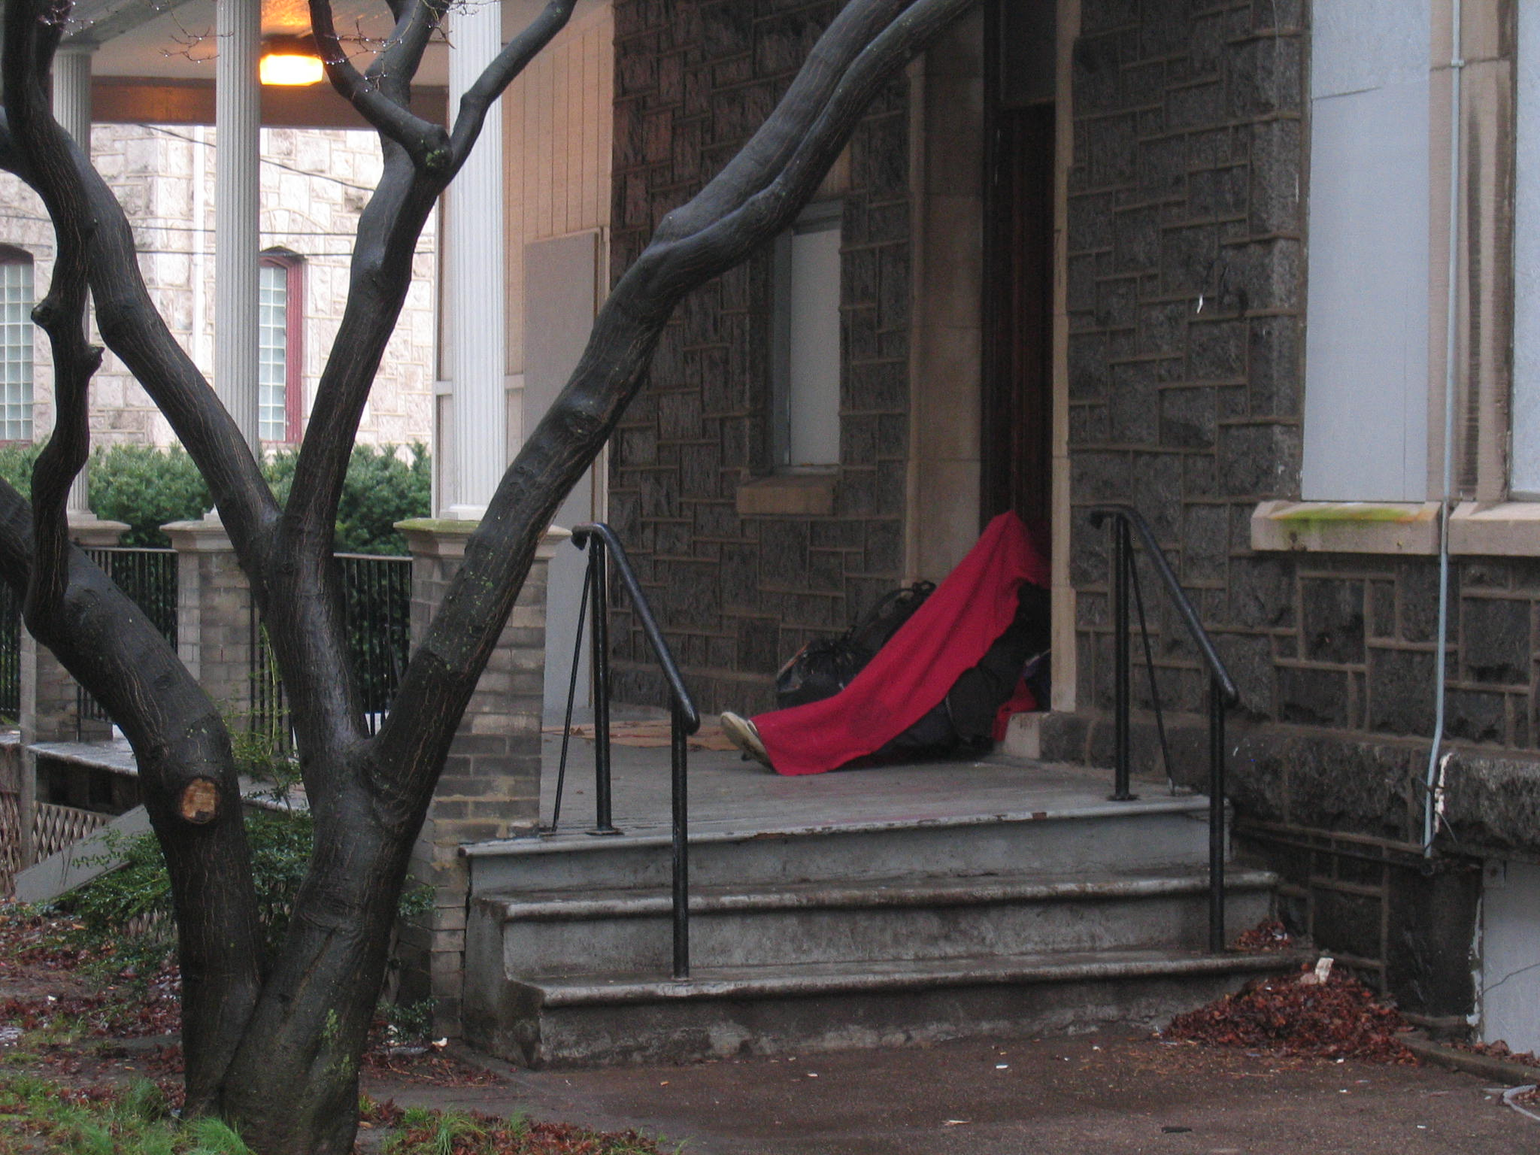

Slide 10
Social and medical factors affecting individual and community health are very prominent in the ex-offender population.
There is poverty, joblessness, homelessness, and despair.
Clients found to be living with HIV disease can also present with substance abuse behaviors and/or mental health conditions.

Slide 11
Within the AIDS Care Group
40% of clients have an incarceration history.
35% have hepatitis C.
20% of the clients seen for medical care and services do not have clean, safe, or affordable housing.

Slide 12
The Hook is Food
Poverty and hunger are pervasive in Chester’s central business district.
Without a poster advertising the opening of the Drop-in-Center, the knowledge of a morning breakfast center became instantly well-known.
Clients came to expect that food and an educator were on-site.

Slide 13
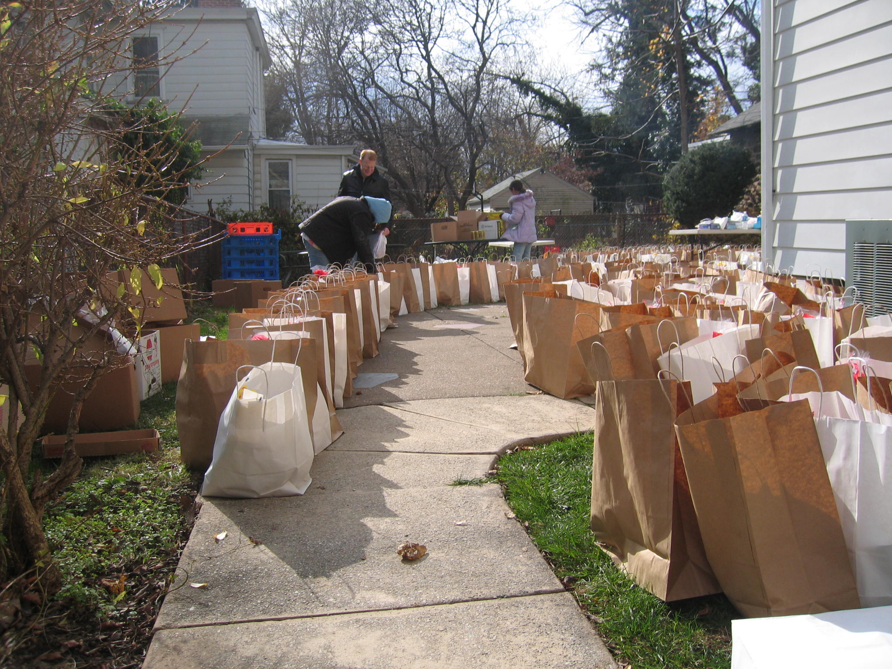

Slide 14
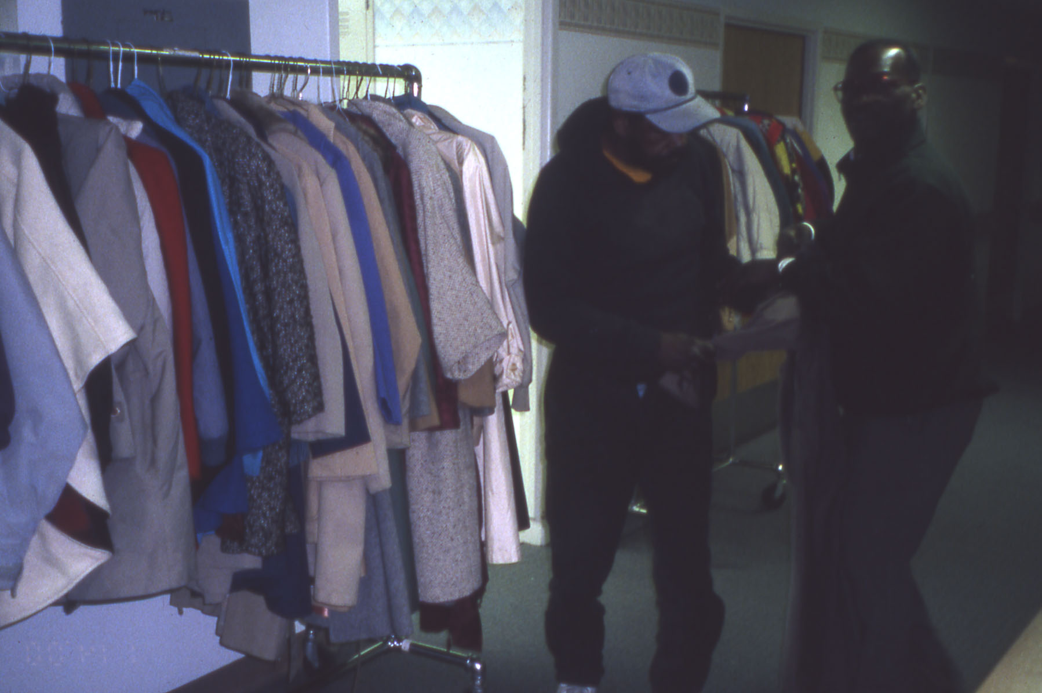

Slide 15
Transportation was added as a service in 1999.
As a resistor to care, transportation was listed in the top three by clients.
AIDS Care Group staff found vehicles and programs to support transportation services.
Our motto became “We’ll come and get you”.

Slide 16


Slide 17
Clinical Care
The AIDS Care Group was meant to be a clinically-based organization.
It is now a clinical and social-services based organization where the clinical care division is busy due to efforts through outreach to keep clients linked to their providers.

Slide 18
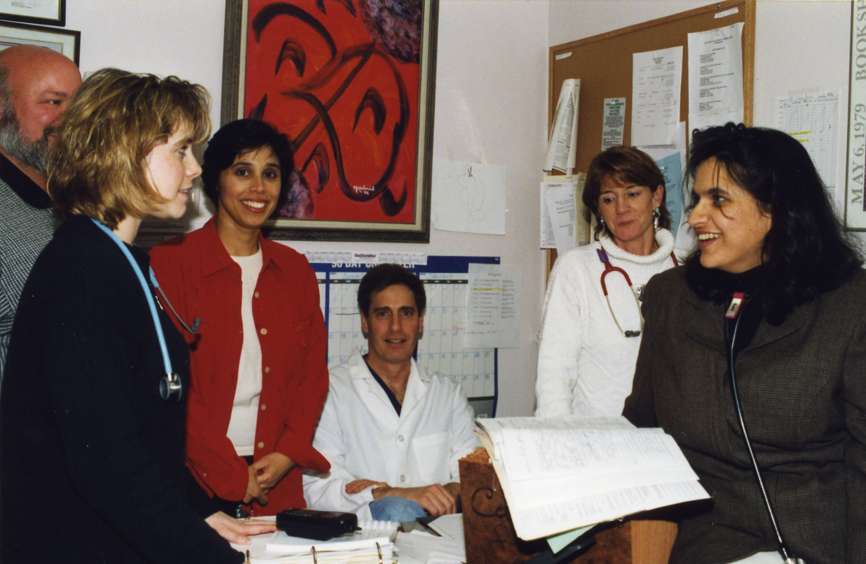

Slide 19
Increase Access to Care and Improve Health Outcomes for People Living with HIV:
  Establish a seamless system to immediately link people to continuous and coordinated quality care when they learn they are infected with HIV.
  Take deliberate steps to increase the number and diversity of available providers of clinical care and related services for people living with HIV.
  Support people living with HIV with co-occurring health conditions and those who have challenges meeting their basic needs, such as housing.

Slide 20
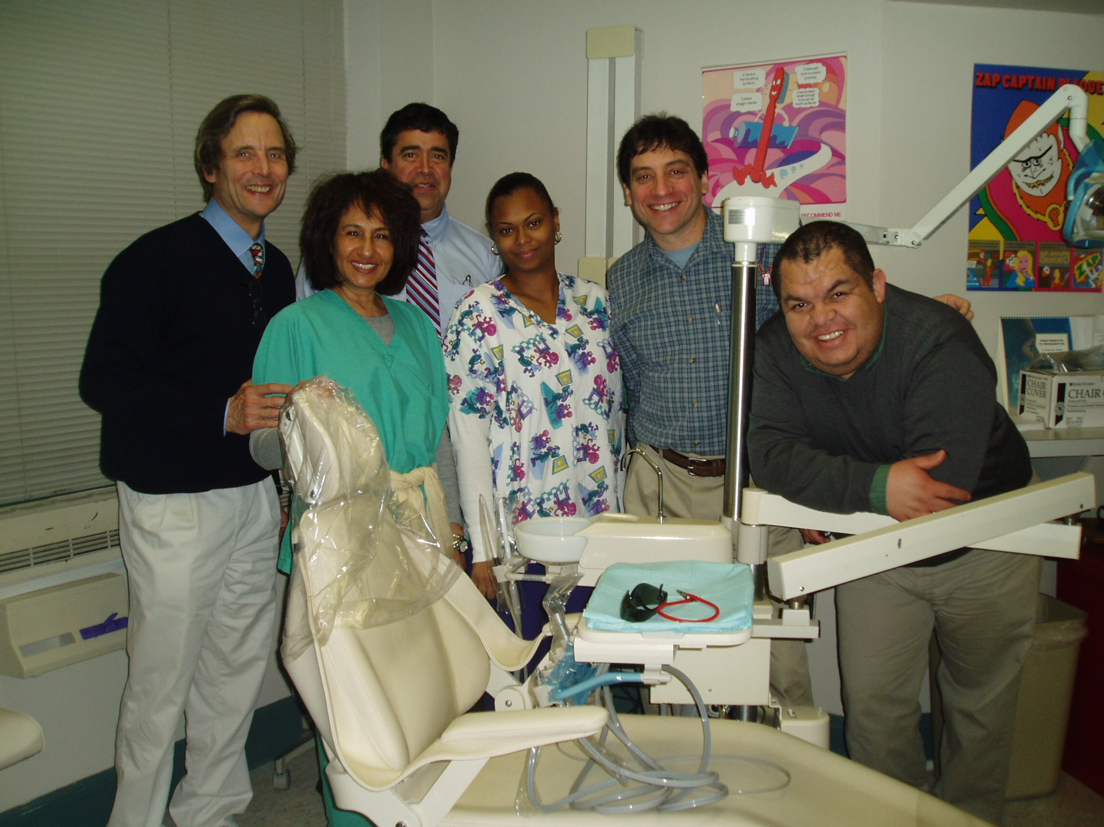

Slide 21
Jails/prisons are in the business of SECURITY with lock downs and life behind bars.
As clinicians in ambulatory settings we are in the business of health; and we tell patients, “go home to heal.”

Slide 22
Model of case management
Short-term and intensive
Emphasis wherever possible on pre-discharge planning
Global sense of purpose, not just linkages into clinical care
Assessing and meeting client needs

Slide 23


Slide 24
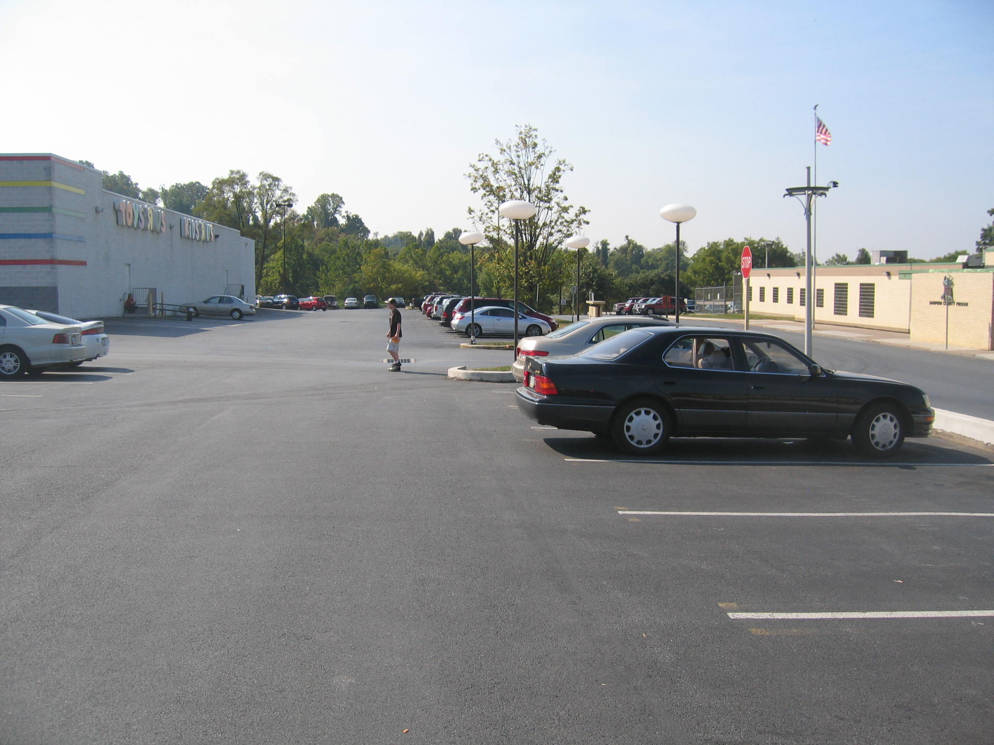

Slide 25
Did you see that? The Dauphin County prison shares a parking lot with “Toys R Us”.

Slide 26
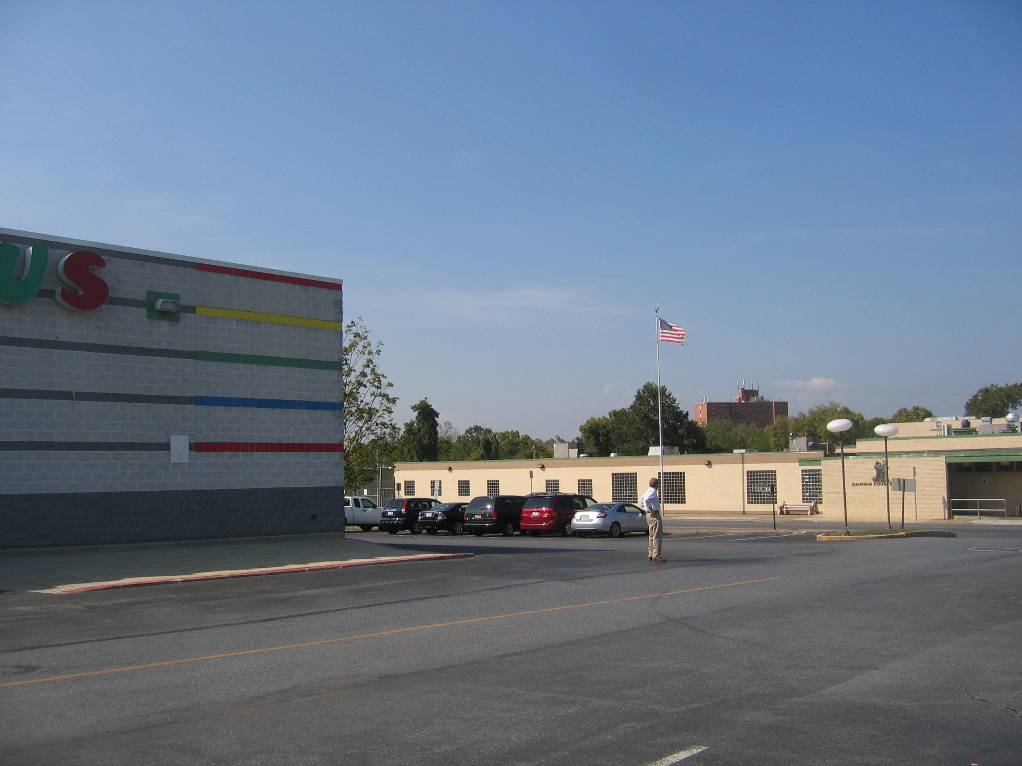

Slide 27


Slide 28


Slide 29
The outcomes of self-care include quality of life, adherence, and better attainment of signs of improving biomarkers such as CD4, viral load, and cognitive status.

Slide 30
Self-care, by definition, is a multidimensional concept that refers to the knowledge, attitudes, and behaviors that clients develop, nurture, or perform to manage a health problem or enhance a health attribute. Instrumental in this model are three identified components: the patient, the provider, and the structural setting (i.e. the home).

Slide 31
(Client) (Customer) (Consumer) (Patient) as central to the strategic plan to link persons to care
Who are our clients?
What do our customers want?
What do our consumers think about us?
What should our patients think about us?
How do we get there?

Slide 32
The Patient
HIV/AIDS epidemic continues to grow among traditionally underserved and hard to reach communities.
Communities of color, women and substance users are an increasing part of the HIV/AIDS epidemic.
Nationally, and particularly through CARE Act programs, we are taking care of people whom society has traditionally ignored: ex-offenders, the homeless, women who are dependent on welfare, people with substance abuse problems, and other disenfranchised communities that have been affected with HIV/AIDS.
Patients enter into care with multiple co-morbid conditions.

Slide 33
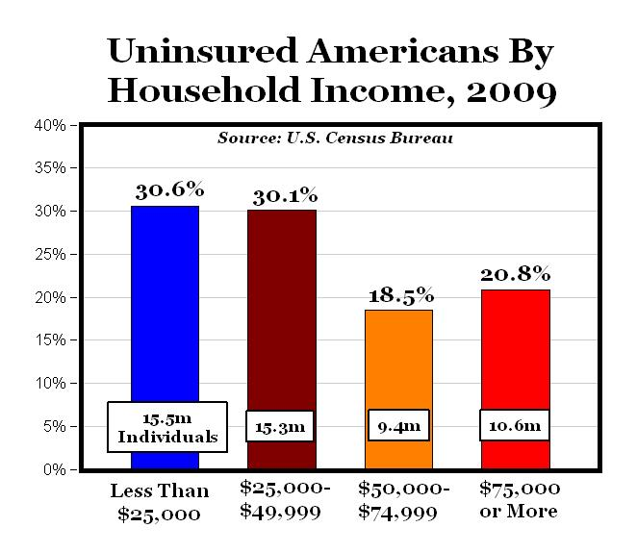
Uninsured Individuals by Household Income

Slide 34
Multiple “Customers”
This makes the job even tougher
For instance, of all uninsured patients
  11% are substance abusers
  5% are homeless
  2.5% are HIV positive
Johnson & Johnson / UCLA
Health Care Executive Program

Slide 35
“Census: Poverty rose by million”
Washington: The number of Americans in poverty and without health insurance each rose by more than 1 million in 2003, the Census Bureau reported Thursday. The number of Americans in poverty rose by 1.3 million to 35.9 million, or one in eight people (USA Today, August 2004). By 2010 the number of Americans living in poverty had grown to 46.2 million.

Slide 36
Current health care delivery systems have aimed at expecting patients to manage their long term illness through self-care on an outpatient basis or at home.

Slide 37
“A death sentence no more”
Jane Eisner, The Philadelphia Inquirer, Sunday, September 5, 2004
Many fatal diseases have become treatable conditions that people can live with for years. But the progress brings ethical and social challenges. Diseases such as diabetes, cancer, Alzheimer’s, and AIDS will no longer be considered an immediate death sentence.
Today, a 22 year old male living with HIV is expected to live an additional 57 years; to have a life expectancy of 77 years
(Anthony Fauci, MD at the IAC 2012)

Slide 38
Structural Issues - The Setting
Surprisingly, not much is being done to improve the socioeconomic dimension of self-care such as the settings, outside of the outpatient setting. Housing is not usually a “provided service” in the outpatient setting.
As a result, patients are empowered with great knowledge and skills, but left to go back on the streets – facing a multiplicity of setting problems such as food or housing instability.

Slide 39
National HIV/AIDS Strategy of the United States-2010
2007-Initiative by the Special Projects of National Significance
Social Determinants of Health
Poverty
Crime
Housing, food, and employment insecurities
Threats of substance abuse
Structural, provider, and client inputs regarding access to health care and health

Slide 40
The Simple Description
Hands-on
Service Oriented
Small Scale
Dependent on Intensive Medical and Social Service Case Management

Slide 41
Complicated Description
Services targeted five Pennsylvania county jails.
Prisoners are ideally identified before release to effectively plan for and carry out comprehensive discharge and reintegration services.
Prisoners are also identified after discharge through linkages with probation and parole.
Once identified, staff utilize psychosocial, substance abuse, and psychiatric assessments; intensive case management; transportation, food, and shelter assistance; and phone cards during the reintegration process to help insure adherence to HIV medical care and reduce recidivism.

Slide 42
Linking re-entry clients into an adherent medical care program was the principal emphasis of the five-year SPNS project.
However, the structural and provider conditions surrounding the patients became the emphatic issues which had to be addressed.

Slide 43
From the Point of Discharge
In an ideal world discharge planning and reintegration programs for inmates from county jails would be structured and comprehensive.
However, structured discharge and reintegration planning from county jails is very often lacking in reality.

Slide 44
Your clients are living with HIV
Now what are you going to do to link them into durable medical care????

Slide 45
Reality check:
No Identification
No birth certificate
No insurance
No housing
Where do you start with relapse prevention facing protracted obstacles like these?
How do you certify them for Ryan White Services?

Slide 46
Facing the Reality of County Jail Discharge and Reintegration Issues
Prisoners are discharged on a random basis.
Prior jail-based work is often just a thing of the past at the point of discharge.
Discharge to deployed case management services is a possible solution that helps to take into account the NEW needs of an OLD prisoner.

Slide 47
Discharge to Streets!!
Case
Manager
Discharge Plan
Food
ID
Housing
Transport
Medical Care
SA/MH

Slide 48
Our work in linking clients into care; and retaining clients in a comprehensive and adherent HIV clinical program, is only as good as the weakest link.
So What?
Is the presence of case management the solution to client needs?

Slide 49
Juggling Needs
Client needs
Provider needs

Slide 50
Formal and Learned Provider View of Client Needs
1. Housing
2. Transportation
3. Food
4. Medical care
5. Clothing
6. Identification
7. Benefits

Slide 51
CLIENT NEEDS – as perceived by the client
SEX
Cigarettes
Drugs – or old behaviors
Food
Housing
Transportation
SEX
Phone
SEX
Identification
Benefits
Medical care

Slide 52
BALANCING NEEDS

Slide 53
Develop relationships that keep clients linked into social services
Meet people on their turf, drive them to appointments of all types (medical, SSI, court appearances)
Address acute needs with great intensity and then transition clients into a more chronic model when it’s appropriate
Be creative and persevere

Slide 54
Expected Challenges
  Jails’ cultures, subcultures, and politics
  Disease stigma
  Poverty, discrimination, addiction and surviving the streets in the communities to which inmates return
  Surviving the low priority given to discharge planning for those living with HIV disease

Slide 55
Addressing the challenges
  Identify barriers unique to each client
  Use multiple service providers capable of addressing barriers
  Link care through deployed case management to help insure the development and continuity of success with the reintegration process
  Keep it real

Slide 56
Discharge Team
Jail liaison
Case managers
Housing specialists
Drivers
Medical team
A supportive administration

Slide 57
Developing and Sustaining a Program
Historical development of services
Transitional phase to expand, improve, and evaluate service delivery system

Slide 58
Know Your Community
Chester is the third poorest city of its size in the nation; the city with the highest crime rate in its county; and the county with the third highest incidence rate of HIV disease in the state.
Know your Target Population
20% of the clients seen for medical care and services do not have clean, safe, or affordable housing.
40% have had an incarceration history.
Notes:
58

Slide 59
With most of the ex-offenders living with HIV/AIDS also homeless or vulnerable to homelessness, to what extent are they able to take better care of themselves under the self-care program?

Slide 60
AIDS Patients’ Dilemma
Inflation affecting rents and value of homes exceeds whatever income source is available to low-income populations and promotes homelessness. (“The rich get rich and the poor get poorer”)
Low income and medically compromised populations need the help of organizations to change the playing field: lock rents low enough and reduce discrimination in the housing setting so the poor can have access to clean, safe, and affordable housing.
Improve the self-care paradigm with a strengthened triad of patient, provider, and structure.

Slide 61
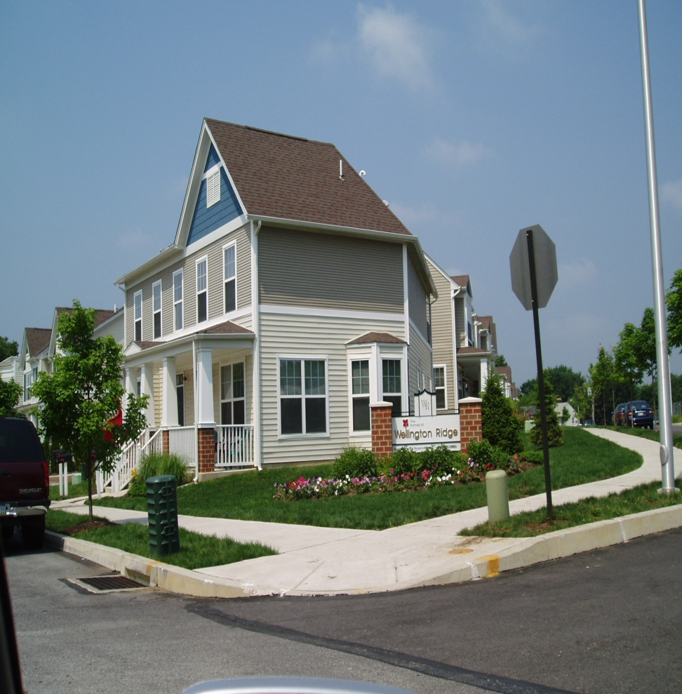
Low-Income Housing
In Chester some beautiful low-income housing has been built.
However, the number of these units is scarce and have been made available to the best-off of the poor.

Slide 62
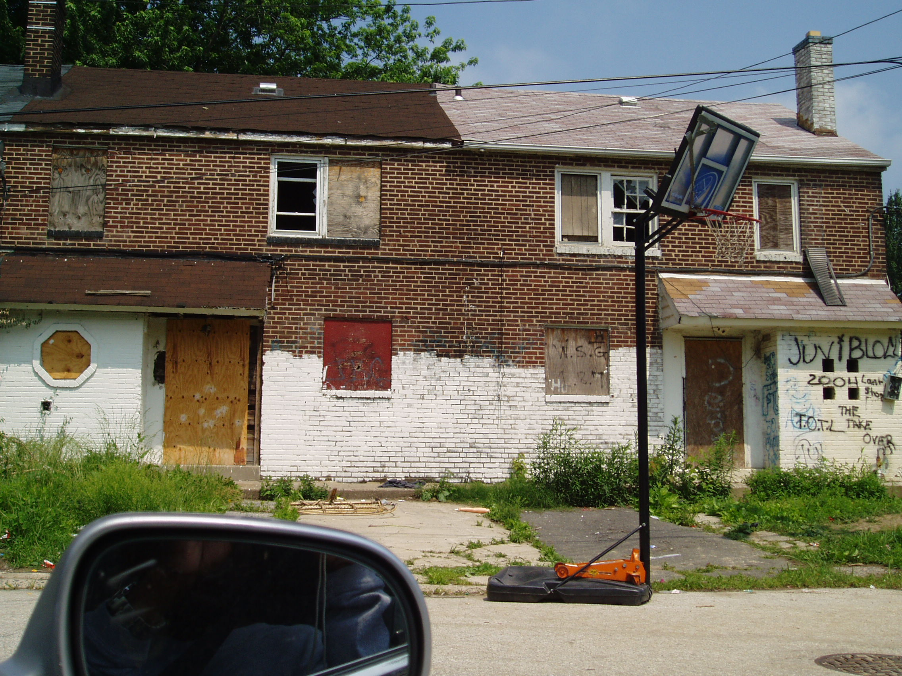
These houses sit across the street from the Wellington Ridge homes on the previous slide.

Slide 63
Poverty and HIV/AIDS in Chester
The richest among the poor make up to $9,600 from social security and other federal benefits. This is half of the national and local poverty level.
As a result, most social security recipients seeing this as their sole income are forced to juggle income; casting out food, clothing, medications, child-care, or housing.

Slide 64
The need for safe, clean and affordable housing
While bactrim and atovaquone are available through every ADAP to AIDS patients, clean, safe and affordable housing is NOT.
While the therapeutics of HIV disease are required as a standard of care, housing is NOT.
With the AIDS epidemic in the U.S. rapidly approaching an epidemiologic profile akin to third-world nations, it is appropriate to undertake the efforts needed to identify ways to remove barriers to housing needs of AIDS patients.

Slide 65
Health Care Providers and Housing
Housing is the major missing element among services provided to AIDS patients.
Housing is a key element to the quality of life and in adherence to medical treatment plans.

Slide 66
Public Housing and HOPWA falling short
In Delaware County, the waiting list for public housing is over 18 months long.
The limitations in HOPWA funding and its eligibility requirements allow only a handful of AIDS-diagnosed individuals to access housing each year.
Clients in the lowest levels of the low-income range and those with an HIV diagnosis without AIDS are in desperate need for clean, safe, and affordable housing.

Slide 67
Housing, incarceration, mental illness, and substance abuse are inextricably tied
115 participants enrolled in the local study.
Among a cohort of 33 enrolled participants, who were homeless and received housing counseling through HOPWA.
There was an AIDS diagnosis in 100%.
26 (78.8%) were males.
7 (21.2%) were females.
African Americans: 19 (58%); Latino: 2 (6%); Caucasian: 12 (36%)
If male; then 73% chance of also having MI/SA
If female; then 100% chance of also having MI/SA

Slide 68
Discharge Planning
Ideal world: done on-site during incarceration
Real world: Referrals after release, walk-ins, blind phone calls

Slide 69
Sustainability
Go through the doors that have been opened. Work beyond structural issues.
Help agency staff to become fluent in “jails” and “prisons.”

Slide 70
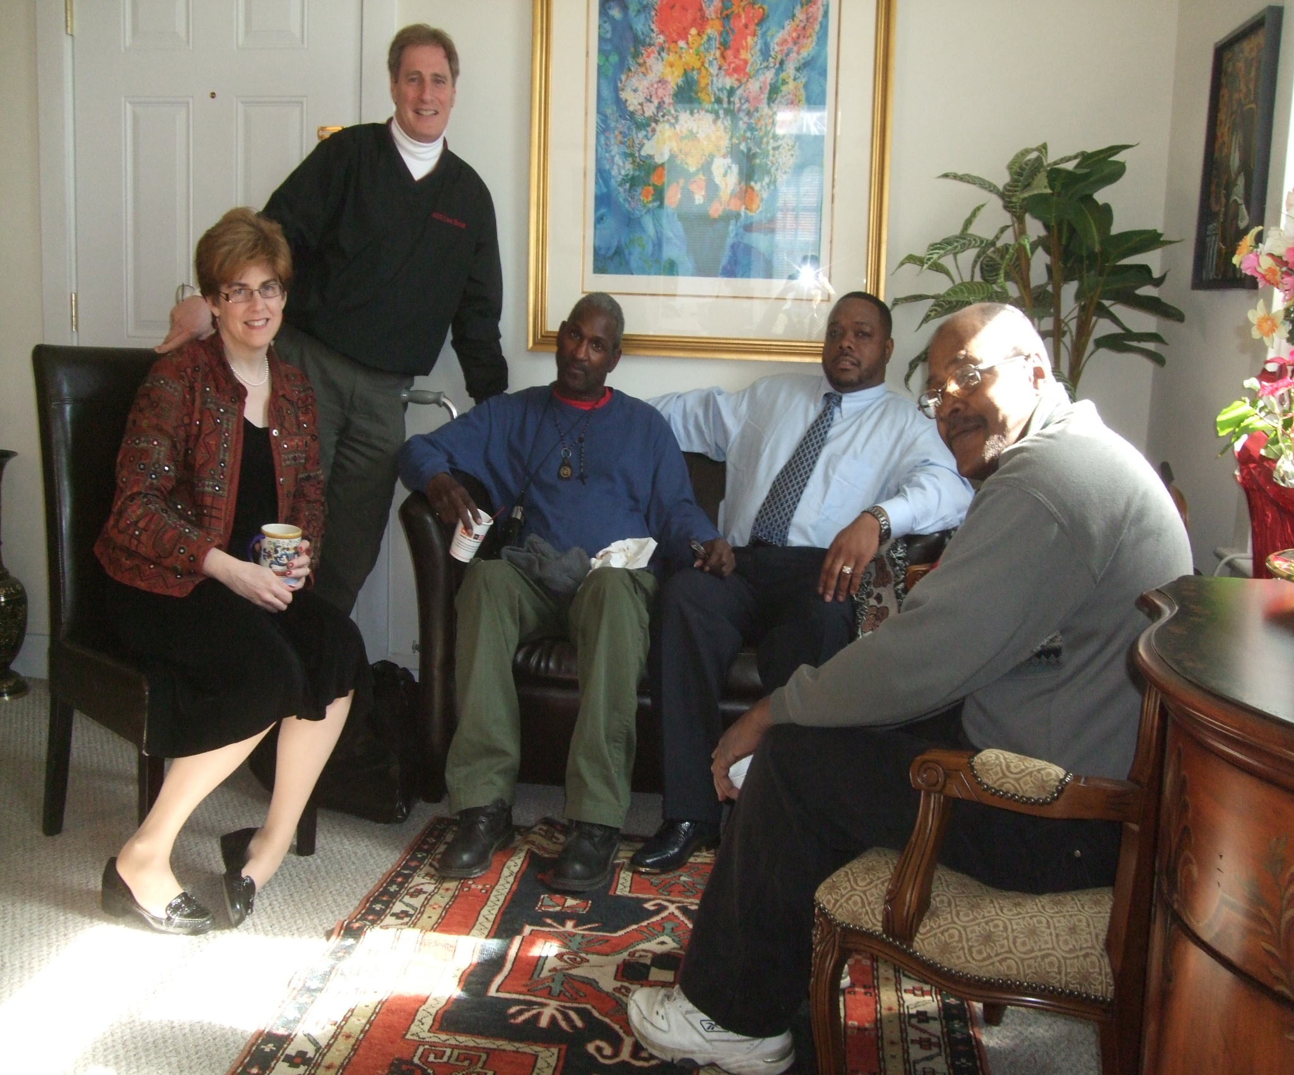

Slide 71
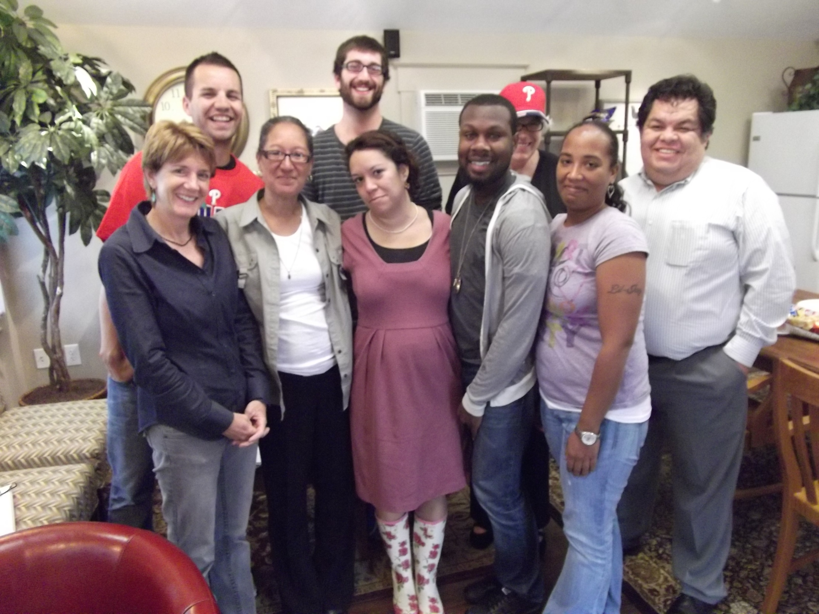

Slide 72
As a result of a unique project, we hope to meet many new clients and help in their re-entry into community life. Our job is to provide medical care and services, while bringing out the best in their spirit and creativity.

Slide 73
“America works best when the poor achieve their dreams.”
Former President Bill Clinton,
Democratic National Convention
July 2004

Slide 74
One goal of the AIDS Care Group, in addressing HIV/AIDS medical care and social services, is to help translate the dream of patients to acquire clean, safe and affordable housing into actual demand.

Slide 75
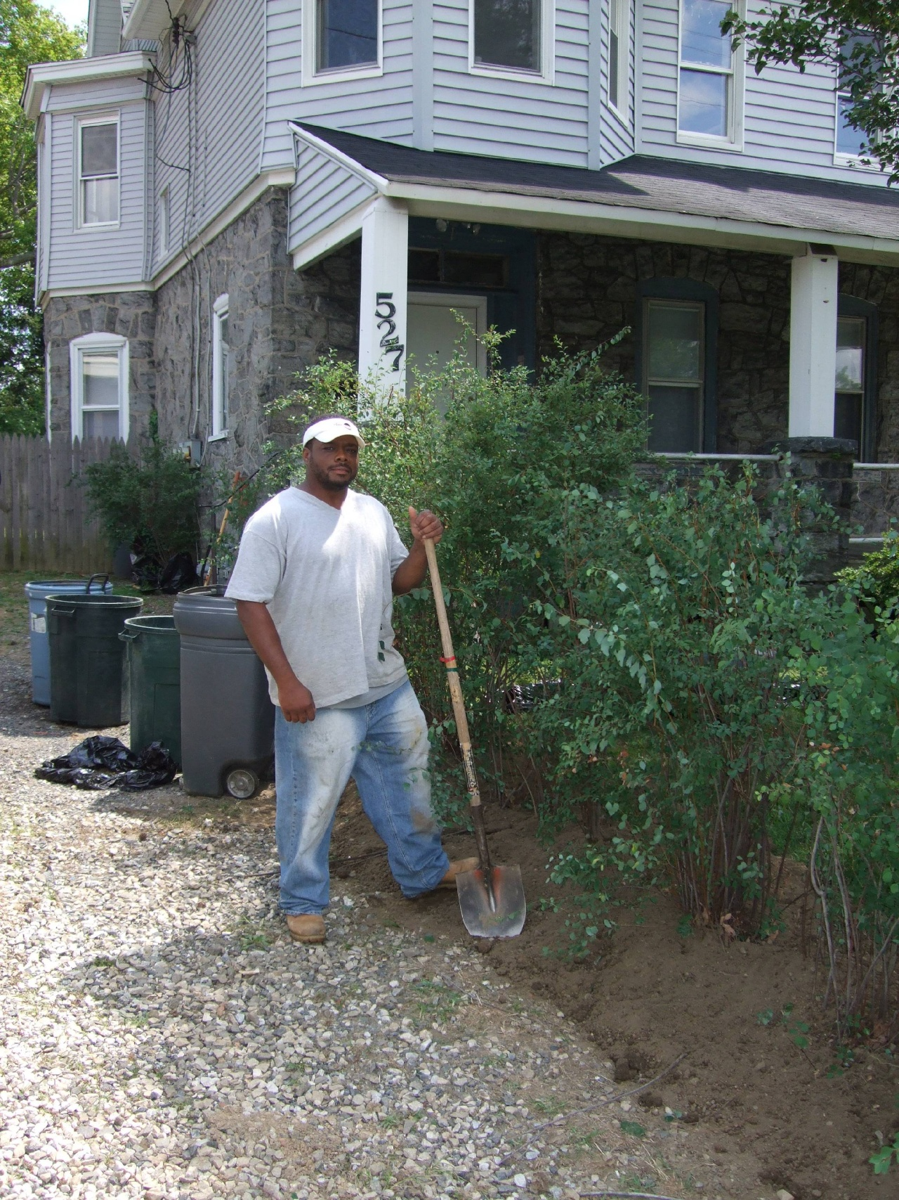

Slide 76


Slide 77


Slide 78


Slide 79


Slide 80
Dr. Jonathan Mann in addressing the HIV epidemic in developing nations asked, “Do we need more doctors, nurses, and clinics? Or, do we need to address other basic societal issues, such as human rights and issues surrounding poverty.” (Johns Hopkins Clinical Care Conference, March 1997)

Slide 81
Since 1997, over the next 15 years:
The gaps between rich and poor, privileged and needy, and insiders and outsiders have grown into chasms.

Slide 82
One in five children in our country is living in poverty.
There are fewer jobs and there are more abandoned homes.
There is more food insecurity.
There are more teen-age pregnancies.

Slide 83
STDs are the leading infectious diseases.
There is more substance abuse, and the criminal justice system is one of the best growth industries in America.

Slide 84
Through our clinical diligence, there are fewer opportunistic infections.
But, there is more hepatitis C.

Slide 85
These issues which could set the stage for another wave of HIV in our cities, and now more than 15 years since discussions of societal determinants of health were discussed by Dr. Mann, have come to be the presenting problems as we embark on our efforts to implement a National HIV/AIDS Strategy - with one goal to reduce new infections by 25% over the next 4 years.

Slide 86
Perhaps current methods and new and as yet undiscovered efforts by our collaborating HRSA grantees, in regards to the National HIV/AIDS Strategy, will provide us with more and better clues on how to address people and their behaviors to help individuals and communities strive to better health.

Slide 87
Until those answers are found, we must recommit to the work we are doing and to honor those who have suffered.
If our work is felt to be sincere, clients may trust our efforts and perhaps let themselves progress to the full range of services we can provide.

Slide 88
And if we can trust our patients – we can interpret their needs with appropriate action.

Slide 89
This work of ours is meant to improve the health of individuals, families, and communities.
It is our campaign.

Slide 90
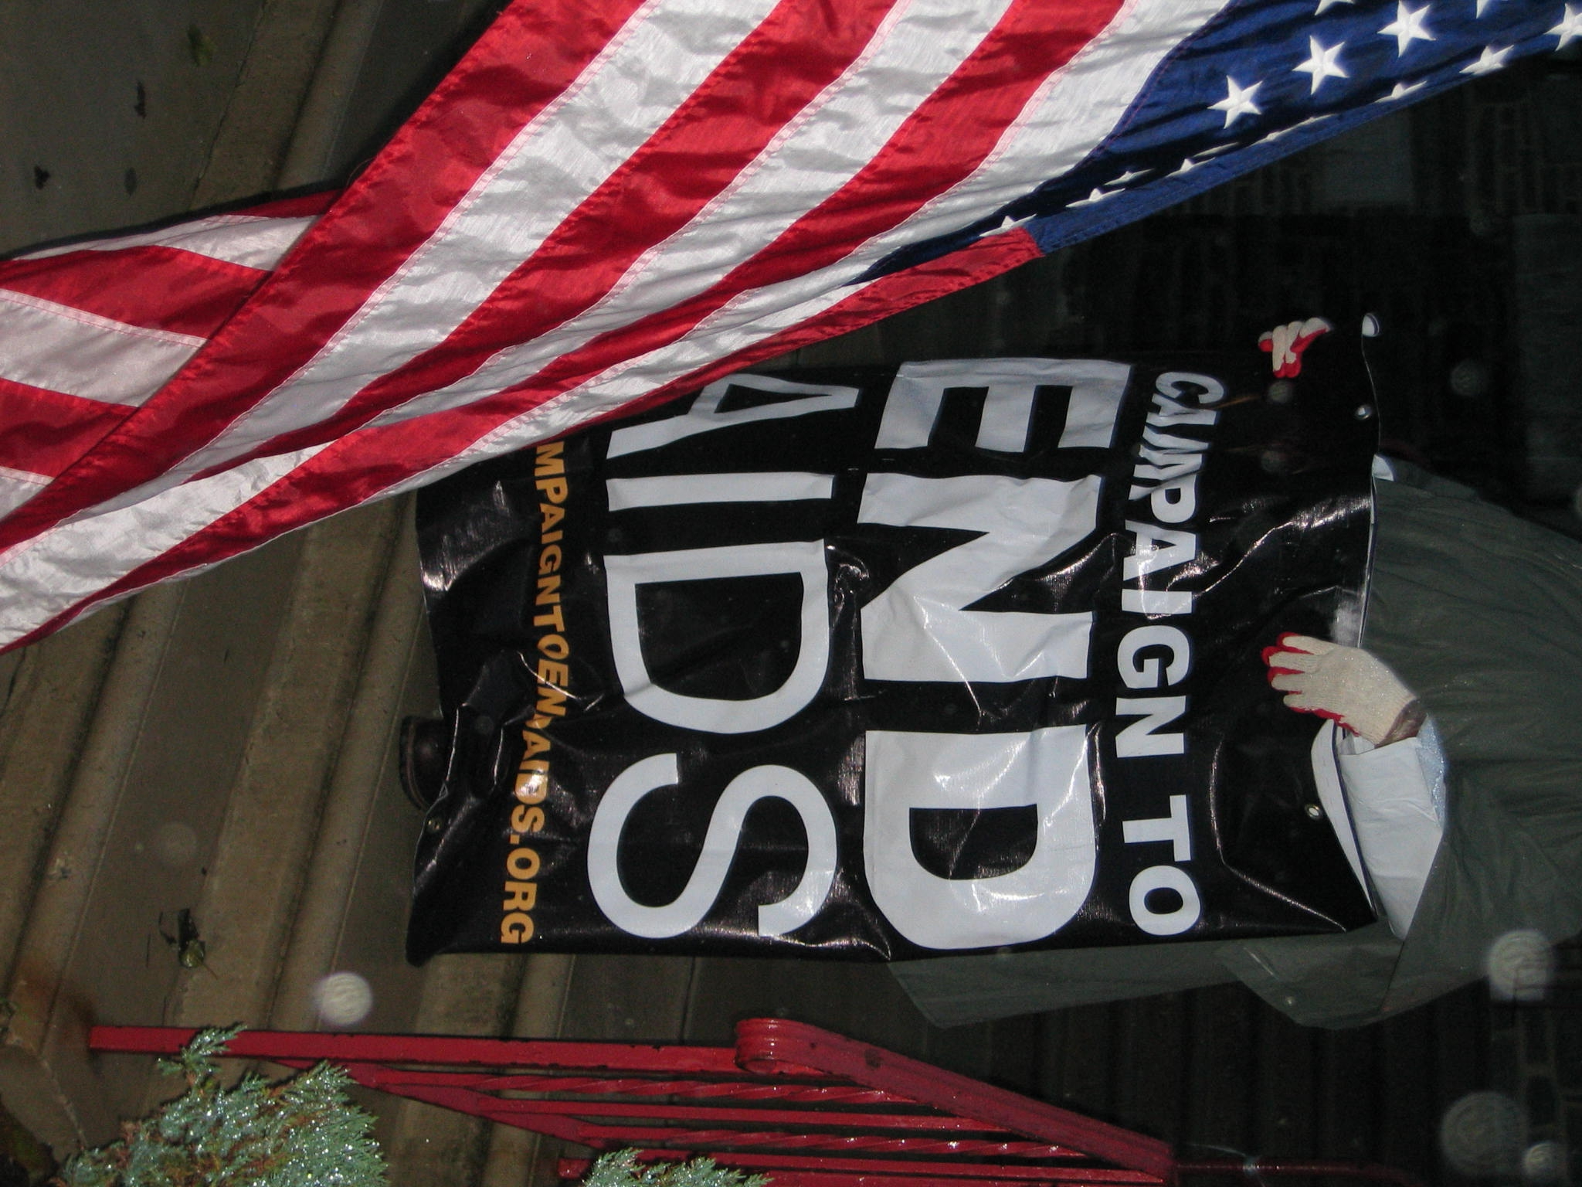

Slide 91
ECONOMICS OF HIV/AIDS IN PRISONS AND THE PRIMARY CARE MEDICAL HOMES MODEL

Slide 92
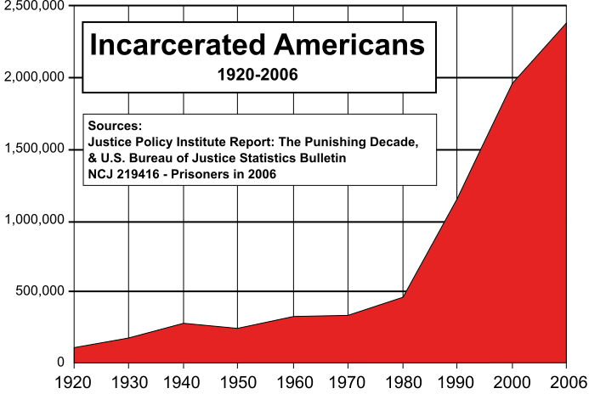
Context of the Problem
Between 1920 and 2006, the general U.S. population increased 2.8 times but the prisons population increased more than 20 times.

Slide 93

Overcrowded Prisons – A Public Health Risk

Slide 94
Positive Externalities of Jails and Prisons
More HIV tests to hard to reach population
More linkages to care and treatment; improved access to ART among prisoners living with HIV
Better adherence to medication due to the structured housing and healthcare.
Eight amendment of the U.S. Constitution: For 51,000 incarcerated in PA, their jailors are their healthcare providers.
What happens after release?

Slide 95
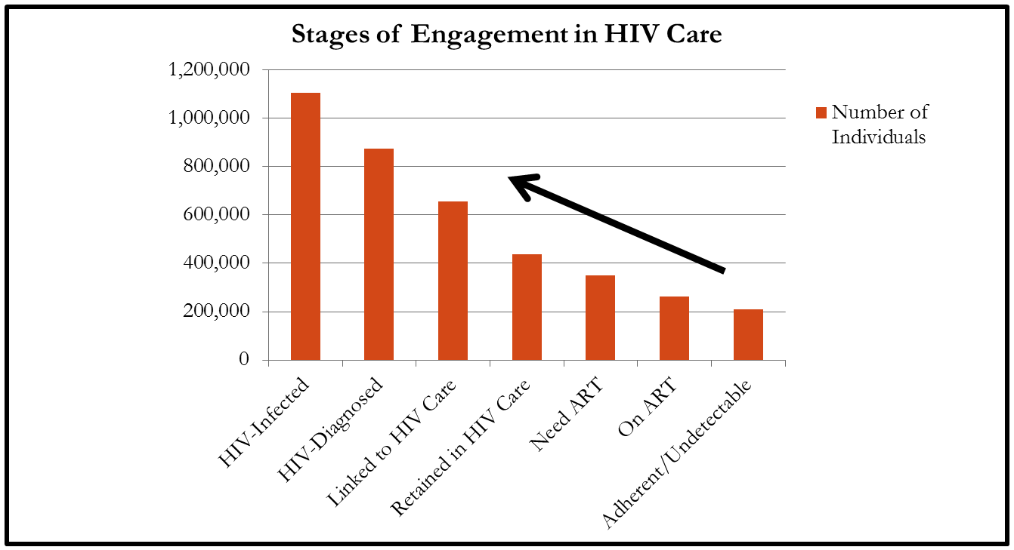
Prisoner Release and the Gardner Cascade

Slide 96
Ex-offenders Going Against the Gardner Cascade
Upon release from prison, most ex-offenders are not linked to care outside prison.
Outside prisons ex-offenders are no longer retained in HIV care; no longer have access to life saving ARTs; and their viral loads will increase, posing danger to their sexual companions in communities they return.
Unless ex-offenders are properly linked to care outside prison, the investment in health care they received while in prisons will only provide short-term benefits with long-term unintended detrimental effects.

Slide 97
Context of the problem – public health crisis in prisons
2010 Statistics
Health Condition | Affected Population
HIV/AIDS | 1.6% of male inmates and 2.1% of female inmates
Hepatitis C | 40%
Syphilis | 2.6 – 4.3%
Gonorrhea | 1%
Mental illness | 16%

Slide 98
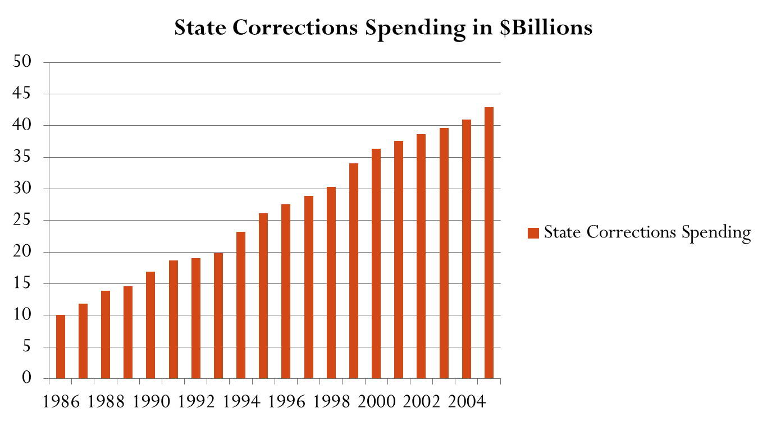
Increasing Costs of Prisons in U.S.
Notes:
35632618

Slide 99
Prison Costs
The U.S. spends more than $66 billion annually housing state and federal inmates.
More than $528 million is spent on ARV medications for prisoners living with HIV/AIDS
State of Pennsylvania alone spends over $1.6 billion housing its 51,000 prisoners and at least $20 million on ARV medications for its roughly 900 inmates living with HIV/AIDS.
New York spending about $60,000 per inmate annually (Fact Sheet, January 2012)

Slide 100
HIV & Costs of Prisons
Table 1: Model parameter assumptions: target population and service costs
Parameter (label) | United States | Pennsylvania | References
Number of people in state and federal prisons | 2,300,000 | 51,400 | 1, 2
% of prison population HIV positive | 1.80% | 1.80% | 3
Number of HIV positive patients in prisons | 41,400 | 918 | Estimated
Average cost of housing a prisoner per year | $28,800 | $32,000 | Vera (6)
Annual costs for HIV medication per year | $24,000 | $24,000
Annual cost of housing a mentally ill prisoner | $51,000 | $51,000
Average number of ER visits/year/HIV positive prisoner | 2 | 2
Average rate of recidivism | 60% | 60%
Confirmed AIDS cases in state and federal prisons | 5,674 |  | 4
Number of AIDS-related deaths in prisons | 167 |  | 4
AIDS-related deaths as % of total deaths in prison | 4.60%

Slide 101
Central Question
How to reduce prison costs while keeping ex-offenders linked to HIV care?

Slide 102
Introducing Primary Care Medical Homes (PCMHs) for Ex-offenders Living with HIV

Slide 103
PCMHs Core Principles
PCMH is an approach to providing comprehensive primary care and core wrap-around services.
Principles:
Each patient has an ongoing relationship with a personal physician trained to provide 1st contact, continuous and comprehensive care.
Whole person orientation – chronic care, preventive services, etc.
Care is coordinated and integrated across all elements of the complex health care system.
Quality and safety are hallmarks of PCMHs.
Enhanced access to care is available through systems such as open scheduling, expanded hours and new options for communication.

Slide 104
Social Services to be Provided in Ex-Offenders PCMHs
Transportation
Disease Education (Baker et al. 2003)
Housing Counseling (Arno et al., 1996 and Cunningham et al., 2007)
Psychiatric Care
Job search assistance
Vocational skills training
Access to food banks
Clothing assistance

Slide 105
Logic Model PCMH for Ex-Offenders
 |  | INTRODUCE LOW RISK PRISONERS LIVING WITH HIV TO DCCS & COMMUNITY MEDICAL CARE PROVIDERS
 |  |  | EARLY RELEASE OF LOW-RISK OFFENDERS LIVING WITH HIV IS CORDINATED WITH MEDICAL HOMES
 | TIME
 |  |  |  | APPROXIMATELY ONE YEAR BEFORE THE OFFICIAL RELEASE, HIV POSITIVE LOW RISK EX-OFFENDERS ARE RELEASED INTO MEDICAL HOMES
 |  |  |  | IN PCMHs EX-OFFENDERS RECEIVE COMPREHENSIVE MEDICAL CARE PLUS WRAP AROUND SERVICES
 |  |  |  |  | EX-OFFENDERS BECOME INDEPENDENT BUT REMAINED LINKED TO THEIR MEDICAL PROVIDERS

Slide 106
Simmulated PA Cost savings
A - $29, 376,000 – Savings from releasing the 918 patients a year early (918 * $32,000)
B - $22,032,000 – Savings from HIV/AIDS medications (918 * $24,000)
C - $2,937,600 - From prevented emergency room visits (2 visits * 918 * $1,600)
D - $17,625,600 - From prevented recidivism in the future
A+B+C = $54,345,600 Direct annual cost savings to the PA state prisons for releasing target inmates into the medical homes
A+B+C+D = $71,971,200 Total savings (This includes prevented ER visits and recidivism)

Slide 107
Net Savings & Medical Homes Sustainability
Medical homes will cost an estimated $10,000 per patient per year
For the 918 State of PA target population it will cost medical homes: $9,180,000 compared to the $29,376,000 for keeping them in prisons.
States can use 33% of their direct housing savings to finance medical homes and they will still have more than $20 million annually in savings.

Slide 108
Results from AIDS Care Group – SPNS Jails Grant
N = 88 Male = 65
Client without problems with Probation (66%) /Parole (13%) 1 yr = 79%
Compliance to HIV primary care appointment = 95%
Compliance to non-HIV medical care appointment = 90%
Compliance to substance abuse services appointment = 100%
Housing insecurity mitigated at 1 year = 39.2%

Slide 109
Changes in last 30 days use of (from base line to 6 months follow up):
No Alcohol: increase from 38% to 52%
No Heroin: increase from 72% to 95%
No Methadone: decrease from 98% to 95%
No other Opiates: increase from 88% to 99%
No Sedatives/Hypnotics: increase 83% to 92%
No Cocaine: increase from 40% to 70%
No Amphetamines: decrease from 95% to 64%
No Cannabis: increase from 75% to 97%

Slide 110
Concluding Remarks
In the HIV/AIDS response, our ultimate measures of success are infections prevented, lives improved for those living with HIV, deaths averted, and the cost-effectiveness of our programs in achieving those goals – Primary Care Medical Homes for ex-offenders move us closer to achieving those goals.

