Slide 1
The AIDS Institute: Funding the Ryan White HIV/AIDS Program-Today and Beyond
Ryan White All Grantees Meeting
Washington, DC
November 28, 2012

Slide 2
Presenters
Carl Schmid, Deputy Executive Director
Bridget Verrette, Policy Associate
Lindsey Dawson, Policy Associate
Ryan White All Grantees 2012

Slide 3
Outline
The Current Budget Environment
Budget
Appropriations
The Impact of Sequestration
Health Reform Implementation
Ryan White All Grantees 2012

Slide 4
The Current Budget Environment
Ryan White All Grantees 2012

Slide 5
Total Spending In FY 2012 = $3.717 Trillion (Outlays In Billions Of Dollars)
Source: http://www.whitehouse.gov
Ryan White All Grantees 2012
Notes:
http://www.whitehouse.gov/sites/default/files/omb/budget/fy2013/assets/budget.pdf

Slide 6
Source: http://budget.senate.gov/democratic/index.cfm/chartlibrary
Notes:
http://budget.senate.gov/democratic/index.cfm/chartlibrary?ContentRecord_id=4b566ec5-6a88-4a9c-b17f-029b06b135f9&ContentType_id=3b6d9d9f-626d-42ac-8b07-4012cc1f13ca&Group_id=09b22c0a-0c73-4536-a8e3-2ebf78883aa6&MonthDisplay=5&YearDisplay=2012

Slide 7
Gross Federal Debt: 2008–2016
(In Trillions of Dollars)
Source: http://www.gpo.gov
Ryan White All Grantees 2012
Notes:
http://www.gpo.gov/fdsys/pkg/BUDGET-2013-TAB/pdf/BUDGET-2013-TAB.pdf

Slide 8
Source: http://budget.senate.gov/democratic/index.cfm/chartlibrary

Slide 9
Budget Control Act of 2011
Congress Passed August 2011
Agreed to Cut Deficit by $2.4 trillion over 10 years
Discretionary spending caps of $917 billion in savings over 10 years
PLUS: a joint bipartisan super committee created to identify an additional $1.2 trillion in cuts
Super Committee failed to reach an agreement
Sequestration will occur on January 2, 2013, unless the Congress and President agree on an alternative
Ryan White All Grantees 2012

Slide 10
The Fiscal Cliff
End of 2012/Beginning of 2013:
Sequestration begins
Bush tax cuts expire
Social Security payroll tax cuts expire
Expiration of federal unemployment benefits
Medicare payment rates for physician services will be reduced (“doc fix”)
Debt ceiling to be reached
The Congressional Budget Office estimates this would cut GDP by four percent in 2013, causing a recession
Ryan White All Grantees 2012
Notes:
http://www.cbo.gov/sites/default/files/cbofiles/attachments/FiscalRestraint_0.pdf
“Taken together, CBO estimates, those policies will reduce the federal budget deficit by $607 billion, or 4.0 percent
of gross domestic product (GDP), between fiscal years 2012 and 2013”

Slide 11
The Current Environment
Split Government
Highly partisan
Few compromises
Government gridlock
Post-Election
Major decisions being delayed
Deferring to lame-duck
Short or long term decisions
Much depends on election results
Ryan White All Grantees 2012

Slide 12
The FY 2013 Budget
Ryan White All Grantees 2012

Slide 13
FY2013 Budget
President
Released February 2012
$1.047 trillion in spending
In accordance with Budget Control Act
Raises individual taxes for top tier, lowers corporate
Structure of Medicaid unchanged
House Republicans
Released by Paul Ryan March 2012
$1.028 trillion in spending
Lowers individual and corporate taxes
Turns Medicaid into block-grant, makes cuts
Ryan White All Grantees 2012
Notes:
http://budget.senate.gov/democratic/index.cfm/files/serve?File_id=d57a6a35-3d59-460b-a962-a88c502b9fd3
Ryan proposed $19 billion less than the BCA
http://www.whitehouse.gov/sites/default/files/side_by_side_040312.pdf

Slide 14
FY2013 Budget
Senate Democrats
In accordance with Budget Control Act numbers
$1.047 trillion in spending (matches President)
Decided through “deeming” resolution March 2012
No final budget agreed to by Congress
House and Senate proceeded with different budget caps
Influences appropriation levels
Ryan White All Grantees 2012
Notes:
http://budget.senate.gov/democratic/index.cfm/files/serve?File_id=d57a6a35-3d59-460b-a962-a88c502b9fd3
refers to legislation deemed to serve as an annual budget resolution for purposes of establishing enforceable budget levels for a budget cycle. A deeming resolution is used when the House and Senate are late in reaching final agreement on a budget resolution or fail to reach agreement altogether

Slide 15
Spending Allocations
Subcommittee Allocations | House | Senate
Defense | $519.2 b | $511.2 b
Labor, HHS | $150.0 b | $157.7 b
Total | $1.028 trillion | $1.047 trillion
~$8 billion difference between Defense and Labor, HHS
Ryan White All Grantees 2012

Slide 16
Ryan White Program Appropriations
Ryan White All Grantees 2012

Slide 17
Ryan White All Grantees 2012
Notes:
Source: http://hab.hrsa.gov/livinghistory/legislation/funding.htm

Slide 18
Ryan White Program Appropriations History 1991-2012
$900
Part A
Part B Base
$800
ADAP
Part C
$700
Part D
Dental Reimb.
$600
AETCs
$500
Millions
$400
$300
$200
$100
$0
1991
1992
1993
1994
1995
1996
1997
1998
1999
2000
2001
2002
2003
2004
2005
2006
2007
2008
2009
2010
2011
2012
Source: HRSA HIV/AIDS Bureau; The AIDS Institute

Slide 19
Ryan White Program Historical Funding
(In Millions) | FY10 | FY11 | FY12
Part A | +$15.0 | (-$0.4) | (-$6.4)
Part B: Base | +$10.0 | (-$0.8) | + $4.2
Part B: ADAP | +$43.0* | +$27 .0 | +$48.3*
Part C | +$4.5 | (-$0.8) | +$9.5*
Part D | +$0.74 | (-$0.3) | (-$0.1)
Part F: AETCs | +$0.42 | (-$0.1) | (-$0.1)
Part F: Dental | +$0.17 | (-$0.1) | +$0.0
Total | +$73.8 | +$24.5 | +$55.4
Includes emergency funding: $25 m to ADAP in FY10, $35 m to ADAP and $10 m to Part C in FY12. An additional $5 m for Part C went to Community Health Centers.
Ryan White All Grantees 2012

Slide 20
Ryan White Program FY13
President’s Budget: $2.472 billion (+$80 million)
Senate: $2.422 billion (+$30 million)
House: $2.345 billion (-$47 million)
cuts to non-ADAP programs of $114 m
Ryan White All Grantees 2012
Notes:
$114 million cut to other Parts of the Program from the House

Slide 21
Ryan White Part A
Source: CAEAR Coalition
Ryan White All Grantees 2012
Notes:
There are 52 Part A jurisdictions in 24 states, Puerto Rico, and the District of Columbia that receive Part A funding.

Slide 22
Ryan White Part A
Funding has decreased since 2010
FY13:
President: flat funding
Senate: -$5.2 m
Confusion over interpretation of TGA funding
House: Unknown – no committee report
Ryan White All Grantees 2012
Notes:
Mention no committee report

Slide 23
Source: NASTAD
Ryan White All Grantees 2012

Slide 24
Ryan White Part B: Base
FY13:
President: +$0.1 m
Senate: +$5.3 m
Confusion over interpretation of TGA funding
House: Unknown
Ryan White All Grantees 2012

Slide 25
Notes: An additional $25 million was provided in August of FY2010 and is included in the FY2010 total.
An additional $35 million was provided in December of FY2012 and is included in the FY2012 total.
Notes:
1996 $52
1997 $167
1998 $286
1999 $461
2000 $528
2001 $571
2002 $620
2003 $714
2004 $749
2005 $787
2006 $789
2007 $790
2008 $794
2009 $815
2010 $860
2011 $885
2012 $933

Slide 26
Ryan White Part B: ADAP
FY13:
President: +$67 million
Incorporates $35 million World AIDS Day funding
Total increase: $102 million
House: +$67 million
Incorporates $35 million World AIDS Day funding
Total increase: $102 million
Senate: +$30 million
Incorporates $35 million World AIDS Day funding
Total increase:$65 million
Ryan White All Grantees 2012
Notes:
Incorporating the funding means other programs do not receive cuts.

Slide 27
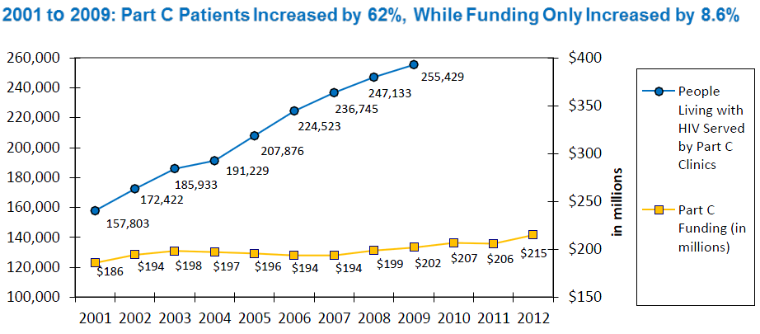
Ryan White Part C
Source: HIVMA
Ryan White All Grantees 2012

Slide 28
Ryan White Part C
FY13:
President: $235.6 million (+$20.5 million)
Incorporates $15 million World AIDS Day funding
Senate: flat
Incorporates $10 of the $15 million World AIDS Day funding
House: Unknown
Ryan White All Grantees 2012

Slide 29
Ryan White All Grantees 2012
Notes:
SPNS Flat

Slide 30
Ryan White Part D and Part F
FY13: Part D
President: -$7.6 m
A 10% cut
Senate: flat
Rejects President’s proposed cut
House: Unknown
FY13: AETCs, Dental, and SPNS
President: flat
Senate: flat
House: Unknown
Ryan White All Grantees 2012
Notes:
NEED HISTORY

Slide 31
The Impact of Partisan Government
No budget agreement
Labor HHS and all other funding bills stalled
House floor passed 6 appropriations bills
Senate voted on none
Fiscal Year began October 1st
As a result, Congress passed a 6 month Continuing Resolution
Through March 27, 2013
At BCA level of $1.047 T
0.612% increase in funding levels across the board
President submits spending plan
Ryan White All Grantees 2012

Slide 32
FY2012 Continuing Resolution
A 0.612% increase in funding levels across the board
Ryan White Program | CR funding | Increase
Part A | $675.41 m | +$4.11 m
Part B: Base | $424.76 m | +$2.56 m
ADAP | $939.0 m | +$5.71 m
Part C | $216.42 m | +$1.32 m
Part D | $77.67 m | +$0.47 m
Part F: AETCs | $34.71 m | +$0.21 m
Part F: Dental | $13.58 m | +$0.08 m
Part F: SPNS | $25.15 m | +$0.15 m
TOTAL | $2.41 b | +$14.61 m
Ryan White All Grantees 2012

Slide 33
The Impact of Partisan Government
FY13 final spending bills can be addressed:
In current lame-duck
By new Congress and next President
Continue CR through the entire year
Omnibus or individual bills
Ryan White All Grantees 2012

Slide 34
HIV/AIDS Programs & the Budget
Despite significant overall budget cuts, Ryan White has been mostly spared, some parts have received increases
Domestic HIV programs have been a priority for Obama Administration
Republican support for some HIV programs continues
How long will this last?
Ryan White All Grantees 2012

Slide 35
The Impact of Sequestration on the Ryan White Program
Ryan White All Grantees 2012

Slide 36
Sequestration
Equal cuts between defense and non-defense through FY 2021
Medicare cuts capped at 2%
Medicaid, Social Security, other low-income entitlement programs exempt
In FY 13, proportional, across-the-board cuts of 8.2% to non-defense discretionary (NDD) programs
FY 2014-2021 spending caps in accordance with BCA
Ryan White All Grantees 2012

Slide 37
Impact of Sequestration
First year: 8.2% cut to non-defense discretionary programs*
PROGRAM | LOSS
Part A | -$55.0 m
Part B: Base | -$34.6 m
ADAP | -$76.5 m
Part C | -$17.6 m
Part D | -$6.3 m
Part F: AETCs | -$2.8 m
Part F: Dental | -$1.1 m
Part F: SPNS | -$2.1 m
TOTAL | -$196 million
For illustrative purposes only. Assume cuts taken from FY 2012 levels.
Ryan White All Grantees 2012
Notes:
MATH?

Slide 38
The AIDS Institute
Funding the Ryan White HIV/AIDS Program: Today and Beyond
The Impact of Health Reform
Lindsey Dawson, Public Policy Associate
2012 Ryan White HIV/AIDS Grantee Meeting
Washington, DC
November 28, 2012
The AIDS Institute

Slide 39
Outline
Role of Ryan White in ensuring care and treatment for people with HIV
Where are we today?
Reauthorization
What coverage can we expect from health care reform?
What gaps will exist?
Gaps in coverage and variability by state and plan
Those without coverage
Support services
Cost sharing
What can we learn from example?
MA
The AIDS Institute

Slide 40
Number And Percentage Of HIV-infected Persons Engaged and Unengaged In Selected Stages Of HIV Care — United States
206,676
Percentage
861,150
941,524
The AIDS Institute analysis. Centers for Disease Control and Prevention. Monitoring selected national HIV prevention and care objectives
by using HIV surveillance data—United States and 6 U.S. dependent areas—2010. HIV Surveillance Supplemental Report 2012;17(No. 3, part A). http://www.cdc.gov/hiv/surveillance/resources/reports/2010supp_vol17no3/pdf/hssr_vol_17_no_3.pdf#page=22.

Slide 41
Today and Beyond: Reauthorization
Last reauthorized by Ryan White HIV/AIDS Treatment Extension Act of 2009
Expires September 30, 2013
Does not sunset, program can continue to be funded
Discussions and studies taking place about how to proceed
HRSA and ASPE Mathematica studies
The AIDS Institute

Slide 42
Today and Beyond: Reauthorization
Three paths forward:
Do Nothing, allow the program continue as is
Funding can be appropriated
But questions remain
How would it be determined?
At what level?
Reform Ryan White with full reauthorization
Difficulty of many unknowns
Jeopardize program
Community consensus can be more difficult
Could be more difficult to get through congress
The AIDS Institute

Slide 43
Today and Beyond: Reauthorization
Minor adjustments to the program
Keep the core of the program as is and make small changes
Allow time to consider the impact of health care reform
Community appears to be advocating for this third option
Will still need to consider funding
The AIDS Institute

Slide 44
Impact of Health Reform
Health reform will have a dramatic impact on access to care and coverage
Questions remain on how it will impact funding
Do we need $2.4B? $933m for ADAP? Funding needs for other parts.
Many people currently served by Ryan White are covered by other payers including Medicaid and private insurance
Funding needs will continue, we know that even those covered by other payers today rely on Ryan White services
The AIDS Institute

Slide 45
*54,007 are unknown/unreported. This number is not included in the percentage totals above
†Response categories are not mutually exclusive.
◊Percentages may not add to 100 due to rounding.
Source: Health Resources and Services Administration: http://hab.hrsa.gov/stateprofiles/2010/states/us/Client-Characteristics.htm#sources
The AIDS Institute

Slide 46
Health Reform: Private Insurance
Critical new protections and subsidies mean that PLWH will have greater and more affordable access
Primarily those over 138% FPL and over 100% FPL in states that do not expand their Medicaid programs
No lifetime limits, no-bans on preexisting conditions, non-discrimination language
Mental health parity and 10 required categories of essential health benefits
But there are still significant costs and unknowns about how robust coverage will be and RW must be adequately funded to cover these gaps
The AIDS Institute

Slide 47
Health Reform: Medicaid
Medicaid will provide health coverage to many people with HIV
SCOTUS decision effectively allows states to choose whether or not to expand their Medicaid programs to include those up to to 138% FPL
Doing away with categorical eligibility
A great number of Ryan White clients will be eligible
Hope to see a phasing in of acceptance as with Medicaid and CHIP in the past
The AIDS Institute

Slide 48
* Missing/unknown values (20%) excluded.
Source: 2010 RW Services Report- Preliminary Data from presentation: L. Cheever. IDWeek. The Evolution of the Ryan White Program Under Health Care Reform. October 18, 2012.
The AIDS Institute

Slide 49
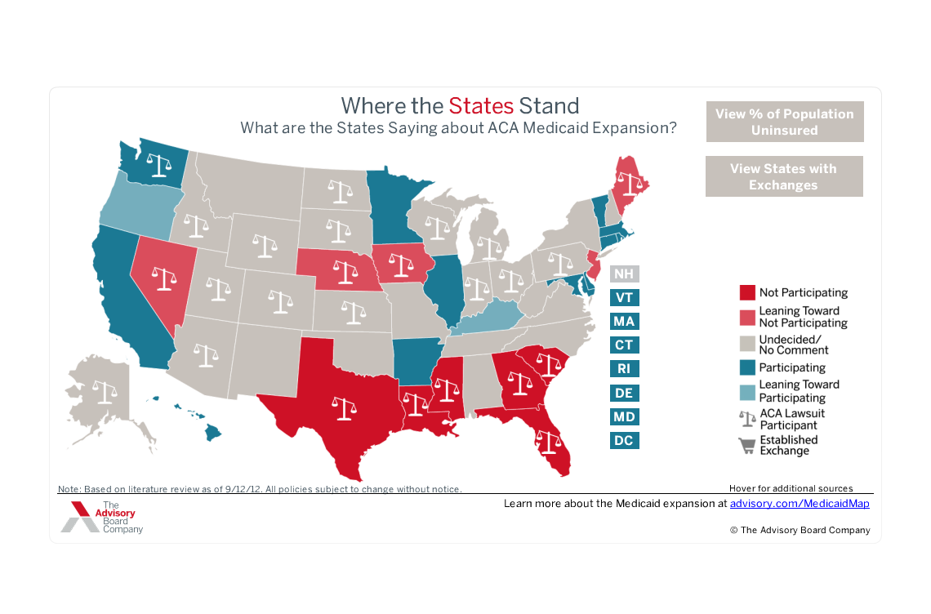
Health Reform: Medicaid
Source: The Advisory Board Company Medicaid Map: http://www.advisory.com/Daily-Briefing/2012/07/18/The-Advisory-Board-Medicaid-map
The AIDS Institute

Slide 50
Essential Health Benefits
Individual and small group plans and expanded Medicaid plans will be subject to the Essential Health benefits
10 categories of services (incl. ambulatory, prescription drug, and preventative services)
Secretary defined by allowing states to benchmark on existing plans
Within a state Medicaid and Private Insurance benchmarks can differ
Will largely determine the coverage floor in a state
Variability will continue by: state, benchmark selected and in exchanges by state mandates, plan chosen
The AIDS Institute

Slide 51
Health Reform: Is it enough?
Health Reform is unlikely to meet the care and treatment needs of people living with HIV on its own
Not everyone will be covered (up to 23m people):
Lost to care, fall-out of care- possibly during churning between programs, undocumented and ineligible immigrants, and those who never access care
Full and seamless implementation will take time
All systems will not be up and ready Jan. 1, 2014
There are bound to be unexpected problems
Current systems must remain until people can be carefully transitioned
Don’t want to jeopardize the good job Ryan White is doing
The AIDS Institute

Slide 52
The AIDS Institute

Slide 53
Service Gaps
Ryan White will continue to be needed to provide wrap around services and fill in less generous plans- critical to preserve the health of PLWH
Oral care
Nutrition Services
Legal Services
Supportive Housing
Transportation
Filling in medical services and drug benefits for less adequate plans (esp. considering one drug per class)
The AIDS Institute

Slide 54
Other future roles for Ryan White
Case Management
Address adherence
Possible role as navigators
Prevention with positives
Continued HIV testing efforts
Cost sharing assistance, affordability will remain a concern
While people maybe able to access healthcare systems as a result of reform, accessing care itself may remain out of reach
Premiums can still be adjusted: age, geography, smoking
Funding to assist with Premiums, co-payments, and coinsurance will be key
The AIDS Institute

Slide 55
* Missing/unknown values (20%) excluded.
Source: 2010 RW Services Report- Preliminary Data from presentation: L. Cheever. IDWeek. The Evolution of the Ryan White Program Under Health Care Reform. October 18, 2012.
The AIDS Institute

Slide 56
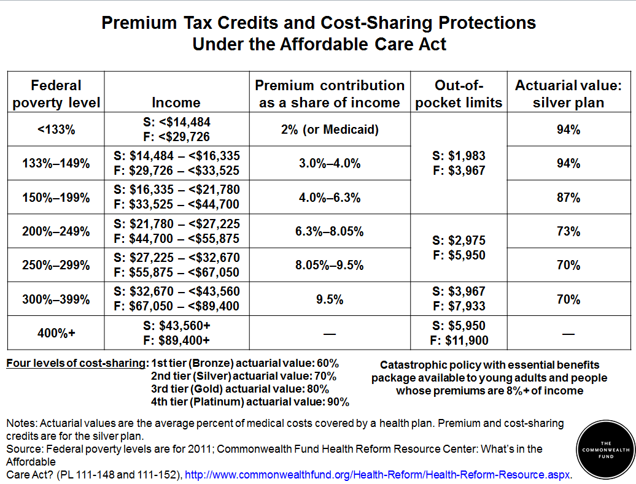

Slide 57
The Massachusetts Example
MA provides a case study for health reform having gone through a state wide health reform and expanding Medicaid
98 % of state residents now have some form of insurance
The state continues to use Ryan White dollars
Helping substantially with cost-sharing
Since health reform, the proportion of ADAP funds used to cover the full cost of drugs has decreased while the share used to cover premiums and cost-sharing has increased
At the same time PLWH are experiencing better health outcomes compared to the nation at large
Source: Massachusetts Division of Health Care Finance and Policy, Key Indicators, June 2011 and Massachusetts Health Insurance Survey,2010.
The AIDS Institute

Slide 58
Examples of Ryan White Program Resource Allocation
Massachusetts ADAP Expenditures by Category
Fiscal Year | Full Pay | Co-Pay | Premiums
FY03 | $ 7,961,862.84 | $ 963,205.88 | $ 1,778,272.33
FY04 | $11,174,879.98 | $ 1,553,758.50 | $ 3,159,200.01
FY05 | $ 9,756,201.76 | $ 1,839,807.23 | $ 6,112,132.85
FY06 | $ 4,634,683.35 | $ 1,893,206.26 | $ 7,015,306.89
FY07 | $ 4,147,713.84 | $ 2,071,118.94 | $ 8,366,273.11
FY08 | $ 4,184,279.93 | $ 2,083,431.58 | $ 9,323,821.42
FY09 | $ 4,695,780.40 | $ 2,567,789.28 | $ 8,835,835.67
FY10 | $ 4,635,751.00 | $ 2,930,016.65 | $ 9,320,425.00
FY11 | $ 4,467,727.48 | $ 3,175,917.00 | $ 10,990,818.00
Source: Massachusetts Department of Public Health

Slide 59
The AIDS Institute

Slide 60
* MA population includes 5% NH residents
The AIDS Institute

Slide 61
(1) CDC defines suppression as ≤200 copies/mL)
(2) Self-reported
The AIDS Institute

Slide 62
Concluding Thoughts
MA makes a strong case for continued funding
Demonstrates that continued Ryan White services and financial assistance along with health reform can impact HIV health outcomes
Help to meet the care and treatment goals of the National HIV AIDS Strategy
Much is to be determined and relies on the election results
Not yet possible to determine future funding needs
We know caring for people with HIV early on is cost-effective
The AIDS Institute

Slide 63
Concluding Thoughts
Health reform will change the landscape regarding access to healthcare yet:
Many new people will enter healthcare systems will need wrap around services and cost-sharing assistance
There will be variability among payers, plans and states
It remains critical to preserve the expertise of the Ryan White system of care
We cannot threaten the wellbeing of those in proven systems of care by uprooting them until we truly understand how implementation plays out and assess gaps (in services and among people)
The AIDS Institute

Slide 64
Concluding Thoughts
Only after full implementation, and the dust settles, can we consider alternate futures for the program
And properly assess possible changes to funding needs
In the mean time we must be vigilant in protecting Ryan White funding, especially against the challenging budgetary climate
The AIDS Institute

Slide 65
Resources
HRSA Ryan White State Profiles:
http://hab.hrsa.gov/stateprofiles/2010/states/us/Client-Characteristics.htm#sources
Health Resources and Services Administration. Going the Distance: The Ryan White HIV/AIDS Program20 Years of Leadership, a Legacy of Care. August 2010. http://hab.hrsa.gov/data/files/2010progressrpt.pdf
The Advisory Board Company Medicaid Map http://www.advisory.com/Daily-Briefing/2012/07/18/The-Advisory-Board-Medicaid-map
Massachusetts Department of Public Health: http://www.mass.gov/eohhs/gov/departments/dph/
JSI Research and Training, Inc. Massachusetts and Southern New Hampshire HIV/AIDS Consumer Study Final Report. December 2011. http://www.mass.gov/eohhs/docs/dph/aids/consumer-study-june-2011.pdf
The Commonwealth Fund. S. R. Collins, R. et. al. The Income Divide in Health Care: How the Affordable Care Act Will Help Restore Fairness to the U.S. Health System. February 2012 http://www.commonwealthfund.org/Publications/Issue-Briefs/2012/Feb/Income-Divide.aspx
The AIDS Institute

Slide 66
The AIDS Institute
THANK YOU
Lindsey Dawson - ldawson@theaidsinstitute.org
202-835-8373
www.theaidsinstitute.org
The AIDS Institute

