Slide 1



2012 All Grantee Meeting
November 28, 2012
Guidance to Using Fotonovelas as a Health Literacy Tool to Educate Latinas on HIV/AIDS
Grant Number
H89HA00041
H12HA24836

Slide 2
Fotonovela Project Partnership
San Antonio Transitional Grant Area Ryan White Part A (Bexar County)
UTHSCA South Texas Family AIDS Network-Ryan White Part D
The Health Collaborative
  San Antonio Health Literacy Initiative
  SAGE Words
  Ana Matiella, ACMA Social Marketing and The Fotonovela Production Company

Slide 3
San Antonio Transitional Grant Area Project Overview
Conceptualization responded to a need for low literacy tool to do outreach to Latina women regarding HIV testing and condom usage
Founded on principals of Health Literacy
  "The degree to which individuals have the capacity to obtain, process, and understand basic health information and services needed to make appropriate health decisions."

Slide 4
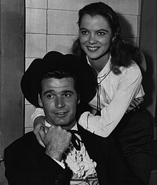
Why fotonovelas?
historically familiar
  “began as a pictorial summary of Hollywood flims in the 1950s and then evolved into their own unique medium”
  “The use of educational fotonovelas began in the 70s with organizations such as Aid for International Development, who produced fotonovelas… in Latin America and Africa.” http://fotonovelacompany.com/history-2/
especially popular with middle-aged Latina women
evidence-based
  they are “a useful medium for health education among Latinos.” http://www.usc.edu/uscnews/stories/15785.html
Notes:
Robin Lewy of the Rural Women's Health Project suggested that the fotonovela's evolution into
an educational medium is somewhat ironic.
"There's a need to change the way in which the form is traditionally used," Lewy said.
"Fotonovelas are a lot about sex and power and domination. And for us, the fotonovela has really
had to acculturate as it's crossed the border in working with immigrant communities."
© 2008 by The Durham Herald Company. All rights reserved.

Slide 5
FotoNovela
Health Collaborative was commissioned to complete the first Foto Novela that would be used to address the importance of safe sex and protection in Hispanic women most at risk:
  Young (Jovencitas) women 18 yrs or older
  Adult (Damas) women 35-55 years
  Seniors (Dona) women over 55 years
Partnership with SAGE Words and Anna Matiella

Slide 6
Health Literacy Tool
fotonovelas are inherently health literate
    dialogue= short text
    graphics based
dialogue models what you need to be able to say
they are narratives: storytelling is a most compelling way to relay and receive information
“people being able to see themselves -- that’s what's the joy of it.” Robin Lewy the Rural Women's Health Project, Gainesville, FL
Notes:
fotonovela is:
based in graphics
based in narrative
not the in the sense of graphics closely related to text—
but not just happy smiling people—use graphics exercise
two good hl strategies

Slide 7
What was the design?
defining the message:
  Prevention and protection = HIV Testing and Condom Usage
  Help and encouragement = cultural competency, health literacy and the use of visual/graphics
  List where resources could be found= access to HIV Testing and services
  Why it’s important= because we are at risk. High rates of infection among Latina Women

Slide 8
What was the approach?
  Convene expert panel
    Expert panel parameters
      Incorporated teach back methods
      Patient friendly education tools/materials to enhance interaction
      Prevention message
      Incorporate cultural awareness and use of graphic
      Why is it important
  Use collaborative composing with HIV infected and affected participants and expert panel participants

Slide 9
Approach (continued)
  Linked with community groups for active participation and interaction about the project
  Upon final draft, conduct usability test and modify as per focus group feedback
  Selected three targeted age groups among Latina women

Slide 10

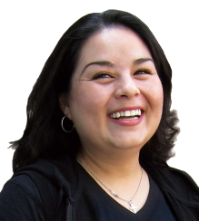
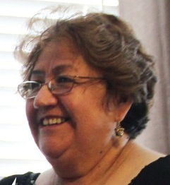
Targeting the message
jovencitas 18-29
damas 30-45
doñas 45 and older

Slide 11
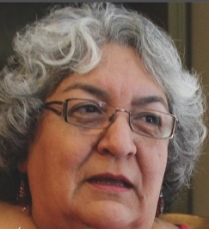
Knowing the receiver
(cultural awareness)
We relied on the knowledge and experience of HIV/AIDS service providers in Bexar county:
        Latinas
        recognition of the importance of different age groups
The context for this message will be different for different age groups. It will need to be delivered differently for each one.
Notes:
Begins with paying attention to who your audience is
Proposal began in with a group of HIV Aids service providers here in Bexar county
knowledge of their clients
knowledge of which clients werent being reached
which clients needed to be reached
1. the total of the inherited ideas, beliefs, values, and knowledge, which constitute the shared bases of social action
2. the total range of activities and ideas of a group of people with shared traditions, which are transmitted and reinforced by members of the group: the Mayan culture
3. a particular civilization at a particular period
4. the artistic and social pursuits, expression, and tastes valued by a society or class, as in the arts, manners, dress, etc
5. the enlightenment or refinement resulting from these pursuits
6. the attitudes, feelings, values, and behaviour that characterize and inform society as a whole or any social group within it: yob culture

Slide 12
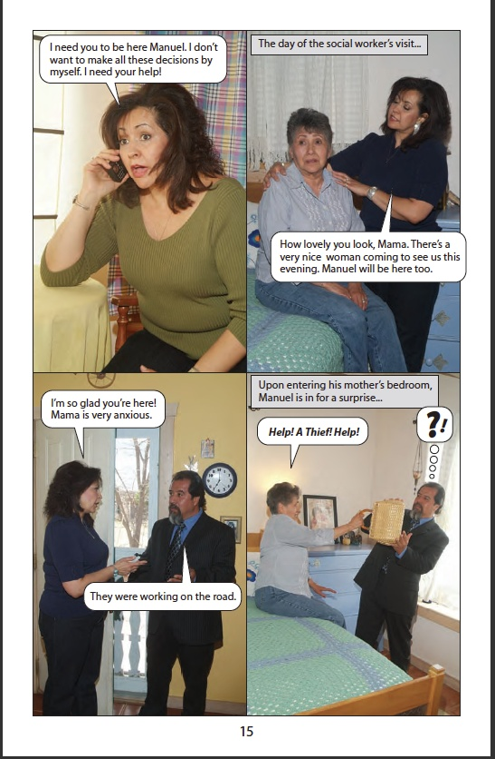
Choosing the form
Fotonovelas—what are they?
A page from “Unidos Podemos –
Together We Can” created by The Fotonovela Production Company in collaboration with Stanford University School of Medicine and The National Alzheimer’s Association.
“The story models how a family can come together, support each other and share the responsibility.”
http://fotonovelacompany.com/

Slide 13
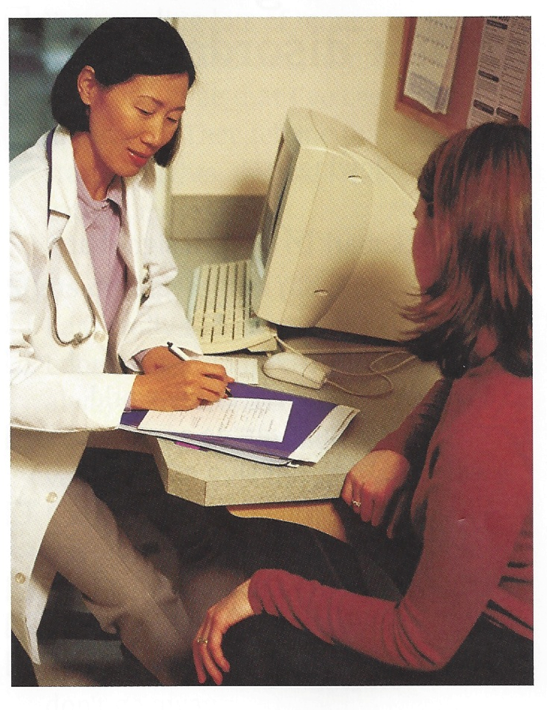
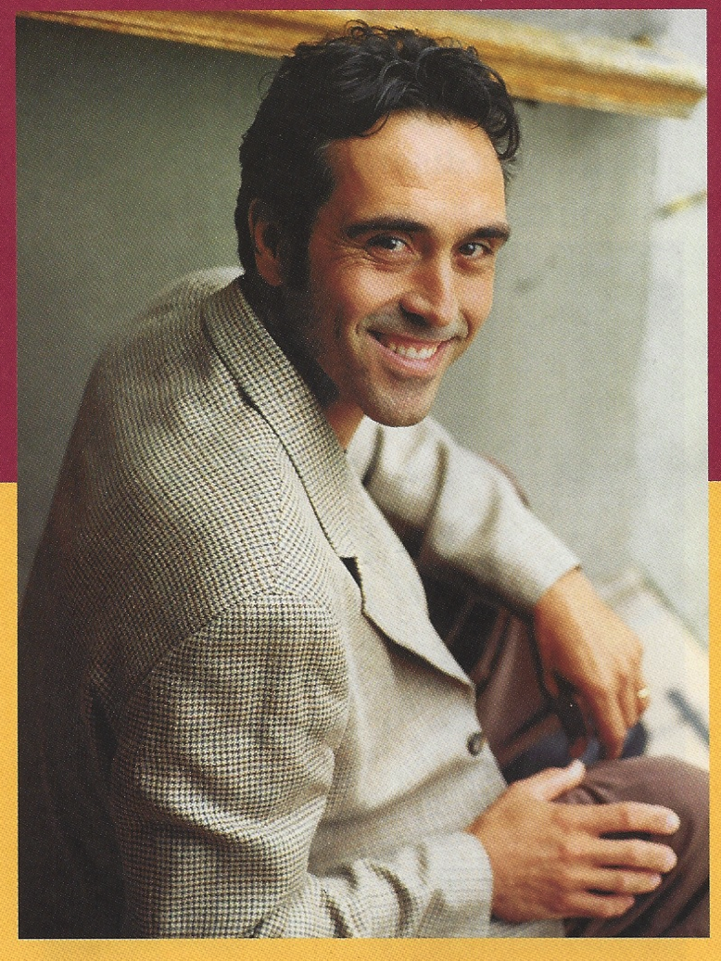
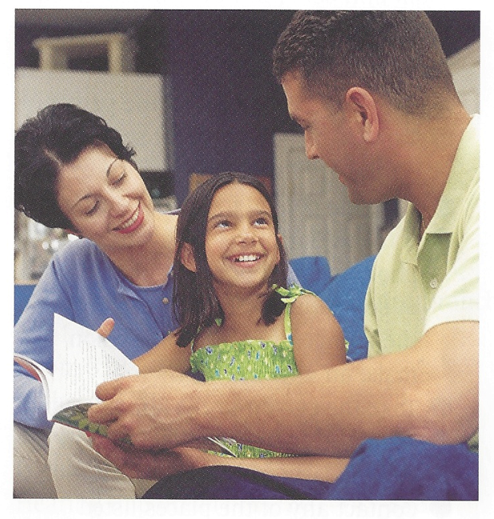
a note about graphics: what is the topic?
Notes:
Just having graphics does not add to comprehension, though using graphics is more likely to invite people to pick it up and to assure them that they can understand.
Graphics in some way or another need to be about the topic and reflective of the audience.
Not—”the text is a caption to the graphics” but “The graphics are the caption to the text”

Slide 14
format reflects the reader
  small in size, easy to keep confidential
  revista (magazine) format:
  an update
  of the fotonovela concept
  a traditional fotonovela

Slide 15
Development Process
  Conducted collaborative composing with three specific age groups
  Developed story line and story boards for Fotonovela based on focus group participant feedback. Specifically allowing participant stories to be used as the basis for the outreach/education/awareness
  Using HL concepts developed illustrations and format that was most appropriate in target messages for the specific age groups.

Slide 16
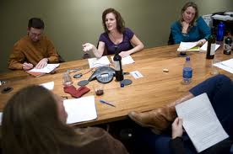
user input: collaborative composing
technique from teaching writing classes
focuses on the generation of many possible points of view/solutions to a problem
the end users write the text. the message is in their own words
the end user has input into
what is important, what is
difficult to do and say
the end user has input into
style and design
Notes:
Best if you have s skilled facilitator
We went to the groups twice, once to generate ideas, once to have them look at and read over and critique

Slide 17
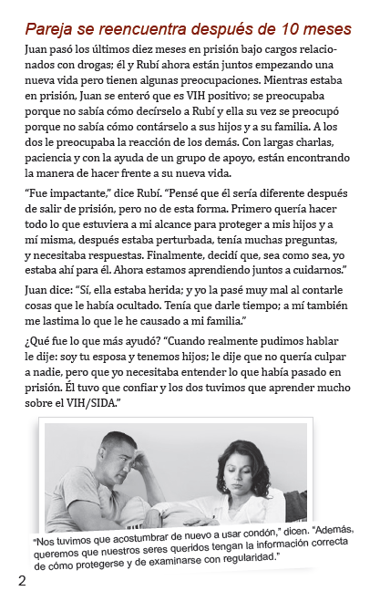



for the damas

Slide 18
how did it work?
Exercises from the workshops
Félix llegó a casa ayer por la noche luego de pasar 10 meses en prisión. ¡Los niños e Isabella están tan contentos de verlo! Me alegro por ellos, pero a la vez estoy preocupada.
Doñas
Notes:
20-25 minutes to do exercises

Slide 19
damas
jovencitas

Slide 20
more high touch: usability testing and focus groups
What is usability testing?
A kind of field testing that settles arguments.
Seeing through the eyes of other people—actual users.
Watching people (actual users from your end user group) use what you’ve made while they think out loud. (Their words can give you a “fix-it” clue)
NOT a focus group.
NOT just opinions, though they can help too
Notes:
you can actually get a fairly objective idea if the message has been comprehended

Slide 21
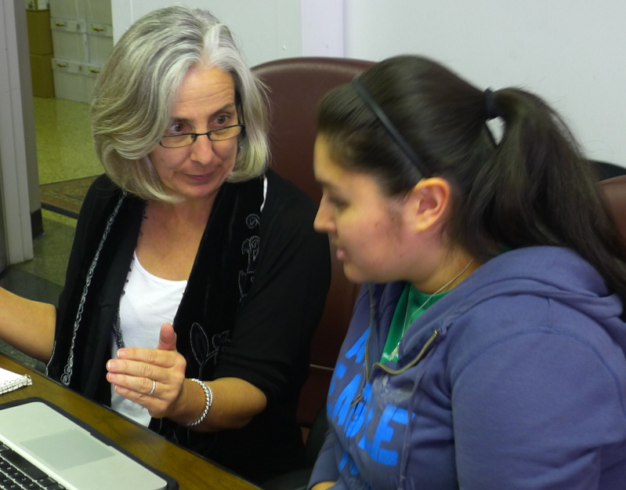
sample questions
Think aloud
You are in a relationship and you want your partner to use condoms or to get tested: What would you say to him? [Record responses, note any instances of repeating the text, or phrases like, “well it says here…” Record any other responses, like confusion, agreement, facial expressions, etc.]
What do you think
the main message is?
Where is one place you can go
to get tested for HIV?
Is there any language or part
of the dialogue that doesn’t
sound real or authentic to you?

Slide 22
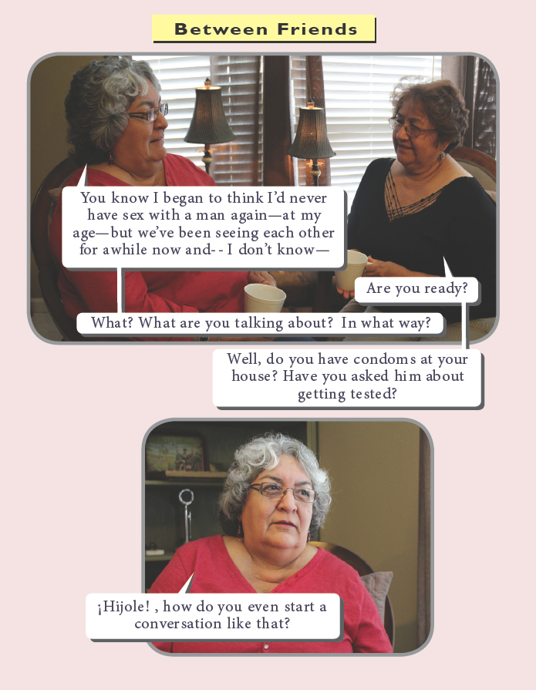
doñas
The small font presented a difficulty for each of the women.
One of three directly stated testing as the main message. It was present in the response of the other two but more subtle.
None of the three identified the sources for testing or saw the resource page.

Slide 23

damas
Four of five said the main message was to use protection. They also said take care of yourself, respect yourself, and educate yourself.
The women also responded strongly to the cover, with many comments about the colors, and repetition of text (that is, testers incorporated lines from the text into their comments to us). Two clients specifically mentioned liking “the shadow side.”
Two of the five clients did not find the resources until prompted.

Slide 24
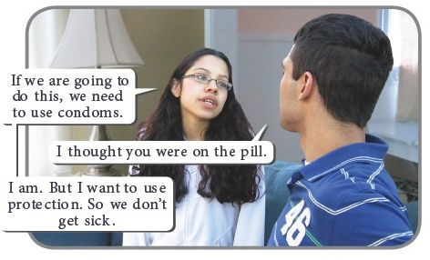
jovencitas
Six out of seven missed the resources page until the facilitator prompted them.
Four of seven
talked about
testing as the
main message.
Five clients said they would pick it up because they needed the information. Four clients also said they would pick it up because the conversation was interesting.

Slide 25
A quick review:
Strategies for patient-friendly education materials
Cultural awareness
Plenty of white space
5th grade reading level
Graphics
Fonts and font size
User input into the content
Plain language
Notes:
What are some of these strategies

Slide 26
Focus Group Partners
San Antonio Aids Foundation
Project FATE
South Texas Family Aid Network Services, UTHSCSA
UHS FFACTS Clinic
UHS Family Planning Services
Beat Aids
Hope Action Care
Mujeres Unidas
Project HEART
AARC
CentroMed

Slide 27
Next Steps
Evaluation and dissemination plan 2012-2013
  Look for new disseminations point
    Gain non-HIV AIDS community support
    Provide other healthcare partners the Fotonovelas for education to their patients (ObGyn, PCP, Pediatricians, Family Practice, ER, Patient Education)
    Use technology to reach other market groups –privacy and reduce stigma
    This is the 3rd presentation: used as a model for effective communication and health education with traditional formats and enhance effectiveness with additional tools.

Slide 28
Q and A
Questions…

Slide 29
For more information on this project and other HIV AIDS Health
Health Literacy training efforts please visit:
http://www.healthcollaborative.net
http://www.sahealthliteracyinitiative.com
Special thanks and partnership acknowledgement to:
Kath Anderson
SAGE Words, Austin Texas
Sagewords.org
512-468-9419
kath@sagewords.org
Resource Consultant Ana Matiella expert in the development of Fotonovelas, of ACMA Social Marketing, LLC.

