Slide 1




HIV Patient Centered
Medical Homes Construction:
A Multi-Site Experience
Erin Gael Friedman
Sonali Kulkarni, MD, MPH
Amy Sitapati, MD
Wayne Steward, PhD, MPH

Slide 2
Disclosures
  This continuing education activity is managed and accredited by Professional Education Service Group. The information presented in this activity represents the opinion of the author(s) or faculty. Neither PESG, nor any accrediting organization endorses any commercial product displayed or mentioned in conjunction with this activity.
  Commercial Support was not received for this activity.

Slide 3
Disclosures
  Erin Gael Friedman
  Has no financial interest or relationships to disclose
  Sonali Kulkarni, MD, MPH
  Has no financial interest or relationships to disclose
  Amy Sitapati, MD
  Has no financial interest or relationships to disclose
  Wayne Steward, PhD, MPH
  Has no financial interest or relationships to disclose

Slide 4
Learning Objectives
  At the conclusion of this activity, the participant will be able to:
  Identify the major elements of a patient-centered medical home (PCMH).
  Characterize how implementation of a PCMH in HIV primary care settings is similar to or different from implementation in other care environments.
  Develop a set of questions to help determine if a PCMH model would work well in his or her own clinic.

Slide 5
Overview
Introduction to the Patient-Centered Medical Homes Demonstration Project Research Initiative
Introduction to the PCMH Model
Implementing the PCMH in HIV Care Settings
  HIV ACCESS, Alameda County, CA
  Department of Public Health, Los Angeles County, CA
  ANCHOR, Owen Clinic, UC San Diego Health System
Summary
Questions & Answers

Slide 6
Introduction to the
Patient-Centered Medical Homes
Demonstration Project
Research Initiative

Slide 7
Patient-Centered Medical Homes (PCMH) Demonstration Project Research Initiative
Supported by the California HIV/AIDS Research Program (CHRP)
CHRP funds research projects that inform HIV prevention and treatment efforts in the state
National Advisory Board for the PCMH Initiative includes HRSA/HAB representation
Funded demonstration sites are all Ryan White Program grantees
Notes:
7
Summary Purpose: In collaboration with researchers at the University of California at San Francisco (UCSF), conduct research that demonstrates the effectiveness of Patient-Centered Medical Homes (PCMH) for persons with HIV /AIDS in California.
The research will examine cost, quality, patient satisfaction, and patient self-management related to organizations and service delivery systems.
The grant funds are
Multi-site evaluation
Collaboration – part of the research is unformed and will depend on who the grantees are (populations served, organizational size and structure, status of PCMH development) The grantees and UCSF will formulate parts of the research.
UCSF (Center for AIDS Prevention Studies – research program) funded through a previously awarded grant that included evaluating new HIV service delivery models
UCSF not involved in the review of proposals, joined initiative after funding decisions are made.
Collaboration – means that part of the research is unformed and will depend on who the grantees are (populations served, organizational size and structure, status of PCMH development) The grantees will work with UCSF to formulate parts of the research.

Slide 8
Purpose of the Initiative
Conduct research that demonstrates the effectiveness of
Patient-Centered Medical Homes (PCMH) for persons
with HIV /AIDS in California.
Notes:
8
Summary Purpose: In collaboration with researchers at the University of California at San Francisco (UCSF), conduct research that demonstrates the effectiveness of Patient-Centered Medical Homes (PCMH) for persons with HIV /AIDS in California.
The research will examine cost, quality, patient satisfaction, and patient self-management related to organizations and service delivery systems.
The grant funds are
Multi-site evaluation
Collaboration – part of the research is unformed and will depend on who the grantees are (populations served, organizational size and structure, status of PCMH development) The grantees and UCSF will formulate parts of the research.
UCSF (Center for AIDS Prevention Studies – research program) funded through a previously awarded grant that included evaluating new HIV service delivery models
UCSF not involved in the review of proposals, joined initiative after funding decisions are made.
Collaboration – means that part of the research is unformed and will depend on who the grantees are (populations served, organizational size and structure, status of PCMH development) The grantees will work with UCSF to formulate parts of the research.

Slide 9
CHRP RFA: Funding & Eligibility
Up to $400,000 per year for three years in direct costs
Single Institution or Consortium
Research populations represent those most highly impacted by HIV, particularly those with a history of health disparities and/or over the age of 50.
Required representative set of critical services provided directly and through referral.
Electronic health record system.
Notes:
9
Decision to fund institutions or consortia that already have key services, provider relationships, and electronic health record system in place enable the research to take place within the three year time frame.

Slide 10
CHRP RFA: Use of Funds
PCMH Model Development
Electronic Health Record Systems
  Improve electronic exchange of information with other providers
  Improve/expand electronic health record system
Dissemination
Direct Patient Care and/or Prevention Services Not Eligible for Funding

Slide 11
Grantees
Five PCMH Demonstration Projects
  San Francisco Department of Public Health
  LA County Division of HIV and STD Programs
  Tri-City Health Center (Alameda County in San Francisco Bay Area)
  St. Mary Medical Center, Long Beach
  UC San Diego Health System, Owen Clinic
Cross-Site Evaluation Center
  UCSF Center for AIDS Prevention Studies
Notes:
San Francisco Department Public Health (Lead Institution)
UCSF Positive Health Program Ward 86 at SF General
Positive Care Center at UCSF Parnassus Campus
Los Angeles County Division of HIV and STD Programs (Lead Institution)
LA County-USC Rand Schrader Clinic
HIV Access/Tri-City Health Center (Lead Institution)
Lifelong Medical Care
Asian Health Services
Alameda County Medical Center (3 sites)
La Clínica de La Raza
15% of Californians with HIV in care
22% of AA
36% Latino/A
17% Women
49% 50+

Slide 12
Introduction to the PCMH Model
Wayne T. Steward, PhD, MPH
Principal Investigator
Cross-Site Evaluation Center
Center for AIDS Prevention Studies
University of California, San Francisco

Slide 13
National Committee for Quality Assurance (NCQA)
“The PCMH 2011 program’s six standards align with the core components of primary care.”
    Access and Continuity
    Identify and Manage Patient Populations
    Plan and Manage Care
    Provide Self-Care Support and Community Resources
    Track and Coordinate Care
    Measure and Improve Performance

Slide 14
Future of Family Medicine
PCMH has the following characteristics:
  Personal medical home
  Patient-centered
  Team approach
  Elimination of barriers to access
  Advanced information systems
  Redesigned offices

Slide 15
Future of Family Medicine
PCMH has the following characteristics (continued):
  Whole-person orientation
  Care provided within a community context
  Emphasis on quality and safety
  Enhance practice finance
  Commitment to provide family medicine’s basket of services

Slide 16
Synthesis
Key elements of a PCMH:
  Structure of Provider Teams
  Structure and Practices of Care
  Structure and Design of Information Systems
  Engagement of Patients
  Performance Monitoring and Improvement

Slide 17
Structure of Provider Teams
Clinical care is designed so that:
  Patients have a primary care provider
  Provider is a part of a team that is collectively responsible for the person’s care
  Care is coordinated across the health care system and patient’s community
  Providers have a patient-centered focus

Slide 18
Structure and Practice of Care
Overall care environment facilitates access. This can be accomplished by:
  Co-location of services
  Assistance with health system navigation
  Coordination and tracking of referrals
  Open-scheduling and expanded hours
  Enhanced patient-provider communication (e.g., secure emails)

Slide 19
Structure and Design of Information Systems
Providers exchange patient health information via electronic health records to:
  Augment quality of care through referral tracking
  Make use of databases containing evidence-based guidelines
  Better track needed tests or care
  Promote better patient-provider dialog by facilitating electronic communications

Slide 20
Engagement of Patients
Goal is promote more active patient engagement (more active role) in care. Facilitated through:
  Patient portals allowing access to electronic health records
  Educational tools and programs
  Patient-provider collaboration in development of treatment plans
  Encouraging use of available community resources

Slide 21
Performance Monitoring and Improvement
Strive for higher quality services
  Consistent review of services provided, both at provider and clinic level
  Conducting patient surveys to understand satisfaction or concerns with services delivered
  Distributing performance findings within and outside of the PCMH

Slide 22
PCMH Causal Pathway
Changes in PCMH elements
(care practices, information systems, and performance monitoring tools and practices)
Changes in care (improved coordination and quality of care)
Patient and Provider Satisfaction
Patient engagement in care
HIV-related health outcomes

Slide 23
Implementing the PCMH in HIV Care Settings

Slide 24

HIV ACCESS PCMH Demonstration Project
Alameda County
Erin Gael Friedman
Project Director

Slide 25
Panel Management Definitions
Population-based, data-driven approach to care improvement, esp. chronic disease
Team-based
Requires registry function
Requires protected time
Allows for shared responsibility, improved coordination of care and “task shifting”

Slide 26
Project Work Plan

Slide 27
Patient Centered Medical Home
Implementation Continuum
Doctor and Staff Centered model
PCMH Fully
Integrated
Pre-contemplation (Inconvenient hours, no outreach to missing patients, difficult to reach clinic on phone) | Visualized as PCMH (Philosophic commitment to PCMH and talk about concepts, no action yet) | Organized as PCMH (Patient navigators, panel management, staff huddles, using registry) | Standardized as PCMH (Staff training and job descriptions include new duties, reimbursement is tied to pt satisfaction) | Recognized as PCMH (By NCQA, etc.) | Realized as PCMH (Org culture and operations have fully integrated PCMH)
27
Notes:
Clinics are starting in various places along the continuum; we are moving toward standardization.

Slide 28
Project Goals
Improve health outcomes
Improve continuity of care
Reduce transmission of HIV

Slide 29
What We Did
Leveraged Countywide alignment of incentives
Capacity building
Recruited executive leaders as project champions
Used Steering Committee members as on-site educators and movement builders
Notes:
Leveraged Countywide alignment of incentives
AQIP, DSRIP
Capacity building
Panel management trainings
Two trainings in 2012, covering panel management, med rec, data management, PCMH concepts
Chronic Care Assistant training for Medical Assistants
Data entry support
Supported AETC webinar on care transitions
Recruited executive leaders as project champions
Connecting leadership to project vision
Reinforcing benefits of PCMH model and panel management as a strategy
Used Steering Committee members as on-site educators and movement builders

Slide 30
Pilot Snapshot
Panel management pilot in early stages at Alameda County Medical Center
Notes:
Improve Health Outcomes
Lower viral loads
Increase scheduled health maintenance activities
Improve Continuity of Care
Getting patients back into care
Reduce transmission of HIV

Slide 31
Preliminary Clinical Outcomes
6 months post-implementation

Slide 32
Tools We Used: Telling a Story
Innovative use of video
Notes:
Innovative use of video
Being interviewed serves as leadership training for project activity
Adam, Phoenix videos
Connects individuals who are directly involved in the change to identify steps in the change process
Patti, Monica videos
Strengthening the adult learning and institutional learning process, engaging stakeholders as co-learners
Building relationship of individuals and clinics within network to the larger project
Creates visibility and opportunity for recognition
Making a human connection for viewers to a socio-technical innovation—what does the project mean?
Andre video
Documenting project progress over time; tells the story of the project
Documenting work in a way that makes it more generalizable and shareable in the field
Adjunct to qualitative evaluation
Steering Committee
Building team with representation from each project site
Creating learning network
Increasing accountability
Problem solving
Sharing knowledge
Coaching
One-on-one coaching on ePM, LabTracker, and NextGen (DJC)
Practice coaching
EGC & MMC trained through Health TeamWorks and CPCA to coach clinics through PCMH transformation
Webinars
NextGen workflow with providers
AETC webinars on health care reform and care transitions
Home Improvement Bulletin
Branding, building project presence & visibility
Serves as project “voice”—providing national resources, policy information, news
Workflow analysis & clinic observation

Slide 33

Tools We Used: Movement Building
Steering Committee

Slide 34
Tools We Used: Clinic Support
Coaching
Webinars
Home Improvement Bulletin
Workflow analysis & clinic observation

Slide 35
What We Learned: Challenges
FQHCs can be a chaotic environment in which to conduct research
Organizational changes at all levels
  Staff turnover made it difficult to build momentum
  Repetition of message and project objectives was key
No way to reimburse for panel management activities

Slide 36
What We Learned: Solutions
Incentives and priorities must be aligned
  Create opportunities for synergistic resource sharing
Leaders must be engaged
System changes take time
  Methodical documentation of change is key
  Job descriptions must reflect enhanced job duties
Keep the focus on the patients
  Patients appreciated extra attention during pilot panel management clinics
Notes:
Incentives and priorities must be aligned
Site support from PCMH Project
DSRIP Category V Grant
HealthPAC Accelerated Quality Improvement Program (AQIP)
Leaders must be engaged
Job descriptions must reflect enhanced job duties
Patients appreciated extra attention during pilot panel management clinics
Andre video

Slide 37
On the Horizon…
Embedding PCMH transformation processes into clinic workflows
  Making PCMH part of “Organizational DNA”
Orientation for staff at participating clinics
  Panel Management 101
  PCMH Concepts
Further engagement of leaders
  Creating systems of accountability

Slide 38
Los Angeles County Patient-Centered HIV Medical Home
Sonali Kulkarni, MD, MPH
HIV Medical Director/Principal Investigator
Division of HIV and STD Programs
Los Angeles County Department of Public Health

Slide 39
Rationale for PCMH in LAC
Fragmented HIV service delivery
    Large service area – over 4,000 square miles
    Medical and support service providers at different locations and/or agencies with limited coordination of care across sites
    Duplication of services with medical and non-medical case management
    Patient information not being shared or used to create care plan that address both medical and psychosocial problems
Suboptimal health outcomes for HIV patients
  Retention in care and viral suppression
Notes:
-The Division of HIV and STD Programs funds 34 HIV medical care providers and xx support service agencies
-Multiple data systems include intake and eligibility, financial screening, appointment scheduling, subspecialty referrals, clinical diagnoses, lab results, medications, social service referrals, assessment and care planning
-Many areas of overlap between medical and non-medical case management but little communication among providers resulting in multiple assessments, referrals and service coordination efforts.

Slide 40
Ryan White “in Care”
Treatment Cascade, 2009
Among RW clients in medical care and on ART, 72% have an undetectable VL.
Ryan White Casewatch Data, January – December 2009 (CY2009)
Notes:
In Calendar year (CY 2009), there were 18,345 PLWHA in RW System of Care.
of whom 12,752 (70% ) were in medical care (defined as having at least 1 medical outpatient visit and a VL within CY 2009)
- Of those who were in medical care, as defined earlier, 90% (11,424) were on ART
- 74% (9,412) were retained in medical care (2 or more visits at least 3 months apart) in 2009
-65% (8,247) had an undetectable VL in comparison to 58% LAC county-wide known PLWH in care.
- Note: among RW clients in medical care and on ART, 72% (8,247/11,424) have an undetectable VL.

Slide 41
LAC-PCMH Model
PCMH Components
Provider Teams
Practice of Care
Engagement of Patients
A Medical Care Coordination (MCC) service model to improve health outcomes and care-seeking behaviors for people living with HIV/AIDS
A population health management system (i2i Tracks) that interfaces with the electronic health record (EHR) to enhance HIV panel management and care delivery
Information Systems
Performance Monitoring and Improvement
Notes:
Discuss how RW planning body was critical to forming MCC standards and idea

Slide 42
LAC-PCMH: Provider Teams
MCC team consists of an RN, a Master-level Social Worker, and paraprofessional Case Worker
Co-located at HIV clinic
Work with all clinic providers to identify and address issues that may be impeding patients’ health
  Attend patient appointments as needed
  Follow-up visits or calls between appointments
  Multidisciplinary case conferencing on regular basis
    Physicians, nurses, psychiatrists, MCC team, navigators
  Brief interventions and referrals

Slide 43
LAC-PCMH:
Structure and Practice of care
MCC team works with patients and their providers to:
  Identify and address medical and psychosocial factors that may affect patient’s health through assessment and development of individualized care plans
  Address preventive health needs (TB screening) or management of comorbidities (out of control diabetes)
  Referrals to needed psychosocial services
  Deliver evidence based interventions
    ART adherence intervention
    Risk reduction intervention (DEBI)
Notes:
The MCC program was developed by DHSP based on a model proposed by the LAC Commission on HIV/AIDS
Targets patients meeting risk criteria for poor health outcomes includes:
-HIV diagnosis in the past 6 months;
-Out of HIV care for more than 6 months;
-Not receiving ARTs despite meeting current clinical guidelines;
-On ART but with detectable viral load; or
-Multiple medical and/or psychological co-morbidities that impact health status
Intensity of service delivery is tailored to patient acuity level
Brief interventions include engagement in HIV care, ART adherence, behavioral risk reduction, and social support and partner services

Slide 44
LAC-PCMH: Engagement of Patients
The services delivered by the MCC team are intended to increase patient self-care capacities through:
  Tracking and monitoring patient acuity levels through formal assessment
  Motivational Interviewing and Strengths Based approach to develop individualized patient-centered care plans
  Brief, structured interventions to support behavior change around health and well-being

Slide 45
LAC-PCMH: Information Systems
i2i Tracks is a population health management software program that integrates EMR, laboratory, pharmacy, and other patient data systems
  Allows providers to track patient outcomes for their panel
  Creates reminders for overdue procedures or referrals to improve quality of care
  Facilitates care coordination and group based panel management
Created HIV-specific tracking module
  Patients with no visit in >6 months
  Patients whose last viral load was >200
Notes:
The i2i Tracks system is being rolled out at all county clinics in January 2012 by the Los Angeles County Department of Health Services (DHS) to improve care coordination for all ambulatory patients through an electronic medical home and to meet state and federal healthcare reform requirements.
We are working with DHS to include an HIV-specific module within the i2i Tracks system to allow for the tracking of HIV-specific service delivery and patient outcomes
Access to aggregated data can provide information about patient populations such as patients assigned to a specific provider or the whole clinic population
Quality of care can be increased by allowing providers to: 1) better monitor patient care delivery (such as service delivery based on DHHS HIV care recommendations) and 2) track patient outcomes (for example, all patients without an HIV care visit in the past 6 months, or patients due for a TB screening)
Examples of care coordination and panel management are: 1) to track and address the needs of all patients, such as receiving all services recommended by DHHS HIV guidelines; and 2) to identify patients with more serious health conditions (i.e. comorbidities) or who are not meeting care service guidelines (such as patients on ART at least 3 months without viral suppression ) for further intervention and prevent them from falling through the cracks

Slide 46
LAC-PCMH: Monitor and Improve
Performance
Health registry to readily generate standard or tailored performance reports for providers
  Programmed 20 HIV performance measures
Providers can assess their performance in comparison to other providers in their practice
Easy identification of areas for improvement and patients to follow up with
Measure | Number | Percentage
Syphillis – Completed in past 12 months | 150 | 75.0%
Syphilis – Not Completed in past 12 months | 50 | 25.0%

Slide 47
LAC-PCMH: Lessons Learned
Successes
  Coordination with RW Planning Body critical
    MCC teams allocated to all 30 RW funded HIV clinics
  CHRP grant has allowed investment of time to develop thorough MCC assessment tools, acuity trees, protocols, and training materials
Challenges
  Time line for making dramatic changes to the LAC RW landscape of services prolonged
    Hiring staff, IT infrastructure to implement disease registry system

Slide 48

UCSD Owen Clinic
ANCHOR
A Novel Centered Home Optimizing Retention
Amy Sitapati, MD
Anchor PI & Owen Clinic Director

Slide 49

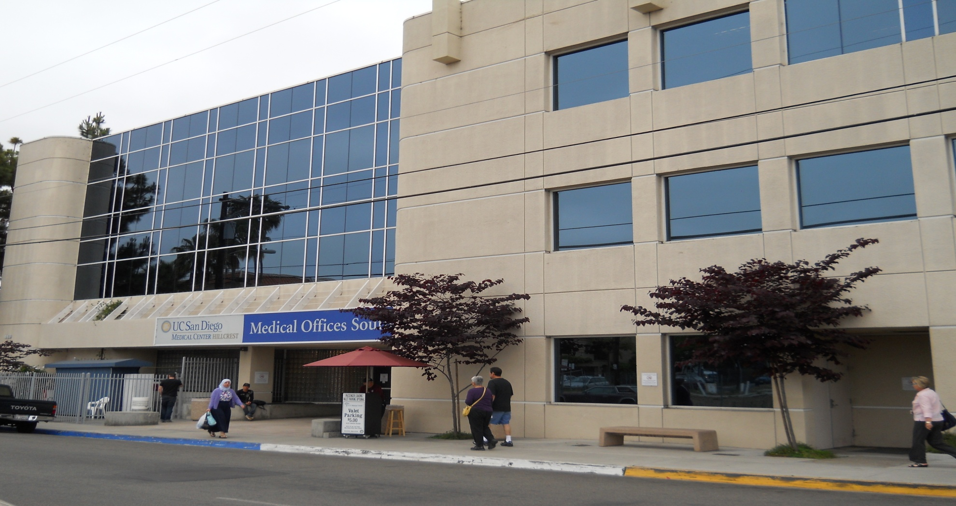


Who are we?
The OWEN CLINIC
University of California, San Diego
20 years of experience
3,000 HIV/AIDS patients
High proportion of Medi-Cal/ Medicare/ RW funding
Funded by California HIV/AIDS Research Program (CHRP) to serve as a pilot center for application of Patient Centered Medical Home in HIV
Site based focus to improve Retention

Slide 50
Where are we?
CY 2011 OSHPD Patient Discharge Data

Slide 51
Definition of terms
Epic Ambulatory Care
  UCSD is running version 2010 of Epic EMR
MyChart Patient Portal
  Secure website for UCSD patients to view EMR
  Population Management
    Clinical workflow to manage groups of patients that need similar health screenings
Group Visit (Shared Medical Appointment)
  A 90 minute office visit with one doctor and 10 patients who are treated sequentially with group observation and discussion

Slide 52
Snapshot
Website for HIV literacy and resources
Computer Training Lab for Patients
Spanish Web Portal for Electronic Medical Record
EHR enhancements
  Registries
  Population management
  Provider Report Cards
  Provider Efficiency Metrics
Shared Medical Visits

Slide 53
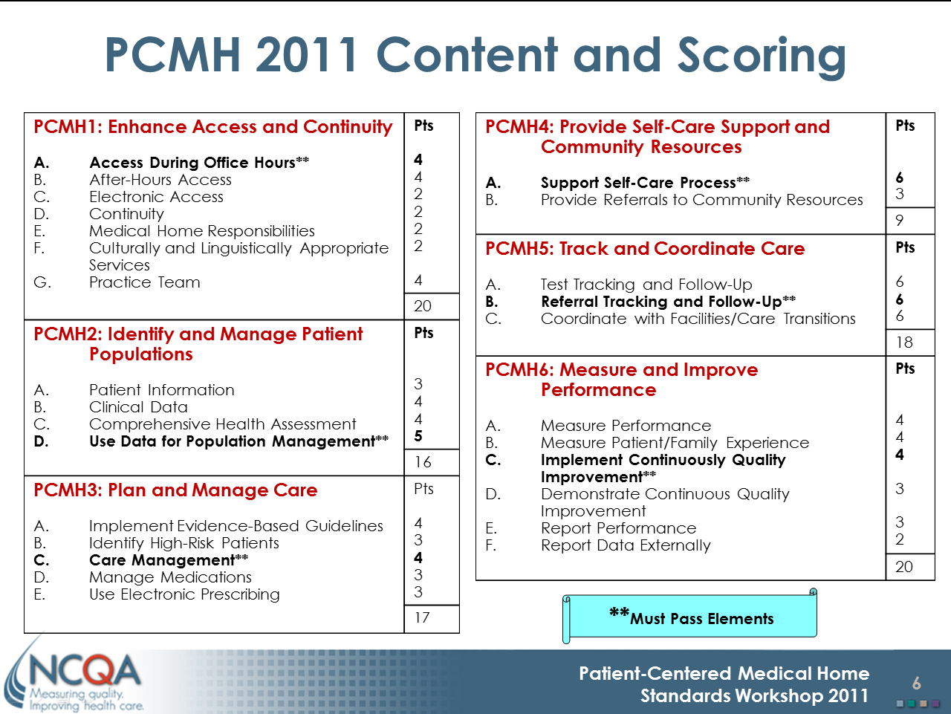
PCMH elements addressed
Spanish MyChart
Web Site/Computer Lab
Shared Medical Visits
EMR Registry Build
Provider Report Cards
EMR Performance Metrics
EMR Health Maintenance
Source: National Committee for Quality Assurance http://www.ncqa.org

Slide 54
Snapshot
Website for HIV literacy and resources
Computer Training Lab for Patients
Spanish Web Portal for Electronic Medical Record
EHR enhancements
  Registries
  Population management
  Provider Report Cards
  Provider Efficiency Metrics
Shared medical visits

Slide 55
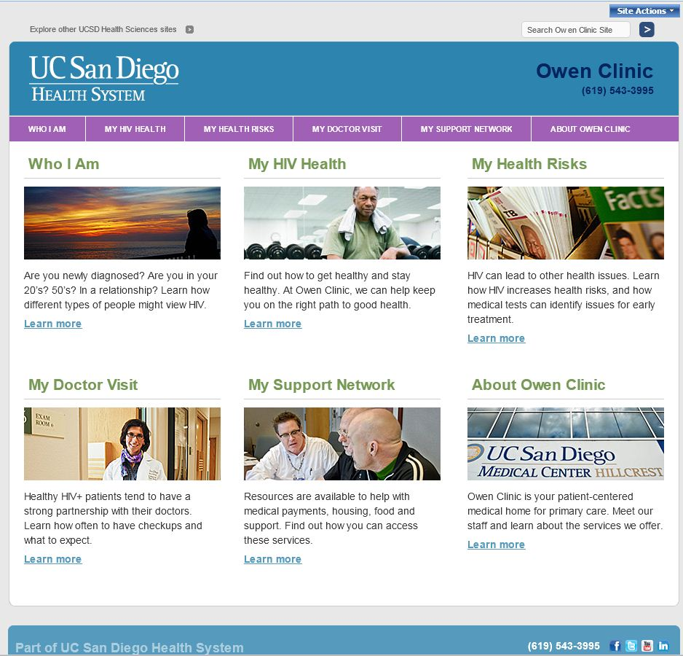
Patient Centered Web site

Slide 56
Snapshot
Website for HIV literacy and resources
Computer Training Lab for Patients
Spanish Web Portal for Electronic Medical Record
EHR enhancements
  Registries
  Population management
  Provider Report Cards
  Provider Efficiency Metrics
Shared medical visits

Slide 57
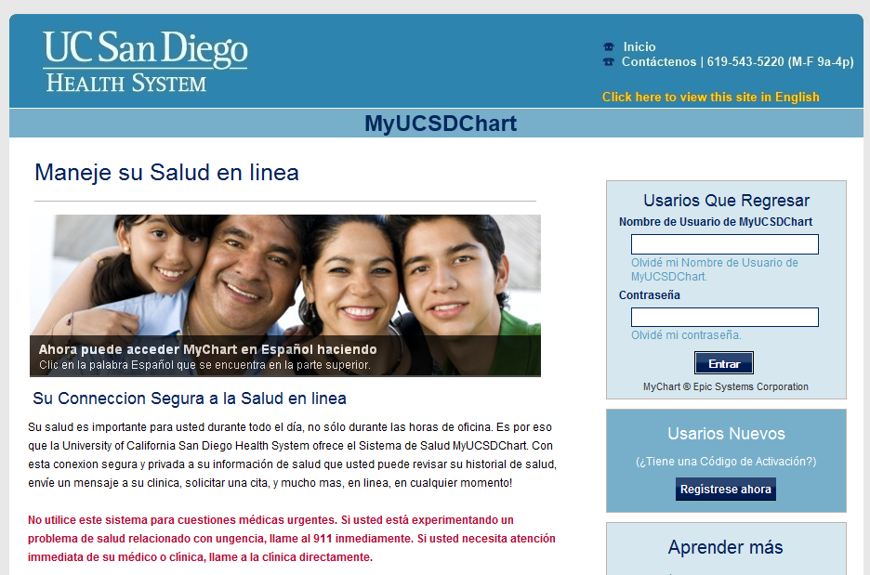
MyUCSDChart in Spanish

Slide 58
Human Translation of Clinical Messages
Compliance and Risk Considerations
Current Laws and Regulations
(Important consideration)
  Federal
    HIPAA – Business Associate Agreement (BAA)
  State
    California SB 853: HC providers must provide language services
  Proposed Legislation
    SAFE-ID Act (Safeguarding Americans from Exporting Identification Data Act): proposed act prohibiting exportation of PI off-shore
Institution Polices and Procedures
Insurance requirements for third party providers of medical translation services
Offshoring of medical translation services

Slide 59
Snapshot
Website for HIV literacy and resources
Computer Training Lab for Patients
Spanish Web Portal for Electronic Medical Record
EHR enhancements
  Registries
  Population management
  Provider Report Cards
  Provider Efficiency Metrics
Shared medical visits

Slide 60
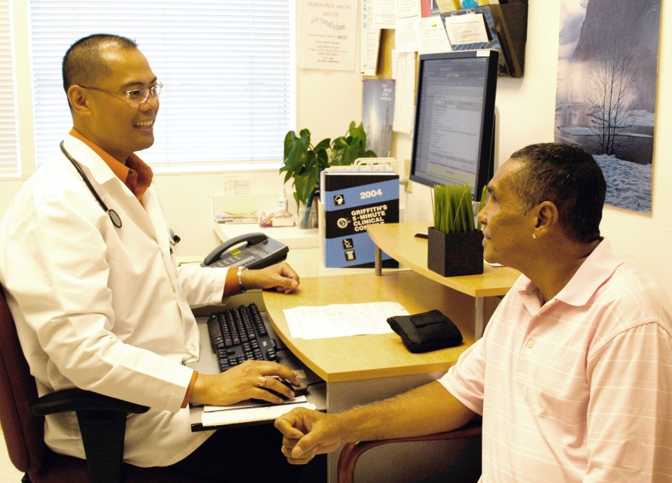
Clinical Metric Model
Clinical Performance
Patient satisfaction
Compliance/Billing
Meaningful Use
Patient
Demographics
Acuity
Epic System Performance
Response time
Decision Support
Click counts
Cognitive load
Provider Performance
EMR use
Provider Report Card (Standards of Care)

Slide 61
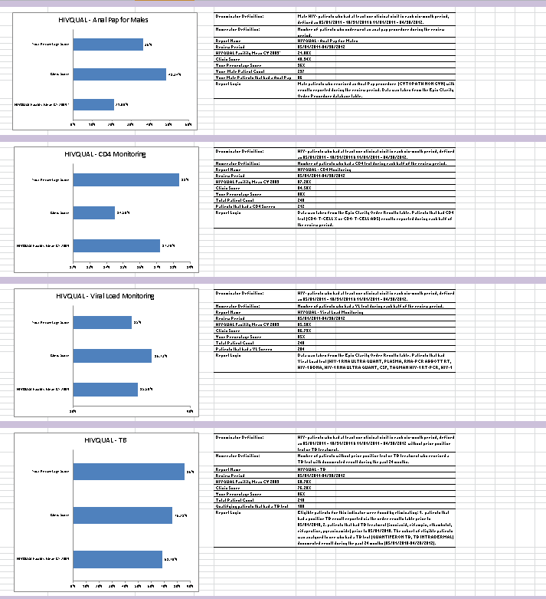
Individual Provider Quality Indicator Report Cards
64
16 HIVQUAL Indicators
Each indicator chart contains
  Provider score
  Clinic score
  HIVQUAL CY 2009 mean score
The indicator sidebar contains
  Indicator definitions
  Provider’s total patient count
  Provider’s compliant patient count

Slide 62
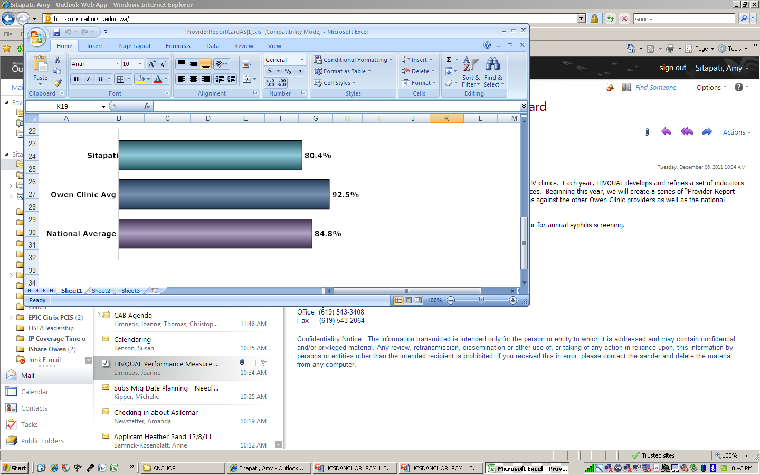
Provider report cards based on HIVQual measures … circulated by email
Notes:
What about the system impact; is the system the problem or the solution; there is a human element to reach that goal; how can a changed system help reach that goal.

Slide 63
Snapshot
Website for HIV literacy and resources
Computer Training Lab for Patients
Spanish Web Portal for Electronic Medical Record
EHR enhancements
  Registries
  Population management
  Provider Report Cards
  Provider Efficiency Metrics
Shared medical visits

Slide 64


Slide 65
Key lessons learned
Core challenges to PCMH uptake
  On-site:
  Dissemination of knowledge across diverse silos
  Limited resources
  Complexity of PCMH construct
  Local/Regional:
  Limited time contact
  Limited baseline knowledge
  State:
  Relevancy across different sites
  Diverse PCMH portfolio and active work
  National:
  Interest in standardization
  Sheer number of different care provider settings,
  Resources, electronic health platform, isolated
  HIV Populations within larger health communities
On-site:
Dissemination of knowledge across diverse silos
Limited resources
Complexity of PCMH construct
Local/Regional:
Limited time contact
Limited baseline knowledge
State:
Relevancy across different sites
Diverse PCMH portfolio and active work
National:
Interest in standardization
Sheer number of different care provider settings,
Resources, electronic health platform, isolated
HIV Populations within larger health communities

Slide 66
Summary

Slide 67
Comprehensive Model
The PCMH represents a holistic change to clinic organization and approach to care
The model has underlying common objectives, but is ultimately tailored to each clinical environment

Slide 68
Diverse Stakeholders
WITHIN a site (e.g., patients, providers, IT department, larger institutions)
ACROSS sites (e.g., providers, IT departments, legal affairs offices, planning groups)

Slide 69
Multiple Steps to Implementation
Create necessary infrastructure (e.g., IT systems, protocols)
Begin using new systems and new protocols
Monitor performance
All three steps are necessary to achieve true PCMH status

Slide 70
Why the PCMH Model is Appropriate for HIV Care
HIV disease is complex. Treatment may involve expertise from multiple healthcare fields.
Vulnerable populations affected by HIV benefit from complementary support services.
As people with HIV age, often experience co-morbid conditions. Treatments must be coordinated.

Slide 71
How the PCMH Model is Unique When Applied to HIV Care
HIV disease has its own routine/preventive care standards.
HIV care, particularly in Ryan White funded settings, has a strong emphasis on support services.
  Linkages between primary care and support services may have different complications than linkages between medical specialties.
HIV notable for its impact on diverse populations that have varying levels of health literacy.
  Not all patients can engage (participate actively) in the same way.

Slide 72
Questions & Answers
Contact Information
Erin Friedman:
echambers@alamedahealthconsortium.org
Sonali Kulkarni: skulkarni@ph.lacounty.gov
Amy Sitapati: asitapati@ucsd.edu
Wayne Steward: wayne.steward@ucsf.edu

Slide 73
Obtaining CME/CE Credit
If you would like to receive continuing education credit for this activity, please visit:
http://www.pesgce.com/RyanWhite2012

