Slide 1
It All Adds Up! Making Sense of Your Part C Budget!
Presenters:
Sandra Lloyd – Public Health Analyst HRSA/HAB Western Branch
Mae Rupert – Public Health Analyst HRSA/HAB North Eastern Branch

Slide 2
Disclosures
Sandra Lloyd and Mae Rupert have no financial interest or relationships to disclose.
Commercial support was not received for this activity.
This continuing education activity is managed and accredited by Professional Education Service Group. The information presented in this activity represents the opinion of the author(s) or faculty. Neither PESG, nor any accrediting organization endorses any commercial products displayed or mentioned in conjunction with this activity.
2

Slide 3
Learning Objectives
At the conclusion of this activity, the participant will be able to:
Describe the salary limitation rule that was enacted by the Consolidated Appropriations Act, 2012.
List the documentation that is required for submitting a request for a budget modification or carryover.
Describe the necessary components of a budget that meets Ryan White Part C legislative and programmatic requirements.
3

Slide 4
By Submitting a Proper Budget the first time you may:
Avoid repetitive submissions
Eliminate need for budget documents to have Conditions of Award
Avoid drawdown restrictions
Avoid delay in approval of Payment Management System requests
Avoid delay in approval of Allocation Report
4

Slide 5
Part C Program Requirements Early Intervention Services (EIS)
5

Slide 6
Part C EIS Overview
Purpose: To provide comprehensive continuum of outpatient HIV primary care in a service area.
Medical Model of Care:
Assess
Treat
Refer
6

Slide 7
Part C Required Services
HIV counseling, testing, and referral
Medical evaluation and clinical care
Other primary care services (directly or via referral):
Oral Health Care
Adherence Counseling
Outpatient Mental Health Care
Outpatient Substance Abuse Treatment
Nutritional Services
Specialty Medical Care
Referrals to other health services
7

Slide 8
Part C -Early Intervention Services
Licensed medical providers who can assess, treat and refer | Mental Health treatment (outpatient)
Proportional medical support – nurses, medical assistants, staff | Nutritional Screening and Treatment
Referring for health and support services | Medical/Dental equipment and supplies
Laboratory, x-rays, immunizations, and diagnostic tests | Substance Abuse treatment (outpatient)
Adherence monitoring/education provided by licensed clinician | Specialty and Sub-Specialty Care Services
Oral Health care | Staff travel - to provide clinical care at satellite sites
8

Slide 9
Part C - Core Medical Services
All Early Intervention Services | Health Insurance Premium and Cost Sharing *
HIV Pre and Post Test Counseling | Home and Community Based Services as defined under Part B*
Medical Case Management | Home Health Care*
AIDS Drug Assistance Program Treatment* | Hospice*
* Generally Funded under Part B not under Part C
9

Slide 10
Part C - Core Medical Services
HIV Pre and Post Counseling
Medical Case Management
Categorized under Core Medical Services only and NOT EIS
Note
10

Slide 11
Part C - Quality Management Program
Costs to maintain a clinical quality management program | Staff training and TA
Continuous Quality Improvement activities | Staff travel to the AGM and HAB clinical Conferences
CQM coordination | Local Travel to improve services
Data collection for clinical quality management | Participation in Statewide Coordinated Statement of Need (SCSN)
Consumer involvement to improve services | EMR/EHR* - Data analysis for CQM activities
11

Slide 12
Part C - Support Services
Local travel by staff to provide support services | Respite Care*
Outreach to identify people with HIV or “at risk”* | Translation or interpretation services*
Transportation for medical appointments* | Non-medical case management*
Peer support | Eligibility Specialists
Patient education materials* | *Need to justify why they cannot be paid for by other funding sources!
12
Notes:
Services that are needed for individuals with HIV/AIDS to achieve their medical outcomes (such as respite care for persons caring for individuals with HIV/AIDS, outreach services, medical transportation, linguistic services, and referrals for health care and support services)

Slide 13
Part C - Administration
Audits | Payroll/accounting services
Clerical Support/Receptionist | Rent, utilities, and other facility support costs
Computer hardware and software | EMR/EHR*
Indirect costs (with approved Federally negotiated indirect cost rate )* | Postage
Non-clinical liability insurance | Telephone
Program Coordination | Office supplies
Personnel Costs | Clinic Receptionist
*Included in the10% Admin cap
13

Slide 14
Part C Fiscal Requirements Early Intervention Services (EIS)
14

Slide 15
Part C Fiscal Requirements
1. Payor of Last Resort
2. Limitation on Administration costs
3. Imposition of Charges Discount
4. Limitation on Charges- “Cap on Charges”
5. Auditing Standards
6. Cost Principles
7. Allocations
8. Financial Management
9. Property Standards
10. Fraud and Abuse
11. Unobligated balances
12. Unallowable Cost
13. Maintenance of Effort
14. Budget Development
15. Reporting
16. Conditions of Award
15

Slide 16
Payor of Last Resort
Allocation of Expenses Among Funding Sources
Grantees Receive Multiple RW Funding
Grantees Receive Other Sources Of Funding
Billing Medicaid, Medicare and other payors
16

Slide 17
Payor of Last Resort
Part C funds will not be used for any service which payment has been or can reasonably expected to be made under any state compensation program, under an insurance policy, under any Federal or state health benefits program, except Indian Health Service, or on a pre-paid basis.
Ryan White HIV/AIDS Treatment Extension Act of 2009 (Public Law 111-87,October 30,2009), §2654 (f)
Note
17

Slide 18
Maintenance of Effort
Grantees must agree to maintain non-Federal funding for HIV EIS at a level that is not less than expenditures for such activities during the fiscal year prior to receiving this grant.
Grantees must spend at least as much of their own funds on HIV EIS as they did the previous year.
18

Slide 19
Maintenance of Effort
Ryan White HIV/AIDS Program Part C funds cannot be used to supplant existing funding streams covering HIV primary care and other services.
Part C Program Requirement
Note
19

Slide 20
Limitations on Administrative Costs
Administration versus Indirect
Direct Program Costs
Costs must be tied to the delivery of services
Hidden Administrative Costs – Rent, Etc.
Limitation 10%
20

Slide 21
Part C Budget Development
Early Intervention Services Costs (>50%)
Core Medical Services Costs (>75%)
Clinical Quality Management (CQM) Costs
Support Services Costs
Administrative Costs (10%)
Ryan White HIV/AIDS Treatment Extension Act of 2009 (Public Law 111-87,October 30,2009), §2651(b)(2)-(c)(1)
21

Slide 22
Part C Budget Cost Categories
Early Intervention Services
Core Medical Services
Continuous Quality Management (CQM)
Support Services
Administrative
22

Slide 23
Part C Budget
Object Class
Personnel and Fringe
Travel
Other
Equipment
Supplies
Contractual
Indirect Costs
23

Slide 24
Budget Development
At least 50% of Part C budget must be allocated for EIS/Primary care costs
At least 75% of the Part C budget, after CQM and Administrative costs are subtracted, must be allocated for Core Medical Services
Administrative costs, including indirect, are capped at 10.0% (to infinity) of the total EIS award amount
Reasonable % for Clinical Quality Management (CQM)
Ryan White HIV/AIDS Treatment Extension Act of 2009 (Public Law 111-87,October 30,2009), §2651(b)(2)-(c)(1)
Note
24
Notes:
Check law reference

Slide 25
Budget Development
Show only Federal Part C funds
Demonstrate how the Part C funds will support a comprehensive system of Early Intervention Services (EIS)
Include calculations of all items in the budget justification
Support HIV EIS medical care
Part C Program Requirement
Note
25

Slide 26
Budget Development
Include travel for :
up to two persons to attend the Ryan White HIV/AIDS Program All Grantee Meeting,
one clinician to attend the Annual HIV Clinical Update Meeting, and
one staff member to attend the Ryan White Services Report (RSR) training update for data reporting
In the year that the AGM is not held, another HRSA meeting or continuing education conference may be substituted
Part C Program Requirement
Note
26

Slide 27
Budget Development
Number of services proposed should be relative to number of clients served
Cost of services should be reasonable
Part C EIS funds should not be used for specialty consultations and treatment at the expense of providing basic HIV primary care services!
Part C Program Requirement
Note
27

Slide 28
Indirect Cost
Indirect cost rates assign an approved percentage of “overhead” to each source of funding
If indirect costs are claimed, a current federally approved indirect cost rate agreement must be submitted
Remember that indirect costs will be counted toward the administrative limit of 10% of the total funding amount.
Note
28

Slide 29
Unallowable Costs
Inpatient services
Residential treatment
Clinical research
Cash payments to clients
Purchase or improvement of real property
X
X
X
Nursing home care
X
X
X
X
Syringe Services
X
Lobbying
Services must be consistent with HAB Policy Notice 10-02
http://hab.hrsa.gov/manageyourgrant/pinspals/eligible1002.html
29
29

Slide 30
Budget Period vs. Project Period
Budget Period
Project Period
Interval of time to which a multi-year period of assistance (project period) is divided for budgetary and funding purposes.
Total time stated in the Notice of Award (including any amendments) for which federal support is recommended.
A budget period is usually 12 months long, but may be shorter or longer, if appropriate.
The period may consist of one or more budget periods.
It does not constitute a commitment by the Federal Government to fund the entire period.
30

Slide 31
Determining FTE
Sally Doe works 16 hours a week with the Part C program. Her full time salary is $40,000.
4 of those hours a week are spent on CQM activities
12 hours per week are spent as a medical case manager
16 ÷ 40 = |  | 0.4 FTE under Part C
4 ÷ 40 = |  | 0.1 FTE under CQM
12 ÷ 40 = |  | 0.3 FTE for Core Medical Only
0.1 x $40,000 = |  | $4,000 for CQM
0.3 x $40,000 = |  | $12,000 for Core Medical Only
31

Slide 32
Support staff must be in reasonable proportion to medical providers!
Example 1
Provider # 1 = | 0.1 FTE
Provider # 2 | 0.1 FTE
Total FTEs for support staff | 3.2 FTE
Example 2
Provider # 1 = | 0.5 FTE
Provider # 2 | 0.7 FTE
Provider #3 | 0.3 FTE
Total FTEs for support staff | 3.2 FTE
Which allocation of support staff to medical provider is reasonable?
32

Slide 33
Parts of a Complete Budget
Budget Information for Non-Construction Programs (SF 424A, federal line item budget)
Part C program-specific line item budget (in table format and PDF)
Budget justification narrative
Staffing Plan
4 Parts
33

Slide 34
Part C Budget Documents
34

Slide 35
Part C Budget Documents
SF-424A
35

Slide 36
SF-424A
Section A
Enter in “New or Revised Budget” column
Section B
Must include the object class category breakdown for the annual amounts in Section A.
Competing Continuation – Provide breakdown for each year of Project Period.
Non-Competing – Provide breakdown for one budget period by cost category and object class category.
Section E
Section F
Use rows to provide budget amounts for each year of the project period
Provide budget amounts for each future budget period within project period.
Complete as applicable.
36

Slide 37
SF-424A
37

Slide 38
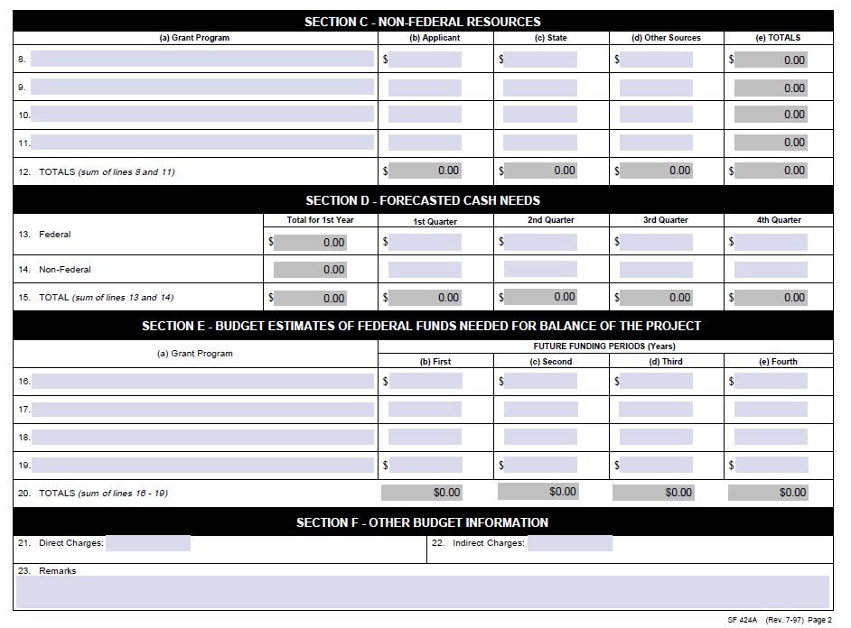
SF-424A
38

Slide 39
Part C Budget Documents
Line Item Budget
39

Slide 40
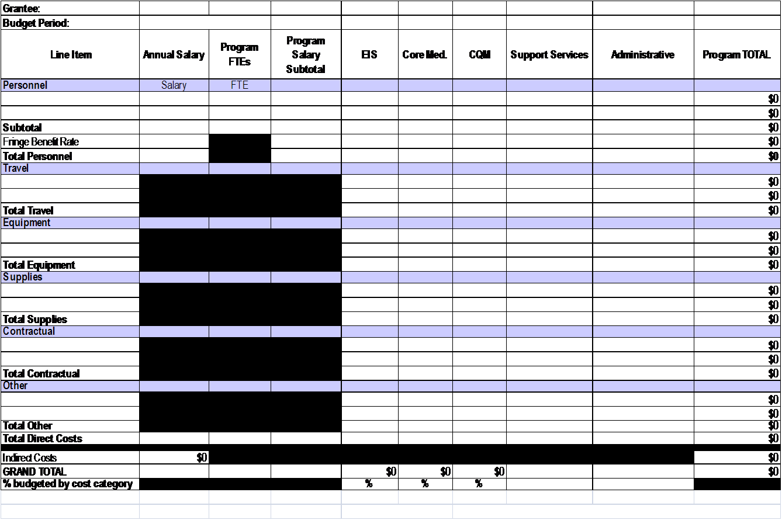
Part C Line-Item Budget
40

Slide 41
Part C Line-Item Budget
50%
10%
75% (less Admin & CQM)
Payroll
Purchasing
Accounts Payable
41

Slide 42
Calculating Percentage for Core Medical Services
Percentage for Core Medical Services are calculated by subtracting total of CQM and Administrative cost categories from total budget (new denominator) and dividing Core Medical Services total into the new denominator.
42

Slide 43
Calculating Percentage for Core Medical
Total Budget | $300,000
CQM | $21,000
Administration | $26,000
Core | $195,000
Total - (CQM + Admin) = [New Denominator] | 300,000 – 47000 = [253000]
Core ÷ [New Denominator] X 100 = Core Percentage | 300,000 ÷ [253000] = 0.771 0.771 X100 = 7%
43

Slide 44
Budget Line Item and Justification
List ALL staff names and position titles to be funded
Be consistent with names, position titles, and FTEs on all budget documents including the staffing plan
Describe each line-item specific to the cost category
Include details of subcontractors, by cost category
Note
44

Slide 45
Budget Line Item and Justification
Include detail of salary and FTE that meets salary limitation requirements!
Include calculations for all items in the budget justification narrative (unit cost, total number of units, and number of persons to be served)
Remember Be Clear and Concise!
Note
45

Slide 46
Part C Budget Documents
Budget Justification Narrative
46

Slide 47
Budget Justification Narrative
Narrative must:
Be divided according to cost categories
Include descriptions specific to cost categories
Provide an explanation for the amounts requested on each line within the budget
Describe how each item will support the achievement of proposed objectives
Justify each item within the “other” category
e.g. – rent, utilities (if it is not included in an approved indirect cost rate)
47

Slide 48
Budget Line Item and Justification
Explain how you determined the cost for each proposed line item amount
Provide a formula or calculation that includes estimated cost per unit and estimated number of units
Include an explanation if contractual is fee for service or if paying FTEs –
Include actual annual salary for FTEs
Adhere to the salary limitation requirements
Note
48

Slide 49
Part C Budget Justification
Object Class
Personnel (and Fringe)
Indirect Costs
Other
Contractual
Supplies
Equipment
Travel
Core Medical Services/EIS
Core Medical ONLY
Clinical Quality Management
Support Services
Administration
Repeat cost category descriptions when applicable within each budget class category
Note
49

Slide 50
Sample Budget Justification Narrative
All Grantee Meeting (AGM)
2 staff to attend All Grantee Meeting
Airfare | 2 staff X $400 = | $800
Hotel lodging | 2 staff X 3 nights X $100 = | $600
Per diem | 2 staff X 4 days X $60 = | $480
Transportation | 2 staff X $50 = | $100
TOTAL |  | $1980
50

Slide 51
Sample Budget Justification Narrative
Dr. John Doe (0.125 FTE / $20,000) will serve as the patients’ primary care provider assuring the delivery of quality, comprehensive outpatient care and be responsible for the initial evaluation and follow-up care throughout the disease spectrum.
51

Slide 52
Sample Budget Justification Narrative
Diagnostic laboratory tests
Other
Viral Loads | 24 Viral Loads/month @ 110.00 / test = | $31,680
Genotype | 12 Genotypes @ 375 / test = | $4,500
Bus passes | 115 bus passes @ $5.00 each = | $575
52

Slide 53
Common Issues with Budgets
Budget documents do not all match
Expenses are allocated to an incorrect cost category
Budget category totals are incorrect
Percentages are miscalculated
Personnel exceed the salary limitation requirements
Expenses are included that are not allowable
Documents are not in proper format
Budget grand total does not match total award!
Note
53

Slide 54
Tips for Creating a Good Budget
Read Funding Opportunity Announcement!!
Allow your program enough time to prepare documents!
Double check all figures and correlation between all budget documents (expense amounts, FTEs)!
Check addition (be sure Excel formulas are not miscalculating totals)!
Check percentages!
Include whole numbers and not decimals!
Submit in PDF format and not Excel!
Note
54

Slide 55
Salary Limitations Requirement (Appropriations Act 2012)
Salaries charged to HHS grants are capped at $179,700 annually for FY2012
Applies to subcontracts
Individual’s base salary, exclusive of fringe benefits and outside income earned
`
Grantee subcontracts with nephrologist for half day clinic at $100/hr. Does this subcontract meet FY2012 salary limitations?
55
Notes:
The Consolidated Appropriations Act, 2012 (P.L. 112-74) enacted December 23, 2011, limits the salary amount that may be awarded and charged to HRSA grants and cooperative agreements.
Award funds may not be used to pay the salary of an individual at a rate in excess of Federal Executive Level II. The Executive Level II salary of the Federal Executive Pay scale currently is $179,700.
This amount reflects an individual’s base salary exclusive of fringe and any income that an individual may be permitted to earn outside of the duties to the applicant organization. The salary limitation also applies to subawards/subcontracts under a HRSA
grant or cooperative agreement.
The salary limitation extends to all programs funded through the Labor/HHS bill (NIH, CDC, HRSA, ACF, CMS, OS).
Budget Revisions – As applicable, grantees will need to submit budget revisions through the EHB to comply with salary limitations requirements.
Example the medical director of a clinic
Income earned from moonlighting at a hospital
Subcontractor – specialty clinic at $100/hr is this within salary limitations

Slide 56
Examples—Salary Limitation
Individual’s full time salary: $350,000
A
Amount that may be claimed on the Federal grant
Individual’s base full time salary adjusted to Executive Level II: $179,700
Please provide an individual’s actual base salary if it exceeds the cap!
50% of time will be devoted to project
Direct salary: | $175,000
Fringe (25% of salary): | $43,750
Total: | $218,750
50% of time will be devoted to project
Direct salary: | $89,850
Fringe (25% of salary): | $22,462
Total: | $112,312
56

Slide 57
Part C Budget Documents
Budget Staffing Plan
57

Slide 58
Budget Staffing Plan
Include the following information for all staff for your HIV program including key staff not funded by the grant:
Education, training, HIV experience and expertise
Language fluency and cultural competence
Provide FTE and all funding sources for each staff member
Specifically identify:
Program Coordinator
Staff managing and overseeing grant activities
Staff monitoring activities of contractors
Medical Director and all medical providers
Lead for quality management activities
Table format is recommended
Note
58

Slide 59
Sample Staffing Plan
Name | Education | Title | FTE | Funding Source | Experience
Doctor Jones | MD | Medical Director | 0.4 | 0.2 Part C 0.2 Program Income | 4 years HIV experience, ID Fellowship
Nurse Thomas | RN | Program Coordinator / Clinic Nurse Mgr | 1.0 | 0.2 Part A 0.8 Part C | 5 years RN with less than 1 year HIV experience
Ms. Kona | Assoc Degree | Admin. Assistant | 1.0 | 0.4 Part A 0.6 Part C | 4 years working in HIV clinic scheduling appts, making referrals, medical data entry
Mr. Lewis | MSW | Medical Case Mgr / CQM Coordinator | 1.0 | 0.5 Part B 0.5 Part C | 3 years providing HIV medical case management, fluent in Spanish
Ms. Johnson | RD | Contracted Registered Dietician | 0.2 | 0.2 Part C | 2 years HIV nutritional Counseling and 20 years nutritional counseling experience
59

Slide 60
Unobligated Balance
Unobligated Balance - the portion of the federal authorized award that has not been obligated by the recipient during the project period.
Carryover - Grantee may request carryover of Unobligated Federal funds remaining at the end of any budget period that may be carried forward to another budget period to cover allowable costs of that budget period.
60

Slide 61
Budget Modification
61

Slide 62
Budget Modification
Submit Budget Modification if:
Cumulative reallocation of expenses throughout budget period reach 25% or $250,000 (whichever is less) of total budget award
Expenses are moved between cost categories (EIS/CMS, CQM, Support or Administration)
Expenses are moved between budget class categories (Personnel, Contractual) and reflect change of program scope New line items are being added to budget
DISCUSS ANY BUDGET CHANGES WITH YOUR PROJECT OFFICER!!!
Simple modifications that do not meet the above criteria can be completed by notifying your Project Officer by email!
Note
62

Slide 63
Budget Modification Process
SF424A
Line item budget modification template
Reflecting your entire budget
Budget justification narrative
Cover letter
Must include an explanation and justification for the requested budget modification (i.e. if the service is being reduced to make up the cost of a proposed activity, explain why or if it is now funded by another source)
Include total amount being reallocated on template cover letter
Including the entire budget
Reflecting expenses being reallocated
Including any approved carryover to be used during this budget period!
63

Slide 64
Sample of Section of Budget Modification Template
Description | Original EIS | Adjustment EIS | New EIS Total
Personnel
Provider Name | 0 | 6750 | 6750
Provider Name | 42259 | -24782 | 17477
Provider Name | 0 | 12207 | 12207
Provider Name | 33638 | 9825 | 43463
Supplies
Medical Supplies | 850 | 0 | 850
Carryover medical supplies | 575 | 0 | 575
64

Slide 65
Budget Modification
Budgets must meet legislative requirements!
Submit through “Prior Approval” through Electronic Handbook
Must submit prior to 60 days before end of budget period
Note
65

Slide 66
Carryover Request
66

Slide 67
Carryover
Carryover funds
Unobligated balances from the previous budget period that are authorized to be used to cover one-time expenses in the current budget period.
Note
Carryover funds cannot be used to cover personnel expenses!
67

Slide 68
Carryover Request
Cannot exceed unobligated balance from previous budget period
Federal Financial Report must be approved prior to request submission
Can be requested with the with the Federal Financial Report submission
Must be requested prior to 90 days before the end of the current budget period.
Must be submitted through “Prior Approval” Electronic Handbook
There are no guarantees that a carryover request will be permitted just because there is an unobligated balance at the end of a budget period!
Note
68

Slide 69
Carryover Request Submission Process
Line item budget
Federal Financial Report
Budget justification narrative
SF424A
Reflecting the requested unobligated amount
Cover letter
Including a narrative description of the amount of the unobligated funds and reason for unobligated funds
Reflecting previous budget period, if one has not been submitted.
69

Slide 70
Reporting Requirements
70

Slide 71
Allocation Report
Due in EHB 60 days after the start of the budget period
Reflects where projected expenses are distributed
Correlates with Line Item Budget
71

Slide 72
Allocations Report
72

Slide 73
Expenditure Report
Due in EHB 90 days after the end of Budget Period
Reflects the actual distribution of expenses
Correlates with Allocation Report unless budget modification requested
Expenditures Report
73

Slide 74
Expenditure Report
74

Slide 75
Document Approval Process
Grantee submits documents through Electronic Handbook
Reviewed by Project Officer
Forwarded to HIV/AIDS Bureau Management for approval
Forwarded to Grants Management Office
There are no guarantees that a carryover request will be permitted just because there is an unobligated balance at the end of a budget period!
Note
75

Slide 76
System of Award Management (SAM)
Central Contractor Registration (CCR) transitioned to the System for Award Management (SAM) at the end of July 2012.
SAM will reduce the burden on those seeking to do business with the government.
Vendors will be able to log into one system to manage their entity information in one record, with one expiration date, through one streamlined business process.
SAM information must be updated at least every 12 months to remain active (for both grantees and sub-recipients).
https://www.sam.gov
76

Slide 77
Activity
What needs to be revised within these budget documents?
77

Slide 78
Questions?
Thank you for attending!
78

Slide 79
Contact Information
Sandra Lloyd
Public Health Analyst HRSA/HAB
Western Branch
301-443-3669
slloyd@hrsa.gov
Mae Rupert
Public Health Analyst HRSA/HAB
North Eastern Branch
301-443-8035
mrupert@hrsa.gov
79

Slide 80
Obtaining CME/CE Credit
If you would like to receive continuing education credit for this activity,
please visit:
http://www.pesgce.com/RyanWhite2012
80

