Slide 1

Guidance to Creating a Culture for Quality Improvement:
101 Session:
Supporting and Sustaining a Quality Management
Program
Kathleen Clanon, MD
November 28th 3:30-5pm
RWA-0247
Notes:
1

Slide 2
Quality Tracks at the AGM
Quality Track 1
Quality Improvement 101 and Ryan White Legislative Requirements for Quality Management: I Am New to Quality Improvement – Where Do I Start?, 11/28, 10 am to 11:30 am
Performance Measurement for Quality – How to Get Started to Measure Quality at My HIV Program, 11/28, 3:30 pm to 5 pm
Building a Sound Quality Management Infrastructure – How to Manage the Quality Management Committee and Write Effective Quality Management Plans, 11/29, 8 am to 9:30 am
Quality Track 2
Guidance to Creating a Culture for Quality: 101 Session: Supporting and Sustaining A Quality Management Program, 11/28, 3:30 pm to 5 pm
Guidance to Creating a Culture for Quality: How to Work with your Subcontractors on Quality Management, 11/29, 8 am to 9:30 am
Improve Your Care and Services with Consumer Input and Participation, 11/29, 10 am to 11:30 pm

Slide 3
Learning Objectives
Understand key components of successful quality management programs
Learn strategies from peers in developing a culture for improvement
Learn strategies from the field in engaging important stakeholders and those resistant to change
[Learn about the power of stories…]

Slide 4
Agenda
Setting the stage
Post-it notes from audience
Overview on how to develop a culture for quality improvement in your agency
‘Human Diffusion Curve’ exercise
Panel presentations
Breakout groups

Slide 5

How is Culture Created? Why Are We Wearing a Tie?
Big dark room with a single source of light on one end of the room, estimate the distance to the light
Wide variety by participants; conformity effect when people worked on groups
Even a year later, the individualized responses were internalized; the ‘tradition’ continued over generations
Status quo bias: once a practice has become established, it is likely to be perpetuated, even there is no particular basis for it
Information courtesy of Clemens Steinbock
[Muzafer Sherif, Sociometry, 1, 1937, 90-98]
Notes:
Overcome the’Status Quo Bias’ William Samuelson and Richard Zeckhauser (1988); automatic renewal - my NYT subscription
Big dark room with a single source of light on one end of the room, estimate the distance to the light; wide variety by participants; conformity effect when people worked on groups; ally was introduced and was able to change the group estimations; Interesting fact: even a year later, the group’s were responses were internalized, when participating in new groups, the tradition continued over generations; groups tend to continue with their established patterns even as new groups formed
Tie - once it was a napkin with use
New employees don’t have the status quo bias, but after a few months, they will conform with the workplace ‘traditions’ and justify the status quo....

Slide 6

Reversing the Death of Rural Communities
Howard in South Dakota, population 3000, had been shrinking for decades
Howard High Schoolers - ‘How can we revitalize the town?’ 50% of residents were shopping outside their county
Discovery - if Howard residents spend 10% of their disposable income at home, $7 million boost for local economy - ‘Keep Miner dollars in Miner County!’
A year later by the South Dakota Department of Revenue: increase by $15.6 million
Information courtesy of Clemens Steinbock
[Wall Street Journal, Jonathan Eig, March 27, 2005]

Slide 7

Reduce Medication Errors
Situation: on average, 1 medication error per 1,000 medications administered; led to 250 errors annually
Solution: create a ‘cone of silence’ (Get Smart), introduction of medication vest for 6-month pilot
Results: errors dropped 47%; adoption by the entire hospital resulted in 20% drop hospitalwide
Information courtesy of Clemens Steinbock
[Becky Richards, Kaiser South San Francisco Hospital, Beacon Collaborative, April 2008]
Notes:
Nurses thought the vest was demeaning; doctors hated it because they were not able to talk to the nurses
20 drop across the entire hospital, except for one unit which did not use the medication vest

Slide 8

Key Questions
How can we generate ideas for improvement that become the new status quo?
How are new ideas adopted in an organization?
How does an organization with a strong culture for quality improvement look like?
What are the key ingredients for creating an agency-wide quality culture?
Notes:
8
The key question we are seeking to answer in this Tutorial is, “how can my HIV care program become more open to innovative ideas?” After implementation with a small group, how can we make sure that the improvements do not slip away, and last,---how can we spread the innovation to a wider group?

Slide 9
Audience Participation
On your chair each participant has post-it note(s)
Audience I – write down 1-2 suggestions:
  ‘How does an organization with a strong culture for quality improvement look like?’
Audience II - write down 1-2 suggestions:
  ‘In your opinion, what is the most important ingredient to develop an agency-wide culture for quality improvement in your HIV program?’
Hand them in after 5min

Slide 10
How can we generate ideas for improvement that become the new status quo?

Slide 11

Hand Washing in Pakistan
Introduction of plain soap and hand washing promotion resulted in:
53% lower incidence of diarrhea
50% lower incidence of pneumonia than controls
34% lower incidence of impetigo
Information courtesy of Clemens Steinbock
[Lancet 2005, Jul 16-22, 366 (9481), 225-33]

Slide 12
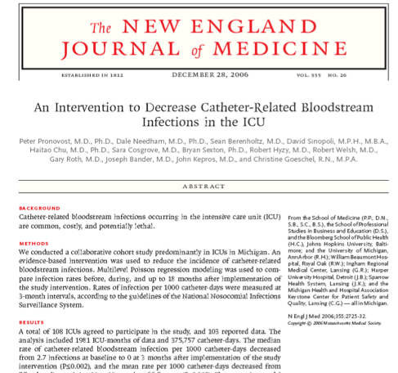

Use of Checklists
Landmark study with 108 intensive care units (ICU) in Michigan:
“The median rate of bloodstream infection per 1000 catheter-days decreased from 2.7 infections to 0 at 3 months after use of checklist.(p0.002)”
ICUs in the study outperformed 90% of ICUs nationwide and saved an estimated $175 million and more than 1500 lives
Information courtesy of Clemens Steinbock
[New England Journal of Medicine, 2006 Dec, 355 (26), 2725-32]
Notes:
A total of 108 ICUs agreed to participate in the study, and 103 reported data. The
analysis included 1981 ICU-months of data and 375,757 catheter-days. The median
rate of catheter-related bloodstream infection per 1000 catheter-days decreased
from 2.7 infections at baseline to 0 at 3 months after implementation of the study
intervention (P≤0.002), and the mean rate per 1000 catheter-days decreased from
7.7 at baseline to 1.4 at 16 to 18 months of follow-up (P<0.002). The regression model
showed a significant decrease in infection rates from baseline, with incidence-rate
ratios continuously decreasing from 0.62 (95% confidence interval [CI], 0.47 to 0.81)
at 0 to 3 months after implementation of the intervention to 0.34 (95% CI, 0.23 to
0.50) at 16 to 18 months.

Slide 13

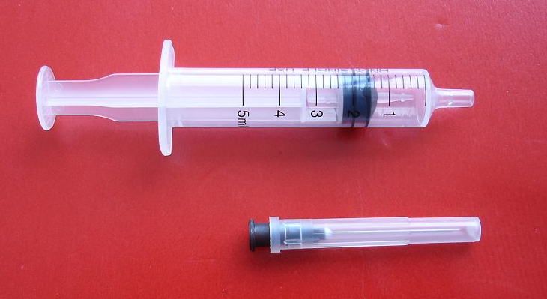
Non-reusable Syringes
Every year, reuse of syringes kills 1.3 million a year (more than Malaria) and about 230,000 HIV infections
Development of non-reusable syringe by Mark Koska; made on existing assembly equipment
Since 2001, 1.8 billion K1 syringes have been sold; 9 million fatal infections have been prevented
Information courtesy of Clemens Steinbock
[www.marckoska.com]

Slide 14
Lessons Learned – To Get Started…
You need to have the right idea
It starts with one person, one patient, one facility
You need a quality champion
You need to have the time and commitment

Slide 15
How are new ideas adopted in an organization?

Slide 16

AIDS Prevention and NBA
All NBA rookies are required to meet in Tarrytown, NY for a mandatory orientation session
Orientation on AIDS and AIDS prevention
Information courtesy of Clemens Steinbock
[Michelle Kaufman, Miami Harold, Oct 5, 2003]
Notes:
locked up for six days in a hotel, no cell.. to learn about media, investments...
two women met in the bar at the hotel, lots of flirting, made plans to meet up later in the week; next day the women were present at the orientation and told the players that they were HIV-positive
one single night could cause a lifetime of regret

Slide 17

Change the System
Moviegoers are offered free soda and popcorns in a large/super-size bucket
Question: Would somebody with a large inexhaustible supply of popcorn eat more than someone with a smaller inexhaustible supply?
Result: People with the super-size buckets ate 53% more popcorn than people with the large bucket
Conclusion: To eat less, reduce the size of serving
Information courtesy of Clemens Steinbock
[Brian Wandsink, Mindless Eating, Bantam]
Notes:
Reduce your plate size and use smaller wine glasses to loose weight....
We change our environments; that’s the reason we childproof our homes, have standardized forms for completion

Slide 18

Improvements are Contagious
Study: 12,067 individuals are followed for 32 years to study obesity
Result: when someone became obese, the odds of that person’s close mutual friend becoming obese tripled; closeness to the person did not matter
Conclusion: obesity ‘spread’ among friends, even when they are in different parts of the country; obesity is contagious
Information courtesy of Clemens Steinbock
[New England Journal of Medicine, 2007, 357, 370-379]
Notes:
Drinking is contagious, Marriage is contagious, even spitting when being around baseball players
New York Times article
Book by authors: Christakis/Fowler

Slide 19
Lessons Learned – To Get Ideas Adopted…
Understand your audience(s)
Implement ideas with their needs in min
Change the underlying system of care
Just do it - improvement are contagious

Slide 20
Critical Mass and Momentum
“The part of the diffusion curve from about 10 percent to 20 percent adoption is the heart of the diffusion process. After that point, it is often impossible to stop the further diffusion of a new idea, even if one wished to do so.”
E.M. Rogers, Diffusion of Innovations (1995)
Notes:
20
Here is a quote from Roger’s work that further explains Gladwell’s tipping point. Rogers talks about the importance of the “10 percent to 20 percent” part of the diffusion curve, that most of the work involved in spreading an innovation comes at this point. Getting to or past this point on the diffusion curve is, however, more complicated than that small percentage would suggest.

Slide 21
The “Diffusion Curve”:
Reaching the Tipping Point
300
250
200
Number of Farmers
150
100
Tipping Point
50
0
1927
1928
1929
1930
1931
1932
1933
1934
1935
1936
1937
1938
1939
1940
1941
Year
Source: Based on Ryan and Gross (1943)
Number of Adopters of Hybrid Seed Corn in Two Iowa Communities
Notes:
21
Objective: Introduce the diffusion curve of E.M. Rogers.
Explanation: This slide is a graphic representation of what Rogers and Gladwell stated earlier. It depicts how quickly (or slowly) Iowa farmers started to use a new brand of hybrid seed corn. On the horizontal (time) axis, one can see the years 1927 through 1941. On the vertical (# of) axis, one can see the number of farmers in this test population. This shows that until the early 1930’s the going was slow. But in the early to mid-thirties, something happened, and the rate of spread took off very quickly. If one examines this graph closely, it happened when between 30-60 farmers had started to use the corn. Notice that at the end of the diffusion curve, the process again slows down. We’ll discuss that later.
Curves similar to this are seen over and over in spread environments.
Bridge to next slide: The next slide is another example of a spread curve.

Slide 22
“Diffusion Curve” in Health Care
“tipping point”
Source: Institute for Healthcare Improvement
Notes:
22
Here’s some evidence that this theory applies in health care, not just in fashion or in agriculture.
This graph shows the actual spread of the Chronic Care Model across 80 clinics. It was slow in the beginning, then it seemed that critical mass was achieved in the 10-20% range, and the spread accelerated. You can also see on both this and the seed corn chart on the following slide, that the rate of spread slowed down near the end. That is because the last people to adopt the best idea are often traditionalists, and by definition are slow to adopt, or may never adopt the change.

Slide 23

Types of Innovators
Innovators - Venturesome
Early Adopters - Respected
Early Majority - Deliberate
Late Majority - Skeptical
Laggards - Traditional
Notes:
23
Let’s examine the five ways that people respond to innovation.
• First, we have the Innovators, the venturesome among us. These are the people who bring new ideas into the system, those who tolerate risk and are willing to accept the possibility of losses in seeking potential gain. Sometimes their very innovativeness causes them to be viewed as “outsiders” by the rest of the system in which they live or work.
• Next along the curve come the Early Adopters. Less “cosmopolitan” than innovators, their dominant characteristic is that they are respected by others in their system. They are well integrated into the local social system, are seen as opinion leaders and advisors of others. Because they serve as role models, their adoption of an innovation decreases uncertainty about the innovation for others, making it more likely that others will try it out.
• The next group is the Early Majority, deliberate in their decision making, relying on, but also trusting, the early adopters. They can be convinced by the logic of the benefit of the change.
• The Late Majority then follows. This group is, in general, skeptical about the innovation (and also is less able to handle a financial risk). They tend to adopt the innovation only in the face of economic necessity or when they face intense peer pressure, and they need to know they will be in the majority if they adopt the innovation.
• Finally, there are the laggards, tied to tradition, connected with the past. They will learn about innovation later than others, and their peer group will be those with similar traditional ideas.

Slide 24
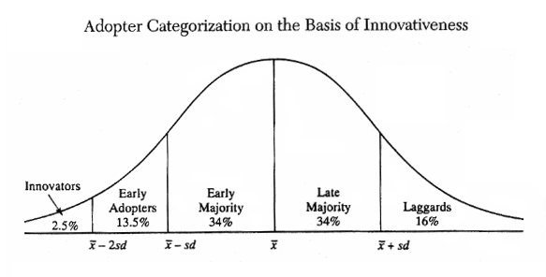
‘Diffusion of Innovation’
Source: Ryan and Gross, “Hybrid Seed Among Iowa Farmers,” 1940
Notes:
24
Why can diffusion be difficult? Because of the different ways people in the population feel about new ideas.
Think about the people you know: probably someone was the first person you knew to get an i-Pod, and probably someone else is still listening to cassette tapes – or even record albums!
This graph is from a study in 1940 that measured how quickly farmers in Iowa accepted a new kind of corn seed. Rogers’ work has shown that this graph applies pretty much no matter what the specific innovation is: corn seed, i-Pods or new processes in health care. It’s basically a bell curve, with a small number of people who will take up a new idea quickly, most people in the middle, and a few people who lag behind.
Take a minute and see where the 20% tipping point lies on this graph, and then we’ll talk more about each of these categories.

Slide 25

Human Diffusion Curve Exercise
2 Volunteers to sell
Participants to buy
Let’s see what we learn….

Slide 26

Rogers’ Five Attributes of Change
Relative Advantage - how much better is the new compared to the old?
Compatibility - how consistent is this idea with current values, experiences, and needs?
Complexity - how difficult is the new idea to understand and use?
Trialability - how easy is it to test the new idea?
Observability - how visible are the results of the new idea?
-- E.M. Rogers, Diffusion of Innovations (1995)
Notes:
26
Rogers also identified five attributes of change:
Relative Advantage: how much better is the new compared to the old?
Compatibility: how consistent is this idea with values, experiences, and needs?
Complexity: how difficult is the new idea to understand and use?
Trialability: how easy is it to test the new idea?
Observability: how visible are the results of the new idea?
Each attribute is on a continuum, and the more of the attribute the change has, the easier it will be to spread. For example, a change with a high degree of compatibility will be easier to spread than one without. A change with visible results will be easier to disseminate that one where the results are subtle.

Slide 27

Rules of Diffusion (by Donald Berwick)
Identify changes that are ready to spread
Find innovators and support them
Invest in early adopters and allow communication with innovators
Make early adopters observable
Allow re-invent innovation
Trust and enable innovation
Notes:
27
What does this knowledge about how people react to innovation allow us to do? Donald M. Berwick, of the Institute for Healthcare Improvement, gives us these helpful rules:
• Identify changes that are ready to be spread. As we said earlier, ideas that are ready to be spread are those that link to the organization’s strategy, have leadership support and a successful improvement team’s work.
• Find innovators and support them. Figure out who’s going to be first to jump on and give them resources, encouragement, and a chance to try out the innovation. But also realize they’re not going to be enough.
• Invest in early adopters and allow communication with innovators. The early adopters are those who have respect within your organization and who will help bring in the early majority, to get you to your 20% “tipping point.” They need to learn from, and be inspired by, the innovators – and you need to link them together.
• Make early adopters observable. Again, the early adopters are respected in your organization. They will convince others. Make their work visible: presentations, posters, discussions – whatever it takes.
• Allow re-invent innovation. Innovators and early adopters will further refine the innovation through their own implementation work. This is OK. Don’t be too rigid in the definition of the innovation that you accept.
• Trust and enable innovation. Be honest with yourself, how do you really feel about innovation? The leadership of an organization has to be willing to support the changes that are taking place. If they are not, the diffusion becomes almost impossible.

Slide 28
How does an organization with a strong culture for quality improvement look like?

Slide 29
Report Back from Audience Suggestions
What themes of how organizations with a strong culture for quality improvement look like were generated?
What were the panel most favorite ideas?
Audience responses

Slide 30
What are the key ingredients for creating an agency-wide quality culture?

Slide 31
Report Back from Audience Suggestions
What themes of key ingredients for creating an agency-wide quality culture were generated?
What were the panel most favorite ideas?
Audience responses

Slide 32
Panel Presentations – 5 min each
How can we best engage all stakeholders/providers around quality improvement? How can we address issues of resistance? How can each provider/staff do their QI share?
How can we establish QI aims that spark the interest of all providers/staff? What are the QI goals of interest to all?
How can we best engage all subcontractors around QI? How can we engage them beyond contract requirements?
How can you effectively make agency-wide senior leaders part of the ongoing QI work? What can we keep them in the loop?

Slide 33
Breakout Groups
Select one of the following 4 topic areas based on your personal interest
Move towards the assigned meeting area
Select a group reporter
Discuss your topic and report back to the larger group

Slide 34
Topic Areas
How can we best engage all stakeholders/providers around quality improvement? How can we address issues of resistance? How can each provider/staff do their QI share?
How can we establish QI aims that spark the interest of all providers/staff? What are the QI goals of interest to all?
How can we best engage all subcontractors around QI? How can we engage them beyond contract requirements?
How can you effectively make agency-wide senior leaders part of the ongoing QI work? What can we keep them in the loop?

Slide 35








Additional Resources
Information courtesy of Clemens Steinbock

Slide 36
Aha Moment and Action Planning
What have you learned from this workshop?
What will you do differently in response to this workshop?
Complete the Action Planning Form on your chair

Slide 37
National Quality Center (NQC)
NYSDOH AIDS Institute
90 Church Street—13th Floor
New York, NY 10007-2919
Info@NationalQualityCenter.org
NationalQualityCenter.org

