Slide 1
Effective Coordination of Care Across Settings for the Criminally Involved Living with HIV/AIDS: Integrated Services for Successful Reentry
Priya Rajkumar, BA
Ariel Ludwig, MPH

Slide 2
Disclosures
This continuing education activity is managed and accredited by Professional Education Service Group. The information presented in this activity represents the opinion of the author(s) of faculty. Neither PESG, nor any accrediting organization endorses any commercial products displayed or mentioned in conjunction with this activity.
Commercial Support was not received for this activity.

Slide 3
Disclosures
Priya Rajkumar Has no financial interest or relationships to disclose
Ariel Ludwig
Has no financial interest or relationships to disclose
CME Staff Disclosures
Professional Education Services Group staff have no financial interest or relationships to disclose.

Slide 4
Learning Objectives:
Participants will be able to identify the challenges facing criminally involved clients living with HIV, as well as the service providers, agencies and municipal, state and Federal Government programs serving them.
Participants will be able to state strategies used to link the criminally involved to care in order to maximize resources unique to this population.
Participants will be able to create a care plan for criminally involved clients based on case studies.

Slide 5
Obtaining CME/CE Credit
If you would like to receive continuing education credit for this activity, please visit:
http://www.pesgce.com/RyanWhite2012

Slide 6
A Brief Description
Florida accounts for the highest number of HIV-infected inmates in the United States, addressing the complex needs of this population is imperative. Moreover, ex-offenders often face numerous barriers, which can be further complicated by their HIV/AIDS status and comorbid conditions.
Metro Wellness and Community Centers (Metro) is a non-profit in Central Florida that offers a broad range of services to inmates and ex-offenders, beginning with our Ryan White funded jail case management to our federally funded HIRE (Health Improvement for Re-entering Ex-Offenders) program. Establishing a seamless system of care requires multiple stakeholders to provide continuous care, transition assistance and comprehensive HIV/AIDS-related services.
This session provides strategies to optimize and integrate services for the criminally involved living with HIV to ensure that resources are maximized.

Slide 7
Metro Wellness and Community Centers
Our Mission: Metro Wellness, a 501(c)(3) organization, is committed to providing premier HIV services, social networking, and other health and wellness programs that enhance the quality of life. We strive to promote a healthy environment for all and to foster diversity within the community as a whole, regardless of race, ethnicity, religion, sexual orientation, gender identity, or economic status.
Our Vision: We dream of a world that is free of HIV and AIDS, but until that happens, we are dedicated to providing the highest standards and quality of services to all infected and affected by HIV/AIDS. We are committed to serving all persons of our community with dignity and respect, regardless of age, race, religion, creed, ethnicity, income, disabilities, gender and sexual orientations.

Slide 8
A Little Bit About Metro
Metro Wellness and Community Centers offer several programs, each one with distinct services and eligibility requirements:
Medical Case Management
Inmate Medical Case Management
Florida Family AIDS Network (FAN)
Clinical Care Coordination – Registered Nurse (RN)
Specialty Care Case Management
Project H.I.R.E.
Linkage to Life
Minority AIDS Initiative (MAI)& MAI-ARTAS
Prevention Programs
Behavioral Health Services – mental health & substance abuse counseling, support groups
LGBTQ and Transgender Support

Slide 9
Medical Case Management
Provides coordination of medical and psychosocial services to meet client needs. The Medical Case Manager develops a plan of care with the client to address all barriers to medical care, adherence and treatment, including transportation, food, housing, insurance coverage, medication co-pay help, and more. This includes the Inmate Medical Case Management Program in the Hillsborough and Pinellas County jails.
Eligibility:
Anyone who is HIV+ or has an AIDS diagnosis
Must reside in Pasco, Hernando, Pinellas, or Hillsborough
Must have income below 400% FPL ($43,560 annual for household of 1)
Must complete primary care visit with physician at least two times in a year

Slide 10
Florida Family AIDS network (FAN)
FAN medical case management is targeted to provide services to women, infants, children, youth and families with HIV/AIDS. This targeted medical case management coordinates and arranges comprehensive services. Case managers address barriers to medical case and treatment, provide education about adherence, and access to community services and programs to ensure that client needs are met.
Eligibility:
Must be a women, infant, child, youth or family infected with or affected by HIV/AIDS
Must reside in Hillsborough County
Must complete a primary care visit with physician at least two times a year

Slide 11
Clinical Care Coordination
Metro’s RN performs assessments of an individual’s overall health status and acts as a liaison with medical providers for coordination of medical care. This program offers disease and medication education and adherence counseling, lab interpretations and nutritional counseling.
Eligibility:
Individuals with HIV+/AIDS diagnosis and present with heightened medical needs (co-diagnosis, newly diagnosed, etc.)
HIV Negative individuals who are at-risk and need medical education. Must be enrolled in another Metro program.
Must reside in Pasco, Hernando, Pinellas, or Hillsborough
HIV+ clients must complete primary care visit with physician at least two times in a year

Slide 12
Specialty Care Case Management
Provides medical case management for participants of the Hillsborough County Healthcare Plan (HCHCP) and helps assist qualified clients in navigating HCHCP application, re-enrollment, and compliance with rules and regulations.
Eligibility:
HIV+ or AIDS diagnosed
Must be US citizen or legal resident and reside in Hillsborough
Monthly income less than $903 for one person household and have assets less than $5000.
Cannot be eligible for private insurance, COBRA, Medicaid, Medicare, or Veteran’s benefits

Slide 13
Minority AIDS Initiative (MAI)
The MAI program educates and supports clients to improve medical and medication adherence, while working closely with the medical case managers to coordinate care. MAI offers educational group sessions as well as one-on-one sessions to help eliminate the barriers that prevent medical adherence. For HIV+/AIDS diagnosed African-American and Hispanic individuals in need of medical adherence and/or education.
Eligibility:
Must reside in Pasco, Hernando, Pinellas, or Hillsborough
Must have income below 400% FPL ($43,560 annual)
Must complete primary care visit with physician at least two times in a year

Slide 14
MAI – Anti-Retroviral Treatment Access Study (ARTAS)
The ARTAS program works specifically with individuals who are newly diagnosed with HIV/AIDS and with HIV+/AIDS diagnosed individuals who have been out of medical care for at least 6 months. The care coordinator works intensively with clients through an intensive 5-session intervention to link them to medical care and ongoing services.
Eligibility:
Must reside in Pasco, Pinellas, or Hillsborough
Must be newly diagnosed or out of medical care for 6 months or more

Slide 15
Prevention Services
Metro Wellness has many different prevention services for different populations in the community who are HIV+ or HIV-.
For individuals over 18:
Minority Empowerment Through Risk-Reduction and Outreach (METRO 2) for women or minority re-entry populations
Women Empowered and Standing Tall (WEST) for women with male partners that are currently in or recently released from jail/prison
For individuals 18-24:
Young Minorities Identifying Necessary Decisions for Safety (Young MINDS) to educate and prevent substance abuse and HIV/AIDS
For individuals 13-19:
Closing the Gap- Bloodlines to teach HIV/AIDS prevention
Closing the Gap- Becoming a Responsible Teen (BART) intervention for black/African-America and Hispanic youth to learn how to make good decisions, and improve health, academics, and self-esteem.

Slide 16
Linkage To Life (L2L)
This program, also funded by the OMH, provides family-centered care to minority families by providing referrals to health and social resources. L2L assists families with obtaining services that ensure a brighter future for their children, and decrease generational cycles of HIV, substance abuse, and incarceration.
Eligibility:
Both HIV+ and HIV – accepted
Must reside in Pinellas or Hillsborough Counties
Must be a parent/guardian of a child or children under the age of 18
At least 1 family/household member affected by substance abuse, incarceration, or youth truancy/DJJ issues

Slide 17
Behavioral Health Services
Metro offers both individual and group services.
Individual:
Psychotherapy and counseling open to the entire community. For HIV+ individuals with no health insurance or are a LGBTQ youth (13-22), services are free. There is a sliding scale ranging from $30-$90 for the rest of the community. Psychiatric medication management is also available.
Group:
Living, Loving, and Learning is a peer and therapist led group for those living with HIV/AIDS.
Positive Choices is an outpatient substance abuse program for those who are HIV+ residents of Pinellas or Hillsborough

Slide 18
LGBTQ and Transgender Support
Transgender Social Support Groups are peer led social groups for the transgender community regardless of HIV status.
LGBTQ Youth Discussion Group is a weekly dinner and discussion group for Lesbian, Gay, Bisexual, Transgender, and Queer/Questioning youth and their Allies.

Slide 19
Incarceration in the United States

Slide 20
Incarceration in the United States
The US has less than 5% of the world’s population, but over 23% of the world’s incarcerated population.
Notes:
The US has <5% of the world’s population, but over 23% of the world’s incarcerated population, making the US incarceration rate the highest in the world, and over 4 times the global average (Hartney, 2006).

Slide 21
Incarceration in the United States
In 2010, there were 1,605,127 prisoners under state or federal jurisdiction.
African Americans are over six times as likely to be incarcerated than Whites, and Latinos are over twice as likely (Hartney, 2006, p.3).
From 2000-2007 the state/federal prison incarceration rate rose 1.9% for males and 3.0% for females (Bureau of Justice Statistics, 2009).

Slide 22
Notes:
Of the 1,610,584 prisoners in 2008, the South accounted for 648,126 or 40% of the prisoners (Bureau of Justice Statistics, 2009).

Slide 23
National Study 2004-2007
Notes:
In a national study from 2004-2007, a total of 567,903 inmates were released with nearly half recidivating, at 43.3% (PEW center 2011). PEW Center 2011

Slide 24
Incarceration by race in U.S.
In 2010, Per 100,000 Male Female
Black, non Hispanic: 66,561 3987
White, non Hispanic: 11,032 1559
Hispanic: 26,847 2105
Other: 24,155 2067

Slide 25
Factors in Incarceration
RACE: 548,300 out of 2.1 million inmates are African American males, which means that 4.7% of all African American men aged 20-39 were incarcerated compared to 0.7 White men (Treadwell, 2007).
POVERTY: “Over 20% of young African American men live in poverty compared to 18% of Hispanic, 12% of Asian and 10% of white men” (Fact Sheet, 2006).
EDUCATION: Less than 8% of African American men, as compared to 17% of Whites, graduated from college in 2004, while nearly three times as many African American men are in prison as of Hispanic men and seven times as much as of white men.
INCOME: The average unemployment rate for Blacks in 2011 was 15.8 percent, compared to 7.9 percent for Whites” (U.S. Department of Labor, 2011).
Notes:
RACE: 548,300 out of 2.1 million inmates are African American males, which means that 4.7% of all African American men aged 20-39 were incarcerated compared to 0.7% White men (Treadwell, 2007).
POVERTY: “Over 20% of young African American men live in poverty compared to 18% of Hispanic, 12% of Asian and 10% of white men” (Fact Sheet, 2006).
EDUCATION: Less than 8% of African American men, as compared to 17% of Whites, graduated from college in 2004, while nearly three times as many African American men are in prison as of Hispanic men and seven times as much as of white men.
INCOME: The average unemployment rate for Blacks in 2011 was 15.8 percent, compared to 7.9 percent for Whites” (U.S. Department of Labor, 2011).

Slide 26
HIV/AIDS in Prison
The rate of HIV/AIDS in prisons is over five times higher than that of the general population (Treadwell, 2007).
Notes:
The rate of HIV/AIDS in prisons is between five times higher compared to the general population (Treadwell, 2007). Moreover, “HIV/AIDS continues to be one of the leading causes of death for African Americans” (Edwards, 2008).

Slide 27
HIV and Prison
Notes:
On December 31, 2008, a reported 20,606 state prisoners and 1,538 federal prisoners were HIV positive. At yearend 2008, an estimated 5,672 inmates in state and federal prisons had a CDC defined AIDS diagnoses? At yearend 2008, the reported number of state and federal inmates who were HIV positive or had a CDC defined AIDS diagnoses totaled 22,144. Of the state and federal inmates who were HIV positive or had a CDC defined AIDS diagnoses, a reported 20,231 were men and 1,913 were women. Between 2007 and 2008, the percentage of male inmates with HIV/AIDS remained stable at 1.5 percent, while the percentage of female inmates with HIV/AIDS decreased slightly from 2.1 percent to 1.9 percent.

Slide 28
Integrating HIV Care with Re-entry Services and:
Hepatitis treatment
Tuberculosis treatment
STD treatment

Slide 29
The Facts:
Incarceration
In
Florida

Slide 30
Incarceration in Florida
Notes:
From July 1, 2011 through June 30, 2012, 32,279 inmates were admitted to prison, and 34,463 inmates were released. During that same period, 90,880 offenders were admitted to community supervision, and 90,626 were released from supervision. Inmates in Florida's prisons in July 2012 ranged in age from 14 to 93.Of the 100,444 inmates in Florida prisons on July 20, 2012, 93% were male and 7% female.

Slide 31
Florida Department of Corrections
General Characteristics of Admissions FY 2010-11
Total Admissions 34,992 100.0%
Gender
Male 30,936 88.4%
Female 4,056 11.6%
Race
White 18,347 52.4%
Black 15,324 43.8%
Other 1,321 3.8%

Slide 32
Prisons VS Jails
Prisons:
Funded and operated by the Department of Corrections (DOC)
Have an average length of stay between 3-5 years
Are mandated to provide a level of care commensurate with community standards
Have a less transitional population than jails
Are mandated to test each inmate for HIV within 60 days of release
Jails:
Are operated and funded by local county governments, often the local Sheriff’s Office
Have an average length of stay of 23 - 46 days
House inmates for not more than a year
Have a very transitional population
Not mandated to provide a certain level of care
Are not required to test inmates, unless they have been convicted of a sex-related crime
Approximately 50% of inmates are released within 48 hours

Slide 33
HIV in Florida Prisons
Florida (3,626), New York (3,500) and Texas (2,450) reported the largest number of HIV/AIDS cases.
While these three states account for 24 percent of the total state custody population, together they account for 46 percent of HIV/AIDS cases in state prison.
Florida continues to report increases in the number of HIV/AIDS cases (up 166).

Slide 34
HIV Testing in Florida Prisons
Florida Law requires that inmates be tested for HIV [FLA. STAT. §945.355 (2008)]:
At least sixty days prior to release unless an inmate’s HIV status is already known. Inmates who have been tested within a year prior to their presumptive release date are only tested upon request.
when there is evidence that an inmate has engaged in behavior that places him or her at a high risk of transmitting HIV (sexual contact with any person, an altercation involving exposure to body fluids, the use of intravenous drugs, tattooing, and any other activity medically known to transmit HIV).
if a correctional officer, employee, or any other person lawfully within the correctional facility believes he or she has been exposed to HIV by an inmate [FLA. ADMIN. CODE ANN. r. 33-401.501 (2008)].

Slide 35
Reentry
Each year over 650,000 ex-offenders return to their homes scattered across the United States.
Notes:
“many suffer from deteriorating health conditions and must confront a hostile environment where their rehabilitation will be difficult to achieve” (Treadwell, 2007). Research identifies that “by 1999, there were 721,500 parents in federal and state prisons, and they were parents to 1.5 million children” (Treadwell, 2007).

Slide 36
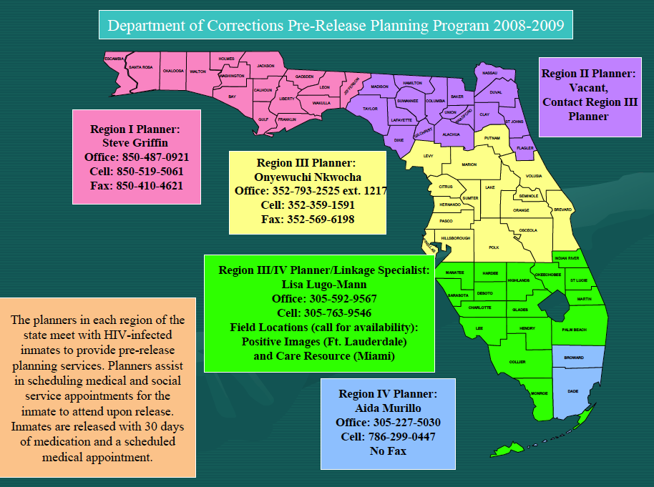
Reentry in West Central Florida Before H.I.R.E.
In 1999 the Department of Health started funding the Department of Corrections under Ryan White Title B. The Department of Corrections has Five Pre-Release Planners that service this population being released from the State of Florida Prisons.
Before HIRE was implemented in 2009 ex-offenders living with HIV/AIDS and returning to the Tampa Bay area (Hillsborough, Pinellas, Pasco and Hernando Counties) were provided with a 30-day prescription of HIV antiretroviral medications and a referral to their local health department.

Slide 37
Florida Corrections Programs
Estimates are that the rates of HIV/AIDS in correctional facilities are three to five times higher than in the general population and approximately 15 to 40 percent of inmates are hepatitis C infected.
Therefore, many of these programs also have a counseling and testing component, not only for HIV, but for sexually transmitted diseases (syphilis, gonorrhea, and chlamydia) and hepatitis B and C.

Slide 38
Needs of Re-entering Ex-offenders
Healthcare & Medication Access
Mental Health Services (SPMI)
Substance Abuse and Relapse Prevention Services
Food/ Nutrition Assistance
Family Services
Employment
Housing
Transportation
Education/ Training
Clothing
Identification (IDs, birth certificates)
Rights Restoration

Slide 39
Additional Needs for HIV+ Ex-offenders
Ryan White Eligibility Determination (NOE)
Healthcare
HIV and OI Medication Access (ADAP & PAP)
Support Groups
Clinical Care Coordination
Prevention for Positives
Partner Notification Assistance
Family Services
Notes:
Barriers/Challenges
• Clients with felonies are ineligible for subsidized housing services.
• There is not enough emergency or transitional housing for those being released and less housing for those with sex offenses.
• Difficulty with securing employment due to criminal history and lack of skills or education.
• Clients with mental health diagnosis have challenges with the transition back to the communities.
• Clients with sex offense charges are not compliant with medical care due being homeless and not being able to provide proof of residency for Ryan White Services Services.
• Clients that are challenged with drug addiction, poverty and homelessness return to the same environment in the communities. Their survival tactics place th them at risk of re-arrest or violation of parole/probation.
• Clients that are institutionalized experience challenges living without structure and have difficulties adjusting in the communities.
• The prisons do not have enough programs to prepare the clients for transitioning back to society.
• Due to funding constraints there is a consistent issue of transportation assistance.

Slide 40
Florida Department of Health Services

Slide 41
Linkage – What is it?
Definition: Linkage can be defined as active referrals and follow-ups/ Linkage is making a connection between two things. The Jail Linkage Program links HIV-infected inmates to health services such as medical care, prenatal care, substance abuse and partner services, as well as to social services such as support groups, transportation, and housing needs.
The linkages are active, not passive referrals. Confirmation for medical care and prenatal care linkages is tracked, therefore a process should be put in place to track and verify these linkages. This data will be reported quarterly to the Corrections Specialist.

Slide 42
Pre-Release Planning Program (PRPP)
The Florida Department of Health (DOH) contracts with the Department of Corrections (DOC) to provide pre-release planning services to HIV-infected inmates preparing to return to their communities. The PRPP, funded through Ryan White Title II, includes all correctional facilities and some transitional programs, such as work camps.
The DOC employs 5 pre-release planners who are divided among 4 regions. The planners provide services directly to the inmate within 6 months of release to determine what community the inmate is retuning to and what services will be needed. The planner then contacts a social service agency, like Metro, to connect the client with care upon release.

Slide 43
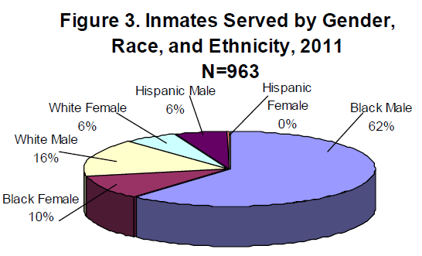
Pre-Release Planning Program (PRPP)
In 2011, the PRPP served 963 HIV-infected inmates. The distribution by race/ethnicity and gender of these inmates is shown here.
Of the 963 inmates
who received services,
748 (78%) had
medical and/or social service appointments scheduled by a
pre-release planner and 68% kept the appointment.

Slide 44
Jail Linkage Programs (JLP)
The DOH currently funds 16 county health departments to implement services in their local jails. These JLP are located in Alachua, Broward, Collier, Duval, Gadsden, Hillsborough, Lee, Manatee, Miami-Dade, Orange, Palm Beach, Pasco, Pinellas, Polk, St. Lucie, and Volusia counties, with an additional unfunded program Monroe County.
These programs include: counseling and testing for HIV/AIDS, Tuberculosis, hepatitis, and STDs; prevention education; pre-release planning for inmates; and follow up services to ensure the releases are still in care in their respective counties. Jail linkage staff often provides STD education sessions with inmates followed by voluntary HIV testing.

Slide 45
Jail Linkage Program (JPL)
Increased HIV testing has been made available through the Expanded Testing Initiative (ETI). This grant expanded the African American Testing Initiative and integrated HIV testing for populations disproportionately affected by HIV, primarily African Americans, but also Hispanic men and women, men who have sex with men, transgender populations, and injection drug users regardless of race/ethnicity. The grant allows funds to be used for screening in jails, among other venues. Six of the DOH funded JLP sites receive ETI funding.
In 2011, the JLP tested 32,157 inmates for HIV and identified 207 positives for an overall positivity rate of 0.6%. Of the 24,616 male inmates tested for HIV, 164 were positive, while 43 of the 7,498 female inmates were positive. The overall positivity rate for males was higher than females; 0.67% versus 0.57%. The distribution of HIV tests by gender and county in 2011 is shown in Table 1.

Slide 46
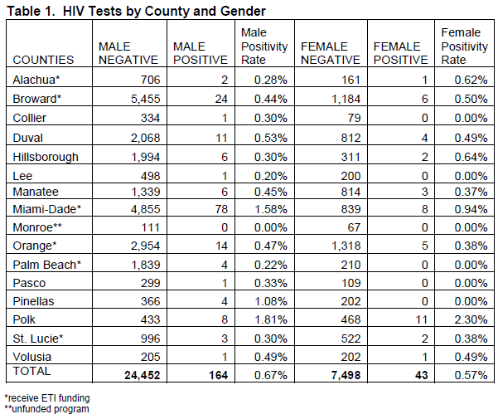

Slide 47
Jail Linkage Programs (JPL)
In 2011, the JLPs provided linkages to 718 HIV-infected inmates preparing to return to their community. Of these inmates, 87% were previously diagnosed with HIV while 13% were newly diagnosed. Staffs made a total of 3,664 linkages for these inmates, equating to over five linkages per client.
The linkages were to various social services, such as Metro, including, but not limited to, case management, mental health, county health departments, housing, substance abuse treatment, and transportation.

Slide 48
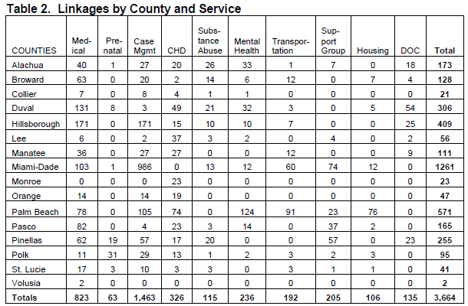
Metro services Hillsborough, Pinellas, Pasco, and Hernando counties.

Slide 49
Jail Linkage Programs (JPL)
The burden is on the JLP staff to work around the security issues that dominate the corrections environment. Public health providers strive to provide services without disrupting the routine of the correctional facility and without putting an extra burden on security and correctional medical staff. It is also important for security and correctional medical staff - to the extent possible - to create an atmosphere conducive to the provision of public health services.

Slide 50
Jail Linkage Programs (JPL) Procedures: Health Departments
Work with local sheriffs and jail medical departments to develop policies and procedures for routinely offering HIV testing to all inmates.
Provide training to personnel from the correctional facility, the health department, or community-based organizations (CBOs) working in correctional facilities
Distribute an inmate information sheet on HIV testing and forms for documenting HIV test results or refusals to test to correctional facilities in their jurisdiction.
Initiate the linkage process for all HIV-infected inmates by making the first appointment with an appropriate care provider, CBO, or both.
Work with participating CBOs to establish procedures and responsibilities for linkage services for inmates as part of release planning.

Slide 51
Jail Linkage Programs (JPL) Procedures: Correctional Facilities
Provide all inmates with information sheets on HIV/AIDS and HIV testing upon entry into the facility.
Routinely offer HIV testing to all inmates during the medical evaluation.
Routinely offer prevention counseling in accordance with DOH counseling, testing, and linkage guidelines. This can be accomplished through referral to the jail linkage program.
Establish procedures and responsibilities for reporting HIV cases to the jail medical staff from the jail linkage program.
Each correctional facility must specify written policies and procedures to:
Determine eligibility for EIA HIV testing and rapid HIV testing.
Ensure care and treatment is provided, based on the inmate’s projected length of incarceration and recommendation of clinician.
Ensure confidentiality and security of data related to HIV testing.

Slide 52
Inmate Case Management
Provided by Medical Case Managers in Hillsborough and Pinellas County Jails
Discharge planning begins at initial intake
Complete RW Eligibility Determination in the jail
Linkage to medical care, treatment, and supportive services upon release
Individual Substance Abuse Counseling provided at jails
Pinellas 148 served/ Hillsborough 164 in the last

Slide 53
Project H.I.R.E.
Health Improvement for
Re-entering Ex-offenders

Slide 54
Project H.I.R.E.
Metro programs serving ex-offenders and minority populations recognize that health comes from a holistic approach, with medical case management that incorporates mental health counseling and substance abuse treatment; intervention programs; vision and dental care; employment and job training services; food, clothing, transportation, and housing; and assistance with obtaining ID cards and birth certificates.
Overall, Metro’s programs seek to improve health outcomes and prevent HIV transmission by providing comprehensive case management and prevention interventions.

Slide 55
H.I.R.E. Case Management
Individuals released to Pinellas or Hillsborough counties will receive direct case management services through our Linkage Case Managers to ensure that all medical, medication, and community needs are met.
At-Risk – Rapid HIV testing was used to measure seroconversion among ex-offenders at-risk of HIV infection, with change in HIV status being used to determine risk-reduction.
HIV Positive – Given its relationship to medication adherence and impact on transmission, ex-offender viral loads were used to assess adherence with appropriate medication and medical care.
Notes:
Better coordination of services for returning inmates can reduce criminal behavior, which in turn can translate into fewer crimes committed and fewer returns to jail or prison. This approach has potential benefits for the families and communities most affected by prisoner reentry as well as for the former prisoner.

Slide 56
H.I.R.E. Outcomes
Served 326 individuals: 81.1% of HIV+ ex-offenders had a decrease in viral load or remained undetectable.
The recidivism rate for all case managed clients over the course of the 3 years of the project was less than 10%. The recidivism rate for the state of Florida over 6 years is over 60% in comparison.
HIRE program appeared to promote increased medical adherence for participating ex-offenders, especially compared to prior reports in which only 20% of ex-offenders enrolled in primary care within 30 days of release and experienced increases in viral loads.
There were no HIV-AIDS related deaths.

Slide 57
Collaborations

Slide 58
Interagency Collaborations
The Corrections Infections Workgroup, led by the Bureau of HIV/AIDS and Hepatitis, is comprised of members from the Department of Juvenile Justice, Department of Corrections, Department of Children and Families (Substance Abuse and Mental Health offices), Bureau of Sexually Transmitted Diseases, and Bureau of Tuberculosis and Refugee Health. The workgroup is dedicated to information sharing, program development and education, and advocacy on issues related to HIV/AIDS, STD, TB, and/or hepatitis in correctional settings. The workgroup meets on a quarterly basis and strives to improve infectious disease screening and healthcare for inmates across the state of Florida.

Slide 59
Collaboration
Collaboration with the health departments, correctional facilities, and other CBO personnel is critical to the successful training and implementation of routine HIV screening and prevention services in correctional facilities and in the community.
Collaboration with correctional facility administration and staff is critical and requires persistence.
Partnerships should be developed among health departments, correctional facilities, and CBOs so that individuals can be linked to care, treatment, and prevention services in the community. These relationships should be negotiated and formally documented in writing, e.g., a letter of cooperation or memoranda of agreement or understanding.

Slide 60
Collaboration
Established with community partners who also serve the ex-offender population but may not be obvious
Leverage other partners strengths and needs – ex. Prevention Education/Risk reduction group sessions provided at partner sites

Slide 61
Contact Info
Priya Rajkumar
Vice-President of Client Health Services
priyar@metrotampabay.org
Ariel Ludwig
Director of ReEntry Programs
ariell@metrotampabay.org

Slide 62
References
2011 Florida Department of Health. Florida Corrections Programs.
Accessed 10/11/12.
http://www.doh.state.fl.us/disease_ctrl/aids/corrections/corrindex.html
2011 Florida Department of Health and Bureau of HIV/AIDS. Florida’s Corrections Programs 2011 Annual Report. Accessed 10/11/12.
http://www.doh.state.fl.us/disease_ctrl/aids/corrections/Annual_Report_2011.pdf
2012 Florida Department of Health. Florida DOH Corrections Programs. Accessed 10/11/12.
http://www.preventhivflorida.org/Corrections/DOH_Corrections_Programs.htm
2011 Florida Department of Health and Bureau of HIV/AIDS. Jail Linkage Program Guidelines and Standards 2011. Access 10/11/12.
http://www.preventhivflorida.org/Corrections/JLP_Procedures_Guidelines_8_24_11.pdf

Slide 63
Authors
Priya Rajkumar, BA
Director of Client Health Services
Metro Wellness and Community Centers Tampa: 1315 E. 7th Ave Ste 201, Tampa, FL 33605 Phone (813) 232-3808 ext. 226 Fax (813) 234-3075 St Pete: 3251 3rd Avenue North, St. Petersburg, FL 33713 Phone (727) 321-3854 Fax (727) 327-7670
Priya is the Director of Client Health Services at Metro. She has been serving the Tampa Bay HIV community for over 13 years. Priya moved to Tampa in 1999 from Long Island New York, where she graduated from Queens College and joined TAN as a case manager. Over the years she has moved up the management ladder within the HIV arena. Priya is well-respected in the HIV/AIDS community for her knowledge of the disease and program management.

Slide 64
Authors
Ariel Ludwig, MPH Program Coordinator - Reentry Programs Metro Wellness and Community Centers Tampa: 1315 E. 7th Ave Ste 201, Tampa, FL 33605 Phone (813) 232-3808 ext. 226 Fax (813) 234-3075 St Pete: 3251 3rd Avenue North, St. Petersburg, FL 33713 Phone (727) 321-3854 Fax (727) 327-7670
Ariel Ludwig currently serves as the Program Coordinator for Re-entry Services at Metro Wellness and Community Centers, a community-based non-profit serving West Central Florida. She received her B.A. from Kenyon College and a Masters in Public Health from Yale University. She has over three years of experience working and researching at the intersection of public health, correctional health, and HIV/AIDS. Prior to this, the author worked for the New York City Department of Health’s Correctional Health Services on Rikers Island.

Slide 65
THANK YOU!!

