Slide 1
The Intersection Between ADAP and PAPs in Addressing Unmet Treatment Needs of People Living with HIV/AIDS
Murray Penner and Britten Pund
National Alliance of State & Territorial AIDS Directors
November 28, 2012

Slide 2
Disclosures
This continuing education activity is managed and accredited by Professional Education Service Group. The information presented in this activity represents the opinion of the author(s) or faulty. Neither PESG, nor any accrediting organization endorses any commercial products displayed or mentioned in conjunction with this activity.
Commercial support was not received for this activity.

Slide 3
Disclosures (continued)
Murray Penner serves as Board Chair for HarborPath but otherwise has no financial interest or relationships to disclose.
Britten Pund has no financial interest or relationships to disclose.
Professional Education Services Group staff have no financial interest or relationships to disclose.

Slide 4
Learning Objectives
By the end of the seminar, participants will:
Become familiar with the process by which ADAPs and/or PAPs provide access to treatment for people living with HIV/AIDS.
Learn about the progress towards created a standardized process and application for enrollment into PAPs, including outcomes from a May 2012 Consultation conducted in collaboration with the Department of Health and Human Services, federal, pharmaceutical, and community partners.
Learn how to expand access to care for people living with HIV/AIDS and better address the current unmet treatment needs of people living with HIV/AIDS.

Slide 5
Agenda
Overview of ADAP
Addressing Unmet Need for ADAP
Patient Assistance Programs and People Living with HIV/AIDS
Welvista and ADAP Waiting Lists
Current Initiative
Questions and answers

Slide 6
Overview of ADAP

Slide 7
What is ADAP?
ADAPs provide life-saving HIV treatments to low income, uninsured, and underinsured individuals living with HIV/AIDS in all 50 states and associated jurisdictions and territories.
In addition, some ADAPs provide insurance continuation and Medicare Part D wrap-around services to eligible individuals. Ryan White Part B programs provide necessary medical and support services to low income, uninsured, and underinsured individuals living with HIV/AIDS in all states, territories and associated jurisdictions.

Slide 8
The National ADAP Budget
Notes:
The national ADAP budget grew to $1.88 billion in FY2011, an increase of approximately $100 million (5%) over FY2010. Since FY1996, the budget has grown nine-fold. While the ADAP earmark continues to represent the largest share of the budget, it no longer drives budget growth, as it did early on in the program’s history. For purposes of determining the overall ADAP budget, federal, state and drug rebate funds are counted.

Slide 9
Estimated Drug Rebates
Notes:
Drug rebates accounted for $618.9 million, or 33%, of the overall ADAP budget in FY2011. Drug rebates have risen from 6% of the budget in FY1996 to 33% in FY2011. ADAPs must actively seek drug rebates and, while not all ADAPs do so (because of varying state drug purchasing mechanisms), drug rebates accounted for a quarter or more of the ADAP budget in 26 states. This funding represents money that is returned to the state as a result of active filing of rebate claims with manufacturers based on past drug purchases.
The Ryan White Program requires that rebate funds, once received, remain in the Ryan White Part B program. This funding is considered a part of the national ADAP budget as it facilitates additional drug purchases and thus drives overall program expenditures.

Slide 10
ADAP Expenditures, FY2010
In FY2010, ADAPs expended $1.5 billion on prescription drugs, representing 82% of all ADAP expenditures.
Two percent of ADAP funds were expended for program administration costs.
Notes:
In FY2010, ADAPs expended $1.5 billion on prescription drugs, representing 82% of all ADAP expenditures. Insurance premiums, deductibles, and co-payments represented 13% of ADAP expenditures. Two percent of ADAP funds were expended for program administration costs.

Slide 11
ADAP Client Enrollment and Utilization
On average, 2,710 new clients were enrolled in ADAP each month in FY2010.
Notes:
ADAP client enrollment and client utilization reached their highest levels in FY2011. ADAPs primarily serve low-income, uninsured clients, most of whom are minorities. Client demographics have remained fairly constant over time, although there are significant variations by state and region.
During FY2010, 226,419 clients were enrolled in ADAPs nationwide, including 32,522 new clients enrolled throughout the year. Client enrollment ranged from 104 in North Dakota to 41,179 in California in FY2010. Typically, fewer clients are served in ADAPs than are enrolled at any given time—ADAPs served 217,905 clients in FY2010.
ADAPs provided medications to 138,173 clients across the country in June 2011. Client utilization in June 2011 increased by 2% between June 2010 and June 2011.
Mirroring the national epidemic, most ADAP clients are concentrated in states with the highest number of people living with HIV. Ten states accounted for 63% (142,031 clients) of total enrollment in FY2010; five states accounted for 47% (California, New York, Texas, Florida, and New Jersey) of total FY2010 enrollment. The distribution is similar for clients served in June 2011.

Slide 12
ADAP Drug Expenditures
ADAP drug expenditures were $135,138,130 in June 2011.
Ten states accounted for 78% of all drug spending; five states accounted for 64% of all drug spending.
Notes:
Drug spending and utilization have increased over time, but actually decreased from FY2010 to FY2011. The distribution of drug expenditures and prescriptions varies across the country, reflecting differing formularies, drug prices and prescribing patterns. Antiretrovirals, the standard of care for HIV, account for the majority of ADAP drug expenditures and prescriptions filled.
ADAP drug expenditures were $135,138,130 in June 2011, ranging from a low of $13,837 in New Mexico, which heavily relies on insurance purchasing for client coverage, to a high of $40.3 million in California. Ten states accounted for 78% ($105,980,821) of all drug spending; five states (California, New York, Texas, Puerto Rico and Florida) accounted for almost two-thirds (64%) of all drug spending.
Drug spending by ADAPs has increased more than nine-fold (806%) since 1996, almost three times the rate of client growth over this same period (341% increase between 1996 and 1. Between June 2010 and June 2011, drug expenditures decreased 8%. Reasons for this decrease likely include the impact of price reductions as a result of ADAP Crisis Task Force negotiations in May 2010, the implementation of health reform which mandated an additional 8% reduction in rebates and a shifting of expenditures to insurance premiums. In addition, data is from a one-month snapshot and may be subject to one-time only events or changes that could in turn appear to impact trends.
The average monthly cost per client served by ADAP was $869 in June 2011.

Slide 13
ADAP Prescriptions Filled
In June 2011, the average expenditure per prescription was $303, compared to $325 in June 2010, representing a 7% increase.
Average expenditures per prescription was significantly higher for antiretrovirals ($464) than non-antiretrovirals ($74 for “A1” OIs and $63 for all other drugs).
ADAPs filled a total of 445,202 prescriptions in June 2011, representing a decrease of 1% compared to June 2010.
Notes:
In June 2011, the average expenditure per prescription was $303, compared to $325 in June 2010, representing a 7% decrease. Average expenditures per prescription was significantly higher for antiretrovirals ($464) than non-antiretrovirals ($74 for “A1” OIs and $63 for all other drugs).
ADAPs filled a total of 445,202 prescriptions in June 2011, representing a decrease of 1% compared to June 2010 (451,148 prescriptions filled). Reasons for this decrease likely include more clients utilizing combination antiretrovirals which count (in most states) as only one medication as opposed to their individual component parts. As well, data is from a one-month snapshot and may be subject to one-time only events or changes that could in turn appear to impact trends.

Slide 14
Addressing Unmet Need for ADAP

Slide 15
Factors Leading to Implementation of Cost-containment Measures
ADAPs reported the following factors contributing to consideration or implementation of cost containment measures:
Higher demand for ADAP services as a result of increased unemployment (19 ADAPs)
Level federal funding awards (16 ADAPs)
Increased demand for ADAP services due to comprehensive HIV testing efforts (14 ADAPs)
Escalating drug costs (11 ADAPs)
Budgets cuts in state Medicaid and other state programs (11 ADAPs)

Slide 16
ADAP Waiting Lists and Other Unmet Need
Over the course of 2011, 14 ADAPs reported an ADAP waiting list.
Since that time, some ADAPs have been able to reduce the overall number of individuals on their waiting list.
As states remove individuals from their waiting lists, however, they continue to add new individuals to their program.
Demand for ADAP has not dwindled.
Notes:
ADAP’s FY2011 began on April 1, 2011. Increases in ADAP client utilization and progression to more costly drug regimens, while likely resulting in important health outcomes for people living with HIV/AIDS, have led to considerable fiscal stress for many ADAPs, unable to keep pace with those demands. As a result of the nation’s continued economic crisis, more Americans living with HIV are relying on public health safety net programs, including ADAP, as a vital resource for medications.
This increasing demand for services, coupled with minimal increases in federal appropriations and fluctuations in state funding, heightened national efforts focused on HIV testing and linkages into care, high drug costs, and new HIV treatment guidelines calling for earlier therapeutic treatments have caused fiscal challenges for many ADAPs as they provide services to those in need.
Over the course of 2011, 14 ADAPs reported an ADAP waiting list. Since that time, some ADAPs have been able to reduce the overall number of individuals on their waiting list. As states remove individuals from their waiting lists, however, they continue to add new individuals to their program. The demand for ADAP has not dwindled. As a result of the variability of ADAP enrollment and funding, waiting lists will likely remain and continue to fluctuate, particularly with increased efforts to identify new individuals living with HIV or re-engage individuals lost to care. Many ADAPs continue to struggle financially, including those without any cost-containment measures currently in place.

Slide 17
Access to Medications
Case management services are being provided to clients on ADAP waiting lists through:
ADAP (1 ADAP)
Ryan White Part B (6 ADAPs)
Contracted agencies (7 ADAPs)
Other agencies, including other Parts of Ryan White (4 ADAPs).
ADAP waiting list states confirm that ADAP waiting list clients are receiving medications through other mechanisms.
Notes:
Case management services are being provided to ADAP waiting lists through ADAP (1 ADAP), Part B (6 ADAPs), contracted agencies (7 ADAPs), and other agencies, including other Parts of Ryan White (4 ADAPs).
For clients on ADAP waiting lists who are currently on or in need of medications, ADAP waiting list states can confirm that ADAP waiting list clients are receiving medications through either pharmaceutical company patient assistance programs (PAPs), Welvista, or other mechanisms available within the state.

Slide 18
Patient Assistance Programs and People Living with HIV/AIDS

Slide 19
The Role of HIV PAPs
PAPs operated by pharmaceutical manufacturers play a small, but very important role in the U.S. health system for delivering medications to people living with HIV/AIDS (PLWH).
PAPs operate in the context of a patchwork health care system
A drug coverage safety net for the public safety net programs
In an environment where ADAPs are restricting access to medications, PAPs become more critical.

Slide 20
The Role of HIV PAPs (continued)
There are approximately 20,000-30,000 patients utilizing PAPs.
Analyses indicates that PAPs serve patients who are in transition between longer term methods of coverage and typically stay in a PAP less than one year.

Slide 21
The Role of HIV PAPs (continued)
Pharmaceutical companies have been strong partners and have fulfilled their obligation to provide life saving medications to patients who would otherwise go untreated.
With revenue from HIV medications now exceeding $10 billion per year, pharmaceutical companies continue to have adequate resources to support PAPs.
Industry and public health officials have long recognized the need for a common portal to access these programs.

Slide 22
The Role of HIV PAPs (continued)
Serve people who get stuck navigating the system and may not be aware of services that are available to them.
Also serve people who can navigate the system, yet for whom no public safety net programs are available to serve them.
Important for under-insured people who may not qualify for public assistance but have limited prescription drug benefits.

Slide 23
The Role of HIV PAPs (continued)
All 8 companies that manufacture HIV antiretroviral medications operate a PAP.
One additional PAP for a two company/combination drug).
Most companies have increased eligibility levels to 500 percent of FPL. Exception processes exist for companies under that amount.
Each company has worked to simplify their PAP enrollment, eligibility and distribution processes: many successes are noted.
Notes:
ADAP income eligibility in June 2011 ranged from 200% FPL in ten states to 500% FPL in five. Overall, 21 states set income eligibility at greater than 300% FPL. Twenty-two states were between 201% and 300% FPL. In addition to using income to determine eligibility, 13 ADAPs reported having asset limits in place in June 2011.

Slide 24
Challenges Accessing PAPs
PLWHA, providers and case managers often report these programs can be difficult for individuals to access for a number of reasons:
Multi-drug regimens (multi-companies) requires multiple applications and varying requirements
Lack of knowledge of PAPs
Confusing and/or challenging application and income verification requirements that vary by company
Delays in eligibility processing (vary by company and on a case-by-case basis)

Slide 25
Challenges Accessing PAPs (continued)
PLWHA, providers and case managers often report these programs can be difficult for individuals to access for a number of reasons:
Communication about status of application
Inconsistent eligibility requirements (eligible for some but not all PAPs)
Differing time frames and locations for receiving medications
Differing re-certification time frames

Slide 26
Welvista and ADAP Waiting Lists

Slide 27
Welvista
A non-profit mail-order pharmacy based in South Carolina
In 2010, Welvista began to provide HIV medications to individuals on ADAP waiting lists as a “one-stop-shop” for client access to HIV medications.
Welvista is supported by the major HIV antiretroviral manufacturers.
Currently licensed to dispense medications in 20 states and is seeking licensure in seven more.

Slide 28
Current Initiatives to
Streamline Access to PAPs

Slide 29
Current Initiative
Analyzed three current options for increased access to care for under and uninsured individuals living with HIV – ADAP, pharmaceutical patient assistance programs (PAPs) and Welvista.
In collaboration with HHS/HRSA and the Clinton Health Access Initiative, NASTAD has worked to develop a standardized PAP enrollment process and application.
This effort, in conjunction with industry and federal partners, will bring HIV/AIDS care and treatment for the under and uninsured to a new era.
Notes:
Many HIV care and treatment programs are struggling financially. In order to address the challenges currently faced by ADAPs and other parts of the Ryan White Program, the National Alliance of State and Territorial AIDS Directors (NASTAD) has embarked on a project to expand access to care and treatment for individuals living with HIV/AIDS by strengthening ADAPs and providing opportunities for individuals to access care beyond ADAP in a more streamlined approach.
NASTAD began this process by analyzing three current options for increased access to care for under and uninsured individuals living with HIV – ADAP, pharmaceutical patient assistance programs (PAPs) and Welvista. Following this analysis and in collaboration with the Clinton Health Access Initiative, NASTAD has worked to develop a standardized PAP enrollment process and application.
This effort, in conjunction with industry and federal partners, will bring HIV/AIDS care and treatment for the under and uninsured to a new era.

Slide 30
Common PAP Process
Working toward reaching consensus on a common application and eligibility/fulfillment process.
Step One: simplifying and streamlining access to PAP medications (HHS Common Form)
Step Two: streamlining eligibility and prescription fulfillment distribution (HarborPath)
Reduce burden for providers, case managers and PLWH.

Slide 31
Common PAP Process
1
Standardize documentation: set expectations for case managers and advocates
2
Streamline eligibility processing: easier to track missing information and facilitates a single approval status
3
Coordinate decision-making for all drugs needed
4
Enable single source pharmacy supply (future step)
A common application form will facilitate consistent eligibility screening protocols and timelines, enabling coordinated drug delivery.
Notes:
31

Slide 32
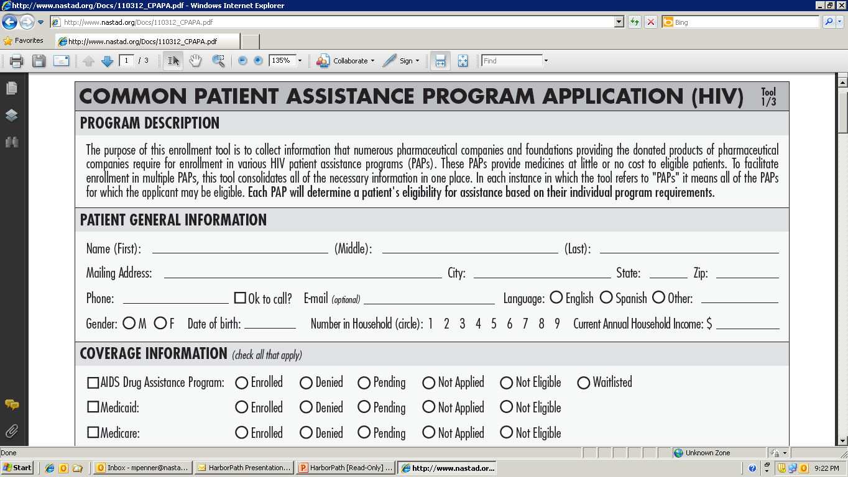
Update: Common PAP Application
Working with industry and NASTAD, HHS/HRSA developed and announced the common form during the International AIDS Conference in July 2012 (www.NASTAD.org/CommonPAPForm).
Form “went live” on September 12, 2012

Slide 33
Update: Harbor Path (Common Portal)
NASTAD and the Clinton Health Access Initiative (CHAI) launched HarborPath (HP) to streamline PAP enrollment, eligibility processing and prescription fulfillment.
HP is a collaborative undertaking between pharmaceutical partners, NASTAD, donors, government agencies, and advocacy groups.

Slide 34
Update: Common Portal (continued)
HP has completed software development for the common portal and can process PAP forms as well as the HHS common form and ADAP waiting list forms.
ViiV Healthcare and Merck are supplying medications to HarborPath.
Discussions continue with Gilead Sciences, Janssen Therapeutics, Abbott Laboratories, and Bristol-Myers Squibb.

Slide 35
Questions and Answers

Slide 36
Obtaining CME/CE Credit
If you would like to receive continuing education credit for this activity, please visit:
http://www.pesgce.com/RyanWhite2012

Slide 37
Contact Information
Murray Penner
Deputy Executive Director
mpenner@NASTAD.org
Britten Pund
Senior Manager, Health Care Access
bpund@NASTAD.org
www.NASTAD.org

