Slide 1
Early Adoption of Healthcare Reform in Los Angeles County
Planning for the Migration of Ryan White Patients into the New Low Income Health Program
Michael Green, PhD, MHSA, Chief of Planning
Carlos Vega-Matos, MPA, Chief of Care Services
Los Angeles County Department of Public Health
Division of HIV and STD Programs
Craig Vincent-Jones, MHA, Executive Director
Los Angeles County Commission on HIV
December 1, 2011
Notes:
This is the main title slide. It should be amended to reflect the name of the person (or people) who is (or people who are) giving the presentation. It should also reflect title and division information for the presenter(s). The title (and subtitle, if appropriate) of the presentation should also be substituted where indicated (see next slide for example). Additional Title Slides should be used where appropriate if a new speaker is introduced within the course of a presentation.

Slide 2
Learning Objectives
Steps involved to ensure continuity of care for RW patients transitioning to payers available through healthcare reform
Priority setting and resource allocation process used to estimate costs during transition
Planning considerations for RW requirements in healthcare reform environment

Slide 3
Presentation Overview
CA “Bridge to Reform” through Section 1115 Medicaid waiver
  Medicaid Expansion; Low Income Health Program (LIHP); Healthy Way LA
Transition Planning
  Grantee/Administrative Agency
  State ADAP
  Planning Council
Considerations for RW Programs

Slide 4

 | Los Angeles County | California
Estimated living HIV/AIDS Cases | 61,700 | 134,303*
Reported HIV/AIDS Cases | 44,250 | 110,994
Estimated Undiagnosed HIV/AIDS Cases | 13,250 | 23,309*
Los Angeles County | California
9,848,011 | 36,961,664
Los Angeles County | California
4,060 sq mi | 155,959 sq mi
Data Source: Los Angeles County Department of Public Health, HIV Surveillance, 2011; California State Department of Public Health, State Surveillance Data, 2010
*133,705 calculated assuming 21% of HIV positive Californians are unaware of their status.
Notes:
(Optional slide): This slide shows Los Angeles County in comparison with the State of California. We are 2.6% of the state’s land area, 26.6% of the population, and 46.1% of the estimated living HIV/AIDS cases as of January 1, 2011.

Slide 5
Los Angeles County
Chicago
Houston
New York City
San Francisco
Philadelphia
Data Source: U.S. Census Bureau, Topologically Integrated Geographic Encoding and Referencing system, 2009. Maps Drawn at 1:750,000 scale.
District of Columbia
Notes:
(Optional slide): With over 4,000 square miles, Los Angeles County is larger than San Francisco (City and County), The District of Columbia, Philadelphia, Houston, Chicago, and all 5 boroughs of New York City combined.

Slide 6
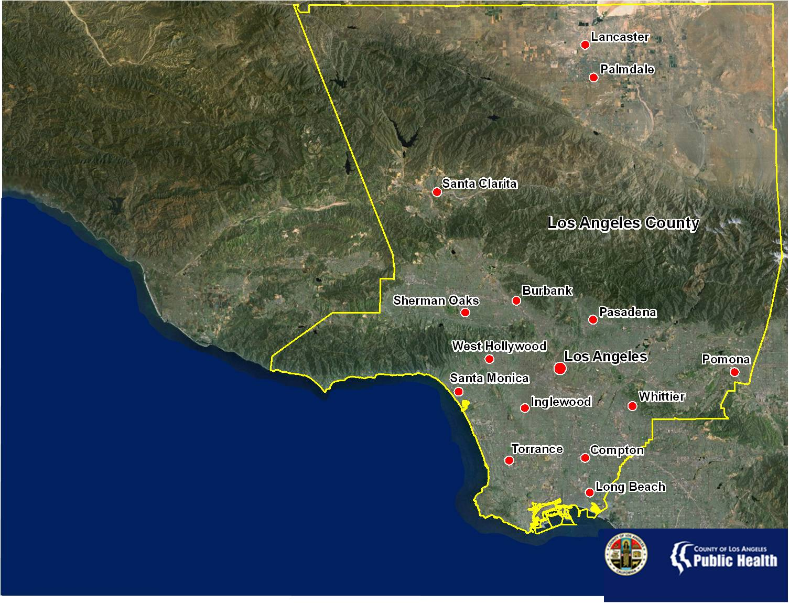
Population | Estimated HIV/AIDS Cases
9,848,011 | 61,700
Data Source: U.S. Department of Commerce, 2010; Los Angeles County Department of Public Health, HIV Surveillance, 2011
Notes:
Los Angeles County is the most populous in the United States with 9.8 million residents. The County is diverse in both it’s people and geography. There is no one majority racial/ethnic group and the County’s geography consists of urban, suburban, and rural areas divided by several mountain ranges.

Slide 7
Los Angeles County Conceptual Model for Continuum of HIV Services
No HIV,
Low Risk
High Risk for HIV
HIV+,
Unaware
PLWHA Linked to Care
PLWHA Retained in Care
HIV+ Aware, But Not in Care
Social marketing
Capacity building
Routine HIV testing
Targeted & Routine HIV Testing
HE/RR
Social Marketing
Syringe Exchange Programs
Biomedical (PEP)
Partner Services
STI Screening and Treatment
Substance use programs
Targeted & Routine HIV Testing
Social Marketing
Partner Services
Substance use programs
Outreach
Early Intervention Programs
Mental health and substance use programs
Ancillary support services
Social Marketing
STI screening and treatment
HIV medical care and ART
Treatment adherence
Ancillary services
Mental health and substance use programs
PS
HE/RR
Social marketing
Notes:
- PLWHA = People living with HIV/AIDS

Slide 8
2012 Estimated Number of Persons
Living with HIV and AIDS in LAC
12,800
1,200
13,250
1,600
3,200
3,200
16,155
43,900
Estimate
~ 59,500 living
with HIV (including AIDS) in LAC
25,895
Estimate
~ 61,700 living
with HIV & AIDS in LAC
Source: LAC HIV Epidemiology Program, reported as of 12/31/2009.
Source: LAC Division of HIV and STD Programs, reported as of 12/31/2011.
(1) Estimate that 21.5% of HIV+ in LA County are unaware of their infection; modified from CDC estimate.
(2) Of 4,853 notifications pending investigation, estimate half of 2,400 who
have detectable VL or confirmatory test to be unduplicated cases.
(3) Out of the 3,200 cases reported as code, half are thought to represent unduplicated cases.
Notes:
8

Slide 9
Changes in the Way We Finance Our Response

Slide 10
California’s Section 1115 Medicaid Waiver

Slide 11
Section 1115 Waiver Overview
November 2010: 1115 Waiver approved by CMS
Designed to be a bridge to implementation of health care reform in 2014
Attempts to stabilize safety net provider systems
Improves care coordination for certain vulnerable populations
Expands coverage to uninsured adults

Slide 12
1115 Waiver in LA County
Medi-Cal 1115 Waiver
Implementation began July 2011
Mandatory Medi-Cal Managed Care for eligible Seniors and Persons with Disabilities (SPD).
Medicaid Coverage Expansion (Healthy Way LA)
– Uninsured with ≤ 133% FPL
Low Income Health Program (LIHP) for uninsured/under-insured adults with low income
Health Care Coverage Initiatives – uninsured with 134% FPL to FPL TBD

Slide 13
LIHP Overview
Designed to extend health coverage to uninsured or underinsured adults;
Help counties identify their uninsured populations and to move these individuals into care prior to 2014;
LIHP beneficiaries will transition to Medi-Cal in 2014;
Programs vary by county;
Los Angeles County’s LIHP is called “Healthy Way LA”;
Healthy Way LA is administered by LA County Department of Health Services (DHS).
Notes:
Explain that LA County was part of an old health initiative also called HWLA. New initiative started on July 1, 2011.

Slide 14
Healthy Way LA
Eligibility
Uninsured*
Ages
19-64
Income at or below
133% FPL
US Citizen or legal resident 5+ years
Los Angeles County Resident
Individual must meet all of the eligibility requirements
Federal Poverty level: Income based on family size
<133% FPL for a single individual in 2011=
$14,484 yr/$1207 month
Not pregnant or eligible for Medi-Cal or Healthy Families
Uninsured persons with HIV who do not meet the eligibility criteria for HWLA will remain eligible for Ryan White supported care and ADAP

Slide 15
Initial “Planning”
What about ADAP?
Does LIHP count as a 3rd party payer?
Are HIV patients exempt? HIV “carved-out?”
???
What does this mean to Ryan White Patients?
???
???
If LIHP a payer, how many RW will transition?
What does RW cover that LIHP doesn’t?
???
???
Who do we talk to about LIHP and HIV?
Notes:
Explain that LA County was part of an old health initiative also called HWLA. New initiative started on July 1, 2011.

Slide 16
Transition Planning
Engage in dialogue with stakeholders
  LIHP administrator: LA County Dept of Health Services
  LAC Dept of Mental Health
  CA Office of AIDS
  Ryan White Medical Providers
  Planning Council (Consumer Communications)
Notes:
Explain that LA County was part of an old health initiative also called HWLA. New initiative started on July 1, 2011.

Slide 17
Transition Planning
Estimate LIHP-eligible clients in RW system
  Potential cost savings and allocation changes
Compare service coverage offerings
  Identify gaps
  Pursue parity of services
Identify potential transition issues
  Ensure continuity of care and medication access
  Ensure standard of care is replicated in LIHP
Work out transition timeframe
Notes:
Explain that LA County was part of an old health initiative also called HWLA. New initiative started on July 1, 2011.

Slide 18

  Introduced in the 1990 authorization of the CARE Act and is found in Parts A, B, C, and F of the Act
  “CARE Act grant funds cannot be used to make payments for any item or service if payment has been made, or can reasonably be expected to be made, with respect to that item or service under any State compensation program, under an insurance policy, or under any Federal or State health benefits program; or by an entity that provides prepaid health care”
Ryan White Payer of Last Resort Mandate

Slide 19
Estimate Patient Migration
Total annual RW clients = 19,000
Private & Public Insurance
Clients with at least one RW medical visit
Insured
5,000
15,800
Eligible for LIHP/HWLA
5,000
Uninsured
Remaining in RW Medical
Clients not using RW for medical care
5,800
3,200

Slide 20
Estimate Patient Migration
Total annual RW clients = 19,000
Private/Public (Medi-Cal Managed Care)
Clients with at least one RW medical visit
Insured
5,000
15,800
Eligible for LIHP/HWLA
5,000
Uninsured
Remaining in RW Medical
Clients not using RW for medical care
5,800
3,200
Minimum number of post-migration RW clients

Slide 21
Estimate Patient Migration
Migration by patient birth month
Review data agency by agency
  Population served varies by agency and number of LIHP-eligible patients varies
Assume migration rate at 1/12 of full year number each month
Migration began July 1, 2012
  After provision for continuity of care

Slide 22
Estimate Patient Migration
FY 2012 = March 2012 – Feb. 2013 = 4 months of full client load + 8 months of gradual patient migration by birth month
FY 2013 = March 2013 – Feb. 2014 = 4 months of patient migration + 8 months of post-migration client load

Slide 23
Health Way LA Service Delivery
Medical Specialty Services
Medical Home
Prescription Drug Coverage
Psychiatric Services*
HIV Clinic
HIV Physician & Healthcare Team
Medical Transportation
Notes:
Labs:
VL Resistance Testing: Public Health Lab Ryan White Funded
Some labs done in house as part of HWLA contract
Some labs done as part of medical specialty ref.

Slide 24
Healthy Way LA
Medical Homes and Primary Care
Worked to ensure that clients are able to continue to receive care from their current HIV medical provider/clinic;
All Ryan White funded medical providers have become part of the HWLA network;
HWLA will allow HIV providers/clinics to serve as client’s primary care provider or “medical home”;
HWLA coverage is free—no out-of-pocket cost or fee for care.

Slide 25
Benefit Comparison
 | Healthy Way LA | Ryan White and ADAP
Coverage | Hospital, ER, urgent care, outpatient, labs, test, specialty care | Outpatient, labs and some specialty care only
Physician/Clinics | Attempting to include the same providers/clinics currently covered under Ryan White | Supports 25 clinics in countywide
Medication Formulary | Covers medically necessary medications including HIV drugs | Covers approximately 200 medications
Formulary Appeals | Option for MD to appeal to have non-formulary drugs covered | No option to appeal to have non-formulary drugs covered
Notes:
See chart in handout package

Slide 26
HWLA HIV Pharmacy Services
DHS partner pharmacy had limited access points prior to discussion about RW transition
Provided expanded pharmacy access
  Added additional pharmacy access points for patients
  Mail order in the near future
Retained 340B pricing
Improved claims and reimbursement process

Slide 27
Healthy Way LA Transition Review
Medical Provider
Bring all RW medical providers into LIHP/ HWLA provider network
HIV medical home = Medical Home
Prescription Drug Coverage
Clients will have expanded access to medications
Small number of clients will have to change pharmacies
Improved access to medical care
Medical specialty
Inpatient (hospital) coverage
DHS created an HIV pharmacy program (clinic and community pharmacies) that resembles ADAP for LIHP/HWLA
Access to non-HIV related care and treatment
Emergency Care
Urgent Care
Ambulance
LIHP screening/ enrollment coincide with ADAP re-certification
Clients continue to be seen by their existing HIV medical providers
No gap between LIHP screening and application
LIHP covers ADAP-covered drugs but offers more non-HIV drugs in formulary

Slide 28
ADAP and LIHP
PBM coordinates with CA Office of AIDS and County DHS
Patient transitions from ADAP to LIHP
Screening and enrollment process
  Payer of last resort provision applies
  Prevent gap of medication coverage
  Allow for sufficient grace period for LIHP application/determination
LIHP/HWLA and ADAP enrollment training

Slide 29
Los Angeles Approach
ADAP enrollment workers and benefits specialists perform LIHP screening, enrollment at time of ADAP recertification (by patient birth month)
Seamless transition for patients
No gap between LIHP referral and application/enrollment
90 days LIHP application grace period

Slide 30
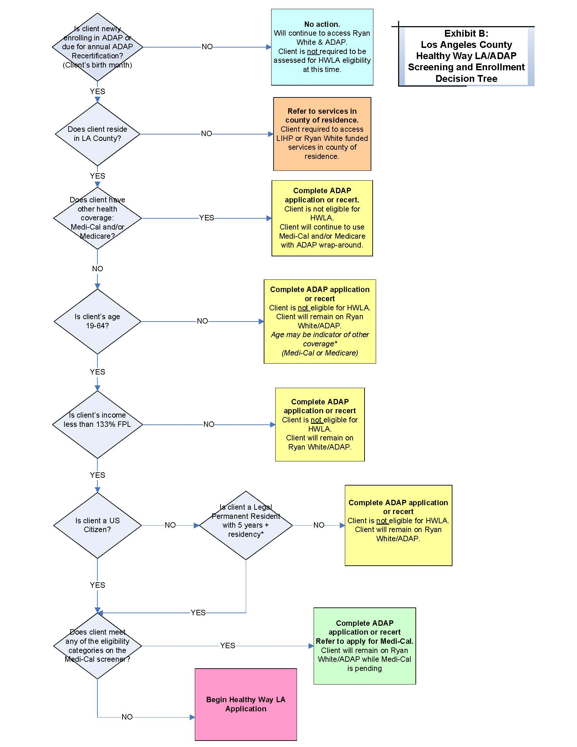
HWLA Screening and Enrollment

Slide 31
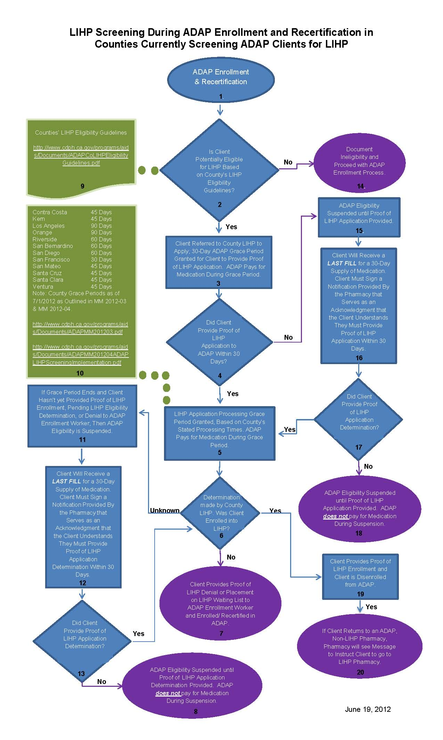
LIHP Screening During CA ADAP Enrollment and Recertification

Slide 32
Ryan White Wrap Around
Ryan White will continue to be the payer for services not covered under Healthy Way LA:
  Dental services
  Case management
  Most mental health services
  Substance abuse treatment

Slide 33
Ryan White Wrap Around
Medical Care Coordination
  Deployed at HWLA and RW medical homes
  Medical and non-medical case management
  Team approach to coordinate patient care holistically
  Care coordination for all, not just RW, patients
  Focus on improved health outcomes
    Viral suppression
  Clinical care as well as public health function

Slide 34
Ryan White Wrap Around in the Continuum of HIV Services
59,500
12,800
15,500
46,700
No HIV,
Low Risk
High Risk for HIV
HIV+,
Unaware
PLWHA Linked to Care
PLWHA Retained in Care
HIV+ Aware, But Not in Care
Ryan White Program Responsibilities
Notes:
- PLWHA = People living with HIV/AIDS

Slide 35
Priority and Allocations
Scenario planning based on financial impact modeling
Matrix of anticipated funding level and patient migration
  Funding level: reduction of <7%;7-15%; >15%
  Patient migration: <1000; 1000-2500; >2500
Estimate by service category
FY 2012 medical outpatient care investment largely unchanged

Slide 36
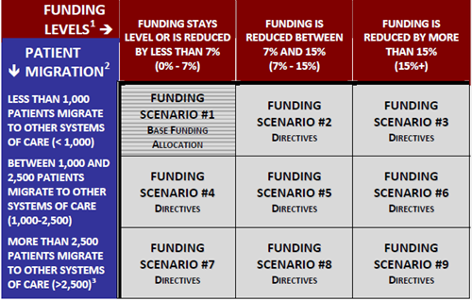
Priority and Allocations

Slide 37
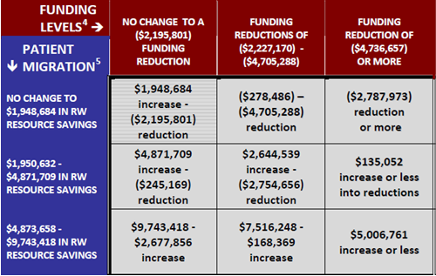
Priority and Allocations

Slide 38
Continuum of Care Planning
Revise service standards
Consolidating service categories
Developing new services
Working towards uniform standards of care for HIV services across health systems
Share lab and health indicator data
DPH to monitor viral loads

Slide 39
Critical Decisions
(Success Factors)
Patient’s continuity of care number one priority
  Medication continuity and access
  HIV doctor/medical home continuity
  No gap screening/referral/enrollment design
Avoid haste to transition
  RW patient transition later than other LIHP
  ADAP and LIHP grace periods

Slide 40
Critical Decisions
(Success Factors)
Client-level data
Critical Partnerships
  LIHP administrator (County DHS)
  California Office of AIDS
  Planning Council (Commission on HIV)
  HIV medical providers

Slide 41
Implementation of ACA
<133% FPL
Full Scope Medi-Cal
134% - 400%
FPL
Subsidized insurance coverage through the insurance exchange
>401% FPL
Insurance coverage through the insurance exchange(No Subsidy)
Notes:
2014 (2 years)

Slide 42
Preparing for 2014
Examine lessons learned 1115 Waiver
  HIV and managed care
  Medical homes and HIV
  Pharmacy networks
  Mental Health
  Data retention
Identify ongoing function of Ryan White:
  Wrap-around support
  Navigation
  Gaps: Dental, Vision, Care Coordination
  Best models of comprehensive care
  Residual populations will remain

Slide 43
Considerations for RWP
Moving forward with healthcare reform…
75% Core Medical Services?
Maintenance of Effort?
Focus of the future Ryan White Program?
Notes:
Do these requirements still make sense?
How do we structure the RWP to meet the new demands?

Slide 44
Thank You!
Division of HIV and STD Programs
600 South Commonwealth Avenue, 10th Floor
Los Angeles, California 90005-4001
Phone: (213) 351-8000

Slide 45
Questions and Answers

