Slide 1
340B AND YOUR ORGANIZATION
Fungisai Nota, PhD. *
Andrew Welsh
Andrew Lofurno
AIDS Care Group
Ryan white all titles meeting, Washington dc
November 27th-29th, 2012
*Contact Information: fnota@aidscaregroup.org

Slide 2
340B Background
Notes:
The Medicaid Exclusion File is a tool that was created to help administer the 340B Program. In order to provide a basic understanding of the Medicaid Exclusion File, we first need to provide some fundamental information regarding the 340B Program, which is run by HRSA OPA.
The 340B Program was created by legislation passed in 1992 (section 340B of the Public Health Service Act). This legislation requires manufacturers, as a condition of participating in Medicaid, to sign an additional agreement with the Secretary of Health and Human Services under which they must sell covered outpatient drugs to certain 340B-covered entities (CEs) listed in the statute at a greatly reduced price.
The 340B Program operates under two statutory prohibitions that make it illegal for a CE to: (1) sell 340B drugs to individuals who are not “patients” of the CE and (2) request payment from Medicaid for 340B drugs, if those drugs are also subject to a Medicaid rebate (a situation known as “duplicate discount”).
The statute also requires the Secretary to set up “a mechanism to ensure that CEs comply with” the duplicate discount prohibition. The mechanism, established through guidelines published in the Federal Register, involves utilizing the Medicaid Exclusion File—the subject of this learning module.

Slide 3
340B Program Evolution
1996
Contract Pharmacy,
Patient Definition
2004
Vendors
2010
Affordable Care Act
1st Proposed Regulations
1992
340B Statute
1993
1st Guidelines
Notes:
The 340B Program was enacted in 1992, with the first guidelines being issued by OPA in 1993. It was not until 1996 that use of contract pharmacies was authorized after request by many entities, who wanted to provide 340B pharmacy services but who did not have the resources to develop an in-house pharmacy.
By 2004, many third-party vendors had come into the marketplace to offer goods and services to 340B entities. In 2010, the Affordable Care Act was signed into law, greatly expanding the types of covered entities that are eligible for the program and resulting in many other changes to the Social Security Act that impacted the 340B Program.
Final guidelines allowing “multiple contract pharmacy arrangements” (another change that expanded participation in the 340B Program) also went into effect in April 2010.

Slide 4
Creation of the 340B Program
340B Program
Certain safety net covered entities
Required for all manufacturers in Medicaid
Price discounts
Outpatient drugs
Notes:
The 340B Program was enacted in the wake of the Omnibus Reconciliation Act of 1990 (OBRA 90), which first established the Medicaid drug rebate. An unintended consequence of OBRA 90 was that manufacturers were no longer offering “charitable,” “good will,” or other discounts to safety net providers because these discounts would lower their OBRA 90 “best price” and hurt their Medicaid bottom line.
A group of safety net providers began to strategize about the best way to counteract this trend and provide pharmacy services to their patients. Their efforts resulted in the federal legislation “Section 340B” of the Public Health Service Act; hence, the terminology “340B Program.”

Slide 5
Intent of the 340B Program
Reduce price of pharmaceuticals for patients
Expand services offered to patients
Provide services to more patients
Stretch scarce federal resources¹
Reach more eligible patients¹
Provide more comprehensive services¹
1. HR Rep No. 102–384, pt 2, at 12 (1992).
Notes:
Congress intended the program be used to benefit specific safety net entities. As stated in official legislative reports at the time, savings on drug prices would enable these providers to improve financial stability and position providers to stretch scarce dollars to serve vulnerable patients. These services may include providing a reduced price of pharmaceuticals for patients, expanding services to patients, and/or providing services to more patients.
In addition to providing a clear benefit to safety net providers, the 340B Program legislation would potentially decrease the taxpayer burden by reducing the federal dollars spent on medications by safety net providers. While 340B entities often pass the pricing discounts on to patients, the entities are not required to do so.
5

Slide 6
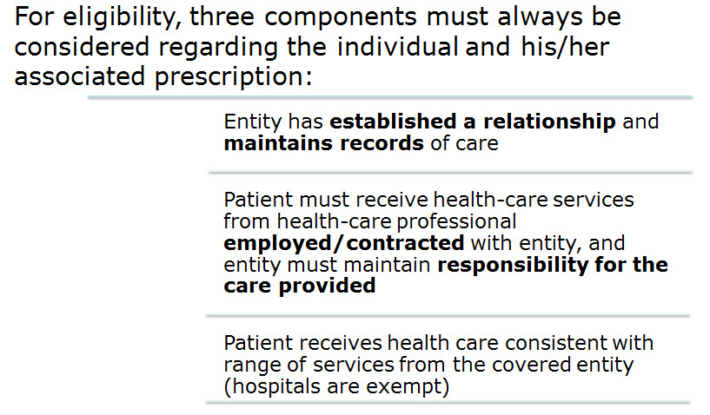
Patient Definition
Notes:
Guidelines defining a 340B patient were issued in an October 24, 1996 Federal Register notice.¹ These guidelines are critical because dispensing 340B drugs to an individual who is not a patient of a covered entity is considered diversion and is prohibited by the 340B statute.
Under the patient definition guidelines, a person is a patient of the entity if the entity has an established relationship with the patient and maintains records of care; the patient receives health care from a healthcare professional employed or contracted with the entity; and the patient receives health care consistent with the range of services from the covered entity.
DSHs are exempt from this last requirement. State AIDS Drug Assistance Program (ADAP) patients are considered a patient of the entity as long as they are registered as eligible by the State program.
An individual will not be considered a patient of the entity for purposes of 340B if the only healthcare service received is the dispensing of a drug or drugs for subsequent self-administration or administration in the home setting.
1. Final notice regarding section 602 of the Veterans Health Care Act of 1992 patient and entity eligibility (definition of a patient. Fed Regist. 1996;61(207):55156–8.

Slide 7
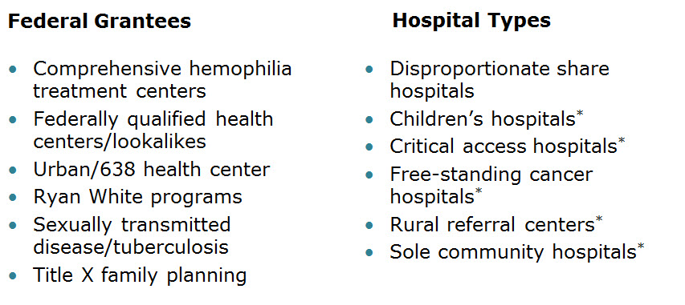
340B Eligible Entities
* 340B eligible through Section 7101 of the Affordable Care Act
Notes:
Eligibility to purchase at the 340B price applies only to the entities named in the legislation, and these entities may choose to provide 340B drugs to any or all of their eligible patients. This exclusive list of 340B eligible entities can be classified into two categories: federal grantees and hospital types. They include:
Grantees
Comprehensive hemophilia treatment centers
Federally qualified health centers/Lookalikes
Urban/638 Health Center
Ryan White programs
Sexually transmitted disease/tuberculosis
Title X family planning
Hospitals
Disproportionate share hospitals
Children’s hospitals*
Critical access hospitals*
Free-standing cancer hospitals*
Rural referral centers*
Sole community hospitals*
Of note: The entities identified with an asterisk became eligible through passage of the Affordable Care Act (ACA) of 2010. There are specific 340B eligibility criteria that each entity type must meet (for example, receiving a certain type of grant, reaching a certain threshold indicator such as a minimum Disproportionate Share Adjustment Percentage, etc.) We will review some of this information during the presentation; however, for more specific details, please contact the Pharmacy Services Support Center (PSSC).

Slide 8
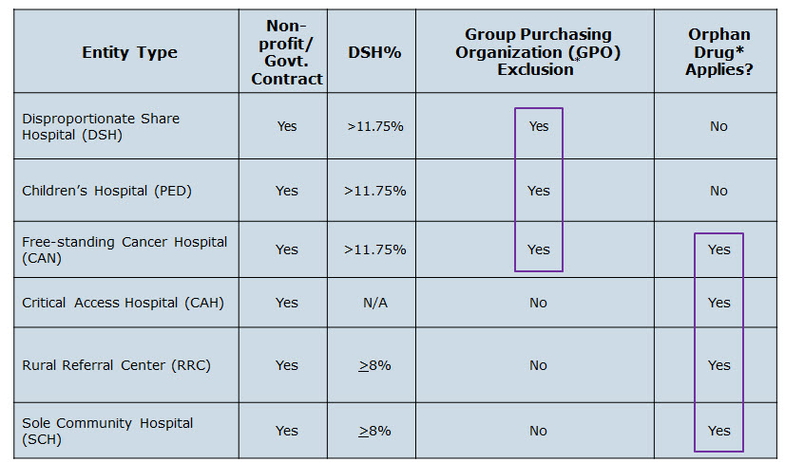
Hospital Eligibility Criteria
*340B eligible through Section 7101 of the Affordable Care Act
Notes:
Within the hospital category of entities, requirements differ for 340B eligibility including disproportionate share adjustment percentage and Group Purchasing Organization (GPO) exclusion criteria. Disproportionate share hospitals (DSHs), children’s hospitals (PEDs), and free-standing cancer hospitals (CANs) must have a DSH adjustment of 11.75% or greater to be eligible. Sole community hospitals (SCHs) and rural referral centers (RRCs) must have a DSH adjustment of 8% or greater. Critical access hospitals (CAHs) are included on this chart as they were newly added under the ACA, but because of the different way they are reimbursed by Medicare, they do not have to meet a DSH percentage threshold.
Entities not listed are not required to meet a DSH rate to qualify for participation in the 340B program. CAHs, SCHs, and RRCs are not subject to the GPO exclusion requirement that applies to other hospital entities. OPA has an Excel spreadsheet on its Web site that contains a listing of all DSHs and their DSH adjustment percentages. This list is updated quarterly, based on information provided by CMS to OPA. Most hospitals calculate their DSH adjustment percentage annually, pursuant to their Medicare Cost Report filing.

Slide 9
Hospital Outpatient Facilities
In order for outpatient facilities to become eligible for the 340B Program:
The outpatient facility must be an integral part of the hospital
The outpatient facility must be included as reimbursable on the covered entity’s most recently filed Medicare Cost Report
To register additional outpatient facilities, complete the online Register an Outpatient Facility registration at: http://opanet.hrsa.gov/OPA/CERegister.aspx
Notes:
An eligible hospital will often have multiple outpatient facilities where 340B drugs are desired, so it is important to discuss outpatient facility eligibility criteria for participation in the 340B Program. Just because the hospital is eligible or the outpatient facilities are on a Medicare Cost Report does not automatically mean that 340B drugs can be used. The eligibility criteria require that the outpatient facility is an “integral part” of the hospital AND is included as reimbursable on the most recently filed Medicare Cost Report.
In registering an outpatient facility as a 340B site, an appropriate official will have to certify that the site is an integral part of the hospital. Examples of things OPA would look for to show this connection are spelled out in a September 19, 1994 guidance¹ and include common clinical and administrative control of the hospital and facilities. Reimbursable facilities must not only appear on the hospital’s Medicare Cost Report, but also must be listed in specific sections of the cost report to meet criteria for eligibility. Please contact PSSC if you have specific questions on the location of reimbursable entries.
Also, the Medicare Cost Report is filed on an annual basis and is what OPA uses to determine outpatient facility eligibility. If the hospital expanded and began including additional facilities in the middle of the year, those new facilities could not participate in the 340B Program until a new cost report is filed, which shows that the new facility is integral and listed as reimbursable.
OPA has recently updated their Web site and made many of the registration and facility registrations automated through online submission. Please visit the specific link above to add an outpatient facility via the online process.
1. Final notice regarding section 602 of the Veterans Health Care Act of 1992 outpatient hospital facilities. Fed Regist. 1994;59(180):47884–6.

Slide 10
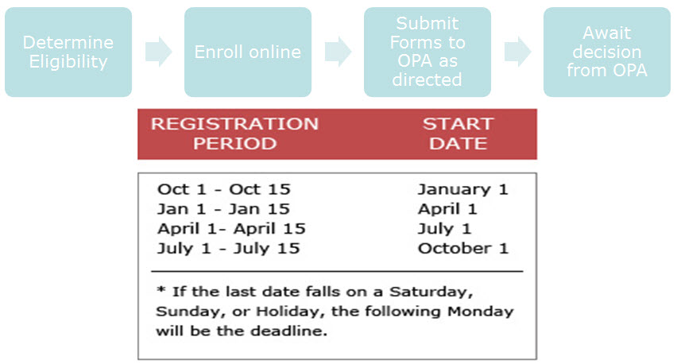
340B Enrollment Procedure
http://opanet.hrsa.gov/OPA/CERegister.aspx
Notes:
Eligible entities are not automatically enrolled in the 340B Program. Entities must go through an online enrollment process. To enroll online, visit http://opanet.hrsa.gov/opa/CERegister.aspx
After OPA receives the enrollment request, the eligibility of the entity is verified. Once approved, the entity will be added to the official OPA 340B database for the next quarterly database update. The database found on the OPA Web site is the essential tool to find and verify information about entities. Unless the entity appears in the OPA 340B database, drug manufacturers and wholesalers will not (and are not required to) sell to the entity at 340B prices.
After OPA adds an entity to the database, the entity will be able to purchase pharmaceuticals at the 340B price beginning the next calendar quarter. Effective October 1, 2012, the registration period for 340B program registration of new covered entities and the addition of outpatient facilities is limited to the following:
October 1 – October 15 for an effective start date of January 1
January 1; January 1 – January 15 for an effective start date of April 1
April 1; April 1 – April 15 for an effective start date of July 1; and
July 1 – July 15 for an effective start date of October 1.

Slide 11
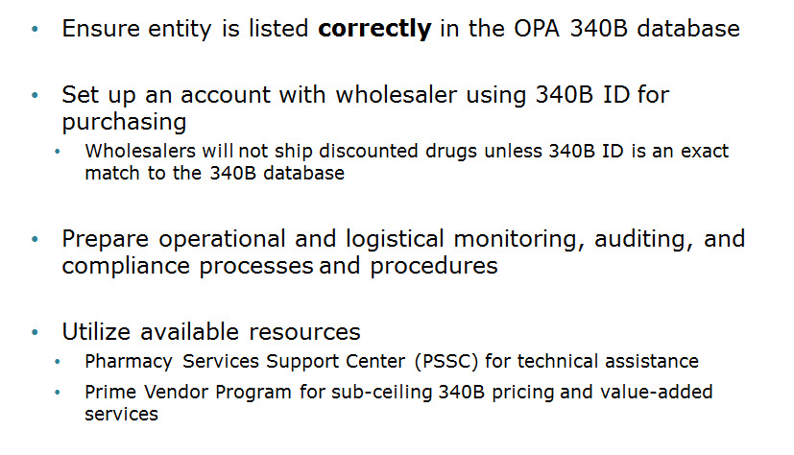
340B Implementation
Notes:
Once enrolled and listed as a covered entity in the OPA 340B database, the entity may begin implementing the 340B Drug Pricing Program. Some aspects of implementation include verifying the OPA 340B database for accurate and complete information so 340B purchases are not denied or delayed; setting up a 340B account with the designated wholesaler; preparing the organization’s policies and procedures in accordance with 340B Program Guidelines for operations and monitoring; auditing to ensure compliance and integrity of the program; and utilizing available resources through the PSSC (for technical assistance) and the PVP (managed by Apexus Inc) for access to sub-ceiling 340B prices and value-added services.

Slide 12
1. History of 340B 2. The Intent of 340B Program 3. Who is eligible 4. Key dates
Part 1 - Summary

Slide 13
340B Prohibitions and Requirements

Slide 14
340B Covered Drugs
Notes:
There is no list of “340B drugs.” The statute says 340B pricing is available for “covered outpatient drugs,” which include all prescription and over-the-counter (OTC) drugs that are prescribed by the provider as part of an outpatient health service, clinic administered drugs, biologics, and insulin.
The use of 340B-priced drugs is not allowed for inpatient settings. Also, vaccines are excluded from the statutory definition of covered outpatient drugs and therefore cannot be purchased under the 340B Program.

Slide 15
340B Prohibitions and Requirements
Exclusions
Duplicate Discounts
Diversion
Notes:
To ensure integrity of the 340B Program, every entity should be aware of and monitor their compliance with program prohibitions and requirements. The 340B statute prohibits duplicate discounts, diversion to individuals who are not 340B patients and GPO use and orphan drug purchases for certain hospitals. We’ll go through each of these in the next several slides.

Slide 16
Duplicate Discount on 340B Drugs
Notes:
A duplicate discount occurs when an up-front 340B discount and a back-end transaction Medicaid rebate are provided on the same drug.

Slide 17
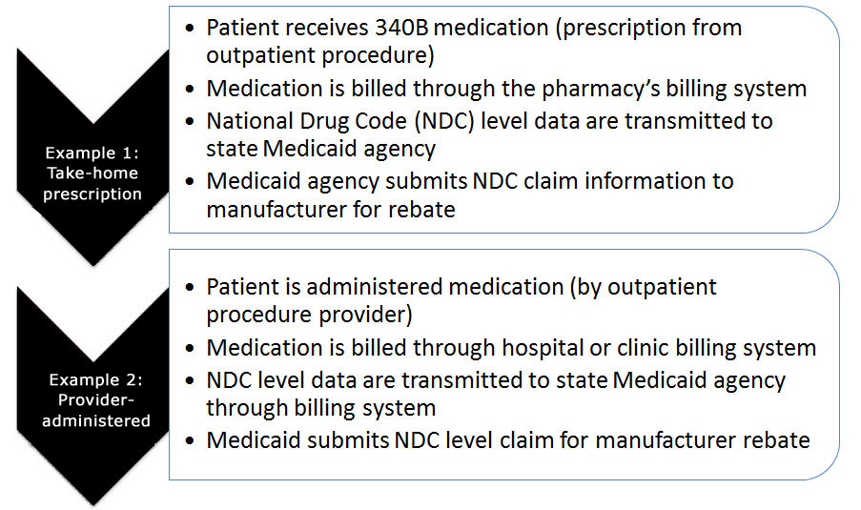
Examples of Duplicate Discounts
Notes:
The following two slides highlight three situations in which a duplicate discount might occur, if both the covered entity and the state Medicaid agency are not aware that 340B drugs are used in the transaction. In each case, specific National Drug Code (NDC) level information would be transmitted to the state for a prescription claim after which the state submits the pharmacy claim for manufacturer rebate.
The first example involves a situation in which a patient is given an outpatient prescription for self-administration and fills it at a 340B pharmacy. The prescription is submitted to Medicaid for payment through the pharmacy’s regular claims adjudication system. Next, NDC level data are transmitted as part of claim adjudication. Finally, the Medicaid agency submits the claim information to the manufacturer for rebate.
The second example involves a situation in which a provider administers 340B prescription medication during an outpatient visit. This medication is billed through the hospital or clinic billing system. Next, NDC level data are transmitted to the state Medicaid agency (this may vary, depending on state Medicaid requirements). Lastly, the Medicaid agency submits the claim information to the manufacturer for rebate
In both of these cases, an up-front 340B discount and back-end Medicaid rebate could potentially be paid on the same drug, which is prohibited as a double discount under the 340B statute.

Slide 18
Examples of Duplicate Discounts Cont’d
1. CMS. Letter re: medication prescription drug rebates. April 22, 2010. Available at: www.ncsl.org/documents/health/42210PPACADrug_Rebate_​SMD.pdf.
Accessed November 22, 2011.
Notes:
In the third example, a patient of a Medicaid managed care organization (MCO) receives a take-home prescription and fills it at a 340B pharmacy for self-administration. The prescription is submitted through the claims adjudication system to the Medicaid MCO for payment to the covered entity or pharmacy. NDC level data are transmitted as part of claim adjudication. The MCO submits the NDC level data from pharmacy claims to the Medicaid agency, which then submits the claim for rebate to the manufacturer.
Until passage of the Affordable Care Act, MCOs did not seek Medicaid rebates on drugs, so duplicate discounting was not a concern. Under the Affordable Care Act, however, Medicaid agencies are required to seek rebate on MCO claims. Even though the Affordable Care Act provision also excludes 340B drugs dispensed by MCOs from the new requirement, the potential for prohibited duplicate discounts must be kept in mind.
Important note: Any potential duplicate discount can be avoided as long as the MCO is aware that 340B drugs are being used, identifies 340B claims, and segregates them from rebate submission. Medicaid agencies have authorization to exclude 340B claims from rebate submission, according to the citation in the final bullet, which says that Section 2501(c) of the Affordable Care Act maintains that state Medicaid agencies are not required to seek rebates on 340B drugs. It amends section 1927(j)(1) stating that, “covered outpatient drugs in this section are not subject to the rebate requirements … [if] subject to discounts under section 340B of the Public Health Service Act.”¹
This statutory provision was further emphasized in a letter to state Medicaid directors from the Centers for Medicare & Medicaid Services (CMS) dated April 22, 2010.¹
1. CMS. Letter re: medication prescription drug rebates. April 22, 2010. Available at: www.ncsl.org/documents/health/42210PPACADrug_Rebate_​SMD.pdf. Accessed November 22, 2011.

Slide 19
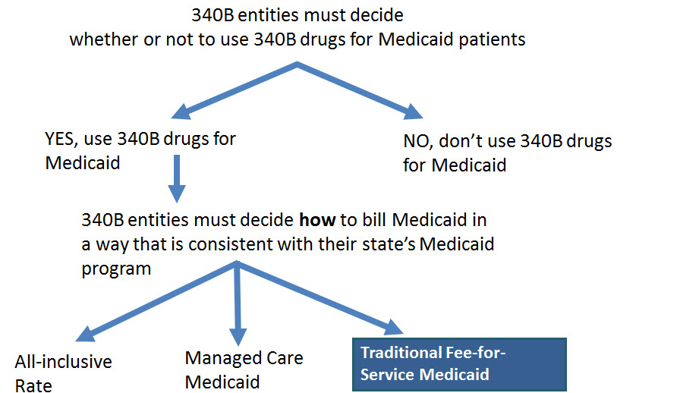
Billing Medicaid
Notes:
As mentioned earlier, OPA’s mechanism to prevent duplicate discounts allows entities to choose whether or not to use drugs purchased under the 340B Program for their Medicaid patients. If the choice to use 340B drugs is made, duplicate discounts on 340B drugs may not be generated. This means that a manufacturer cannot be made to pay a 340B discount and a Medicaid rebate on the same drug. If a state has a Medicaid billing policy particular to 340B drug reimbursement, covered entities must follow their state’s reimbursement policy. Guidance published in the Federal Register in 2000 recommends that covered entities refer to their respective Medicaid state agency’s drug-reimbursement guidelines for applicable billing
1. Notice regarding the section 340B Drug-Pricing Program—program guidance clarification. Fed Regist. 2000;65(51):13983–4.

Slide 20
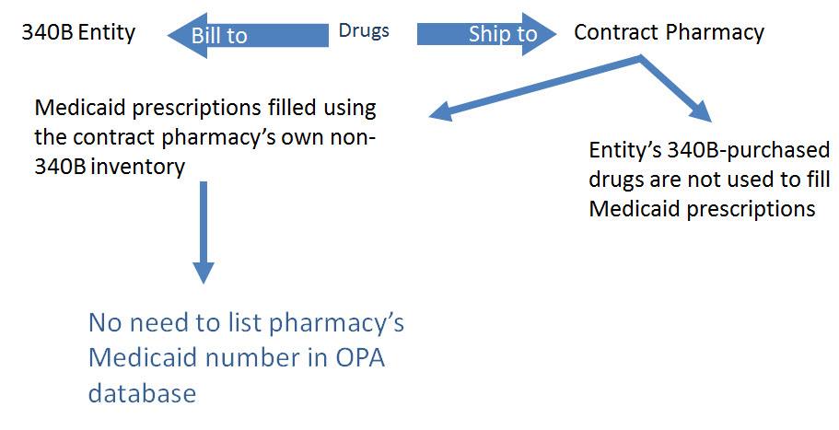
Medicaid Exclusion File and 340B Contract Pharmacies
Notes:
Entities are permitted to contract with pharmacies to provide dispensing services for the entity’s 340B drugs. In this arrangement, the 340B entity purchases the drugs, which are usually shipped to the pharmacy. In other words, the wholesaler bills the CE and ships the drugs to the contract pharmacy).
Because of the complexities, 340B entities that contract with a pharmacy generally do NOT include Medicaid prescriptions as part of their contract-pharmacy arrangement. Prescriptions from the entity are filled by the contract pharmacy using 340B prices, except for Medicaid prescriptions. Medicaid prescriptions are filled by the contract pharmacy (or any pharmacy to which the patient chooses to take the prescription) using non-340B drug stock. This procedure eliminates the possibility of a duplicate discount.
However, given the recent changes to Medicaid managed care and provider-administered drugs (discussed previously), entities must carefully examine, and verify with their state agency, whether they can use 340B drugs for Medicaid managed care prescriptions or if they should forgo use of 340B drugs. In this scenario, the contract pharmacy will need to determine if there are 340B drugs used for any fee-for-service or managed care prescriptions. If the state is seeking rebates on managed care prescriptions, the NPI also must be added to the OPA database.
In all cases, the entity must notify OPA regarding how it will handle Medicaid transactions in its pharmacy operations. However, if no Medicaid prescriptions (including managed care prescriptions) are filled using drugs purchased at 340B prices, there is no reason to provide OPA with the contract pharmacy’s Medicaid number/NPI, as this might cause the Medicaid agency to unnecessarily forego rebates on Medicaid claims filled by this pharmacy.

Slide 21
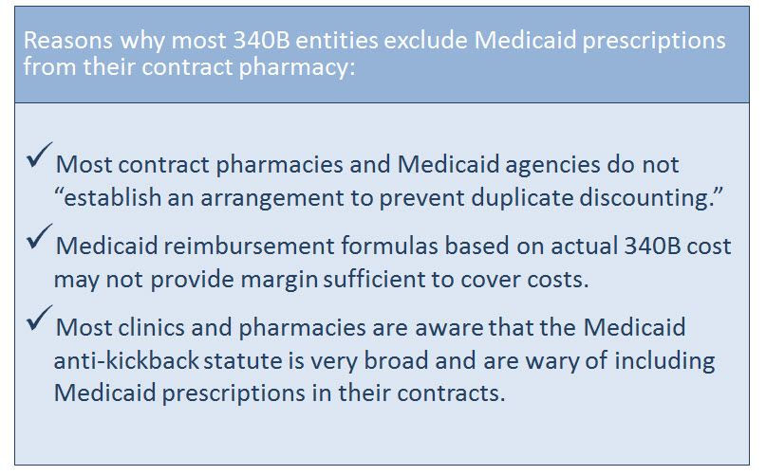
The Medicaid Exclusion File
Notes:
There are a few reasons that most 340B entities exclude Medicaid prescriptions from their contracts:
• The Contract Pharmacy Services Guidelines published in the Federal Register state that, “Neither party will use drugs purchased under section 340B to dispense Medicaid prescriptions, unless the contract pharmacy and the state Medicaid agency have established an arrangement to prevent duplicate discounting.”¹
• Clinics are advised that if their state has a Medicaid billing policy particular to 340B-drug reimbursement, CEs must follow their state’s reimbursement policy. Guidance published in 2000 in the Federal Register recommends that CEs refer to their respective Medicaid state agency drug reimbursement guidelines for applicable billing limits.² They may be required to bill Medicaid at cost for drugs purchased at 340B prices, plus a dispensing fee. Often, the dispensing fee is inadequate to cover the true costs of dispensing. Private pharmacies are not bound by 340B cost reimbursement because they do not use 340B drugs to fill prescriptions. Most contract pharmacies and 340B entities prefer to exclude their Medicaid patients from the 340B contract pharmacy arrangement for this purpose.
• The Contract Pharmacy Services Guidelines published in the Federal Register state in section C(6): “In negotiating and executing a contracted pharmacy service agreement pursuant to these guidelines, contractors and covered entities should be aware of and take into consideration the provisions of the Medicare and Medicaid anti-kickback statute, 42 U.S.C. 1320a-7b(b).”¹ This statute makes it a felony for a person or entity to knowingly and willfully offer, pay, solicit, or receive remuneration with the intent to induce, or in return for the referral of, Medicare or a State health care program business.
Notice regarding section 602 of the Veterans Health Care Act of 1992; contract pharmacy services. Fed Regist. 1996;61(165):43549–56.
Notice regarding the section 340B Drug-Pricing Program—program guidance clarification. Fed Regist. 2000;65(51):13983–4.

Slide 22
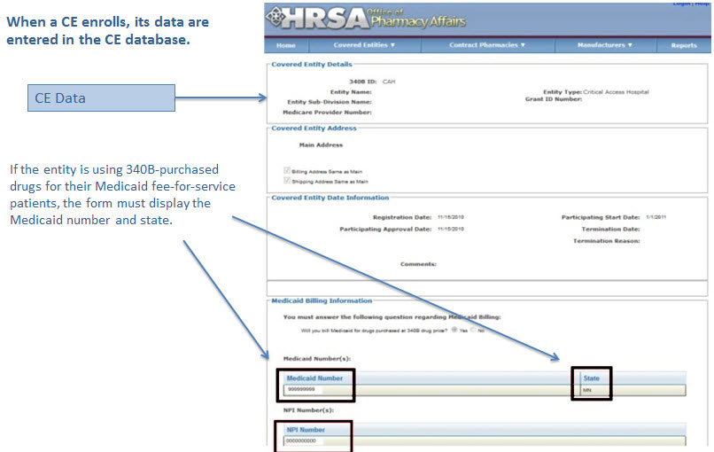
CE Decision to Use 340B Drugs Carve-In
Notes:
This slide is an example of how the Exclusion File would look for an entity choosing to use 340B drugs for their Medicaid prescriptions. Under the question, “Will you bill Medicaid for drugs purchased at 340B drug price?” the registrant has selected “Yes.” When completing the enrollment form the CE will enter its NPI for submission to OPA.

Slide 23
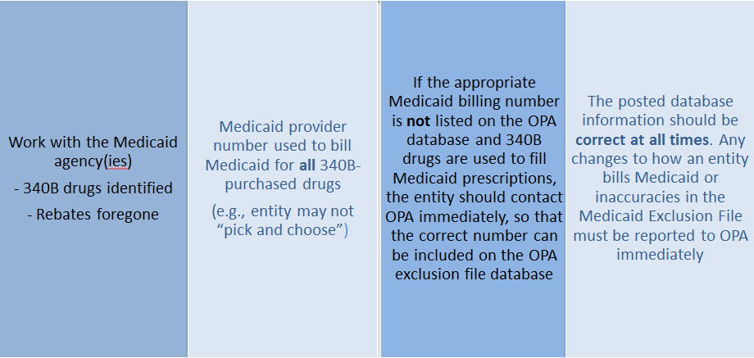
CE Responsibilities for Avoiding Duplicate Discounts
It is ultimately the responsibility of the 340B participating entity to ensure accurate reporting of Medicaid billing of any 340B drugs to OPA and the state Medicaid agency.
Notes:
What are the responsibilities of CEs regarding avoiding duplicate discounts?
It is ultimately the entity’s responsibility to: (1) ensure accurate reporting of Medicaid billing of any 340B drugs to OPA and the state Medicaid agency, and (2) work with the Medicaid agency(ies) so that 340B drugs can be identified and rebates foregone.
The Medicaid provider number should be used when billing Medicaid for all 340B-purchased drugs (e.g., an entity may not “pick and choose”).
If the appropriate Medicaid billing number is not listed on the OPA database and 340B drugs are used to fill Medicaid prescriptions, OPA must be contacted immediately, so that the correct number can be included on the OPA exclusion file database.
The posted database information must be correct at all times. Any changes to how an entity bills Medicaid, or any inaccuracies in the Medicaid Exclusion File, must be reported to OPA immediately.

Slide 24
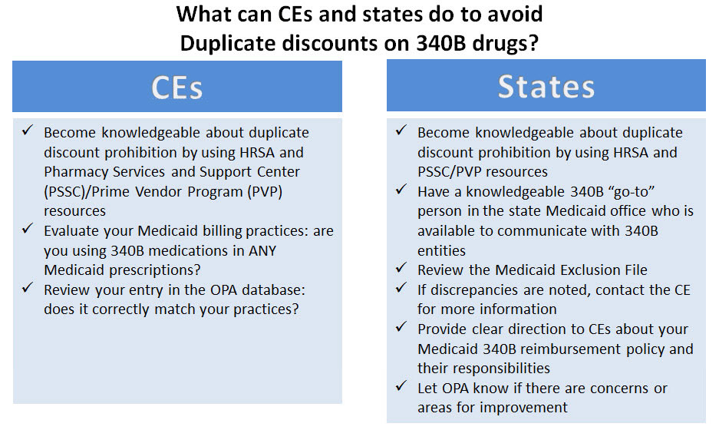
Avoiding Duplicate Discounts
Notes:
This slide provides helpful tips for avoiding prohibited duplicate discounts. Both CEs and state Medicaid agencies are encouraged to become knowledgeable about duplicate discount prohibition by utilizing resources available from HRSA, the Pharmacy Services Support Center, and the Prime Vendor Program.
Entities are advised to evaluate their use of 340B drugs with respect to Medicaid, confirm their entry in the OPA database matches their practices, follow procedures with respect to the use of 340B drugs and Medicaid billing consistent with their database entry, and make changes needed to ensure program compliance.
Likewise, states are encouraged to utilize the Medicaid Exclusion File and access the OPA database to ensure their procedures do not subject 340B drugs to a back-end Medicaid rebate. Development of Medicaid 340B-reimbursement policies that are clearly communicated to OPA and entities would prove extremely helpful.

Slide 25
Diversion Prohibition
Notes:
An additional important prohibition is that of reselling or transferring (diverting) a 340B drug to an ineligible organization or to a person who is not a patient of the entity.
Diversion occurs when a drug is provided to an individual who is not a patient of the entity under current OPA guidelines. Entities must have strong policies, procedures, and processes in place to ensure appropriate application of patient definition requirements. (We will address the 340B patient definition in more detail later in the presentation.)
Diversion may also occur if a drug is dispensed in an area of a larger facility that is not eligible (e.g., an inpatient service area or noncovered clinic). To ensure appropriate usage of 340B within hospital settings, entities must meet outpatient facility eligibility requirements discussed earlier, must register all eligible outpatient or satellite sites with OPA, and must maintain auditable records of compliance.

Slide 26
GPO Exclusion
Notes:
Some hospitals that participate in the 340B Program for covered outpatient drugs are subject to GPO exclusion. This means that these hospitals cannot purchase any covered outpatient drugs through a GPO or other group-purchasing arrangement. This GPO exclusion is found in the 340B statute in §340B (a), 4(L), and applies even if an item is available at a lower price through the GPO. Hospitals can continue to purchase all products for inpatient operations through a GPO, even if their outpatient departments participate in 340B. GPO exclusion goes into effect as of the “Participating State Date” of the covered entity listed in the searchable OPA database. This prohibition only applies to Disproportionate Share Hospitals (DSHs), Children’s Hospitals (PEDs), and Free-standing Cancer Clinics (CANs).

Slide 27
The Orphan Drug Exclusion
The Orphan Drug Product Designation Database can be found at:
http://www.accessdata.fda.gov/scripts/opdlisting/oopd/index.cfm
Notes:
A last minute amendment to the ACA created yet another wrinkle in the 340B Program. The amendment added section 340B(e), which says that new hospital entities added by the ACA (e.g., CAHs, SCHs, RRCs, and CANs) are prohibited from purchasing drugs designated by the FDA as “orphan drugs” at 340B prices. This provision does not affect other entity types.
Orphan drugs are used to treat rare conditions and meet other designation criteria set forth by the FDA. The Orphan Drug Product Designation Database can be found at: http://www.accessdata.fda.gov/scripts/opdlisting/oopd/index.cfm
HRSA has issued a proposed regulation to implement orphan drug exclusion that as of December 2011 is under review.

Slide 28
Part 2 - Summary
Determining which drugs are covered under 340B
Diversion / Exclusion / Duplicate discounts
Carving – in or Carving - out Medicaid
GPOs and Orphan drugs

Slide 29
OPTIMIZING YOUR 340B PROGRAM

Slide 30
340B Prime Vendor Program
PVP Mission and Goals
Improve access to affordable medications for covered entities and their patients
Primary goals:
Lower participants’ supply costs by expanding the current PVP portfolio of sub-340B priced products
Provide covered entities with access to efficient drug distribution solutions to meet their patients’ needs
Provide access to other value added products and services meeting covered entities’ unique needs

Slide 31
Estimated Prices For Selected Public Purchasers as a Percent of AWP
0%
20%
40%
60%
80%
100%
AWP
100.0%
AMP
80.0%
Medicaid (Min.)
67.9%
Medicaid Net
60.5%
FSS
51.7%
Private Sector Pricing
340B
49.0%
FCP
47.9%
VA Contract
34.6%
Stephen Schondelmeyer, PRIME Institute, University of Minnesota (2001)

Slide 32
The 340B Price
340B
Drug Pricing Program
25%–50%
of the average wholesale price
The 340B price is actually considered a “ceiling” price
Can offer sub-ceiling prices
Drug Manufacturers
Notes:
How “discounted” is the 340B price? The 340B discount is very steep, one of the largest discounts available on drug prices in the United States. Studies have reported that the 340B price is approximately 25% to 50% of the average wholesale price (AWP), and 340B prices are reported to represent savings of 22% (or often much greater) on the entity’s total drug purchases.
The 340B price is at least as low as the price that state Medicaid agencies pay and is actually a “ceiling” price, meaning it is the highest price a participating entity may be charged under the statute. However, drug manufacturers are free to offer entities sub-ceiling prices on drugs as well, and the 340B Prime Vendor Program negotiates sub-ceiling prices regularly.
The data used to calculate the 340B ceiling price are kept confidential because of Social Security Act requirements. Manufacturers calculate the ceiling price using a 340B statute formula. Manufacturers report the confidential data components used in the formula to the Centers for Medicare and Medicaid Services, or CMS, and CMS shares these components with the Office Pharmacy Affairs, which then uses these CMS data to calculate and verify 340B prices.
Under changes made by the Affordable Care Act, HHS (or HRSA) will be required to provide secure Internet access to entities to the 340B ceiling prices calculated by CMS or HRSA. Although underlying pricing data would still be kept confidential, this access will make the 340B pricing process more transparent and help entities determine if they are receiving the right price.

Slide 33
Benefits of PVP to Participants
Ease of enrollment and activation of pricing by wholesaler
Access to 340B sub-ceiling prices for covered drugs
Access to discounts on other value added outpatient products such as vaccines and diabetic supplies
Participant communications
Support of DSHs and HRSA grantees by funding 340B education and networking opportunities

Slide 34
Value of PVP to Participants
Savings - average sub-ceiling savings on PVP contract purchases for all participants = 16% in 2007
Diminishes the need for Independent Sub-Ceiling contracts and the resources that they require to manage
Provides a “One Stop Shopping” model for outpatient pharmacy services such as 340B split-billing software
Access to lowest priced vaccines in the marketplace
Access to market reports to help cut formulary costs

Slide 35
Cost Savings Analysis Summary
Current Annualized Purchases = $538,576
Projected Annualized Purchases if the participant takes advantage of all categories of savings (1:1, generic exchange, and therapeutic exchange = $331,131
Annualized Savings of $205,455
Percent Savings of 38%
This analysis was for a FQHC switching from a GPO Model to a 340B plus Prime Vendor Model

Slide 36
Supplier Agreements
Allendale Pharmaceutical
Alliant Pharmaceuticals
AMO (pending)
Astra-Zeneca Pharmaceuticals
Abraxis Pharmaceutical
Akorn Inc.
ASD (flu vaccine)
Bayer Diagnostics
Bedford Labs
Can-am Care LLC
Caraco Pharmaceutical Labs
Cytogen
Dabur Pharmaceuticals
FFF (flu vaccine)
G&W Laboratories
Geritrex Corporation
GlaxoSmithKline
Hawthorne Pharmaceuticals, Inc
Home Diagnostics Inc.
Early Detect
Lilly & Company
Major Pharmaceuticals
Medicure
Morton Grove Pharm Inc.
NitroMed Inc.
Novartis Vaccines
Novo Nordisk
Okomoto USA Inc.
Organon USA, Inc.
Paddock Labs
RD Plastics Co Inc.
Rx Elite Holdings, Inc.
Sandoz Pharmaceutical
Teva Health Systems
Total Pharmacy Supply
Tri State Distribution
Stratus Pharmaceuticals
Trinity Biotech
X-Gen Pharmaceuticals
Watson Pharma Inc.
Wyeth Pharmaceuticals

Slide 37
Other Products and Services
Vaccines
PAP software
Split billing software
Auditing/overcharge recovery services
Repackaging services
Prescription vials/labels/printer cartridges
Diabetic/TB syringes
PBM services
OTC diagnostic test kits
HIV rapid test kits
Pharmacy automation/technology

Slide 38
Manufacturers & 340B Pricing
Must provide 340B pricing if their drug(s) is covered by Medicaid
Cannot sell covered drug above 340B ceiling price to covered entity
Are not prohibited from selling outpatient drugs at below 340B ceiling price
Prices offered covered entities are exempt from “best price” but not Non-FAMP calculation
Are not required to offer sub-ceiling price to other covered entities or Medicaid
Can obtain Non-FAMP pricing exemption for sub-ceiling pricing through HRSA’s 340B Prime Vendor Program

Slide 39
Manufacturers – 340B Pricing and Medicaid Rebate Programs
Medicaid and 340B entities receive prices based on either “Best Price” OR Average Manufacturer Price (AMP) – 15.1% for branded drugs
Additional discounts are applied if price increases exceed the Consumer Prime Index (CPI)
Generics – AMP minus 11%
“Best Price” is not part of generic calculation
Pricing - recalculated quarterly
Discounts are upfront. No backend rebates

Slide 40
PRIME VENDOR CONTRACTING
Contract methodology
- build upon existing supplier relationships
- new supplier contracting
- savings vs. revenue
- target high dollar/ proprietary drugs
- negotiations vs. bidding on select drug classes
- value added products and services

Slide 41
CHOOSING A CONTRACT PHARMACY
Positive (+)
Negative (- )
Entity pays flat fee per claim
Stop-loss function (prevents 3rd party transmission is loss to entity)
Entity does not pay fees on claim reversals
Entity pays lowest of U&U, MAC, and 340B
Entity pays fees based on % of revenue or drug cost
Entity does not keep Medicaid/3rd party reimbursement
Vendor recruits patients to its mail order pharmacy
Early cancellation fees
Entity not allowed to select wholesaler
Entity might end may end up purchasing partial bottles at high rates due to non-replenishment

Slide 42
Part 3 - Summary
Understanding PVP
Expected gains from joining the PVP
Choosing contract pharmacies

Slide 43
340B POLICIES

Slide 44
340B Policies
Guidelines
Regulations (proposed)
Patient Definition*
Contract Pharmacy*
Audits*
Dispute Resolution*
Outpatient Facilities
Duplicate Discounts
Manufacturer Civil Monetary Penalties
Administrative Dispute Resolution
Orphan Drugs

Slide 45
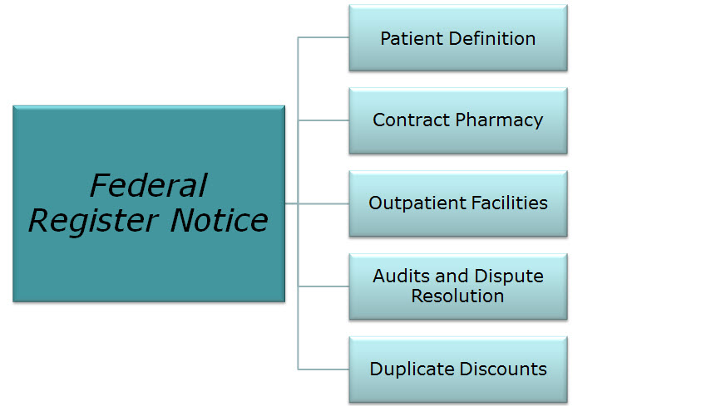
340B Guidance and Policy
http://www.hrsa.gov/opa/federalregister.htm
Notes:
While the statue does establish the basic requirements and prohibitions of the 340B Program, it does not spell out operational details or address all potential compliance situations associated with the program. Interpreting the legislation and implementing the 340B Program may, at times, be challenging because the statute fails to address numerous issues.
In an effort to fill in some details, OPA has issued 340B Program Guidelines, which foster program integrity and provide direction that supports the original 340B legislation. Program guidance is issued primarily through publication of Federal Register notices. These notices invite public comment on a proposed guideline; comments are then received and notices are finalized. These finalized notices lay the framework for much of the practical implementation of the 340B Program and are available on the OPA Web site at: http://www.hrsa.gov/opa/federalregister.htm
Not every potential 340B situation is specifically addressed in law or policy. Participation in the 340B Program is voluntary, and in all cases—even with regard to situations that seem not to be specifically addressed—entities are ultimately responsible for compliance with all program requirements, for maintaining program integrity in their 340B operations, and for having auditable records that demonstrate their compliance with 340B Program laws and guidelines. Entities should consider obtaining legal counsel to ensure appropriate interpretation of the statute and guidelines.

Slide 46
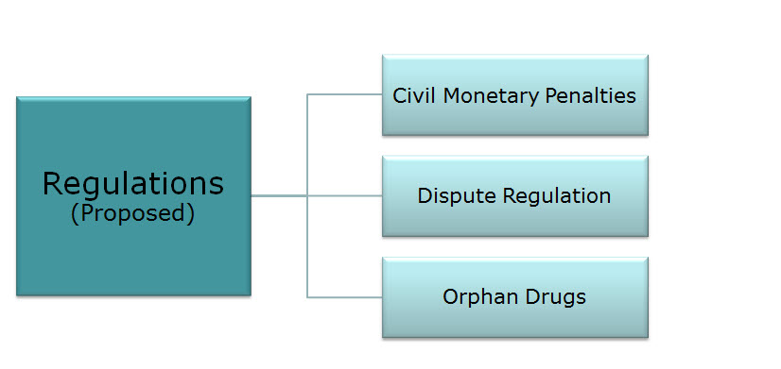
340B Proposed Regulations
Notes:
More recently, OPA has begun to develop regulations, as opposed to guidelines. Once finalized, these will have the force and effect of law.
OPA has published three proposed regulations in the Federal Register:
Advance notice of proposed rulemaking for 340B drug pricing program manufacturer civil monetary penalties. Fed Regist. 2010;75(181):57230–2.
Advance notice of proposed rulemaking for 340B drug pricing program administrative dispute resolution process. Fed Regist. 2010;75(181):57233–5.
Notice of proposed rulemaking for exclusion of orphan drugs for certain covered entities under 340B program. Fed Regist. 2011;76(98):29183–90.
As of November 2011, all of these proposals are being reviewed but have not been finalized.

Slide 47
Drug Delivery Contract Pharmacies
Notes:
The Federal Register notice on multiple contract pharmacy services was published on March 5, 2010. The effective date of the final guidance on multiple contract pharmacy services was published on April 5, 2010. This allowed 340B covered entities the option of utilizing more than one contract pharmacy per healthcare delivery site. Therefore, the covered entity or any eligible site of a covered entity may enter into contracts with one or as many contract pharmacies as are needed, including chain pharmacies, to meet the needs of their patients. Covered entities may also supplement their in-house pharmacy with contract pharmacies. This notice includes compliance elements that must be met. In addition, contract pharmacies must be registered in the OPA database and use the online registration process found on the OPA Web site.
This process allows “ship to/bill to,” which refers to an arrangement set up by the covered entity who is responsible for purchasing 340B drugs from wholesalers and/or manufacturers and directs those drugs to be shipped to the contract pharmacy. In other words, the covered entity maintains title and purchasing of the 340B drugs as required, but the contract pharmacy(ies) houses the drugs and provides dispensing services to patients of the covered entity.
The multiple contract pharmacy option has been very popular, with the number of contract pharmacy sites growing from about 3,000 sites before publication of the policy to about 9,000 sites currently registered in the OPA 340B database.
Covered entities, along with contract pharmacies, are responsible for ensuring compliance with all 340B requirements to prevent diversion and duplicate discounts. OPA recommends that covered entities engage legal counsel to review all contracts or other legal documents to ensure that all federal, state, and local requirements are met.

Slide 48
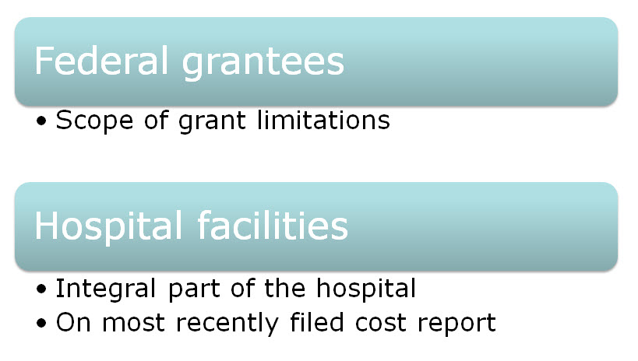
340B Usage Considerations
Notes:
In certain cases of 340B usage or expansion of services to other patient populations (e.g., most frequently encountered scenarios include incarcerated individuals, long-term care/nursing home facilities, or hospital clinic sites), entities must evaluate special usage considerations. In order to be considered a patient under the 340B Program, the services provided to the individual must be within the scope of eligibility of the covered entity.
For federal grantees who are eligible based upon grants qualifying them as a covered entity, certain requirements or limitations regarding scope of service may be listed in the grant stipulations. Entities should consult their grant or project officer for clarification of type and scope of services allowable before engaging in expanded services for 340B patients. The entity should also ensure any notifications or updates to the OPA database are provided to ensure program compliance and integrity.
Similarly, hospitals may offer services to multiple care sites within a large health-care system that may or may not be 340B-eligible based on the most recently filed Medicare Cost Report, which requires that the setting be an integral part of the hospital and be listed as reimbursable.
In general, each 340B designation represents a separate 340B entity with potentially different responsibilities/scopes of practice. Every covered entity must maintain auditable records demonstrating that drugs purchased under the authority of a particular covered entity type only go to patients of that covered entity.

Slide 49
340B Program Support
Notes:
There are three primary resources for the 340B Program: integrity, access, and value. The Office of Pharmacy Affairs represents the integrity resource. Program integrity assures stakeholders that the 340B Program’s intent is being met and that rules are being followed.

Slide 50
Office of Pharmacy Affairs (OPA)
Notes:
The primary integrity resource is OPA, a component of HRSA’s Health-Care Systems Bureau. OPA has three primary functions. It:
Administrates over the 340B Drug-Pricing Program, through which certain federally funded grantees and other safety net health-care providers may purchase prescription medications at significantly reduced prices
Develops innovative pharmacy service models and provision of technical assistance to help entities implement effective pharmacy programs
Serves as a federal resource about pharmacy
In all of its activities, OPA emphasizes the importance of comprehensive pharmacy services functioning as an integral part of primary health care. Comprehensive pharmacy services include patient access to affordable pharmaceuticals, application of "best practices," efficient pharmacy management, and application of systems that improve patient outcomes through safe and effective medication use.

Slide 51
340B Program Integrity Resource
Notes:
As the integrity resource of the 340B program, OPA must address several complexities inherent to the program.
First, 340B is composed of a variety of different stakeholders. Among these are entities such as community health centers, Disproportionate Share Hospitals (DSH), and manufacturers. OPA must be sure to address each stakeholder's different interest. Second, the legal resources relating to 340B often need clarification. Third, the 340B Drug Pricing information is not public. OPA must be sure that eligible entities are receiving the correct price. Fourth, there are over 14,000 entity sites in the OPA database that require frequent information updates. OPA must ensure all database updates are made accurately so entities can participate in 340B. Finally, as entities enroll into the program, they often need practical information and guidance from OPA.

Slide 52
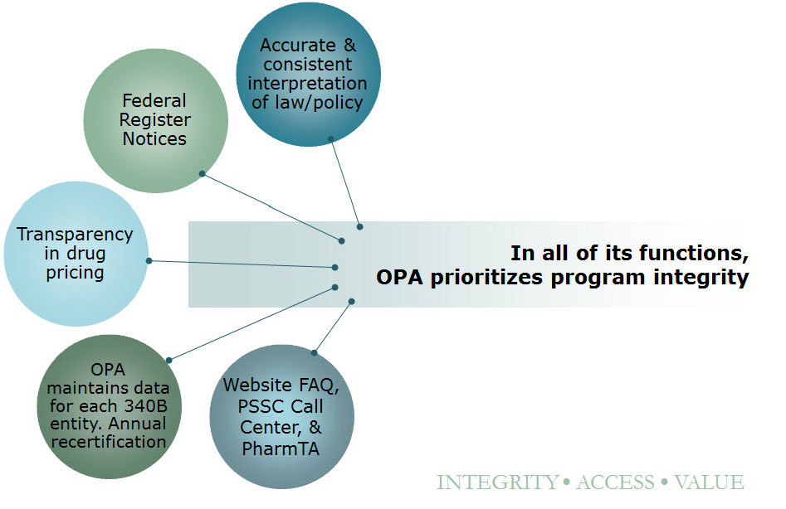
340B Program Integrity Resource
Notes:
The 340B Program is based upon law and guidelines, and it is the OPA’s responsibility to provide accurate and consistent information regarding interpretation of this law and policy. OPA uses publication in the Federal Register as the primary means of policy communication.
Regarding transparency in drug pricing, The OPA calculates the 340B Ceiling Price and will compare this calculated ceiling price with the selling price submitted to OPA. OPA will also produce a verified price file and post the price file on a secured website as required under the Affordabale Care Act of 2010.
To provide accurate information about the 340B entities, OPA maintains data for each participating entity in its database. Under the Affordable Care Act, all covered entity types are required to recertify their information annually to sustain the accuracy of the data.
To address questions pertaining to the 340B program, the OPA ensures that accurate and consistent information is conveyed via high quality information response systems. These systems are available through the Frequently Asked Questions (FAQs) and other information on the OPA website, the PSSC Information Call Center, and the PSSC Pharmacy Technical Assistance Program.
In all of its functions, OPA prioritizes program integrity.

Slide 53
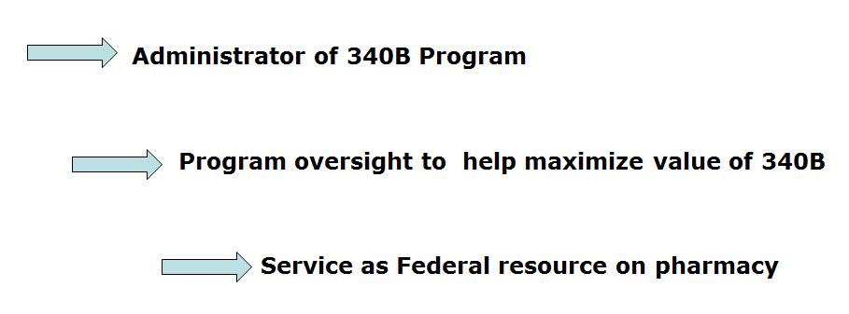
Functions of OPA
Notes:
OPA has three primary functions that support its role as the 340B program integrity resource. First, OPA functions as the administrator of the 340B Program. Second, OPA provides program oversight to help entities maximize the value of the 340B program. And finally, OPA serves as a federal resource about pharmacy.

Slide 54
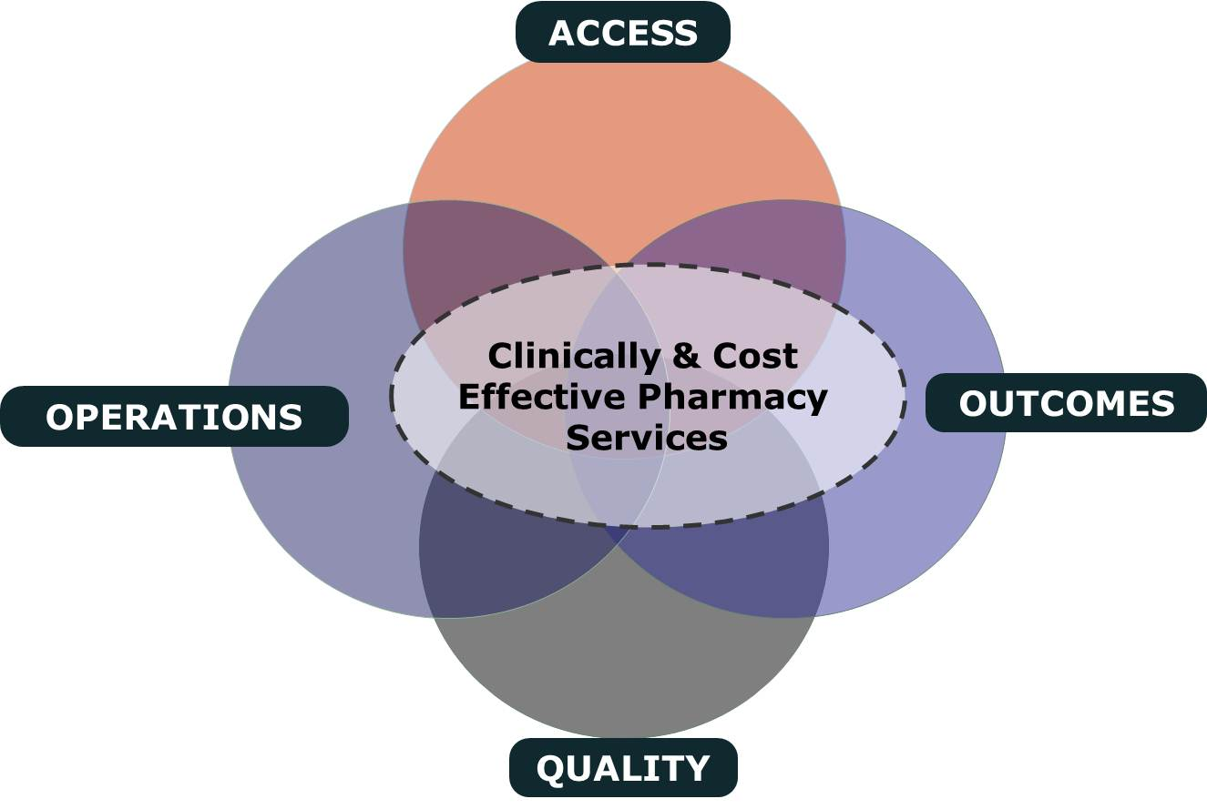
Clinically and Cost-Effective Pharmacy Services
Notes:
In all of its activities, OPA emphasizes the importance of clinically and cost effective pharmacy services as an integral part of primary health care. The four cornerstones of clinically and cost effective pharmacy services are: patient access to affordable medication, outcomes-driven pharmaceutical care, efficient business practices, and quality assurance.

Slide 55
MAKING 340B PROGRAM WORK
Maintain updated records on OPA website.
Choose your contact pharmacy wisely
Conduct regular internal audits
Devote adequate quality personnel for 340b
Develop and update your organization’s 340B standard operating procedures (SOPs)
If you deliver the medication – combine it with case management to increase adherence

Slide 56
GETTING READY FOR AN AUDIT
Have Policies and Procedures
- do not create them for the purpose of the audit
- detail entire process
Be proactive
- get information to the auditor when requested in an easily digestible format
Audit Now
- trace clinically significant encounters monthly
- involve social workers, patient financial services, and medical records.
Understand state Medicaid managed care
- get to know your Medicaid office that processes claims for your entity
Stand your ground with C-suite, do not be pressured into risky practices.

Slide 57
QUESTIONS

Slide 58
MAIN SOURCES USED
OPA
HRSA
APEXUS – 340B PVP

