Slide 1
PCIP—Jumping into the High Risk Pool
Lucy Cordts, LCSW
Heather Weaver, LCSW
2012 Ryan White Program Grantee Meeting
November 27-29, 2012
Washington, D.C.

Slide 2
Disclosures
This continuing education activity is managed and accredited by Professional Education Service Group. The information presented in this activity represents the opinion of the author(s) or faculty. Neither PESG, nor any accrediting organization endorses any commercial products displayed or mentioned in conjunction with this activity.
Commercial support was not received for this activity.
Lucy Cordts, LCSW
Has no financial interest or relationships to disclose.
Heather Weaver, LCSW
Has no financial interest or relationships to disclose.
CME Staff Disclosures
Professional Education Services Group staff have no financial interest or relationships to disclose.

Slide 3
Learning Objectives
At the conclusion of this activity, the participant will be able to:
Describe the process for developing PCIP-related training for HIV direct service providers;
Recognize the training methods demonstrated to be effective in imparting PCIP-related information to HIV direct service providers from the information presented;
Extrapolate best practices from this workshop for the creation and delivery of similar direct service provider training projects

Slide 4
Training Need
The HIV service delivery system has been impacted by current and upcoming changes introduced by Patient Protection and Affordable Care Act (PPACA);
Ryan White service providers must be knowledgeable of relevant changes impacting access to essential health care services for those living with HIV, with emphasis on the Pre-existing Condition Insurance Plan (PCIP);
Ryan White service providers must be able to navigate changes ensuring access, maintenance, and the ability to troubleshoot and collaborate with supportive Ryan White resources as needed.

Slide 5
Key Stakeholders
Louisiana Ryan White Parts A and B service providers and planning bodies
Louisiana State University medical centers
Consumer population
Pharmacy representatives
Notes:
Discuss the role of aforementioned stakeholders

Slide 6
Process Overview
The need to react to PPACA changes state-wide became apparent;
State-wide collaboration determined necessary given broadly applicable changes;
Organized leadership desired by partners, HCWG formed;
Plan of action formulated and delivered state-wide.
Notes:
(B1) Description of state-wide service delv system: EMA/TGA/Regions’ interrelatedness; (B2) ADAP/HIP implications for State; (B3) discuss HCWG formation process—membership, operations, deliverables, etc.

Slide 7
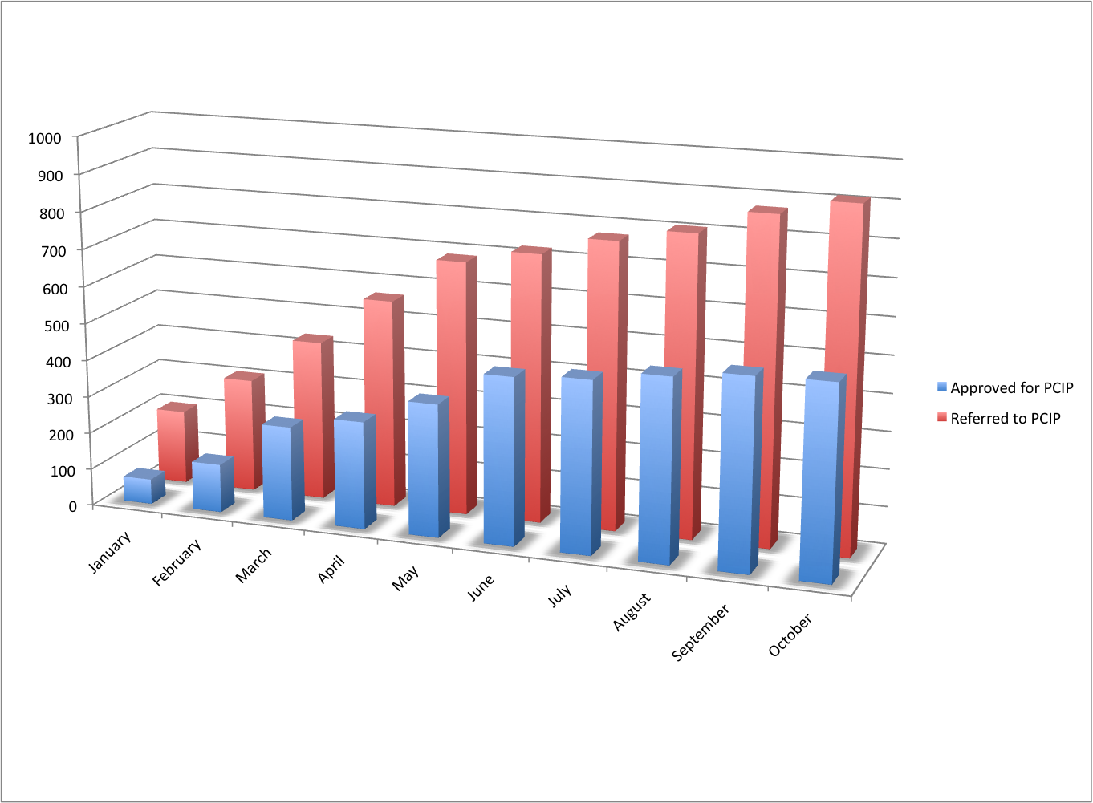
Louisiana Snapshot
Notes:
Perhaps insert some seeeexy MCW data (HIP/PCIP/ADAP #s over time…perhaps at time = 0 and time=most current avail.?

Slide 8
Plan of Action
Form leadership group responsible for initiating needed provider training;
Develop training materials reflecting resources available, population served, and challenges anticipated;
Provide training in a variety of formats to ensure maximum participation and efficacy;
Establish a straightforward trouble-shooting process to support the needs of providers;
Continually update training information so as to remain current.
Notes:
(B2) discuss tools developed [det. insu. cvg and maint. charts; LA health insurance guide, etc.]. do we want to insert these as slides [but not spend a sig. amt. of time going through them? You know…people love pictures; discuss time/resource limitations (B3) spend time here talking about what’s worked and not worked for service providers in terms of obtaining and retaining technical info such as PCIP info [one of our stated Learning Objectives for CME]

Slide 9
Training Content
Review of the PPACA and discussion of impact on HIV;
Overview of the PCIP in the context of HIV, including eligibility, application, utilization, and maintenance;
Discussion of provider’s and consumer’s roles in the process;
Orientation/re-orientation to Louisiana Ryan White resources available for health coverage access and maintenance;
Discussion of target population;
Notes:
(B1) Quick n’ dirty PPACA overview? (B2) Quick n’ dirty PCIP overview including a glance at the application [I think you stated we were going to do that on the abstract submission]? (B3) role of education, application assistance, care access and coordination, importance of correspondence [mail/fax/email/tele] (B4) Quick n’ dirty LA RW overview? (B4) ADAP consumers, medically complex, those desiring non-RW care, etc.

Slide 10
Who Might be a Good PCIP Applicant?
An individual prescribed and taking HAART or multiple costly medications (e.g. currently accessing medications through ADAP, MAP/PAP, RW);
AND/OR
An individual lacking insurance coverage who wishes to access medical care in the private sector;
AND/OR
An individual who wishes to have comprehensive insurance coverage for other cost-effective reasons (e.g. complex medical condition, limited healthcare access, etc.)

Slide 11
Credible Coverage is credit for previous health coverage when moving from one type of insurance coverage to another.
Does individual have some form of insurance?
Yes
No
Non-Credible Coverage
ADAP
Most Hospital Free Care
Ryan White Services
Most Medicaid Waiver Plans
Patient Assistance Programs
Is it credible coverage?
Screen for all coverage options (see Types of Credible Coverage)
Yes
No
Stop
BOX 1
Has had credible coverage in last 6 months?
Was coverage obtained?
Is it credible coverage?
Yes
No
No
Yes
No
Yes
Types of Credible Coverage
COBRA
VA
Full Medicaid (Bayou Health)
Private Insurance (Individual/Group)
TriCare
Pre-Existing Condition Insurance Plan
State High-Risk Pool
Medicare
Is the individual undocumented?
Go to Box 1
Yes
No
Stop
Reevaluate
May qualify for non-credible coverage
Client is ineligible for PCIP
Rescreen once 6 months has elapsed from last day of credible coverage
Was coverage obtained?
No
Yes
Refer to available Ryan White services
Stop
Notes:
Determining Credible Coverage – Also in poster hall

Slide 12
Lessons Learned
Service providers knowledge of available resources, including ability to access and troubleshoot varies greatly;
Consumer population is diverse, individuals’ situations present unique challenges for service access;
Resources routinely transform—flexibility is essential;
Collaboration among state-wide Ryan White service providers is both necessary and complex;
Knowledge of the PPACA and Ryan White resources at the local, state, and national level is required for effective response.
Notes:
Would you rather fold these into the pres.? Or, we could fold ‘em in and re-cap here. OOOOR, we could just talk about ‘em here and exclude them from the prev. slides.

Slide 13
Model Adaptation
Scan national and local landscapes to determine service gaps and needs;
Consider available resources, knowledge of their availability, and ease of access;
Assess providers’ and consumers’ access to and knowledge of complex, often fragmented resources;
Ensure providers’ and consumers’ competence through routine, effective continuing education.
Notes:
Again, one of our stated Learning Objectives for CME

Slide 14
Summary
Processes for developing PCIP-related training for HIV direct service providers have proven to be necessary and effective;
Methods demonstrated to be effective in imparting PCIP-related information to HIV direct service providers should be comprehensive and flexible;
Extrapolation and application to local settings best practices from this workshop for the creation and delivery of similar direct service provider training projects

Slide 15
Resources
Health Resources and Services Administration (HRSA) HIV/AIDS Bureau (HAB):
www.hab.hrsa.gov
PCIP:
www.pcip.gov
www.pciplan.com
Presenters:
Lucy Cordts lucyc@noaidstf.org
Heather Weaver heather.weaver@la.gov

Slide 16
Questions?

Slide 17
Obtaining CME/CE Credit
If you would like to receive continuing education credit for this activity, please visit:
http://www.pesgce.com/RyanWhite2012

