Slide 1
Using and Monitoring Data to Improve Client Care
Evelyn Torres, MBA
Sebastian Branca, MSW
Philadelphia Department of Public Health

Slide 2
Disclosures
This continuing education activity is managed and accredited by Professional Education Service Group. The information presented in this activity represents the opinion of the author(s) or faculty. Neither PESG, nor any accrediting organization endorses any commercial products displayed or mentioned in conjunction with this activity.
Commercial Support was not received for this activity.

Slide 3
Disclosures
Evelyn Torres, MBA
Has no financial interest or relationships to disclose
Sebastian Branca, MSW
Has no financial interest or relationships to disclose
CME Staff Disclosures
Professional Education Services Group Staff have no financial interest or relationships to disclose

Slide 4
Learning Objectives
At the conclusion of this activity, the participant will be able to:
Understand the various components of a quality management program
Utilize and monitor data to improve system outcomes, including quality improvement activities
Use RW CAREWare to strengthen their quality management program

Slide 5
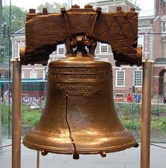
PHILADELPHIA EMA

Slide 6
The Philadelphia Story An Integrated Approach
Grantee responsibilities
Ryan White
Part A
Administrative agent for Part B
CDC and state prevention
HIV surveillance for Philadelphia
HIV Planning Council
Both RW and PPG
Integration of both bodies
Notes:
Two states, nine counties
People of color account for >75%
75% of PLWHA live in Philadelphia
Second poorest of 25 largest cities
________ total allocation for Part A RW Yr 12
Top 3 Core services: Medical Case Management (4500 clients served), Ambulatory/Outpatient Medical Care (8100 clients served), Local AIDS Pharmaceutical (1000 clients served)
Services are offered through a network of public and private nonprofit clinics, hospital outpatient programs, ASOs/ CBOs

Slide 7
Continuum of Care and Prevention
Providers receive RW and CDC funding
Project Officer monitors both contracts
Focus on key indicators
Linkage and retention
Prevention with positives
Care
Prevention

Slide 8
Utilizing Multiple Data Sources
RW program data
RW CAREWare
RSR Combiner
Medical Export
Surveillance data
Laboratory results
CD4s
Viral loads
Special projects
Medical Monitoring Project (MMP)
National HIV Behavioral Surveillance (NHBS)

Slide 9
Utilizing Multiple Data Sources
Client Services Unit
Intake data
Follow-up forms
Grievances
HIV Planning Council
Consumer survey
Qualitative data
Provider narrative reports
QIPs
Notes:
Customer base – Everyone with HIV in the EMA

Slide 10
Philadelphia Engagement in Care, 2009

Slide 11
Every 100 People Living with HIV
US
Philadelphia
Number
82 | Are aware of their infection
66 | Are linked to HIV care
37 | Stay in HIV care
33 | Get antiretroviral therapy
25 | Have a very low amount of virus in their body
Number
82 | Are aware of their infection
62 | Are linked to HIV care
52 | Stay in HIV care
46 | Get antiretroviral therapy
30 | Have a very low amount of virus in their body

Slide 12
THE QUALITY MANAGEMENT PROGRAM

Slide 13
Philadelphia Quality Management (QM) Program
QM process consists of three primary components
Quality assurance
Outcomes monitoring and evaluation
Continuous quality improvement
2.7% ($648,428) is dedicated to the QM program
QM plan is the organizing principle
Incremental progress
Increasing number of measures
Including services in addition to O/AMC
Complexity of the system
Notes:
What we did in 2003 vs. 2012
Quality Assurance (QA)
Degree to which providers adhere to contract provisions addressing administrative and programmatic requirements for each service
Primarily handled through grantee’s Program Services Unit (PSU)
Includes the EMA’s consumer grievance mechanism, operated by the grantee’s Client Services Unit (CSU)
Outcomes Monitoring and Evaluation
Tracks client- and provider-related performance for all funded services
Predominantly through RW CAREWare
Monitored by the Information Services Unit (ISU)
Evaluates system outcomes including access to services by race/ethnicity, sexual minority populations and uninsured patients
Feedback and benchmarking
Continuous Quality Improvement (CQI)
Focuses on specific measures for improvement in order to improve consumer outcomes
Data-driven methodology
Evaluated through the collection of Quality Improvement Plans (QIPs) by ISU for all core services

Slide 14
Aligning QM & NHAS
Reducing new HIV infections
Adherence counseling
Risk reduction
Reducing HIV-related health disparities
Used data from EMA’s RW CAREWare Medical Export tool
Corrective action plans

Slide 15
Aligning QM & NHAS
Increasing access to care
Retention measure for most core services
HRSA system measure for appointment availability
Improving outcomes for PLWHA
Individual and community viral load measures
Retention in care

Slide 16
QM is a Shared Responsibility
Grantee
Program Services Unit
Client Services Unit
Surveillance Unit
Information Services Unit
Providers
QM committees
QI projects
Consumer involvement
Self-monitoring through RW CAREWare
Notes:
PSU provides quality assurance and monitors CQI activities at the provider level
CSU is responsible for follow-up of linkage in MCM and the consumer grievance process
Surveillance provides current epidemiological data and information from its ongoing and special studies such as the MMP
Information Services Unit is responsible for developing, implementing, and coordinating CQM Program activities, including the delivery of CQM-related targeted technical assistance to providers

Slide 17
QM is a Shared Responsibility
Consumers
Surveys
Grievance line
Content experts
Dental
MCM
HIV Planning Council
Feedback of data
Oversight by management team
Medical Director
RW QM Coordinator
ISU Manager
Program Administrator
Notes:
Epidemiologist and Practicing ID physician
QM Coordinator
ISU Manager
Program Administrator

Slide 18
QM Activities
Collecting and monitoring data to assess client outcomes
Local and HAB performance measures
Other available data
Using data to improve client outcomes
Ongoing feedback to providers
QIPs
Quarterly meetings
Individual TA

Slide 19
QM Activities
Improving access to HIV medical care
Retention in care measure for core and supportive services
Improving the HIV system of care
Benchmarking
HRSA Systems Measures
PDPH management team
HIV Planning Council

Slide 20
Performance Measures

Slide 21
Outcome Monitoring in the EMA
Performance measures
System measures
Care outreach outcomes
Early intervention outcomes
Disparities in care
Consumer satisfaction

Slide 22
Performance Measures
27 measures for medical (O/AMC) services
22 HAB Group 1-3 measures
5 local measures
9 MCM measures
2 HAB measures
5 Part B measures (extended to Part A)
2 local measures
5 HAB oral health measures
Measures for all other services

Slide 23
Outpatient-Ambulatory Medical Care Measures
The number of performance measures in the EMA has tripled in the past ten years
AACO collects these measures from providers every two months
The exception to this is VL
suppression which is
collected once per year

Slide 24
MCM Measures
Added to RW CAREWare in the EMA in 2012
Data collected on 2 HAB and 5 state measures every two months
2 local measures monitored through CSU
Simplifies reporting at programs offering both MCM and O/AMC
Facilitates multidisciplinary team approach
Allows for regular monitoring of performance in a large EMA
Will send feedback reports once system is populated with data (2013)

Slide 25
Oral Health Measures
Collected through database created by the EMA
Database similar to RW CAREWare in its functionality
Data entry form functions as client record
Calculates and generates performance measure reports
Identifies patients who are Not in Numerator
Program reviews charts based on sample size calculator (5-7% confidence interval)
5 HAB oral health measures

Slide 26
Monitoring Medical and MCM Performance
AACO Reporting Calendar sent annually to all programs
Reminders with attached instructions for generating report
PDPH monitors provider submissions
Program generates performance reports
AACO Report Generator (O/AMC)
Performance Measure Worksheet (MCM)
Oral health database

Slide 27
Monitoring Medical and MCM Performance
Performance measures for O/AMC, MCM and oral health submitted every two months
ISU enters and analyzes data using PMR Master tool
Feedback reports sent to programs
Providers analyze data and develop QIPs
Grantee provides feedback on QIPs
Outcome monitoring by provider and grantee

Slide 28
Monitoring and Feedback
EMA places strong emphasis on feedback
Quickly highlights trends, strengths and needs
Data visualization is critical in getting attention of program leadership
Benchmarking contextualizes data and can capitalize on competitiveness of providers
Can promote buy-in and assist in overcoming resistance by slow adopters
Assists in prioritizing QIPs

Slide 29
Monitoring and Feedback Tools
PMR Master for Medical and MCM
AACO enters performance data bimonthly
Remaining process is automated
Tool generates aggregate performance data, including city, state and funding
Trend data for both system and provider
Flags all significant improvements and declines
Ranks provider performance for each measure
System and provider trend data on all measures
Generates an individualized Performance Feedback Report for every provider

Slide 30
Monitoring and Feedback Tools
EMA Aggregate Reports
Sent after analysis of bimonthly submission of data by programs
Identifies upcoming submissions and explains data
Feedback to all O/AMC providers on system performance
Includes EMA trend data and highest-lowest performers
Aggregate for O/AMC sent to MCM programs to aid in identifying regional priorities when coordinating with O/AMC providers

Slide 31
Monitoring and Feedback Tools
Performance Feedback Reports
Sent to providers every two months
Number of measures presents challenges for data visualization
Uses a dashboard format
Provides trend data on each measure, including VL missed opportunities
Flags improvements and declines
Ranking in the EMA on all HAB/local measures
Flags top and bottom 5 performers in EMA

Slide 32
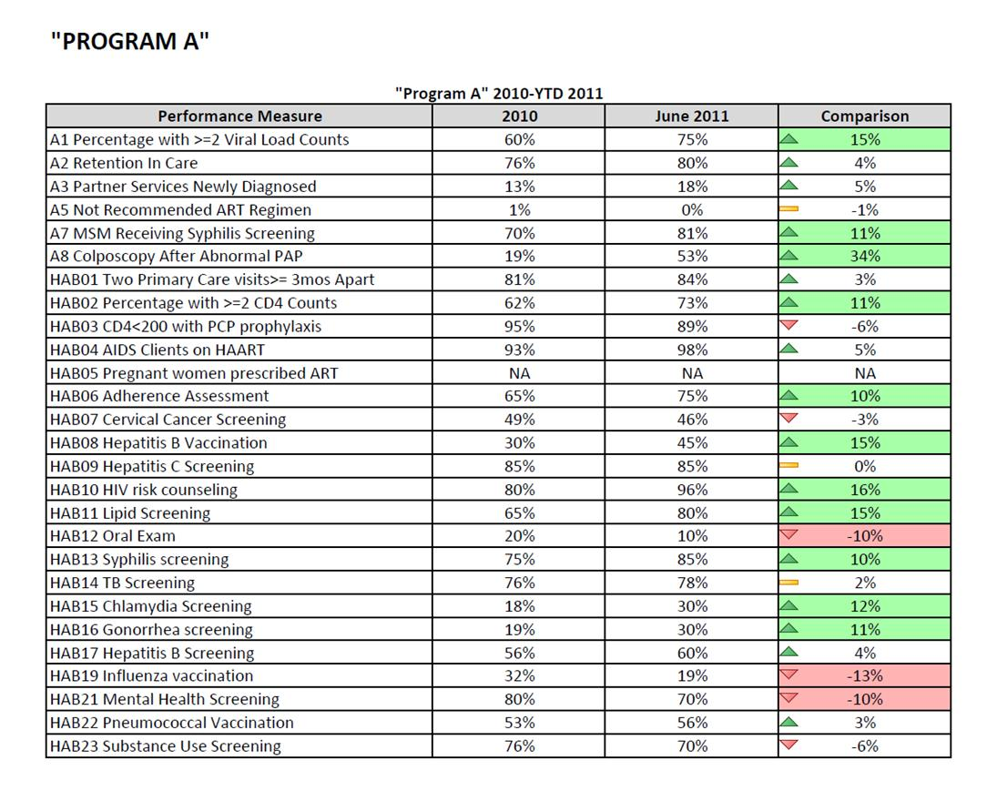
Performance Feedback Reports

Slide 33
Performance Feedback Reports

Slide 34
Quality Improvement Projects

Slide 35
Quality Improvement Projects
Expanded to all core services in 2012
EMA uses form developed by PA’s Part B QM Committee for all core services except O/AMC
All QIPs updated quarterly and submitted
Grantee provides feedback to providers on all plans and requires revisions as needed
In 2012, 126 QIPs were collected and reviewed
Grantee works with programs that will need to submit more than 5 QIPs per year to identify priorities

Slide 36
Individualized Approach
EMA has moved away from regional measures to a more individualized approach
Value in working toward common goal- facilitates sharing of best practices
Number of O/AMC measures makes priority-setting critical
Last regional measure saw providers with high performance doing a QIP at the expense of other key measures with low performance

Slide 37
Individualized Approach
Success on one measure is not necessarily predictive of success on other measures
EMA has defined key measures and set automatic thresholds for QIPs
Programs may still select other measures for improvement in addition to any required QIPs

Slide 38
Triggers for QIP Submissions
0% performance on any measure
Greater than 10% gap between VL and visits
Below 50% on colposcopies
Below 60% on cervical exams
Significantly below EMA (lowest 5 performer)
Significant declines
Viral load 5%
Syphilis 5%
Cervical exams 5%

Slide 39
Medical QIPs
Narrative format for O/AMC
QI committee, including program leadership
Focus on specific performance measure(s)
Root causes for low performance (data-driven)
Action steps target processes related to root causes
Plan for implementing actions and goal
Quarterly updates

Slide 40
Nonmedical QIPs
QI Storyboard for all other core services
Developed by PA’s Part B QM Committee
Strict adherence to FOCUS PDSA process
Each step mapped out
Particularly useful for new providers or those struggling with CQI
Strong emphasis on incorporating data into the process

Slide 41
EMA’s Criteria For Evaluating Quality Improvement Projects
Do not confuse QA with QI
Focus on systems and processes
Are data-driven
Utilize a sound QI process (e.g. FOCUS PDSA)
Consistency between the measure, causes and action steps
Investment by program leadership
Incorporation of consumers in the QI process

Slide 42
EMA’s Criteria For Evaluating Quality Improvement Projects
Identified causes supported by data
Apply the 80-20 rule to identify and prioritize changes
Clear and specific actions targeting causes
Implementation strategy with timeline
Compares baseline to outcome
Produces desired improvements

Slide 43
Consumers and CQI
PDPH emphasizes consumers in the QI process
Consumers on QI teams or committees
Obtain input from Consumer Advisory Boards during key stages of a QI process
Consumer focus groups
Client surveys to obtain client input relating to causes for low performance or proposed action steps

Slide 44
DATA IN THE QM PROCESS

Slide 45
Data in the QM Process
Measures convey symptoms
Generally inadequate at diagnosing root causes
Performance measure reports are starting points for QIPs in the EMA
Measures are the problem to solve in a QIP
Other RW CAREWare tools are generally needed in moving toward an understanding of the problem

Slide 46
RW CAREWare Data Tools
Performance Measures Worksheet
AACO Report Generator
Medical Cleanup Tool
QM Medical Export
RSR Combiner

Slide 47
RW CAREWare in the CQI Process
Not in Numerator list in the Performance Measures Worksheet
Real Time
Quick Paper
Use of Medical Cleanup Tool
in the AACO Report Generator
Custom reports

Slide 48
AACO Report Generator
Provides more detailed data related to all HAB and local measures
Facilitates RW CAREWare data cleanup
Provides all CQI resources available in RW CAREWare for EMA’s local measures
Module simplifies process for generating Performance Measure Reports
Generates Annual QM Medical Export of all client level data

Slide 49
Annual Medical Export Data
Extracted through AACO Report Generator
Contains all client-level O/AMC data
Data is combined and can be unduplicated
VL suppression measure
Disease status at time of entry into care
Disparities in care

Slide 50
Disparities in Care
AACO combines all annual QM medical exports into master data set
Run analysis on CQI Data Points
Analysis on EMA aggregate and by agency for statistically significant disparities
Disparities in medical visits and VL by race, ethnicity and insurance

Slide 51
Disparities in Care
Present findings on overall system at EMA’s regular QM meetings
Send program-specific data to providers
Programs with statistically and clinically significant disparities conduct further analysis
Providers identify cause(s)
Program develops action steps to resolve

Slide 52
RSR Combiner
Provides another opportunity for looking at client-level data
EMA developed process for combining RSR data
Developed hierarchies for each key data point to address duplicates with conflicting information
Unduplicated key data points into a flat table for further analysis
Service utilization data extracted and reported to EMA’s HIV Planning Council in 2012

Slide 53
EMA FINDINGS

Slide 54
Outcomes
Overall EMA performance improved on 21 out of 27 O/AMC measures between 2010 to 2011
Decline on only three measures,
with no decline greater than 2%
Outcome goals
Maintain past improvements
Continue to build on trend of
steady improvement each year

Slide 55
Outcomes
The following measures improved between 2010-2011:
Partner Services Newly Diagnosed 15%
Colposcopy after Abnormal Pap 7%
HIV Risk Counseling 6%
Hepatitis B Vaccination 10%
Influenza Vaccination 11%
Pneumococcal Vaccination 8%
Oral Exam 6%

Slide 56
Outcomes
Particular improvement was seen on screenings and Group 3 measures
Gonorrhea Screening 27%
Chlamydia Screening 27%
Hepatitis B Screening 8%
TB Screening 12%
Adherence Assessment 4%
Mental Health Screening 8%
Substance Abuse Screening 11%

Slide 58
CONCLUSIONS

Slide 59
Challenges
Managing increasing demands
Reporting complexity
AACO Reporting Calendar
Continuing expansion of performance measures
Determining priorities for CQI activities
Limited resources
Meaningful consumer involvement
Minimizing resistance in a changing environment

Slide 60
Challenges
Maintaining continuity with other RW Parts
AACO participates in Part B committees as coalition member
Meets with Part D grantee
to coordinate activities
Coordination with Part C
and Part D
Ryan White All Parts
Design Team

Slide 61
Lessons Learned
Data drives QM processes and decisions
Use all available data to evaluate client care
Sustain performance over time
Focus on low performers to improve overall system
Individualize your approach
Agency by agency
Measure by measure
QM should be organic to the grantee and providers

Slide 62
Lessons Learned
Maximize resources
Private/Public partnerships
Consequences for poor performance
RFPs
Corrective action plans
Defunding agencies

Slide 63
ACKNOWLEDGEMENTS

Slide 64
Questions or Comments

Slide 65
Obtaining CME/CE Credit
If you would like to receive continuing education credit for this activity, please visit:
http://www.pesgce.com/RyanWhite2012

