Slide 1
Expanding Access to HIV Oral Health Care Innovative Program Models
Jane Fox, MPH, Boston University
Avi Nath, DDS, SF Dept of Health
Howell Straus, DMD, AIDS Care Group
Amanda McCluskey, HIV Alliance
Notes:
Sally

Slide 2
Learning Objectives
Discuss different program designs that addressed gaps in HIV oral health care in both rural and urban areas
Compare strategies for addressing geographic obstacles to care, including transportation, and care coordination
Describe outreach and retention strategies for patient engagement in care and self-care management
Notes:
Multi-site data was collected to measure outcomes including; increased access to oral health care, patient outcomes and program implementation processes, strategies to overcome reimbursement obstacles, provider and patient education training outcomes, and lessons learned that will be useful for a broader audience.

Slide 3
SPNS Sites
Notes:
15 sites across the US.
2 in NYC, 2 in CA and one in USVI. The remainder are scattered.

Slide 4
Multi-Site Evaluation Patients by Site N=2469
Site Name | # Multi-site patients
AIDS Care Group | 206
AIDS Resource Center of Wisconsin | 55
Community Health Center, Inc. | 208
Harbor Health Services, Inc. | 74
HIV Alliance of Lane County | 205
Louisiana State University | 291
Lutheran Medical Center | 90
Montefiore Medical Center | 58
Native American Health Center | 99
Sandhills Medical Foundation, Inc. | 140
Special Health Resources for Texas | 187
St. Lukes - Roosevelt | 289
Tenderloin AIDS Resource Center | 173
University of Miami | 265
University of North Carolina | 129
Notes:
Total N is 2469.
We asked urban sites to attempt to recruit at least 200 patients for the study and non-urban sites to recruit at least 100.

Slide 5
Patient Demographics N=2469
75% male
82% US born
Mean age: 44, range 18 – 81
Mean years HIV+: 10
33% completed high school
43% > high school
95% in HIV medical care
78% on ART
39% no regular place of dental care
53% had no dental care in 2+ years
Notes:
33% of patients reported not working due to disability and an additional 35% were unemployed
Since testing HIV+, 48% stated needing dental care but were unable to access it
Cost was the primary reason
39% had no regular place for dental care
When asked to rate the health of their teeth and gums, 32% of patients said “poor” and 31% reported “fair”

Slide 6
Models of care
Patient navigation
Co-location of services
Collaboration with schools
Provision of ancillary services
Patient education
Mobile dental units

Slide 7
Original Model of the Oral Health Initiative in Tenderloin
Oral Health Coordinator paired with Outreach
Intake and follow-up was assigned to coordinator
Heavily administrative with data entry, meeting organization, and other tasks emphasized

Slide 8
SF Department of Health
Strategies for addressing barriers to care
Transportation
Co-location of services
Care coordination

Slide 9
SF Department of Health
Outreach and retention strategies for engaging patients into care
Methods for retaining patients in care
Strategies for increasing patient self-care

Slide 10
Barriers to Care
Structural
No dental clinic in the TLH district
Financial
Patient either lack or are unaware of medical coverage
Individual
Discrimination due to HIV/AIDS, LGBT
Language and educational limitations
LGBT
Notes:
10

Slide 11
Site Specific Challenges
Homeless patients are difficult to track since they move constantly
Organizational instability at TLH
Staff turnover
Statewide MediCal/DentiCal cuts

Slide 12
CLINICAL METHODS - issues & SOLUTIONS
Target population
Triple Diagnosed
Integration with primary care and medical case management
Co-location with Medical services
Unstably housed
Dental Case Manager

Slide 13
Dental Case Manager’s Role
Patient Recruitment
Transportation and Scheduling
Visit Accompaniment and Translation
Referrals and Explanation
Collaboration with HIV Case Managers
Patient Education
Retention Services

Slide 14
Clinical Methods- Collaboration
Partners & Linkages to Care
Integration with Primary Care at SFDPH-Ward 86 at SFGH
Referrals agencies
Asian Pacific Islander and Wellness Center
Larkin Street Youth Services
Rehab Centers (Walden House,Ferguson Place)
Community-Based Dental Partnership with UCSF for speciality services

Slide 15
Results - Clinical
TLH
Dental “HOME” established
Established a LOCAL two-operatory dental clinic
450 of ~1500 HIV patients residing in the Tenderloin now being served by the dental clinic
Speciality training provided to ALL staff to improve cultural sensitivity, especially towards LGBT

Slide 16
Results-Significant changes
Good practices - improvement
Brushing
Flossing
Bad practices - reduction
Smoking
Candy consumption
Soda Consumption
Outcome | Baseline | 12 Months
Unmet need for OHC | 48% | 17%
Good Health of Teeth & Gums | 38% | 67%
Oral Health Symptoms (Mean) | 3.35 | 1.78

Slide 17
Clinical Outcomes- significant changes
Good practices - improvement
Brushing
Flossing
Bad practices - reduction
Smoking
Candy consumption
Soda Consumption

Slide 18
Sustainability- future plans
Sustainability
What was the plan at the end of the grant
Successfully applied for Ryan White Part A funds
How did it work out
Clinic running and continues to serve PLWH/A in Tenderloin district
What is the current status
Tenderloin Health is closed . Services taken over by SFDPH and API .
Notes:
18

Slide 19
AIDS Care Group
The AIDS Care Group was awarded a Special Projects of National Significance grant for
“Oral Health Care – Outreach Project”
A new clinic was established in Coatesville in October, 2006

Slide 20
AIDS Care Group
Where medical care is hard to get, dental care is almost impossible to get.
Consequently, many patients seeking care have extensive needs; have extensive fear; or have extensive emotional and physical barriers to care.

Slide 21
AIDS Care Group
AIDS Care Group staff have opened the door to dental care to patients from over 14 Pennsylvania counties that are currently experiencing a dental professional shortage; and where care and services to people living with HIV disease are limited.

Slide 22
Counties in PA

Slide 23
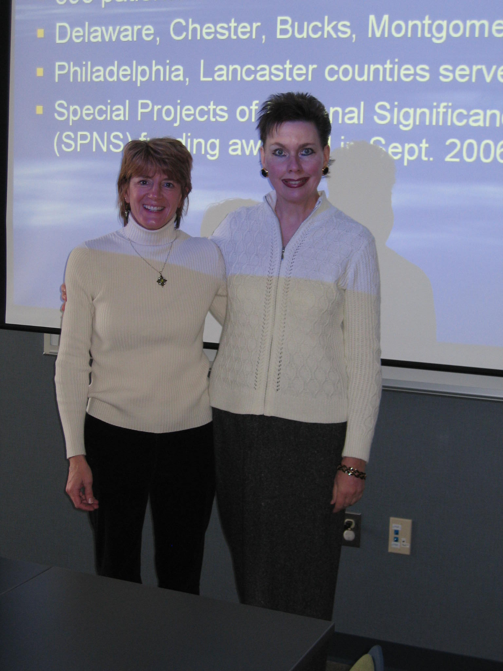

Slide 24
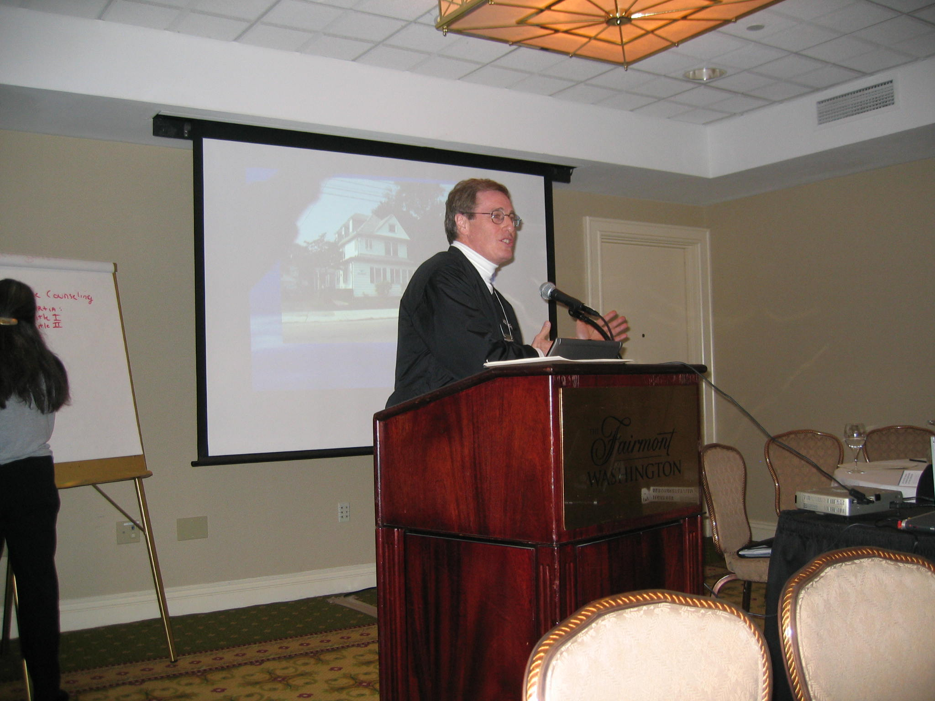
Notes:
24

Slide 25
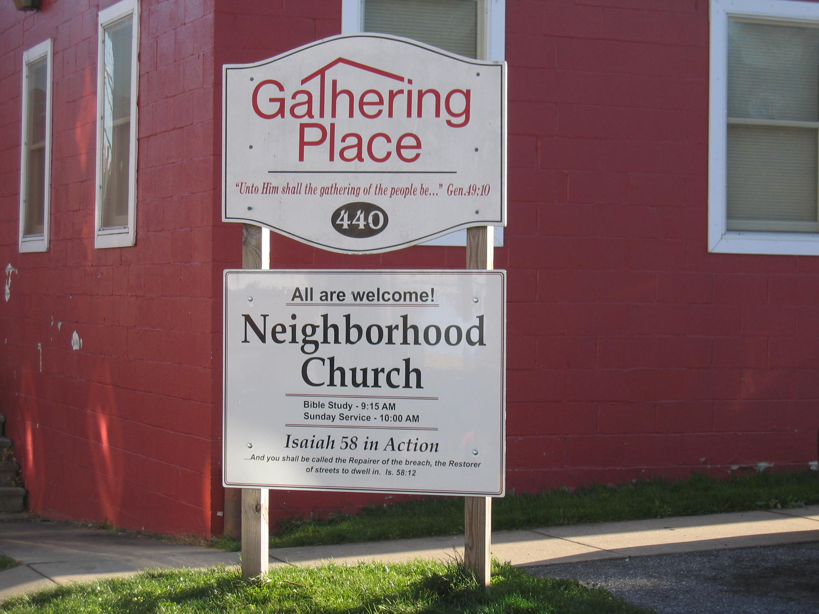
Notes:
25

Slide 26
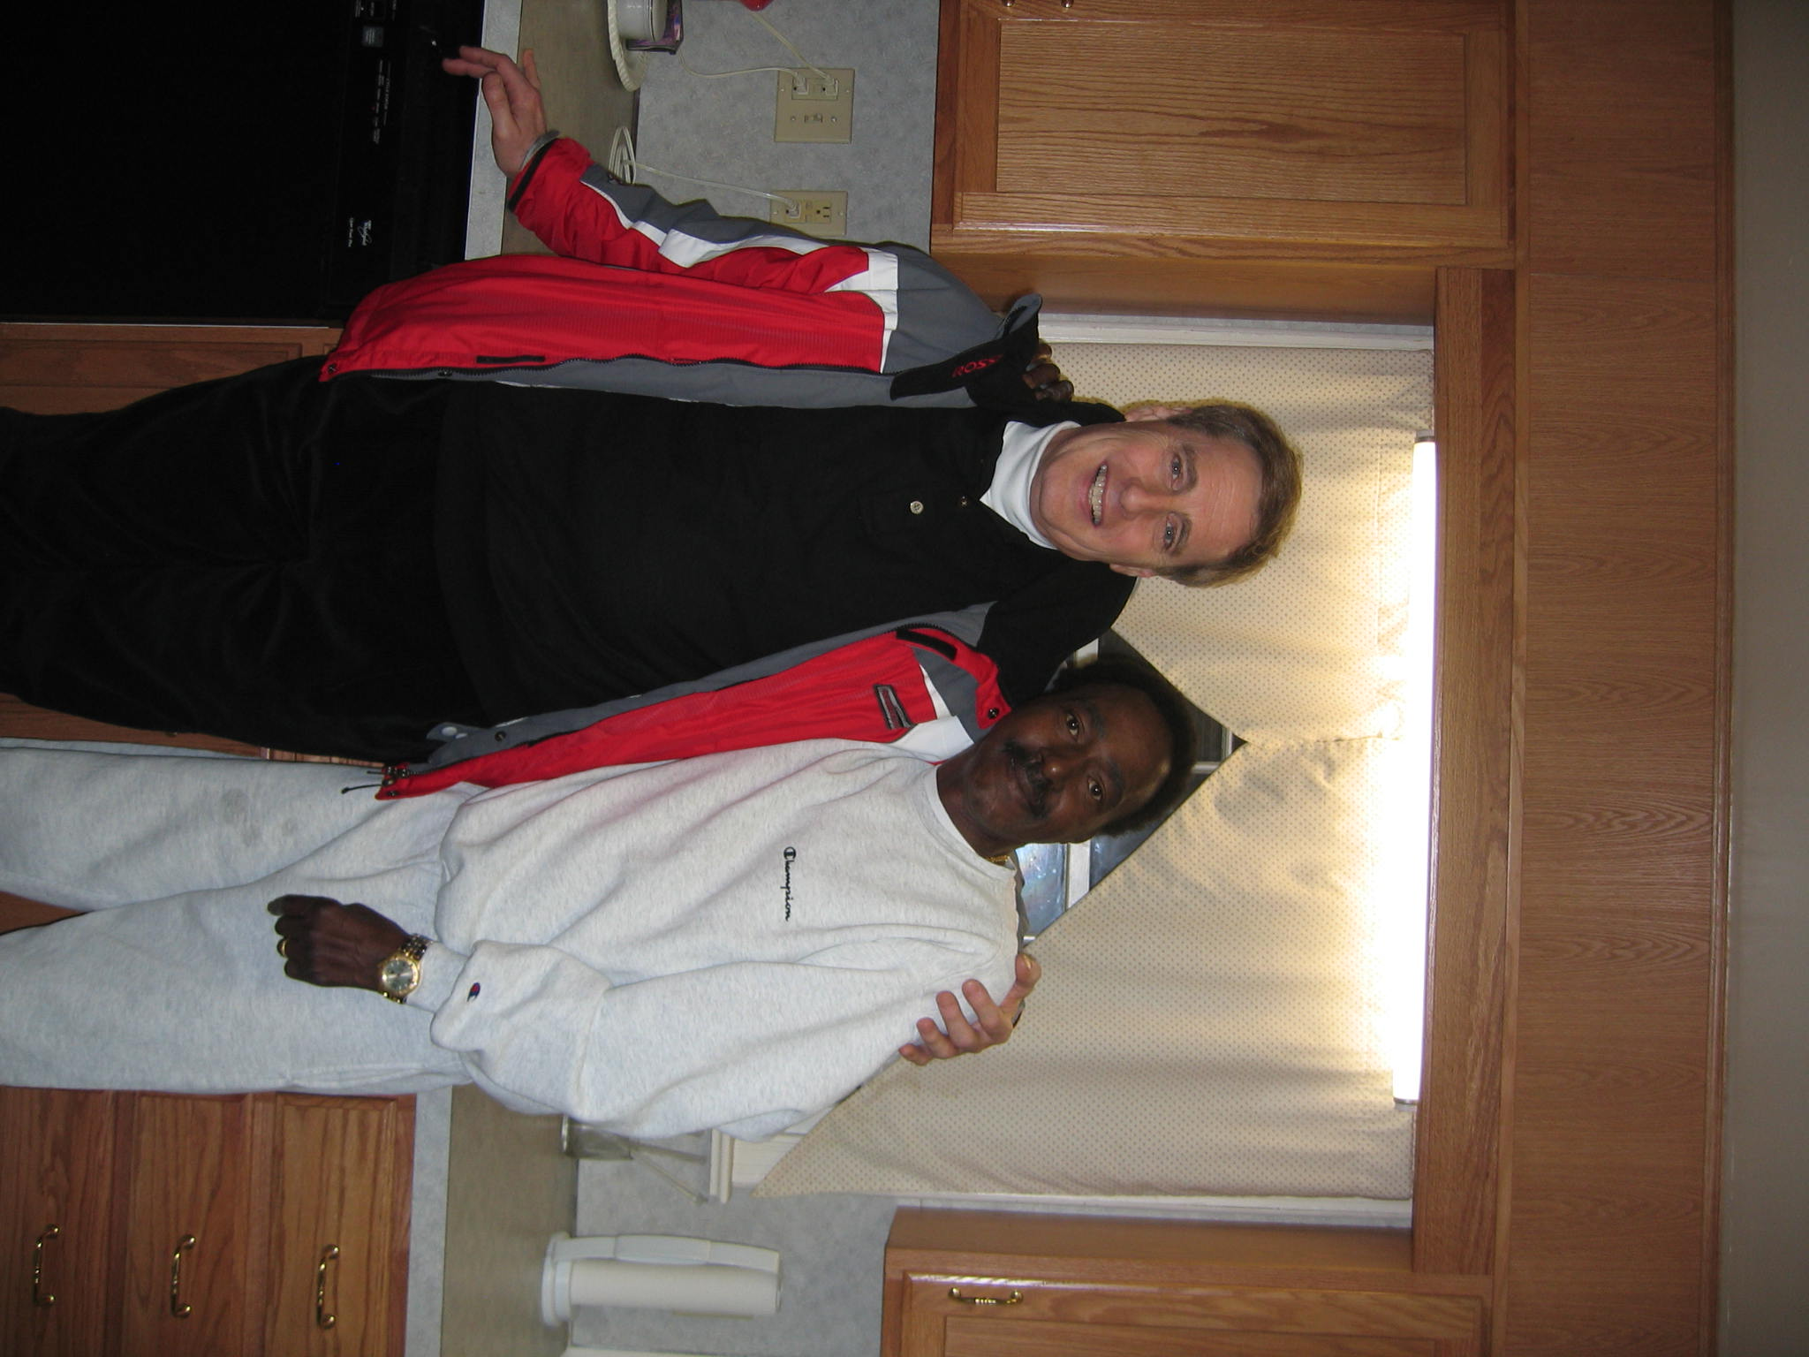
Notes:
26

Slide 27
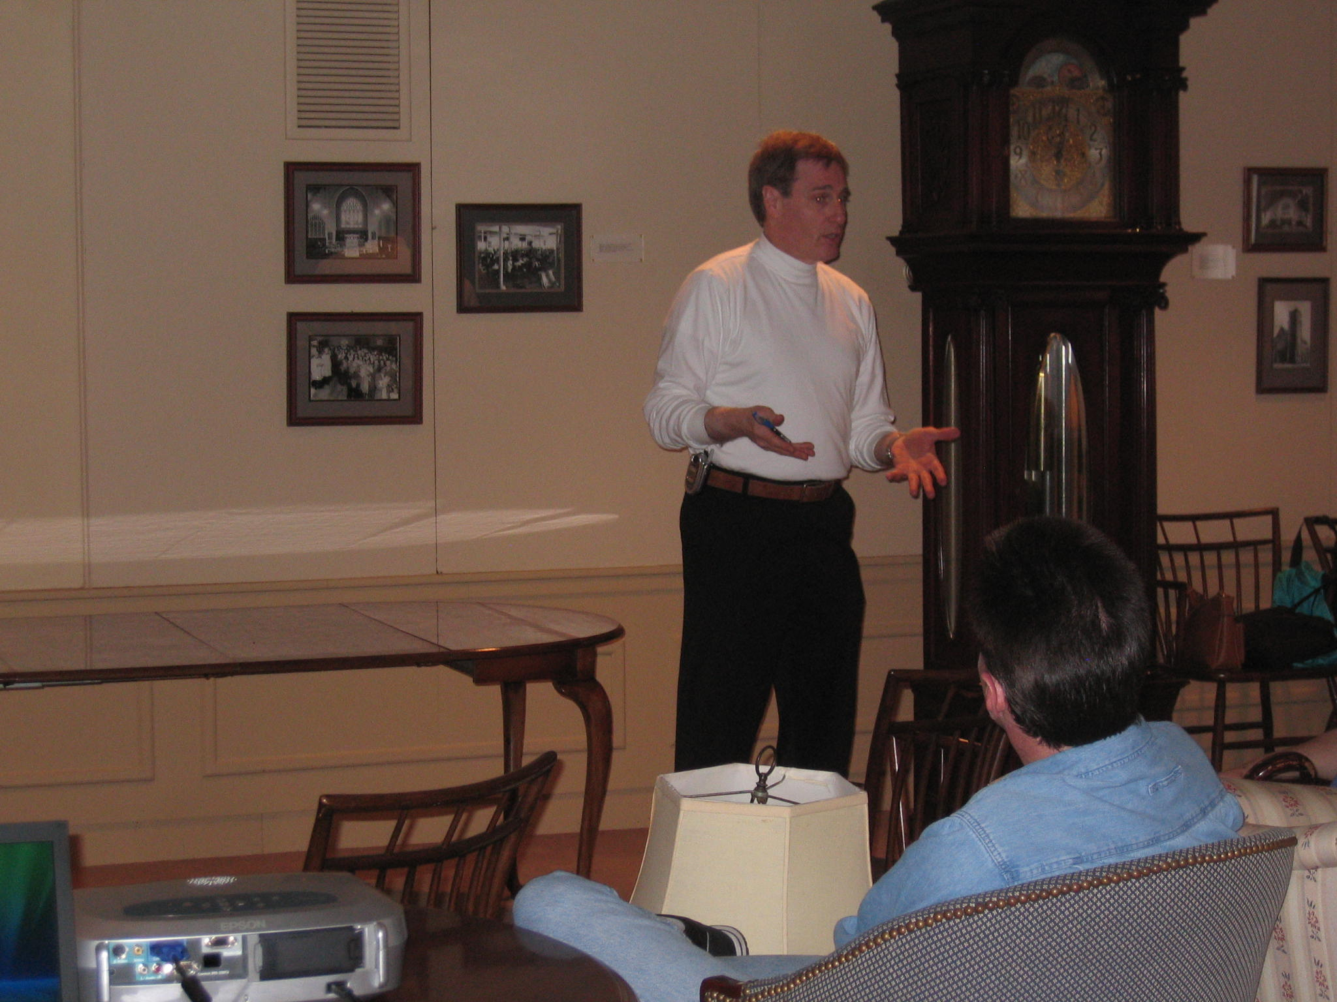
Notes:
27

Slide 28
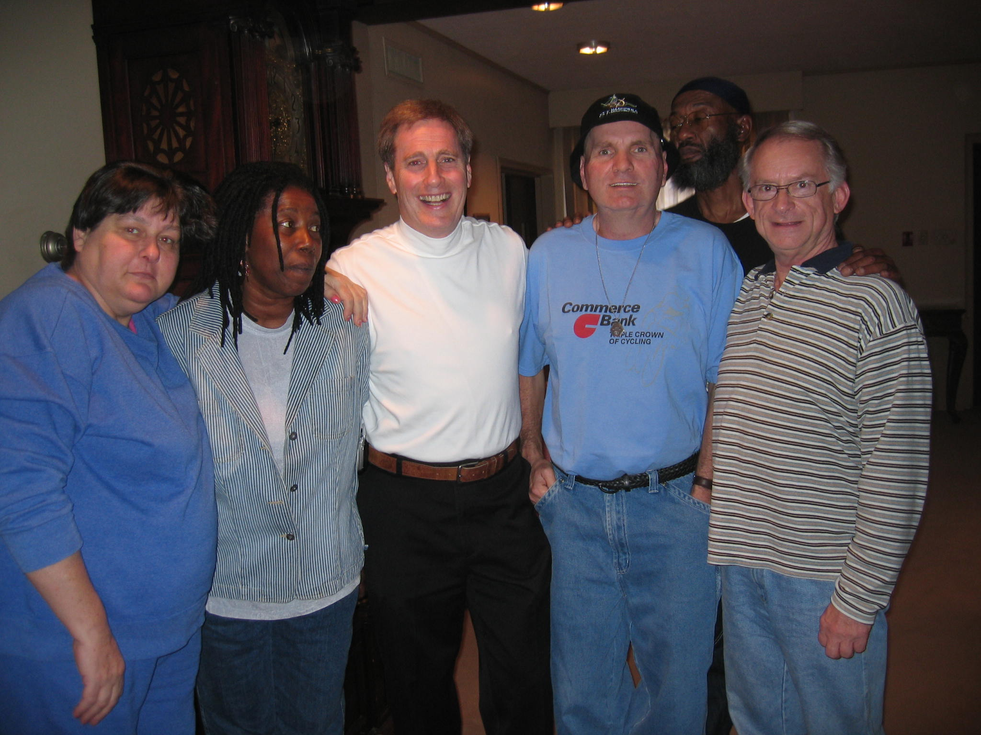
Notes:
28

Slide 29
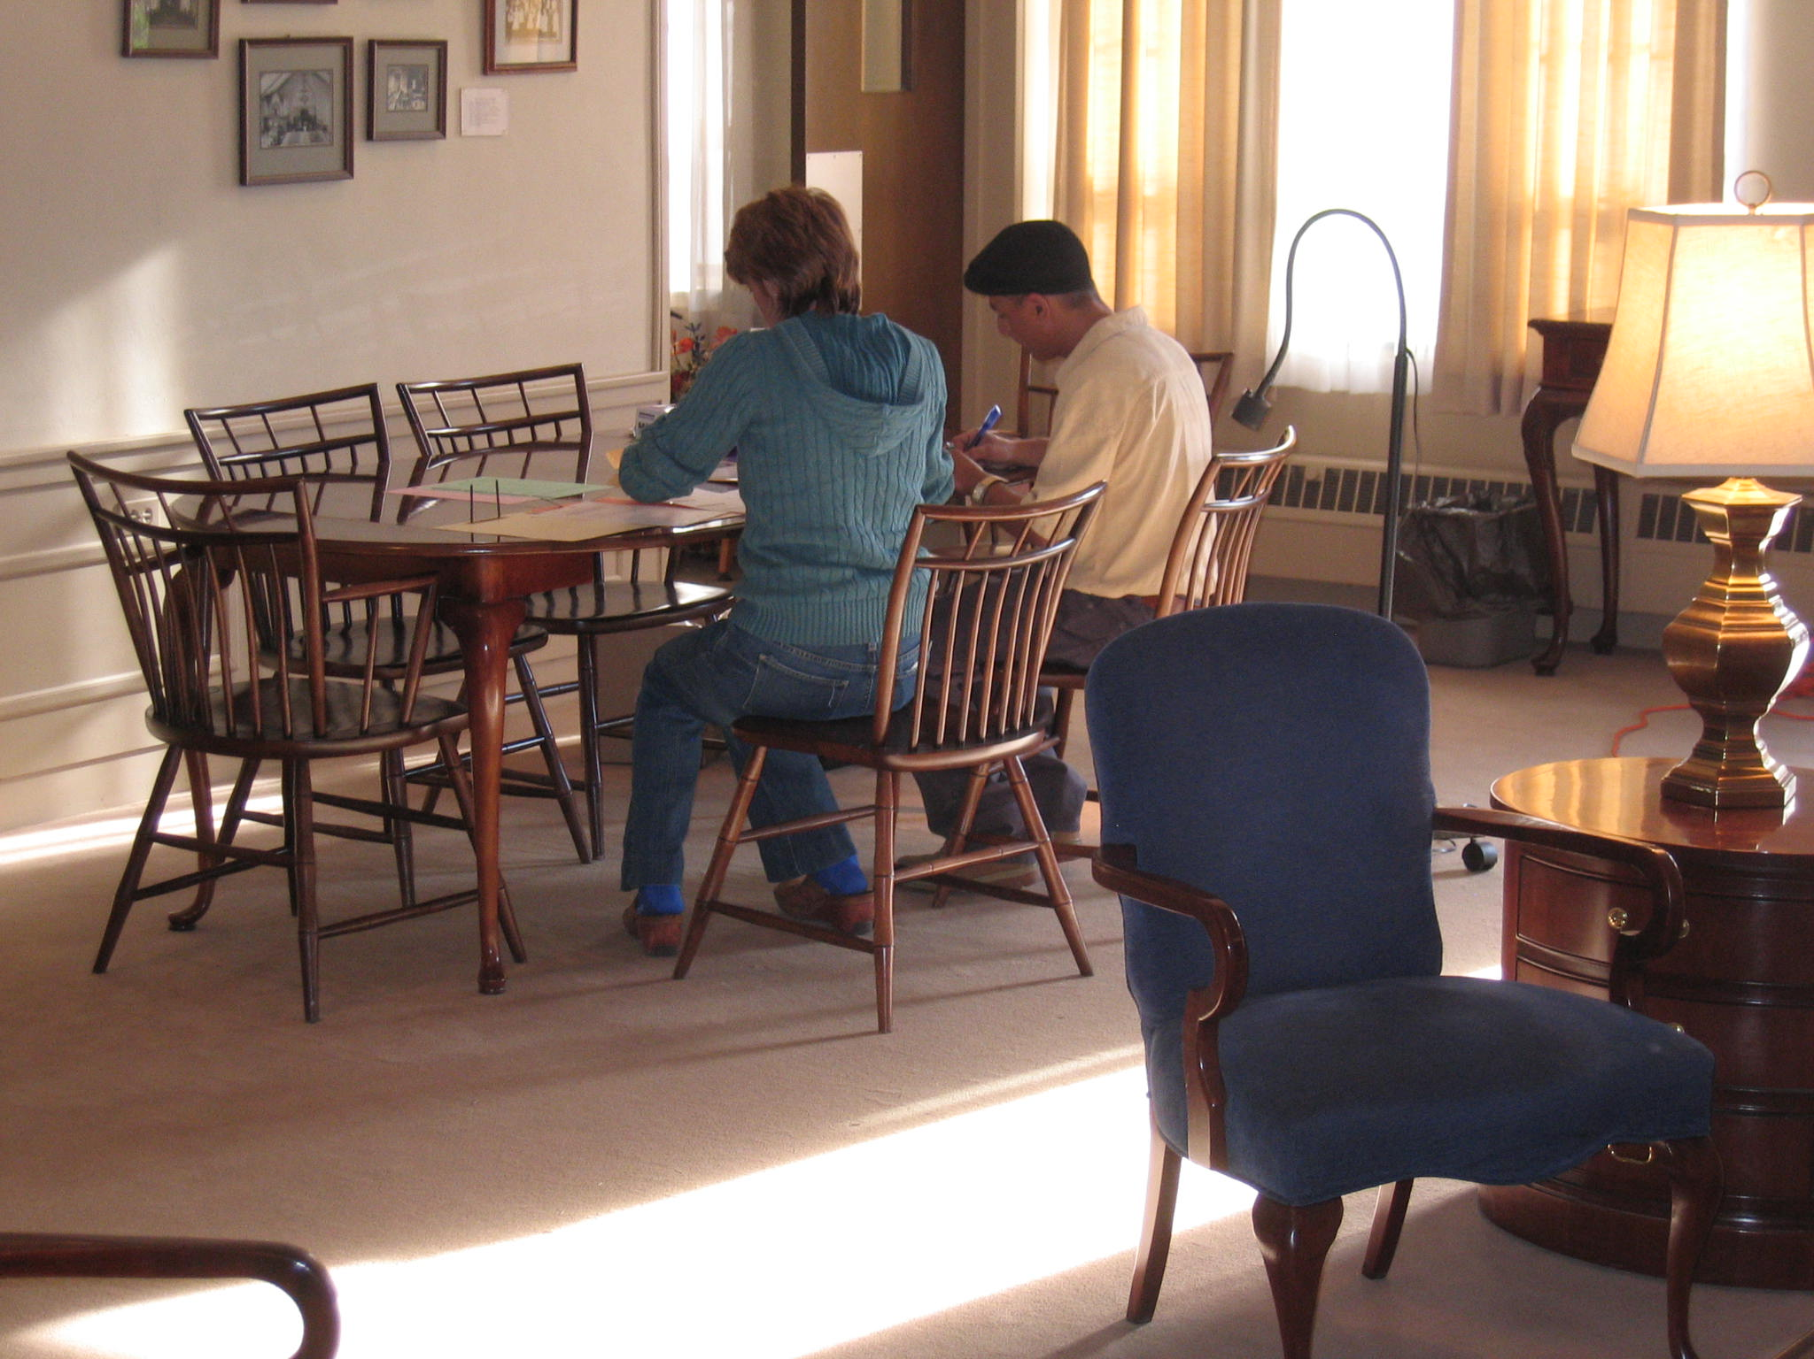
Notes:
29

Slide 30
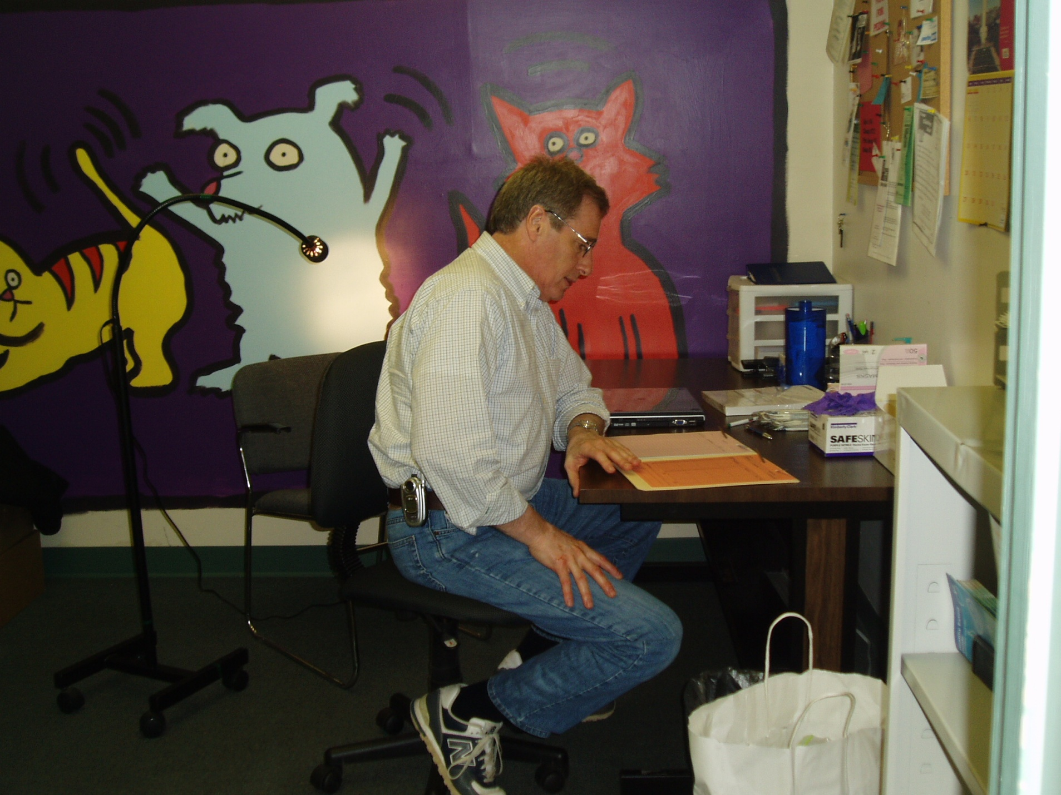
Notes:
30

Slide 31
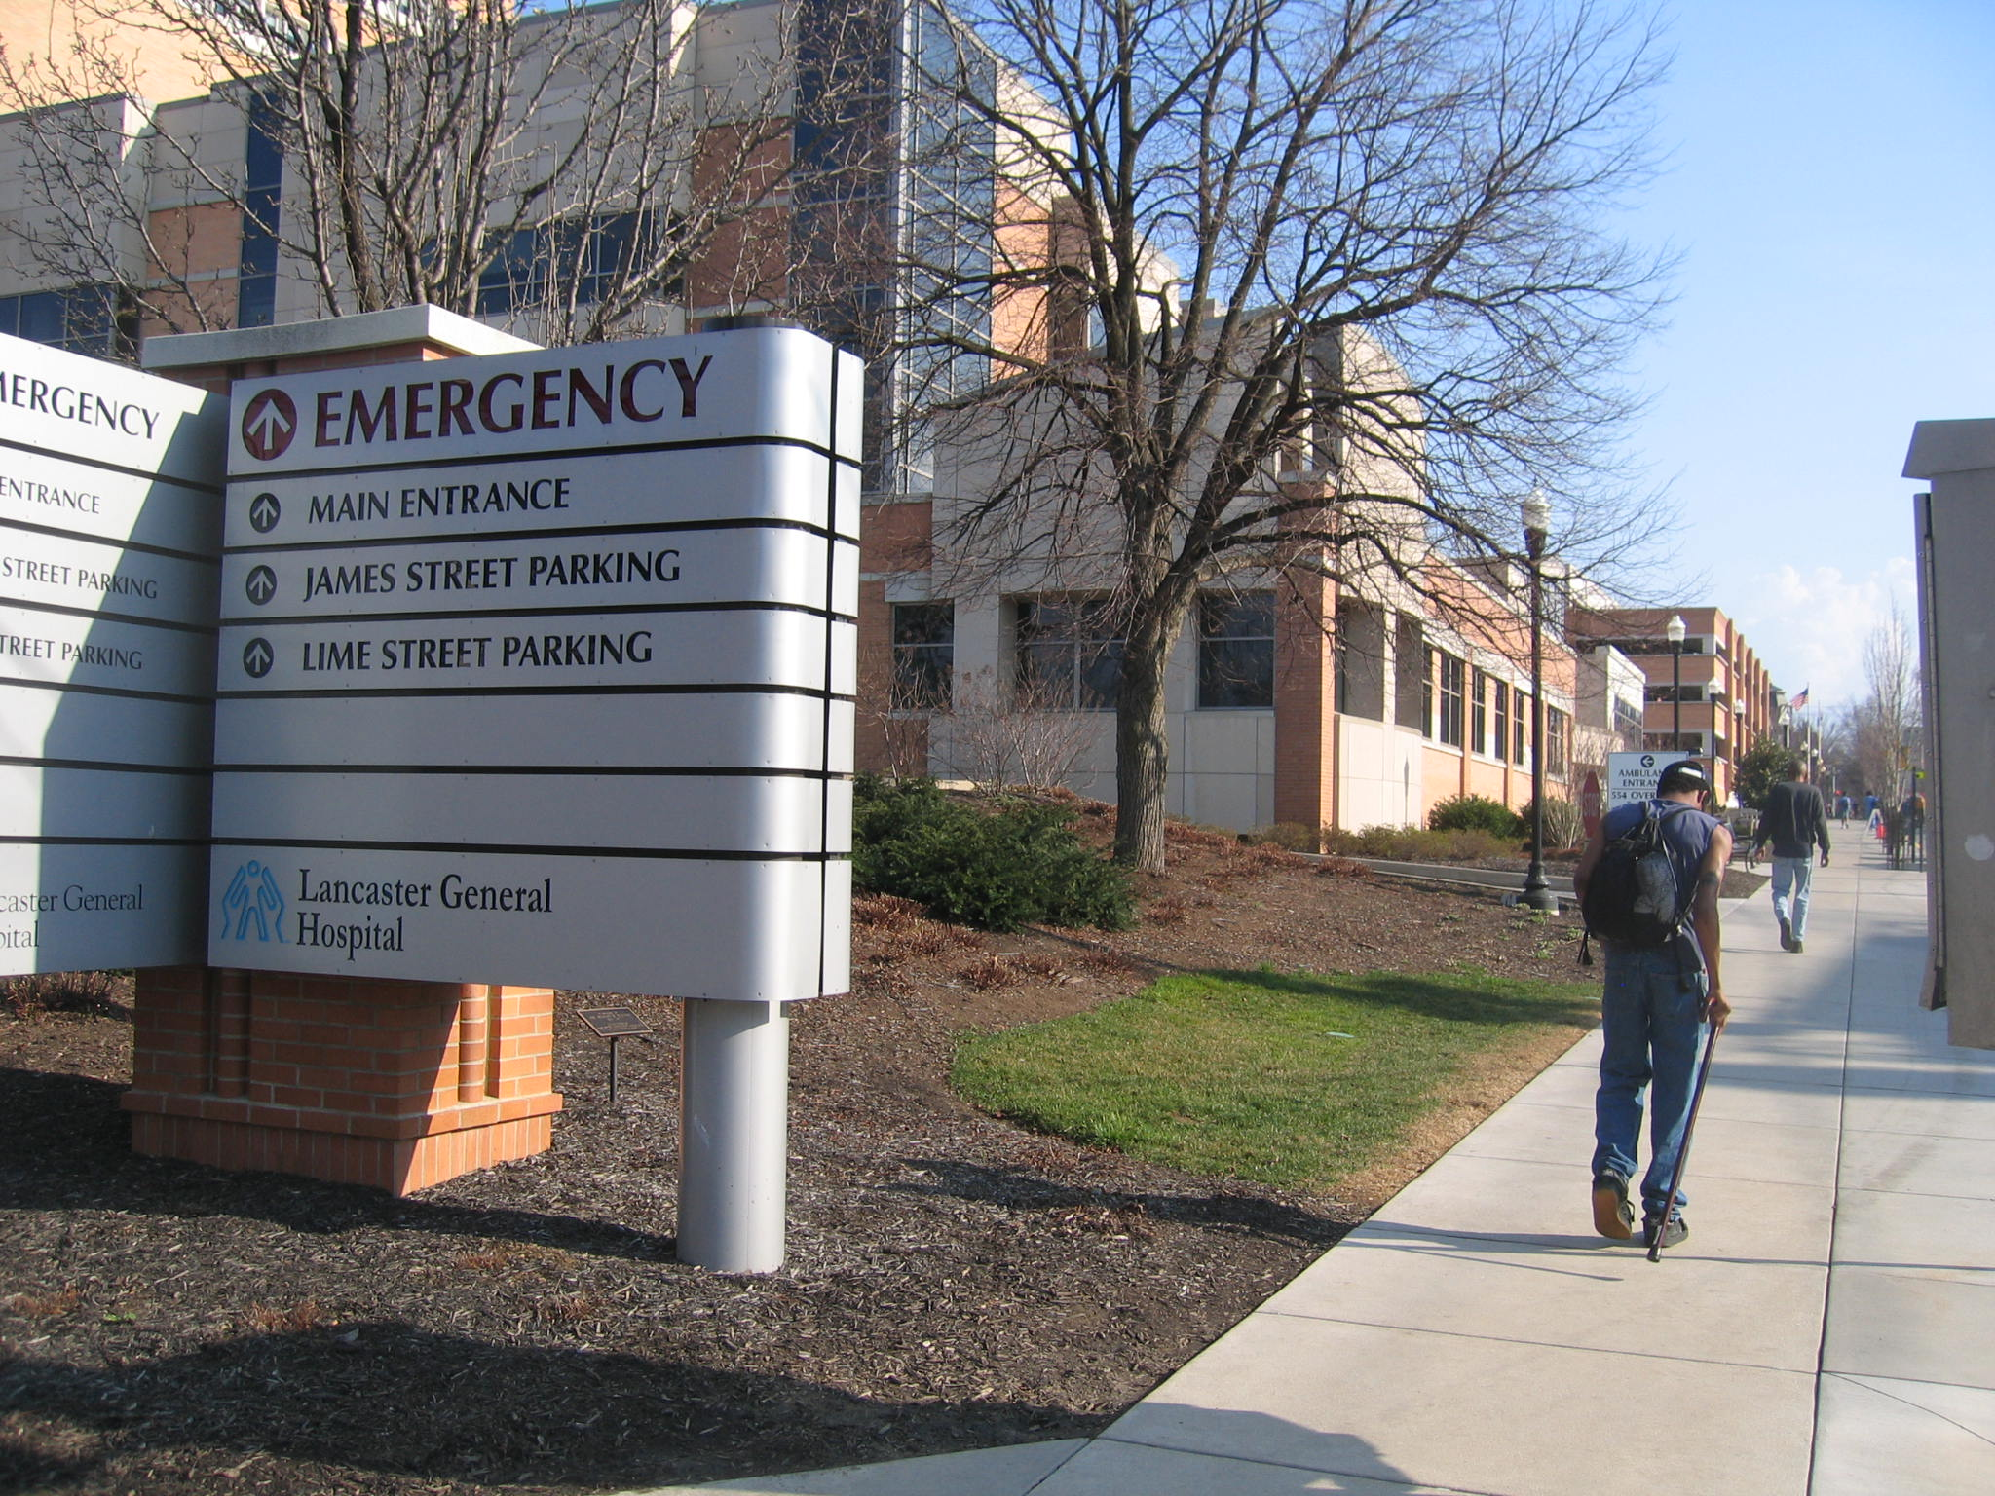
Notes:
31

Slide 32
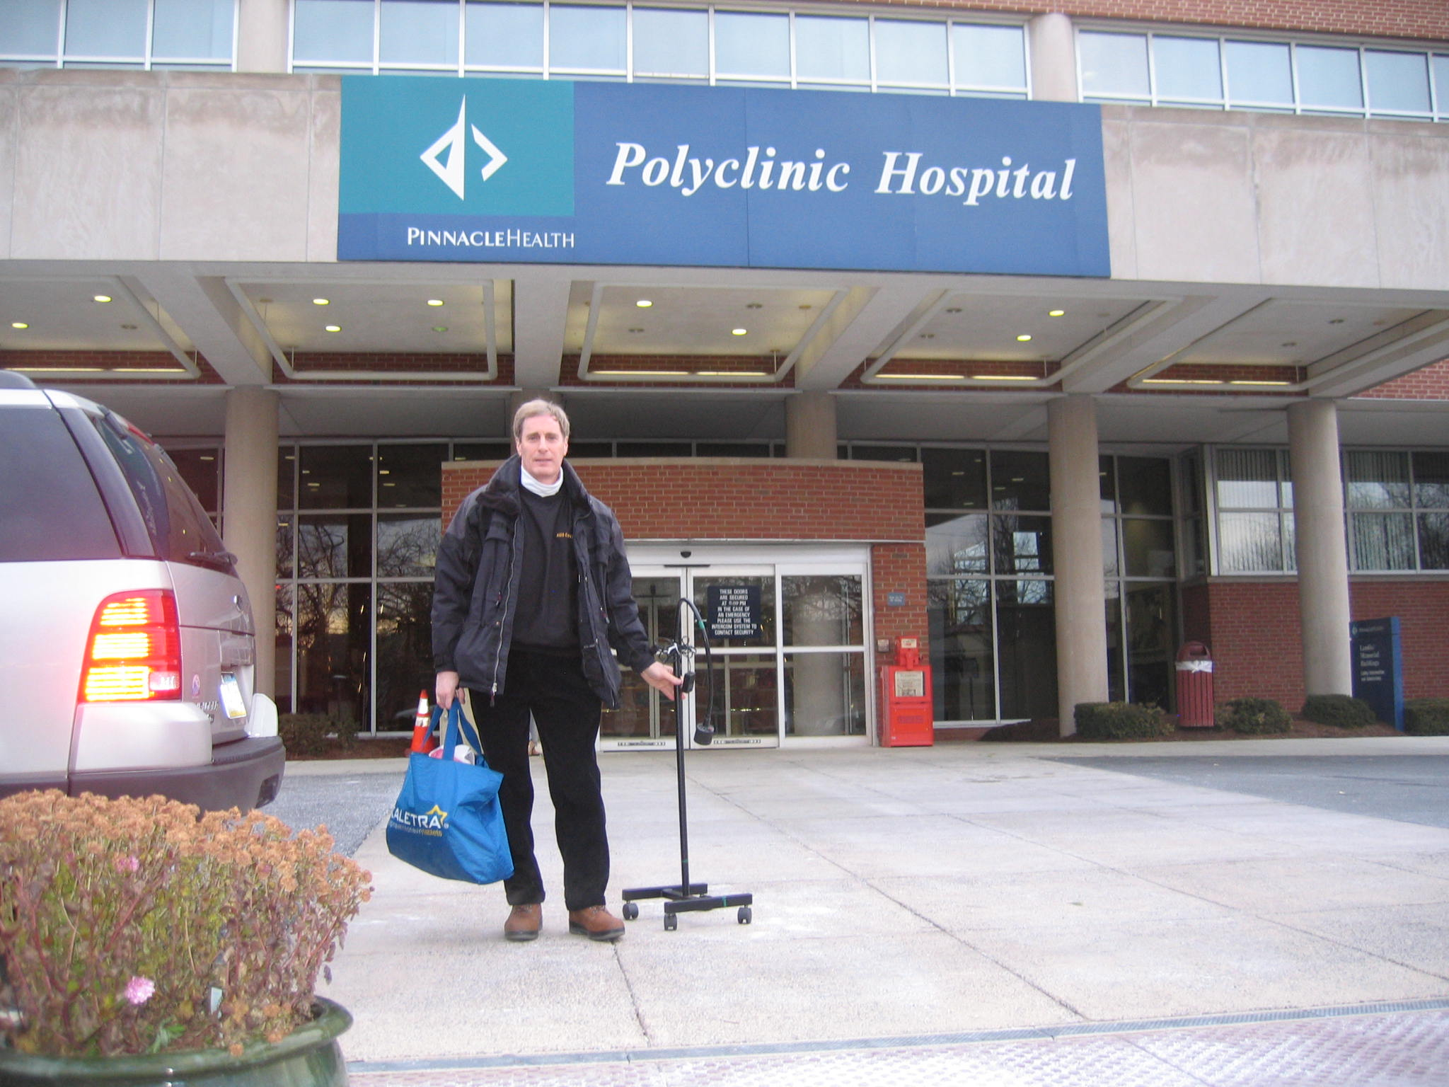

Slide 33
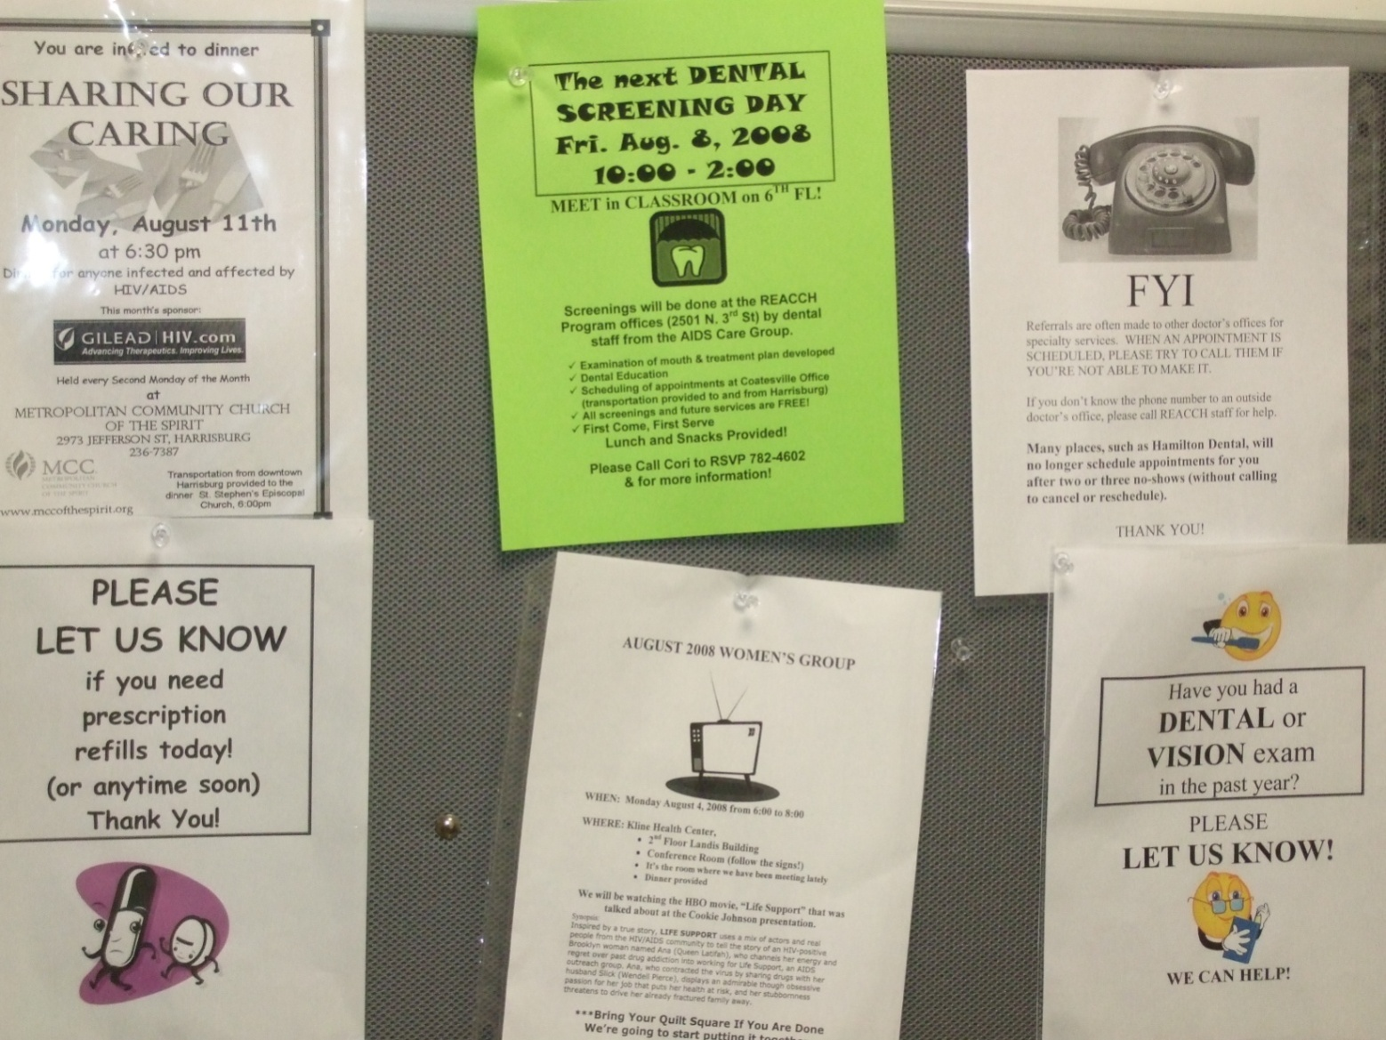

Slide 34
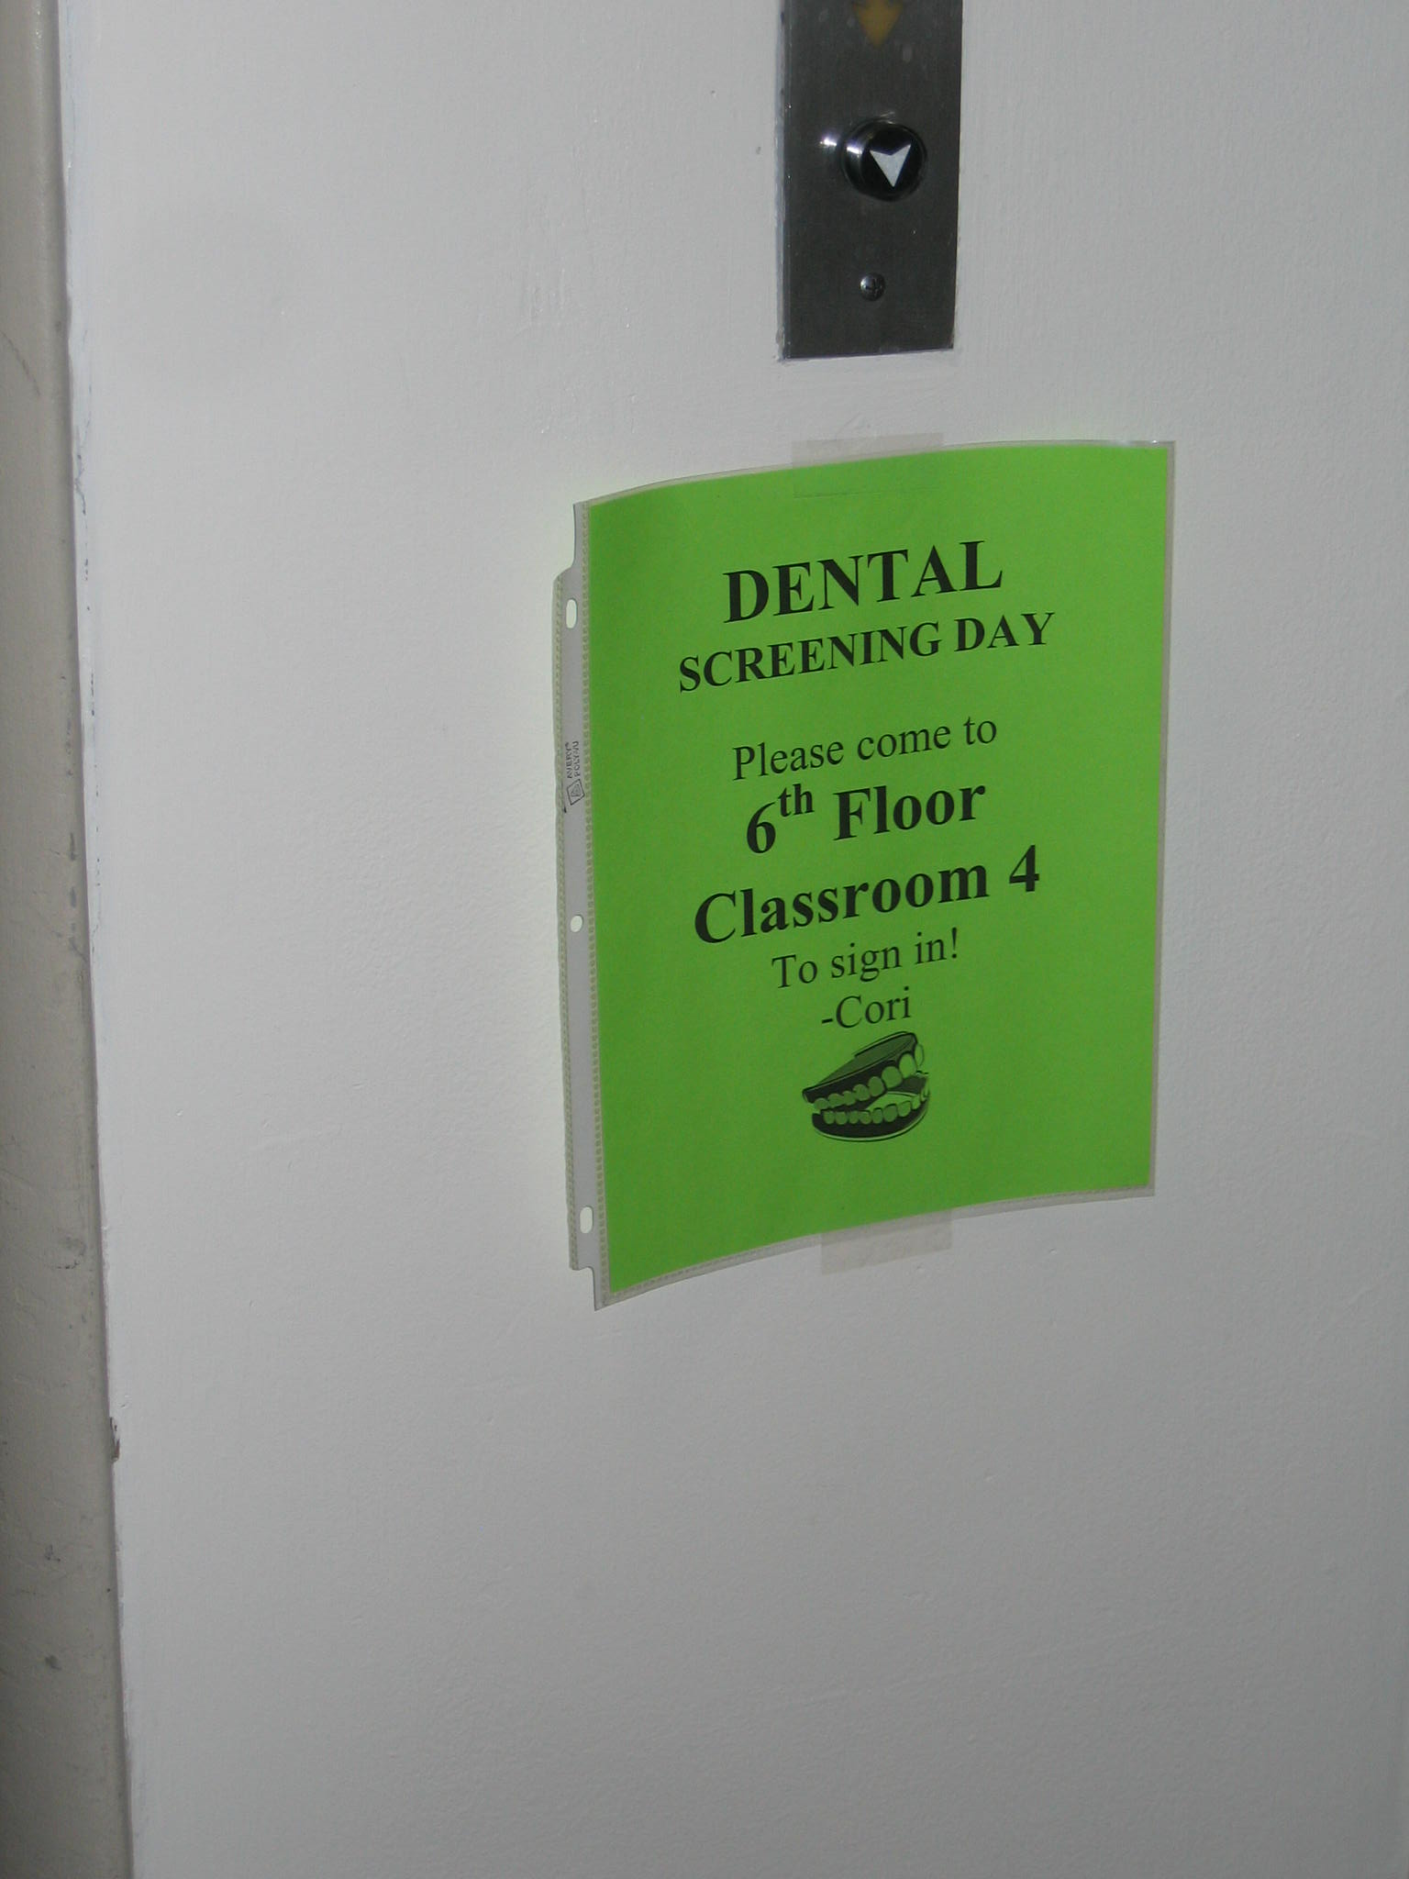

Slide 35
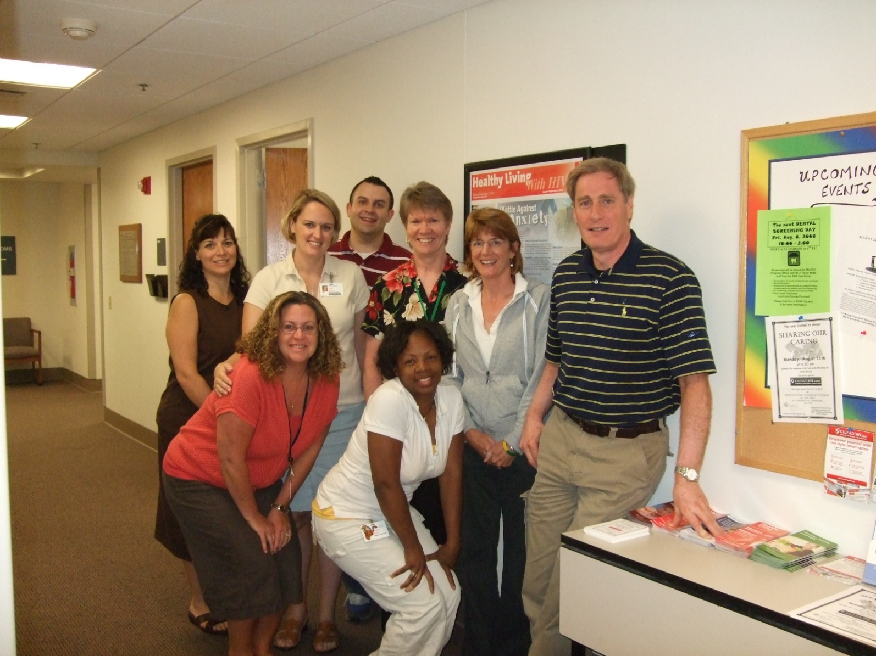

Slide 37
AIDS Care Group
Transportation: New van logged 35,000 miles in first year of operation; exclusively for the dental outreach program.
Food: 500 meals were provided in the first year to clients who spent a full day traveling and receiving dental care.
Staff: Traveled over 2,000 miles in the first year to meet agency staff and clients on their turf to develop linkages into care.

Slide 38
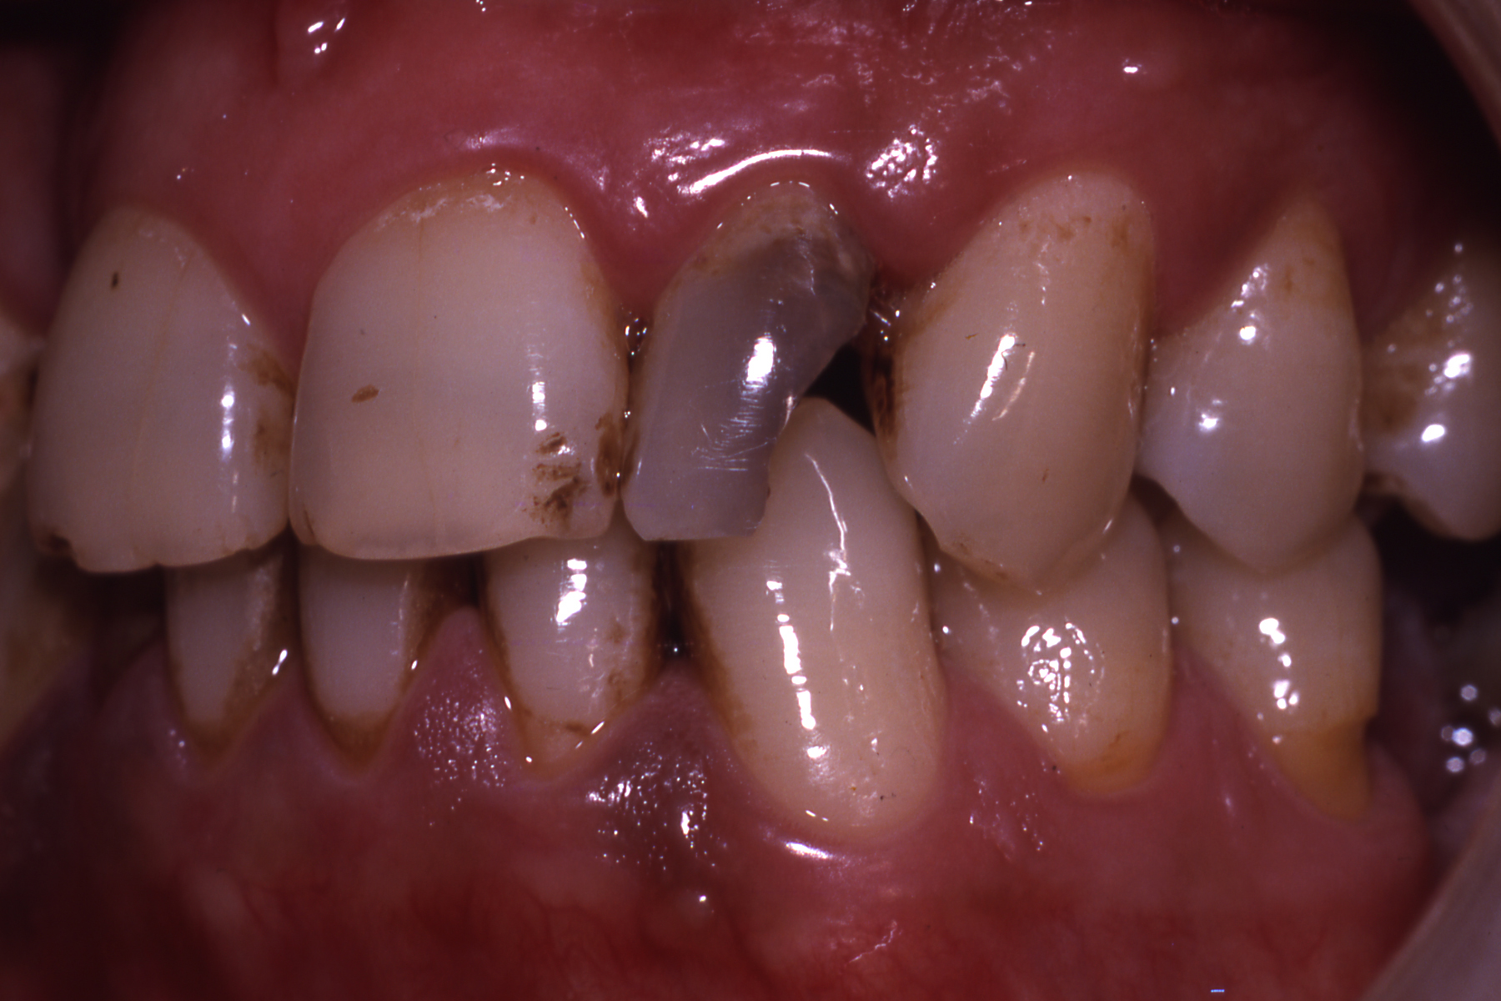

Slide 39
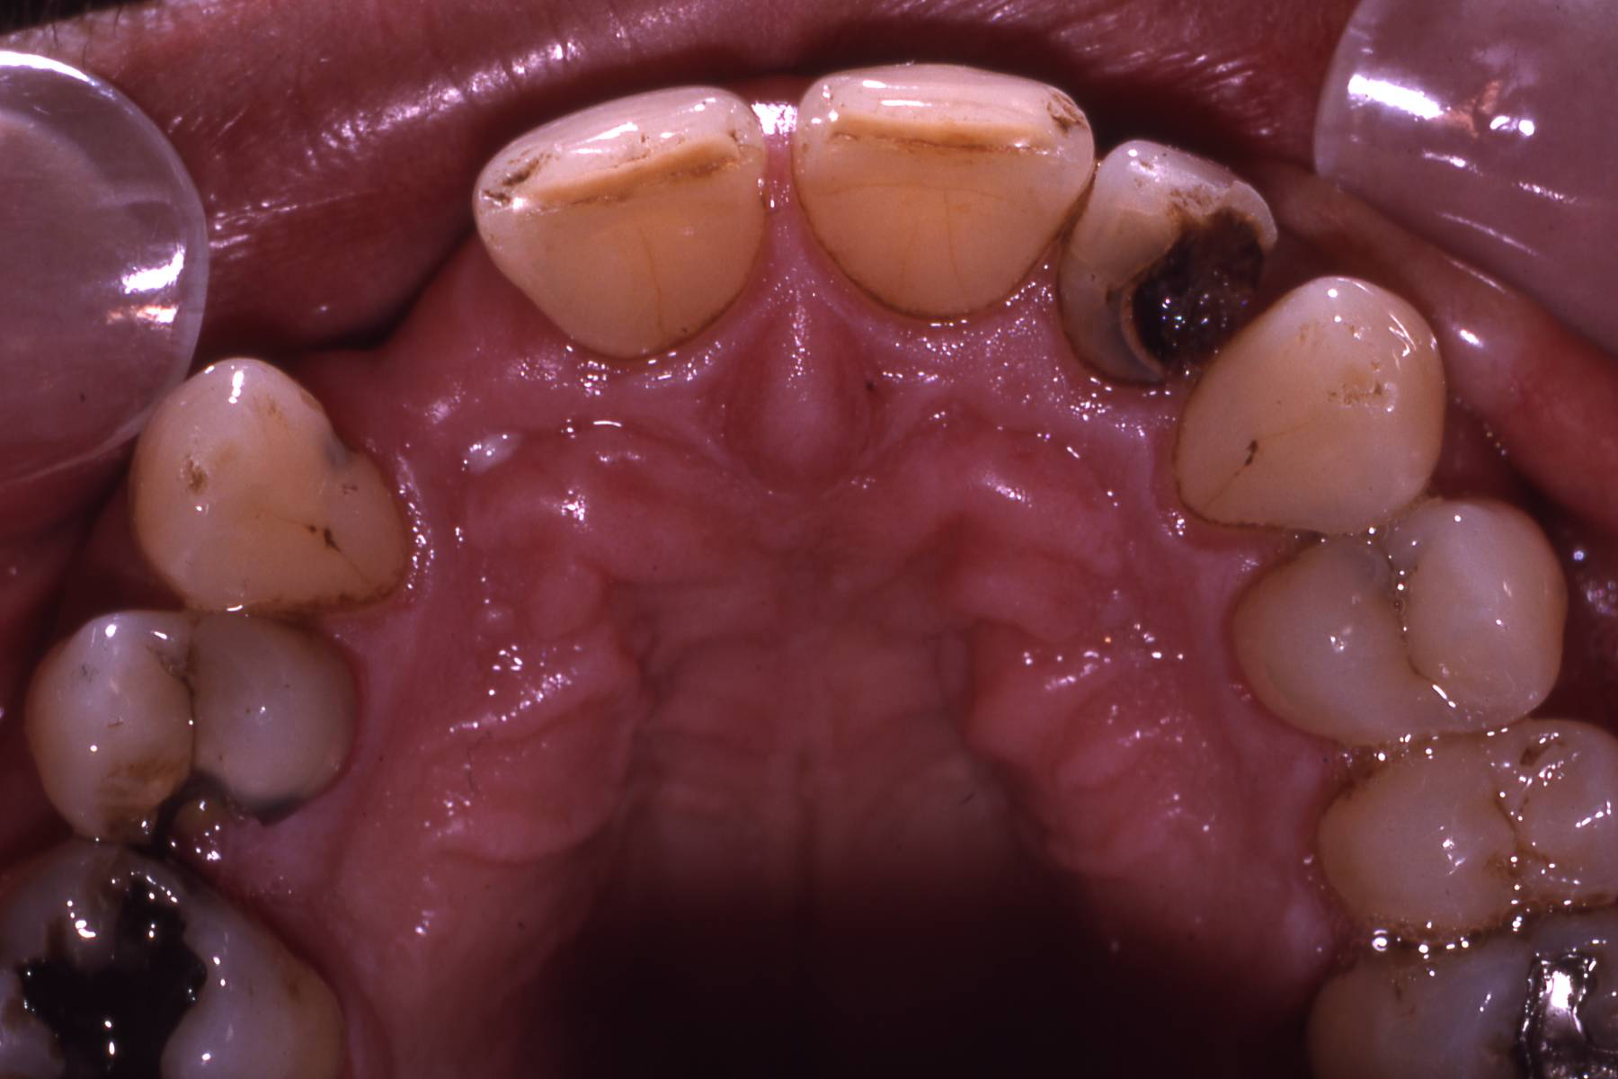

Slide 40
AIDS Care Group
32 y/o white male living with HIV was receiving medical care that could not link him to routine dental services. He was told that the pain from his tooth was due to an abscess, but due to his low platelet count he would need hospitalization for a surgical removal. Fearful of a hospitalization, he asked his case manager to refer him for a second opinion.

Slide 41
AIDS Care Group
Patient had <50 CD4+ cells. Platelet count was 50,000.
Painful tooth was not mobile; there was no fistula; and there was no periapical radioluscency. There was response to the electric pulp test.

Slide 42
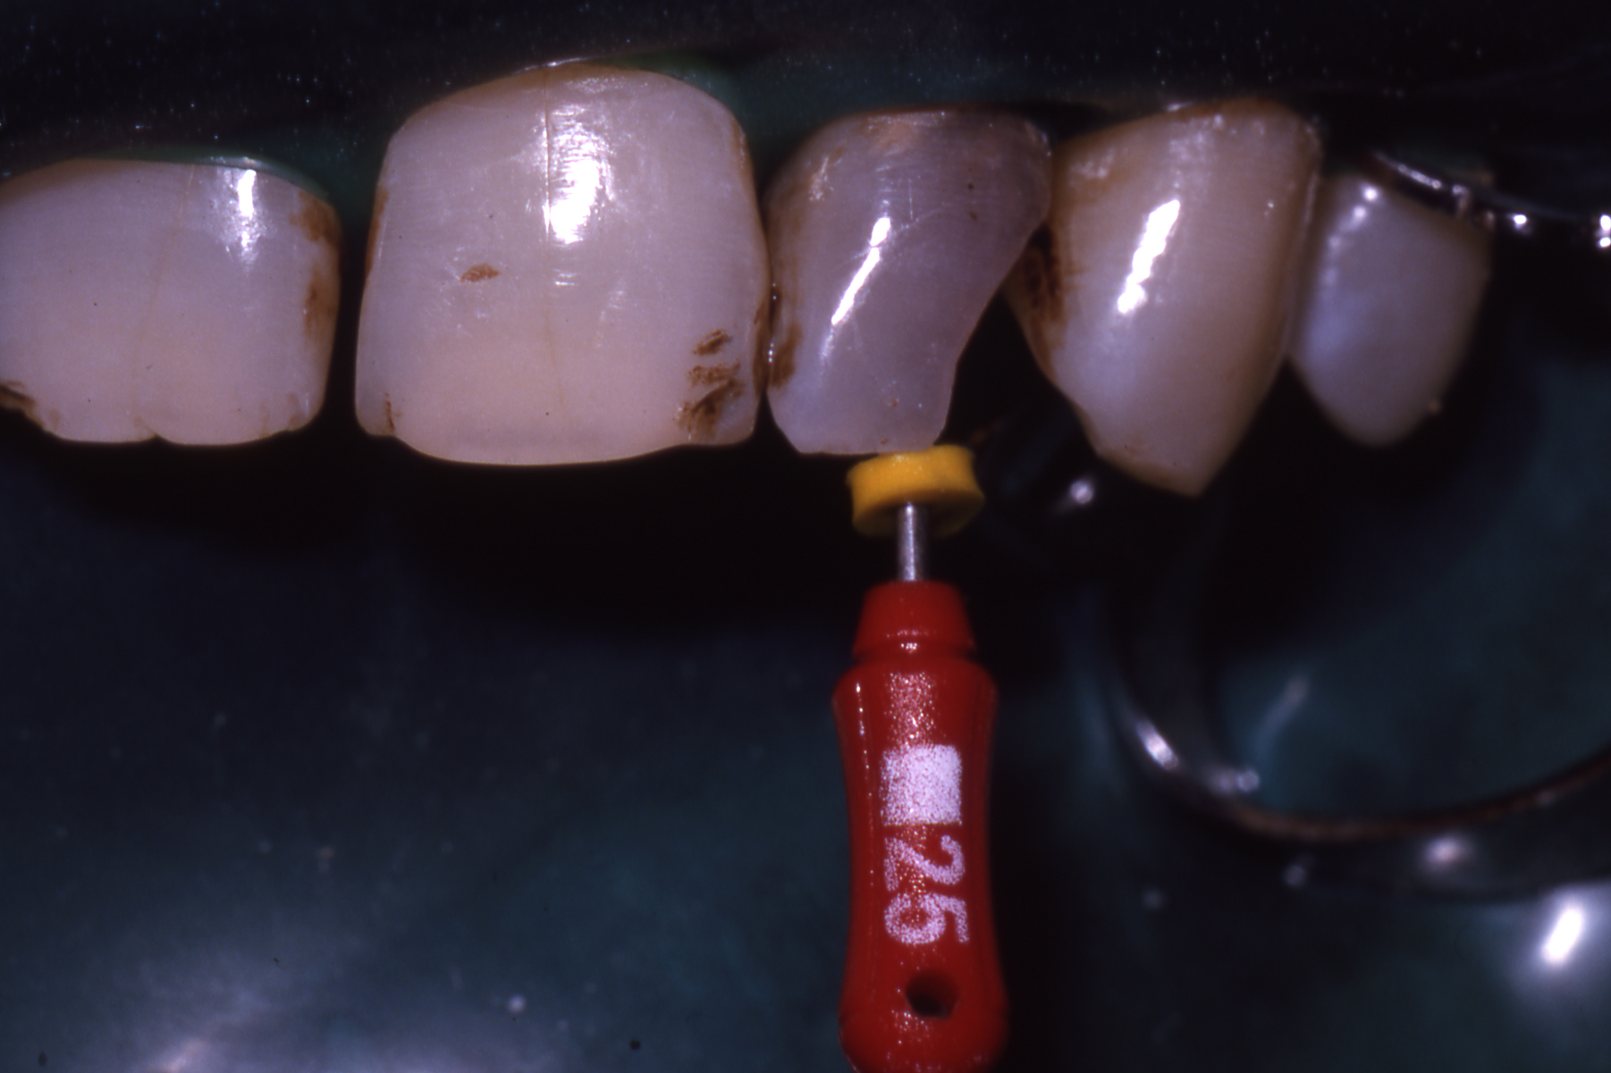

Slide 43
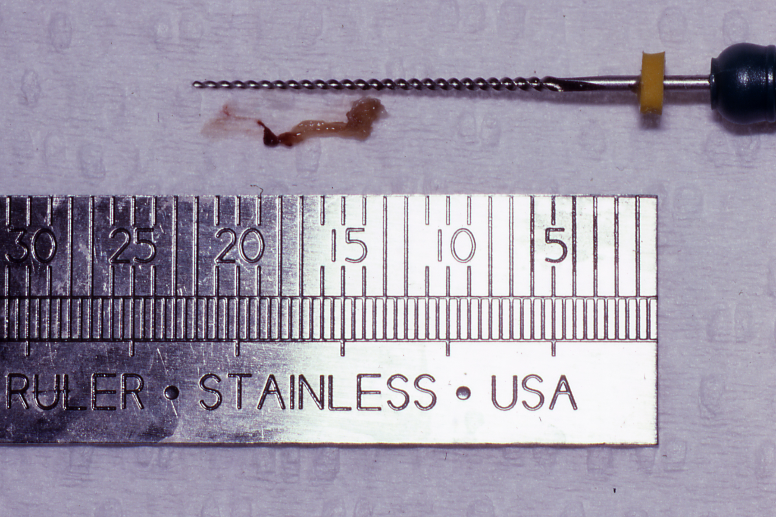

Slide 44
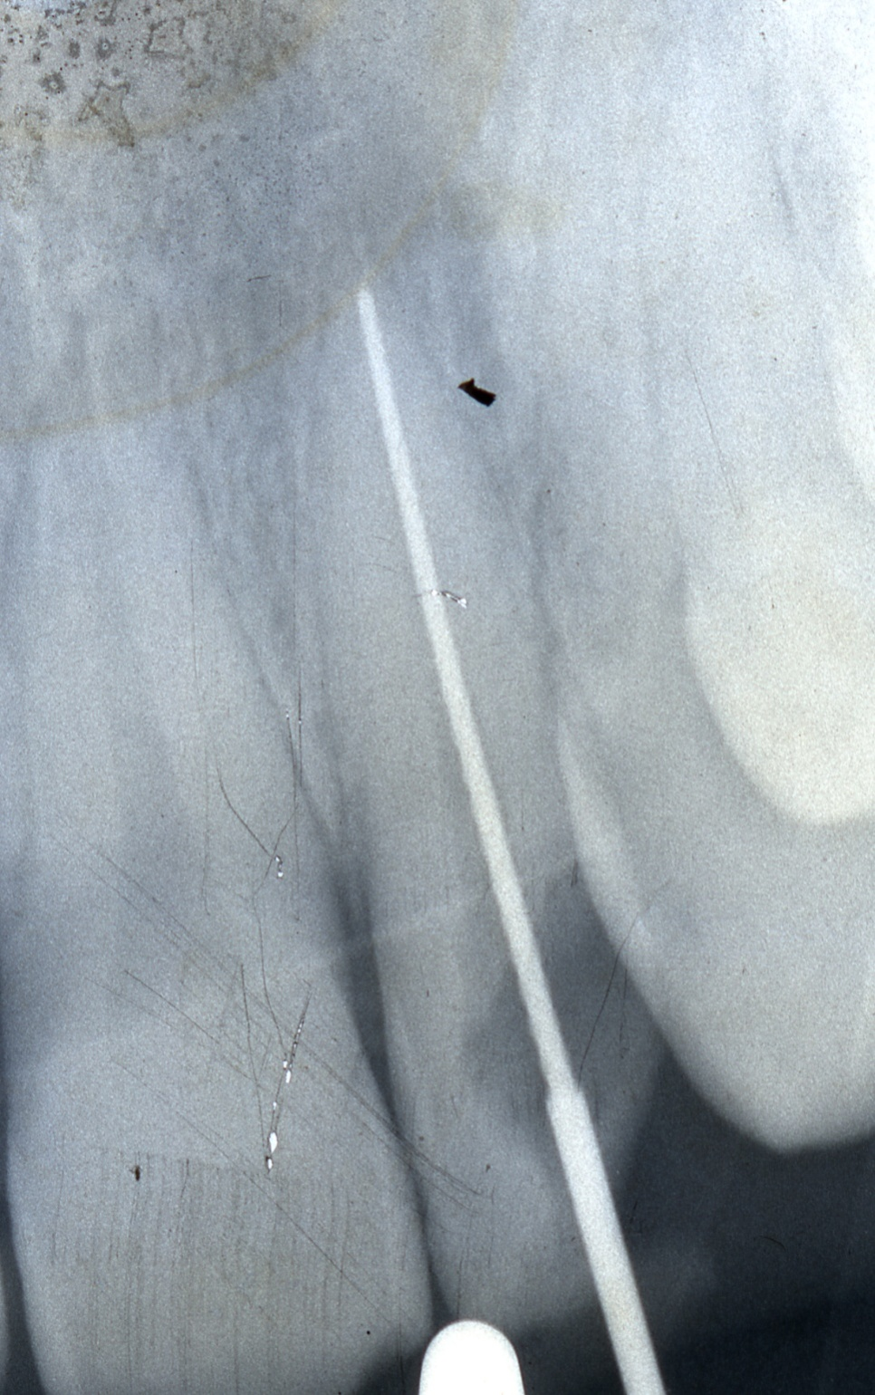

Slide 45
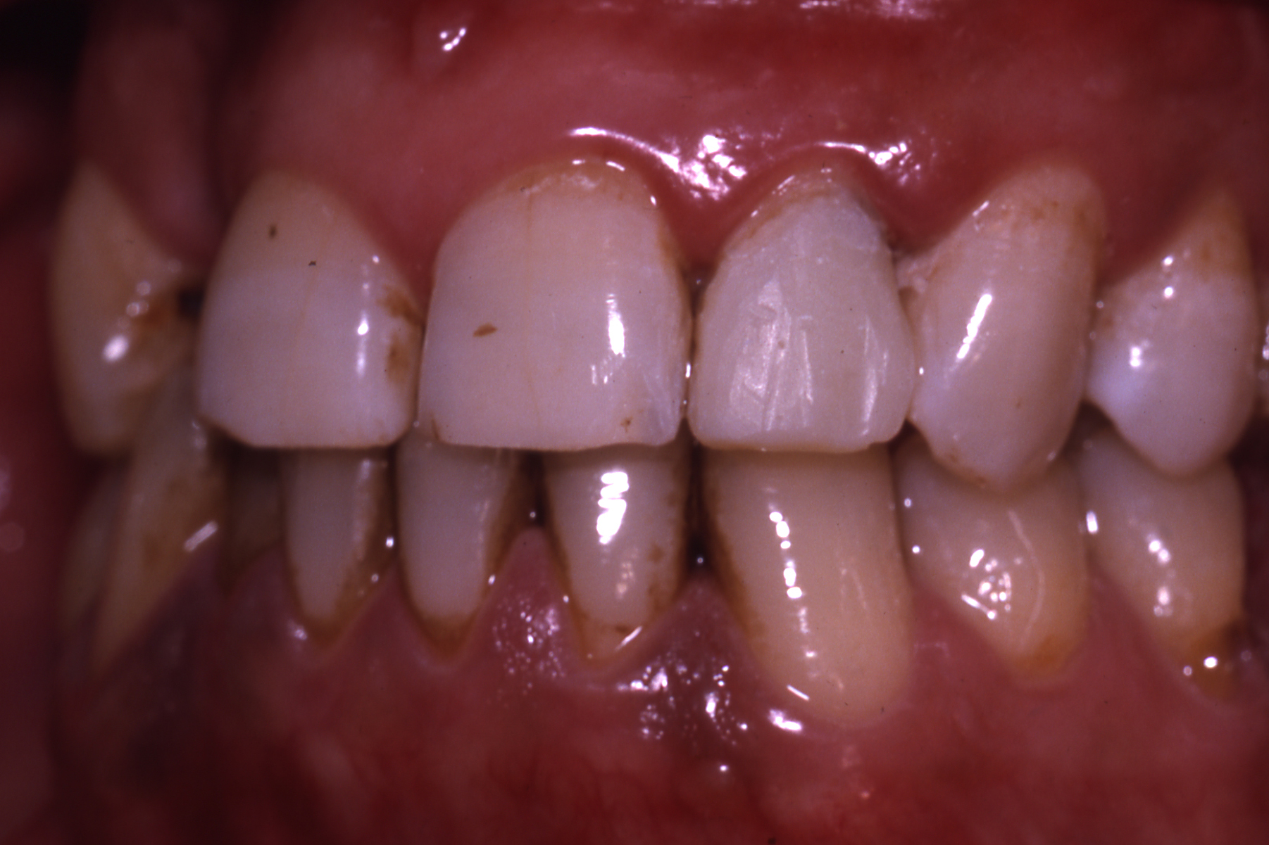

Slide 46
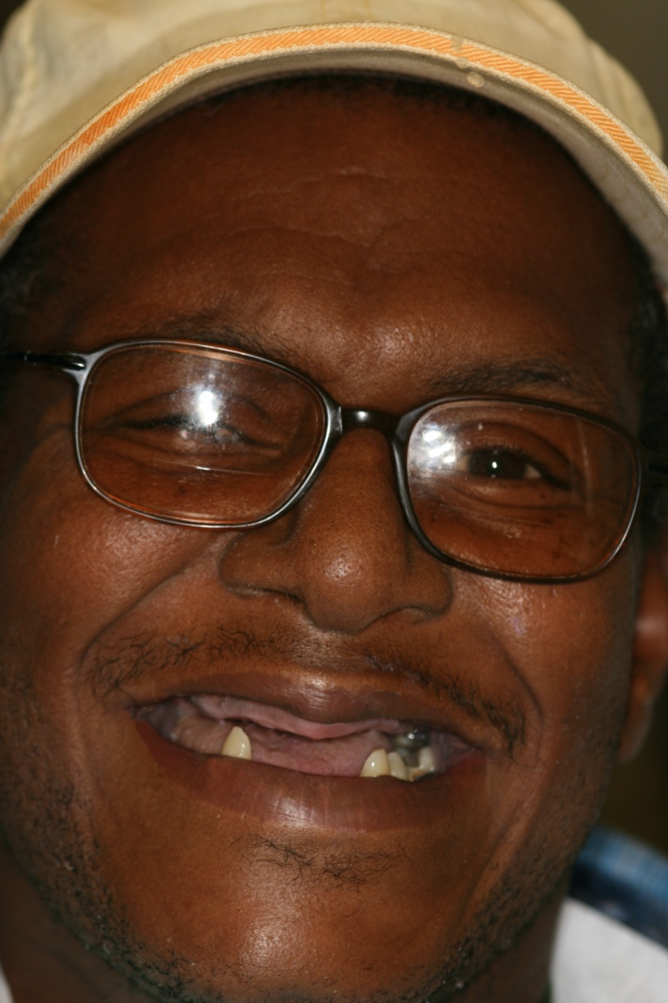

Slide 47
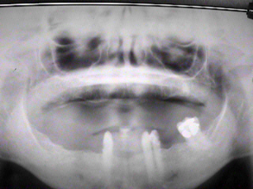
Dental Treatment
Initial Exam
Panorex

Slide 48
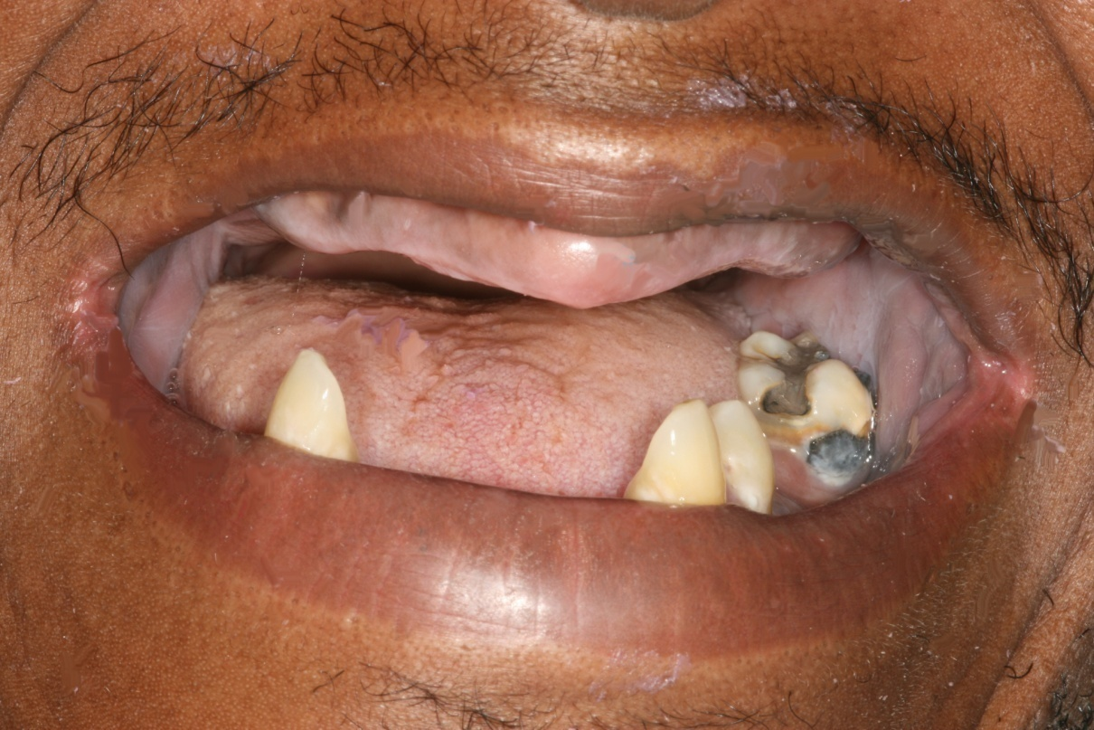
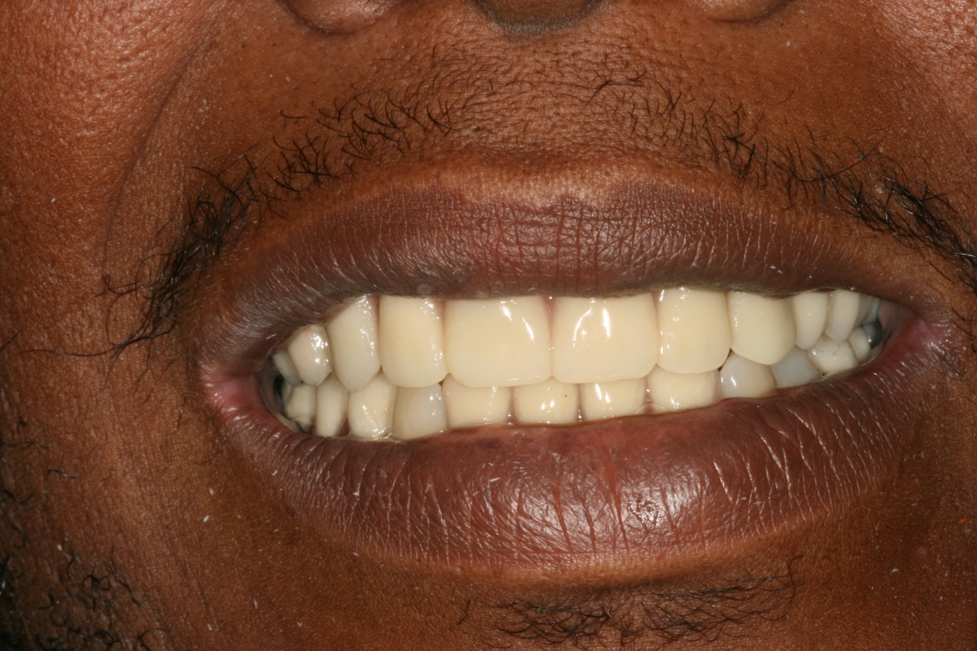

Slide 49
Patient Background
Lives alone in public housing
Handicapped
Patient uses a walker and is unable to transport himself
History of IDU, alcohol, tobacco, and cocaine abuse
HIV diagnoses in 1998 (MSM)
Mental illness and depression
Ostracism from his lifestyles
Inability to find or access services
Poverty

Slide 50
Why is this case important?
Patient has been navigating his HIV disease for 11 years in the presence of addictions, poor living conditions, poverty, and depression.
Within a two year period of time, Medicaid insurance complications caused him to lose access to dental care and then to medical care.
His fee-for-service physician referred the patient to the AIDS Care Group for medical care and services.
Distance to care increased, but transportation services closed that barrier.
HIV under control, but other systemic diseases are not:
Patient has diabetes, metabolic syndrome elements, kidney disease, neurologic syndromes, and history of addictions. These may be his greater worries.

Slide 51
Major DECLINE in the
Implementation Cascade

Slide 52
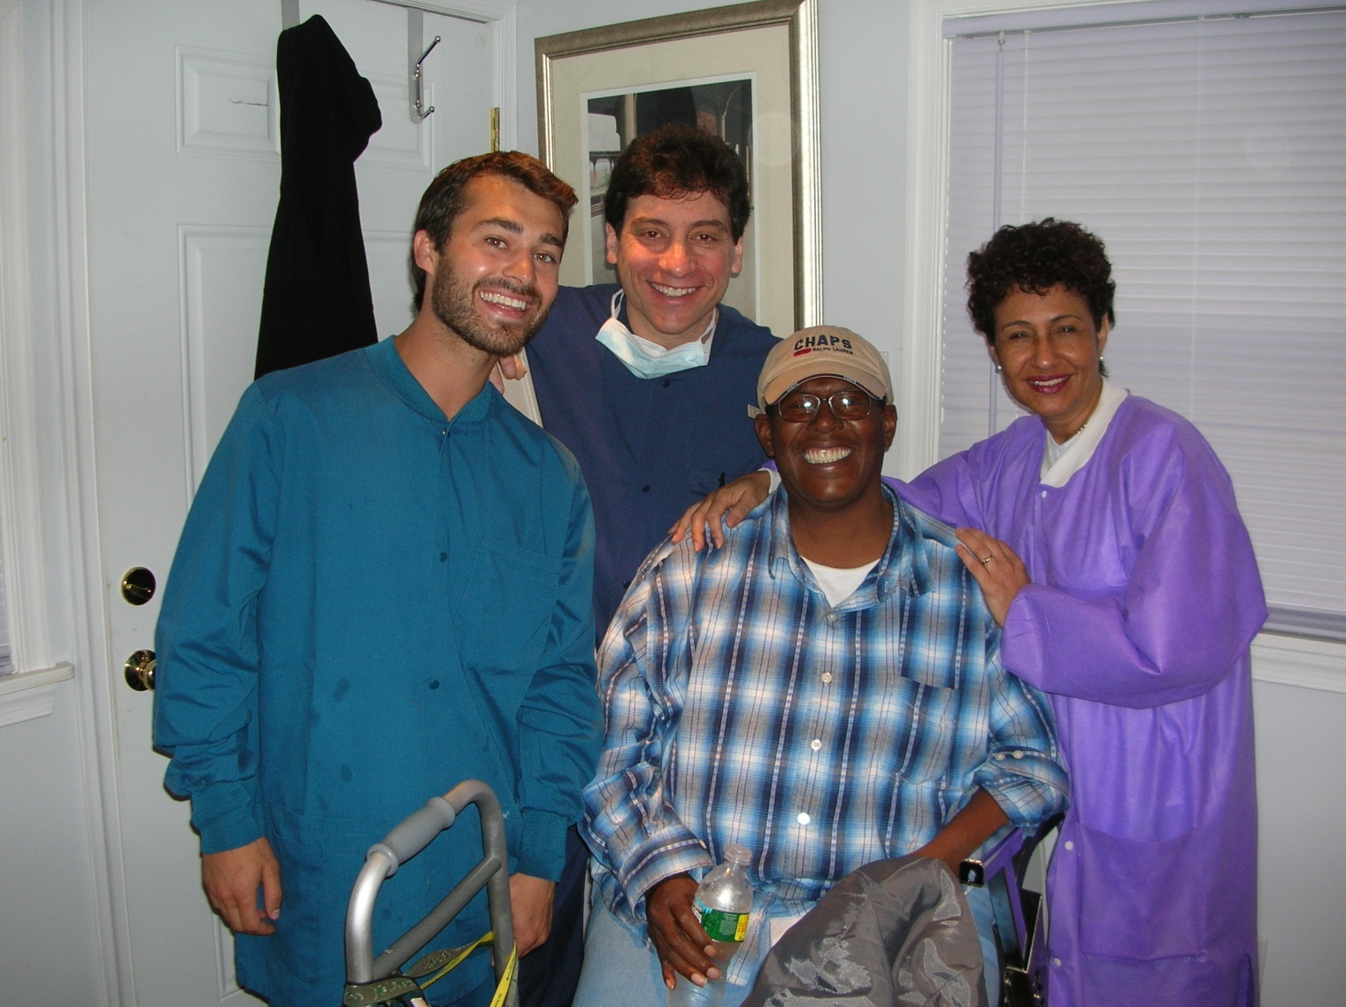
Making a Difference
AIDS Care Group
Medical, Dental, and Social Services in Delaware County, PA since 1998

Slide 53
AIDS Care Group
The AIDS Care Group SPNS project is proving that an open-door policy in a non-judgmental environment is conducive to recruiting patients for care. Continuity in their treatment program is a judgment that they make. Access to care is considered by many to be “the care they need”. By whatever name we call our services, our goal is to remove barriers and install quality care and compassion.

Slide 54
AIDS Care Group
Perhaps these efforts will provide us with more and better clues on how to address people and their behaviors to help individuals and communities strive to better health.

Slide 55
AIDS Care Group
Sustainability

Slide 59
HIV Alliance
Strategies for addressing barriers to care
Transportation
Co-location of services
Care coordination

Slide 60
HIV Alliance
Outreach and retention strategies for engaging patients into care
Methods for retaining patients in care
Strategies for increasing patient self-care

Slide 61
HIV Alliance
Sustainability
What was the plan at the end of the grant
How did it work out
What is the current status

Slide 62
Questions

Slide 63
Contact Information
Jane Fox, MPH | Boston University | 617-638-1937 | janefox@bu.edu
Howell Straus, DMD | AIDS Care Group | 610-389-2301 | howellstrauss@aidscaregroup.org
Amanda McCluskey | HIV Alliance | 541-342-5088 | amccluskey@hivalliance.org
Avi Nath, DDS | SF Dept of Health | 415-355-7528 | avinathdds@yahoo.com

