Slide 1
RWA 0131
Defining, Extracting, and using HIVQual and Meaningful Use in a Patient Centered Medical Home
Amy Sitapati, M.D. Interim Director, Owen Clinic
Barbara Berkovich, MA, Ambulatory Systems Analyst

Slide 2

Disclosures
This continuing education activity is managed and accredited by Professional Education Service Group. The information presented in this activity represents the opinion of the author(s) or faculty. Neither PESG, nor any accrediting organization endorses any commercial products displayed or mentioned in conjunction with this activity.
Commercial Support was not received for this activity.

Slide 3
Disclosures
Amy Sitapati, MD
Has no financial interest or relationships to disclose
Barbara Berkovich, MA
Has no financial interest or relationships to disclose

Slide 4
Learning Objectives
At the conclusion of this activity, the participant will be able to:
List three sources of pre-defined quality metrics.
Discuss human factors that influence how metric data is perceived and acted upon through the use of provider report cards.
Identify novel techniques for reporting/reviewing metric data.

Slide 5

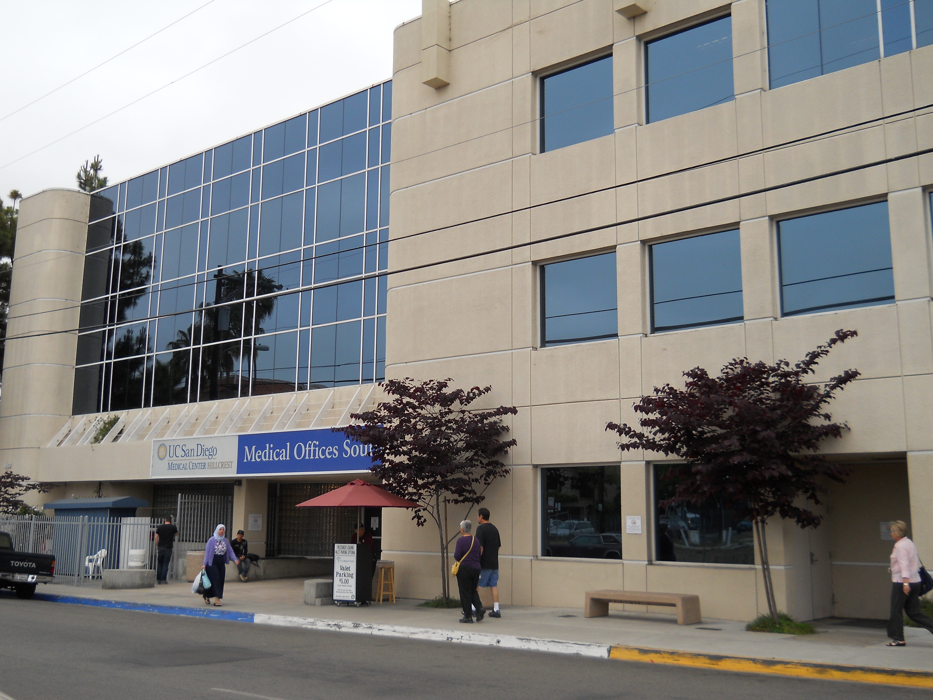


Who are we?
The OWEN CLINIC
University of California, San Diego
20 years of experience
3,000 HIV/AIDS patients
High proportion of Medi-Cal/ Medicare/ RW funding
Funded by California HIV/AIDS Research Program (CHRP) to serve as a pilot center for application of Patient Centered Medical Home in HIV
Site based focus to improve Retention

Slide 6
Who are we?
The OWEN CLINIC
University of California, San Diego
20 years of experience
3,000 HIV/AIDS patients
High proportion of Medi-Cal/ Medicare/ RW funding
Funded by California HIV/AIDS Research Program (CHRP) to serve as a pilot center for application of Patient Centered Medical Home in HIV
Site based focus to improve Retention

Slide 7
CY 2011 OSHPD Patient Discharge Data

Slide 8
San Diego County HIV/AIDS Prevalence
(Living: 12/31/11)
6
Prevalent* AIDS Cases, 2011 Rates per 100,000
 | Male | Female
White | 435.5 | 27.4
Black | 892.2 | 207.1
Hispanic | 421.9 | 53.9
Asian/Other | 97.2 | 17.1
TOTAL | 407.3 | 42.8
Prevalent* HIV (not AIDS) Cases, 2011 Rates per 100,000
 | Male | Female
White | 305.4 | 19.8
Black | 562.5 | 145.6
Hispanic | 245.2 | 32.5
Asian/Other | 76.1 | 8.0
TOTAL | 267.8 | 28.1
*Prevalent Cases: Living at December, 31 2011
Data Source: SD HHSA HIV/AIDS Epidemiology Unit
Epidemiology and Immunization Services Branch

Slide 9
Owen Clinic Patient Demographics
Distribution of Patients by Race/Ethnicity
 | 2011
Race/Ethnicity | # | %
Asian | 69 | 2.2%
Black | 449 | 14.6%
Hispanic | 788 | 25.6%
Native American | 11 | 0.4%
Pacific Islander | 4 | 0.1%
White | 1,572 | 51.2%
Other | 155 | 5.0%
Not Reported | 25 | 0.8%
Total | 3,073 | 100.0%

Slide 10
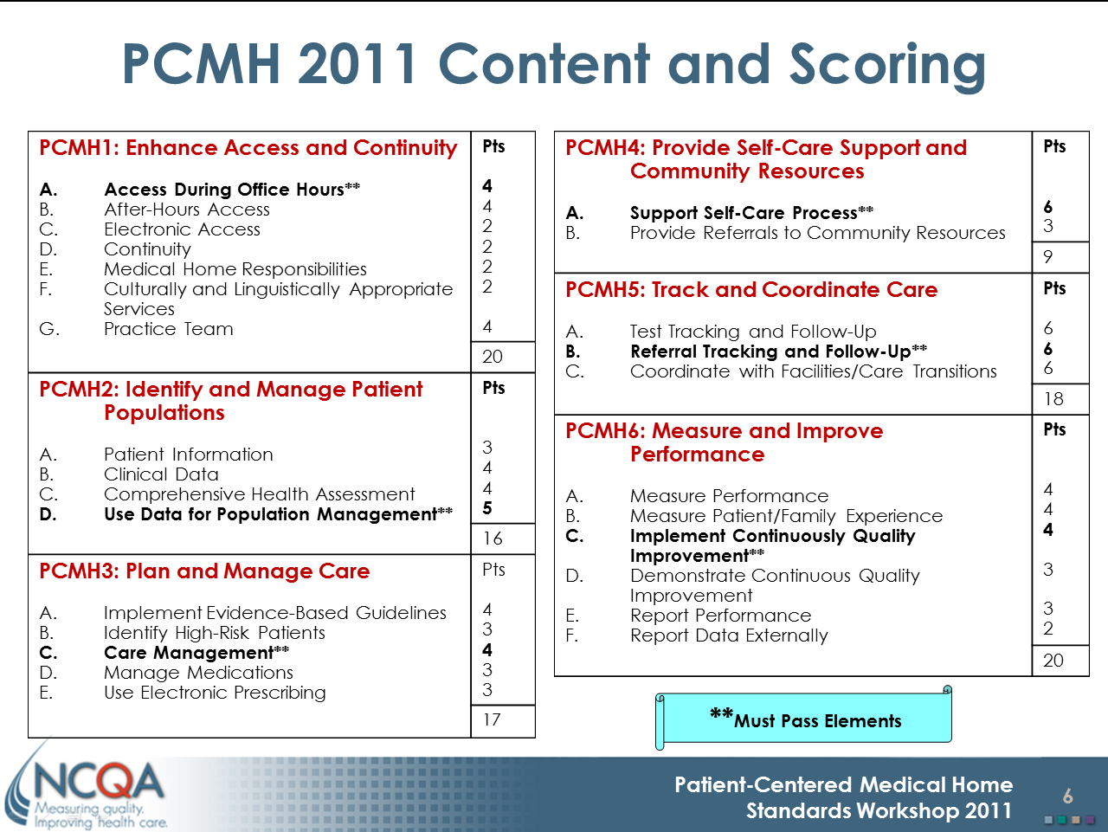
Where do Metrics fit in PCMH Model?
Source: National Committee for Quality Assurance http://www.ncqa.org

Slide 11
Audience Poll
By show of hands:
  In addition to the required reporting for Ryan White,
  how many report provider activities and/or patient outcomes
    Every 6 months?
    Every quarter?
    Every month?
    More often?
  How many of have observed that a reported metric resulted in action creating meaningful change?
  Is that the norm or the exception?
Notes:
Lets give a few examples of what we’re talking about when we say metrics.
Examples include:
Open Overdue Encounters
Number/percent No Show appointments
Number of flu shots given in a season
Surgery patients who received VTE prophylaxis

Slide 12
Opener
We’ve gotten pretty good at putting data into the EHR…
We are really good at analyzing the data we have.
Now we are trying to figure out how to make our reports create a reaction in our organization resulting in measureable improvements…

Slide 13

Learning Objective 1
List three sources of pre-defined quality metrics relevant to measuring PCMH performance
PCMH

Slide 14
Key measures for HIV care
HIVQUAL-US
Indicator Comparison
2011
Amanda Bowes, NYSDOH AIDS Institute
Thursday, May 24, 2012
  https://www.ehivqual.org/scripts/HIVQUAL%202011%20Measures%20Comparison.pdf

Slide 15
Key Players
Organization | Population
HRSA HIV/AIDS Bureau (HAB) | Ryan White Grantees
HEDIS | Health payor plans General primary care
JCAHO | Certifying Organization for quality and safety in health care delivery
Centers for Medicare and Medicaid Services (CMS) Meaningful Use (MU) Physician Quality Reporting Initiative (PQRI/PQRS) Accountable Care Organization (ACO) | Medicare/Medicaid providers
National Quality Forum (NQF) | Contracted by DHHS to establish a portfolio of quality and efficiency measures

Slide 16
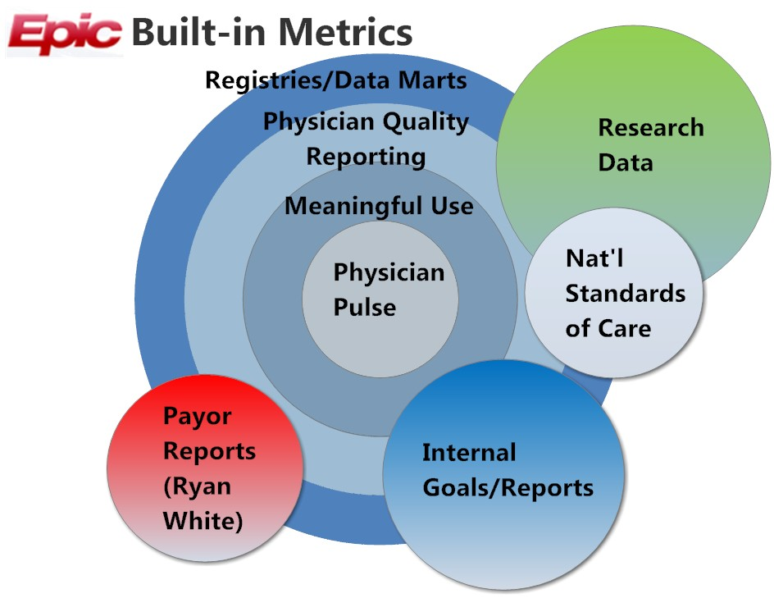
HIVQUAL/HAB
CMS PQRS

Slide 17
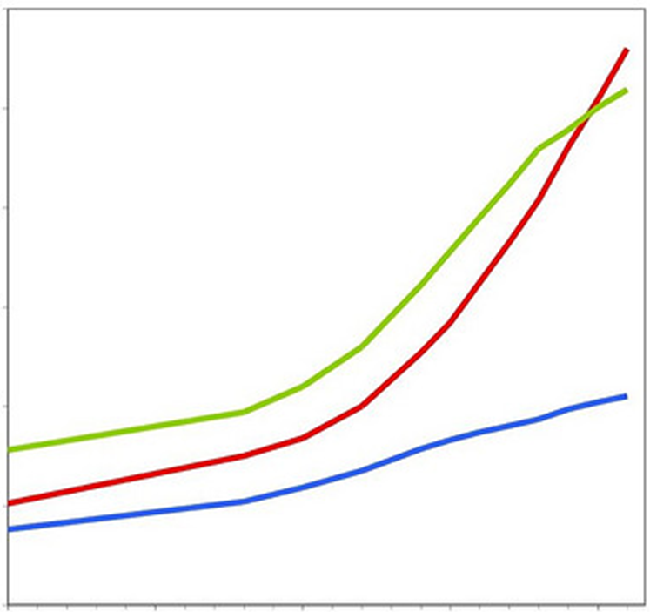
Plan your metrics program
Level of Difficulty
Research
Payor
Internal
Number of Metrics Requested
Notes:
Barbara Speaks

Slide 18
Example 1 Meaningful Use (First Year)
Metrics were pre-built in Epic EHR
The Decision Support Group turned on reports
Owen Clinic reviewed overall performance of its providers

Slide 19
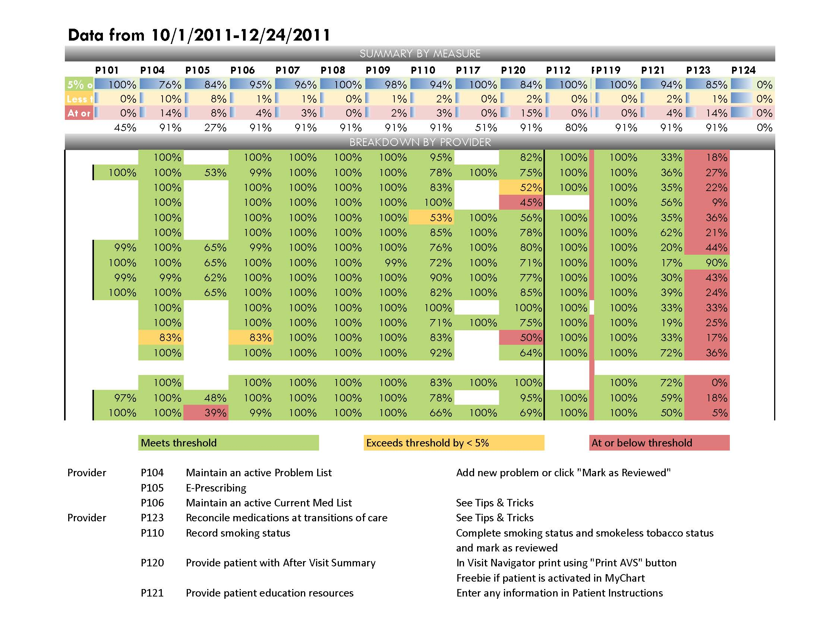
Baseline Meaningful Use January 2012 report
Widespread problem meeting measure P123 - Physician marks meds reviewed
Notes:
Meaningful use: very helpful to get everyone aligned within 3 months; clinic level added additional strength

Slide 20
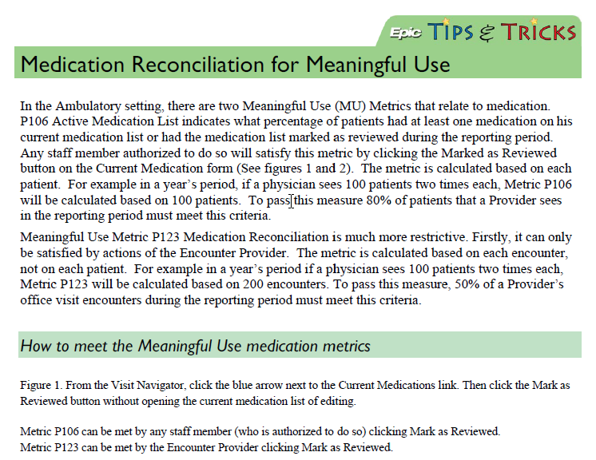
Intervention – Tip Sheet and Demonstration
Notes:
Meaningful use: very helpful to get everyone aligned within 3 months; clinic level added additional strength

Slide 21
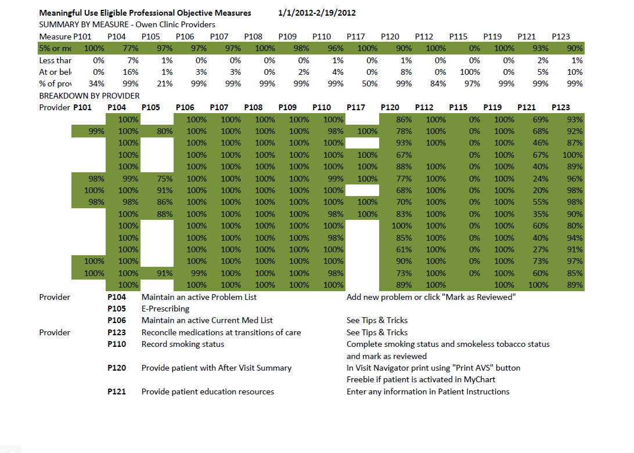
Meaningful use March 2012 report
All measures met by all eligible providers

Slide 22

Example 2 PQRS

Slide 23
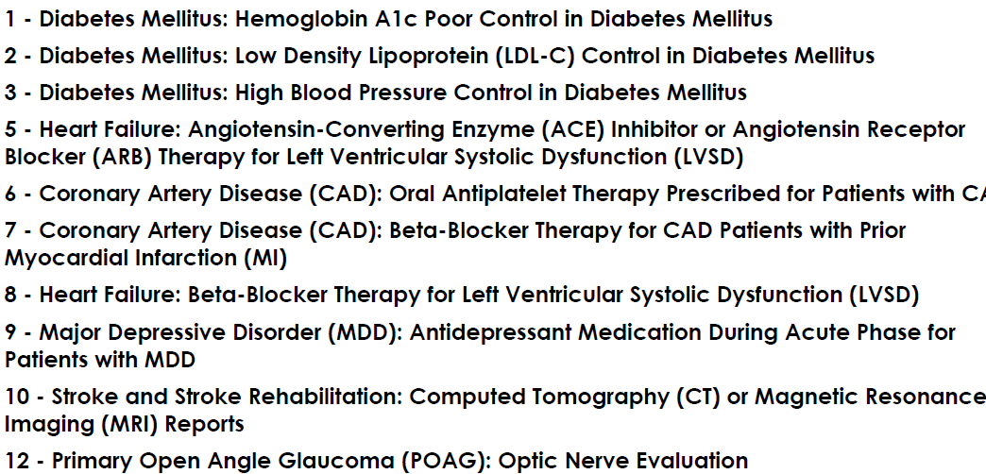
Physician Quality Reporting – Sample Metrics

Slide 24
Physician Quality Reporting – At Owen

Slide 25
Summary
Metric Data is requested for many reasons
Data requests can be overlapping
Some EHR systems produce metrics automatically
There’s a challenge matching metric request to pre-built metrics in commercial EHRs

Slide 26
Learning Objective 2
Discuss human factors that influence how metric data is perceived and acted upon through the use of provider report cards.

Slide 27
Audience Poll
By show of hands:
  How many think publishing the numbers is enough to produce change?
  How many think individuals should be held accountable for metrics (what does that really mean?)
  How do you think clinicians feel about having their quality data presented among their peers?

Slide 28
Provider Report Cards
Purpose
      Improve patient care and compliance with national HIVQual standards of care for HIV+ patients.
    Process
Create a report card for each provider that will compare his or her percentage of patients meeting national standards to clinic and national results.
The first provider report card (RPR) was created and distributed in December 2011.
with positive PPD or Quantiferon results who are prescribed INH
with high grade cervical or anal pap results who receive subsequent procedures
who tested positive for an STD and received appropriate treatment
who tested positive for Hep C and received appropriate treatment or follow
    Measurement
2011 HIVQual standards will be compared to 2010.

Slide 29
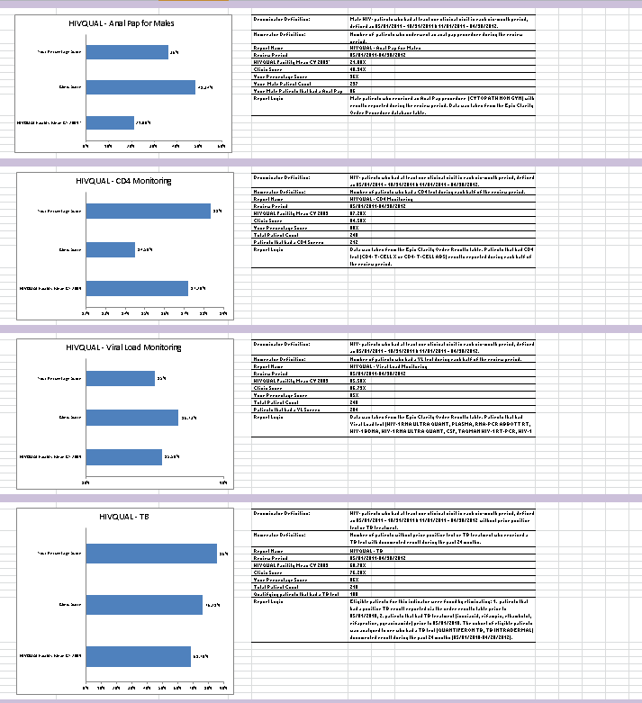
Individual Provider Quality Indicator Report Cards
64
16 HIVQUAL Indicators
Each indicator chart contains
  Provider score
  Clinic score
  HIVQUAL CY 2009 mean score
The indicator sidebar contains
  Indicator definitions
  Provider’s total patient count
  Provider’s compliant patient count

Slide 30
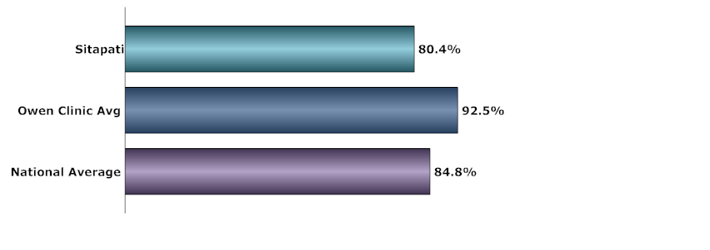
Provider report cards based on HIVQual measures … circulated by email
Notes:
What about the system impact; is the system the problem or the solution; there is a human element to reach that goal; how can a changed system help reach that goal.

Slide 31
Learning Objective 3
Identify novel techniques for reporting/reviewing metric data.

Slide 32
The Human Side
The Human Side – Amy Sitapati, MD
Building your team…
When the data you need isn’t already there
Using clinical metrics to improve health measures
Using performance metrics to change behavior
Notes:
Switch to Dr. Sitapati

Slide 33
Our Team
Grant team
  PI – Clinical Champion
  Reporting Analyst Clarity Certified
  Epic Analyst Ambulatory & MyChart Certified
  Research Analyst
Extended team
  Decision Support Team Clarity & Reporting Workbench
  Security Team
  Orders Team
  Epic TS
  Subject matter experts (Clinicians, PharmDs)
  CQI Team for pilot clinic
  Patient advisory board

Slide 34
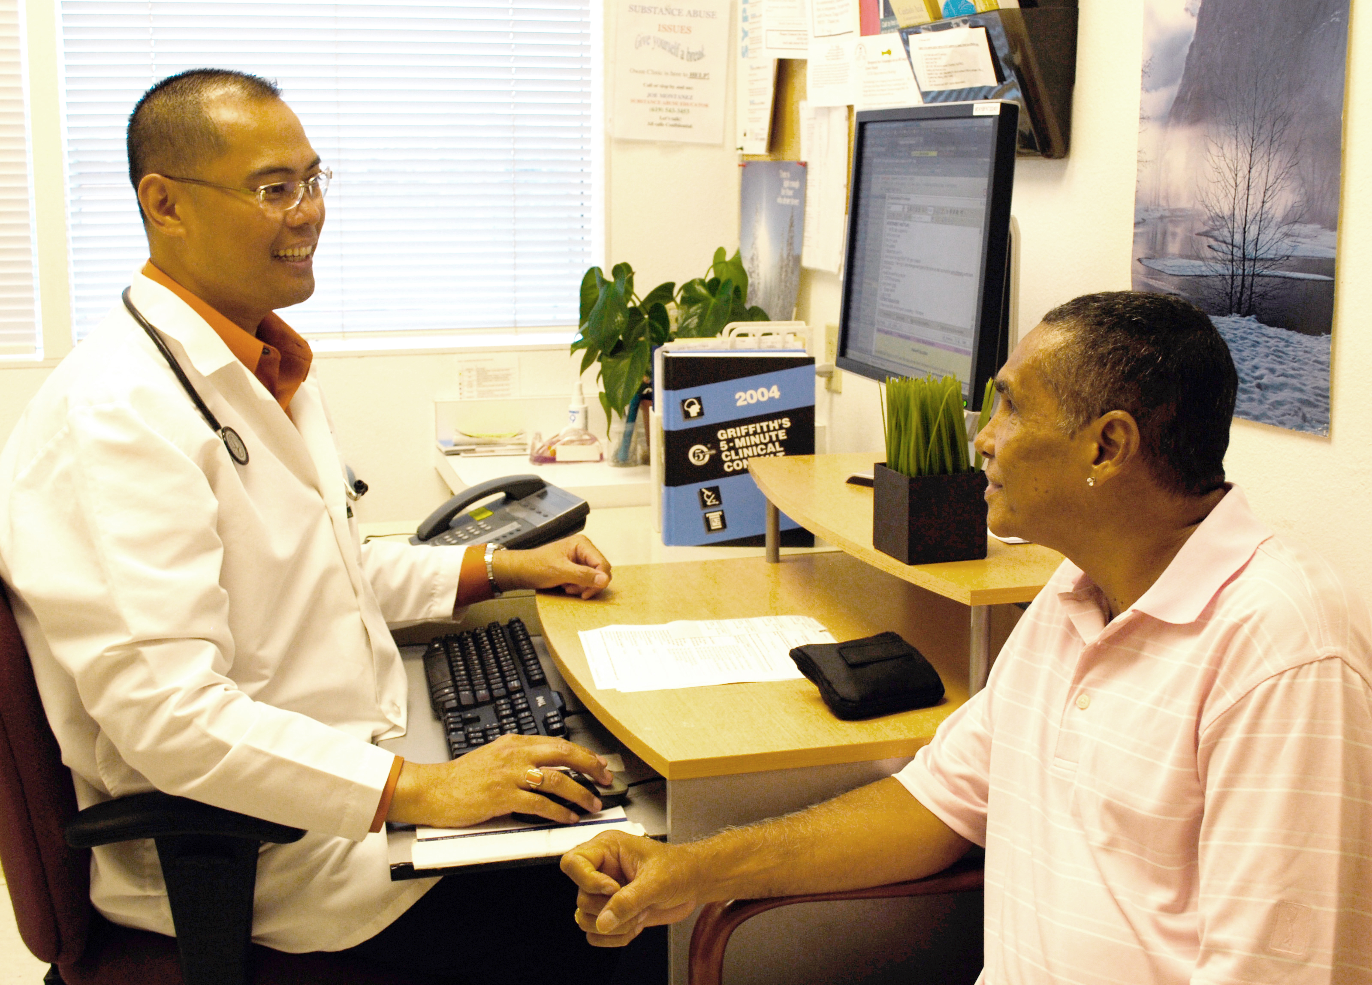
Clinical Metric Model
Clinical Performance
Patient satisfaction
Compliance/Billing
Meaningful Use
Patient
Demographics
Acuity
Epic System Performance
Response time
Decision Support
Click counts
Cognitive load
Provider Performance
EMR use
Standards of Care

Slide 35
Clinical Metric Categories
Health Measures
Panel Management
Patient Descriptors
Patient Engagement
Performance – Clinic
Performance – Provider
Performance – Staff
Performance – System
Referral Management
Notes:
We have mandatory reporting requirements; how it is possible to use ACCESS database to make the relationships of the MAP about the data; show the snapshot

Slide 36
Assess measures in context
Office visit activity only a portion of physician activity

Slide 37
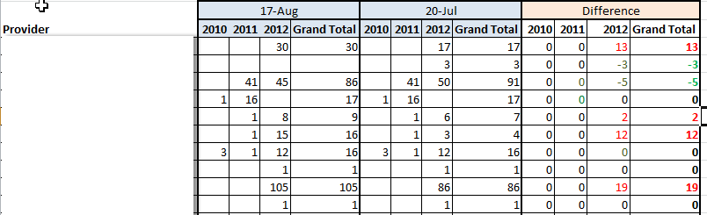
View Trends Over Time
Example: Open Overdue Encounters Reports
Current Month Previous Month Green (fewer)
Red (more)
Notes:
OOE: its killing me! Continues to be a struggle; for those close/easy and done (helps) for those far from goal (not enough)
Bad: test ordering utilization….Good: confidential disclosure

Slide 38
Looking toward the future
Reporting used to be exclusively retrospective.
With Registry, we are building tools to impact standards of care in the office visit with concise Clinical Summary reports
And creating a Panel Management program where groups of patients are managed with bulk actions
Notes:
Ans: All of the above
Refer to handout for specific of best match

Slide 39
Registries/Data Marts
This is the hardest, but the most exciting
Registries live in Hyperspace, and organize a snapshot of critical data for a population group (like diabetics, asthmatic, etc), to make reporting of clinical data quicker and easier.
Data marts contain registry data, but reside outside Hyperspace. The Data Marts can help your reporting team create population reports more easily, quickly, and more consistently than writing multiple individual reports.

Slide 40
Summary
To build a strong metrics program, you need an interdisciplinary team
Your metric program will likely have a mix of required metrics, and custom calculations
The closer you are to the metric the easier it is to move
When metrics don’t move, you need to look beyond individual motivation and training, and look at possible workflow and system causes

Slide 41

Thanks to the OWEN ANCHOR TEAM:
Moira Mar-Tang
Pavel Tseytlovskiy
Susan Benson
Dorothea Northcutt
Jan Limneos
Dr. Chris Mathews
CQI committee
The California HIV/AIDS Research Program; Award number: MH10-SD-640

Slide 42
Photo credits
The Owen Clinic ©2012 by Moira Mar Tang with Permission
Clinical Metric Model slide
Doctor patient interaction ©2012 by Moira Mar Tang with Permission
Population Growth and Income Level Chart by Matt Lemmon
http://www.flickr.com/photos/mplemmon/3202553069/
Reproduced under Creative Commons License
http://creativecommons.org/licenses/by-sa/2.0/deed.en

Slide 43
THE END
Thank you

Slide 44
Obtaining CME/CE Credit
If you would like to receive continuing education credit for this activity, please visit:
http://www.pesgce.com/RyanWhite2012

