Slide 1
Guidance to Achieve NCQA Patient Centered Medical Home Recognition
Ayesha Mirza, Melissa Scites, Mobeen H. Rathore
University of Florida Center for HIV/AIDS Research, Education & Service (UFCARES)

Slide 2
Disclosures
This professional activity is managed and accredited by Professional Education Service Group. The information presented in this activity represents the opinion of the authors. Neither PESG nor any accrediting organization endorses any commercial products displayed or mentioned in conjunction with this activity
Commercial support was not received for this activity
The authors have no relevant commercial relationships or interests to disclose

Slide 3
LEARNING Objectives
At the end of this discussion the participant will be able to:
Define the meaning and purpose of a medical home
Express why practices need to consider medical home recognition
Demonstrate the steps required to achieve medical home recognition
Differentiate a medical home from a general practice
Analyze the differences between the two

Slide 4
New Vision for Quality Health Care
Care based on continuous healing relationships
Customization based on patient needs and values
The patient as the source of control
Shared knowledge and the free flow of information
Evidence-based decision making
Safety as a system property
The need for transparency
Anticipation of needs
Continuous decrease in waste
Cooperation among clinicians
Crossing the quality Chasm: A New Health System for
the 21st Century (IOM, 2001)

Slide 5
Consumer Perspective
Patients value well-organized and coordinated experience with their doctor
Most important factor – physician’s ability to communicate and show a caring attitude (Robinson & Brodie, 1997)
Performance “Opportunities”
Staff/doctor returns calls in a timely manner
Staff/doctor follows up with a phone call
The doctor is familiar with the patient’s medical history
The doctor is good at diagnosing and treating any problem

Slide 6
What is a medical home?
Based on a concept that facilitates partnerships between individual patients and their personal physicians and when appropriate the patient’s family
Ensure that patients participate in their care side by side with their medical providers
Ensure that patients get the care they need, where and when they need it, and in a culturally and linguistically appropriate manner

Slide 7
Patient Centered Medical Home (PCMH) Principles
Personal Physician
Physician directed medical practice
Whole person orientation
Care is coordinated or integrated
Quality and safety are hallmarks
Enhanced access to care

Slide 8
Helping Primary Care Practices Transform Health Care
“The Patient-Centered Medical Home is a
model of 21st century primary care that
combines access, teamwork and technology to
deliver quality care and improve health.”
Margaret E. O’Kane, President, National
Committee for Quality Assurance (NCQA)

Slide 9
NCQA PCMH Recognition
A nationwide program that recognizes physician practices functioning as medical homes
Comprehensive & extensive assessment of medical home standards within the practice to demonstrate performance
Survey tool to assess readiness and document processes, procedures, reporting & tracking capabilities via policies, system screen shots and sample documentation and follow-up
Level 1, 2, or 3 Recognition
3 year Recognition Status

Slide 10
Must Pass Elements (2011)
Standard 1A: Access During Office Hours
Standard 2D: Using Data for Population Management
Standard 3C: Care Management
Standard 4A: Self-Care Process
Standard 5B: Referral Tracking and Follow-Up
Standard 6C: Implement Continuous Quality Improvement Process

Slide 11
Why PCMH??
Continued Emphasis on Improving Quality and Reducing Costs
Potential greater reimbursements and cost savings by health plans
Medicaid programs considering implementing some type of PCMH demonstration
Improved Health Outcomes for Patients

Slide 12
UF CARES Experience
Purchased Survey Tool in December 2010
Review of Materials and Standards began in January 2011
Incorporated PCMH evaluation into monthly Clinical Effectiveness Group Meetings
Feb-May: Started meeting twice a month, then hit roadblock with accessing EMR reports, and progress slowed
June : Met with organizational leaders and gained support to utilize system resources to provide required reporting.
June-present: detailed review of each element uploading hundreds of pages of documentation and screen shots to demonstrate performance
Required hard look at current processes and need for system changes and improvements
Submission Goal: July 2011
Concurrent challenges: undergoing EMR transition and provider changes
Difficult to implement new policies and procedures during period of instability
Strengths: buy-in and support from senior leadership, participation and interest in process from all staff disciplines

Slide 13
where to start??
Go to website: www.ncqa.org
Take time to review &understand concept
Download Standard & Guidelines (free)
Download Application (free)
Purchase Survey Tool ($80)

Slide 14
Next steps….
Understand what you want to accomplish
Do you have capacity and resources?
Communicate with your senior leadership and staff – get buy in!
Identify Project Team
5-9 key staff
1-2 “champions” with 1 being project leader
Patient/Peer Advocates/CAB?
Develop Timeline, Set Goals for Completion

Slide 15
Be Prepared for…
Rigorous and Lengthy Process
Transformation with need to develop, change and improve processes
Possible Resistance to Change
Challenges with Commitment, waning enthusiasm, competing priorities
Other administrative barriers – contractual issues, IT support

Slide 16
Tips for success
Be realistic on timeline, don’t be too ambitious so team is not overwhelmed
Be thorough in your review of guidelines, participate in available trainings
Meet regularly, make it a priority
Communicate regularly with entire staff focusing on benefit of achievement
Celebrate milestones and progress

Slide 17
 |  |  | Pts possible | Pts Earned | Target Completion Date | Completed | Comments/Linked Documents/Pending Information
Survey Tool Purchase |  |  |  |  | 11/24/2010 | 11/24/2010
NCQA Application |  |  |  |  | 7/11/2011
Business Associate Agreement |  |  |  |  | 7/11/2011 |  | 6/13/11 - downloaded and submitted to Contract services
General Agreement/Contract |  |  |  |  | 7/11/2011
Standard 1: Access and Communication
 | Element A - Access and Communication processes** |  | 4 | 4 | 5/1/11 | 100% | Policy – Completion of Appointment Requests (Pt Online) Patient Online web screen shot and copy of brochure Policy – Continuity of Care SOP – Patient Scheduling & POC Coord (PPC1A_2F_3E) Policy – Telephone Triage Policy – After Hours Answering Service Policy – Interpreter Services SOP – Health Insurance Resources for Patients
 | Element B - Access and communication results** |  | 5 | 3.75 | 5/16/11 | 100% | Screen shots of Allscripts appt schedules (5 pts) Pt satisfaction survey results On-call schedule Language services brochure and invoice
 |  |  | 9 | 7.75 |  | n/a
Standard 2: Patient Tracking and Registry Functions
 | Element A - Basic system for managing patient data |  | 2 | 2 | 5/25/11 | 100% | Basic data/demographic report received from Allscripts/IDX IDX/Allscripts screen shots of demographic fields to show capacity (5)
 | Element B - Electronic system for clinical data |  | 3 | 3 | 8/2/11 | 100% | Allscripts screen shots of clinical data (immunizations, allergies, VS, HC and advance directives) Portal Screen shot of radiology imaging, pathology, & labs Portal screen shots of labs
 | Element C - Use of electronic clinical data |  | 3 | 3 | 8/2/11 | 100% | *Record Review Worksheet. Rec'd report from Allscripts 6/22 of all pts seen last 3 mo. Identified 1st 36 pts with clinical condition (HIV) EMR Chart review conducted of data elements

Slide 18
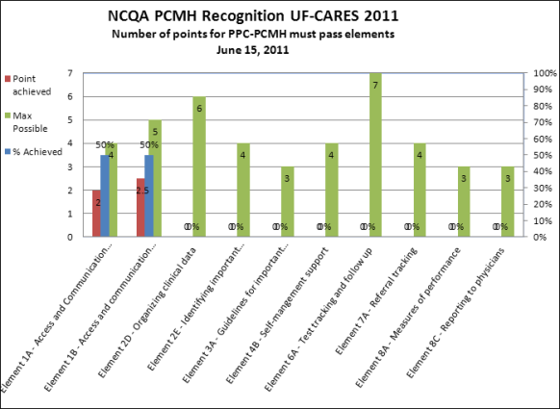

Slide 20
Standards & elements
2008 PPC-PCMH
9 Standards
30 Elements
161 scored items/factors
2011 PCMH
6 Standards
28 Elements
152 scored items/factors

Slide 21
Scoring
Both have “Must Pass” Elements (receive a 50% score or higher
2008 Standards had 10 “Must Pass” Elements
Level 1: 25-49 pts and 5 of 10 “Must Pass”
Level 2: 50-74 pts and 10 of 10 “Must Pass”
Level 3: 75-100 pts and 10 of 10 “Must Pass”
2011 Standards
Level 1: 35-59 pts
Level 2: 60-84 pts
Level 3: 85-100 pts
All require 6 of 6 “Must Pass” elements

Slide 23
PCMH 2011 Standards and Scoring
PCMH1: Enhance Access and Continuity Access During Office Hours** After-Hours Access Electronic Access Continuity Medical Home Responsibilities Culturally and Linguistically Appropriate Services Practice Team | Pts 4 4 2 2 2 2 4
 | 20
PCMH2: Identify and Manage Patient Populations Patient Information Clinical Data Comprehensive Health Assessment Use Data for Population Management** | Pts 3 4 4 5
 | 16
PCMH3: Plan and Manage Care Implement Evidence-Based Guidelines Identify High-Risk Patients Care Management** Manage Medications Use Electronic Prescribing | Pts 4 3 4 3 3
 | 17
PCMH4: Provide Self-Care Support and Community Resources Support Self-Care Process** Provide Referrals to Community Resources | Pts 6 3
 | 9
PCMH5: Track and Coordinate Care Test Tracking and Follow-Up Referral Tracking and Follow-Up** Coordinate with Facilities/Care Transitions | Pts 6 6 6
 | 18
PCMH6: Measure and Improve Performance Measure Performance Measure Patient/Family Experience Implement Continuously Quality Improvement** Demonstrate Continuous Quality Improvement Report Performance Report Data Externally | Pts 4 4 4 3 3 2
 | 20
**Must Pass Elements
Notes:
23

Slide 24
let’s look at some examples…
Using worksheet handout, review factors and check yes for the items you are currently able to demonstrate
Indicate your data source: P&P, SOP, Reports
Tally score to see if you passed standard
Discuss responses from group
What did UF CARES provide?

Slide 25
Standard 1: access & communication
Has written standards for pt access & communication:
Scheduling each pt with a personal clinician
Coordinating visits during 1 trip
Determining through triage how soon a pt needs to be seen
Capacity to schedule pts same day they call
Scheduling same day appointments based on triage
Scheduling same day appointment base on pt request
Providing telephone advice during office hrs
Providing urgent phone response 24/7
Providing email consultations
Interactive practice website
Language services
Health insurance resources

Slide 26
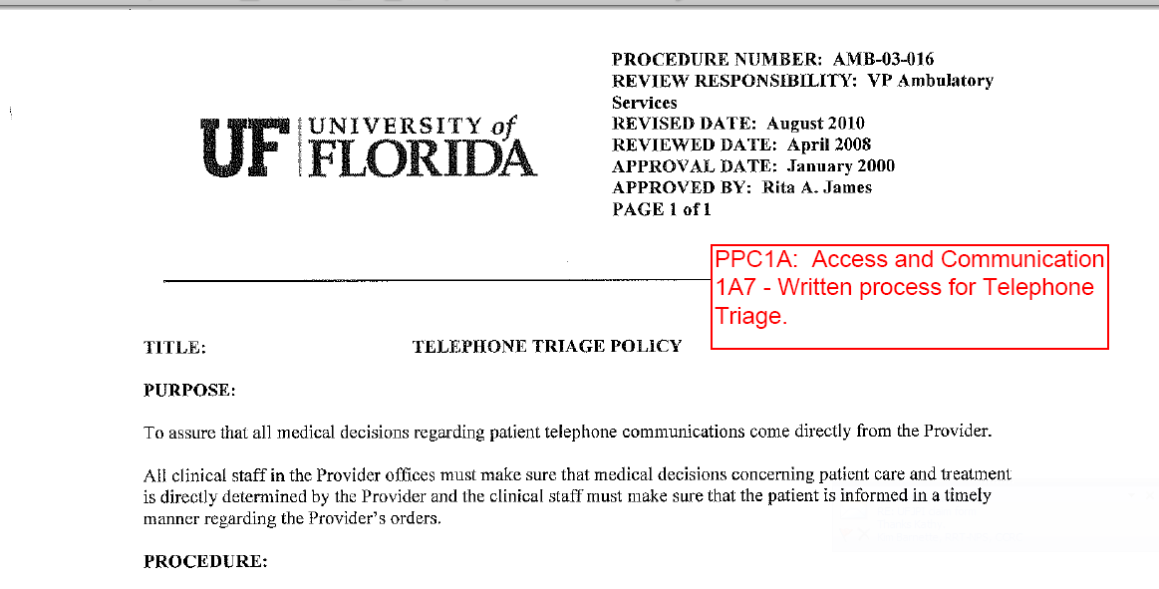

Slide 27
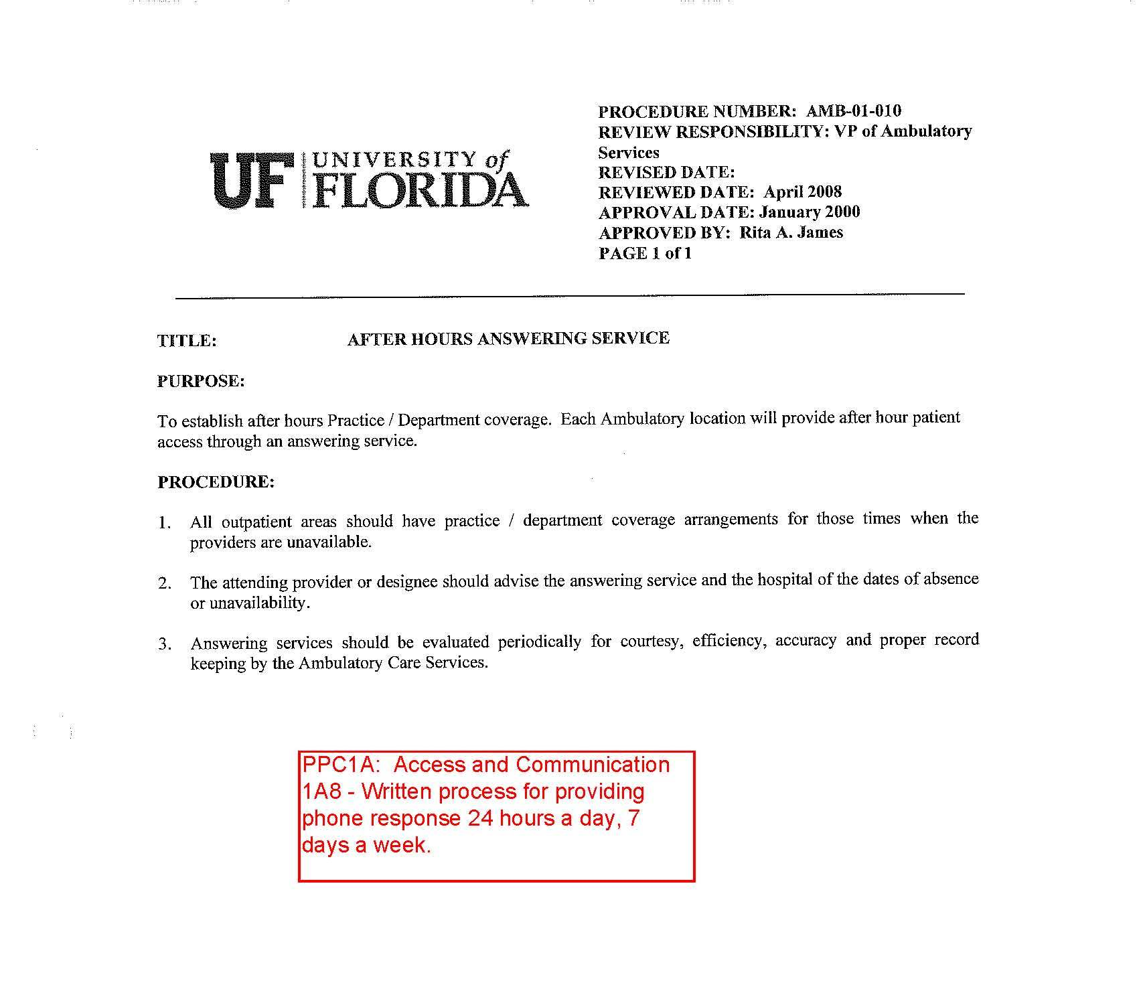

Slide 28
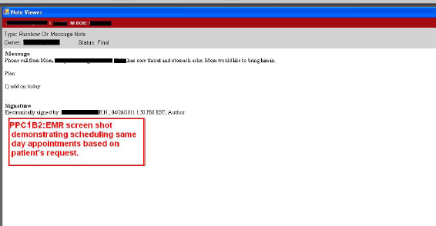

Slide 29
Standard 2: Patient tracking & registry
The practice systematically manages pt information & uses information for population mgmt to support patient care
Basic System for Managing Patient Data
Electronic System for Clinical Data
Use of Electronic Clinical Data
Organizing Clinical Data
Identifying Important Conditions
Use of System for Population Management

Slide 31
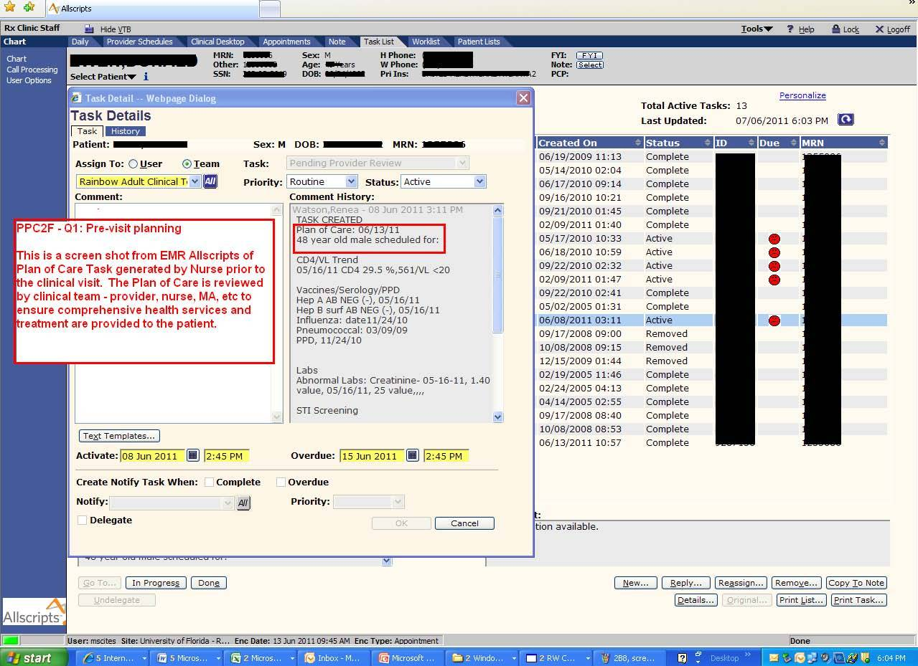

Slide 32
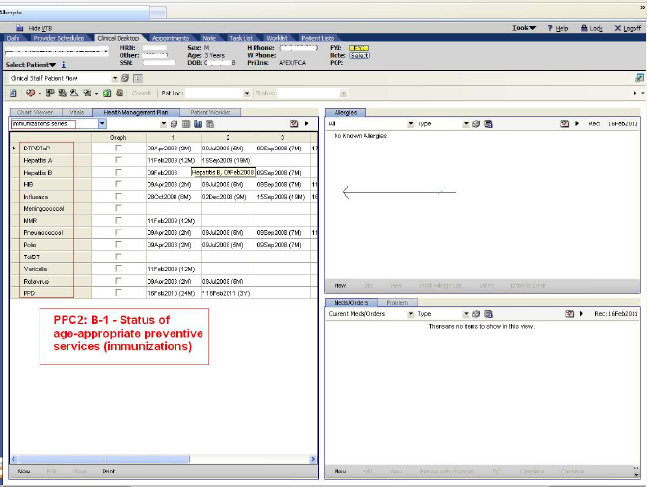

Slide 34
Standard 3: Care management
Practice maintains continuous relationships with pts by implementing evidence-based guidelines and applying them to the identified needs of individual pts over time
Guidelines for Important Conditions
Preventive Service Clinician Reminders
Practice Organization
Care Management for Important Conditions
Continuity of Care

Slide 35
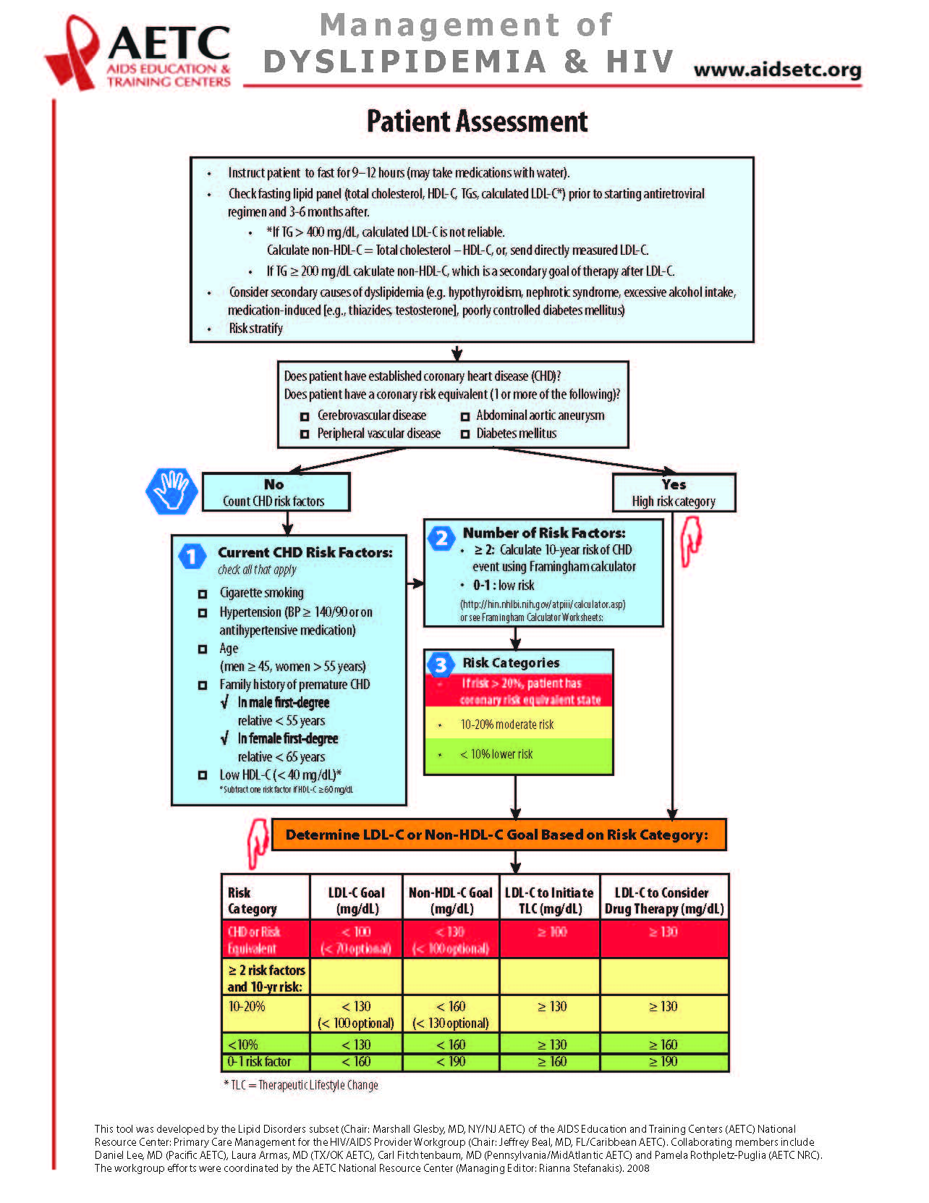

Slide 36
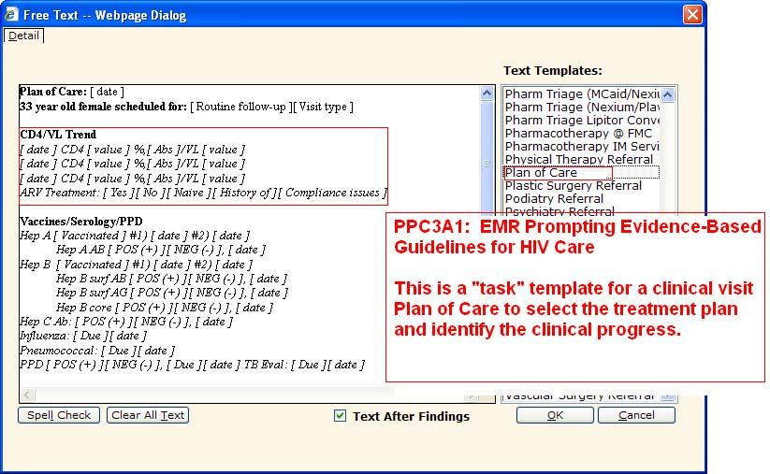

Slide 37
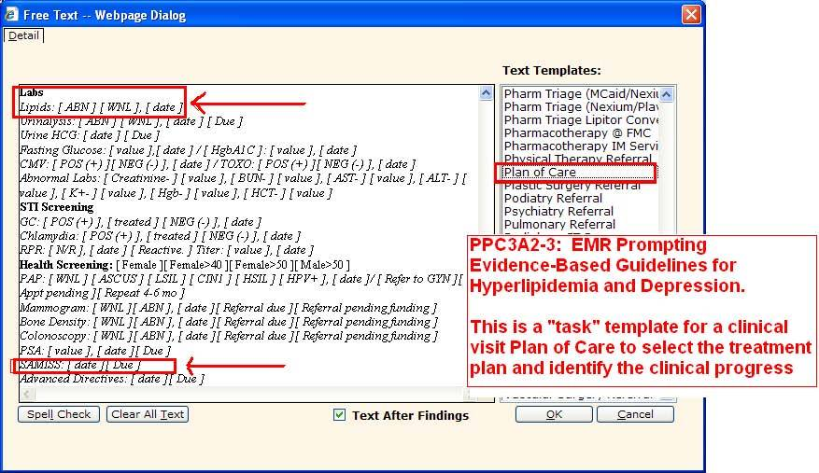

Slide 38
Standard 4: pt self- management support
The practice collaborates with pts & families to pursue goals for optimal achievable health
Documenting Communication Needs
Providing Self-Management Support

Slide 39
Standard 5: electronic prescribing
The practice seeks to reduce medical errors and improve efficiency by eliminating handwritten prescriptions and by using drug safety checks and cost information when prescribing
Electronic Prescription Writing
Prescribing Decision Support
Safety
Efficiency

Slide 41
Standard 6: test tracking
The practice works to improve effectiveness of care, pt safety & effciency by using timely information on all tests and results
Test tracking & follow-up
Electronic system for managing tests

Slide 42
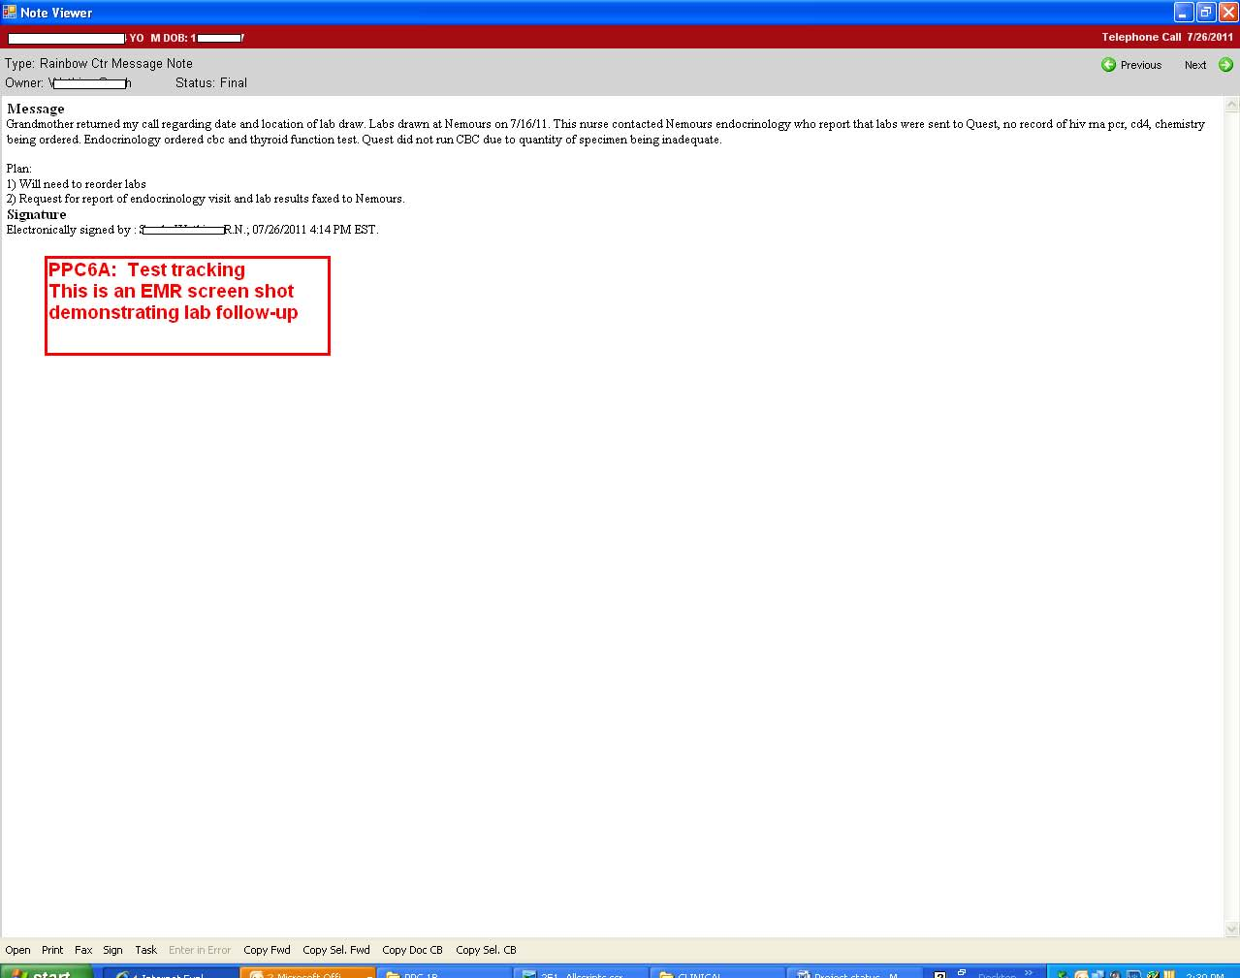

Slide 43
Standard 7: referral tracking
The practice seeks to improve effectiveness, efficiency, timeliness & coordination of care by following through on consultations
Referral tracking

Slide 44
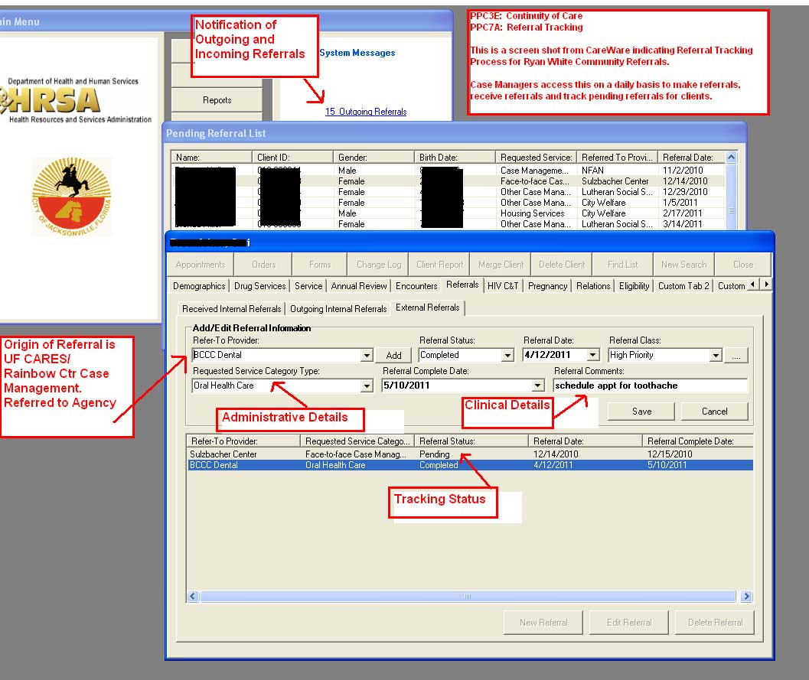

Slide 45
Standard 8: performance reporting & improvement
The practice regularly measures its performance and takes actions to continuously improve
Measures of Performance
Patient Experience Data
Reporting to Physicians
Setting Goals and Taking Action
Reporting Standardized Measures
Electronic Reporting – External Entities

Slide 46
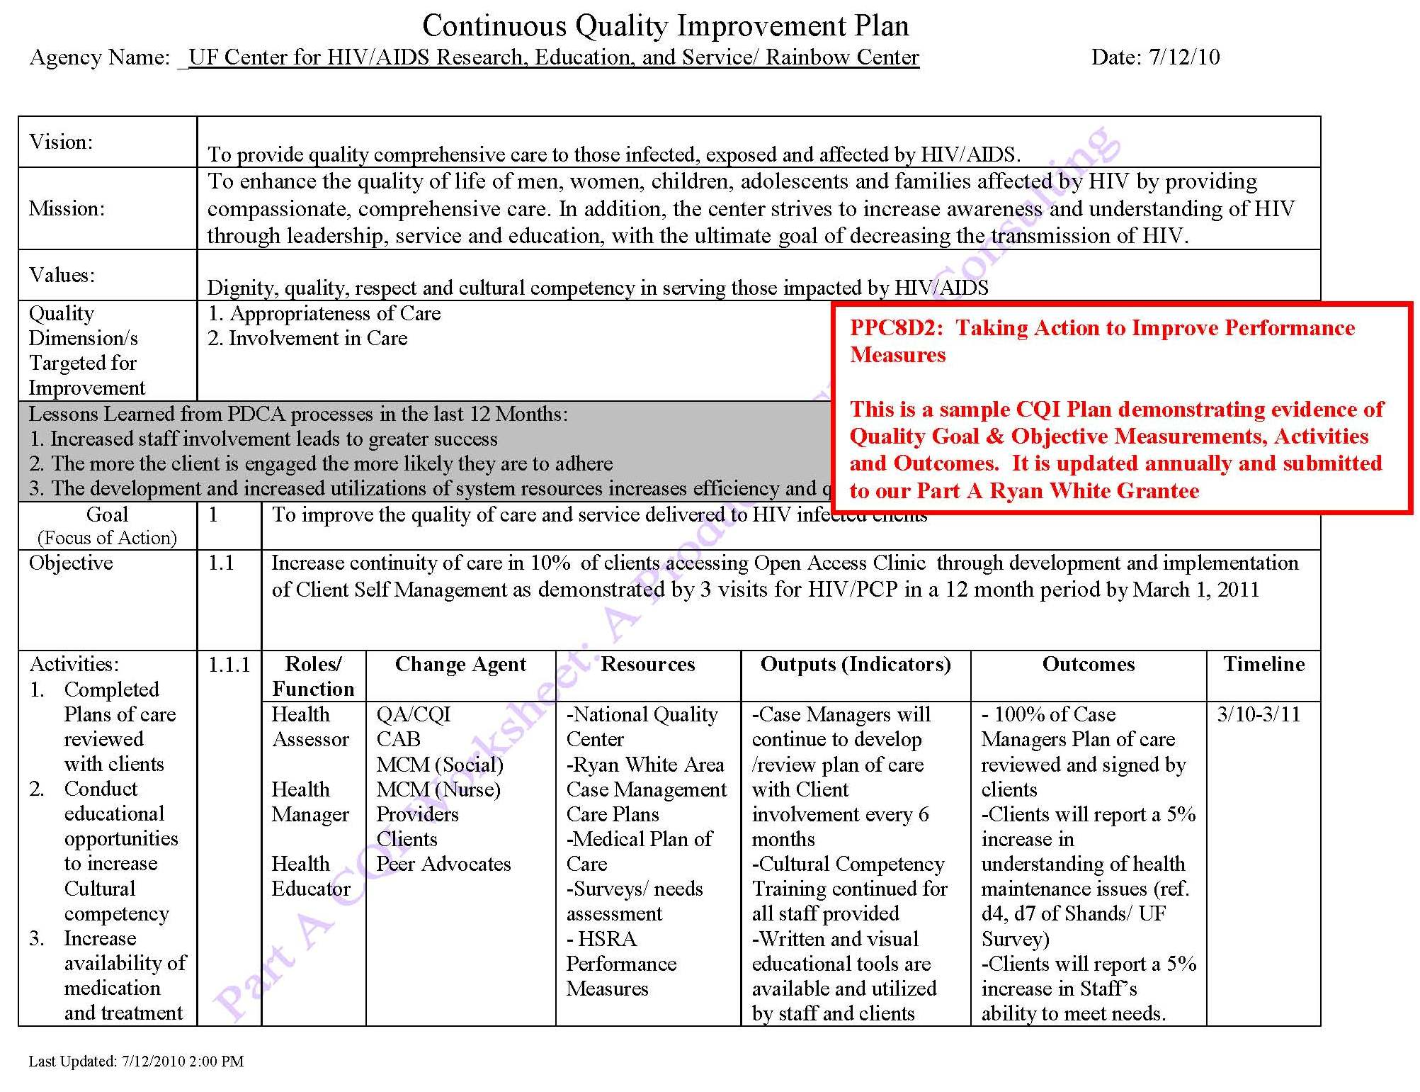

Slide 47
Standard 9: advance electronic communication
The practice uses electronic communication to improve timeliness, effectiveness, efficiency & coordination of care
Availability of Interactive Web Site
Electronic Patient Identification
Electronic Care Management Support

Slide 48
Ready or not…
Take the next step to receive recognition for the hard work your programs are already doing!
Receive the distinction for your commitment to excellence in quality care and patient safety!
Good Luck!!

Slide 49
Acknowledgements
Syed Bukhari
Glen Edwards
Bonita Drayton
Naoma Woods
Saniyyah Mahmoudi
and the entire UFCARES team

Slide 50
UF CARES team

Slide 51
Obtaining CME/ce credit
If you would like to receive continuing
education credits for this activity, please
visit:
http://www.pesgce.com/RyanWhite2012

