Slide 1

Welcome to Day 3!

Slide 2
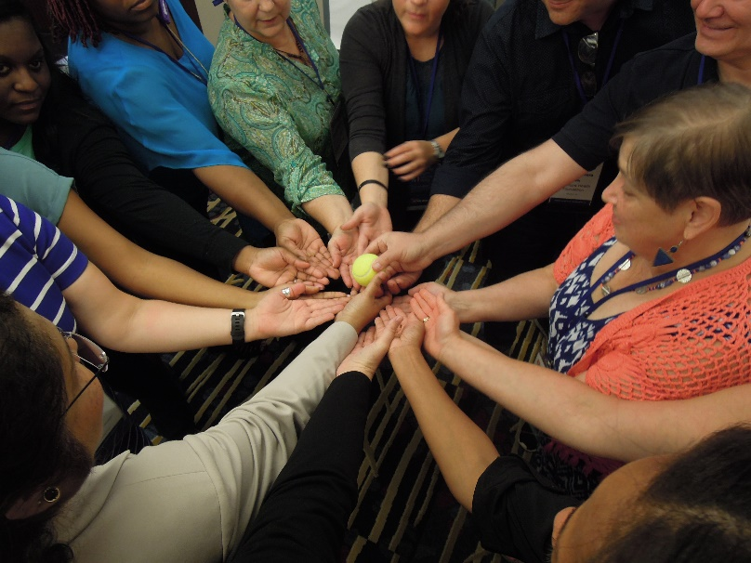
Module 17 – Day 3
8:00am – 8:30am (30 min)
Welcome to the TOT Program
Day 3

Slide 3
Agenda – Day 3
8:00
8:30
9:45
10:15
11:00
11:20
12:30
1:15
2:15
3:00
3:30
Welcome & Warm-up Activity
Accelerated Learning - Mini-Trainings
Break
Evaluating Training Effectiveness
Presenting & Facilitating Learning
Training Nightmares, Mishaps & Messes
Lunch
Presentations Pt 2 (2)
Game Plan Going Forward
Aha! Moments, Evaluation & Celebration
Adjourn

Slide 4
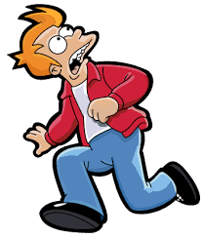
Fears and Challenges

Slide 5
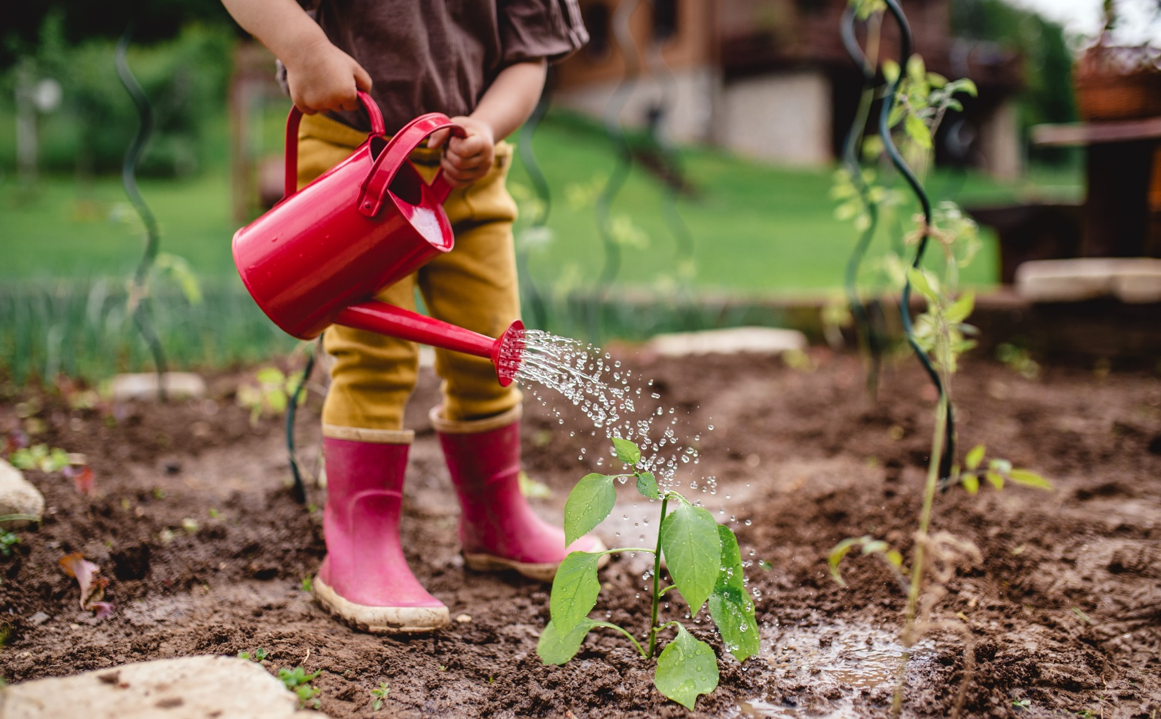
Garden

Slide 6

Module 18 – Day 3
8:30am – 9:45pm (75 min)
TOT Handout-of-Handouts: Module 18
Accelerated Learning
Mini-Trainings
Part 1

Slide 7
Learning Objectives
Apply TOT guidance to development of training
Improve training skills through experience
Receive immediate feedback on mini-training

Slide 8
Evaluating Training Effectiveness
Module 19 – Day 3
9:15am – 9:45am (30 min)
TOT Handout-of-Handouts: Module 19

Slide 9
Framing Question
How and what do you measure?

Slide 10

Kirkpatrick Model
Reaction
Learning
Behavior
Results
Notes:
Talk about advantages and disadvantages of each level and difficulties

Slide 11

Bottom Line Question
What do you do with the information?
Notes:
Talk about it in relation to levels

Slide 12

9:45am to 10:15am

Slide 13
Tools for Effective Presentation and Group Facilitation
Module 20 – Day 3
10:15am – 11:00am (45 min)
TOT Handout-of-Handouts: Module 20

Slide 14
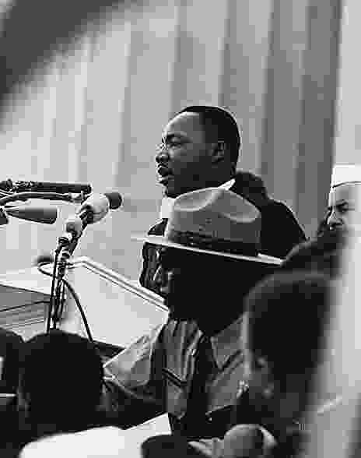
Framing Question
“In your experience, what types of things make for a great presentation?”
Notes:
Small group work come up with list – share one idea per table

Slide 15

What They Hear

Slide 16
What We Hear
Pitch
Pace
Volume
Pause
Fillers

Slide 17
What They See

Slide 18
What We See
Body Stance/Movement
Gestures
Facial Expressions
Eye Contact
Nervousness

Slide 19
Managing Nervousness
Have a strategy for questions or exercises
Control your breathing
Be prepared
Have an exercise, ice breaker, story ready
Move around
Learn how to deal with silence
Practice, practice, practice

Slide 20
Managing Anxiety
Plan for it
Relaxation techniques
Positive visualization
Keep perspective
Try not to take it personal
Familiarize yourself with the training environment, audience, and content

Slide 21
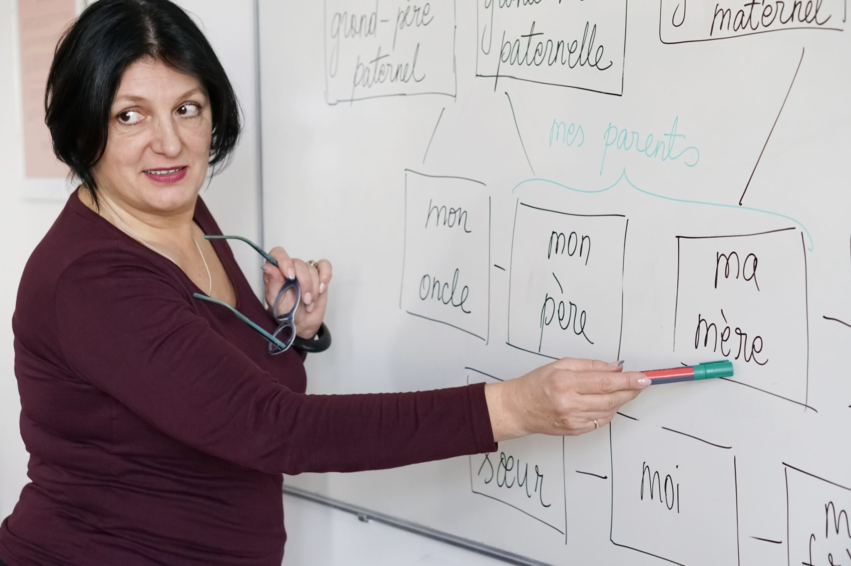
How You Show It!
(Visual Aides)

Slide 22
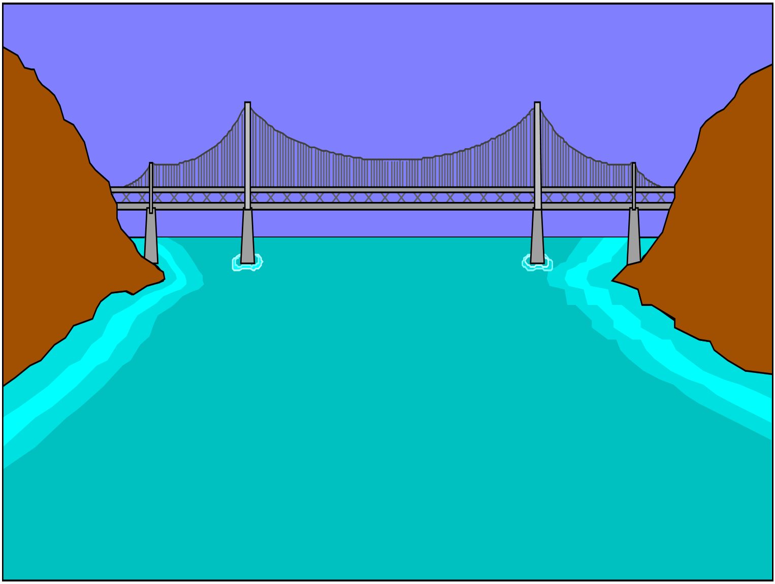
Image of Bridge
They forget 70% of what
we tell them.
What is the 30% we want
them to remember?
© HOWICK ASSOCIATES, Inc. 2004
Notes:
Example of a picture ?

Slide 23
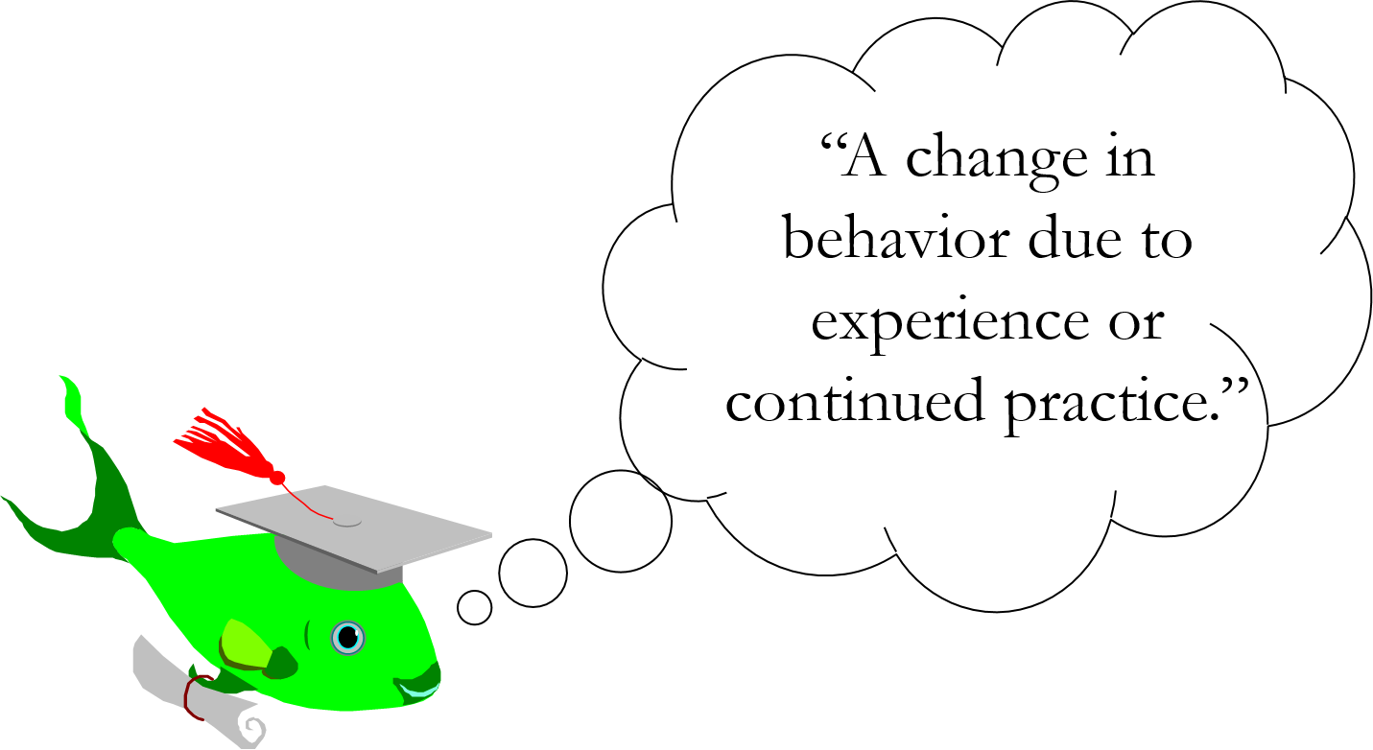
Learning is defined as...
Notes:
Another way to present beside bullets

Slide 24
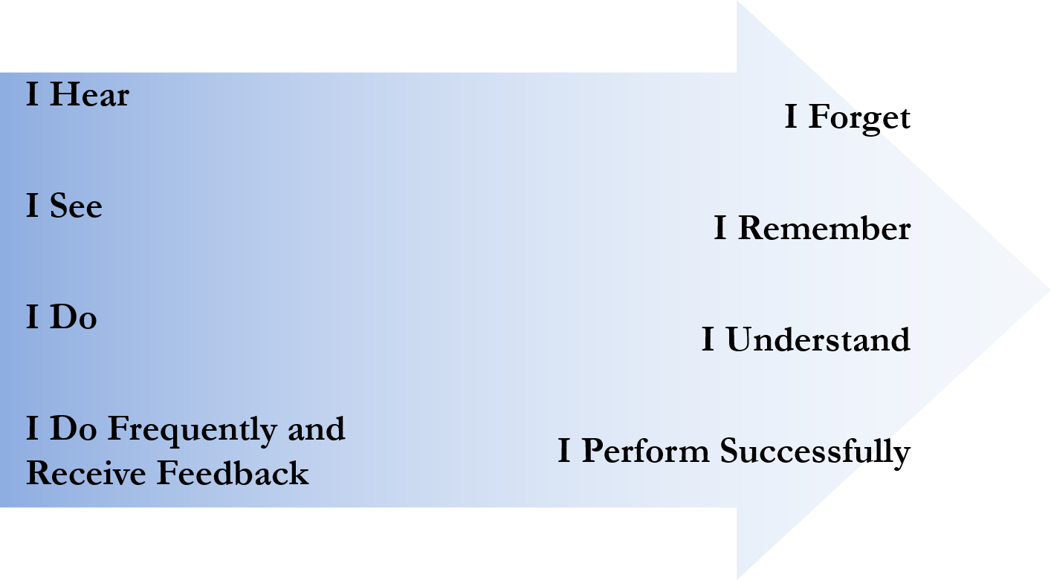
Adult Learning
© Howick Associates, Inc. 1997

Slide 25
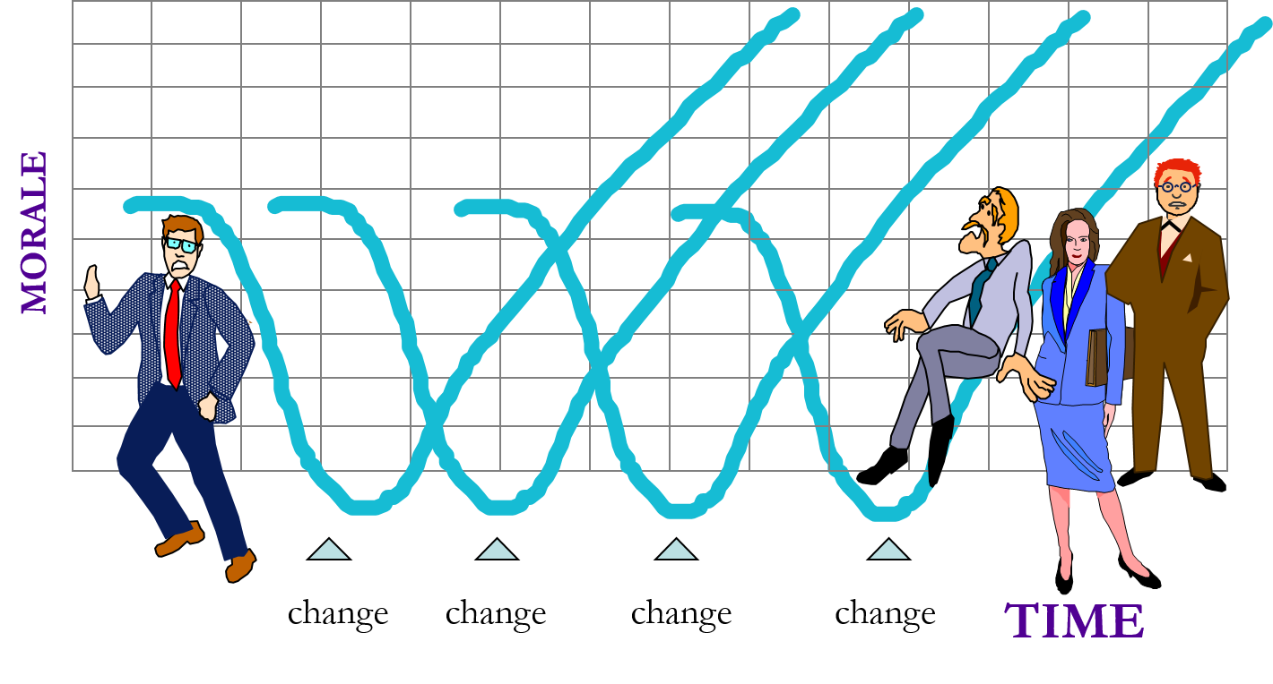
Riding the Waves of Change

Slide 26

Presentationzen

Slide 27

Conference Call
Video: Conference Call in Real Life
https://www.youtube.com/watch?v=z_tiqlBFjbk

Slide 28
Training is a blend of presentation, facilitation, interactivity, and relationships.
Notes:
Group work is about accomplishing something (the WHAT), that is the leader’s and groups responsibility.
How the group works together more effectively is about the process of the group, and that is the domain of the facilitator.

Slide 29
Facilitation - A Brief Review
The word facilitate has its origin in the Latin word facilis, which means “easy.” Group work is potentially made easier by the contributions of a facilitator.
Notes:
Group work is about accomplishing something (the WHAT), that is the leader’s and groups responsibility.
How the group works together more effectively is about the process of the group, and that is the domain of the facilitator.

Slide 30
Training Nightmares, Mishaps & Messes
Module 21 - Day 3
11:00am – 12:30pm (90 min)
TOT Handout-of-Handouts: Module 21

Slide 31
Critical Incident
Think of a time when you were training (or you were in a training) and something really went wrong. It was a genuine nightmare. It comes to mind easily and quickly because it was so vivid.
Notes:
Make sure to tell them that they will share the story

Slide 32
Make A Few Notes
What happened, when, and where did it happen?
Why did it happen and who was involved?
What was it about the situation that made it so painful for you?
What did you do?

Slide 33
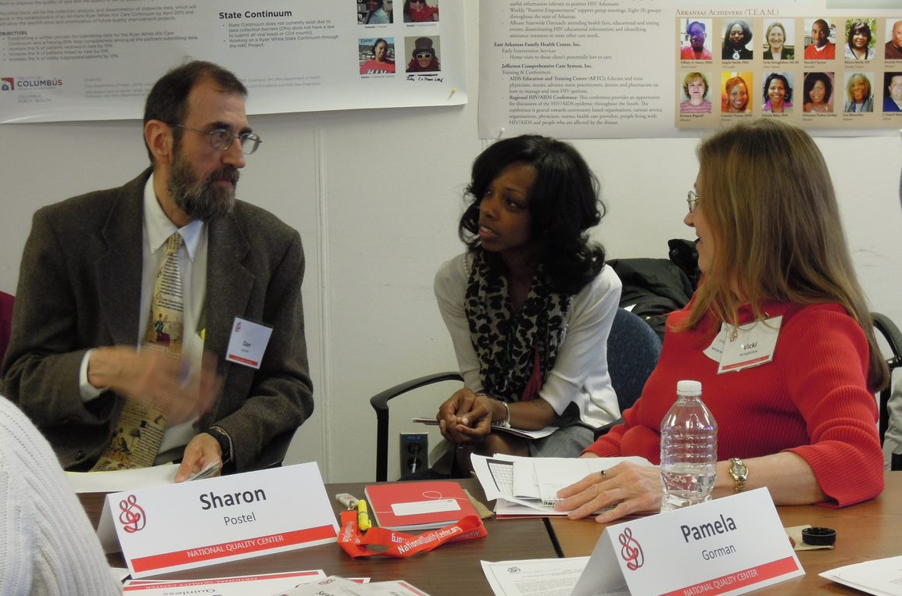
At Your Tables
Step 1: Find someone at your table that you don’t know too well yet
Step 2: Pair-share your stories…
Step 3: Large group debrief
Notes:
Use store is to elicite what to do in these situations… try to get simple rules –KAC

Slide 34
Tips and Simple Rules
Be prepared to arrive at least 45 minutes before the session to prepare?
What equipment will you need? Confirm it will be there well before you arrive and consider an equipment back-up plan
Identify and meet with the person responsible for troubleshooting technical/equipment issues before the session begins
Make yourself familiar with training location, rest rooms, handicap access, fire exits, ground rules, etc. before you begin the session
See if you can do the room set-up well in advance

Slide 35
Tips and Simple Rules
Who does have the participant materials and how will they get to the training location?
Distribute materials in advance at the tables; use different colors to help with distribution
Allow for some quiet time before the session to center yourself; be sure to know the first slides well
Be flexible, relax, have fun, and know their will be glitches as you go - if you don’t overreact when problems occur, it’s likely your participants won’t either
And remember, it’s not about you, it’s about the learners

Slide 36
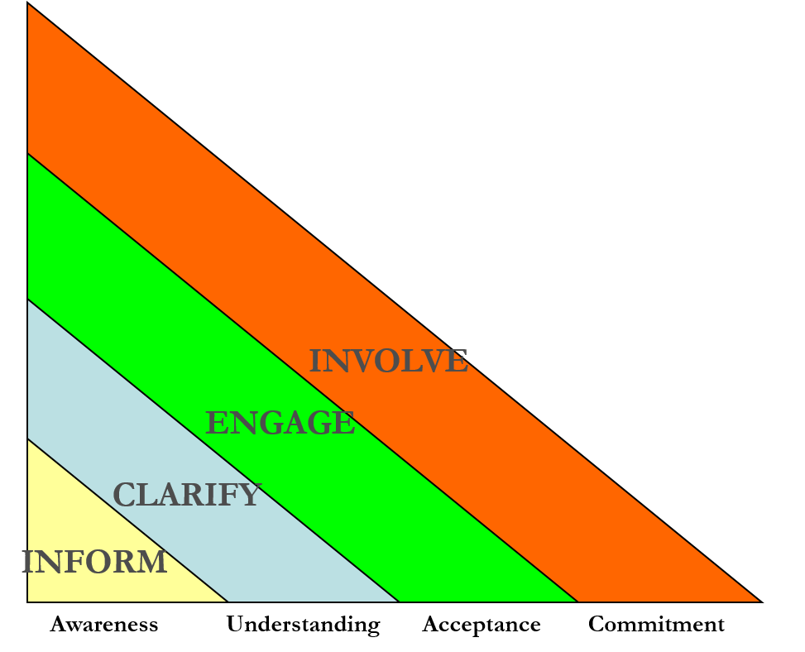
Purposes of Communication
Notes:
GO THROUGH THIS SLIDE AND LINK TO WHAT WE LKEARNED FROM THE NIGHTMARES AND HOW THIS MODEL COULD HELP

Slide 37
Interactive Presenting
Checking expectations & needs as you go…
Parking lot
Checking questions (open and closed)
Use polling results from the applications
Small group/pairs discussion
QI games
Ice breakers
Role playing
Fish bowl
Others?
Notes:
OTHER TOOLS – COULD THEY HAVE HELPED WITH NIGHTMARES?

Slide 38
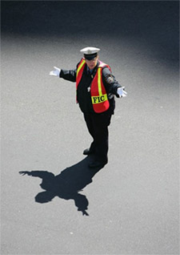
The Role of the “Traffic Cop”
Specific words and phrases useful in directing traffic:
Observing
Clarifying
Focusing
Stimulating
Balancing
Summarizing
Notes:
Go to the book and review pages 40-41. How to use language to help you in your role.

Slide 39
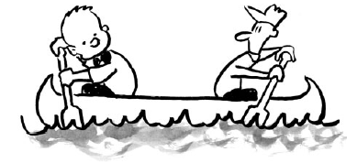
Dealing with Difficult Behaviors

Slide 40
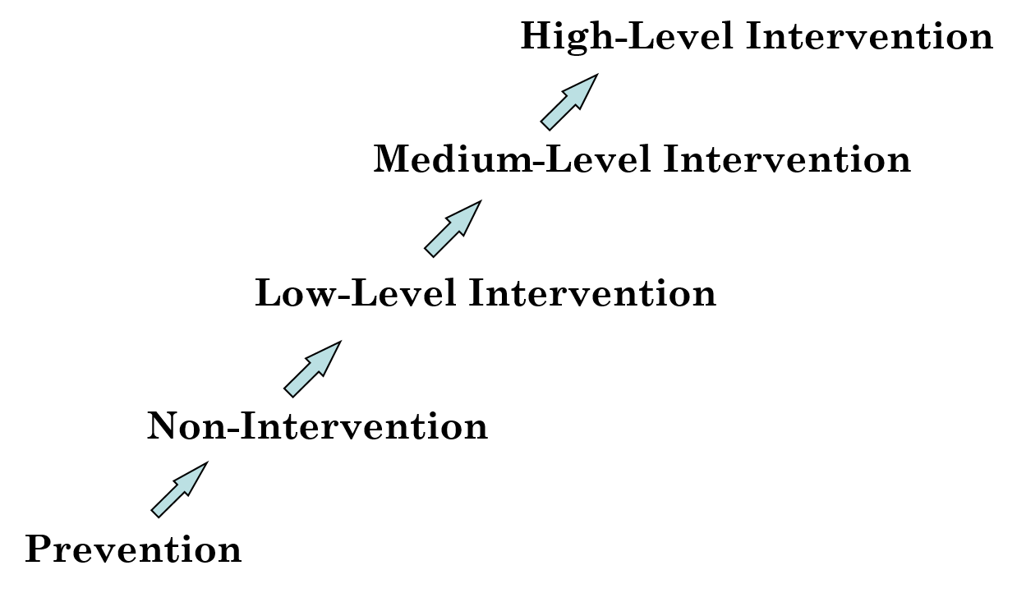
Intervention Strategies
Notes:
Have them read and then ask if any questions??? Advice??

Slide 41
Intervention Examples
Prevention
Work done before a group convenes
Talk with participants before the first session
Build ground rules to define appropriate group norms
Remind participants that they are responsible for upholding the ground rules
Non-intervention
Pause a moment and let go
Oftentimes, participants will bring others into line by referring to the ground rules
Low-level intervention
Reference the ground rules
Shift in eye contact or asking for input from another learner
Medium-level Intervention
Talk with the individual between modules or at a break
Create an informal contract in which the person
High-level Intervention
This is not a step to be taken lightly since it can alienate others
Avoid blaming
Use constructive feedback and focus on problem solving
Keep personalities and stereotypes out of it

Slide 42
Closing
“Don’t put people in learning experiences, put them in doing experiences. Achieving enables people to grow.”
Peter Drucker

Slide 43
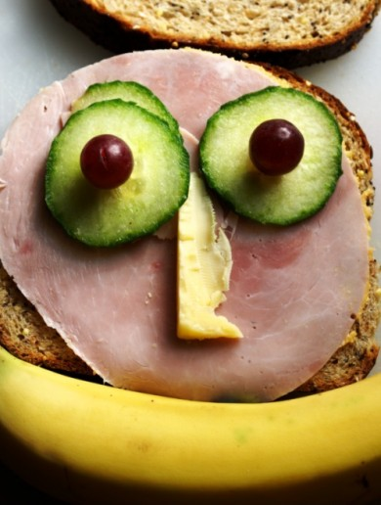
Lunch
12:30pm – 1:15pm

Slide 44
Module 22 – Day 3
1:15pm – 2:15pm (60 min)
TOT Handout-of-Handouts: Module 22
Accelerated Learning
Mini-Trainings
Part 2

Slide 45
Learning Objectives
Apply TOT guidance to development of training
Improve training skills through experience
Receive immediate feedback on mini-training

Slide 46
Module 23 – Day 3
2:15pm – 3:00 (45 min)
TOT Handout-of-Handouts: Module 23
Game Plan Going Forward

Slide 47
Expectations of TOT Participants
Post-TOT work
  Provide 3 QI trainings within 120 days of completion of the TOT session and report these trainings to CQII
  Meet with assigned TOT Study Groups at least twice within 120 days of the TOT
  Participate in post-TOT webinars with CQII staff and TOT faculty

Slide 48
Provide 3 QI Trainings within 120 Days
Today
Review and update your individual training form; ask faculty for help if needed
Share your training plans with your training neighbor
After TOT
Report your training to the Center by going to
https://www.surveymonkey.com/r/totreport

Slide 49
TOT Study Groups
Today
Ensure that you have identified the two dates and are set up
  Within 30 days of the TOT session (Study Group Session 1)
  Between 60-90 days out (Study Group Session 2)
After TOT
CQII will send out the Study Group reminders
  Study Group Session 1: Focus on your training plans
  Study Group Session 2: Focus on trainings you conducted

Slide 50
Post-TOT Webinar
After TOT
CQII will send out the webinar notice for upcoming post-TOT webinars with CQII staff and TOT faculty
Participate, meet all TOT peers, and learn from each other

Slide 51
Aha! Moments, Evaluation & Celebration
Module 24– Day 3
3:00pm – 4:00pm (45 min)
TOT Handout-of-Handouts: Module 24

Slide 52
Module Agenda
Personal Highlights or Aha! Moments
Polling Survey
Went Well / Do Differently

Slide 53
Highlights & Aha! Moments
What have been some of your personal highlights or Aha! Moments from today’s session?
Use the next 2 minutes to reflect on today, identify a few ideas

Slide 54
Poll

Slide 55
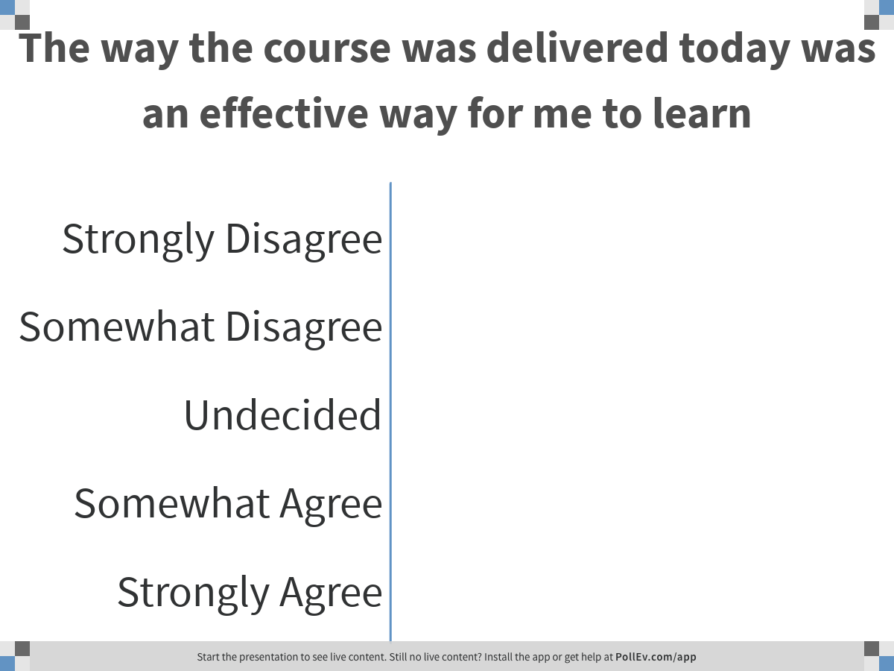
Notes:
Poll Title: The way the course was delivered today was an effective way for me to learn
https://www.polleverywhere.com/multiple_choice_polls/D1Vpcvsf8hlNYtnW5A9JG

Slide 56
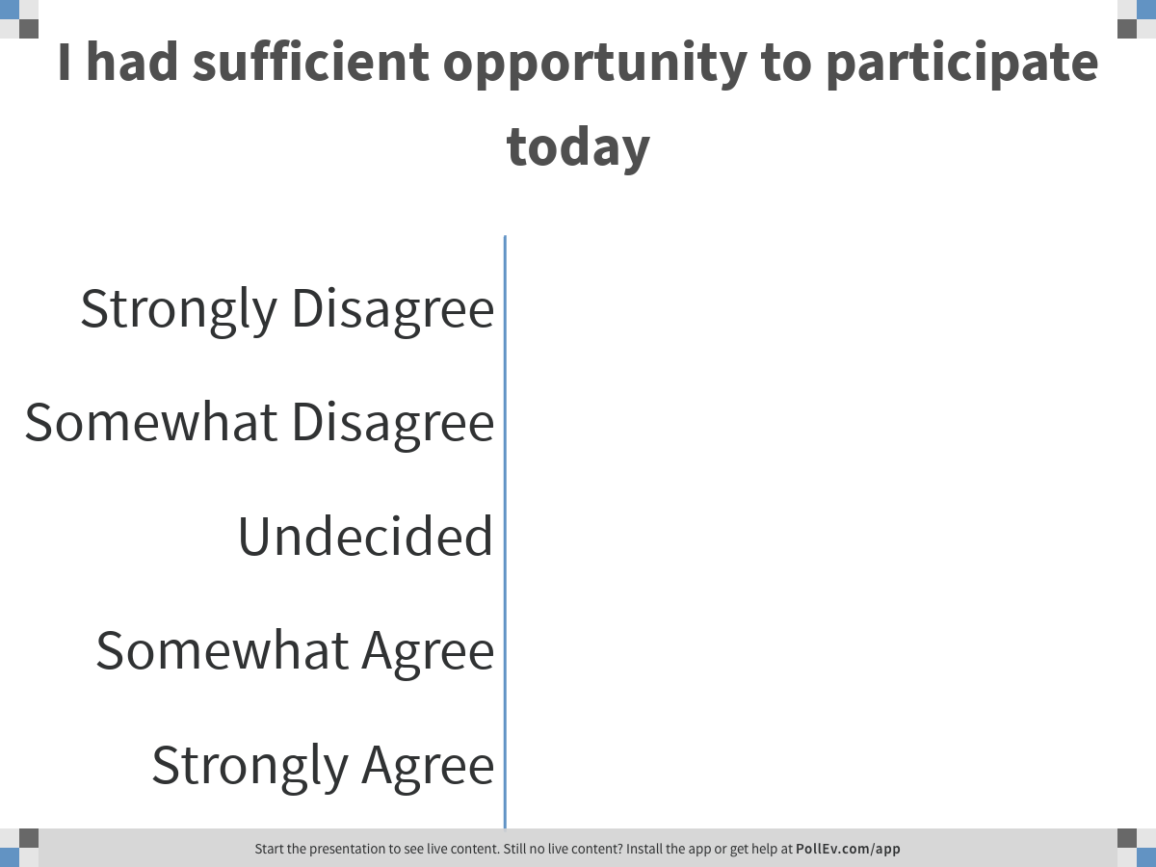
Notes:
Poll Title: I had sufficient opportunity to participate today
https://www.polleverywhere.com/multiple_choice_polls/NChQCqJe65KM6L1dlDhfx

Slide 57
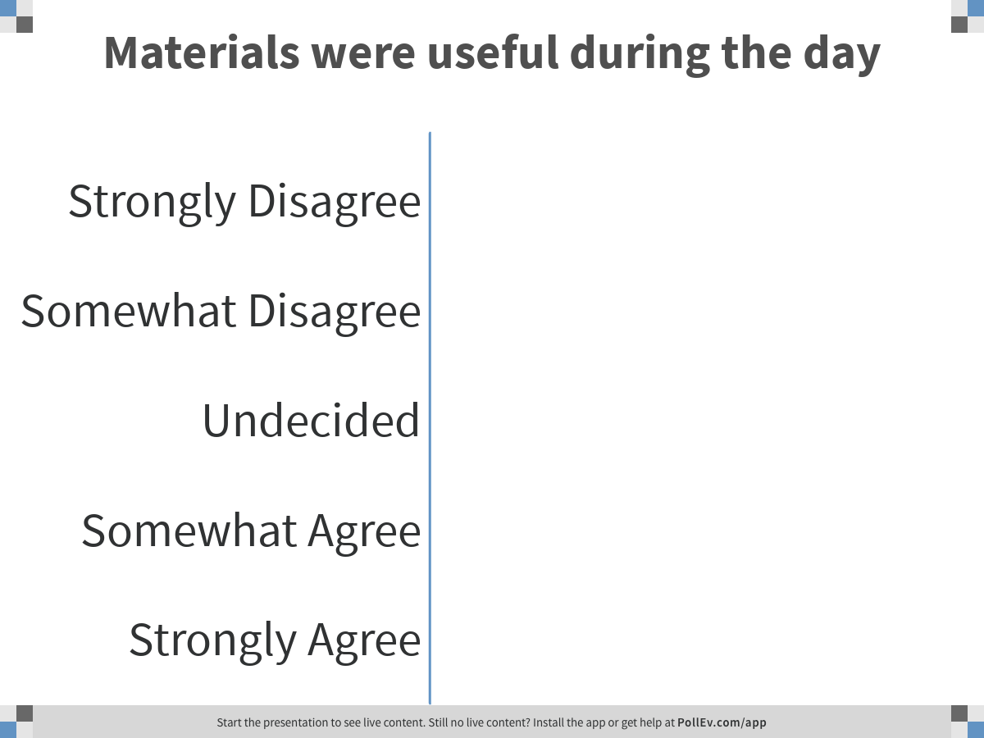
Notes:
Poll Title: Materials were useful during the day
https://www.polleverywhere.com/multiple_choice_polls/EAJwRhbH5WhOFWwLH9tVF

Slide 58
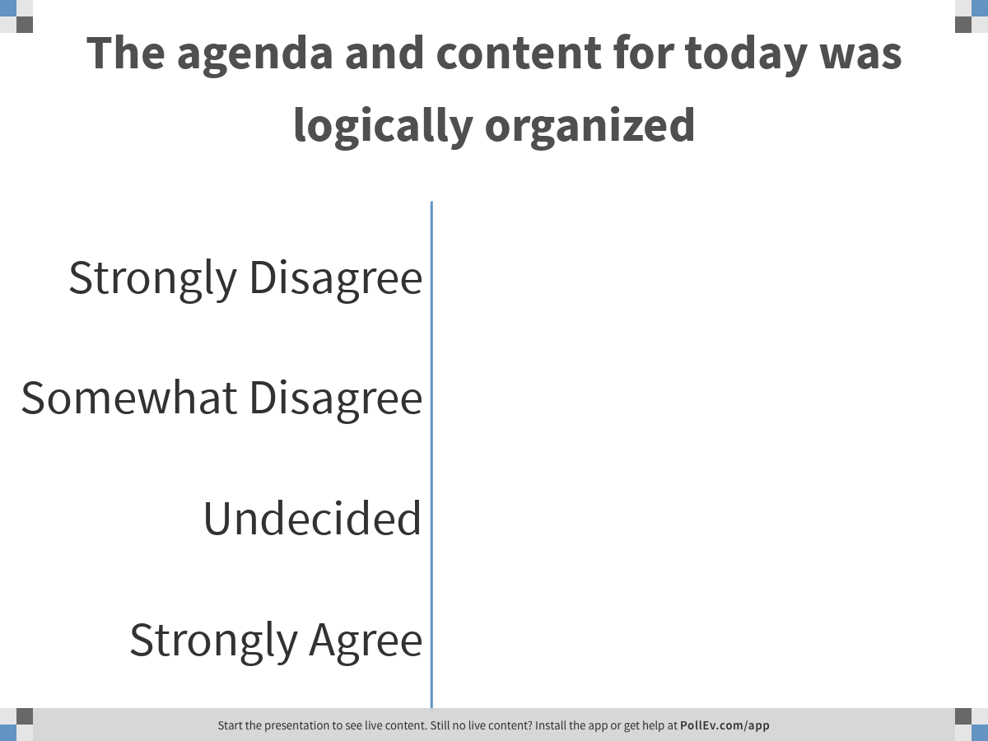
Notes:
Poll Title: The agenda and content for today was logically organized
https://www.polleverywhere.com/multiple_choice_polls/ye8PEv8YG6dvGwDRTkf8Y

Slide 59
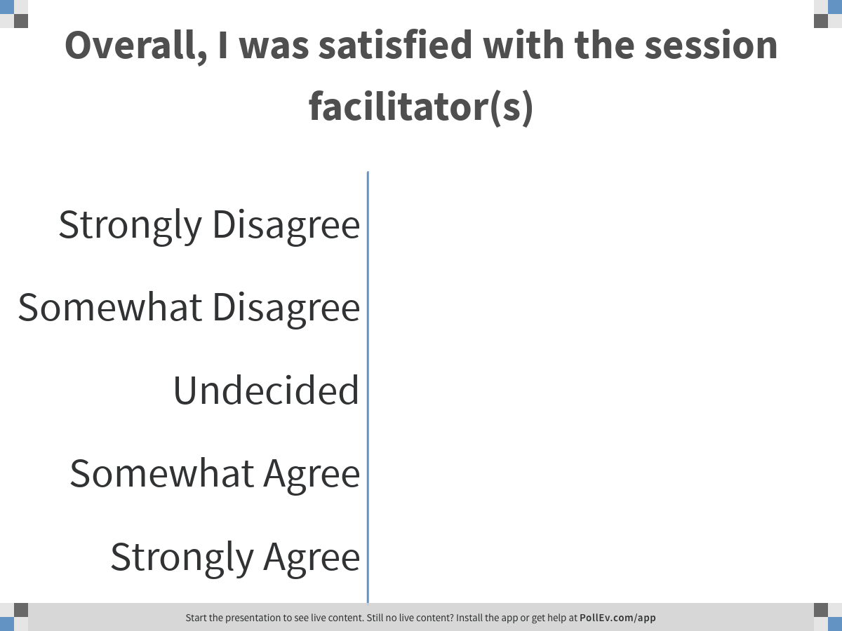
Notes:
Poll Title: Overall, I was satisfied with the session facilitator(s)
https://www.polleverywhere.com/multiple_choice_polls/ZgZymxy1fqe7hRIyn7XBb

Slide 60
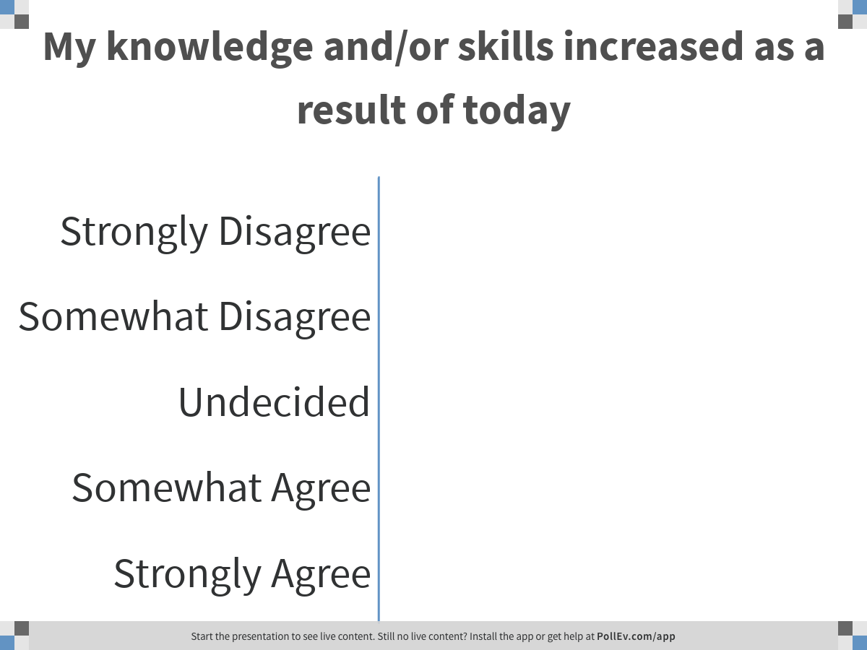
Notes:
Poll Title: My knowledge and/or skills increased as a result of today
https://www.polleverywhere.com/multiple_choice_polls/oLK0m6sz9gxnUejp4eONX

Slide 61
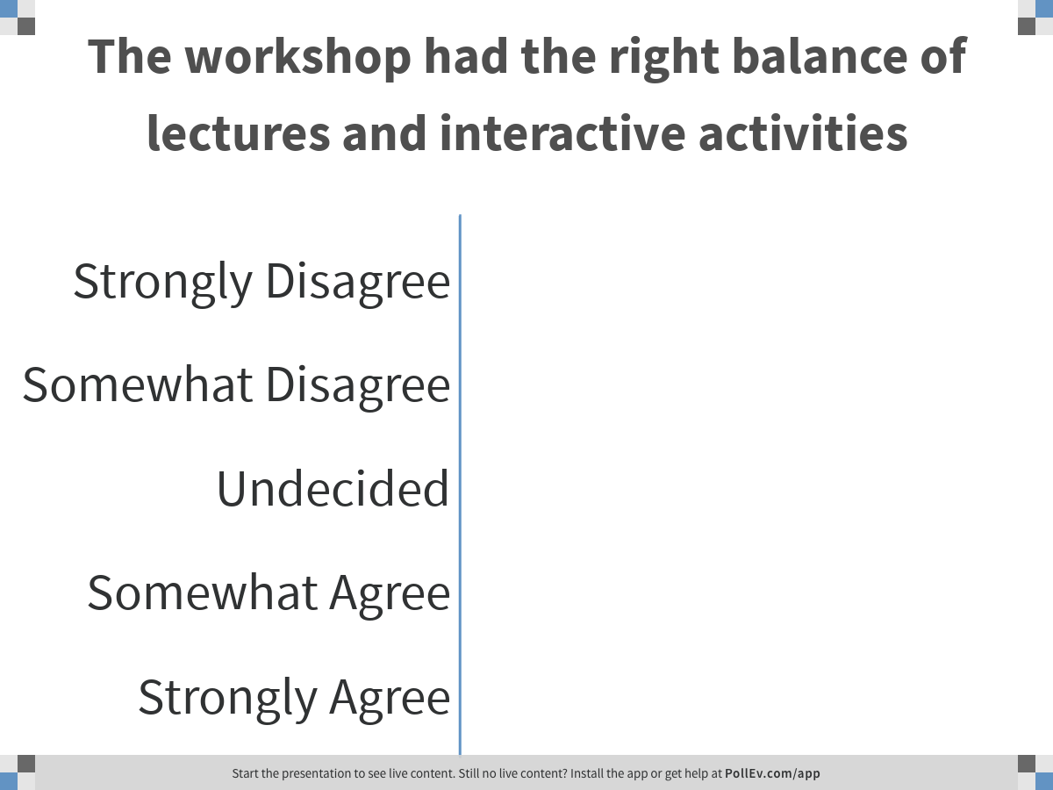
Notes:
Poll Title: The workshop had the right balance of lectures and interactive activities
https://www.polleverywhere.com/multiple_choice_polls/wSXUCIOwE8vx7XYdrUm6e

Slide 62
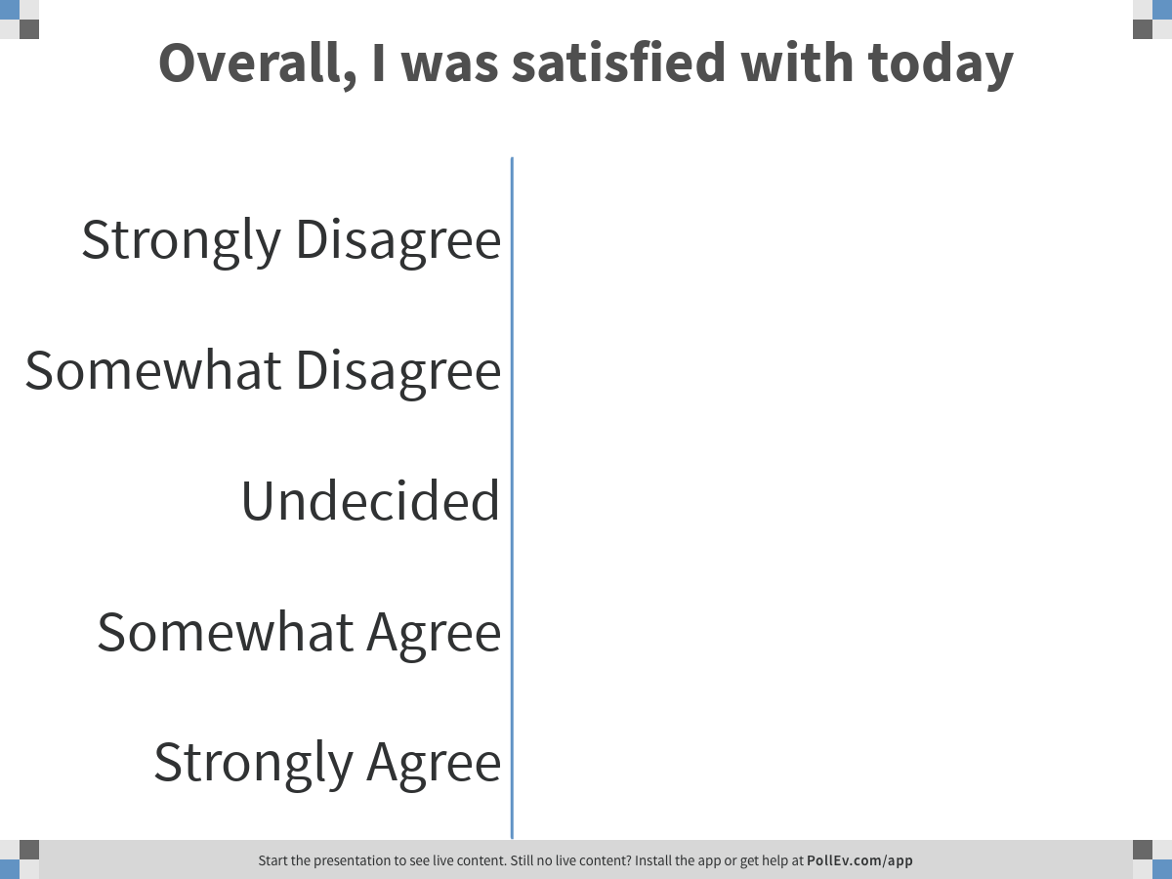
Notes:
Poll Title: Overall, I was satisfied with today
https://www.polleverywhere.com/multiple_choice_polls/JUTrWgLAd3VVRePAXXrwa

Slide 63
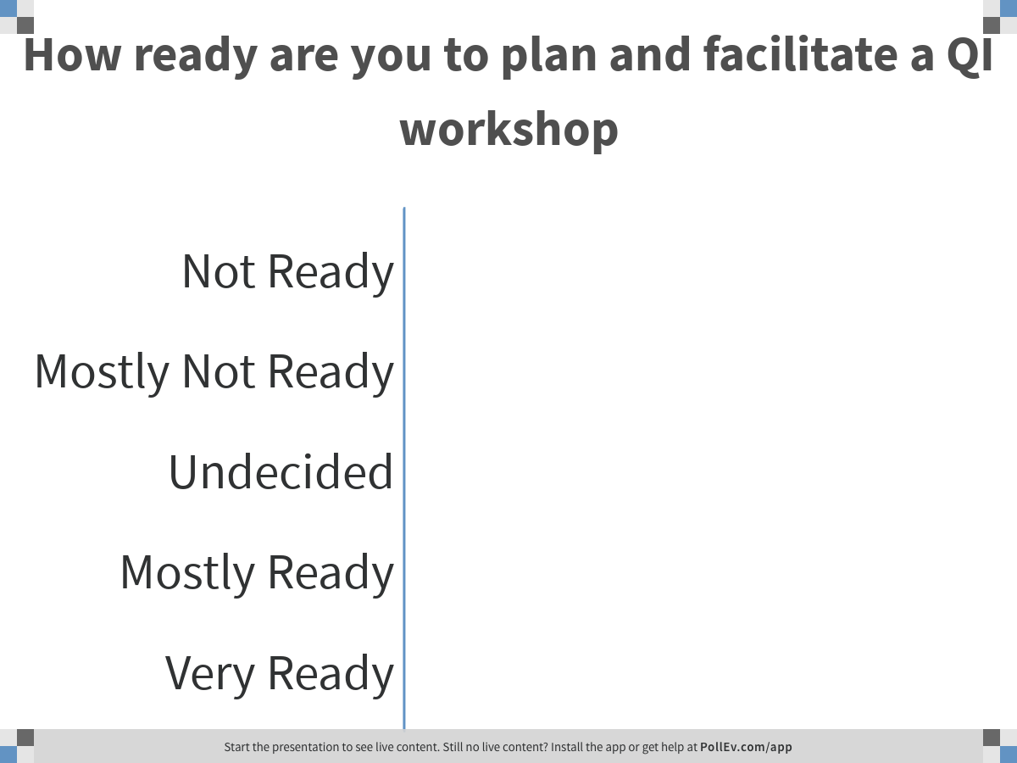
Notes:
Poll Title: How ready are you to plan and facilitate a QI workshop
https://www.polleverywhere.com/multiple_choice_polls/4LLODuJLmRZwkf5TtVPWV

Slide 64
Additional Comments about Today
What worked well today for you?
What should we do differently tomorrow?

Slide 65
Closing
Closing Remarks
Certificates
Group Picture
Leave name badges and remotes on your table
Remember: take all your personal belongings

Slide 66
Team Picture

Slide 67

Safe Trip Home!
This project is supported by the Health Resources and Services Administration (HRSA) of the U.S. Department of Health and Human Services (HHS) under grant number U28HA30791 and the HRSA Ryan White HIV/AIDS Program Implementation Center for HIV Quality Improvement and Innovation for $1.5 M. This information or content and conclusions are those of the author and should not be construed as the official position or policy of, nor should any endorsements be inferred by HRSA, HHS or the U.S. Government.

