Slide 1
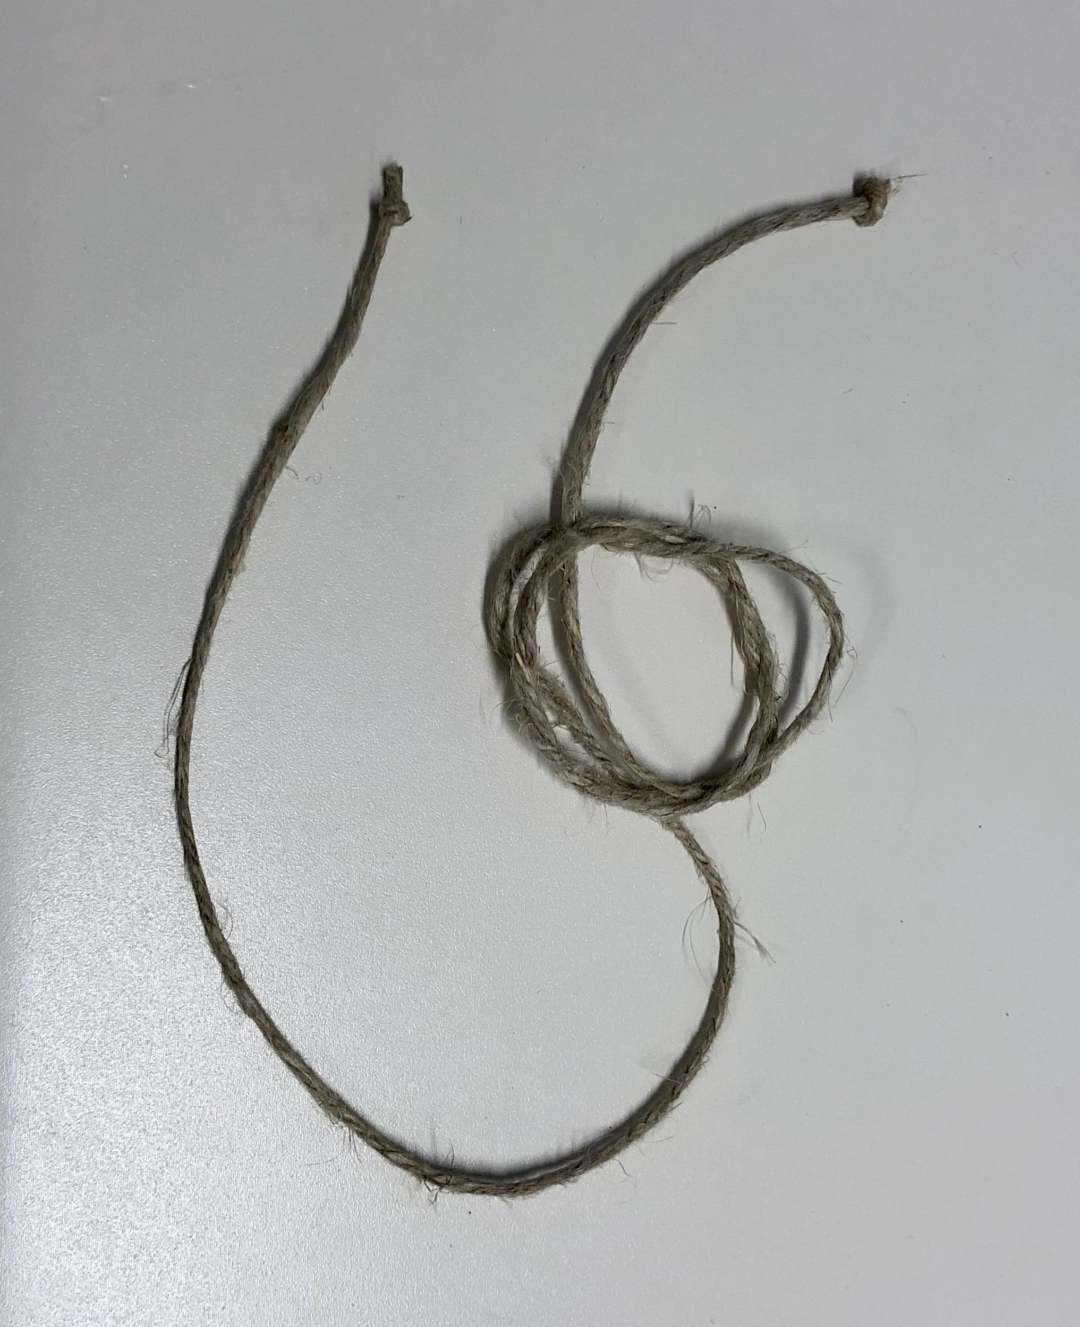

Game: Knot or Not

Slide 2
Overview
Game: Knot or Not | Length: 10-25 minutes
Type of Game: An interactive game to guess the result based on demonstrations. | Target Audience: Anyone, whether it is clinical or administrative staff, QI team members, managers, people with HIV, etc., who are looking to get to know each other.
Learning Objectives Engage participants in problem-solving. Familiarize participants with facing barriers when working in a group trying to make a decision. Get to know fellow participants and team members. Learn how to articulate decisions.
Agenda Setting the stage for the interactive exercise. Playing the Knot or Not game. Debrief and discussion on what lessons learned are and how they apply to HIV care. Feedback and close.
For more information | Check out the CQII Virtual Game Guide (2021) at www.CQII.org, including additional games, resources and the corresponding facilitator guide

Slide 3
Game: Knot or Not
Step 1: First, start the video by showing the knot (not the solution) and ask participants to decide if - when the two ends of the rope are pulled – will it become a knot or not.
Step 2: Inform everyone
  if they believe it is a knot, put “1” in their Zoom profile name
  if they think it will not become a knot, put a 2 in their name
Step 3: Once everyone has made their decision, reveal the answer by finishing the video.
Step 4: Repeat the process by showing live demonstrations; set up the string and ask participants to guess whether it is a knot or not.

Slide 4
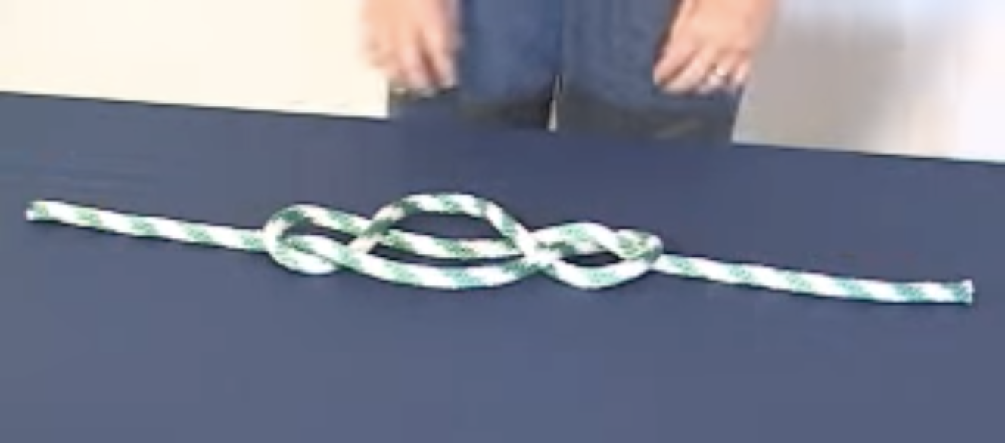
Game: Knot or Not
https://www.youtube.com/watch?v=RC03wAlU76c (start playing video at time 3:26)

Slide 5

Game: Knot or Not
Live Demonstrations

Slide 6
Debriefing
What did you observe? Any trends? Comments? Reflections?
What behavior helped the group to accomplish the task? What behavior hindered the group in completing the task?
How does this game apply to HIV care and/or your HIV program?

Slide 7
Center for Quality Improvement & Innovation
212-417-4730 (phone)
212-417-4684 (fax)
www.CQII.org
Info@CQII.org
This project is supported by the Health Resources and Services Administration (HRSA) of the U.S. Department of Health and Human Services (HHS) as part of an award totaling $1.5M. The contents are those of the author(s) and do not necessarily represent the official views of, nor an endorsement, by HRSA, HHS or the U.S. Government.

