Slide 1
Orienting Team Members to Community Health Workers (CHWs)

Slide 2
Learning Objectives
At the end of this unit, you will be able to:
Create a welcoming environment for CHWs
Outline steps associated with orienting a team to include a CHW
Identify challenges to achieving buy-in for a CHW position
Create an action plan to orient CHWs to other staff members
Notes:
Review the objectives.

Slide 3
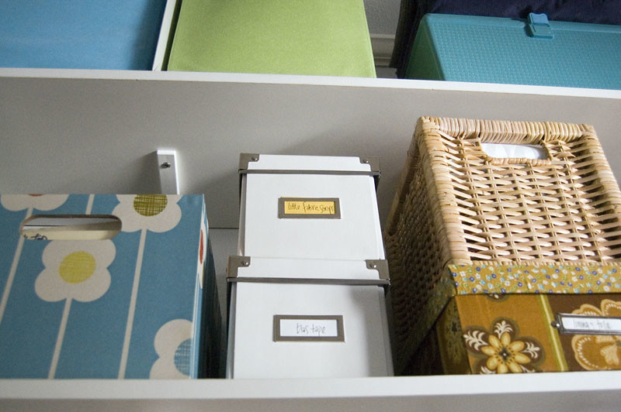
Welcome CHWs
VS
Notes:
Opening discussion:
Let’s take stock of our organization’s abilities and challenges in bringing in new staff members.
Ask, “How many of you feel the picture on the left describes the current state of affairs in your organization? How many feel the picture on the right represents your organization?”
Ask, “What are some of the items a CHW may need to start their role in the team?”

Slide 4
What CHWs Need
Space
Supplies
Protocols
Formal training
Professional development activities
Supervision
Notes:
Read the slide.
Talking points:
These items should be a starting point for your plan to welcome a CHW. Facilitate discussion on how organizations can create a welcoming and structured work environment for CHWs.
CHWs should feel there is a purpose and plan for their work and receive guidelines on how to carry out their duties.
Facilitate drawing activity (see lesson plan).
Now that you have a plan for where the CHW will work in the agency, it is important to have a formal orientation session/process for new hires. Ask, “What will your orientation look like for the CHW role?”

Slide 5
Importance of Orientation
It is critical to the success and sustainability of CHW programs that all employees in an organization understand the unique roles, philosophy, and goals of utilizing CHWs.
This understanding will also provide a workplace culture that is more likely to value CHW work and leadership within the organization (not valuing CHW work can lead to poor performance, absences, and turnover).
It also helps set the stage for new employees to view CHWs as their colleagues and coworkers.
Notes:
Review the slide.
Talking points:
The CHW model is still unfamiliar to many. Stakeholders’ opinions regarding CHW integration into delivery teams vary widely. In general, while patients’, CHWs’, and administrators’ reports are overwhelmingly positive, health care providers and staff tend to express more mixed feelings. For instance, some providers credit CHW services with improved quality of care, patient outcomes, and clinic operations, while others are hesitant to accept or are completely against the CHW role and presence on the team. (from the Sinai Urban Health Institute practice guide; link to resource in the lesson plan)
Ask, “What is your understanding of the CHW role?”

Slide 6
Orienting the Team
What the team needs:
To understand the unique role, philosophy, and goals of the CHW model
Help viewing CHWs as colleagues with a unique perspective
A work culture that is welcoming and values the CHW role
To know how to discuss CHW services with patients
To know how to plan services together
Ability to contribute to the ongoing development of CHWs
Notes:
Review the slide.
Ask for a volunteer to read each bullet and give an example if possible.

Slide 7
Strategies for Orienting Non-CHW Staff
Conduct an in-service presentation/training during an all staff meeting. Share the job descriptions that CHWs will perform to foster understanding.
Set up a series of individual meetings between CHW and non-CHW staff.
Test non-CHW staff for understanding of the CHW role.
Present the CHW role as yet another way to support our patients—show non-CHW staff how the CHW role will enhance their understanding of the patients.
Make sure non-CHW staff are making ongoing referrals to the CHW and marketing CHW services appropriately.
Notes:
Ask for a volunteer to reach each bullet on the slide.
Talking points:
Providing non-CHW staff with an orientation can result in the following outcomes:
CHWs, who may not have the depth of professional experience that other employees bring, will enter into a work culture that is welcoming and values their skills.
Non-CHW employees will be in a better position to know when to access CHW services; they will be able to maximize overall support for patients they may be working with collaboratively.
Non-CHW employees will know how to discuss CHW services with the broader community of service providers and clinicians; therefore increasing referrals to the CHW.
Diversity within the organization will be enhanced; more often than not, the inclusion of CHWs within the larger work context enhances diversity in terms of life experience, race, and class, which creates a stronger team in supporting patients.

Slide 8
Challenges to Achieving Buy-In
Challenges | Consequences | Potential Solutions
Notes:
Brainstorm with participants:
What are some of the challenges to buy-in with staff?
What are some of the consequences?
What are potential solutions?
Note responses on a flip chart sheet.

Slide 9
Challenges to Achieving Buy-In
Challenges | Consequences | Potential Solutions
Physicians and staff expressing difficulty in trusting or accepting CHWs due to paraprofessional status Clinical staff expressing resentment about or feeling threatened by the presence of a CHW on the team (staff competition) Lack of time; schedule disruption | Underutilization of CHW CHWs appease staff by doing favors (e.g., acting as receptionist, retrieving charts, faxes) – diverting CHW’s time from their duties CHW under supervised | Educate clinical staff about CHW training and appropriateness to role Include key medical staff in training process; development of training standards Educate staff on CHW model, role, boundaries, referral structure Foster teamwork Emphasize role as supplemental and not a replacement for other staff
Notes:
Review the slide, highlighting the similarities and differences between the points generated by the group and those on the slide.

