Slide 1
CQII Quality Academy The PDSA Cycle

Slide 2
Let’s Review
So far, we have discussed:
Performance measurement and its importance
Data as the key in knowing what to improve
The Model for Improvement and its three steps
This gives us a structured methodology
We use different techniques to finalize an idea for improvement
And today we will go over…
2

Slide 3
Learning Objectives
Today we will give you a better understanding of:
The steps in the PDSA Cycle
How you learn from theory and prediction
How to start a PDSA Cycle
The importance of a plan with clear objectives and staff roles and commitments
How your data help you tweak and improve your plan
3

Slide 4
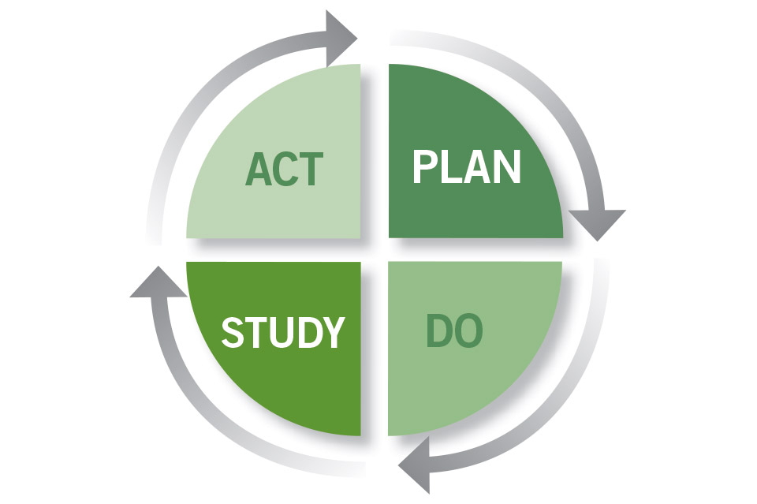
Introducing the PDSA Cycle AKA The Deming Wheel
The PDSA Cycle, designed to test a change, was first introduced to W. Edwards Deming by his mentor, Walter Shewhart of Bell Laboratories in New York.
Deming amended the Shewhart Cycle and replaced Check with Study. He felt it made individuals look more deeply at their data.
4

Slide 5
Why Do We Use PDSA Methodology? Why Do We Need To Test Change?
To increase your belief that a change will result in an improvement
To evaluate how much improvement can be expected from the change
To decide if the change will work in your environment
To evaluate cost, benefits, impact, and unintended consequences
Lessen stakeholder resistance by starting small and proving the concept
5

Slide 6
Understanding the PDSA Cycles
The PDSA Cycles start with small tests and ramps up to bigger tests
After each test, see if your result matches your hypothesis
Implement another test based on the results of the prior test
If successful, increase the number of clients or days or providers, or whatever is needed to expand the scope of the test
If not successful, tweak your test and try again with a small sample
Don’t be afraid to abandon the idea if continuous testing doesn’t match the hypothesis
Each test of the change helps to improve your ability to reach your goal by adjusting the intervention according to what you learned
10

Slide 7
Step 1: PLAN
State the objective of the test
Choose the team and clarify roles: Who will do what, when, why and where
Your hypothesis makes a prediction about what will happen (ours was: If we lower the no-show rates, then our viral suppression will increase)
Determine your first test population – start small
Develop your step measures
Step measures give you an indication of the accuracy of your hypothesis
They provide structure to make sure you’re accurately measuring the test
You collect data on them in the Do Cycle so you can compare the test result to the hypothesis
Document each test – leave an audit trail for this project and a teaching aid for future projects
11

Slide 8
PLAN Cycle Example Decreasing the “No Show” Rate
Our Data Analysis, Root Cause Analysis, Brainstorming, and Force Field Analysis have led us to the hypothesis that implementing an Uber contract for client transportation will decrease the “No Show” rate from the current 30% to 10%
Hypothesis: If we do this, then this will happen
We have brought more specificity to our hypothesis
12

Slide 9
PLAN Cycle Example Decreasing the “No Show” Rate
The plan for the first cycle is:
One Case Manger will arrange the transportation for clients with the highest “No-show” rates
The number of missed appointments will be documented
The client’s satisfaction with the service will be documented
The first cycle will include one client with an appointment on one day, who has already missed 2 appointments in a row due to lack of transportation
We choose one client to start
The receptionist will collect the data
13

Slide 10
Let’s Examine The Plan and Review
You analyzed data
You set step measures:
The number of missed appointments will be documented
The client’s satisfaction with the service will be documented
You started small (one client, one day)
You have the infrastructure in place
14
Notes:
Data collection instrument

Slide 11
Step 2: DO
Carry out your plan
Collect data on your step measures
Make sure the data are directly related the hypothesis
Use a standardized data collection tool
Check sheet
Excel
Document
Documenting steps as a permanent record of your activities
It acts as a road map for future tests
It’s a training tool for staff now and in the future; turn over negatively affects quality
Note anything unexpected that happened
15

Slide 12
DO Example
Case Manager arranges the Uber pick up for the one client
Receptionist notes that the client did not miss the appointment
Client satisfaction with service was logged
No barriers were noted, nothing unexpected happened
The check sheet may look like this:
Pt Id | Pt. presented | Pt. saw prescriber | Pt satisfaction rating 1 = Bad/5 = good | comments
12345 | Yes or no | Yes or no | 4
16

Slide 13
Step 3: STUDY
Analyze the data collected by your step measures
Compare your data to your hypothesis
Did the test work as predicted?
Did the data match or come close to the hypothesis?
Summarize and reflect on what you learned
17

Slide 14
Step 3: STUDY Example
The cycle was implemented with one client and the plan worked as predicted
The step measures showed:
The client indicates satisfaction with the service
The client made the appointment
Feedback from the case manager and receptionist indicates that expanding the scope of the test as is, would be advised
Continue
18

Slide 15
Study Cycle Summary
We analyzed the data
We see that we achieved the result we thought we would
We received input from the team
We then proceed to the Act Cycle
19

Slide 16
Step 4: ACT
Your action should depend on what you learned
Should you expand the scope of the test for the next cycle?
Do you need to modify the intervention and retest a small sample?
After a few tests, decide if:
You should abandon if no test seems to support the hypothesis
Rethink the hypothesis if inconclusive
Share your results and get feedback and input from your quality improvement teammates
20

Slide 17
Step 4: ACT Example
The results of the first test are shared with the team
The team decides to expand the test to 3 other clients who are chronic no-shows
Enter the Plan phase for Cycle 2
Continue
21

Slide 18
Act Cycle Summary
This is where you apply your analysis and observation
If you are satisfied with the result, you expand the test
If you are not satisfied with the result, you may consider tweaking it
In this phase, you conceptualize the next test
How many clients involved
The staff member(s) involved in testing
Move on to the next cycle
22

Slide 19
Plan Cycle 2: Three Clients
PDSA Cycle Step | Action
Plan | Expand test to 3 additional clients
Do | Case Manager contacts 3 clients with upcoming appointments and arranges their Uber transportation
Study | > Receptionist documents that 2 clients arrived and departed as planned > One client was not available for pick up > Follow up indicates that 2 clients were satisfied with the service and 1 client was waiting for pick up at a different address > Case Manager notes that the agency had to pay for all 3 rides
Act | > Case manager adds an updated address check before arranging rides, to her To Do list > Case manager advises a small increase in test scope
23

Slide 20
Cycle 3: Five clients
PDSA Cycle Step | Action
Plan | Case Manager confirms current addresses and arranges Uber rides for 5 clients with appointments in the first 2 weeks of May
Do | Four clients arrive on time and 3 arrived at home at the prescribed time. One client cancels appointment the day of appointment
Study | > Three clients express satisfaction, 1 client expresses frustration with Uber delay going home. Driver got caught in the Cinco De Mayo parade traffic > Receptionist did not make Case Manager aware of the cancellation, so agency had to pay for that ride
Act | > Test not matching the hypothesis > Case manager calls a team meeting before entering next cycle
Continue
24

Slide 21
Time for a Team Meeting
Case Manager expresses frustration at the amount of work involved
Requests that clients be able to schedule their own rides
Due to possibility of abusing Uber Health rides and charges, the team denies the request
Receptionist offers to schedule rides. Since she already handles the cancelations, she will be the point person for ride schedules
Receptionist will add the Uber information when the standard client appointment reminders go out
Receptionist will coordinate with Case Manager, and Case Manager will to continue to document success and failure of rides as well as client satisfaction
25

Slide 22
Cycle 4: Repeat with 5 New Clients
PDSA Cycle Step | Action
Plan | > The team plans to pick 5 new clients > Receptionists schedules 5 rides for clients for the following Monday
Do | > Reminders that include the Uber Health info are communicated to the client two days prior to appointment > Pick up addresses are confirmed by receptionist
Study | > Four clients arrive and depart on time, one client cancels appointment > Four clients express satisfaction with the service > Fifth client pick was able to be cancelled, so no charges to the agency for that client
Act | Expand test to all clients who are chronic no-shows for the following week who need transportation
26

Slide 23
Summary
Small tests are necessary to test the idea
If the idea works in a small test expand the test
If the idea isn’t supporting the hypothesis; decide to review the data and test a new idea, tweak the current idea or abandon your hypothesis
If an idea is fully implemented without testing, the results could harm the operation of an organization
Imagine the confusion if there were dozens of chronic no-show clients now getting Uber Health rides
Imagine the task of tracking all these clients
In our model project, we saw:
Inconsistent early results
Frustration by the case manager
Changes to our test
Receptionist takes on more coordination responsibilities
Communication was approved; cancelled appointment coordination improved
27

Slide 24
Summary
We made adjustments as necessary
Our repeated tests gave us increase confidence in our change idea
The quality improvement project team worked together to analyze the data and keep the focus on the project
PDSA Cycles are iterative; never claim success or failure after one test
28

Slide 25
Resources
PDSA Cycles
https://www.youtube.com/watch?v=gEbV1yg0LwU
PDSA Cycle worksheet
https://targethiv.org/library/mfipdsa-worksheet
Foundation and History of the PDSA Cycle
https://deming.org/uploads/paper/PDSA_History_Ron_Moen.pdf
Request CQII technical assistance
https://targethiv.org/cqm-ta-request
29

Slide 26
To view the presentation, go to: https://youtu.be/tJSB5GesaWA

Slide 27
Properties
On passing, 'Finish' button: Goes to next slide
On failing, 'Finish' button: Goes to next slide
Allow user to leave quiz: After user has completed quiz
User may view slides after quiz: Any time
Show quiz in menu as: Multiple Items
Edit in Quizmaker
Edit Properties

