Slide 1
Using Data for Decision Making: Part 1
May 23, 2019
2:00 PM - 3:30 PM ET
Molly Tasso (Planning CHATT)
  Jesse Carter (Planner, HIV/STD Prevention and Care Branch, Texas Department of State Health Services)
Notes:
Molly
Hello everyone, and welcome to today’s webinar, part one of the Using Data for Decision Making webinar series. My name is Molly Tasso and I am a Technical Assistance Coordinator for the Planning CHATT project.

Slide 2
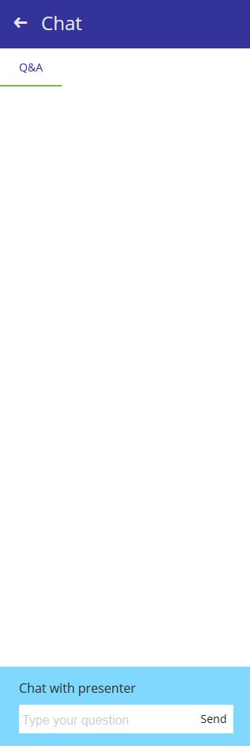
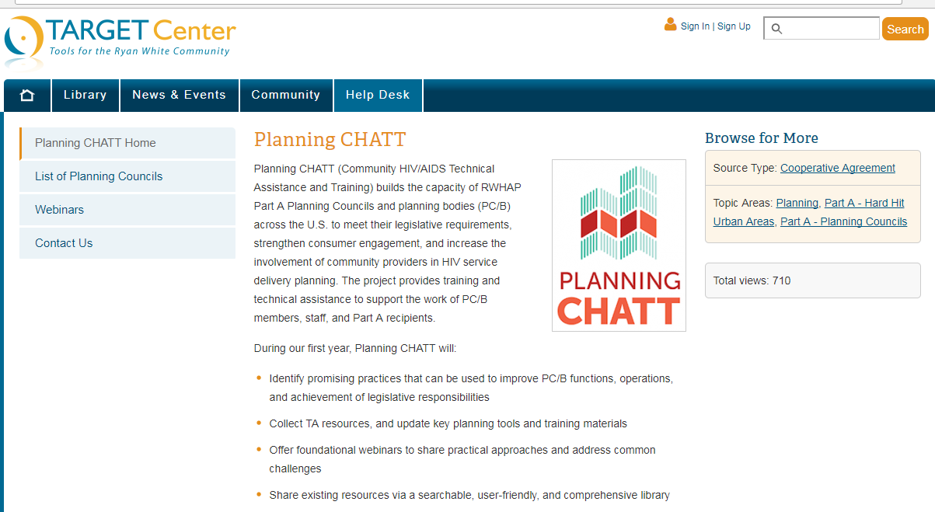
How to Ask a Question
Attendees are in listen-only mode.
If you have a question, use the chat box at the lower-left of your screen to chat with the presenter.
You may also email questions to planningCHATT@jsi.com after the webinar.
Notes:
[Molly ]
Before we get started, here are some technical details. First, attendees are in listen-only mode but we encourage you to communicate with each other and ask lots of questions using the chat box! You can submit your questions at any time during the call, or during the question period at the end. Our presenters, along with Planning CHATT staff, will take as many of your questions as we can at the end of today’s session. And if you think of a question after the webinar that’s fine too – you can always email questions to us at planningCHATT@jsi.com.

Slide 3



Can You Hear Us?
The audio is being shared via your computer speakers/headset.
If you can’t hear the audio, make sure your computer audio is turned on.
If you’re still having problems, please chat the host.
Call-in number: 800-289-0459
Passcode: 482318
Notes:
[Molly ]
The easiest way to listen to our webinar is through your computer. If you can’t hear very well, check to make sure your computer audio is turned on. If you still can’t hear us, or if you experience a sound delay at any point, try refreshing your screen.
And finally – if needed - you can mute your computer audio and call in using your telephone at the number you see on your screen. You’ll need to use a passcode, which is also listed on the screen. We have also put this information in the chat box.

Slide 4
Agenda
Importance of Data in RWHAP Planning
Types and Sources of Data Commonly Used for RWHAP Planning
Addressing Gaps in Data
Assessing Data Quality and Usefulness
Importance of Using Multiple Data Sources for Decision Making
Resources
Questions and answers
Notes:
Molly
We’ll start off today with an overview of the importance of data in RWHAP planning and types and sources of data commonly used for RWHAP Planning, then move into strategies to address gaps in data, assess data quality and usefulness and talk about the importance of using multiple data sources for decision making. We’ll go over some resources that you can refer to after the webinar, then answer questions at the end. We’ll be taking questions through the chat box throughout the webinar, but we’ll wait to respond to them until the end of the presentation.

Slide 5
Objectives
By the end of the webinar, you will be able to:
Articulate the benefits of using data for HIV planning and decision making.
Define important data-related terminology.
Identify and describe types of data PC/PBs use for HIV planning and decision making.
Assess quality and comprehensiveness of data.
Notes:
Molly
As you can see here, by the end of the webinar, our objective is that you are:
Articulate the benefits of using data for HIV planning and decision making.
Define important data-related terminology.
Identify and describe types of data PC/PBs use for HIV planning and decision making.
Assess quality and comprehensiveness of data.

Slide 6

Planning CHATT
Notes:
Molly
As you know, these webinars are put on by the Planning CHATT project.

Slide 7
Community HIV/AIDS Technical Assistance and Training (Planning CHATT) Project
Planning CHATT builds the capacity of Ryan White HIV/AIDS Program (RWHAP) Part A planning councils/planning bodies and planning bodies (PC/PB) across the U.S.
Our goal is to help PC/PB to meet legislative requirements, strengthen consumer engagement, and increase the involvement of community providers in HIV service delivery planning.
Notes:
Molly
Planning CHATT builds the capacity of Ryan White HIV/AIDS Program (RWHAP) Part A planning councils/planning bodies and planning bodies (PC/PB) across the U.S.
Our goal is to help PC/PB to meet legislative requirements, strengthen consumer engagement, and increase the involvement of community providers in HIV service delivery planning.

Slide 8
Webinar Presenters
Molly Tasso
Planning CHATT
Jesse Carter
  Planner, HIV/STD Prevention and Care Branch
  Texas Department of State Health Services
Notes:
Molly
Today, we’re thrilled to have with us Jesse Carter, a Planner with the HIV/STD Prevention and Care Branch of the Texas Department of State Health Services. BIO HERE.
Jesse will be presenting most of the information on today’s webinar, drawing from his experience conducting planning activities for planning bodies across the state of Texas, and I will be popping in to help facilitate polls and discussion questions. My colleagues from the Planning CHATT project, as well as Emily McKay from EGM Consulting, will be answering questions together at the end of the presentation.

Slide 9
Importance of Data in RWHAP Planning
“Without data, all anyone has are opinions. Data elevates the probability that you’ll make the right decision.”
– W. Edwards Deming
Notes:
Jesse

Slide 10
What is Data-based Decision Making?
Definition: Decision making that is guided and supported by documented information – data – rather than based primarily or solely on personal experience, observation, anecdotes, or intuition/insight
Data used by PC/PBs should include:
  Quantitative and/or qualitative information obtained and reviewed systematically using sound methods
  Information from multiple sources, gathered using several different approaches
Some experts prefer the term “data-informed” decision making, since decisions are based on multiple factors
Notes:
Jesse

Slide 11
Qualitative v. Quantitative Data
Quantitative data: Information that can be expressed in numbers, counted, or compared on a scale – such as epi data or PLWH survey data
Qualitative data: Information that cannot easily be measured or expressed in numbers – such as narrative data from a focus group, consumer town hall meeting, open-ended interview, or direct observations
  Usually described in terms of common themes and patterns of response
  Often complement and help explain quantitative data
Notes:
Jesse

Slide 12
Poll
Why is it important to use data for HIV planning? (select one)
Helps establish, support, and improve systems of care.
Data guide important HIV planning processes.
Helps make accurate and appropriate planning decisions.
Helps avoid decision making based on ‘impassioned pleas’.
All of the above
Notes:
Molly
Answer: Correct answer is E – all of the above.
Each of these are reasons that data is important for HIV planning. I’m going to hand it back over to Jesse who’s going to go into a little more detail…

Slide 13
Importance of Data
Data-based decision making is essential to establishing, supporting, and improving a system of quality care
Data guide the entire planning process – essential for all PC/PB roles:
  Understanding service needs, barriers, and gaps in your service area – overall and for PLWH subpopulations
  Making sound decisions about use of available funds
  Targeting funds to particular service models, geographic areas, and PLWH subpopulations
  Improving care for disproportionately affected groups
Notes:
Jesse
Talking points:
Data from multiple sources are needed to:
Provide an understanding of diverse service needs of PLWH with varied characteristics and/or from different parts of the service area
Highlight service barriers and gaps
Help identify service models with positive clinical outcomes for all PLWH or particular subgroups
Help ensure best use of limited resources
Contribute to fair and objective decisions
Without access to adequate data from multiple sources, decisions are often based on personal experience or “impassioned pleas”

Slide 14
Challenges of Using Data
Everyone uses data in daily life, but people new to community planning may have limited experience in use of data for planning decisions
Most PC/PB members need training on HIV-related data terms,
data sources, and how to assess and use data
Data are not always presented in user-friendly formats
Full discussion and review of new data and analyses require time
and effort
Notes:
Jesse

Slide 15
Discussion
What are some of your PC/PB’s challenges in using data for HIV planning? Chat in answer.
Notes:
Molly
So we’re going to take a quick moment and have you respond to this question in the chat box - what are some of your PC/PB challenges in using data for HIV planning? For example, do you have challenges getting some types of data? Do your members have trouble understanding and interpreting data? Or are there challenges discussing or talking about data?

Slide 16
How PC/PBs Use Data to Illuminate and Address Disparities
Notes:
Jesse

Slide 17
Four Common Types of Disparities Addressed
Through HIV Planning
Unmet need
Service gaps
Availability of services
Geographic disparities
Notes:
Jesse

Slide 18
Unmet Need
What it is: Refers to individuals with HIV in a jurisdiction who know their status but are not receiving HIV-related medical care
How it’s measured: Estimate based on a HRSA/HAB Unmet Need Framework, now being updated – basic approach:
  Determine the number of PLWH in the jurisdiction through surveillance data
  Subtract the number who are “in care” based on measures like viral load or CD4 count – the rest are assumed to be out of care and have unmet need.
How it can be addressed with HIV planning: Provide funding for service categories and help develop strategies that link PLWH to care immediately after diagnosis and for find, relink, and retain in care those who dropped out
Notes:
Jesse
EGMC:
Funding of Early Intervention Services or Outreach, directives or refined models such as use of Community Health Workers associated with MCM -- all examples of addressing unmet need. The estimate is done by surveillance/recipient. The PC/PB usually does an assessment of unmet need every few years as part of Needs Assessment to find out more about people who are out of care.

Slide 19
Service Gaps
What it is: The identified unfulfilled need for HIV- related services other than primary medical care among individuals who know their HIV status and live in a specified geographic area.
  This term is used to avoid confusion with the HAB definition of “unmet need” as referring to primary medical care.
How it’s measured: Through needs assessment & recipient data
  A PLWH survey asking what services they needed but didn’t receive
  Recipient identification of services with waiting lists or appointment delays
How it can be addressed with HIV planning: Provide funding or directives designed to make needed services more available
Notes:
Jesse
To include in talking points:
This term (service gaps) is used to avoid confusion with the HAB definition of “unmet need” as referring to primary medical care.
From EGMC:
Typically a PLWH survey lists service categories and asks what services the respondent needed and got, needed but didn't get, or didn't need. Profle of Provided Capacity and Capability can also ask providers which if any of their services have appointment delays or waiting lists and which services clients need but they have trouble making successful referrals to arrange them. Can also ask through focus groups, of course. Often recipients ask subrecipients to report any waiting lists or delays in access top their services in their monthly or quarterly narrative reports.

Slide 20
Availability of Services
What it is: Level or number of available “slots” within a service category in a specified geographic area, and whether there are waiting lists
How it’s measured: As part of a Resource Inventory or Profile of Provider Capacity and Capability, asking providers (Part A and non-Part A) how many service slots they have for each HIV service, and whether they have more demand than slots
How it can be addressed with HIV planning: Increase funding for service categories with insufficient slots or explore refined service models
Notes:
Jesse
Module 4 Trainer Notes:
Availability of services: The level or number of “slots” within a service category that exist in a specified geographic area—such as the total number of funded outpatient substance abuse treatment slots for PLWH within an EMA or TGA
EGMC:
This can also be addressed jointly by the recipient and PC/PB by looking at access to care issues -- might mean increasing training for case managers or being sure there is a good Resource Directory for referrals, involving providers in roundtables at the PC/PB to discuss how to improve access to services through changes in how services are delivered, etc. -- part of the shared responsibility of maintaining a comprehensive and high quality system of HIV care

Slide 21
Geographic Disparities
What it is: Differences in access to needed services based on where an
individual lives
How it’s measured: By comparing the number (or capacity) of service providers offering needed services across geographic areas in the EMA or TGA in an
accessible way
How it can be addressed with HIV planning: EMAs and TGAs can use this information, found in the needs assessment, to better understand and address geographic disparities and inequities in access to care.
Notes:
Jesse
From Module 4 Trainer Notes:
Geographic disparities are differences in access to appropriate services based on where within the EMA or TGA an individual lives. Equal access to quality services for all PLWH, regardless of where they live in the EMA or TGA, is an important RWHAP commitment. Many EMAs and TGAs use needs assessment to better understand geographic disparities and inequities in access to care.
This might be determined through combining data from the Resource Inventory and the Profile of Provider Capacity and Capability, which might show, for example, a lack of service providers offering outpatient ambulatory health services (OAHS), medical case management, mental health services, and/or support services for PLWH who live in a rural community or outlying county. Such issues can also be identified through a PLWH survey that asks how far the individual has to travel to obtain services or what if any services are not available or are not appropriate due to lack of language or cultural capacity.

Slide 22
Types and Sources of Data Commonly Used for RWHAP Planning
Notes:
Molly
(move to poll on next slide)

Slide 23
Poll
Which of these five data sources are you MOST comfortable working with (select one)?
Epidemiologic Profile Data
Care Continuum Data
Needs Assessment Data
Resource Inventory
Service Expenditure and Cost Data
Client Characteristics & Service Utilization Data
Notes:
Molly
Before we move into a discussion of different Types and Sources of Data Commonly Used for RWHAP Planning, let’s take a couple quick polls to see where people are at in terms of their level of comfort working with data.
Please respond to this question…which of these give data sources are you most comfortable working with?

Slide 24
Poll
Which of these five data sources are you LEAST comfortable working with (select one)?
Epidemiologic Profile Data
Care Continuum Data
Needs Assessment Data
Resource Inventory
Service Expenditure and Cost Data
Client Characteristics & Service Utilization Data
Notes:
Molly
And somewhat similarly, please let us know which of these five data sources you’re least comfortable working with…

Slide 25
Epidemiologic Profile
What it is and what it shows:
A document that describes the burden of HIV on the population of an area including distribution of HIV in various populations in an area in terms of sociodemographic, geographic, behavioral, and clinical characteristics
Includes characteristics of the general population, persons newly diagnosed with HIV infection, persons living with HIV disease, persons at risk for HIV
Trends in the epidemic
Where it comes from:
Provided by state or local HIV surveillance staff, from eHARS (enhanced HIV/AIDS Reporting System) data
Usually based on a calendar year
Notes:
Jesse

Slide 26
Epidemiologic Profile, continued
How it’s used:
Provides an overall picture of HIV in the service area
Helps in identifying subpopulations and geographic areas with increasing rates of HIV
  Enables recipient and PC/PB to develop or refine services to ensure appropriate care for emerging groups
  For an integrated prevention and care PC/PB, helps in identifying populations for primary prevention, testing, and prevention for HIV-positive individuals
Helps in identifying populations for focused special attention in assessment of PLWH service needs and barriers
Notes:
Jesse

Slide 27
Sample Epi Profile Chart:
Newly Diagnosed HIV Cases by Year and Gender Identity
645
526
437
392
347
Source: Annual Epidemiology and Surveillance Report: Data through 2016, Washington, DC
Notes:
Jesse

Slide 28
HIV Care Continuum Data
What it is and what it shows:
Model that outlines the stages of HIV medical care that people living with HIV go through from initial diagnosis to achieving the goal of viral suppression and shows the proportion of individuals living with HIV who are engaged at each stage.
Two kinds of care continuums: Prevalence based and diagnosis based
Where it comes from:
Data provided by state or local HIV surveillance staff
Provided at least annually; sometimes more often
How it’s used:
Helps PC/PB understand strengths and weaknesses in system of care and identify need for additional attention to particular steps (e.g., linkage, retention, viral suppression) and PLWH subpopulations.
Notes:
Jesse

Slide 29
Prevalence-based HIV Care Continuum, U.S., 2014
Source: CDC
This is called the prevalence-based HIV care continuum because it shows each step as a percentage of the total number of people living with HIV, including people who have been diagnosed and aware they are living with HIV and those who have not been diagnosed and don’t know they are living with HIV.
Notes:
Jesse

Slide 30
Diagnosis-Based HIV Care Continuum, U.S., 2014
Source: CDC
This is called the diagnosis-based HIV care continuum because it shows each step as a percentage of people living with diagnosed HIV.
Notes:
Jesse

Slide 31
Discussion
Which of type of HIV care continuum do you think is most useful for your PC/PB – prevalence-based or diagnosis-based?
Tell us which one and why in the chat box.
Notes:
Molly
We’re going to pause quickly and see if anyone has any reactions to this last piece about HIV care continuums … take a moment and let us know in the chat box, if you think a prevalence-based or diagnosis-based care continuum might be more useful for your PC/PB, and why.

Slide 32
Needs Assessment Data
What it is and what it shows:
Number, characteristics, service needs and barriers of PLWH, both in and out of care
Provider resources available to meet those needs
Service gaps, overall and for various PLWH subpopulations
Where it comes from:
  Data from needs assessment activities conducted by PC/PB, including staff and/or consultants
  Usually a multi-year cycle, with some new data collected each year
How it’s used:
Set priorities, allocate resources, develop directives, and improve service access and quality, overall and for specific populations
Notes:
Jesse

Slide 33
Sample Needs Assessment Data: PLWH Survey
The most frequently reported life situation PLWH said they dealt with over the past 12 months was not having money for food and other necessities
Male PLWH were the most likely to report not having enough money for food and other necessities and being in danger of losing their home
Transgender PLWH were the most likely to report homelessness
Notes:
Jesse

Slide 34
Resource Inventory Data
What it is and what it shows:
A regularly updated, comprehensive listing and description of HIV-related services available to PLWH in the EMA or TGA, regardless of funding source
Provides information on types of services provided, location and hours, number of clients served, and funding sources – often in chart form
Often includes information on levels of funding from non-Part A sources
Where it comes from:
  Usually developed as part of the Needs Assessment, under PC/PB supervision
How it’s used:
  Used in integrated/comprehensive plan development and during the PSRA process
  Often used to develop Resource Guide for service providers and clients
Notes:
Jesse

Slide 35
Example of resource inventory
Provider Name | Location/ Service Area | Funding Sources | Core Medical Services and # of Slots | Support Services and # of Slots
Jefferson Clinic | MidCity – Serves entire TGA | Part A, Part C plus private funds – $3.7 million | OAHS - 240 MCM – 200 Mental Health – 100 Med Nutr Ther – 75 | Transportation – 50% of clients Outreach – 120
Wellington Community Health Center | North End – targets Wards 2 and 3 | Part A, Part B – $3.2 million; State Mental Health - $700K | OAHS – 150 MCM – 200 Oral Health – 300 Mental Health – 100 | Transportation – 30% of clients Food Pantry – 300
Women Helping Women | South Side – targets women in central city | Part A, Part D, State Substance Abuse Funds – $1.3 million | Outpatient Substance Abuse – 78 Mental Health - 56 MCM – 50 | Transportation – 70 NMCM – 55
Notes:
Jesse

Slide 36
Service Expenditure and Cost Data
What it is and what it shows:
  Projected and actual expenditures by service category, plus:
      Costs for one unit of service, such as 1 case management visit lasting 30 minutes
      Cost to serve one client for a year
Where it comes from:
  Recipient or administrative agency
  Expenditures usually provided monthly, with an annual summary
How it’s used:
  Helps PC/PB make funding decisions, adjusting allocations based on actual use of funds and determining costs to serve additional clients
Notes:
Jesse

Slide 37
Sample TGA Expenditures Summary for Core Medical Services
Notes:
Jesse
What percent of funding would you expect to see expended as of the end of the 10th month of the program year?
What concerns does this report raise for the PC/PB?
How might the PC/PB use this information?

Slide 38
Client Characteristics and Service Utilization Data
What it is and what it shows:
  Information about the use of RWHAP Part A services, including the number and characteristics of clients, overall and by service category, and the amount or units of service provided
Where it comes from:
  Recipient, usually gathered through its client-level data system and included in the RWHAP Services Report (RSR)
  Provided annually
How it’s used:
  Helps PC/PBs understand demand for specific services and identify differences in use of services by various PLWH groups
Notes:
Jesse

Slide 39
Sample SW EMA Client Data
Notes:
Jesse

Slide 40
Poll
What other types of data do you use for HIV planning? Select all that apply.
HIV tests and diagnoses
Unmet need data (estimate and assessment)
Clinical Quality Management (CQM) data
Recipient monitoring data
Performance measures and clinical outcomes data
Other? Chat it in.
Notes:
Molly
Before we move onto the next section, we’re curious if there are other types of data that you and your PC/PB use for HIV planning. If so, please select one of the answers on the screen, or chat in the chat box if the data type you’re thinking of isn’t listed.

Slide 41
Addressing Gaps in Data
Notes:
Jesse

Slide 42
Dealing with Data Gaps
No PC/PB has all the data needed for decision making
Data gaps often caused by:
  Limited resources
  Limited needs assessment and data analysis skills and experience on the part of PC/PB and/or recipient staff
  Lack of agreements with state surveillance staff to provide newer types of data
  Limited time for data gathering or analysis, given other responsibilities
  Lack of agreement between PC/PB and recipient regarding data needs and how best to meet them
Notes:
Jesse

Slide 43
Addressing Data Gaps
Become familiar with the various types of data that should be available to the PC/PB based on sound practice and HRSA/HAB guidance
Incorporate data sharing agreements into your Memorandum of Understanding (MOU), including:
  What data the recipient will provide
  In what formats
  On what schedule
Explore what data needs can be met by the PC/PB, PCS, or consultants through needs assessment, town halls, roundtables, or other approaches
Notes:
Jesse

Slide 44
Addressing Data Gaps, cont.
Maximize use of existing data through improved analysis
Make a chart showing needed data types, content, use, and current or potential sources
Develop a plan to fill remaining gaps
  Explore what PC/PB members, service providers, or other stakeholders can provide
  Seek help from area universities
Notes:
Jesse

Slide 45
Assessing Data Quality & Usefulness
Notes:
Jesse
Talking point:
All data are not “created equal” so PC/PBs need to assess the quality of the data and reports they receive.

Slide 46
Not All Data are Created Equal!
There are multiple ways data can be ‘of poor quality’
Outdated
  Example: Care continuum developed using data from 10 years prior
Incomplete
  Example: Service expenditure data with several service categories missing
Unclear
  Example: Resource inventory data does not specify RWHAP funding source for services (e.g. RWHAP Part A, Part B, Part C, etc.).
Notes:
Jesse

Slide 47
Bottom line:
Data quality is important!

Slide 48
Assessing Data
PC/PB member roles:
Review data from multiple sources
Ask questions about how data were gathered, tabulated, and analyzed
Compare and weigh data from different sources and studies
Decide how much confidence to place in the data
Give the greatest weight in decision making to the “best data”
PC/PB Support Staff, Consultants, and Recipient Staff roles:
Provide/present data from various sources
Understand and share information on data quality and limitations
Notes:
Jesse

Slide 49
Helpful Questions to Ask in Assessing and Interpreting Surveys and Studies
Who was responsible for the study?
Were knowledgeable consumers and other PLWH involved in design?
Does the “tool” use good questions? Are they clear and understandable? Do they seem likely to generate reliable data that really measure what the study is supposed to be measuring? Was the tool pre-tested?
What was the sample size? Is it representative?
What evidence is there that the data were collected using appropriate methods and trained individuals?
Was there “quality control” to be sure the stated data gathering and analysis process was followed?
Notes:
Jesse

Slide 50
Importance of Using Multiple Data Sources for Decision Making
Notes:
Jesse

Slide 51
Data Triangulation
A PC/PB can have additional confidence in findings found in more than one needs assessment activity, study, or data set, and can use multiple methods to increase understanding of a topic or issue – that process is called triangulation.
Bottom line: Review more than one data source when available.
Notes:
Jesse
Information to use for talking points
Triangulation:
Can involve data from several types of needs assessment (e.g., PLWH survey, focus groups, epi data, provider survey)
Can also involve data from the recipient or other sources – epidemiologic data, RSR data on client utilization, performance measures such as HIV care continuum data
Often involves comparing quantitative and qualitative data
Comparisons should involve critical review of methods used to obtain data from each of the sources, to decide how much confidence to place in the data

Slide 52
Triangulation of Data
The process of comparing data on the same topic from 2 or more sources or research studies to:
  See whether they report similar findings – “cross check” or “cross-validate” the data
  Increase understanding of the topic
PC/PB can have greater confidence in findings that are reported from several different studies or sources, or obtained through different methods
Notes:
Jesse
Information to use for talking points
The process of Triangulation involves:
Look at multiple data sources to see what information they provide on the topic of interest
Compare data to determine similarities and differences
Explore possible reasons for differences
Assess data sources to determine which should receive the most “weight”
Where findings are similar across sources, especially the “better quality” sources, use those findings in decision making
Use findings to inform additional data gathering

Slide 53
Resources
Notes:
Molly
Thanks so much, Jesse!
I see that you all have been chatting in questions as we’ve been going through this. We’ll get to them in a moment, but I first want to direct you to some resources that you can access after this webinar. While I’m talking about the resources, think about any questions that you have and chat them in.

Slide 54

Compendium of Materials for Planning Support Staff
www.targetHIV.org/planning-chatt/pcs-compendium
Quick Definitions and Descriptions for Data-related Terms and Concepts Used by RWHAP Planning Bodies
Understanding and Using Data: Model Planning Council Training Session
Notes:
Molly
As many of you hopefully know, the Compendium of Materials for Planning Council Support staff is available on the Planning CHATT website and contains some great resources. Specifically, the Quick Definitions and Descriptions for Data-related Terms and Concepts Used by RWHAP Planning Bodies and the Model Planning Council Training Session on Understanding and Using Data are two great resources both related to what we’ve talked about today, and I would encourage you to check them out.

Slide 55
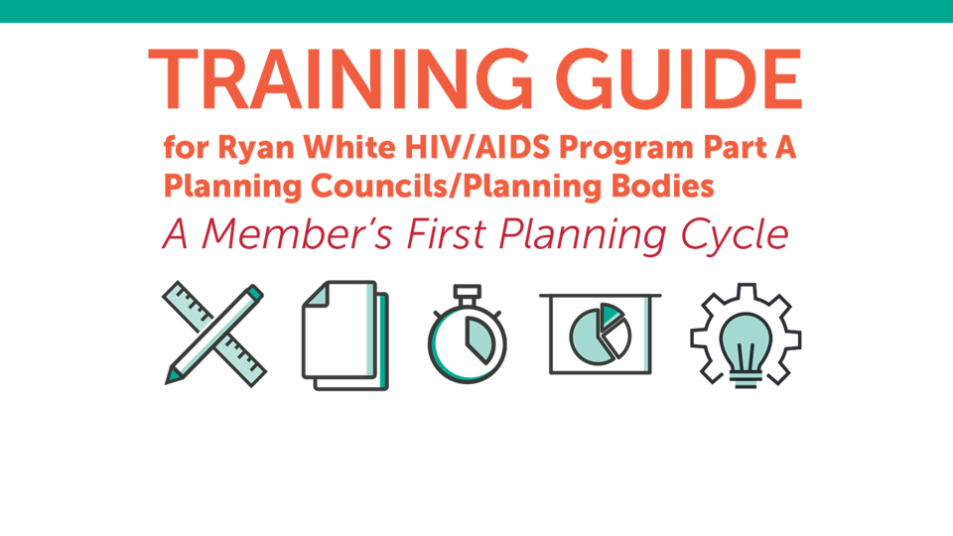
Training Guide for RWHAP Part A Planning Councils /Planning Bodies
www.targetHIV.org/planning-chatt/training-guide
Notes:
Molly
Lastly, the Training Guide is designed to help planning councils/planning bodies (PC/PB) conduct orientation and ongoing training to prepare members to participate fully in RWHAP Part A planning and decision making.
The Training Guide is composed of ten modules and includes things like trainer notes, presentation slides, experiential activities and quick reference handouts. It’s a really great resource to help onboard new PC/PB members – or can be a great refresher for those who have been around a while.

Slide 56
Data-specific Training Guide Modules
Module 4: Needs Assessment
Module 5: PSRA
Module 7: Maintaining and Improving a System of Care
Coming soon!
Module 10: Data-based Decision Making: Understanding, Assessing, and Using Data
Notes:
There are a number of modules which delve into PC/PB activities that involve the collection, assessment, understanding and use of data (about PLWH needs, service availability, service utilization and service quality).
I’m excited to announce that Module 10 - Data-based Decision Making: Understanding, Assessing, and Using Data – will be released very soon and includes, but also goes above and beyond the content covered today. We will be sending an email to our CHATT listserve once the module is posted online so make sure you’re signed up to receive this alert.

Slide 57
Questions & Answers
Notes:
Molly
So let’s move into the Q&A right now... We’ll try to get to all of your questions, but if we can’t, we’ll answer them in a Q&A document that will be posted to the Planning CHATT website.

Slide 58
Coming soon!
Using Data for Decision Making Part 2
May 30, 2019
2:00-3:30 pm ET/11:00 am -12:30 pm PT
Notes:
Molly
Before you go, I’d like to encourage you to sign up for Part 2 of this webinar series being held next Thursday at the same time, 2:00pm EST. We’ll continue to delve into the ways PC/PBs can use data for HIV Planning, offer strategies and best practices for data visualization and presentation, and also discuss the role of PC/PB members as advocates and planners. Registration details are posted to the Planning CHATT website now and will be included in the follow up email that you’ll receive after this webinar is concluded.

Slide 59

Planning CHATT
www.targetHIV.org/planning-CHATT
Notes:
Molly
And we’ll also be posting the transcript and recording of this webinar on our website in the next few days, so anyone who was unable to attend this session but would like to catch up before next week’s second webinar, can easily do so. All participants in today’s call will also receive an email when it is posted so you can share with your colleagues (and when you do that – encourage them to join next week, too!)

Slide 60
Thank You
Please complete the evaluation!
www.targetHIV.org/planning-CHATT
Sign up for our mailing list, download tools and resources, view archived webinars and more…
Contact Planning CHATT: planningCHATT@jsi.com
Notes:
Thank you all again for joining, and for Jesse for presenting such great information to us this afternoon.
An evaluation form is going to pop up in a minute, and we ask that you take just a minute and fill it out. Thank you again for joining us today, and we hope to talk with you next week!
Chat evaluation link

