Slide 1
Participating in Your First Planning Cycle as a RWHAP Part A PC/PB Member
Slides for Module 3

Slide 2
Participating in Your First Planning Cycle
The Annual RWHAP Part A Planning Cycle
Successfully Completing Annual Planning
How the PC/PB and Recipient Collaborate in Annual Planning

Slide 3
Training Objectives
Following the training, participants will be able to:
List and describe each component of the RWHAP Part A annual planning cycle
Identify the entities responsible for each of the major annual planning tasks
Describe the roles of individual PC/PB members in the annual planning cycle
Describe 4 key dates in the annual planning cycle
Provide 3 examples of PC/PB-recipient collaboration needed for successful annual planning

Slide 4
The Annual RWHAP Part A Planning Cycle
Integrated Plan Review/Updates
Annual Work Plan: “Plan to Plan”
Epidemiologic Profile and Needs Assessment
Review of All Data
Priority Setting and Resource Allocation (PSRA)
Data Review and Reallocation
Evaluation and Planning Outcomes

Slide 5
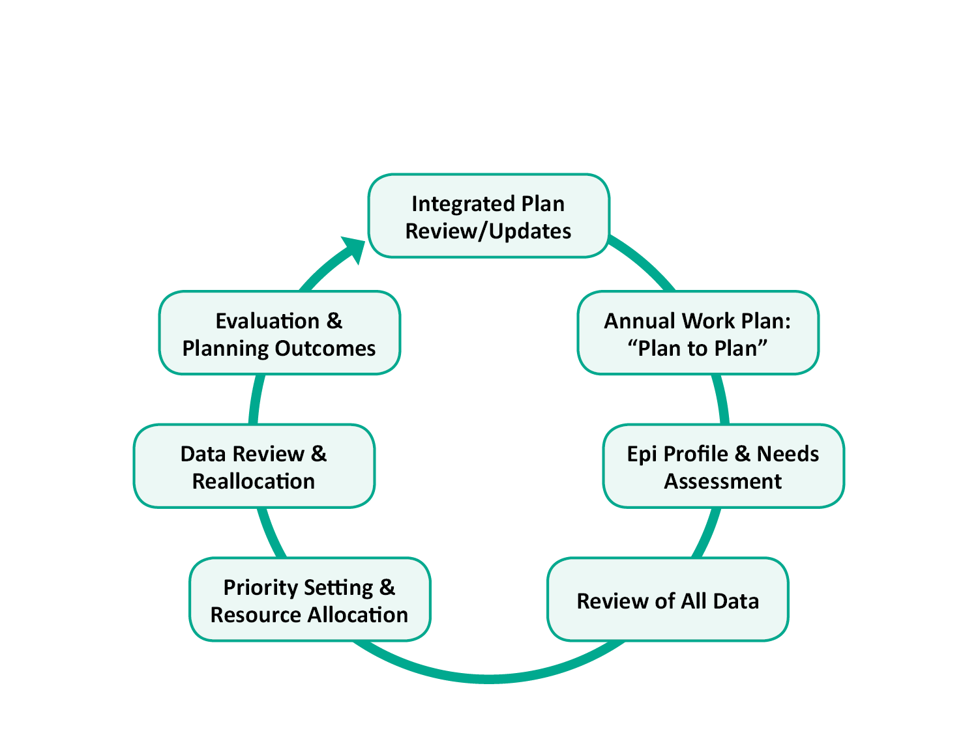
The Annual RWHAP Part A Planning Cycle

Slide 6
Expectations: RWHAP Part A Comprehensive/Integrated Plan
Legislation requires preparation of comprehensive plans that set goals and objectives and guide the work of the program
HRSA/CDC Integrated HIV Prevention and Care Plans, including the Statewide Coordinated Statement of Need (SCSN) for 2017-2022 submitted in September 2016
PC/PBs play a lead role in plan development, review, and updating
Notes:
AMELIA

Slide 7
Expectations: RWHAP Part A Comprehensive/Integrated Plan (cont.)
Programs expected to regularly review Plan progress and refine objectives and strategies as needed – plan should be a living document that guides the annual planning cycle
Where joint plan was developed with the State’s RWHAP Part B program, the Part A program is expected to have a clear work plan that will help it meet the joint goals of the plan
Notes:
AMELIA

Slide 8
Annual Work Plan: “Plan to Plan”

Slide 9
Expectations: Annual Workplan
Annual work plan for PC/PB – often in chart format – to guide the planning process, based on:
Current HRSA/CDC Integrated Prevention and Care Plan
Workplan in annual application
Legislative and administrative requirements
Local structures and processes
Based on an annual master calendar that integrates PC/PB and recipient events, products, and deadlines
Committee workplans to coordinate task completion
Continuing attention to engaging consumers and other diverse community stakeholders in the planning process
Notes:
EGM

Slide 10
Work Plan Format: Examples/Excerpts
Task/Event | Deliverable | Timing (Start/End) | Primary Responsibility | Notes/ Concerns
Needs Assessment | PLWH Survey Report Special Study on Youth Linkage and Retention | October -April | Needs Assessment Committee | Must hire consultant by 10/31
Data Presentation | PPTs with key data & analysis | End of May | PSRA Committee | Need data from all sources
PSRA | Prioritized services Allocation by category – 3 scenarios | June - July | PSRA Committee | Full day; decisions to recipient by 8/1
Application Submission | Application – submitted online | July - September | Recipient | PC/PB writes some sections, reviews draft
Notes:
EGM

Slide 11
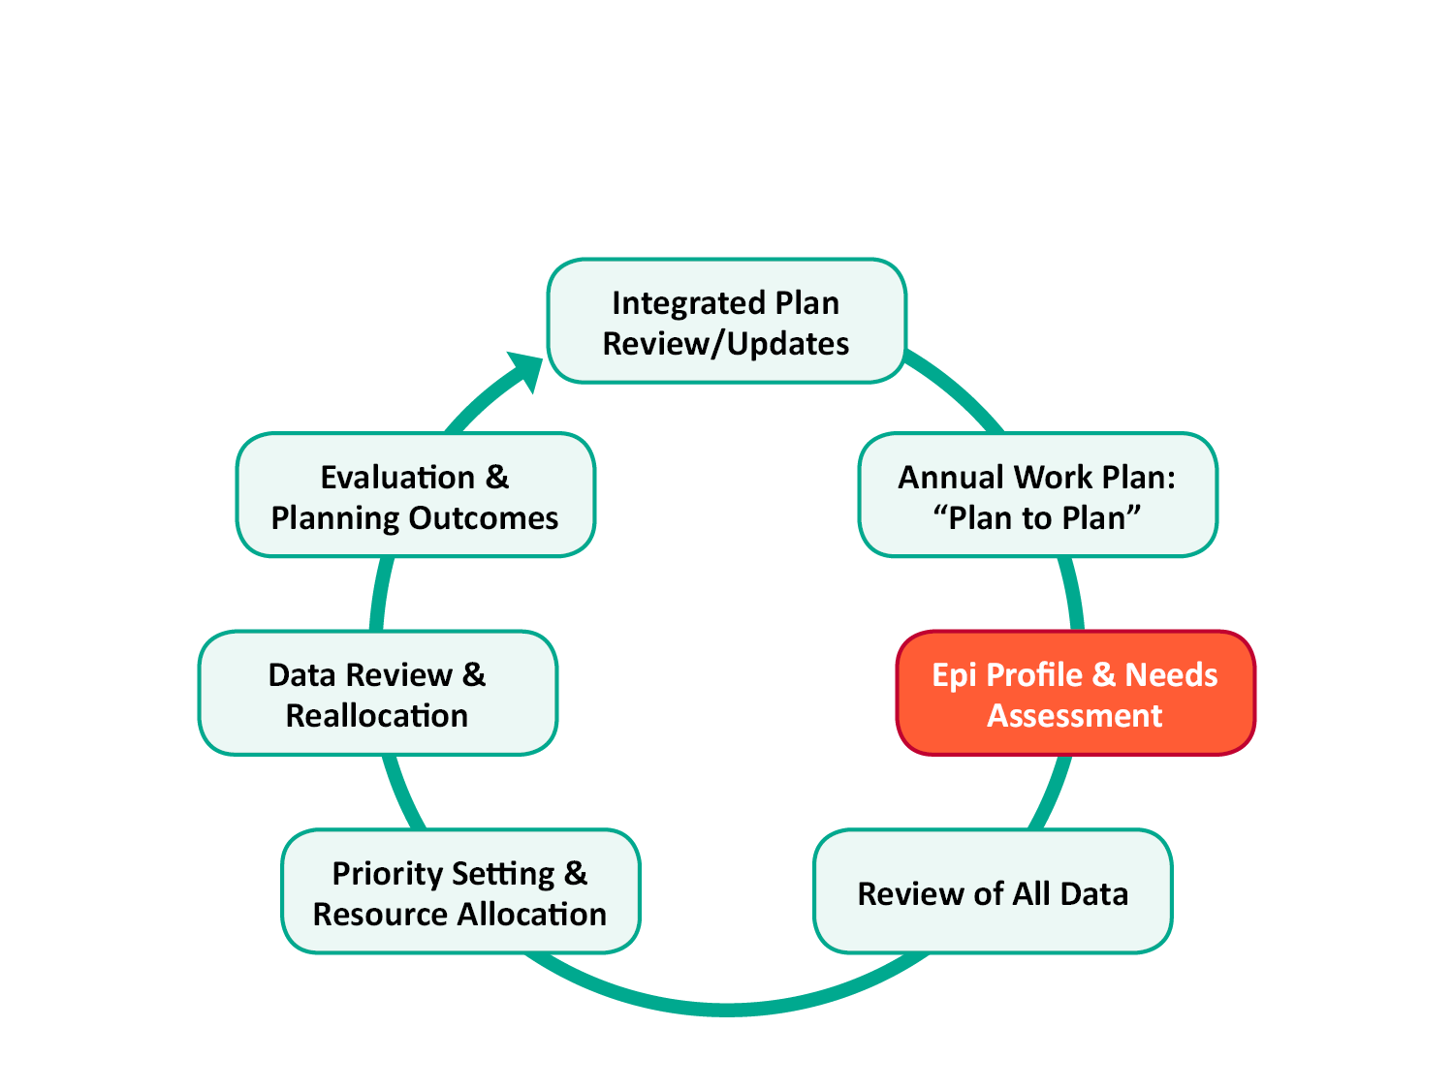
Epi Profile and Needs Assessment

Slide 12
Expectations: Epidemiologic Profile
Describes the HIV epidemic in the service area
Focuses on the social and demographic groups most affected by HIV and the behaviors that can transmit HIV
Should include advice on how to interpret the epi data for use in HIV planning
Often prepared by the state but should focus on jurisdictional (EMA or TGA) data and needs
Notes:
EGM

Slide 13
Expectations: Epidemiologic Profile (cont.)
Related data, also provided:
Estimate of the number and characteristics of PLWH who know their status but are not in care (unmet need)
Estimate of the number and characteristics of PLWH who are unaware of their HIV status
Notes:
EGM

Slide 14
Expectations: Needs Assessment
Needs assessment should explore:
What services are needed
What services are being provided
What service barriers and gaps exist, overall and for particular populations, in and out of care
Includes input from people living with HIV (PLWH) on their service needs, barriers, and gaps
Uses epi profile and estimate and characteristics of PLWH with unmet need and PLWH who are unaware of their HIV status

Slide 15
Expectations: Needs Assessment (cont.)
Includes information on current services and provider capability and capacity:
Resource Inventory identifies full range of services (resources) available to PLWH, including medical and support services, regardless of funding source
Profile of Provider Capacity and Capability provides more detailed data about service providers, including service levels and appropriateness for particular PLWH subpopulations
By comparing PLWH needs with system of care data, PC/PB can identify gaps in services overall and for particular PLWH subpopulations

Slide 16
Needs Assessment: Sound Practices
Multi-year needs assessment plan
Use of multiple approaches:
Quantitative (numerical) measures – like survey data
Qualitative (non-numerical)methods – like focus groups
Periodic large-scale data gathering from PLWH, seeking a sample “representative” of all PLWH in the area
Innovative approaches to include PLWH in & out of care
Training of PC/PB members/consumers to conduct focus groups, chair town halls, and help with surveys
Use of technology to reach PLWH without excluding those who have limited access to it

Slide 17
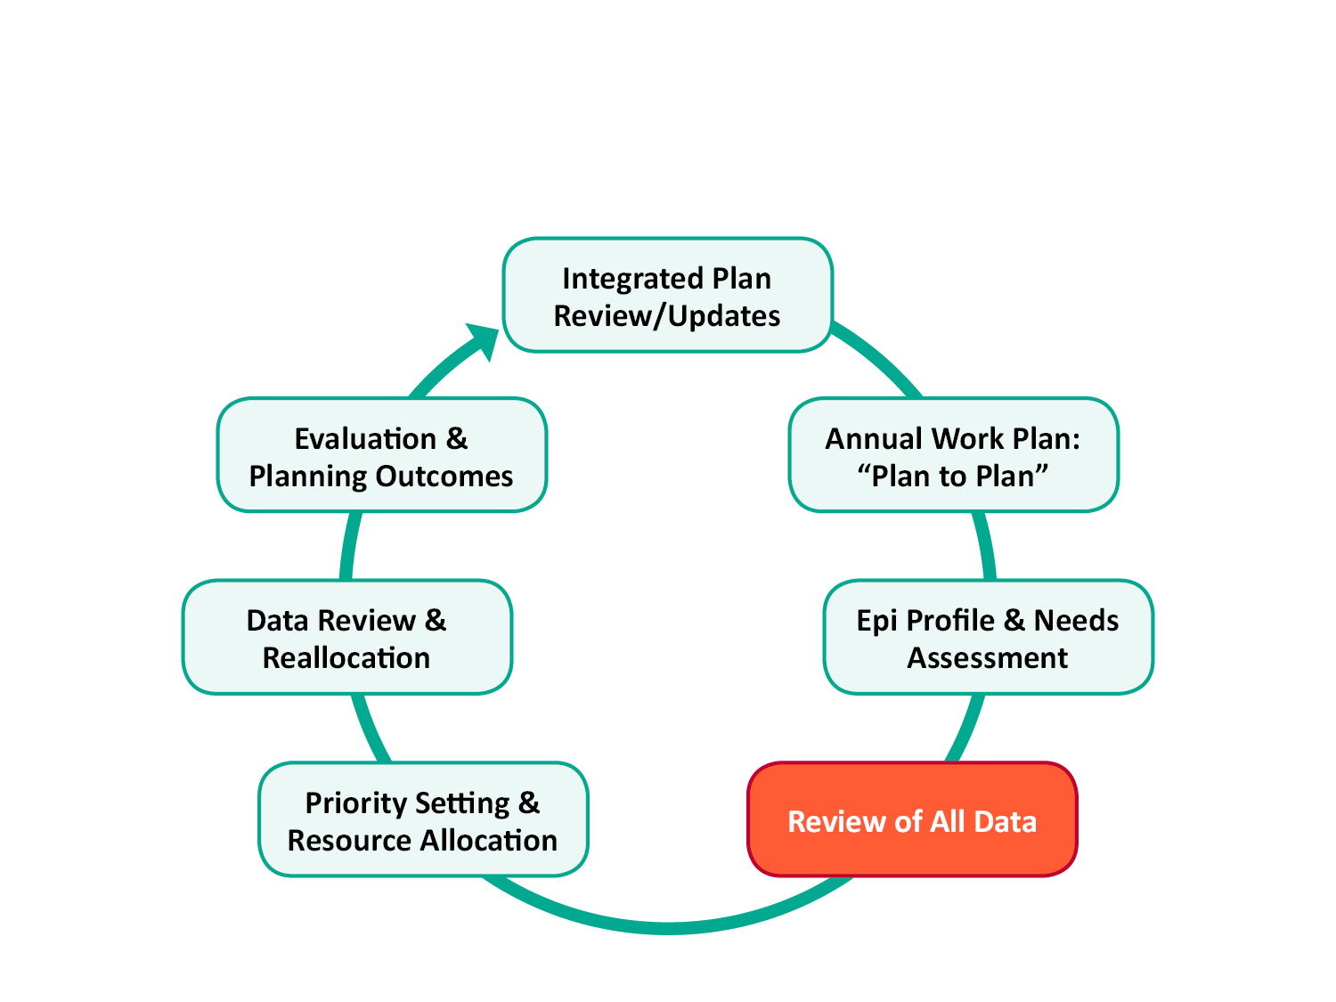
Review of Data

Slide 18
Types of Data Needed for RWHAP Part A Planning
Epidemiologic Profile
Unmet Need Estimate & Profile (PLWH who are out of care)
Unaware PLWH Estimate & Characteristics (PLWH who don’t know their status)
Assessment of PLWH Service Needs and Barriers
Resource Inventory
Profile of Provider Capacity & Capability
HIV Care Continuum data
Client Characteristics & Service Utilization – often from the RWHAP Services Report (RSR)
Service Expenditures data
HIV Testing and Diagnoses
Clinical Quality Management (CQM) data
Monitoring, Performance and Clinical Outcome Measures

Slide 19
Expectations: Access to & Use of Data
Major focus on data-based decision making by the PC/PB and recipient
Use of many types of data from multiple sources
Includes program data, provided regularly by the recipient, in formats useful for analysis
Subrecipient data provided in the aggregate, by service category – never with provider identified
Presentation and discussion of data at PC/PB meetings
Formal data presentation to summarize data from all sources at start of the Priority Setting and Resource Allocation (PSRA) process

Slide 20
Expectations: Review of All Data
Data needs refined annually and negotiated with recipient – sound practice is to include data sharing expectations in the Memorandum of Understanding between recipient and PC/PB
Data provided in clear, user-friendly formats
PC/PB members trained on assessing and using data
Data from various sources reviewed and compared
Assessment of the quality of different data sets/reports
“Triangulation” of data: comparisons of data from multiple sources/studies to see if findings are consistent

Slide 21
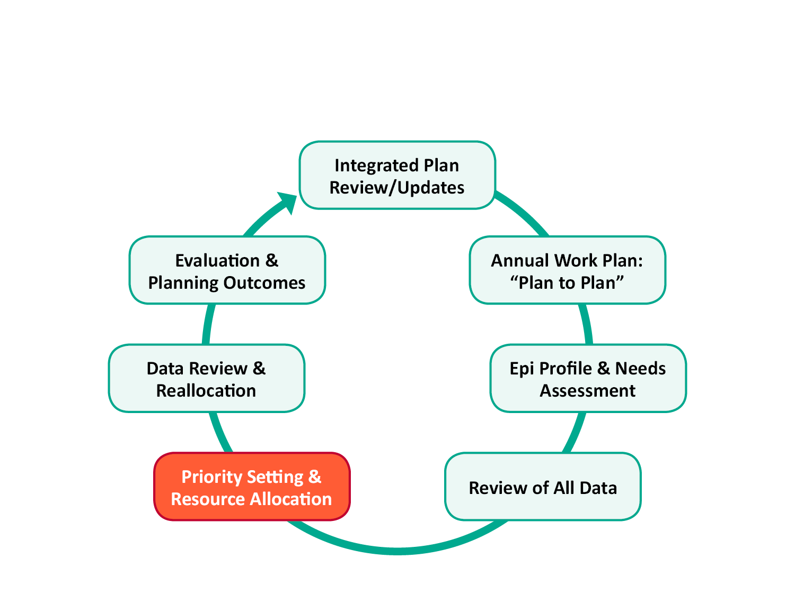
Priority Setting and Resource Allocation

Slide 22
Expectations: Priority Setting and Resource Allocation (PSRA)
Most important responsibility of PC/PBs
Should actively involve the whole PC/PB (not just a committee)
Includes:
Priority setting: deciding what services and program support categories are most important for PLWH in the EMA or TGA and putting them in priority order
Resource allocation: deciding the amount of RWHAP Part A funds that should go to each priority service category
Directives to the recipient on how best to meet these priorities
Reallocation as needed during the year

Slide 23
PSRA: Sound Practices
Provide data presentations and discussions throughout the year – and use them for training on understanding and using data
Have – and enforce – a policy and process to manage conflict of interest
Base decisions on the data, not personal experiences or preferences

Slide 24
Ensuring Fairness and Avoiding Grievances
Every PC/PB must have a grievance procedure regarding funding, and can face a grievance if the PSRA process does not follow established policies and procedures
For a fair process that is unlikely to face a grievance:
Have an updated, written PSRA process – and follow it
Recognize and manage Conflict of Interest
Involve the whole PC/PB in decision making
Ensure that members understand that they must plan for all PLWH in the EMA or TGA
Make decisions data-based

Slide 25
Members as Advocates & Planners
Members often come as Advocates:
Bring passion
Provide a voice for their communities or for PLWH subpopulations their organization serves
Learn to advocate on behalf of other subpopulations that may not be directly represented in PC/PB deliberations

Slide 26
Members as Advocates & Planners (cont.)
Members must learn when/how to be Planners:
Consider the entire community – all PLWH
Seek Win-Win versus Win-Lose
Listen and ask questions
Come prepared – review data and reports
Make decisions based on data – not “impassioned pleas”
Understand boundaries

Slide 27
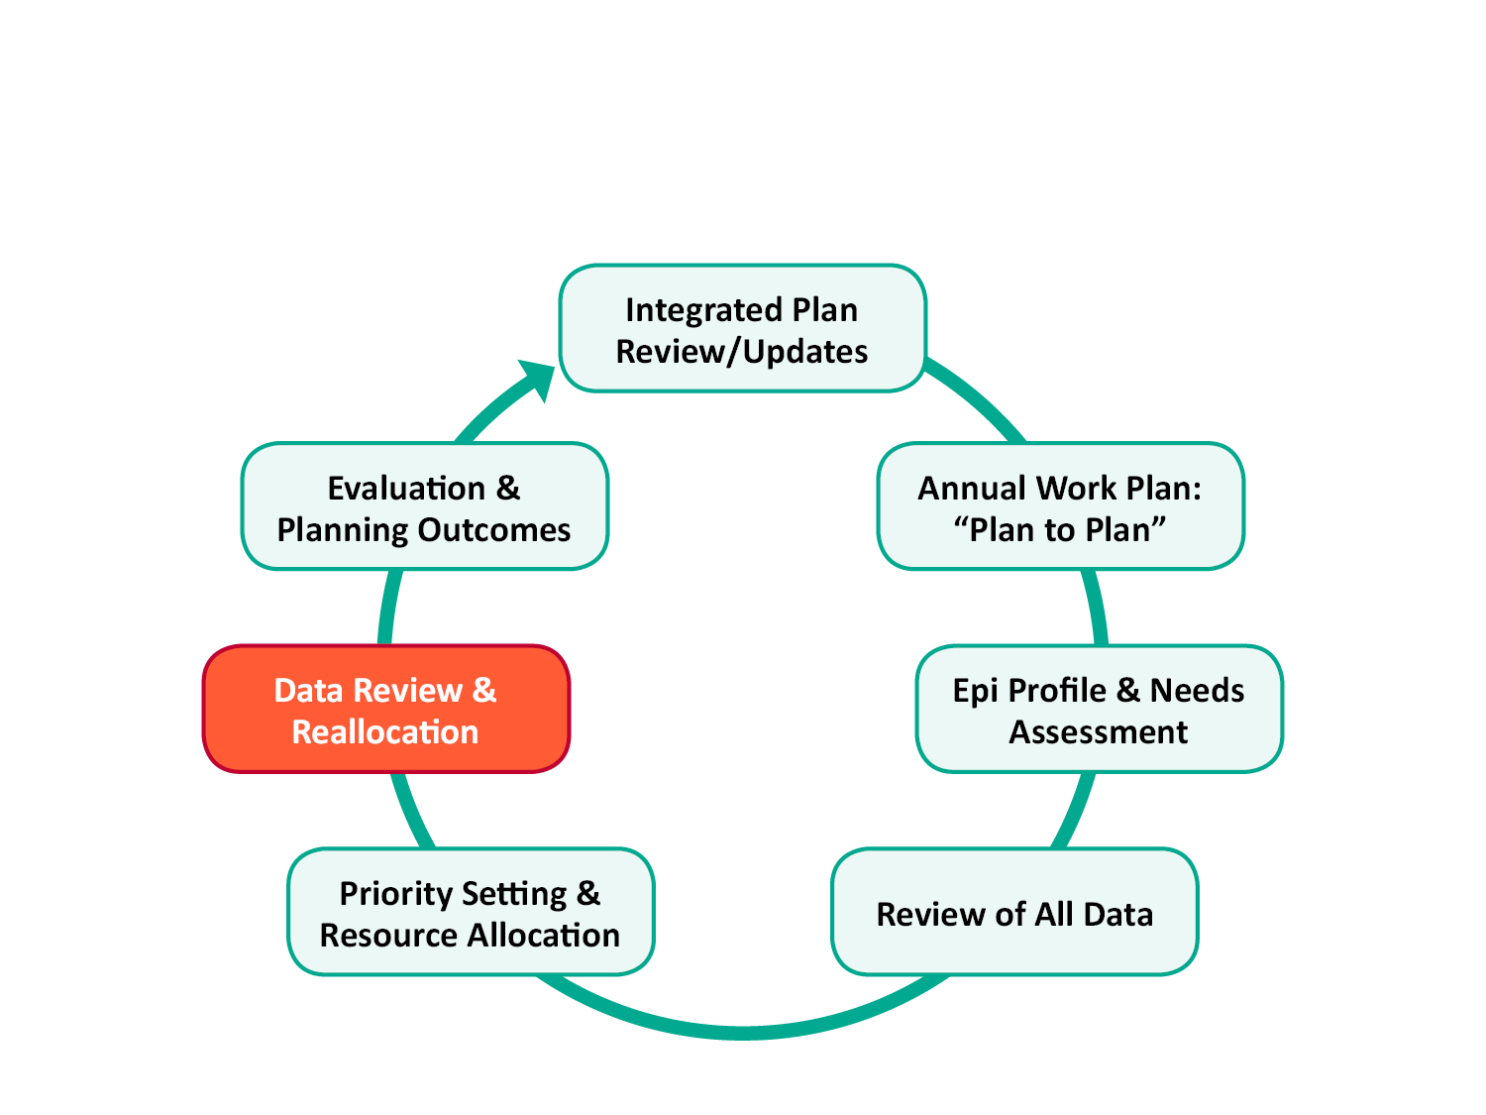
Data Review and Reallocation

Slide 28
Expectations: Expenditures Data Review and Reallocation
Regular review of planned and actual monthly expenditures by service category – from recipient
Training provided on how to read and understand financial reports
Identify trends in expenditures and service utilization and reasons for them – including serious under- or over-expenditures
Reallocate funds when necessary, so all funds are spent on needed services – PC must approve moving funds from one service category to another
Notes:
EGM

Slide 29
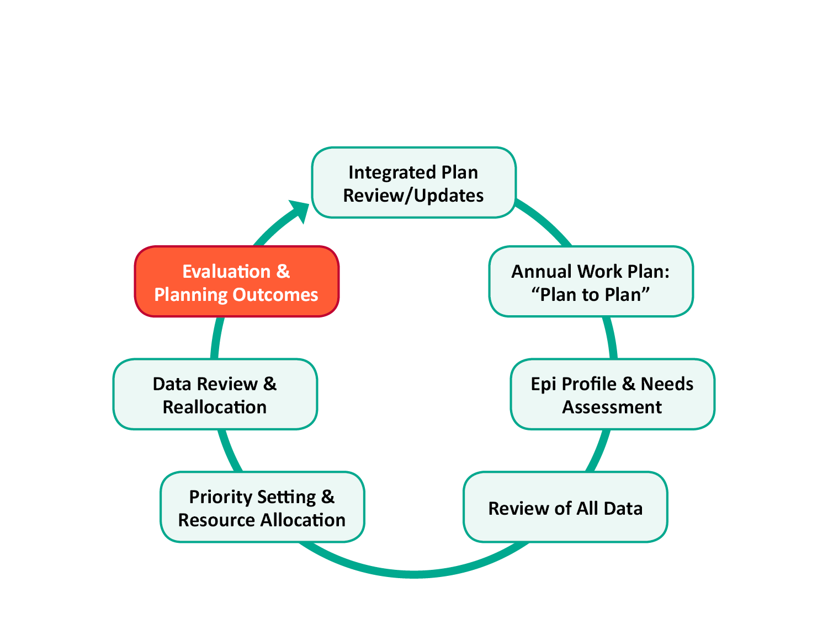
Evaluation and Planning Outcomes

Slide 30
Expectations: Evaluation and Planning Outcomes
Completes the updated planning cycle
Includes a “review of variances”
Actual versus planned level of services (e.g., clients and subpopulations served, units of service, expenditures)
Actual versus planned quality measures and client/program outcomes
Requires comparing PSRA-approved priorities and allocations with actual use of funds
Provides an assessment of the planning process
Provides data for refining the HRSA/CDC Integrated Prevention and Care Plan

Slide 31
Successfully Completing Annual Planning
Special Considerations for Integrated Prevention-Care Planning Bodies
Key Planning Challenges
Responsibilities of Individual PC/PB Members
Committee Roles
Responsibilities of the PC/PB as a Whole

Slide 32
If you have an integrated prevention-care planning body…
Planning requirements for RWHAP Part A unchanged
HRSA/CDC Integrated HIV Prevention and Care Plan review and updating likely to receive additional attention – including periodic written revision of the plan
Time needed for regularly receiving, reviewing, and discussing data on prevention topics (interventions, HIV awareness, testing, PrEP and nPEP, prevention for positives, treatment as prevention) – including links between prevention and care needs and services
[PrEP = Pre-Exposure Prophylaxis; nPEP = non-occupational Post-Exposure Prophylaxis]

Slide 33
Key Planning Challenges
Need for Sufficient:
Knowledge: community planning, RWHAP legislation, Conflict of Interest (COI) management
Skills: needs assessment, analysis & use of data, group decision making, negotiations, group process
Resources: for needs assessment, data analysis, PC/PB staffing & support
Data: client characteristics, service utilization, costs, service needs, barriers & gaps

Slide 34
Responsibilities: Committees
Understanding and implementation of assigned tasks such as:
Needs assessment
Integrated/comprehensive plan reviews and updates
Obtaining and review of data from the recipient
Data presentations
PSRA, including development of directives
Review of program expenditures by service categories and recommendations for reallocation
Annual PC/PB calendars and work plans

Slide 35
Responsibilities: Executive Committee
Coordinate the work of other committees, including any joint planning tasks by several committees
Review committee work products and recommendations and ask for changes if needed prior to consideration by the full PC/PB
Monitor progress and deadlines on key tasks
Set/discuss PC/PB meeting agendas
Agree on special planning-related meetings such as data presentations and PSRA

Slide 36
Responsibilities: Full PC/PB
Review of committee findings, products, and recommendations
Active discussion and decision making about PSRA: priorities, resource allocation, and reallocation
Identification of issues that need to be addressed by the PC/PB

Slide 37
Responsibilities: Individual Members
Participate in training – and ask for additional training or one-on-one advice if needed
Read background materials and review data prior to meetings
Always attend data presentations prior to PSRA decision making
Learn about the role of your committee and help ensure it does its work well and on time
Ask questions – it will help everyone learn

Slide 38
Responsibilities: PC/PB Support Staff
Serve as liaison with the recipient to obtain data, reports, and other information needed by the PC/PB for decision making
Ensure that committees and full PC/PB have needed information and logistical support for each meeting
Staff committees and PC/PB meetings
Provide technical expertise in various tasks such as needs assessment and data review
Review progress and help PC/PB ensure that planning tasks are completed on time

Slide 39
How the PC/PB and Recipient Collaborate in Annual Planning
Shared Responsibilities
Flow Chart Showing How the PC/PB and Recipient Work Together
Importance of Timing
Sound Practices for Collaboration

Slide 40
Shared Responsibilities
Most legislative responsibilities are shared – for example:
Needs assessment: PC/PB as lead, but recipient ensures cooperation from subrecipients in data gathering
Integrated/comprehensive planning: PC/PB as lead, but recipient participates in developing objectives and implementing tasks – and usually takes the lead in assessing progress

Slide 41
Shared Responsibilities (cont.)
Even where one entity has full responsibility, the other often provides data or support:
PSRA: PC/PB responsible, but recipient provides a great deal of data (client characteristics, service utilization, performance measures, aggregate quality management data) and often makes recommendations
Preparation of the annual application: Recipient responsible, but PC/PB provides needs assessment data, PSRA decisions and process, letter of assurance or concurrence – and often reviews the draft application

Slide 42
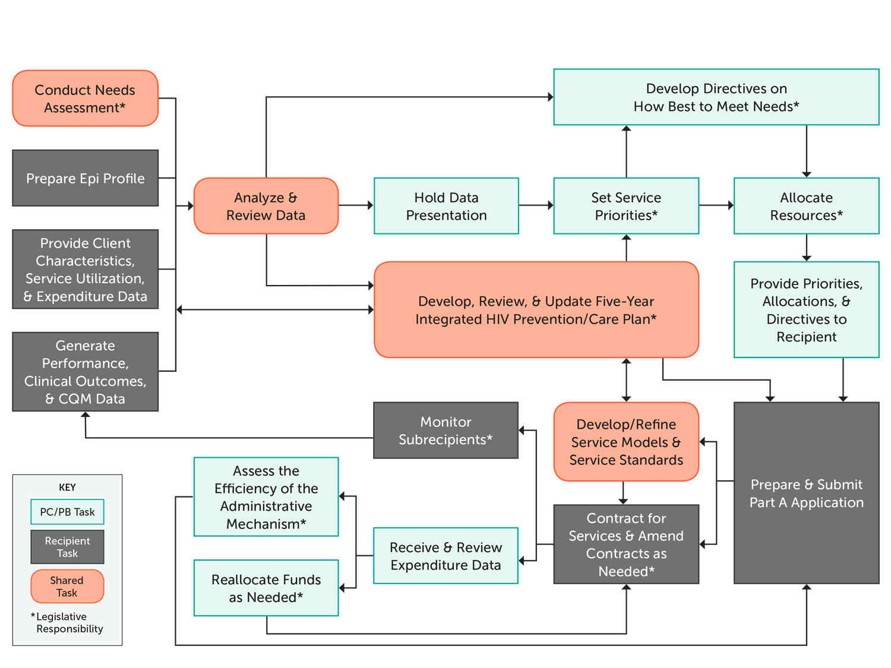
Annotated Flow Chart of the Annual RWHAP Part A Planning Cycle

Slide 43
Timing is Everything!
Both recipient and PC/PB need to complete their planning tasks and products on time so that the other entity can carry out its responsibilities
Delays slow the entire annual planning process
Some important dates that affect planning:
Start of the RWHAP Part A funding year (March 1)
Annual RWHAP Services Report [RSR] due (March)
RWHAP Part A application deadline (usually September)
Carryover request deadline (December 31)

Slide 44
Time-Sensitive PC/PB Needs
Recipient outreach to subrecipients to ensure access to clients for PLWH surveys and other needs assessment activities
An updated epi profile, client characteristics and service utilization data to support data-based PSRA
Recent data on projected and actual expenditures by service category to reallocate funds during the year, so all funds are expended

Slide 45
Time-Sensitive Recipient Needs
Solid, regularly updated needs assessment data and timely PSRA decisions to include in the annual application
Updated service standards for use in Request for Proposals for services and for quality assurance/subrecipient monitoring
PC/PB rapid reallocation process near the end of the calendar year so funds can be moved and spent, and carryover estimated and minimized

Slide 46
Sound Practices for Collaboration
Develop a joint annual plan/calendar
Schedule monthly committee and PC/PB meetings with an understanding of recipient responsibilities/schedule
Provide realistic deadlines and meet them – don’t overpromise
Schedule annual or ongoing activities like needs assessment and PSRA so each is done at about the same time every year
Minimize unexpected demands on the other entity
Formalize collaboration through an MOU

Slide 47
Sum Up
Understanding the annual planning cycle helps a PC/PB carry out organized planning, meet key deadlines, and make sound planning decisions
Successful planning requires understanding of:
Components and tasks
Committee and full PC/PB responsibilities
Key dates and importance of timing
Importance of collaboration between PC/PB and recipient
For integrated bodies, schedule time to address both prevention and care

Slide 48
Optional Slides for Activity

Slide 49
Quick Activities to Apply Learning
Following are 3 quick scenarios and discussions to increase interaction during your presentation/lecturette and help participants apply what they are learning to practical situations. Revise them if needed to fit your situation, and use them in small groups or pairs, or in the full group. Following is the title of each activity and where you may want to insert it:
Insert Quick Scenario A: Committee Work Plans after slide 10
Insert Quick Scenario B: Data Review after slide 20
Insert Quick Discussion C: Planning Responsibilities after slide 38

Slide 50
Quick Scenario A: Committee Work Plans
Your PC/PB develops a fairly “high level” work plan that includes completion dates for major tasks like Needs Assessment, PSRA, and AAM, based on some due dates from the recipient. Committees use these dates but most have no detailed work plans. There have been some problems in meeting key deadlines, so the Executive Committee wants committees to do more detailed work plans for next year. The benefits are clear.
What are likely to be the first-year challenges of developing and using committee work plans?
How can the Executive Committee and staff help make this process work?

Slide 51
Quick Scenario B: Data Review
Your PC/PB collects or receives a lot of data. It has challenges in getting the data reviewed and integrated, presented to the full PC/PB, and used for decision making. The Co-Chairs suggest two options for improving that process:
Present data at PC/PB meetings every month or two, with mini-trainings, so everyone becomes comfortable with the data and is ready for major data-based tasks like PSRA; or
Provide data training to the PC/PB in the spring; have the committees responsible for Needs Assessment and PSRA, with staff assistance, review, integrate, and summarize all data; and have a full-day Data Presentation just before PSRA begins.
Which of these options seems more practical and why?
Can you describe another approach that might work better?

Slide 52
Quick Discussion C: Planning Responsibilities
Implementing the planning cycle is a shared responsibility of individual members, committees, the full PC/PB as a body, PC/PB support staff, and the recipient. What actions can PC/PB leadership take to help each of the following successfully meet their responsibilities? [Discuss one, as assigned]:
New PC/PB members
New committee chairs
The PC/PB, through its meetings

Slide 53
Activity: Annual Planning Cycle – Components/Tasks, Responsibilities and Timing
Instructions:
Work in a small group, with a facilitator, recorder, and reporter (and perhaps an expert advisor)
Review the blank Annual Planning Cycle Chart and Supporting Information
Work as a group to fill out the Annual Planning Cycle Chart, specifying primary and secondary responsibility for each planning task and starting and ending months
Identify any areas of uncertainty
Be sure your recorder is prepared to present your work to the full group

Slide 54
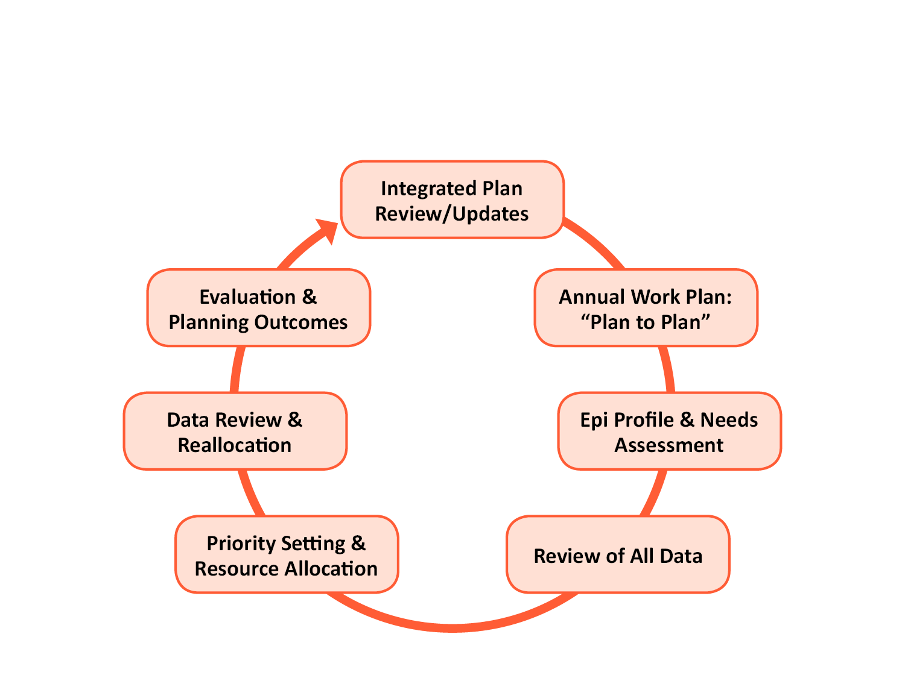
Planning Cycle Components

Slide 55
Annual Planning Cycle Components/Tasks, Responsibilities, and Timing
Planning Cycle Component | Primary Responsibility | Secondary Responsibility | Timing: Start-End
Integrated Plan Review/Update
Annual Work Plan: “Plan to Plan”
Epi Profile
Needs Assessment
Review of All Data
Data Presentation
Priority Setting
Resource Allocation
Directives
Data Review ($)
Reallocation
Evaluation and Planning Outcomes

