Slide 1
Programmatic and Fiscal Accountability
Adeola Fawehinmi, DMHAP Project Officer
Frances Hodge, DMHAP Project Officer
Department of Health and Human Services
Health Resources and Services Administration
HIV/AIDS Bureau

Slide 2
Housekeeping Rules
Please hold all questions until the designated sections breaks.
Break for a 10 mins activity.

Slide 3
Agenda
Program Terms Components
Part A and MAI Planned Allocations Table
Planning Council Membership Roster
Revised SF 424A and Budget Narrative
FY 2013 Implementation Plan
Consolidated List of Contracts (CLC)
Contract Review Certification (CRC)
Maintenance of Effort (MOE)
Women, Infants, Children, and Youth Expenditure Table
Final Expenditure Table
Improper Payments

Slide 4
Program Terms Report Components

Slide 5
Part A and MAI Planned Allocation Table
Purpose: Serves as a reporting tool used by grantees to report their allocation of Ryan White funds, in accordance with the conditions of the award. The allocation table:
Identifies categories of services that are being funded
Notes:
The information gathered from the allocations table not only used to inform POs of their grantee’s allocations for the FY,
It also enables our office of policy and data (DPD) to ascertain how much funds are allocated to each service categories.
Which informs our data system, for example for FY 2009 RW spent a whopping $2.15 billion , 66% of which went to Primary medical care and ADAP.
Another very good use of the data is informing congress on how much is allocated and spent on the service categories.

Slide 6
Part A and MAI Planned Allocation Table
What does an Allocation Table depict?
Dollar amounts allocated for the Ryan White Program for the current fiscal year (FY 2013), including MAI amounts
Prioritized funding set by the Planning Council/planning body with regard to the 75/25 rule (applies to both Part A and MAI)
Administrative and CQM dollars

Slide 7
Allocations Table
Verify Grantee Information
Verify Award Amount = Total Grant Award
Verify Service Categories & Amounts Match Implementation Plan
Verify Total Amounts & %’s are Accurate
Verify 75% Requirement Met (unless waiver), after 10% Admin and 5% CQM Deducted
Verify 25% Requirement Met (unless waiver)
Total Services Allocation = Total Contractual HIV Services in Budget Narrative & SF 424A
CQM Amount = CQM Amount on SF 424A and Narrative and is ≤ 5% or $3 million, whichever is less
Administration ≤ 10%
Total Allocation = Total Award Amount

Slide 8
Part A & MAI Planned Allocation Table - Checkpoints
Before submitting your Allocation Table, ensure compliance with the following:
Verifies that the Total Part A funds equals the Total Allocations under Combined Total on the table
Total award amount by type of funding can be found on the final Notice of Award (NoA)
Verifies that total and percentages are accurate
75/25 rule was applied. If not, Core Medical Services Waiver was obtained
Administration cost ≤10 percent of total award
Clinical Quality Management (CQM) ≤ 5 percent or $3 million (whichever is less)
Make sure to use current year template

Slide 9
Planning Council Membership Roster
Purpose: Lists membership of the Planning Council (PC) to reports on representation and its reflectiveness of the HIV/AIDS epidemic in the EMA/TGAs.
Key criteria of the PC roster:
Membership Category/Agency Affiliation
Name
Race/Ethnicity
Term
Gender

Slide 10
Planning Council Membership Roster
Section 2602(b)(1) of the Ryan White HIV/AIDS Treatment Extension Act of 2009.
The chief elected official shall establish or designate an HIV health services Planning Council that shall reflect in its composition the demographics of the population of individuals with HIV/AIDS in the eligible area involved, with particular consideration given to disproportionately affected and historically underserved groups and subpopulations
See Section 2602(b)(2) for an entire list of membership categories
Membership nominations on the council must be done through an open process, and candidates shall be selected based on locally delineated and publicized criteria
The selection process shall include a conflict-of-interest standard, see Section 2602(b)(1) for a detailed list of standards

Slide 11
Planning Council Membership Roster - Checkpoints
Before submitting your PC roster, ensure compliance with the following:
Roster accurately reflects key PC membership criteria
33 percent of PC are non-aligned people living with HIV/AIDS (PLWHA) consumers, accessing Part A Services
Non-aligned means there is no benefitting party affiliation with the PLWHA consumer
PC as a whole, including the 33 percent PLWHA non-aligned consumers must reflect HIV/AIDS demographics
The mandated membership categories are fulfilled
If membership categories are not fulfilled, grantee must document its plan to comply with this requirement
Conflict of interest standard is applied to the administration of the PC

Slide 12
SF 424A
Purpose: A reporting tool that captures award amounts in the appropriate budget categories and object class categories for the current fiscal year.
Budget Categories - Administration, Clinical Quality Management, HIV Services, MAI
Object Class Categories - Personnel, Fringe Benefits, Travel, Equipment, Supplies, Contracts, Indirect Costs, Program Income, Other
Notes:
Within each of the budget categories, you must specify the costs allocated for each Object Class Category also known as line items.
Each Object Class Category has been defined in the FOA

Slide 13
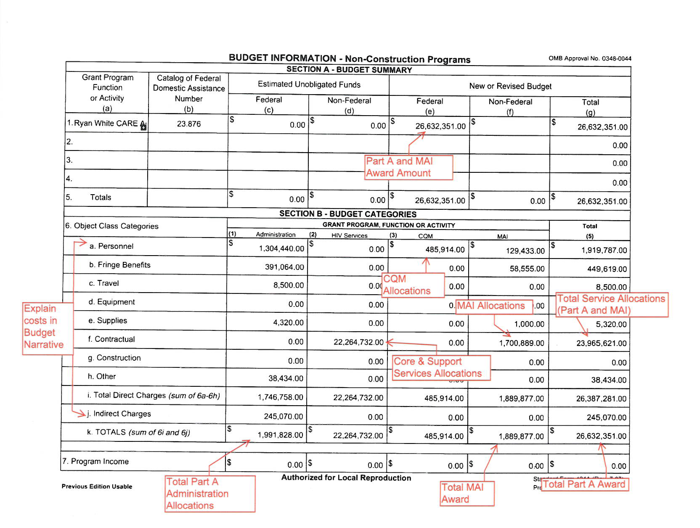
SF 424A
Notes:
Like I said earlier on this is a govt form, Do not alter any of the categories listed in this form.
Further showing the relationship btw the documents of the program terms is the fact that the total amount on your SF424A must match your total award on your allocations table for that FY, including MAI
We have not discussed the budget narrative but you want to make sure that the line items cost list in the SF424A match that of the Budget narrative.
Some changes require approval from your PO
Though it clearly states that on the SF 424A, construction cost is not allowable. However minor alterations and renovations are allowable with Prior permission from your PO
Change in program scope or purchase exceeding $25000 (if not included in the original approved budget)
Any re-budgeting exceeds 25% of the total approved budget (direct and indirect) for that budget period or $250,000, whichever is less.

Slide 14
SF 424A - Checkpoints
Before submitting your SF 424A, ensure compliance with the following:
Appropriate budget categories are used
SF 424A Amounts Correspond with:
Notice of Award (NoA)
Amount on the Budget Narrative
Amount on Contract Review Certification
Allocations Report
To access the SF 424A, use the U.S. PHS Grant Application Packet (Form PHS 5161-1) http://www.hhs.gov/forms/PHS-5161-1.pdf
Notes:
The appropriate budget categories should be used when completing the SF424A. It is important to check the funding categories outlined in the Notice of Award. The SF424A total should equal to the total award in the Notice of Award.

Slide 15
Budget Narrative
Purpose: A reporting tool that provides justification for all budgeted line items with regard to:
Administration
Clinical Quality Management
HIV Services
MAI
Notes:
So the budget narrative gives some substance to the SF424A,
like you saw earlier the SF424A is just an aggregate of number, understandable but just numbers.
The budget narrative tells you what each line item is for and why it is necessary or its purpose.

Slide 16
Budget Narrative
Includes a “Justification Column”- grantee should be specific in response and clearly state how the efforts/activities for each object class category make a contributing impact to support the Part A HIV service delivery system. The justification column is an integral part of the table.
Notes:
Refer to Part A and Part B Sample Budget Narratives

Slide 17
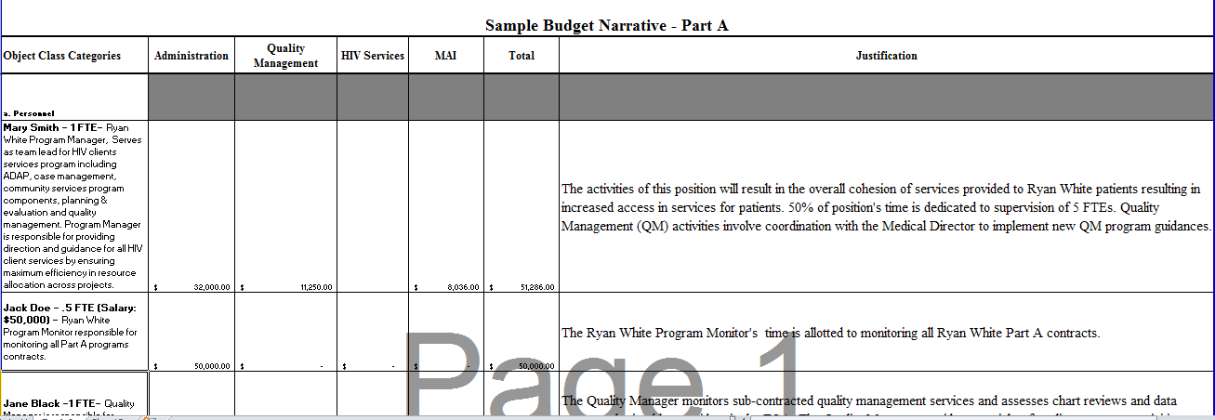
Budget Narrative
IMPORTANT! Clearly explain how each activity impact the
Part A HIV service delivery system
All positions budgeted less than 100 percent to the Ryan White Part A Program
include the other funding sources of that position
Total amounts listed must match the revised SF 424A

Slide 18
Budget Narrative – Checkpoints
Before submitting your budget narrative, ensure compliance with the following:
Admin Cost ≤10 percent
Clinical Quality Management ≤ 5 percent or $3 million, whichever is less
Cross reference with Allocations Table and SF 424A
Personnel:
Personnel cost include percent of time and effort as documented in the justification column
Award funds were not used to pay the salary of an individual at a rate in excess of Executive Level II or $179,700 or $86/hour
Notes:
Salary Cap: HRSA funds may not be used to pay the salary of an individual at a rate in excess of $179,700. This salary limitation also applies to subawards/subcontracts for substantive work under a HRSA grant or cooperative agreement e.g. Part A, Part C, BPHC.

Slide 19
Implementation Plan
Purpose: Identifies core medical and support services categories prioritized and funded by the Planning Council or through local community planning processes. It also contains goals and objectives that describe how funded services are implemented to achieve program outcomes.
Notes:
Is the “blue print” for service delivery within your continuum of care.
Identify core medical and support services categories prioritized and funded by the planning council or through local community planning processes. It also contains goals and objectives that describe how funded services are implemented to achieve program outcomes.
The Comprehensive Plan should drive development of Implementation Plan goals & objectives.
The Implementation Plan describes how goals and objectives in the Comprehensive Plan are achieved.
The Comprehensive Plan should be guided by goals and objectives of the National HIV/AIDS Strategy and Healthy People 2020.

Slide 20
Implementation Plan Key Components
Goals
Objectives
Outcomes
Service Category
Name
Priority Number
Allocation Amount
Service Unit Definition
# of Units Provided
# of People Served
Time Frame
Funding / Objective
Notes:
Going to go into more details of each component later on.

Slide 21
Implementation Plan Goals
Goals are broad statements that:
Define what you want to accomplish
Are concise and easy to understand
Provide the framework for the objectives
Notes:
One or more service GOALS must be developed for each of the core medical & support services listed.
Goals are broad statements that define what you want to accomplish, and should:
State the effect the service will have on reducing health problems
Be a declarative statement
Be free of jargon
Be concise, easy to understand, and written in positive terms
Provide the framework for the objectives

Slide 22
Implementation Plan Objectives
S
M
A
R T
pecific
easurable
ttainable
ealistic
ime Sensitive
An objective describes how you will accomplish your goal.
Notes:
Objectives
Are measurable targets that describe specific end results that a program is expected to accomplish within a given time period. It answers the question: “How will you accomplish your goals?”
Are narrow and concrete
One system for developing objectives is called the SMART approach. SMART is an acronym that stands for:
Specific: (Who? - identify the target population and activity; or What? - action/activity)
Measurable (Indicate how much or how many);
Attainable / Achievable (Can be accomplished given current resources and constraints);
Realistic (Addresses and establishes reasonable programmatic steps); and
Time sensitive (Provides a timeline indicating when the objective will be met/accomplished).

Slide 23
Implementation Plan Outcomes
An outcome:
Is the results or consequences of the implemented objective(s)
Reflects the results of a program compared to its intended purpose
Quantifies or measures the results of service delivered

Slide 24
Example of Goal, Objective, and Outcome
Goal (what you want to accomplish):
Increase access to care for people living with HIV
Objective (how you accomplish the goal):
By 2/28/14, 100 percent of case managers will have bus passes and taxi vouchers available for distribution to clients requiring assistance with transportation to medical appointments.
Outcome (the result of providing service):
Decrease the percentage of clients who identify transportation as a barrier to accessing medical care from 70 percent to 30 percent. Increase the percentage of Ryan White eligible clients living with HIV in the jurisdiction with at least two medical visits with a provider with prescribing privileges from 70 percent to 85 percent.

Slide 25
Implementation Plan
Enter Service Priority Name, Number, and Allocation - Corresponds to Allocations Table
Enter Grantee Name
Ensure Part A funding source is checked
Header Section
(see Instructions p. 7, Section 4.5)
Relates to a Comprehensive Plan strategy
Ensure Objectives are SMART
Enter HRSA Service Unit Definition
Sum of Funds = Total Priority allocation
Ensure Number of People Served and Units are reasonable based on funds allocated
Within the grant period

Slide 26
Implementation Plan - Checkpoints
Before submitting your Implementation Plan, ensure compliance with the following:
Services are allowable per the service category definitions
Service category goals are linked to current Comprehensive Plan strategies
Objectives describe how the service goal for the specified service category is accomplished
Budget Narrative and Allocations Table are cross referenced
Costs are reasonable
Notes:
There should be a hierarchal relationship between the Comprehensive Plan, Service Goal, and Objectives. The goal of the Comprehensive Plan should be broad in focus, with the service goal getting more specific, and the objectives even more specific as it relates to providing HIV care.
Salary Costs vs. Unit Costs-If the grantee is reimbursing salaries, sometime the math for unit costs will not be clear in your review or the unit definition maybe unclear. The grantee should note when the allocation are covering salary e.g. Case Manager T & E.

Slide 27
Consolidated List of Contracts
Purpose: Identifies all Part A and MAI service providers receiving funds for the current grant year.
The Consolidated List of Contracts (CLC) form is the only form that identifies minority and faith-based providers
To be considered a minority provider, the organization must:
Have more than 50 percent of the positions on the executive board or governing body filled by persons of the racial/ethnic minority group to served
Have more that 50 percent of key management, supervisory, and administrative positions filled by persons of the racial/ethnic populations to be served
Notes:
The CLC is the only report that enables us to report to congress and necessary stakeholders how much of Part A funds goes to faith based and minority providers.
Give the example of the congressional request of what is spent on faith-based and/or minority.

Slide 28
CLC Components
For each service provider include the following:
Address
Tax Payer Identification Number (EIN)
Contact Information of Contractor
Service Type Code
The codes can be found under the instructions section of the CLC Table
Contract Amount
Minority Provider Status
Faith-Based Provider Status

Slide 29
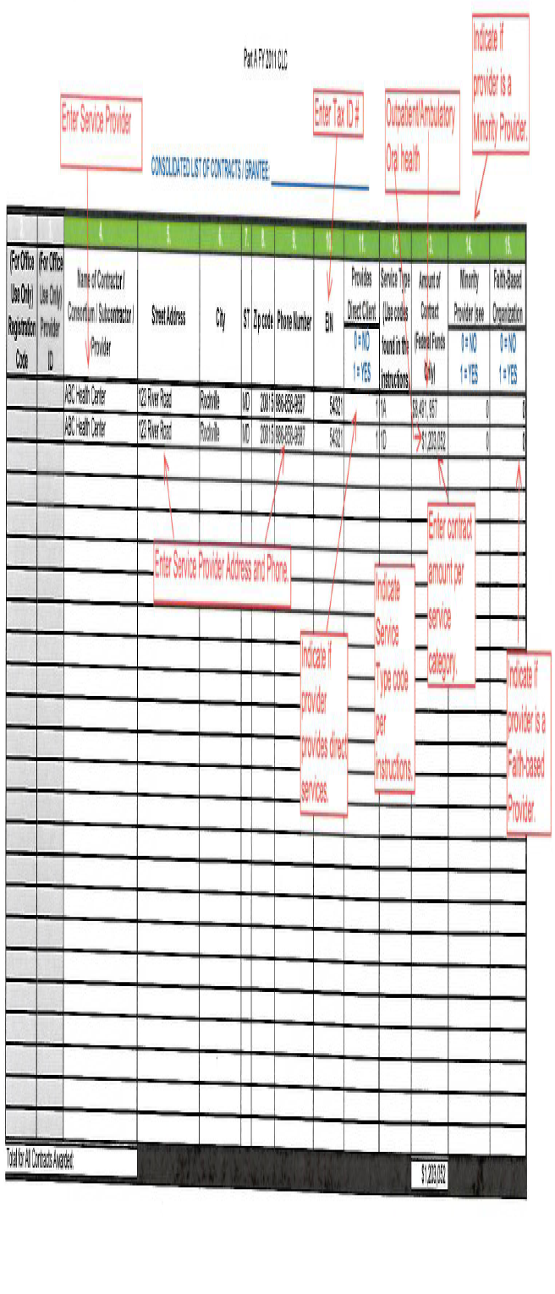
CLC Table
Part A Current Year CLC

Slide 30
CLC - Checkpoints
Before submitting your CLC, ensure compliance with the following:
Agencies funded for multiple service categories are listed separately for each contracted service, with corresponding amounts
Confirm that the minority and faith-based sections are filled
Allocations Table and Implementation Plan are cross referenced
Notes:
If one service provider has contracts for four different services (Provider X is funded for Outpatient/Ambulatory Care, EIS, medical case management, and psychosocial services), the provider must be listed on the CLC four different times, once for each entry.

Slide 31
Contract Review Certification (CRC)
Purpose: A reporting tool used by grantees to certify all service contracts awarded by the grantee for the current grant year were reviewed and comply with Office of Management and Budget (OMB) and other Ryan White requirements.

Slide 32
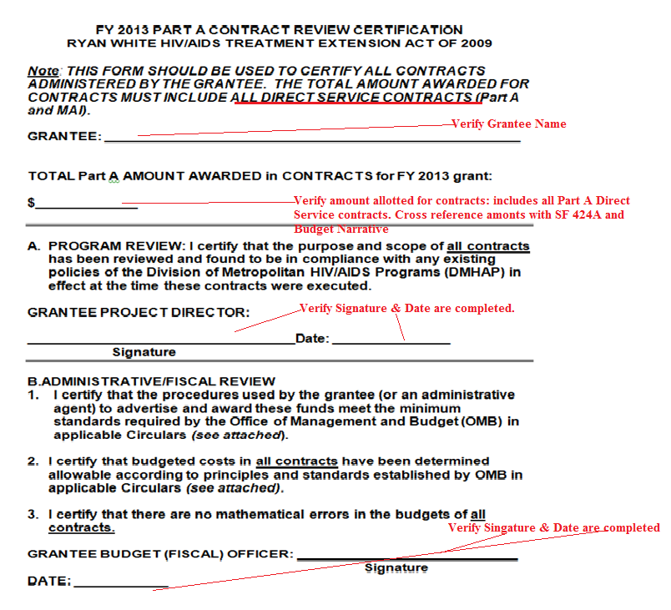
CRC
Notes:
Incase you are asked about the applicable circulars, refer grantees to the Part A Manual, under Grants administration section for the list applicable circulars.

Slide 33
CRC - Checkpoints
Before submitting your CRC report, ensure compliance with the following:
Certify that the procedures used to advertise and award funds meet the minimum standards required by the Office of Management and budget (OMB) in applicable circulars
Certifies the budgeted costs in all Direct Service contracts have been determined allowable according to principles and standards established by OMB in applicable Circulars.
All contracts are direct service contracts, including MAI.
Certify that there are no mathematical errors in the budget of all Direct Service contracts.
Signed by both the Program Director and Grantee’s Budget (Fiscal) Officer.
Cross reference with SF 424A and Budget Narrative.

Slide 34
End of Program Terms

Slide 35
Exercise and Questions
Notes:
We will now break for ~ 10 mins for a quick exercise
Can I have you all break into small groups
In your groups please identify a note taker and someone to present your findings
The activity is a review of a complete allocations table
Taking in to consideration all that I said earlier about this table and its parameters
Please review it for possible errors
I will give you all 5 mins to review it and the new will go over the errors.

Slide 36
WICY Expenditures Table
Purpose: A reporting tool which demonstrates allocation of resources for Women, Infants, Children, and Youth (WICY), at no less than the percentage reflected by women, infants, children, and youth with HIV/AIDS to the general population with AIDS.
An estimate of the percentage of WICY with HIV/AIDS is provided annually to Part A from CDC
WICY waivers are approved for grantees who can verify that required expenditure amounts were met through other Federal/state programs
Prospective Waivers
Retrospective Waivers

Slide 37
WICY Waivers
Prospective Waivers - due within 90 days of receiving Part A grant award, recognizes that the grantee expects to satisfy the WICY expenditures for one or more priority populations through other Federal/state programs funds.
Retrospective Waivers - due within 120 days after the end of the budget period, should demonstrate that the required minimum expenditures for one or more WICY population were satisfied, using other Federal/state program funds.

Slide 38
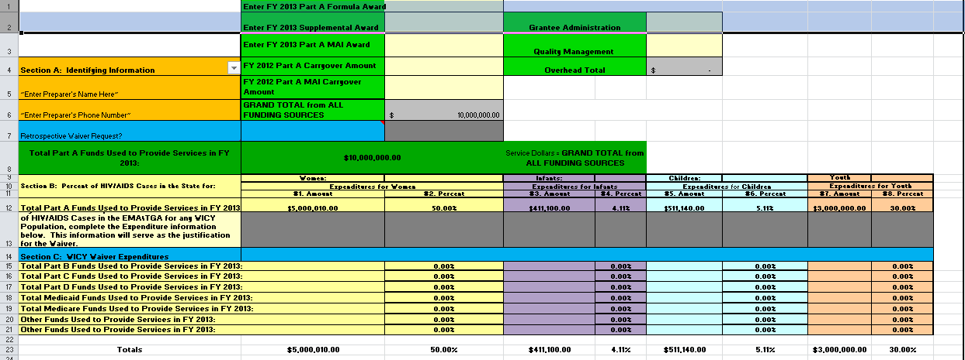
WICY Expenditures Table
Current Year WICY Expenditures Worksheet
If you requested a Retrospective Waiver, complete Section C: WICY Waiver Expenditures.
Enter preparer's Name and
number
Enter the percent of estimated living HIV/AIDS cases in your State/jurisdiction for WICY
in cells C12, E12, G12 and I12 respectively. (This information, prepared by the CDC,
has been provided in a separate spreadsheet.)
Enter the total amount of funds expended on
services per funding source for WICY on Lines 15-21 (where applicable).

Slide 39
WICY Expenditures Table - Checkpoints
Before submitting your WICY report, ensure compliance with the following:
Compare required percentages with actual expenditure percentages for each population
In the presence of a waiver, use the prospective or retrospective waiver review checklist
Be sure that funds being used for calculations are only service dollars

Slide 40
Final Part A and MAI Expenditure Report
Purpose: A reporting tool used to document the amount expended in services provided during the prior grant year. The report identifies the amount spent in each service category and also helps track if amount allocated for services changed during the grant year.
Accounts for prioritized funding set by the planning council with regard to the 75/25 rule (applies to both Part A and MAI funds)
Accounts for administrative and Clinical Quality Management expenditures
Accounts for prior year carry over expenditure amount

Slide 41
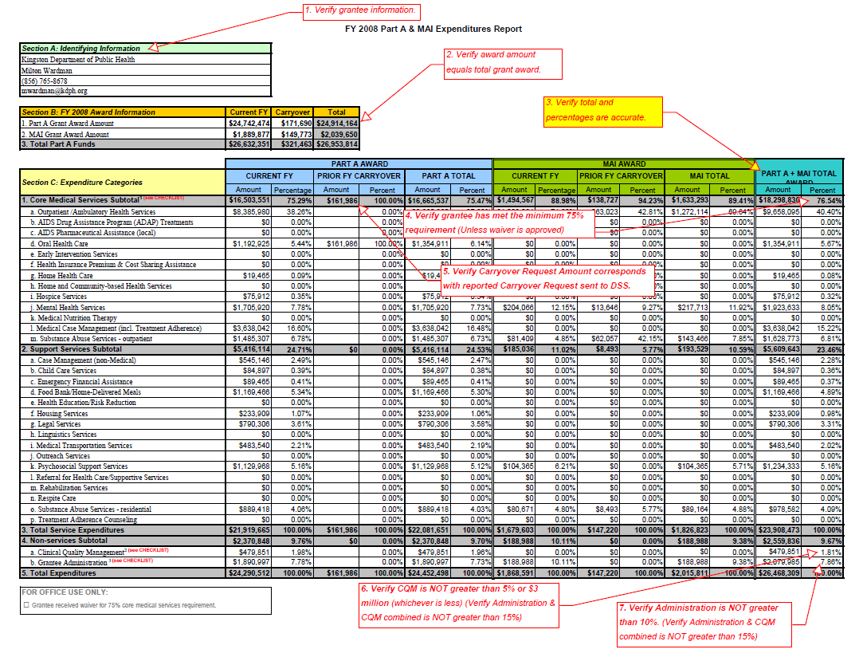
Current Year Part A and MAI Expenditures Report

Slide 42
Final Part A & MAI Expenditure Report - Checkpoints
Before submitting your expenditure report, ensure compliance with the following:
Award amount equals the total grant award
Total amount and percentages are accurate, though tables are preset with calculations
75/25 Core/Support services rules are applied. If not, a waiver was approved
Administration ≤ 10 percent of total award
Clinical Quality Management ≤ 5 percent or $3 million, whichever is less
Compare carryover expenditure amount
Compare final amount expended with FFR

Slide 43
Maintenance of Effort (MOE)
Purpose: A monitoring tool used to verify funds spent by Grantee’s political subdivision on HIV/AIDS related Core medical services are at a level equal to the one (1) year preceding the FY for which the grantee is applying to receive a Part A grant.
“As we communicated during the Part A Directors' Meeting at the All Grantees Meeting last November, grantees will not be required to resubmit their FY 2013 Maintenance of Effort information as a separate reporting requirement. We will accept the MOE information reported in the FY 2013 application as satisfying the MOE reporting requirement.”

Slide 44
End of Reporting Requirements

Slide 45
Questions
Notes:
We will now break for ~ 10 mins for a quick exercise
Can I have you all break into small groups
In your groups please identify a note taker and someone to present your findings
The activity is a review of a complete allocations table
Taking in to consideration all that I said earlier about this table and its parameters
Please review it for possible errors
I will give you all 5 mins to review it and the new will go over the errors.

Slide 46
Fiscal Accountability and Improper Payments
Purpose: To provide a review of the importance of fiscal accountability and preventing improper payments.
Fiscal accountability is the ability to document and account for all grant funds
To provide assurances that funds are expended according to Federal requirements
To prevent improper payments
To initiate corrective actions when necessary
Notes:
Don’t talk about the purpose, just go to the bullet points dfor
This presentation will focus on Improper payment, which like I mentioned early is a component of fiscal accountability.

Slide 47
Improper Payments
What are they?
Unallowable cash payments or services received by eligible recipients; or
Allowable cash payments or services to ineligible recipients
Notes:
So what are improper payments……a great example of an improper payments… take for example a Part A grantee in Maryland has been funding a program working with African immigrants who are HIV Positive. Their data on retention in care is really great and they have been asked to come an present their model and data at an international summit in South Africa. Travel is included in the agency’s current budget. While it is great that they have created a model with promising results and we always encourage the replication of good initiatives, in this situation it would be improper for the grantee to use Ryan white funds to pay for their travel to South Africa, as RW program does not cover foreign travel.

Slide 48
Improper Payments
Why are they important?
The Improper Payments Act of 2002 requires each agency to annually review all of its programs and activities and identify those that are susceptible to significant improper payments and actions taken to mitigate it.
HRSA is required to report its risk assessment of improper payments for CARE Act Programs
Notes:
legislation greatly expanded the Administration's efforts to identify and reduce erroneous payments in the government's programs and activities. When implemented, this guidance promises to improve the integrity of the government's payments and the efficiency of its programs and activites.
are required to report annually on the extent of the erroneous payments in those programs and the actions they are taking to reduce erroneous payments.

Slide 49
Improper Payments
Risk factors for assessing improper payments are found in the legislation and include:
Administrative Caps - for both grantees and providers
Maintenance of Effort (MOE)
Payer of Last Resort
Allowable service costs to eligible clients
For example - primary care to low-income clients
These risk factors are monitored by both HRSA and grantees.

Slide 50
Improper Payments
Types of improper payments include:
Unallowable administrative costs
Use of Federal funds to supplant state/local funds required for MOE
Payment for services that are covered by another Federal funding stream (e.g., Medicaid)
Unallowable services received by eligible clients (services not allowed by CARE Act legislation or HAB Policies)
Allowable services received by ineligible clients
Not low-income
HIV negative clients

Slide 51
Improper Payments
Who is responsible for preventing improper payments?
Grantees and Direct Service Providers are responsible for developing/identifying systems to prevent improper payments.

Slide 52
Improper Payments
How are they identified?
Continuous fiscal monitoring
Annual audits
Grantee’s A133
Annual subcontractor audits: HRSA expects grantees to identify and report improper payments resulting from audits
Office of Inspector General (OIG) audits
Notes:
A133 - Federal agencies shall apply the provisions of the sections of this Circular to non-Federal entities, whether they are recipients expending Federal awards received directly from Federal awarding agencies, or are subrecipients expending Federal awards received from a pass-through entity (a recipient or another subrecipient).

Slide 53
Improper Payments
Best Practices to prevent improper payments
Maintain strong and routine program monitoring systems and protocols
Efficient fiscal (accounting) control systems
Develop cost controls
Allocations
Tracking
Reporting
Clear and functional fiscal policies and procedures
Regular use of policies and procedure
E.g. Part A Fiscal Monitoring Standards
Clear fiscal responsibilities and expectations in contracts

Slide 54
Questions

Slide 55
Contact Information
Adeola Fawehinmi
Project Officer
Division of Metropolitan HIV/AIDS Programs
HIV/AIDS Bureau, HRSA
(301) 443-9236
(301) 443-5271 fax
afawehinmi@hrsa.gov
Frances Hodge
Project Officer
Division of Metropolitan HIV/AIDS Programs
HIV/AIDS Bureau, HRSA
(301) 443-1892
(301) 443-5271 fax
fhodge@hrsa.gov

