Slide 1


Health Information Exchange: From New York to Hawaii (and everywhere in between)
Don Kyles
AIDS Community Care Team
State of Hawai’i
Jesse Thomas
RDE Systems, LLC
Pete Gordon, MD
New York Presbyterian
Columbia University

Slide 2
Health Information Exchange: From New York to Hawaii (and everywhere in between)
Workshop Objectives:
  Describe two examples of HRSA Ryan White supported programs who are utilizing Health Information Exchange (HIE) to improve patient care, care coordination, and RSR reporting.
  Define and Explore opportunities for the RW Community to adopt and utilize state-of-the-art HIE in support of their clinical programs and regulatory reporting responsibilities

Slide 3



November 28, 2012
Facilitated by:
Don Kyles, Hawai’I AIDS Community Care Team
Jesse Thomas, RDE Systems, LLC

Slide 4
Where Are We From?

Slide 5

Today’s Agenda
Introduction
State-wide Data Exchange
Medical Data Linkage and Exchange
ADAP Innovation
ADAP Data Report (ADR)

Slide 6

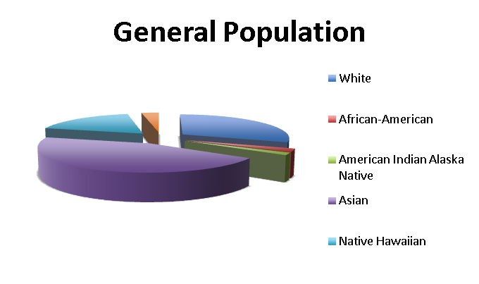
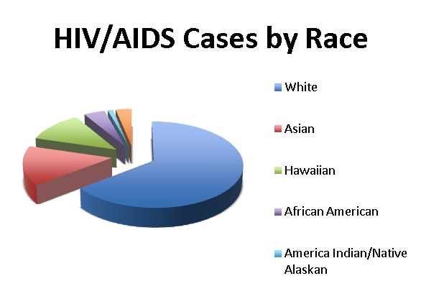
Population 1,288,198

Slide 7
Current Strategy
eCOMPAS serve as platform to be adapted to local needs and new innovations.
Operate within a “partnership paradigm” instead of a traditional “transactional paradigm” with our technology partner to achieve our large vision in a short time frame.
RDE Systems, makers of eCOMPAS, fit perfectly with this needed approach.

Slide 8
Data Collection Systems Timeline
COMPIS era
ReggieHAWAII decade
1990
2000
2008
2009
2010
2012
Hawaii receives first Ryan White CARE Act funding.
SPNS Grant Awarded
RDE Contract
Awarded
Life Foundation begins using ReggieHAWAII with rollout to other agencies within 2 years
e2Hawaii launched
ADR Module launched
State mandates use of COMPIS for data collection and reporting
e2 ver. 2 released
Notes:
8

Slide 9
Have respondents participated in the design of e2Hawaii?
88.5% of users provided feedback during the customization of e2

Slide 10
Launch Accomplishments
One-day, smooth launch of very user friendly system
RSR Compliant on Day 1
3,795 clients and 409,000 units of services spanning over 18 years of data converted from legacy system. 99.92% data conversion success
Little-to-no training required!
High user satisfaction
More engaged users

Slide 11

Electronic Comprehensive Outcomes Measurement Program
for Accountability and Success (e2)
Developed by
RDE Systems, LLC
A System and an Approach

Slide 12
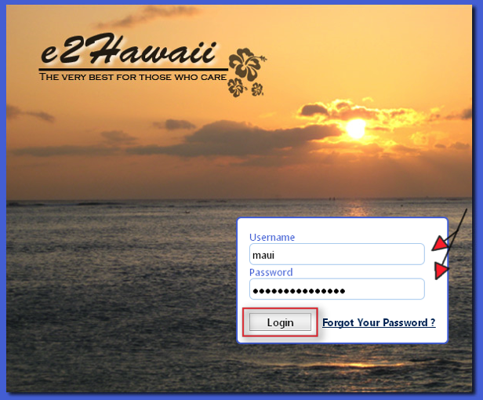
Client Intake – Login

Slide 13
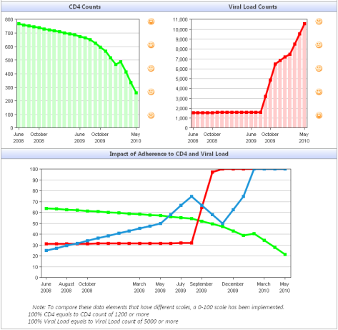
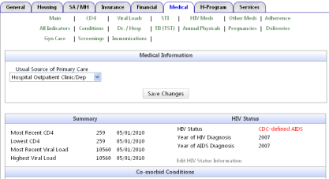
Features
Comprehensive Medical Module

Slide 14
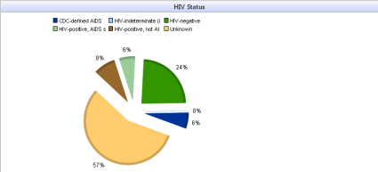
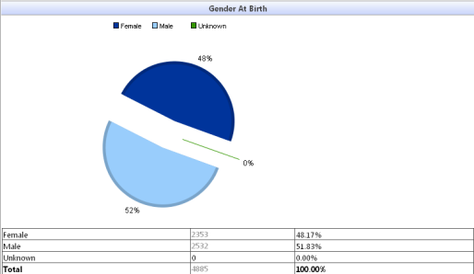
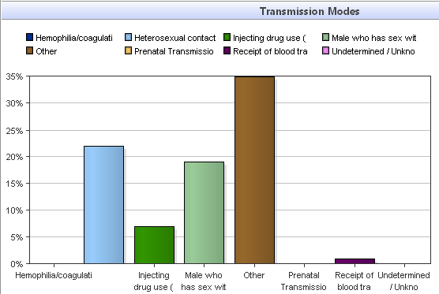
Features
Visual Analytics

Slide 15

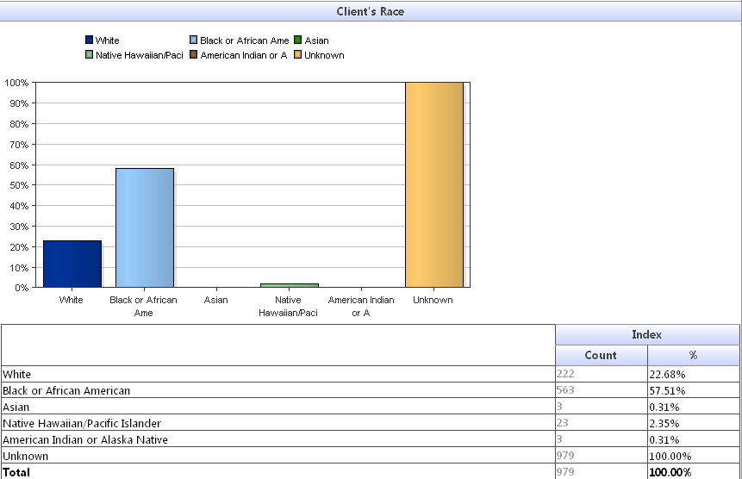
Features
One-Click RSR

Slide 16
State-wide Data Sharing

Slide 17
Importance and Impact
Time
Data quality (Error-reduction and duplication prevention)
Data Timeliness (Real-time)
Coordination of Care
Client/Patient Convenience
Data Analysis and Reporting
Duplicative work is stressful!

Slide 18
Client Record in a Networked Sharing Model – e2Hawaii
Housing
HOPWA
Medical / Clinical
Dr. Visits
Case Manage-ment
Demographic Data
ADAP / COBRA
Participation Status
Rent Subsidies
CD4/Viral Load Counts
Other Clinical Indicators
Online Enrollment
Insurance Data
Ryan White Eligibility

Slide 19
eCOMPAS (e2Hawaii)
Implementation and Data Sharing
Outcomes

Slide 20
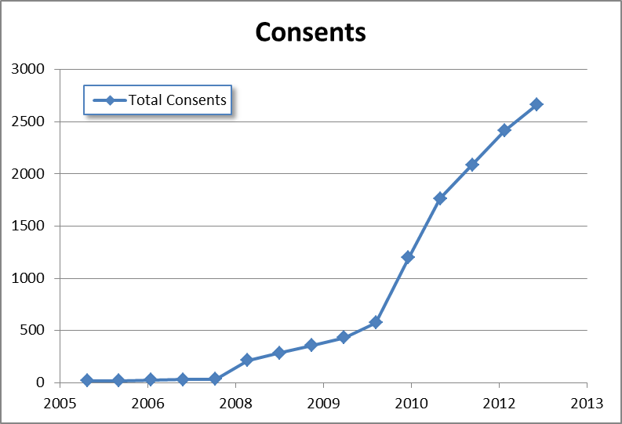

Slide 21
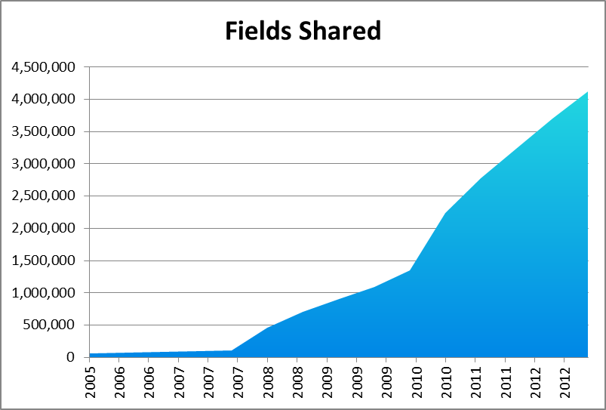

Slide 22
Source: Survey data collected while previous system was used (Reggie) compared to a post-launch survey conducted five months after e2Hawaii (eCOMPAS) was launched.

Slide 23
Total of 5,659 Hours Saved by e2Hawaii Each Year
An additional 2,000 hours of savings is projected by the Waikiki Health Center based on the e2Hawaii Electronic Health Record Data Exchange Module developed by RDE Systems for a total of 5,659 hours saved per year.

Slide 24
Has e2Hawaii helped users consistently use reports to understand demographic, needs, and health outcomes?
22% Improvement

Slide 25
Has e2Hawaii helped users view clients’ past treatment history before planning and providing services to consumers prior to each visit?
160% Improvement

Slide 26

Part C SPNS Vignette:
Using SPNS to Transform
Client Level Data Requirements to Drive State-Wide Electronic Health Information Exchange

Slide 27





The Old Way
Manual
Data Entry
Manual
Data Entry
Manual
Data Entry
Reggie
Certified
EHR
For:
Practice
Management
and EMR
For:
Part B
Billing and
Reporting
For:
Part C
RSR
Reporting

Slide 28
Problems with the Old Way
Triple data entry!
Data quality errors and time lost due to triple data entry.
Keeping all sources of data in sync not feasible – meaning data is not kept current in all systems.
Data is not used fully for quality improvement.

Slide 29






The New Vision
Manual
Data Entry
Part B Billing
Part B Reporting
Part B RSR
Part B ADR
Part C RSR
Quality Management and Quality Reports
eCOMPAS
Data Import
Engine
Certified
EHR

Slide 30
Project Challenges
EHR had incomplete and out-of-date Data Dictionary.
EHR documentation incomplete and out-of-date No Data Extract capability.
EHR training insufficient for report generation and data extracts.
EHR doesn’t track all fields required by HRSA Ryan White programs.
The exported data must follow both HRSA requirements and State-specific requirements.

Slide 31
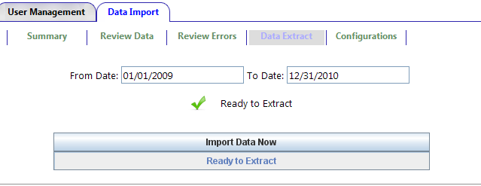
One Click Data Import
Browser extract tool – no software installation needed
System checks connectivity to database automatically

Slide 32
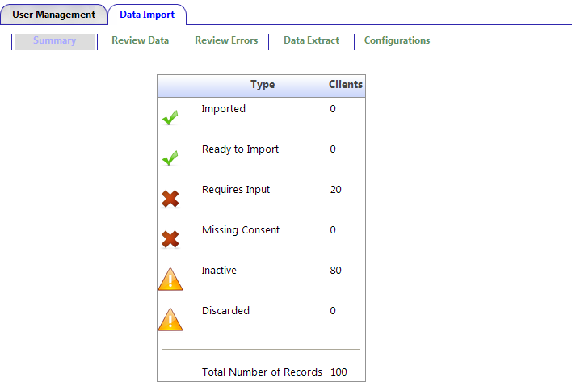
Import Summary at-a-glance

Slide 33
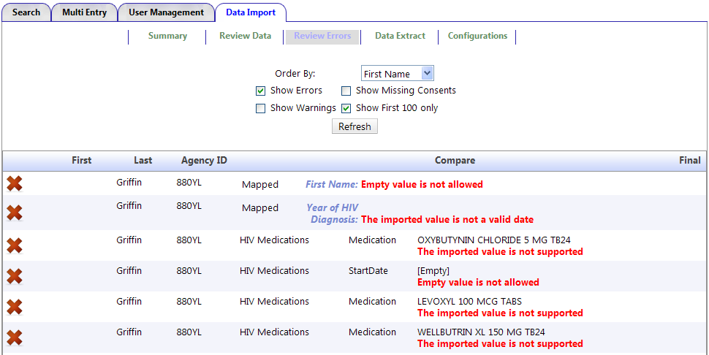
Data Quality Assurance Module

Slide 34
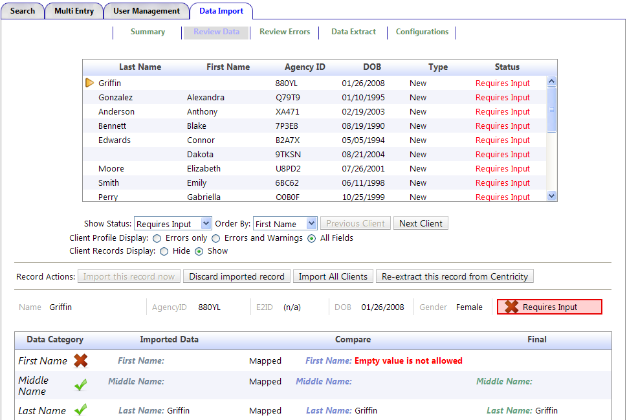
Data Import Details

Slide 35
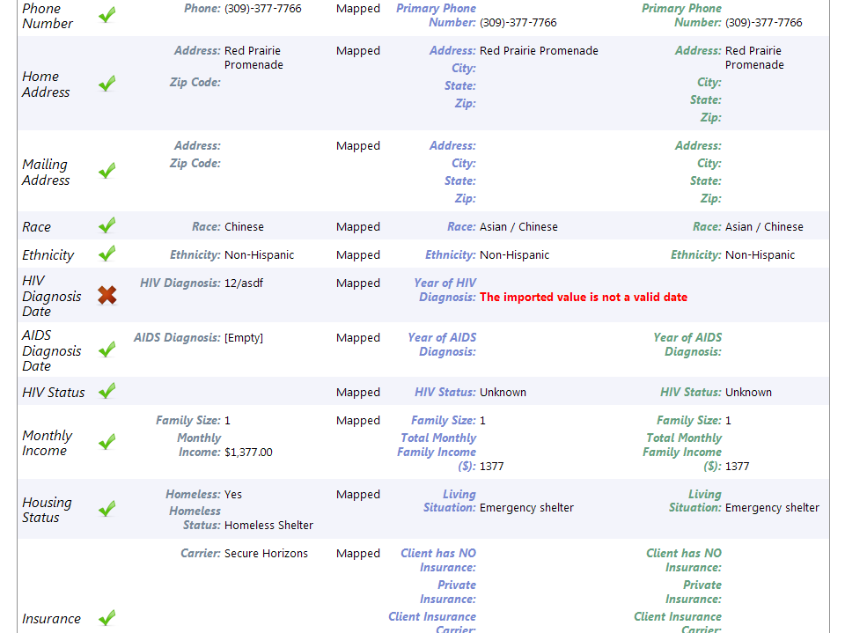
Data Import Details (continued..)

Slide 36
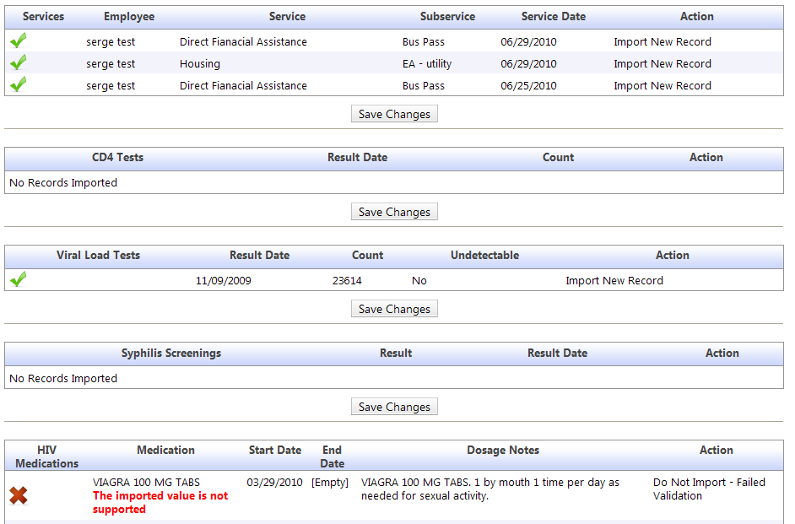
Data Import Details (continued..)

Slide 37
Project Accomplishments cont’d
Estimated 80-90%+ data entry savings (some fields are not tracked by EHR)
No further need to maintain multiple systems.
Combined with innovative state-wide model of sharing data, this project will allow other agencies to see medical data important to the treatment and service of clients.
Leveraged Part C SPNS grant to integrate seamlessly with State-wide eCOMPAS system for sustainability.

Slide 38
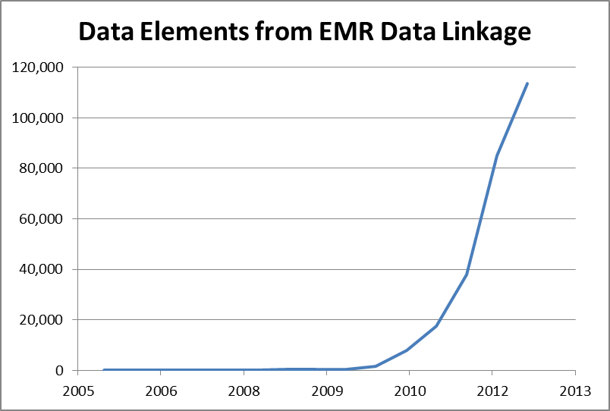

Slide 39
ADAP Innovation
Using eCOMPAS to Connect Case Managers with State ADAP
Problem Statement and Vision

Slide 40
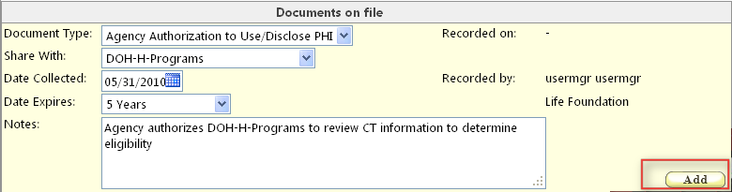


H-Programs – Step 1: Sharing

Slide 41
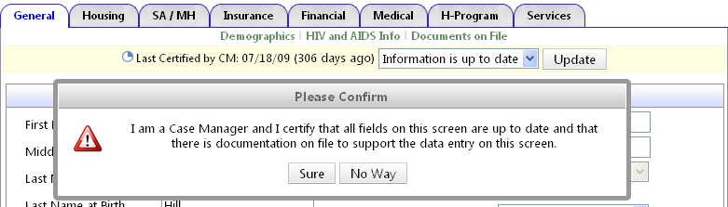
H-Programs – Step 2: Certification

Slide 42


H-Programs – Validations

Slide 43
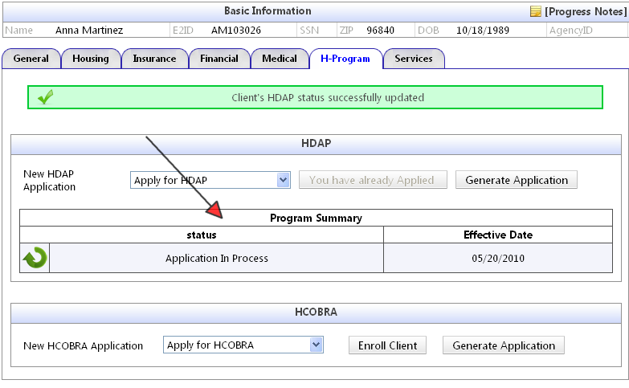
H-Programs – Step 3: Application

Slide 44
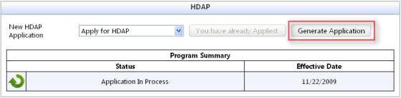
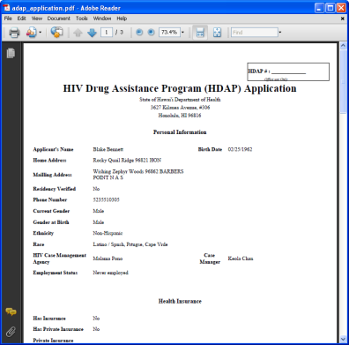

H-Programs – Step 3: Application cont.

Slide 45
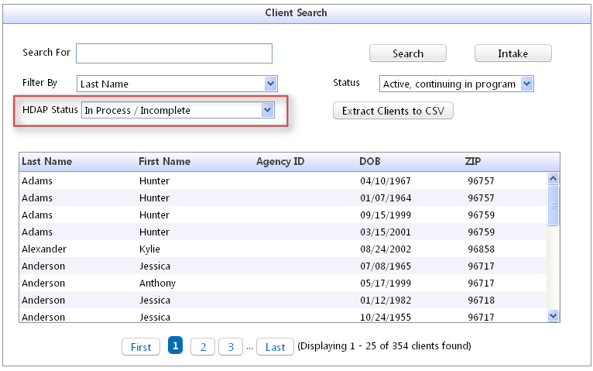
State Department of Health’s View – Processing Applications

Slide 46
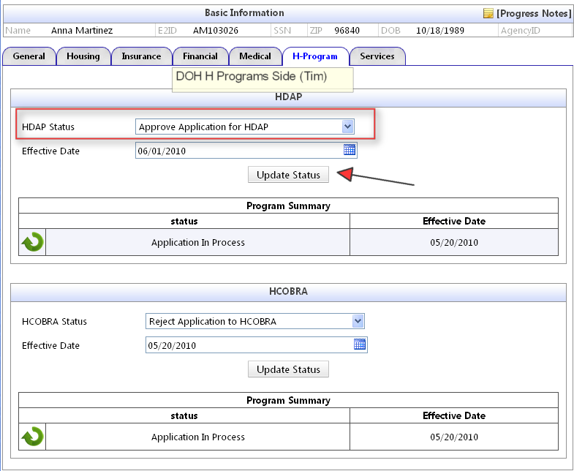
H-Programs – Processing Applications

Slide 47
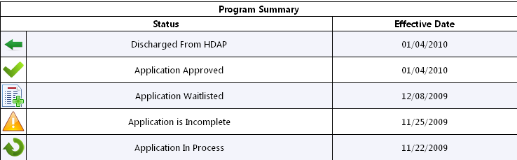
Real-Time Updated Information Between Case Managers and State Department of Health

Slide 48
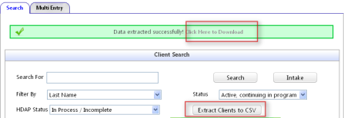

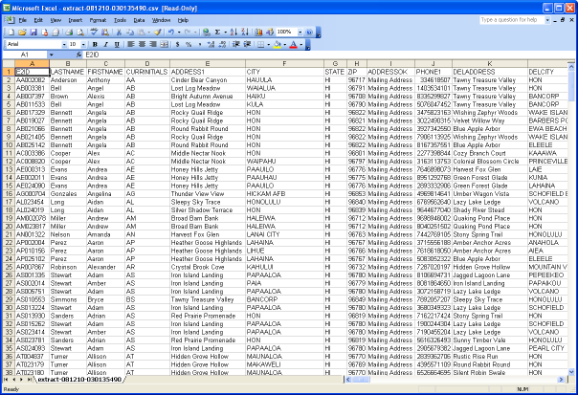
H-Programs – Data Extract

Slide 49
Source: Survey data collected while previous system was used (Reggie) compared to a post-launch survey conducted five months after e2Hawaii (eCOMPAS) was launched.

Slide 50
ADAP Data Reporting
SPNS to the Rescue
eCOMPAS + Hawaii DOH

Slide 51
ADR Report Before
Manual Entry of Premiums into H-COBRA Access Database
Manual Entry of Drug Pricing into HDAP Access Database
Manual Entry of Drug Ordering/Purchasing into HDAP Access Database
Import of e2 Client Demographics and Enrollment Data
Manual merge and de-duplication to produce ADR Data / AQR

Slide 52
The Challenge

Slide 53
ADR Report Before
Drug Wholesaler
Pharmacy
partial pay claims
Insurers
eligibility
secondary payer billing
ordering/purchasing
pricing
dispensing
manual entry of premium payments made to insurance co; former employer; or 3rd party COBRA administrator
HDAP Access database
H-COBRA Access database
enrollment
demographic, application & recertification data
e2Hawaii Web-Based System
enrollment
Manual data merge / de-duplication and reporting
ADAP Data/AQR

Slide 54
ADR Reporting After
Drug Wholesaler
Pharmacy
partial pay claims
Insurers
Secondary payer billing
Pricing
dispensing
Service Delivery Batch Import
Enrollment
Demographics
Application and Recertification
Entry of Premium Payment
e2Hawaii Web-Based System
Automated real-time process with
Visual Analytics and
drill-down capabilities
ADR

Slide 55
ADR Report After
Automatic import of Drug Pricing in e2
Import of pharmacy dispensing data
Automatic HDAP Payment Amount calculations based on drug pricing and quantity dispensed
Batch entry of Premium Payments
Real-time ADR Report XML Export

Slide 56
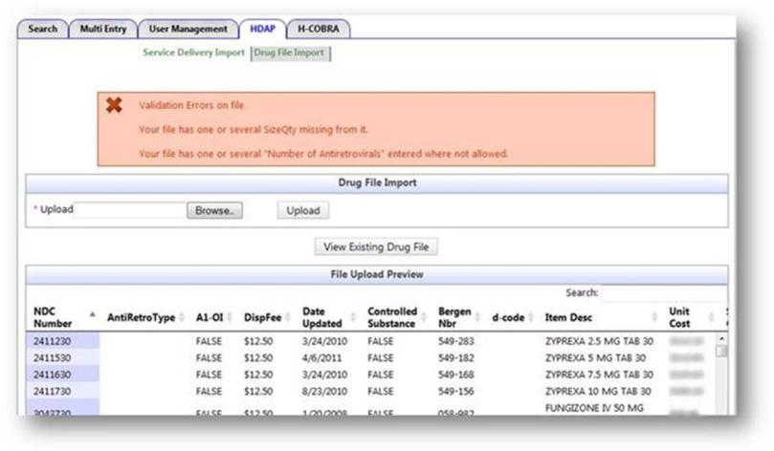
Highlighted Features
Automatic import of Drug Pricing in e2

Slide 57
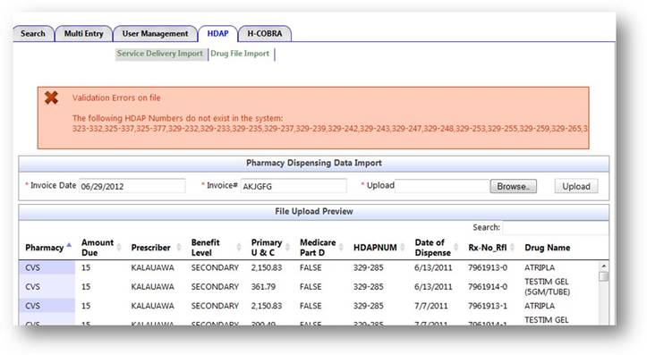
Highlighted Features
Pharmacy Dispensing Data Import and Pricing

Slide 58
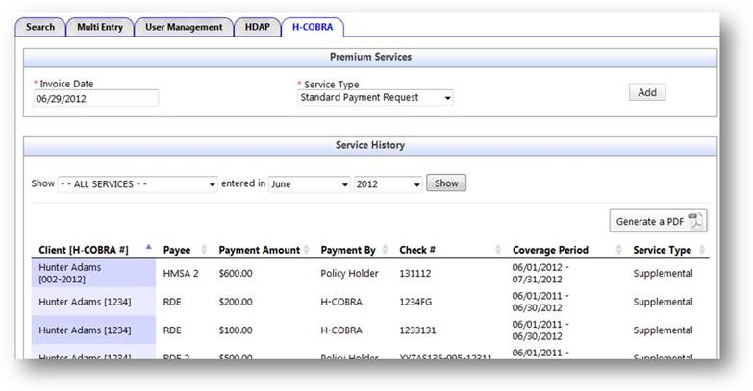
Highlighted Features
Batch Premium Payments Requests

Slide 59
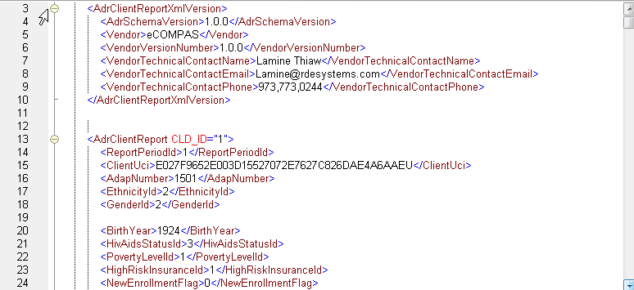
Highlighted Features
Real-time XML Export

Slide 60
CMS NDC to HRSA NDC Mapping
ADR Requires reporting of drugs in d-Codes format (letter “d” followed by 5 numbers)
Pharmacies use NDC codes (National Drug Codes)
=> HRSA provided a NDC to d-Code mapping spreadsheet
Problem: HRSA has simplified their NDC format => it’s now different from the Pharmacies’ NDC format

Slide 61
CMS NDC to HRSA NDC Mapping
Example
Current HRSA NDC Format
005050034
Current Pharmacy NDC Format
505003401
Differences
  No Quantity Code on HRSA’s NDC
  Pharmacy NDC is not always 9 digits
  → e2Hawaii solved all these issues algorithmically
Drug Code (9 digits padded with 0s)
Quantity Code
Drug Code

Slide 62
Highlighted Features
Recertification Due Report
  Seamless and built-in client recertification
  Color coding to indicate where attention is needed
  Very frequent Recertification due to sharing with CM
  Improve data quality and meet recertification requirements at the same time
  → Time Saving: No follow up required to get recertification done

Slide 63
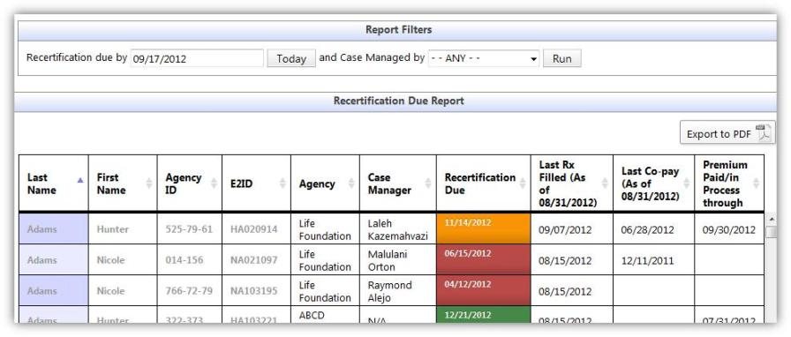
Highlighted Features
Recertification Due Report

Slide 64
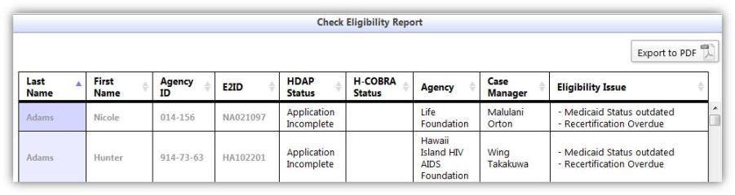
Highlighted Features
Check Eligibility Report
  Proactive, real-time eligibility check
  Very quickly check eligibility of all client in the system before the 6 month recertification

Slide 65
Highlighted Benefits
Medical Case Managers have direct access to pharmacy dispensing data for their clients instead of client self reporting
  Adherence issues can be addressed
  CM can follow up with client if a month is missing data or medication
  Proactive follow up if no Drugs requested for a time period
  Better outcomes as clients stay on their medications longer

Slide 66
Highlighted Benefits
Financial Savings: As outcomes improve due to proactive follow up, Adherence improves and client can stay on Drugs for a long time, vs. non Adherent clients that develop drug resistances and require stronger, more expensive drugs (change in regimen)

Slide 67
Highlighted Benefits
Unique Integration with RW Part C, Department of Health and Case Management (Sharing of Clients)
Time Savings: No manual merge of data from multiple sources
Automatic de-duplication of Dispensing Data by RX Number to prevent double billing
Automatic NDC to d-Code mapping

Slide 68
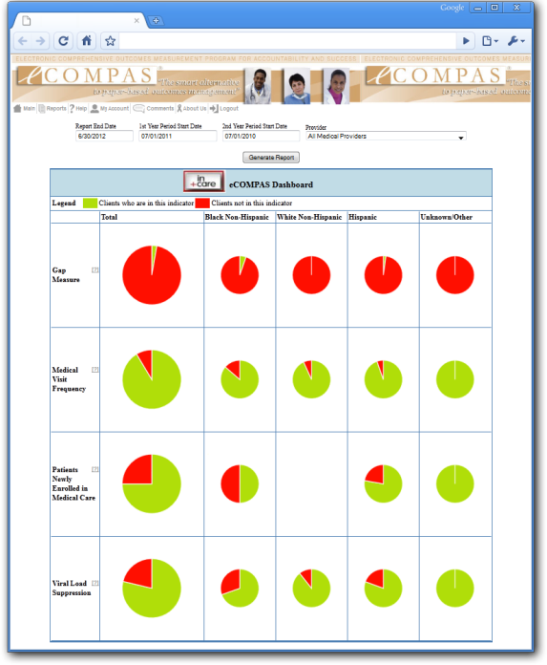
On the Horizon:
in+care eCOMPAS Dashboard
At-a-glance
Visual
Red/Green
Populations
Region vs. Provider
Drilldown

Slide 69
Quotes
"I am so in love with E2."
“I love that we can now do batch entries!”
“The ability to communicate directly with someone when there's a problem or concern makes it much easier to continue to do our job.”
“For the amount of money we had, what we accomplished with RDE was MIRACULOUS!”

Slide 70
Lessons Learned

Slide 71

Support and encourage staff so they’re not afraid to get their feet wet!

Slide 72

Be Creative and Share your Ideas
The small stuff counts too!

Slide 73

Teamwork makes a difference

Slide 74

How do we accomplish ambitious goals?
One bite at a time.

Slide 75
The Story of Lani

Slide 76
Friday August 13, 2010
Hey you guys:
What a wonderful system to have at our beck and call!! The multi services screen is BEAUTIFUL!!! I love it. You all have exceeded yourselves in E2. I believe one can absolutely NOT make mistakes during the services input. The system allows one to
see your work,
make changes that are erroneous in just that ONE page instead of getting out of one screen to access another to correct the error,
get finished in one-eighth of the time it originally took,
have plenty time to go on to other projects.
Gosh, you all are full of surprises. Myself did not know it would be so simple. Even a cave-man can do it!!
Thank you, thank you, thank you….
Aloha, Lani
P.S. The client roster screen is very very informative. This is extremely beneficial to our case managers. I know they express their astonishment at your accomplishments. We did not expect such detailed information.
Thank you again, Lani

Slide 77

Health Information Exchange: From New York to Hawaii (and everywhere in between)
Important Themes from this Workshop:
Health Information Exchange
Interoperability
HIT Standards and Guiding Agencies (ONC)
Process and Outcomes
Vendors / Strategic Partnerships
Notes:
Add disclosures here…

Slide 78

Story #1: HIE and The New York Experience…..
Setting: The Comprehensive HIV Program at New York Presbyterian, a.k.a. Columbia University Medical Center
The Problem: Multifactorial
Drowning in data and reporting requests
Multiple IT systems that:
  Do not ‘talk’ to each other
  Cannot ‘extract’ information easily
  Result in ‘shadow’ processes that result in duplicative work
Divert critical personnel manpower from service provision to data abstraction
Messy process….. Many errors… Is the resultant data accurate enough to be useful?

Slide 79




Slide 80
NYP/Columbia Comprehensive HIV Program (CHP)
Adult Program Women and Children Care Center Project Stay
1800 individuals LWH
Multidisciplinary, multi-functional, and evolving
2 clinical care sites, 2 community based care coordination sites, street level outreach efforts
RW support:
Part A
Part B
Part D
Part F
Data
Data
Data
Data
Data
Data
•RSR
•Patient Care (!)
•QA/QI
•Other grant and regulatory reporting

Slide 81
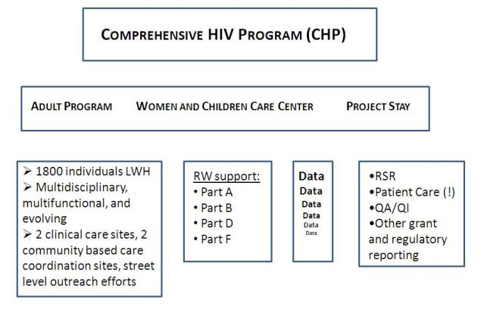
Where does the information come from in your program?
How much data?
What is the data?
Notes:
Untill recently….

Slide 82


Slide 83


Slide 84


Slide 85
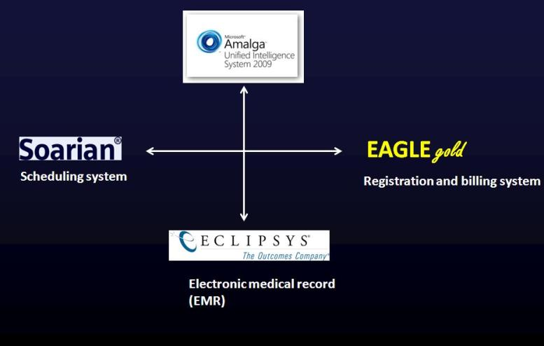
The ‘Medical Record’ is typically an amalgamation of multiple electronic systems, tied together by an IT network that exchanges information –a form of Health Information Exchange
Notes:
The ‘Medical Record’ is generally thought of as the repository of ‘all’ information, but actually as a single entity it often does not exist, rather it is a collection of IT systems linked together by an IT network. More on this later.

Slide 86
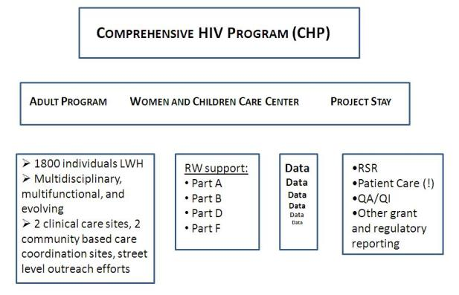
Where does the information come from in your program?
How much data?
What is the data?
Notes:
So

Slide 87

How much data?
NYP/Columbia must track and manage over 800,000 data elements annually for grant and regulatory reporting purposes:
• HRSA, NYC DOHMH, AIDS Institute, CDC
• RSR, AIRS, eSHARE
• 95 ‘users’ who need to contribute, add, manage, and export data

Slide 88
Where does the information come from in your program?
How much data?
What is the data?
Notes:
So

Slide 89

What is the data?
Demographic
Services
Clinical
Care Coordination

Slide 90
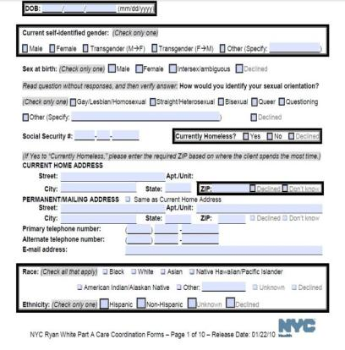
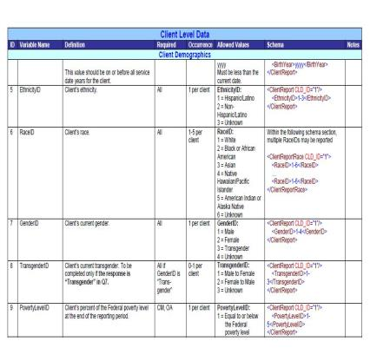
What is the data?
Often duplicative and derived from common sources
NYC DOHMH MCM Program
RW Part D WICY Program
Notes:
Well, much of the data is duplicative and derived from the RSR – at least for our Part A, B, D, and F supported programs. Here is an example from our Medical Case Management grant from the NYC DOHMH – a Part A supported program – and our Part D WICY program.

Slide 91



A typical workflow process at NYP/Columbia for how a patient gets scheduled, registered, documented in an EMR, and billed.
EAGLE gold
Scheduling system
Registration and billing system
Electronic medical record (EMR)

Slide 92
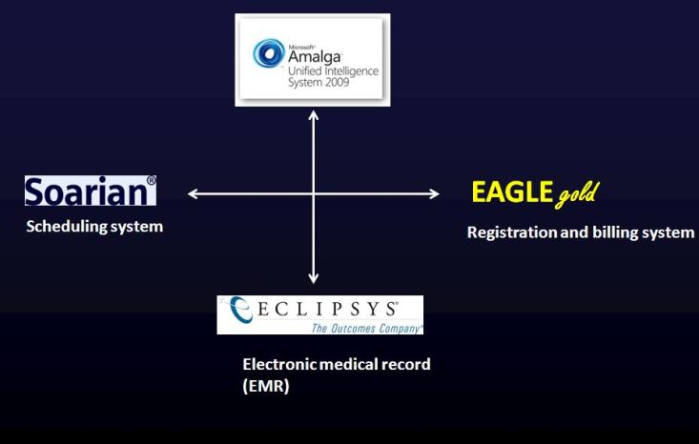

This is the way it might work in a perfect world….

Slide 93
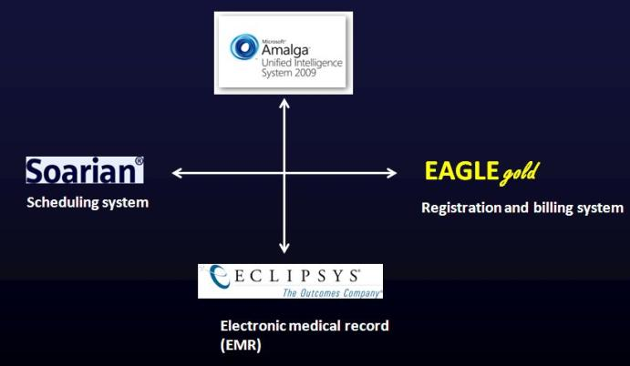


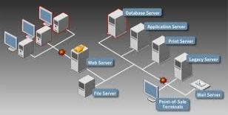
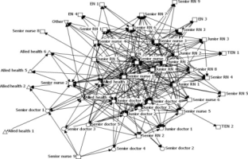

Slide 94
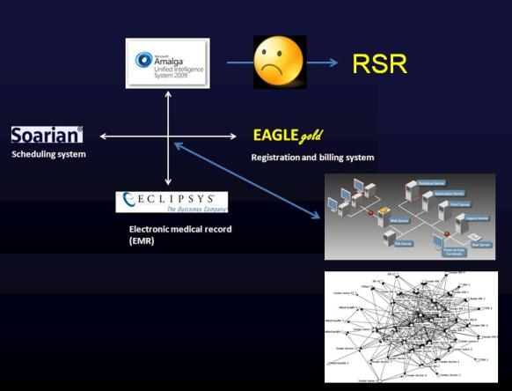


Slide 95


This is the way NYP/Columbia is making it work in the ‘real’ world of competing institutional priorities

Slide 96




To quickly recap….
Notes:
The River….. (No choice, but the foundation of your HIE)
The Aggregator…… (A lot of choice, but here is where you want to be very, very careful)

Slide 97
Electronic Comprehensive Outcomes Measurement Program
for Accountability and Success (e2)
Developed by
RDE Systems, LLC
A System and an Approach

Slide 98


NYP == CHP Network Diagram for eCOMPAS
2/15/2012
NYP Columbia / Cornell
SunGard
NYSGCLINDB
IP: 10.171.22.187
InfoNet / Clinical Applications / VPN
NYSGECOMPIIS
IP: 10.178.22.224
eCOMPAS.nyp.org
SQL
User Access to eCOMPAS via:
Web
InfoNet,
Eclipsys
VPN
NYSGECOMPTEST
IP: 10.178.22.223
DNS: eCOMPAStest.nyp.org
NYSGECOMPINT
IP:10.178.22.116
Interface Box
ASSET# 72258
NYSGECOMPIIS
IP: 10.178.22.224
DNS: eCOMPAS.nyp.org
ASSET# 72259
NYSGECOMPTEST
IP: 10.178.22.223
DNS: eCOMPAStest.nyp.org
RDE Access via VPN
ADT/LAB/Other from eGATE

Slide 99
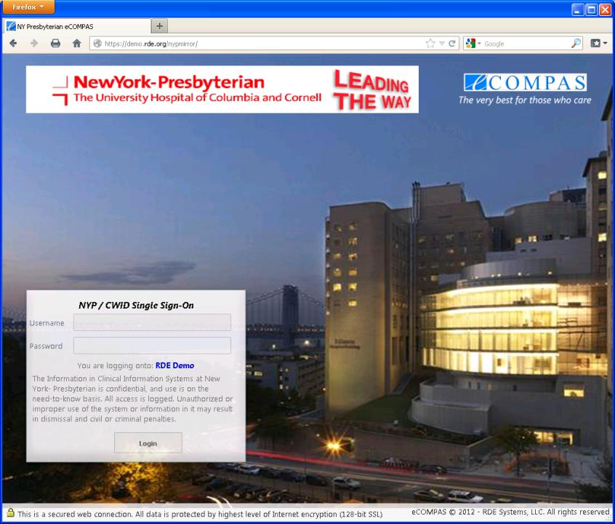

Slide 100
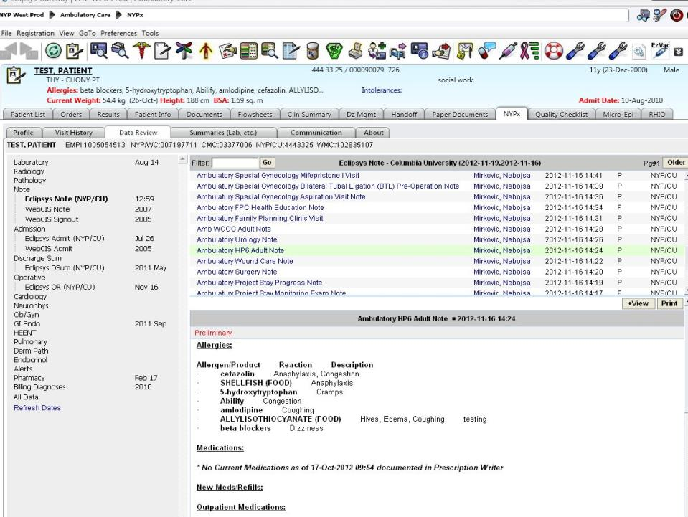

Slide 101
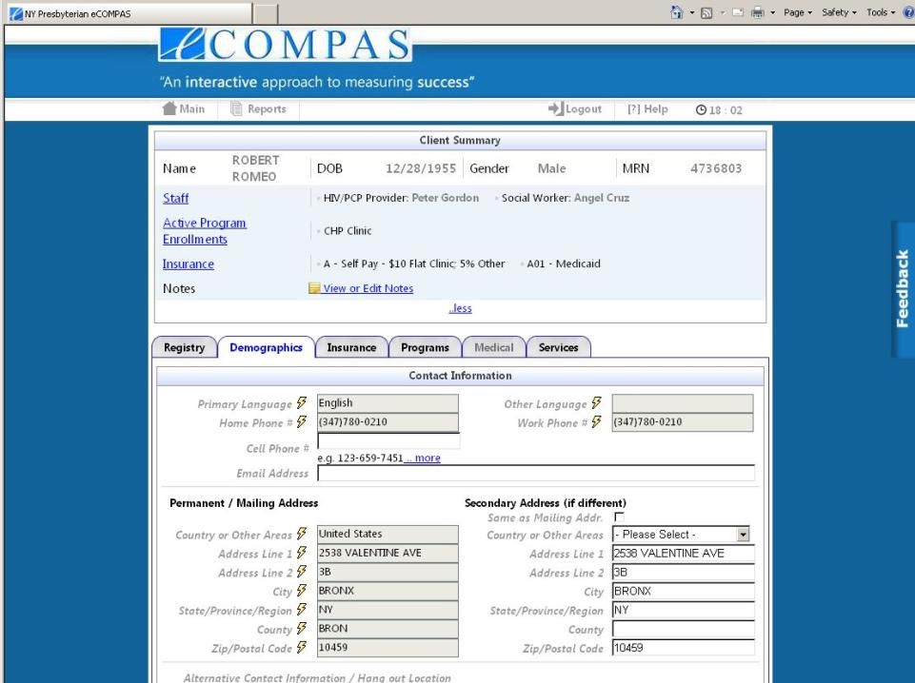
Obama, Barack

Slide 102
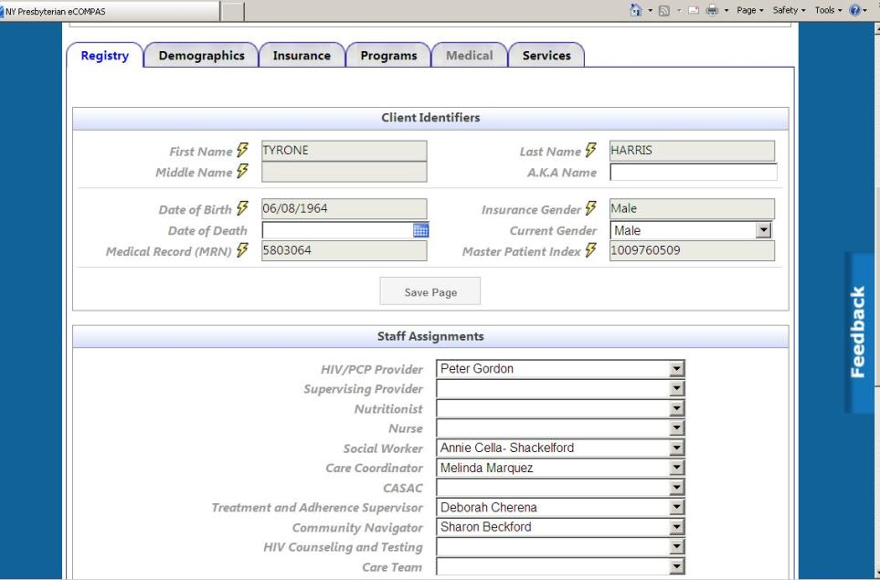

Slide 103
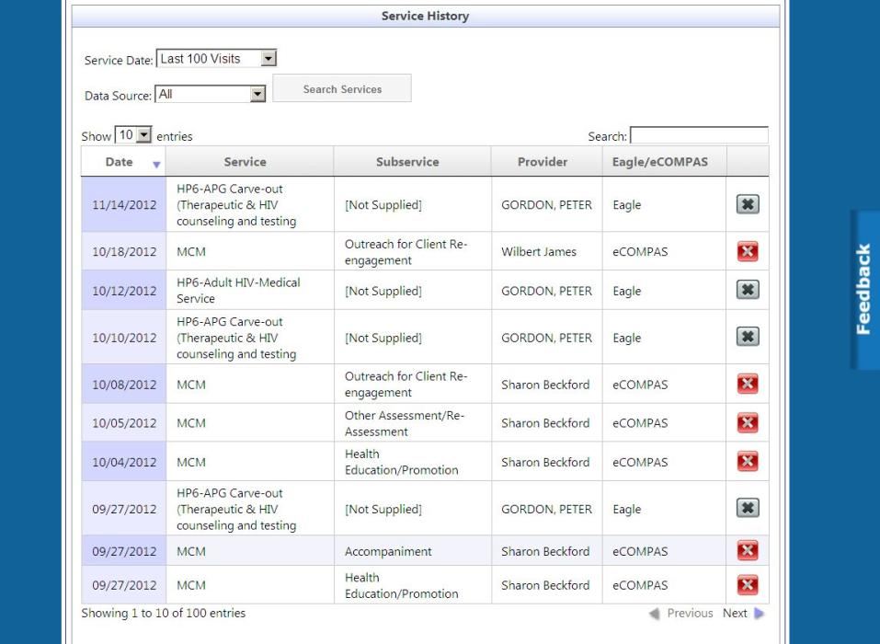

Slide 104

So what is the impact of this kind of HIE on NYP/Columbia’s program?
Time
Data Quality
Reporting
Population Management
Notes:
You can ask yourself what this approach might mean to your program in terms of manpower hours saved to devote to patient care and care coordination….. what this might mean in terms of data quality for reporting purposes as well as for your own QA/QI uses.

Slide 105
Time and Data Management: The Potential Impact of HIE
NYP/Columbia must track and manage over 800,000 data elements annually for grant and regulatory reporting purposes:
• HRSA, NYC DOHMH, AIDS Institute, CDC
• RSR, AIRS, eSHARE
• 95 ‘users’ who need to contribute, add, manage, and export data
How utilizing HIE and implementing eCOMPAS has impacted
• 187,696 data elements updated/added via HIE since March 2012 (demographics, visits/services, staff assignment)
• 521 hours of data entry saved (very conservative)

Slide 106
Data Feed 2
Data Feed 1
Data Feed 3
eCOMPAS
Interface Engine
1,000 est. hours saved each year!
6.3 million
HL7 Messages
Automated Data Transformation
PCP and Care Coordinator
Assignment
Care Engagement and
Population Management
188,000 Data Elements
Direct Data Integration
Automated Data Transformation Engine
Master Database

Slide 107
Notes:
System adoption is the best measure of ‘value’

Slide 108
Notes:
Especially by the most important individuals, those delivering the services

Slide 109
HIE and eCOMPAS: Once you have the data what can you do with it?
Automated data transfer (HIE)
  188,000 data elements updated/added via HIE since March 2012 (demographics, visits/services, staff assignment)
PCP and Care Coordinator Assignment
  Calculated from HIE visit feeds, highly accurate, no evolutionary divergence
Care Engagement and Population Management
  Calculated from HIE visit feeds, FORC and LTFU derived, enables care coordination team to generate population level care engagement work lists
Notes:
You can then use the data in new and innovative ways, saving time, vastly improving accuracy, moving to manage populations as well as individual clients

Slide 110




How much is automated vs. manual?

Slide 111


Slide 112


Slide 113

Notes:
So drilling down once again you can see that of these 10 patients/clients that have fallen out of routine care (FORC) 1 is in an enhanced care coordination program, 1 is in a treatment adherence program, the remaining 8 may be candidates for enhanced CC but certainly could be aggressively outreached.

Slide 114



Slide 115

Other potential benefits of HIE: Empowering consumers via patient portals

Slide 116

Other potential benefits of HIE: Empowering consumers via patient portals

Slide 117
NewYork-Presbyterian System
SelectHealth
My Health Profile
a Member Continuity of Care Document (CCD) for people living with HIV
a ‘snapshot’ of critical clinical and care coordination information
a standards based approach to HIE and access
Core Elements of a CCD include:
CCD Identifying Information
Patient’s Health Status
  Diagnoses
  Medications
  Laboratory results
  Procedures/Imaging
  Allergies/adverse reactions
  Social history/Family history
Advanced Directives/Life Documents
Care Documentation
Practitioners
HRSA Special Projects of National Significance
Information Technology Networks of Care Initiative (2007-2012)
Notes:
Offers patients and providers access to key elements of their clinical, psychosocial, and administrative record over a secure, web-based portal
117

Slide 118

Notes:
118

Slide 119

Notes:
119

Slide 120

Notes:
120

Slide 121


Slide 122


Slide 123


Slide 124


Slide 125

Notes:
125

Slide 126

Notes:
126

Slide 127

Conclusions….
Harnessing Health Information Exchange (HIE), whether internally, regional, or statewide offers many, many important opportunities
Designing and building your system to fully participate in HIE means design with Intraoperability in mind
Look for IT Partners instead of IT Vendors

Slide 128


A heartfelt thanks…..
Especially,
Adan Cajina
Chief, Demonstration and Evaluation Branch
Notes:
Adan Cajina - MS: Chief, Demonstration and Evaluation Branch

Slide 129

The subliminal message….

Slide 130
eCOMPAS®, e2, e2Hawaii © 2009 RDE Systems Support Group, LLC. All Rights Reserved.
Thank You!

