Slide 1
Program and Financial Integrity for the HIV Emergency Relief Program July 29, 2013 Presented by Lawrence Horlamus, Auditor Office of Federal Assistance Management Division of Financial Integrity

Slide 2
Agenda
Program Integrity Initiative at HRSA
A-133 Audit Findings
Allowable/Unallowable Costs
Allocation and Segregation of Costs
Grant Personnel Charges
Financial Management – Good and Bad Practices
Questions and Answers

Slide 3
Program Integrity Initiative
“The Program Integrity Initiative is designed to target the greatest risks of fraud, waste, and abuse and reduce those risks by enhancing existing program integrity operations, share new and best program integrity practices, and measure the results of our efforts.”

Slide 4
Program Integrity at HRSA
Agency-wide Workgroup
Grantee Outreach: Technical Assistance, Webinars, Social Media
Increased Collaboration Amongst Bureaus, Divisions, and Grants Management Operations
Training

Slide 5
2010 A-133 Audit Findings
Program Name | CFDA | Total # of Audits | Total # of Audits with Findings
HIV Emergency Relief Program | 93.914 | 82 | 162

Slide 6
2011 A-133 Audit Findings
Program Name | CFDA | Total # of Audits | Total # of Audits with Findings
HIV Emergency Relief Program | 93.914 | 103 | 154

Slide 7
2011 A-133 Audit Findings
 |  | 2011
Compliance Requirement | Description | # of Findings | % of Total Findings
A | Activities allowed or un-allowed | 13 | 8%
B | Allowable costs/cost principles | 27 | 18%
C | Cash management | 11 | 7%
D | Davis-Bacon Act | 0 | 0%
E | Eligibility | 16 | 10%
F | Equipment and real property management | 1 | 1%
G | Matching, level or effort, earmarking | 9 | 6%
H | Period of availability of Federal funds | 1 | 1%
I | Procurement and suspension and debarment | 7 | 5%
J | Program income | 6 | 4%
K | Real property acquisition and relocation assistance | 0 | 0%
L | Reporting | 28 | 18%
M | Sub-recipient monitoring | 8 | 5%
N | Special tests and provisions | 2 | 1%
P | Other | 25 | 16%
TOTALS |  | 154

Slide 8
Compliance Requirements
Activities Allowed or Unallowed (A)
Eligibility (E)
Matching, Level of Effort, Earmarking (G)
Period of Availability of Federal Funds (H)
Program Income (J)
Reporting (L)
Source: A-133 Compliance Supplement, June 2012

Slide 9
A-133 Audit Findings
Summary:
Grantees can do their part to strengthen Program Integrity by avoiding audit findings!

Slide 10
Federal Cost Principles
Federal Regulations
Entity Type | OMB Circulars | Cost Principles | Uniform Admin. Reqs.
Education Institutions | OMB A-21 | 2 CFR 220 | 45 CFR 74.27
State and Local Governments | OMB A-87 | 2 CFR 225 | 45 CFR 92.22
Non-Profits | OMB A-122 | 2 CFR 230 | 45 CFR 74.27

Slide 11
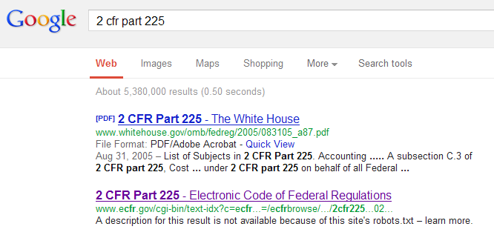
Allowable Costs

Slide 12
Cost Allocation and Segregation
Grantees should be sure to fairly and accurately allocate direct costs to their grant and non-grant activities.
Grantees should be sure to segregate grant fund expenditures by grant to ensure accurate draws of Federal funds.

Slide 13
Personnel/Labor Charges
Allowed to charge grants for actual labor not budgeted labor
Accurate labor charges help an organization create accurate budgets and applications
Accurate labor charges help an organization determine the true cost of a project or meeting grant objectives

Slide 14
Personnel/Labor Charges
Refer to the section entitled “Compensation for Personal Services” in 2 CFR Part 225 for more information.

Slide 15
Financial Management – Good Practices
Having well documented Policies and Procedures
Periodically performing internal audits of grant performance and grant fund management
Providing plenty of training on managing grants and the OMB Circulars, including cost principles
Notes:
The following are some good practices that grantees should follow.

Slide 16
Financial Management – Bad Practices
Not adequately documenting grant costs – would be unallowable if audited/reviewed
Time sheets reflect budgeted hours instead of actual hours worked
Drawing down funds in excess of immediate needs
Not segregating grant expenditures from non-grant expenditures or other grant expenditures
Notes:
The following are some bad practices that grantees should avoid.

Slide 17
Questions ?

Slide 18
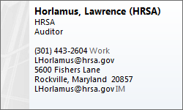
Contact Information
Health Resources and Services Administration
U.S. Department of Health and Human Services

