Slide 1
Understanding the Legislation Authorizing the Ryan White HIV/AIDS Program (RWHAP)
Supplemental Orientation for New PC Members

Slide 2
Training Objectives
Following the training, participants will be able to:
Provide 3 reasons the RWHAP is so important in providing HIV care
Explain and differentiate the 5 RWHAP Parts
Describe at least 3 important similarities between RWHAP Part A and Part B
Describe at least 4 key characteristics of RWHAP Part A
2
Notes:
Revised from Module 1 PowerPoint, slide 3

Slide 3
Topics
Importance of the RWHAP
“Parts” of the Legislation
How the “Parts” Work Together
3
Notes:
New

Slide 4
Importance of RWHAP: Scope and Outcomes
More than 1.1 million people in the U.S. are living with HIV
About 1 in 7 do not know their status
About half of PLWH who know their status receive at least one medical, health, or related support service from a RWHAP-funded provider
In 2016:
More than 80% of RWHAP clients were retained in care – they had at least two outpatient ambulatory health services (OAHS) visits during the year, at least 90 days apart
About 85% of clients receiving outpatient OAHS through RWHAP achieved viral suppression
Notes:
Combines 2 Module 1: slides 13 and 15

Slide 5
The Ryan White HIV/AIDS Program
Provides a comprehensive system of care for people living with HIV
Most funds support primary medical care and other medical-related and support services
Provides ongoing access to HIV medications
Small amount of funds used for technical assistance, clinical training, and development of innovative models of care
5
Notes:
Module 1, slide 22

Slide 6
RWHAP Part A
Funding for areas hardest hit by the HIV epidemic
Funding for two categories of metropolitan areas:
Eligible Metropolitan Areas (EMAs), with at least 2,000 new cases of AIDS reported in the past 5 years and at least 3,000 people living with HIV
Transitional Grant Areas (TGAs), with 1,000 – 1,999 new cases of AIDS reported in the past 5 years and at least 1,500 people living with HIV
Funds are used to develop or enhance access to a comprehensive system of high quality community-based care for low-income PLWH
6
Notes:
Module 1, slide 24

Slide 7
RWHAP Part B
Funding to all 50 States, DC, Puerto Rico, U.S. territories and jurisdictions to improve the quality, availability, and organization of HIV health care and support services
Provides funds for medical and support services
Includes the AIDS Drug Assistance Program (ADAP), which provides access to HIV-related medications through direct purchase, and purchase of health insurance
Also provides funds to emerging communities with a growing epidemic, reporting 500-999 new cases in the past 5 years
7
Notes:
Module 1, slide 25

Slide 8
RWHAP Part C
Funding to support “early intervention services”: comprehensive primary health care and support services for PLWH in an outpatient setting
Competitive grants to local community-based organizations, community health centers, health departments, and hospitals
Priority on services in rural areas and for traditionally underserved populations
Capacity development grants provided to help public and nonprofit entities deliver HIV services more effectively
8
Notes:
Module 1, Slide 26

Slide 9
RWHAP Part D
Funding to support family-centered HIV primary medical and support services for women, infants, children, and youth living with HIV
Competitive grants to local public and private health care entities, including hospitals, and public agencies
Includes services designed to engage youth with HIV and retain them in care
Recipients must coordinate with HIV education and prevention programs designed to reduce the risk of HIV infection among youth
9
Notes:
Module 1, slide 27

Slide 10
RWHAP Part F: Minority AIDS Initiative (MAI)
Funds used to improve access to HIV care and health outcomes for disproportionately affected racial and ethnic minorities
Part A programs apply for MAI funds as part of the annual application and receive funds on a formula basis
Formula is based on the number of racial and ethnic minority individuals with HIV/AIDS in the jurisdiction
10
Notes:
Module 1, slide 29

Slide 11
RWHAP Part F: Other
Two types of Dental Programs:
Dental Reimbursement Programs run by dental schools and other dental programs
Community Based Dental Partnership Program, to provide dental services for PLWH while providing education and clinical training for dental care providers
Special Projects of National Significance (SPNS)
Supports the development of innovative models of care to better serve PLWH and address emerging client needs
AIDS Education and Training Centers (AETCs)
Supports a network of 8 regional centers that provide targeted, multidisciplinary education and training programs for health care providers serving PLWH
11
Notes:
Combines Module 1 PPT slides 28, 30, and 31

Slide 12
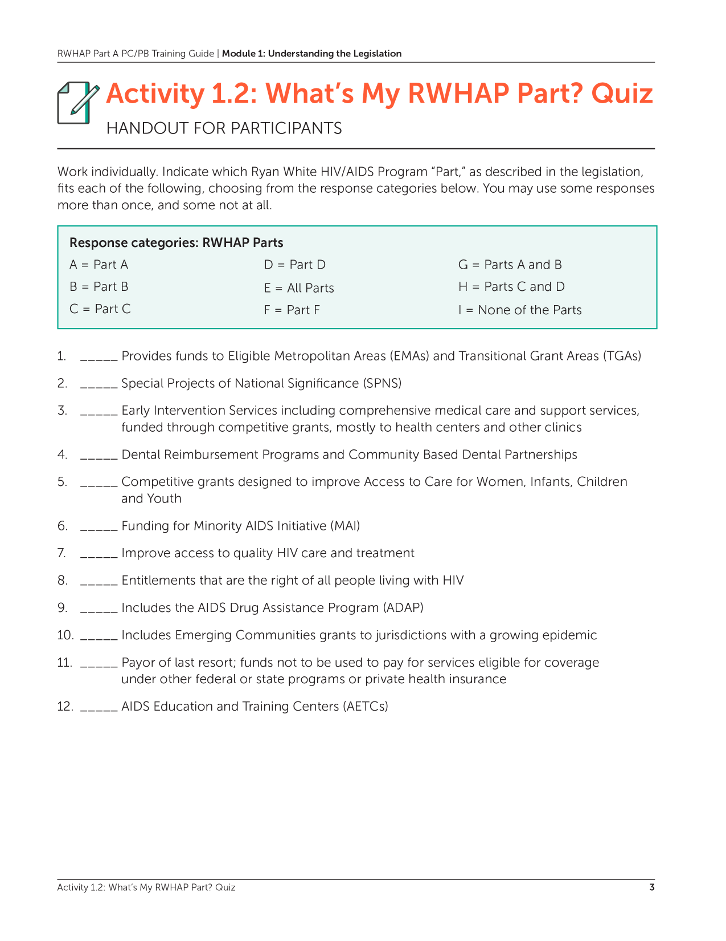
Activity: What’s my RWHAP Part?
12
Notes:
Module 1, slide 48
Module 1, Activity 1.2 is the What’s My RWHAP Part Quiz. Print copies of the quiz for all training recipients.

Slide 13
Quiz Instructions
Individually answer the 12 questions, using the following lettered responses (some may be used more than once, some not at all). Then share at your table.
Part A
Part B
Part C
Part D
All Parts
Part F
Parts A and B
Parts C and D
None of the Parts
13
Notes:
Module 1, slide 49

Slide 14
Importance of Collaboration Across RWHAP Parts
Representatives of all RWHAP Parts represented on Part A planning councils (PCs)
Coordination of needs assessment by all RWHAP Parts through the Statewide Coordinated Statement of Need (SCSN), led by Part B
Collaboration in development of the HRSA/CDC Integrated HIV Prevention and Care Plans, submitted by RWHAP Parts A & B
Coordination in targeting and use of resources
14
Notes:
Slightly modified from Module 1 PPT slide 32

Slide 15
Coordination of Care Across Parts
A single RWHAP client living in an EMA or TGA might:
Receive medications through RWHAP Part B ADAP
Get oral health care from a RWHAP Part F-funded dental program
Obtain other services funded through RWHAP Part A, Part C, and/or Part D
Participate in a RWHAP Part F demonstration SPNS project
15
Notes:
Module 1 slide 33

Slide 16
Quick Scenario: Collaboration
The committee of your PC that is responsible for Care Strategies is concerned about recent data showing low rates of retention, treatment adherence, and viral suppression among young African American and Latino men who have sex with men. You are planning a “roundtable” to learn more about the situation and what might be done to improve outcomes.
How could Part B, Part C, Part D, and Part F recipients contribute to this discussion – what might each of them bring?
16
Notes:
New – a quick scenario designed to help participants explore the benefits of collaborative in HIV planning

Slide 17
Ryan White HIV/AIDS Programs: Part A
Funding for Eligible Metropolitan Areas (EMAs) and Transitional Grant Areas (TGAs) that are severely & disproportionately affected by the HIV epidemic
In 2018, 24 EMAs and 28 TGAs
Service areas can include a single county or a multi-county area
11 programs have service areas that cross state boundaries
Funds go to the Chief Elected Official (CEO) of “the city or urban county that administers the public health agency that provides outpatient and ambulatory services to the greatest number of individuals with AIDS” [§2602(a)(1)]
17
Notes:
Combines Module 1 PPT slide 35 with part of slide 36

Slide 18
RWHAP Part A: Requirement for Community Planning
Legislative requirement for extensive community planning, including participation of consumers of RWHAP Part A services
EMAs required to have planning councils that decide how program funds will be used – they are not advisory
TGAs strongly encouraged by HRSA/HAB to maintain planning councils
TGAs that choose not to have planning councils encouraged to have planning bodies with roles, responsibilities and membership that are as much like planning councils as possible
18
Notes:
Module 1, slide 37, renamed

Slide 19
RWHAP Part A: Types of Funding
RWHAP Part A programs receive both “formula” and “supplemental” funding:
Part A formula funding is based on the number of living case of HIV and AIDS in the EMA or TGA
Minority AIDS Initiative (MAI) formula funding is based on the number of minorities living with HIV and AIDS
Supplemental funding is competitive, based on demonstration of additional need in the annual application
19
Notes:
Module 1, slide 38, renamed

Slide 20
Services Fundable under RWHAP Part A
Core medical-related services identified in the legislation For example: Outpatient Ambulatory Health Services, Oral Health, Medical Case Management, Mental Health
Support services needed so that PLWH can achieve their medical outcomes For example: Medical Transportation, Emergency Financial Assistance, Food Bank/Home-Delivered Meals
HRSA/HAB provides service definitions and descriptions Refinements to service categories and definitions in 2016 and 2018 [Policy Clarification Notice (PCN) #16-02]
20
Notes:
Module 1, slide 39

Slide 21
Sum Up
RWHAP plays a critical role in responding to the HIV epidemic
Each RWHAP Part has a special role in overall HIV services – and all Parts need to collaborate to provide a seamless system of prevention and care
RWHAP Part A plays a special role in HIV planning and services in metropolitan areas with a high rate of HIV
21
Notes:
Revised Module 1 PPT slide 44

