Slide 1
Measuring HIV Planning Effectiveness: Assessment Tools for Integrated HIV Planning Bodies
June 3, 2021
1:00-2:00 PM EST
Notes:
Measuring HIV Planning Effectiveness:
Assessment Tools for HIV Planning Bodies

Slide 2
Q&A Feature
If you have questions during the call, please use the Q&A feature. To do so:
Click on “Q&A” located along the bottom of your screen
Notes:
Julie: We will be answering questions at the end of the call and will answer as many as time permits. If you have questions during the call, please submit them using the Q&A feature.
I also wanted to mention that after the webinar ends, an evaluation will pop up immediately. We hope that you will fill this out as it helps us improve and inform future webinars and trainings.

Slide 3
About the IHAP TAC
Notes:
The IHAP TAC began in 2016 – and the current project continues through 2023 - to support Ryan White HIV/AIDS Program Parts A and B recipients and CDC grantees and their respective planning bodies with their overall integrated planning efforts and the implementation and monitoring of their Integrated HIV Prevention and Care Plans. We provide both national and targeted technical assistance and training activities. The IHAP TAC is led by JSI with our partner HealthHIV.

Slide 4
Delay of Integrated Plan Guidance for 2022-2026
Guidance for preparation of Integrated HIV Prevention and Care Plans for 2022-2026 has been postponed due to the COVID-19 pandemic
February 2021 letter from HRSA and CDC HIV program leaders
Outlines expectations for continued use of existing Integrated Plans
Encourages jurisdictions to refine ongoing planning efforts, incorporating Ending the HIV Epidemic planning and community engagement activities
Notes:
Julie
Guidance for preparation of upcoming Integrated HIV Prevention and Care Plans for 2022-2027 has been postponed due to the COVID-19 emergency. That news is outlined in a June 17, 2020 letter from HRSA and CDC HIV program leaders. The letter explains that the expected summer release of the guidance (an update from 2015) will be delayed (with further information provided late in the year). HRSA and CDC also outline expectations for continued use of existing integrated plans and encouragement for refinement of ongoing planning, incorporation of Ending the HIV Epidemic plans, and community engagement.
CHAT: https://targethiv.org/sites/default/files/Integrated_HIV_Prevention_Care_Plan_Guidance_Postponement_June_2020.pdf
RWHAP Part A and B recipients and DHAP funded state and local health departments continue to utilize the existing Integrated HIV Prevention and Care plans as their jurisdictional HIV/AIDS Strategy or roadmap. HRSA and CDC know that many RWHAP and HIV prevention programs at the local and state levels have integrated planning activities; such activities encompass joint comprehensive needs assessment, information and data sharing, cross representation on prevention and care planning bodies, coordinated/combined projects, combined meetings, and fully merged planning bodies. Overall, we continue to encourage planning groups to streamline their approaches to HIV planning even as those approaches evolve in the context of a public health pandemic.

Slide 5
Coordination with Ending the HIV Epidemic (EHE) plans
HRSA has noted:
Jurisdictions’ EHE plans and Integrated Prevention and Care Plans should align
The forthcoming Integrated Prevention and Care Plan Guidance will incorporate the four EHE pillars: diagnose, treat, prevent, respond
Pieces of EHE plan submission may be used to meet Integrated Plan requirements
Notes:
Julie
We also acknowledge that many of you have developed your Ending the HIV Epidemic Plans that were required as part of the Ending the HIV Epidemic initiative funding from CDC and may be in the process of further refining those plans now. We encourage you to incorporate your community engagement for the EHE plans and your integrated planning activities to the extent that is helpful. The Integrated HIV Prevention and Care Plan is the umbrella plan for all of your HIV-related resources and activities and the EHE plan should work in conjunction as a subset of focused resources and activities.

Slide 6
Webinar Objectives
Following the webinar, participants will be able to:
Discuss the need to evaluate the effectiveness of state and local integrated HIV prevention and care planning efforts.
List barriers that integrated HIV planning bodies face to effective HIV planning in their communities.
Summarize the adaptable tools available for conducting a self-assessment of HIV planning effectiveness.
Understand how to adapt the tools for your own planning body.
Notes:
We hope that after today, you will be able to:
Discuss the need to evaluate the effectiveness of state and local integrated HIV prevention and care planning efforts.
List barriers that integrated HIV planning bodies face to effective HIV planning in their communities.
Summarize the adaptable tools available for conducting a self-assessment of HIV planning effectiveness.
Understand how to adapt the tools for your own planning body.

Slide 7
HealthHIV Introductions
Marissa Tonelli
Director of Health Systems Capacity Building
Eve Kelly
Senior CBA Project Coordinator
Grace Hazlett
Capacity Building Intern
Notes:
Julie or Marissa – introduce HH
Name, title, prior relevant experience, role on the assessment project - 30-45 secs
Marissa
Eve
Grace

Slide 8
Today’s Agenda
Review the state of HIV planning bodies and their barriers to effective planning
Introduce HealthHIV’s HIV Planning Body Assessment Tools
Discuss lessons learned from HIV planning bodies that have implemented the assessment tools
Review how to use the tools as a self-assessment
Wrap up and Q&A
Notes:
Marissa

Slide 9
State of HIV Planning Bodies
Need for HIV planning to end the epidemic
Integration of prevention and care bodies
Many responsibilities and priorities
Awaiting release of Integrated HIV Prevention and Care Plan Guidance for 2022 - 2026
Adaptation to COVID-19 pandemic
Notes:
Marissa

Slide 10
Challenge: Barriers to Effective Planning
Planning burnout among key stakeholders
Aligning funder priorities for integrated HIV prevention and care planning activities and plan development
Engaging community and members in integrated HIV planning in ways that are meaningful, representative, inclusive and equitable
Uncertainty on developing metrics and measuring HIV planning’s impact on community health outcomes
Limited feedback loops that track planning body accomplishments and provide updates to community
Inefficiency in updating policies and procedures to reflect the changing HIV and healthcare landscapes
Notes:
Marissa

Slide 11
Effectiveness Defined
“Effectiveness” is defined by how well the planning body’s structure, policies and procedures, and consumer engagement supports its ability to carry out its mission and objectives.
Notes:
Marissa

Slide 12
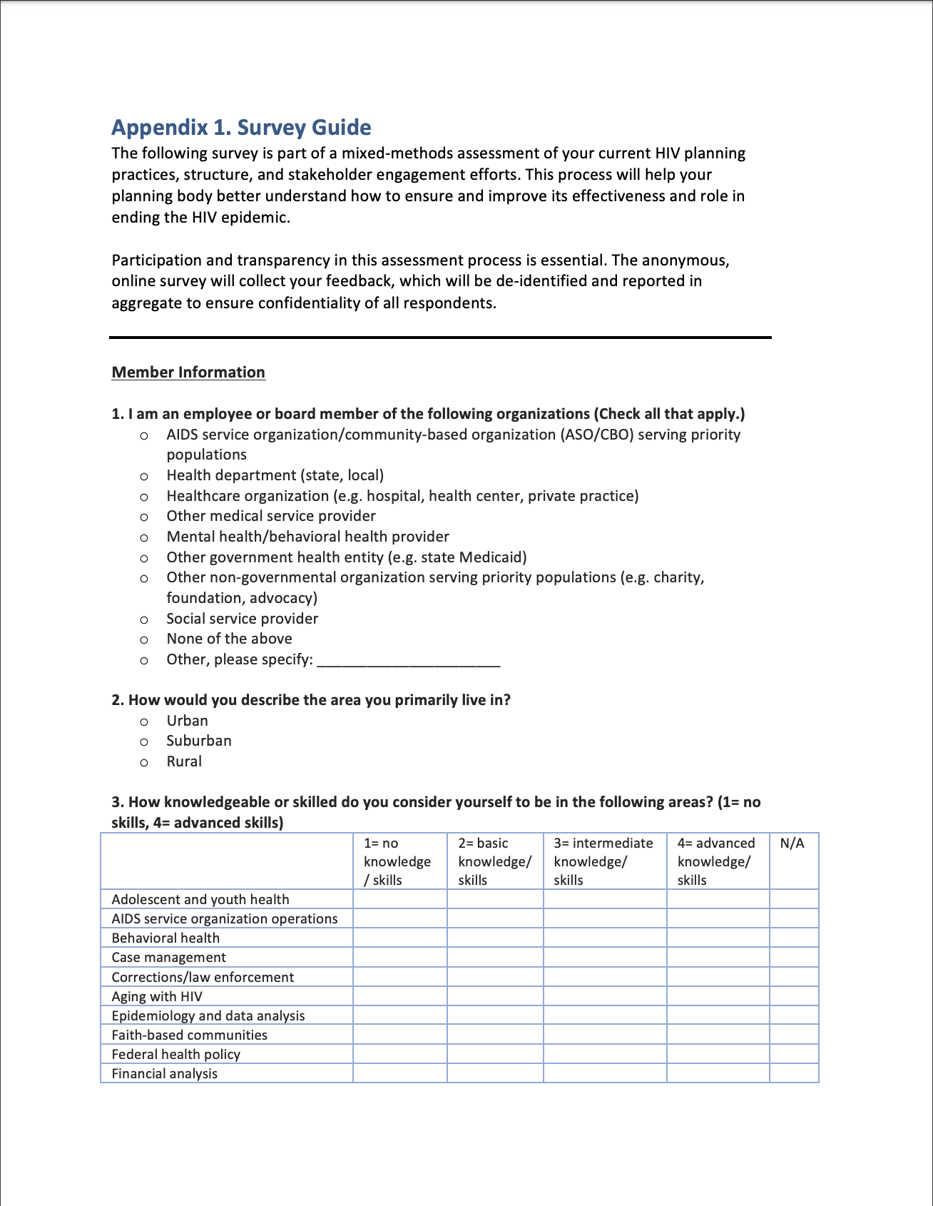
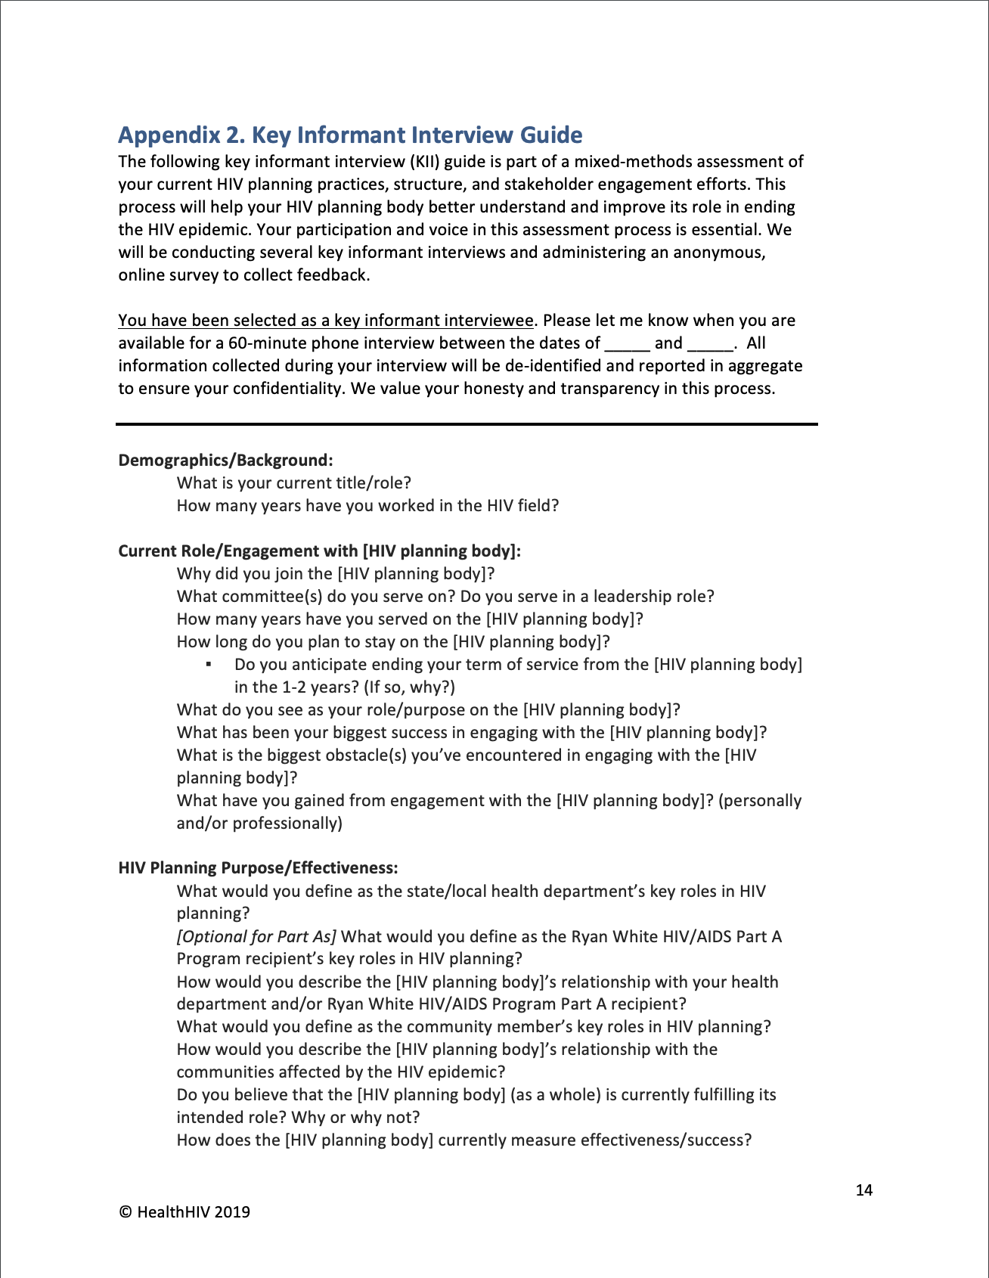
Solution: HIV Planning Body Assessment
HealthHIV developed first-of-its-kind HIV planning body assessment tools
Fielded with eight diverse HIV planning bodies over two years
Rationale for tool: Gather community and HIV planning member insights and feedback to improve effectiveness of HIV planning
Notes:
Marissa - piloted first in 2019 with three sites
End by 1:10pm

Slide 13
Assessment Tools
Anonymous Survey
All members and key stakeholders
40 questions (multiple choice and open ended)
Fielded online (via SurveyMonkeyTM)
Key Informant Interviews (KIIs)
6-8 members selected with diverse perspectives
28 open ended questions
Conducted by phone in 60 minutes
Notes:
Grace - “foundation/foundational assessment tools” - 30 secs

Slide 14
Assessment Topics
Areas of assessment:
Membership demographics, background and skills
Member engagement and understanding of role
Planning body structure & policies
Recruitment and orientation activities
Relationship with external stakeholders
How Integrated HIV Prevention and Care Plan outcomes are measured
Engagement in EHE
Key successes and areas for improvement
Future goals/anticipated challenges
Notes:
Grace - 30 secs, don’t need to read them all off

Slide 15
Purpose of Assessment
Goal
Outcomes
Identify key strengths and areas for improvement related to the effectiveness of an HIV planning body’s:
Operating structure,
Policies and procedures,
Membership, and
Stakeholder/consumer engagement.
Clear, actionable findings and implications based on a confidential survey, key informant interviews, and documents review shared back to the planning body to facilitate reflection and solutions development.
Notes:
Grace - 30-45 secs and hit key points

Slide 16
Lessons Learned & Testimonies from 2021 Assessment Cohort
Notes:
Grace - set the stage about when we kicked off for this cohort (mid-COVID), engaging planning bodies with competing priorities, 60-90 secs

Slide 17
Planning Body Assessment Cohort
2 in the Midwest
1 in the South
1 on the West Coast
3 state level
1 city level
2 low incidence areas
1 medium incidence area
1 high incidence area
Notes:
Grace - 30 secs

Slide 18
HIV Planning in 2021
Adaptation/ transition to virtual meetings - more accessible, but less interactive/personal
Agendas not conducive to discussion or time constraints
Lack of comprehensive, population-specific data within jurisdictions
Need to evaluate internal biases and inequities
Conflicting priorities among key members/stakeholders
Steep learning curve for new members
Insufficient orientation on prevention and care terminology, and interpretation of epi and other Integrated Plan metrics data
Some jurisdictions are tracking Integrated Plan metrics more closely than others
Formalities interfering with substantive and accessible meetings
Notes:
Grace - 1) what is happening now in HIV planning, 2) what have we observations have we seen across bodies -- what makes a planning body effective or not, 3) data/findings that drive home the point that measuring effectiveness
2-3 mins
End by 1:20-1:25pm

Slide 19
Speaker Introductions
Darin Rowles
HIV Supports Manager, Minnesota Department of Human Services
Part B Representative - Minnesota Council for HIV/AIDS Care and Prevention
Bridget Gordon
Co-Chair, Integration Advisory Board
LA Commission on HIV
David Lee
Associate Director, Drew Center for AIDS Research, Education, and Services
Co-Chair - LA Commission on HIV
Notes:
Eve - introduce speakers - confirm bios with speakers
Introduce yourself, your role, integrated?, anything unique about the planning body - 1 min each
React to what HH shared about state of HIV planning or HIV planning in 2021

Slide 20
Panel Questions
Why did your planning body choose to participate in the assessment of HIV planning effectiveness?
How did timing and other factors contribute to the desire to participate?
What was the planning body hoping to get out of the assessment?
What did you learn through the assessment process that will support your integrated planning efforts and the development of your 2022-2026 Integrated Plans?
Notes:
Eve - if you have questions for myself or the panelists, you can drop in the chat feature and we will ask at the end
(20 mins) End by 1:40-1:45pm

Slide 21
Implementing Assessment Tools with Your Planning Body
Notes:
Eve - every jurisdiction and planning body is different

Slide 22
Assessment Timeline
Phase 1: Stakeholder Engagement, Weeks 1 - 3
Phase 2: Assessment Implementation, Weeks 2-10
Phase 3: Reflection & Solutions Development, Weeks 11-16
Notes:
Eve - 30 secs, more detail in the assessment guide

Slide 23
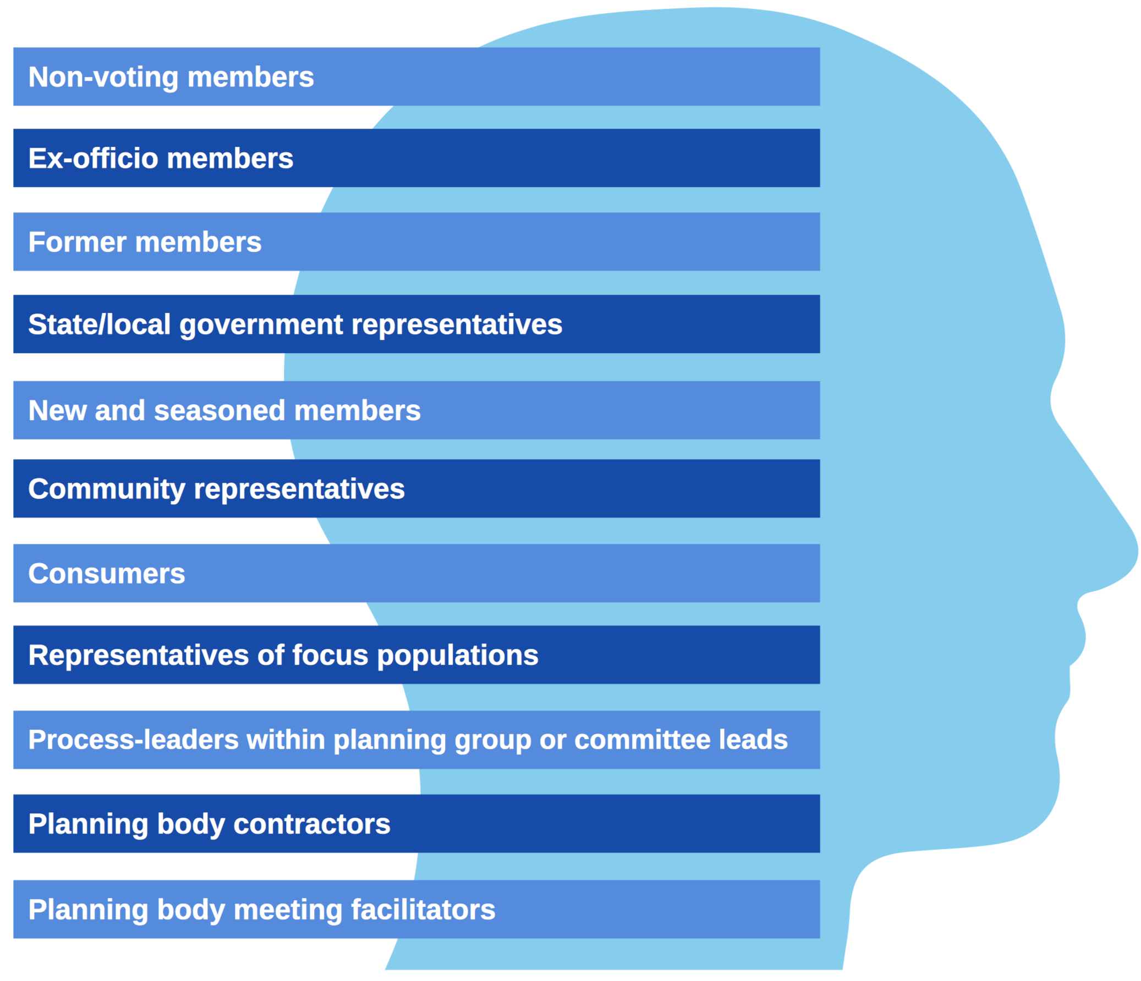
Key Partners and Stakeholders
Notes:
Eve - 30 secs

Slide 24
Tips for Self-Assessment
Define roles, secure buy-in, and establish consistent lines of communication from the beginning.
Adapt the tool for each use, and update it regularly!
Allow input from a variety of members in different roles.
Consider who will lead implementation of the assessment.
Aim for 90% participation from members.
Incentivize participation and compensate participants for the time and effort they have provided, if possible.
Take measures to protect member confidentiality.
Select a diverse group of members for key informant interviews.
Use KIIs to supplement open-ended questions in the survey.
Use findings from tools to facilitate discussion around solutions.
Notes:
Eve - up to 2 mins
Take measures to protect member’s confidentiality - ex: create a dedicated committee to run the assessment, rely on an external consultant to report back members’ data in aggregate, utilize an anonymous survey platform such as SurveyMonkeyTM, etc.
Engage all members of the HIV planning group in initial communications and secure buy-in early.
Ensure all HIV planning body members, and other stakeholders as necessary, participate in online survey to ensure the data accurately reflects HIV planning body composition.
Implement key informant interviews with a diverse group of members and key stakeholders, such as: new and seasoned members, government and community representatives, consumers, representatives of focus populations, committee leads, contractors, and/or planning meeting facilitators.

Slide 25
Access the Tools - Next Week!
HIV Planning Body Self-Assessment Guide will be available for download on the IHAP TAC website
IHAP TAC will send email notifications when the tool and webinar recording are available on: https://targethiv.org/ihap
Questions now? Email Eve@HealthHIV.org
Notes:
Eve - 30 sec
End by 1:45-1:50pm

Slide 26
Questions
Please chat your questions into the Q&A box located at the bottom of your screen.
Notes:
Julie: Thank you. If you have any questions for any of our presenters, please chat them into the Q&A box that you can find at the bottom of your screen.
While we wait for the questions to come in, please note that immediately after the webinar ends, an evaluation of this webinar will pop up on your screen in a moment. Please fill out this evaluation as it helps us plan and develop additional webinars and resources.

Slide 27
Thank you!
Contact us at ihaptac@jsi.com!
Obtain more information, join our mailing list, request TA, or share your experiences or resources.
This project is supported by the Health Resources and Services Administration (HRSA) of the U.S. Department of Health and Human Services (HHS) under grant number U69HA30144, Ryan White HIV/AIDS Program Integrated HIV Planning Implementation. This information or content and conclusions are those of the author and should not be construed as the official position or policy of, nor should any endorsements be inferred by HRSA, HHS or the U.S. Government.
Notes:
Julie
Please contact us to obtain more information, request TA, share your experiences with integrated planning or join our mailing list.
As a reminder, please fill out the evaluation that will pop up in a moment.
Thank you and have a great afternoon.

