Slide 1
One Year Later: Lessons Learned from the COVID-19 Public Health Emergency
Melanie Lawrence (New York EMA)
Lisa Best (New York EMA)
Glenda Blackmon Johnson (Dallas EMA)
Rev. Marvin Krieger
Jamal Refuge (Planning CHATT)
Wednesday, March 10th, 2021, 3PM-4:30PM ET

Slide 2
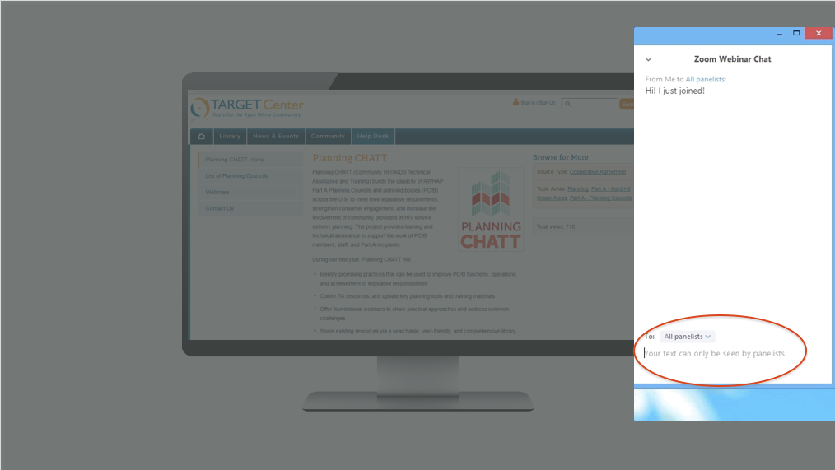
How to Ask a Question
Attendees are in listen-only mode.
If you have a question, use the Q&A box at the lower-left of your screen to chat with the presenter.
You may also email questions to planningCHATT@jsi.com after the webinar.

Slide 3
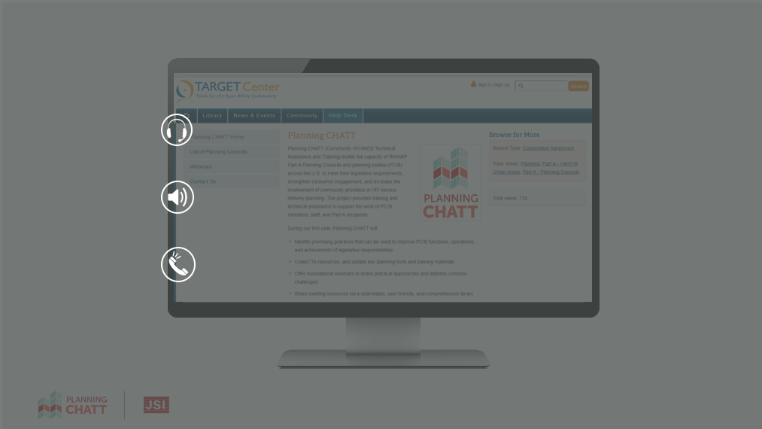
Can You Hear Us?
The audio is being shared via your computer speakers/headset.
If you can’t hear the audio, make sure your computer audio is turned on.
If you’re still having problems, please chat the host.
Call-in number: 301-715-8592
Webinar ID: 945 5632 9155
Passcode: 247311

Slide 4
Agenda
Welcome and Introductions
Overview of Legislative Requirements
Challenges and Successes with Meeting Legislative Requirements
Addressing Grief and Loss of Planning Council/Planning Body (PC/PB) Members
Questions and Answers

Slide 5
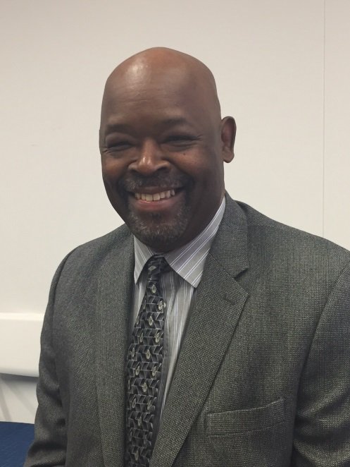
Planning CHATT: A HRSA-supported Cooperative Agreement (U69HA39085)
Lennwood Green Project Officer
Division of Metropolitan HIV/AIDS Programs
HIV/AIDS Bureau, HRSA

Slide 6
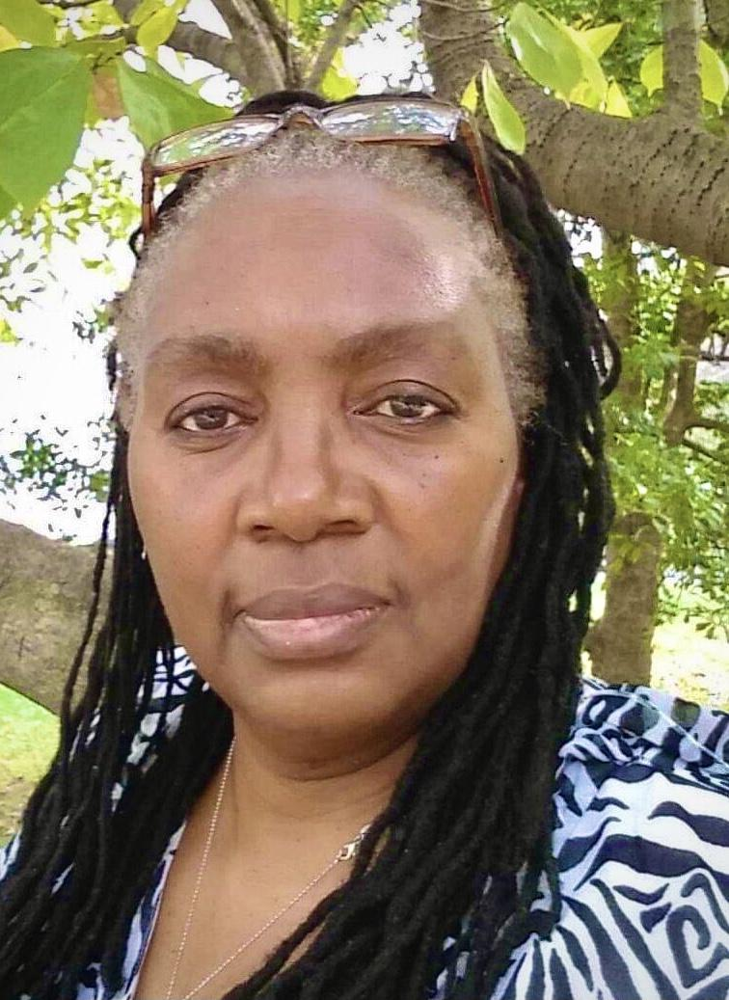
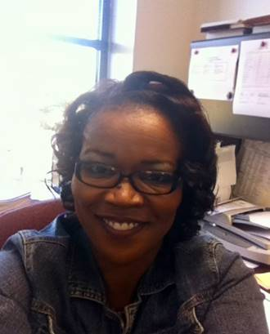
Webinar Presenters
Melanie Lawrence
New York EMA
Lisa Best
New York EMA
Glenda Blackmon Johnson
Dallas EMA

Slide 7
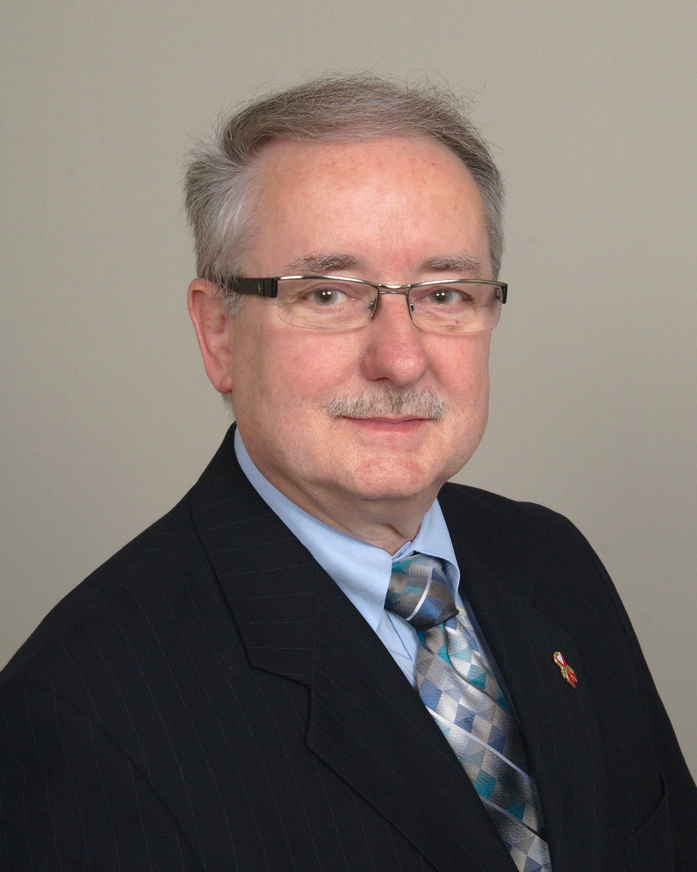
Webinar Presenters
Reverend Marvin Krieger
Jamal Refuge
Planning CHATT

Slide 8
Objectives
By the end of this webinar you will be able to:
Reflect on the impact of COVID-19 on your PC/PB activities
Evaluate lessons learned from jurisdictions to address legislative requirements during the COVID-19 public health emergency
Adapt existing policies to support PC/PB operations during the COVID-19 public health emergency
Utilize strategies to address loss and grief

Slide 9
Overview of Legislative Requirements

Slide 10
Legislative Requirements of Planning Councils/Planning Bodies
PC/PB membership
Recruitment/nominations
Roles and responsibilities
Needs assessment
Priority setting and resource allocation (PSRA)
PC/PB operations
Orientation and training
Remote meetings
Open meeting requirements

Slide 11
Legislative Requirements of Planning Councils/Planning Bodies (continued)
COVID-19 has made fulfilling legislative commitments challenging for some PC/PBs.
Some PC/PBs may have found it difficult to meet their work plan goals and objectives during this time.

Slide 12
Resource

Slide 13
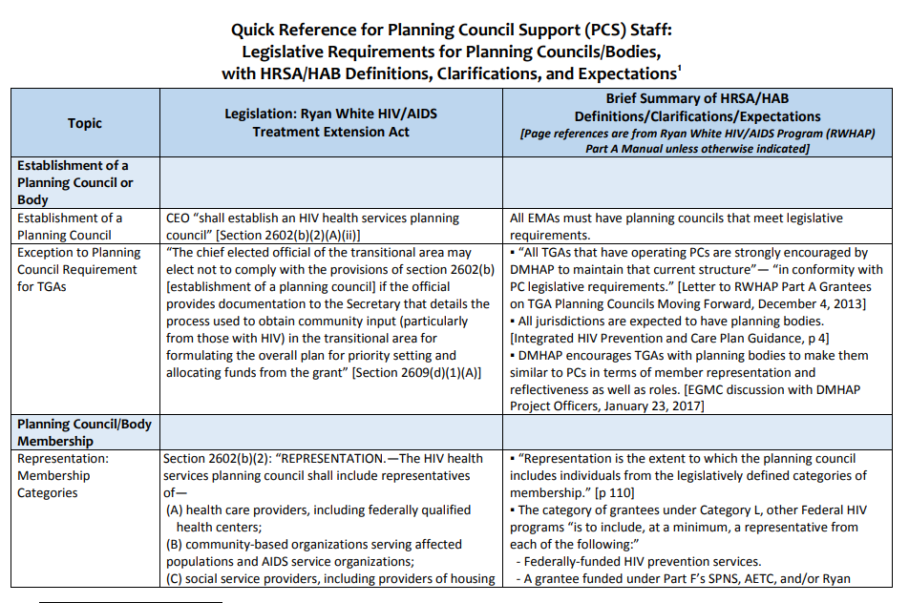
Quick Reference for Planning Council Support (PCS) Staff: Legislative Requirements for Planning Councils/Bodies, with HRSA/HAB Definitions, Clarifications, and Expectations
Compendium of Materials for Planning Council Support Staff

Slide 14
Challenges and Successes with Meeting Legislative Requirements

Slide 15
Which legislative requirement(s) are you most proud of meeting, despite the difficulties presented by COVID-19?

Slide 16
New York
Challenge
Strategies to Address Challenge
Not being able to conduct key activities (needs assessment and PSRA) in the way they have traditionally done so
Conducted four town halls between April 2020 and September 2020 to educate consumers and gather testimony, as an informal needs assessment
Data collected from the town halls helped identify priorities and inform the PSRA committee’s process to reallocate funds to consumers in need

Slide 17
Dallas
Challenge
Strategies to Address Challenge
Maintaining Planning Council Members & Staff (PCs) during the COVID-19 public health emergency
Recruitment/Representation
Local Stay in Place Order
Assess decisions/action steps within my span of control
Hire and train new staff
New staff stepped up to fulfill roles
Identify/define leadership needs
Rule of Thumb: Is it necessary/reasonable?

Slide 18
PC/PB, Recipients, and PCS Adjustments

Slide 19
What adjustments did the PCS, RWHAP Part A Recipient, or PC/PB members have to make during the emergency?

Slide 20
New York
Recipient Adjustments
PC/PB Adjustments
Members had to adjust to using technology to conduct PC/PB business
Basic training on how to use Zoom
Operating iPads
Connecting to Wi-Fi
Recipient allocated all additional funding and carryover to address critical rises in food and housing needs for PWH on an accelerated timeline as compared to non-pandemic years
Initiated gift cards for consumer attendance in virtual meetings

Slide 21
Dallas
PC/PB Adjustments
Migrate and adjust to the virtual platform
Policies regarding purchased electronic equipment
Dos and don'ts of equipment use guide
Work with Admin Agency and IT department to get assistance with technology configuration and get equipment shipped out
Allocation time to take on additional tasks
Learning to “Fly The Plane As We Build It”

Slide 22
Resources

Slide 23
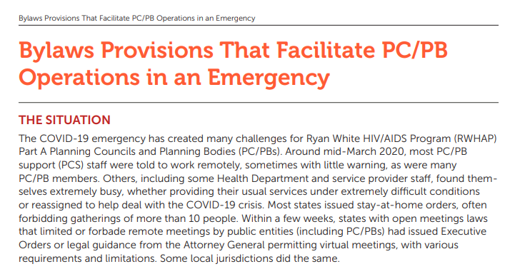
Bylaws Provisions That Facilitate PC/PB Operations in an Emergency
More Resources for Planning Councils/Planning Bodies

Slide 24
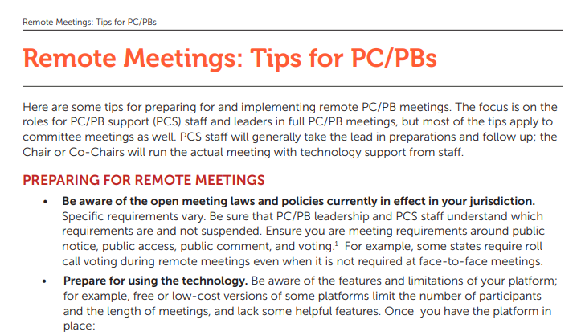
Remote Meetings: Tips for PC/PBs
More Resources for Planning Councils/Planning Bodies

Slide 25
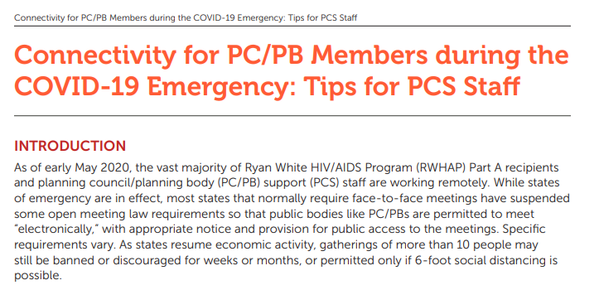
Connectivity for PC/PB Members during the COVID-19 Emergency: Tips for PCS Staff
More Resources for Planning Councils/Planning Bodies

Slide 26
Have you made any adjustments that you think will be beneficial to continue once the COVID-19 pandemic is over?

Slide 27
Future PC/PB Efforts
New York
Dallas
Incentivizing consumers for their participation in meetings, such as through virtual meal and gift cards
Continuation of virtual meeting access once in person meetings can resume
Facilitate digital capacity among consumers – finding means of Wi-Fi support, printer access
Continue to meet electronically
PC/PB meetings may be a primary source of socialization for some PC/PB members

Slide 28
If you were talking to a peer in another jurisdiction, what would you share with them about your experience this past year?

Slide 29
Coping with Grief and Loss During COVID-19

Slide 30
Identifying Grief
Five Stages of Grieving:
Denial
Anger
Bargaining
Depression
Acceptance
Finding Meaning - Recently added sixth stage
Recognize that loss brings about grief

Slide 31
Grief and Loss During COVID-19
Identifying grief places those feelings into context.
Recognize that some losses during this pandemic are more ambiguous and harder to identify.
Allow others to share their loss and the grief they are experiencing.

Slide 32
Experiencing HIV and COVID-19
PC/PBs are part of the family
Acknowledge anticipatory grief
Fear of getting a positive COVID test may hinder PWH seeking out COVID-19 testing services
Fear that living with HIV and being diagnosed with COVID-19 may result in death
Isolation often leads to depression
Survival guilt is a reality and needs to be addressed

Slide 33
Signs of Grief
Some signs that you might be coping with grief in light of the pandemic include:
Trouble focusing on normal tasks
Sleeping much more or less than usual
Feelings of anger and irritability
Headaches and upset stomach
Fatigue or low energy
Re-experiencing feelings of past grief
Engaging in activities such as eating, drinking, or online shopping to cope with anxiety
Avoiding thinking or talking about the pandemic
Understanding Grief in the Age of the COVID-19 Pandemic, Kendra Cherry

Slide 34
Talking with PC/PB Members About Grief and Loss
Check in with your staff and PC/PB members
Identify those who have experienced loss and who may be grieving
Text messages can be a great way to check-in and let a person know that you are thinking about them, but a phone call is even more personal
Listen without judgment or criticism

Slide 35
Talking with PC/PB Members About Grief and Loss
Recruit others to assist in making phone/texting contacts
Be aware of existing grief support groups for referral purposes
Encourage staff and members to practice self-care
Create support activities for staff and Planning Councils/Planning Bodies
Stay in touch with the Recipient and Subrecipients in order to assist each other during the pandemic

Slide 36
Special Thank You
Tonya Williams
Timothy Daniels – Center for Comprehensive Care, Jersey City, NJ
Liz Schedl – Director, Hudson Pride Connections, Jersey City, NJ
Chad Balodis – Hudson HIV/AIDS Planning Council, Staff Administrator
Dr. M. Katherine Shear, Director, Center for Complicated Grief at Columbia University

Slide 37
Wrap-Up & Key Takeaways
Ensure that your annual work plan is up to date to address the challenges of the COVID-19 public health emergency.
Think creatively about how to address the digital divide among your PC/PB members.
Consider talking about grief and loss with your PC/PB members and other stakeholders.
Prioritize your physical and mental wellbeing.

Slide 38
Questions and Answers

Slide 40
Thank You
Please complete the evaluation!
TargetHIV.org/planning-CHATT
Sign up for our mailing list, download tools and resources, view archived webinars and more…
Contact Planning CHATT: planningCHATT@jsi.com

