Slide 1
What Does It Mean to Be a CHW Supervisor?

Slide 2
Learning Objectives
At the end of this unit, you will be able to:
Contrast the differences of supervising CHWs as compared to other staff.
Recognize the importance of the cultural and experiential contexts that shape the supervisory relationship with CHWs.
Identify and practice the skills that are helpful in supervising CHWs.
Notes:
Welcome participants and review the objectives.

Slide 3
“The lived experience of differences and conflicts within the supervisory relationship is one of the most valued sources of mutual growth and development for supervisor and supervisee”
A Practical Guide to Reflective Supervision. Heller and Gilderson c. 2009
Notes:
Ask for a volunteer to read the quote.
Ask, “What does this quote mean to you? How can conflict be a source of personal and professional growth? Would someone like to share an experience that would serve as an example?”

Slide 4
How is Supervising a CHW Different?
Rewards | Challenges
Notes:
Provide handout or use a flipchart sheet with two columns labeled Rewards and Challenges
Ask participants to take a couple of minutes to reflect on the following question: What are the differences between supervising CHWs and supervising other staff?
Next: Divide participants into groups and ask them to list different rewards on their handout or flip chart sheet. Do the same for challenges. Facilitate discussion using the examples below if needed.
Rewards
Better patient experience
Community representation
Cultural competency for rest of staff
Improved outcomes
Committed to client and social change
Shared life experiences with clients
Part of the community that the agency serves/Knows the community
Advocates for clients
Knows resources in the community
Bridges clinic and community
Challenges:
Could identify as a client rather than staff
Boundaries are challenging
Lack of understanding of the role of the CHW
Can have lower level of education and training
CHWs can work in isolation/challenge to integrate into the care team
Clients and other staff can disparage CHW for not being “real” health workers
High levels of attrition and burnout
Not enough time to supervise properly
CHW may not be used to constructive feedback
Challenges bridging systems (clinic and other agencies)

Slide 5
Cultural and Experiential Contexts
Stumbling blocks to understanding | Culture, ethnicity, gender, sexual orientation, age, education, social class, physical/mental ability, learning style, personality, appearance, spiritual beliefs
Culturally aware and insight-oriented supervisors are able to: | Increase trust and cooperation Help overcome CHW’s fear of mistakes Encourage risk taking in sharing information Help overcome fear of competition or conflict Promote inclusion and equity Increase respect and mutual understanding
Notes:
In continuing with our discussion about the differences of supervising CHWs compared to other staff, and the rewards and challenges of supervising CHWs, let’s think about the factors that contribute to these differences.
Recognize the importance of the cultural and experiential contexts that shape the supervisory relationship with CHWs.
Facilitate discussion on the implications of culture and life experience.
Having a diverse workforce that reflects the makeup of an organization’s client base is an important aspect of care. However, as supervisors, we may not have the same background or life experiences as other team members. Let’s look at the “stumbling blocks to understanding.”
Ask, “Can someone provide an example of a difference in culture and how that might affect a work situation?” (Example – some cultures value the team over the individual)
Ask if someone would pick another item from the list and provide an example of how it affects understanding. Depending on time, repeat this process to facilitate dialogue.
Look at the next block in the table on culturally aware and insight-oriented supervisors. How can having knowledge of different cultures, ethnicity, gender, etc. represented in our staff help us, as supervisors, increase trust and cooperation between us and a CHW and between a CHW and the rest of the staff? Consider writing down ideas on a flip chart page under the heading “trust and cooperation.” Repeat this process with each statement.
Optional activity: Divide participants into groups to discuss each bullet point and write down ideas, then share back with the large group.

Slide 6
The CHW Supervisor: The CHW’s CHW
Role | Skill
1 Leader | Team-building skills; mastering politics of identity, power and privilege, historical discrimination
2 Director | Managing mix of workers; using life experience and clinical knowledge appropriately
3 Educator/Teacher | Teaching skills
4 Facilitator | Conflict prevention, problem solving skills
5 Mentor/Coach | Coaching skills — developing professional skills
6 Evaluator | Assessment skills
7 Advocate | Supportive skills —> advocating on behalf of the CHW; and encouraging CHW to be an advocate —> planning councils
8 Collaborator | Foster relationship building and maintaining relationships in the community
Notes:
Ask for a volunteer to reach each role and accompanying skill.
Ask participants, “Given our conversations so far, why are these skills important as we supervise CHWs?”
Key Talking Point: A supervisor/manager must wear multiple hats. Here is a list of some common roles that supervisors carry out and examples of skills that are needed to carry out these different roles. Which of these skills do you possess now that have helped you, or will help you as a supervisor of CHWs? What skills would you like to further develop?
Remember – just as clients look to CHWs for positive support, guidance, knowledge and hope, so do CHWs look to you.

Slide 7
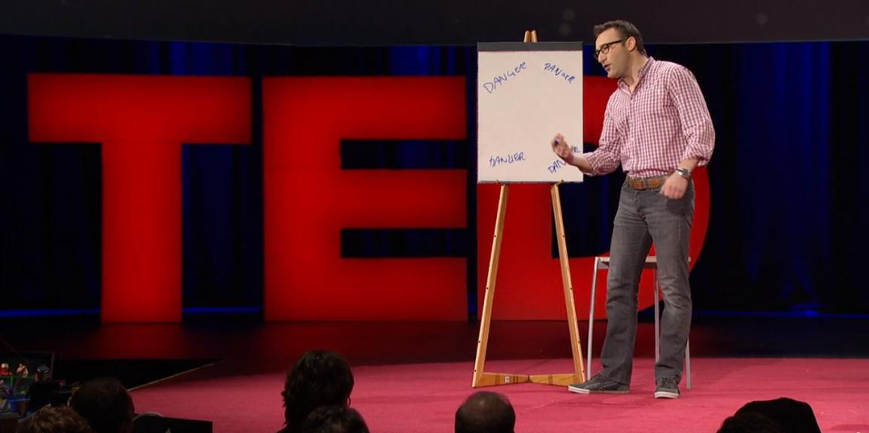
TED Talk
Simon Sinek: Why good leaders make you feel safe
TED Talk
Notes:
https://www.ted.com/talks/simon_sinek_why_good_leaders_make_you_feel_safe#t-699384
(12 minutes)

