Slide 1
Entrevista motivacional y escucha activa
Notes:
This session will cover the Stages of Change and Motivational Interviewing (MI) models in order to support our work as CHWs.
Many of you have already experienced, or perhaps have used, elements of Motivational Interviewing. We invite everyone to share their knowledge and experience.

Slide 2
Objetivos
Al final de esta sesión, las participantes podrán hacer lo siguiente:
Comprender los componentes clave del modelo de etapas del cambio.
Definir entrevista motivacional (Motivational Interviewing, MI).
Identificar y hacer distinciones entre ejemplos positivos y negativos de las habilidades de MI en la práctica.
Practicar las habilidades de entrevista motivacional, incluidas las reflexiones simples, complejas y de doble cara y la escucha activa.
Notes:
Review the slide.

Slide 3
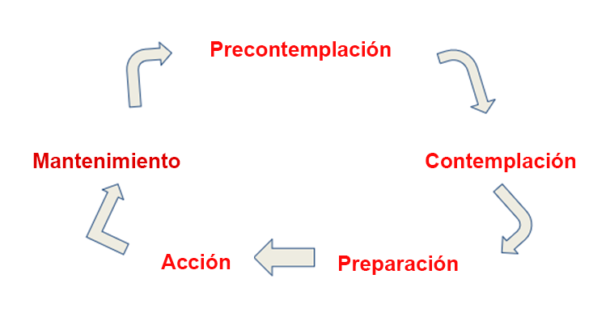
Las etapas del cambio
Notes:
To build upon your experience, we would like to first present the Stages of Change model.
Pass out index cards to five volunteers with each stage of change on the card.
Ask volunteers to come up to the front, read their card, and stick it on the wall.
Provide a brief explanation of the different stages.

Slide 4
Las etapas del cambio
Video
Las etapas del cambio en psicología de la salud explican o predicen el éxito o el fracaso de una persona para lograr un cambio de comportamiento propuesto, como el desarrollo de diferentes hábitos. Intenta responder por qué el cambio “se atascó” o, por otro lado, por qué no se realizó.
Notes:
Show video: https://youtu.be/Twlow2pXsv0
Review the slide.

Slide 5
Las etapas del cambio
Las etapas del cambio, en la actualidad el modelo de etapas más popular en psicología de la salud (Horwath, 1999), han demostrado ser exitosas con una amplia variedad de comportamientos de salud simples y complejos, que incluyen el abandono del tabaquismo, el control de peso, el uso de protector solar, la reducción de grasa en la dieta, la incorporación de ejercicio, el cese del consumo de cocaína, la realización de una mamografía y el uso del condón (Prochaska, et al., 1994).
Notes:
Ask for a volunteer to read the slide.

Slide 6
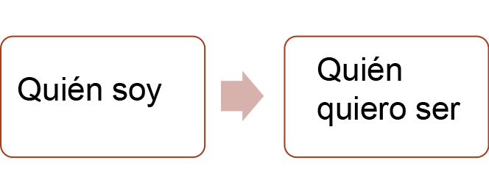
Introducción a la entrevista motivacional (MI)
La entrevista motivacional es un método directivo centrado en el cliente para mejorar la motivación intrínseca para cambiar al explorar y resolver la ambivalencia
La ambivalencia es un estado conflictivo de favorecer el cambio y apoyar el status quo
Ayuda al cliente a “despegarse” de sentimientos ambivalentes
Explora las razones personales del cliente para hacer un cambio.
Acerca al cliente a quien quiere ser desde quien es ahora.
Notes:
Define the following terms:
Client-centered approach: A client-centered approach places emphasis on a client's autonomy and right to choose goals and/or interventions based on his or her identified needs for services.
Intrinsic motivation: Intrinsic motivation can be described as doing something that is motivated from our own passions without the incentive of reward or fear of a negative consequence. Doing the behavior is often its own reward.
Ambivalence: Ambivalence is often described as a state of being “wishy-washy.” It is the gap between who I am and who I want to be.
In many cases, people hold expectations for themselves that favor change while simultaneously supporting the status quo. That inner struggle (ambivalence) often drives indecision and a sense of feeling stuck that is common in all people. Motivational Interviewing is a client-centered, skillful practice that aids people in moving beyond ambivalence to get closer to who they want to be.
Facilitator’s Resource:
Motivational Interviewing Definition, Principles and Approach document
https://www.umass.edu/studentlife/sites/default/files/documents/pdf/Motivational_Interviewing_Definition_Principles_Approach.pdf

Slide 7
Entrevista motivacional (MI) se define como...
Un enfoque colaborativo, centrado en la persona para extraer y fortalecer la motivación de una persona para cambiar su comportamiento. Una MI implica un conjunto de principios y estrategias, pero lo más importante, es un enfoque que incorpora el espíritu de colaboración, empatía y de encontrar a las personas donde están.
Mal ejemplo
Buen ejemplo
Notes:
Video: We will view two videos. One video will demonstrate effective MI skills and the other, ineffective MI skills. Participants should take note when they see effective and ineffective MI skills employed.
Bad example: https://youtu.be/kN7T-cmb_l0
Good example: https://youtu.be/-RXy8Li3ZaE
Video Debrief:
What did you observe?
What didn’t work well?
What worked well?
When did you see examples of compassion, client-centered care, acceptance, and collaboration?

Slide 8
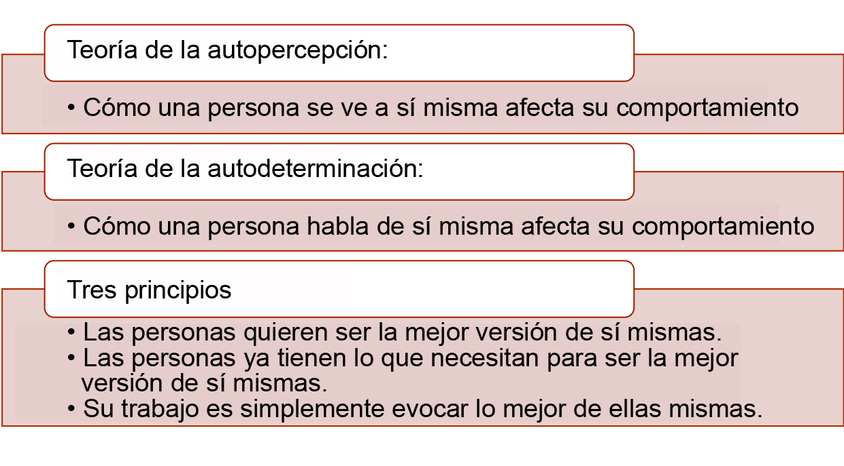
Teoría, principios y desafíos
Notes:
Review the slide.
We understand that Motivational Interviewing is a way of working collaboratively with people to support their motivation for and commitment to change. The following 2 theories and 3 principles serve as important anchors to ground the CHW’s disposition and perspective when working in partnership with clients.
2 Major Theories:
Self-Perception Theory: A key idea in Self-Perception Theory is how people view themselves impacts their behavior. If a person feels negatively about themselves, they are less likely to take positive action. Consider the influence of your own self-perception and the impact when making changes in your life.
Self-Determination Theory: Self-Determination Theory can be considered generally as the way a person talks impacts their behavior. For example, If they speak negatively, they perform negatively.
These two theories underscore the work of the CHW who uses Motivational Interviewing techniques because they help us see why it is important to support people in talking and feeling more positively about themselves and their challenges when they want to make and sustain changes in their lives.
Read the 3 Principles on the slide.
CHWs work with people whose lives and experiences can be very complicated. It can be easy to propose solutions or prioritize the client’s circumstances according to our own values. These three principles help to ground the CHW in a client-centered approach by honoring the virtue in each statement and being willing to prioritize viewing the client’s concerns through the eyes of the client and not our own. Strong alignment with these principles can have transformative effects in the CHW/client relationship.

Slide 9
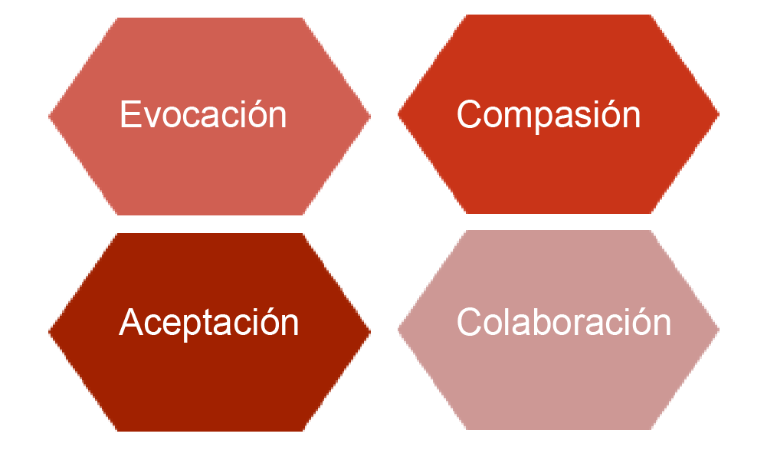
El espíritu de la MI
¿Cuáles son algunas acciones que hacemos que reprimen la aceptación?
¿Cómo encuentran un equilibrio entre su interés y el del cliente?
¿Qué podemos hacer para conocer las fortalezas del cliente?
¿Qué hacemos para intervenir en el conflicto y el desacuerdo?
Notes:
When using Motivational Interviewing skills, the following four qualities should undergird your approach with people. Define each characteristic and briefly explore the questions on the slide with participants.
Acceptance: Embody a disposition of acceptance by recognizing that people have the right to make their own choices free of judgment from others.
Compassion: Employ compassion by extending empathic care without judgment.
Evocation: Be intentional to ask the right questions to help people resolve ambivalence.
Collaboration: Work in partnership with people to examine their situations and ways to respond.
Reflection Questions
What are some actions we do that stifle acceptance?
How do you find a balance between your own self-interest and the client’s?
What can we do to learn about our client’s strengths?
What do we do to contribute to conflict and discord?

Slide 10
Estrategias centrales para destacar o apoyar a alguien con ambivalencia
Expresen empatía.
-el esfuerzo por “ponerse en su lugar” y sentir lo que están pasando
Desarrollen la discrepancia.
-señalen conflictos entre los objetivos y los comportamientos establecidos.
Respondan a posibles desacuerdos.
-sin discutir ni pelear
Apoyen la autoeficacia.
-refuercen la capacidad de las personas para lograr sus objetivos
Notes:
Express empathy (your effort to “put yourself in their shoes” and feel what they are going through)
Empathy helps to build trusting and supportive relationships that aide in the CHW/client collaboration.
Develop discrepancy (pointing out conflicts between stated goals and behaviors)
Example: You want to be healthier, but you do not show up for your medical appointments.
Respond to potential discord (don’t argue or fight)
Developing discrepancy or responding to potential discord isn’t synonymous with confronting or wrestling with a client about their behavior. The goal is to empathetically shine light on a situations in such a way that the client can view their own behavior.
Support self-efficacy (reinforcing people’s ability to accomplish their goals)
We understand from the self-perception theory that how we view ourselves can impact our behavior; thus, reinforcing a client’s belief in their ability can have a positive impact and aide change.

Slide 11
Habilidades de asesoramiento para promover el cambio de comportamiento
Entrevista motivacional
O: “Open-ended questions” (preguntas abiertas)
A: "Affirmations" (afirmaciones)
R: “Reflective listening” (escucha reflexiva)
S: “Summarizing” (resumen)
Notes:
O.A.R.S. is a set of skills that help to create an open, affirming, accepting environment where the client can explore their feelings, behaviors and beliefs. O.A.R.S. skills help to move MI conversations forward and allow clients to freely express content that can position them to hear and make progress toward change.
Review O.A.R.S. skills and provide examples. (If time permits, invite participants to reflect and share the value of using O.A.R.S. skills.)
Open-ended questions
Use open-ended questions that invite elaboration or descriptive information. Open questions usually require more than a yes or no response and encourages the client to talk more. Examples: What helps you stay on track with your medications? Tell me more about…
Affirmations
Using affirmations helps to reinforce the client’s strengths. Affirmations can be used to validate the client’s experience or feelings.
Examples: You’ve accomplished a lot in a short time. I appreciate your honesty.
Reflective listening
Reflective listening is a way to clarify statements and demonstrate that you heard and understood your client.
Examples: It sounds like you… You’re wondering if…
Summarizing
Summarizing statements link material that has been discussed to reinforce what has been said and demonstrates that you have been listening carefully.
Examples: Here’s what I’ve heard… Let me see if I got this right…

Slide 12
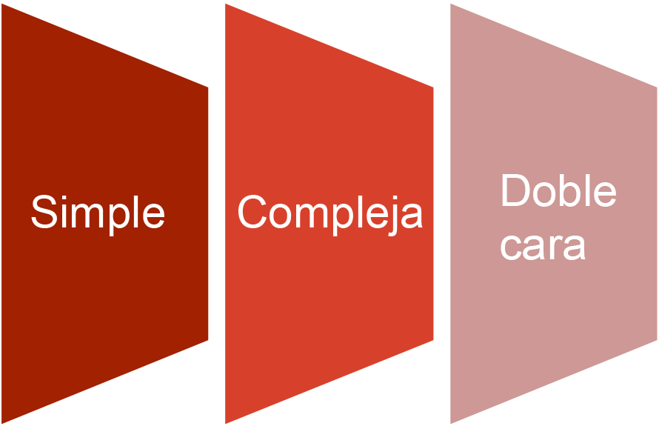
Declaraciones reflexivas
Notes:
Define the difference between simple, complex, and double-sided reflections.
Simple: A simple reflection is a basic restatement of the client’s own words, being careful to use the client’s language.
Complex: Complex reflections add meaning, value, or emotion to the client’s words. In essence, you are reflecting a deeper layer of the simple reflection that helps to open new perspective.
Double-sided: The aim of double-sided reflections is to highlight the discrepancy between the client’s words/values and their actions.

Slide 13
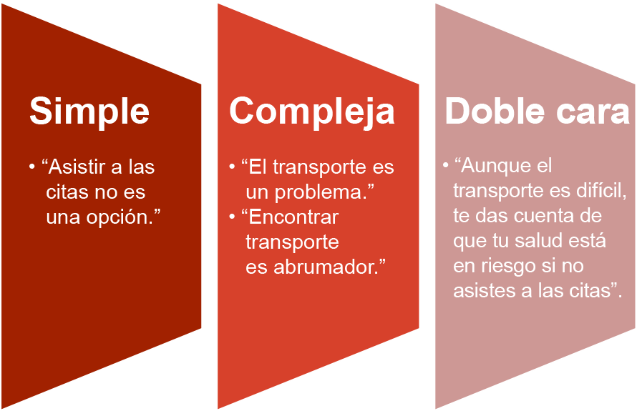
Practiquemos juntos
Declaración del cliente: “Asistir a mis citas no es una opción a menos que pueda darme boletos de autobús”.
Notes:
Review examples on slide.
Activity: Ask participants to get into pairs. Read a simple reflection below. Ask participants to take turns making complex and double-sided reflections.
“I don’t see how this program is going to help me.”
“I just don’t like wearing a condom.”
“I am not going to take my meds. My meds make me sick.”
“Keeping my appointments is hard for me.”
“I can’t quit smoking.”
“I just can’t commit to exercise.”
“Going to AA is sometimes a hassle.”
“No one understands what it’s like to not be able to pay my bills.”
Summarize and close.

Slide 14
Práctica de entrevista motivacional y escucha activa
3 escenarios posibles con preguntas de reflexión y juego de roles
Notes:
Review the slide.

Slide 15
Referencia a O.A.R.S.
Preguntas abiertas (preguntas que invitan a la explicación)
Afirmaciones (reforzar las fortalezas del cliente)
Escucha reflexiva (aclarar afirmaciones que ilustran el significado subyacente)
Resumen (vincular el material que se ha analizado para llegar a un entendimiento)
Notes:
The next activity will allow more time to practice Motivational Interviewing (MI) and active listening skills.
Distribute handouts: Case Scenarios and Strategies of Motivational Interviewing: OARS.
See lesson plan for activity details.
Display this slide as a reference.

Slide 16
Referencias y recursos
“Stages of Change” https://youtu.be/Twlow2pXsv0
“MI Bad example”: https://youtu.be/kN7T-cmb_l0
“MI Good example”: https://youtu.be/-RXy8Li3ZaE
“Motivational Interviewing Definition, Principles, and Approach”: https://www.umass.edu/studentlife/sites/default/files/documents/pdf/Motivational_Interviewing_Definition_Principles_Approach.pdf
“Strategies of Motivational Interviewing – OARS:” http://www.myacpa.org/sites/default/files/Intervention%20Handout.pdf
“Communication Techniques – OARS:” http://provideaccess.org/wp-content/uploads/2012/09/Communication_Skills_-_OARS_.pdf
“Motivational Interviewing & HIV: Reducing Risk, Inspiring Change:” https://aidsetc.org/sites/default/files/resources_files/etres-441.pdf
Notes:
Share the series of resources and videos for the participants.

