Slide 1
Integrated HIV Prevention and Care Planning: What you need to know
Tuesday, December 15
1:00 PM – 2:30 PM EST

Slide 2
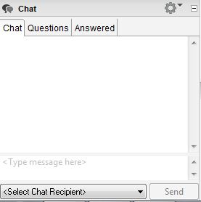
Chat Feature
If you have questions during the call, please use the chat feature. To do so:
Use the drop down arrow to send your comments and/or questions to “Broadcast to All”
Chat comments and/or questions here, and please indicate which jurisdiction you’re from.

Slide 3
About the Integrated HIV/AIDS Planning TA Center

Slide 4
Webinar objectives
After this webinar, participants will be able to:
Describe the five optimal stages of integrated HIV prevention and care planning.
Describe at least one best practice for developing Integrated HIV Prevention and Care Plans.
Identify at least one resource to help support integrated planning efforts and the development of future Integrated HIV Prevention and Care Plans.

Slide 5
How Does Integrated Planning Support Other Initiatives?

Slide 6
Understanding the landscape
Integrated HIV Prevention and Care Planning Guidance (2017-2021)
National HIV/AIDS Strategy (NHAS) continues to guide all national efforts
Ending the HIV Epidemic: A Plan for America initiative
10-year national initiative to end HIV in the US
The first phase focuses on 57 priority jurisdictions
State or local initiatives, such as Getting to Zero, Ending the Epidemic, and Fast Track Cities

Slide 7
Delay of Integrated Plan Guidance for 2022-2027
Guidance for preparation of Integrated HIV Prevention and Care Plans for 2022-2027 has been postponed due to the COVID-19 pandemic
June 17, 2020 letter from HRSA and CDC HIV program leaders
Outlines expectations for continued use of existing Integrated Plans
Encourages jurisdictions to refine ongoing planning efforts, incorporating Ending the HIV Epidemic planning and community engagement activities

Slide 8
Coordination with Ending the HIV Epidemic (EHE) plans
HRSA has noted:
Jurisdictions’ EHE plans and Integrated Prevention and Care Plans should align
The forthcoming Integrated Prevention and Care Plan Guidance will incorporate the four EHE pillars: diagnose, treat, prevent, respond
Pieces of EHE plan submission may be used to meet Integrated Plan requirements

Slide 9
IHAP TAC assistance available to jurisdictions
Conducting integrated planning activities
Engaging community in integrated planning efforts
Aligning Integrated HIV Prevention and Care Plans with other initiatives
Implementing and monitoring Integrated HIV Prevention and Care Plans
Optimizing resource allocation methodologies

Slide 10
Tell us about yourself!
What is your knowledge of integrated planning?
Expert (e.g. I was heavily involved in the development of the 2017-2021 Integrated Plan and integrating planning in my jurisdiction)
Intermediate (e.g. I am responsible for implementing activities of the 2017-2021 Integrated Plan)
Novice (e.g. I'm new to my position and/or unfamiliar with the 2017-2021 Integrated Plan)
What's Integrated Planning?
Other? Please chat into the chat box!

Slide 11
Why Integrate HIV Prevention and Care Planning?

Slide 12
Why is integrated planning important?
Fosters new approaches to address barriers to HIV prevention, care, and treatment
Serves as a jurisdictional roadmap
Leverages existing resources and improves efficiency and coordination of HIV prevention and care service delivery
Promotes collaboration and coordination in the use of data for prevention and care program planning, resource allocation, evaluation, and continuous quality improvement efforts
Establishes ongoing mechanisms for stakeholder engagement

Slide 13
What Do We Mean by Integration?

Slide 14
What do we mean by integration?
Integration may occur in multiple domains
Planning groups
Specific planning activities - needs assessment, plan development, resource allocation, etc.
Physical integration of recipient services - co-location of prevention and treatment administration
Recipient staff - staff roles and responsibilities are integrated across prevention and care
Procurement of HIV prevention and care services

Slide 15
How do we measure integration?
Integration occurs across domains and across a spectrum within the domains
IHAP TAC developed an instrument to help measure progress toward integration across multiple domains
Piloted with eight RWHAP Part A and Part B recipients
Revised measures included in forthcoming needs assessment launching next month
Will support measurement of integration changes over time

Slide 16
Integration domains
Organizational Structure
DOMAIN | NO INTEGRATION | SOME INTEGRATION | FULL INTEGRATION
Communication | Staff communicate only when essential | Periodic communication | Staff communicate routinely
Data sharing | Data are shared only in the aggregate; no data sharing agreements in place for client level data | Data sharing agreements permit information to be shared between state and local health department and other service delivery partners upon request | Comprehensive and bi-directional data sharing agreements facilitate routine linkage, re-engagement, and retention in care
Organizational structure and leadership | Staff and leadership are organized separately with distinct reporting structures | Staff and leadership are in the same organizational unit | Full integration of staff and leadership using the same reporting structures, teams are integrated

Slide 17
Integration domains
Procurement
DOMAIN | NO INTEGRATION | SOME INTEGRATION | FULL INTEGRATION
Procurement | Procurement of resources occurs separately | Planning underway towards joint procurement | Procurement of resources occurs through an integrated process known as braided funding
^{[1]} A process in which “stakeholders coordinate funding from individual sources, with each individual funding source keeping its specific identity.
Adapted from the Association of Government Accountants, “Blended and Braided Funding: A Guide for Policy Makers and Practitioners,” December 2014.

Slide 18
Integration domains
Planning
DOMAIN | NO INTEGRATION | SOME INTEGRATION | FULL INTEGRATION
Planning body structure | Separate planning bodies | Some shared members | One joint planning body
Decision making/Priority setting | Process is separate across programs | Consult/communicate regarding decision making | Process is shared across HIV care and prevention programs
Resource allocation | Allocated separately | Some coordination in allocation | One coordinated process for resource allocation
Planning process for special initiatives | Separate planning processes | Episodic planning | Formal, coordinated planning process

Slide 19
Models of Integrated Planning

Slide 20
Models of integrated planning
Jurisdictions are encouraged to explore different types and levels of integration
There are multiple approaches to integrated planning depending on what is feasible for jurisdictions
Determine which model best suits its unique needs
Recognize integration is an ongoing process
Levels of integration can be intensified over time

Slide 21
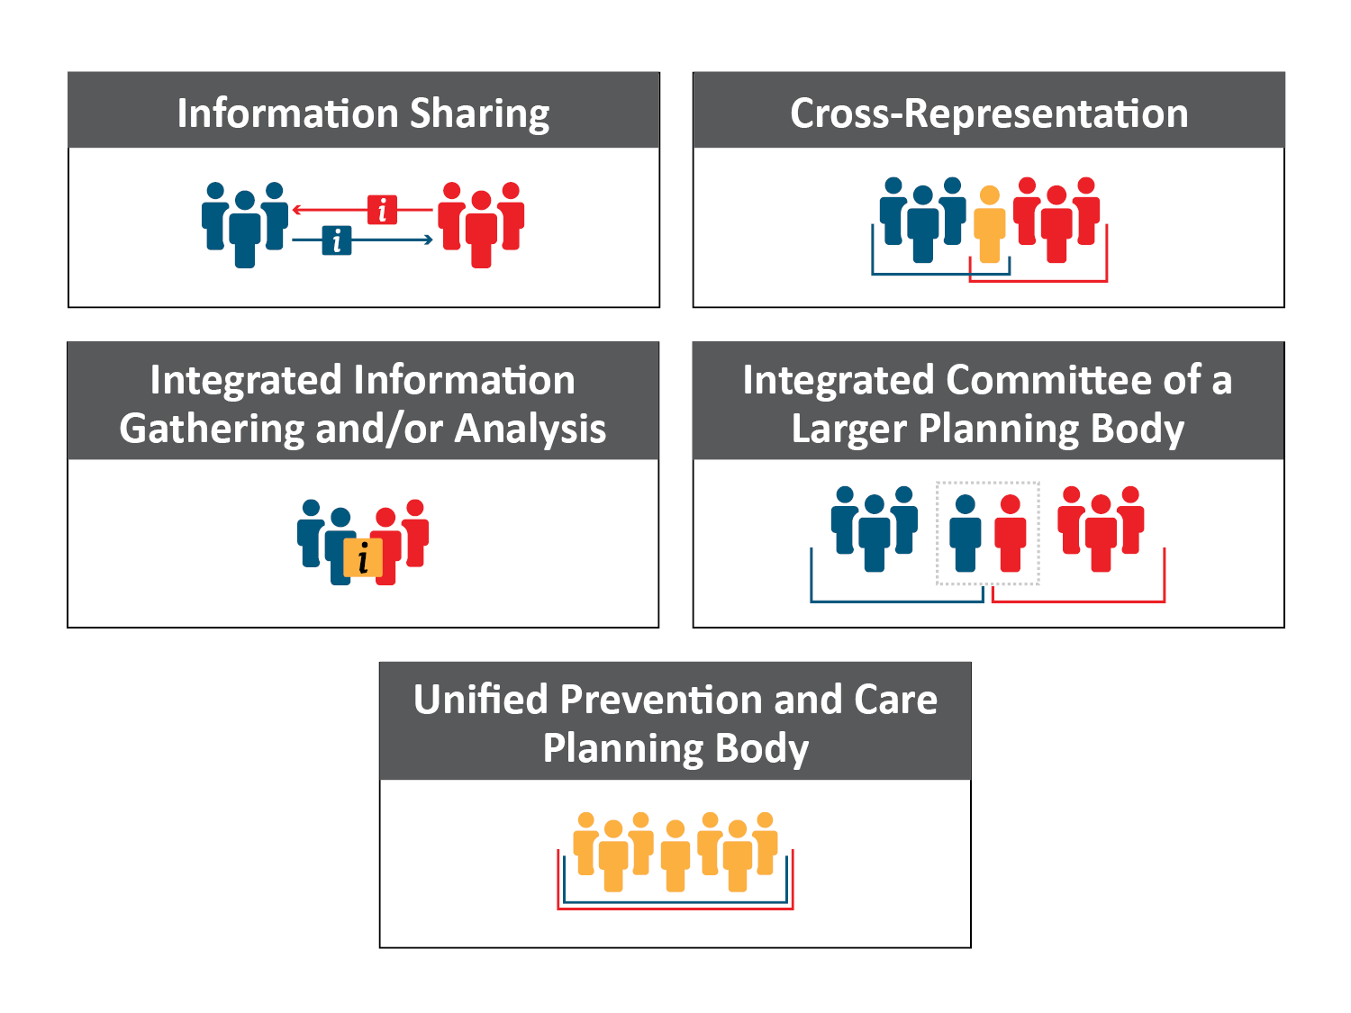
-

Slide 22
1. Information sharing
Each planning body informs the other of their work using presentations, reports, webinars, conference calls, and other communication activities
Adapted from EGM Consulting resource 'Integrated HIV Prevention-Care Planning Activities'

Slide 23
In action! Information sharing
A representative from the local HIV Prevention Group (HPG) attends the RWHAP Part A planning council/planning body (PC/PB) meeting and provides reports on issues affecting HIV prevention services statewide and nationally
Adapted from EGM Consulting resource 'Integrated HIV Prevention-Care Planning Activities'

Slide 24
2. Cross-representation
One or more members of each planning body serve as members of the other body
Adapted from EGM Consulting resource 'Integrated HIV Prevention-Care Planning Activities'

Slide 25
In action! Cross-representation
Cross-representation between the Boston RWHAP Part A Planning Council and the RWHAP Part B Massachusetts Integrated Prevention and Care Committee (MIPCC)
Adapted from EGM Consulting resource 'Integrated HIV Prevention-Care Planning Activities'

Slide 26
3. Integrated information gathering and data analysis
Care and prevention planning bodies engage in data-based collaboration through joint activities:
Needs assessment activities
Evaluations
Consumer input activities (e.g. town-halls, roundtables)
Analysis of jurisdictional HIV care continuum data
Service planning and strategy development
Adapted from EGM Consulting resource 'Integrated HIV Prevention-Care Planning Activities'

Slide 27
In action! Integrated information gathering
A joint workgroup with prevention and care representatives designs and implements the needs assessment and develops an epidemiological profile for both the state and the RWHAP Part A jurisdiction
The HPG participates in the development of the RWHAP Statewide Coordinated Statement of Need
In 2018, the Ohio RWHAP Part A and Part B recipients and the Ohio Department of Health HIV Prevention Program initiated a multi-year joint statewide needs assessment focused on Ohioans at increased risk for HIV infection and individuals with HIV
Adapted from EGM Consulting resource 'Integrated HIV Prevention-Care Planning Activities'

Slide 28
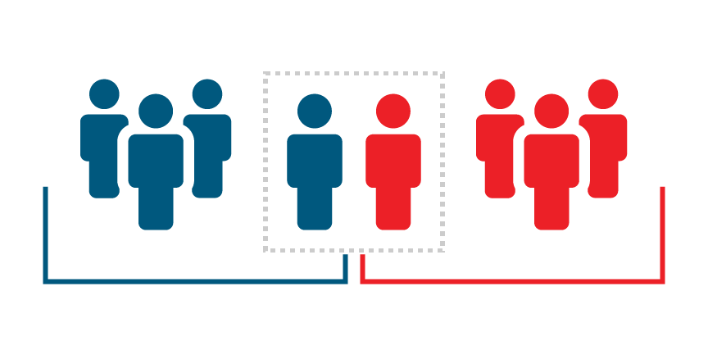
4. Integrated committee of a larger planning body
Standing committee on a larger planning body carries out collaborative planning tasks for both prevention and care
Adapted from EGM Consulting resource 'Integrated HIV Prevention-Care Planning Activities'

Slide 29
In action! Integrated committee of a larger planning body
RWHAP Part A PC/PB establishes a standing prevention committee or a joint program committee
In Houston, the Early Identification of Individuals with HIV/AIDS (EIIHA) workgroup includes members of the Ryan White Planning Council and the Houston Prevention Planning Group, who work together on an EIIHA strategy
Adapted from EGM Consulting resource 'Integrated HIV Prevention-Care Planning Activities'

Slide 30
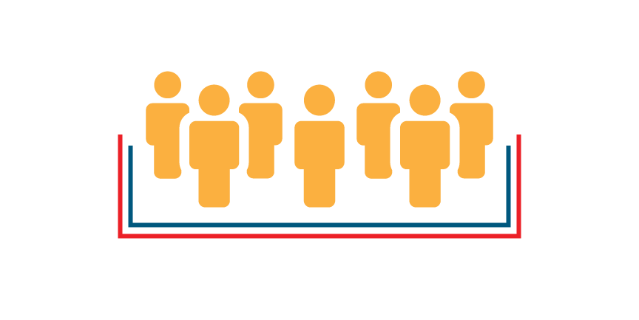
5. Unified prevention-care planning body
Single statewide or RWHAP Part A regional PC/PB responsible for carrying out both prevention and care planning
Adapted from EGM Consulting resource 'Integrated HIV Prevention-Care Planning Activities'

Slide 31
In action! Unified prevention-care planning body
Advisory body supported by the State Department of Health, which is responsible for conducting care and prevention planning
Combined prevention and care planning bodies in cities that receive RWHAP Part A funds and those that both do and do not receive direct CDC prevention funds
St. Louis, San Diego, and Kansas City do not receive direct CDC prevention funds but have been integrated into the work of RWHAP Part B care planning bodies
Adapted from EGM Consulting resource 'Integrated HIV Prevention-Care Planning Activities'

Slide 32
Integrated Planning Model Poll
What type of integrated HIV prevention and care planning model does your jurisdiction have?
Information sharing
Cross-representation
Integrated information gathering and data analysis
Integrated committee of a larger planning body
Unified prevention-care planning body
Other? Share in the chat!

Slide 33
IHAP TAC resource

Slide 34
Stages of Integrated Planning

Slide 35
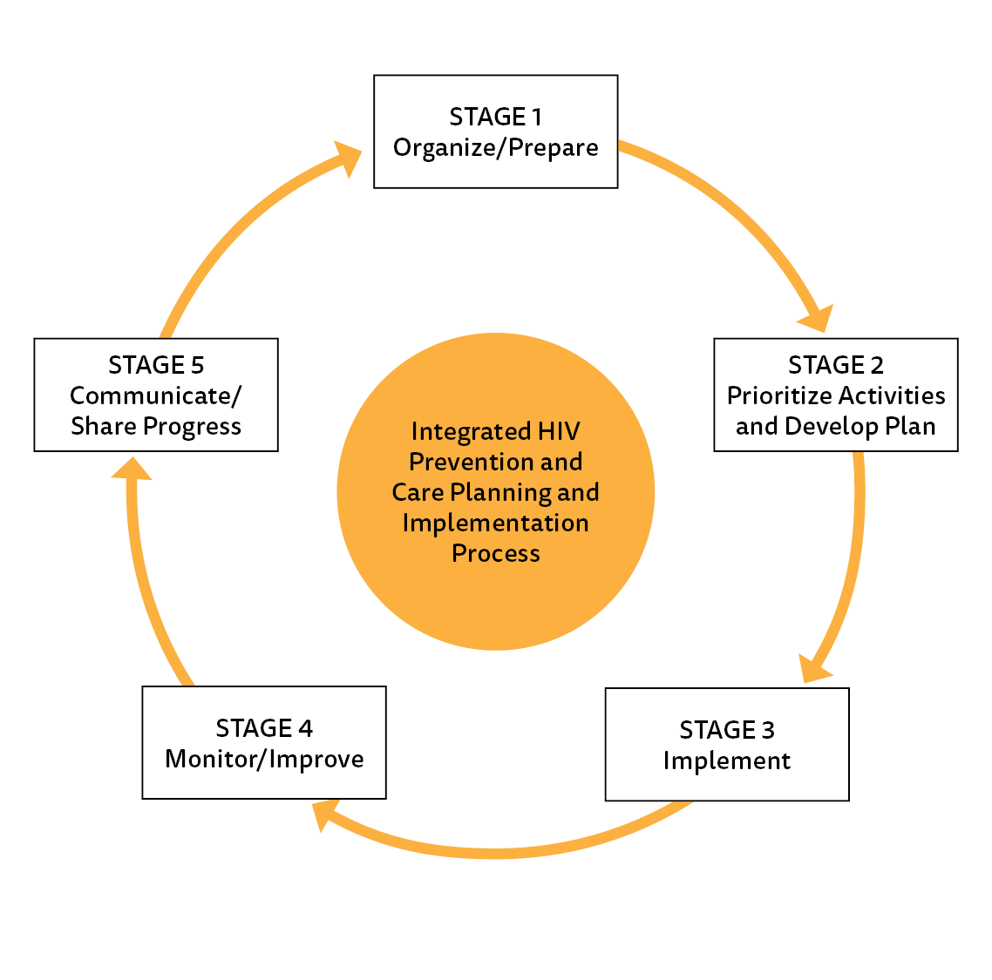
Stages of Integrated Planning

Slide 36
Stage 1: Organize and Prepare

Slide 37
During the organization and preparation stage…
Foster meaningful stakeholder and community engagement
Provide orientation and training to prepare staff and community members for plan development processes
Establish communication strategies to ensure use of clear language, including common definitions
Develop a committed and diverse planning group
Encourage cooperation between RWHAP Part A and B planning bodies and any prevention planning groups

Slide 38
Stage 1 activities: Engage stakeholders
Meaningful engagement of the community from the beginning
Provides the foundation for the planning process
Enhances coordination, collaboration, and seamless access to services
Includes people with personal or professional experience, expertise, and skills in HIV
HRSA and CDC require HIV planning processes to involve community stakeholders

Slide 39
What is ‘meaningful stakeholder engagement’?
Is continuous, ongoing, and bidirectional
Considers the unique needs and challenges in each community
Seeks input from a wide range of stakeholders and occurs in a variety of venues and formats
Includes gathering feedback remotely (e.g. virtual townhall, online comment submission)
May take us out of our comfort zone to challenge conventional wisdom and encourage innovation

Slide 40
Community Engagement Strategies during COVID-19
Increased use of e-newsletters and stakeholder distribution lists.
Record meetings.
To combat Zoom fatigue, schedule more 1-on-1 meetings by phone.
Use COVID funding to increase infrastructure for virtual engagement.
Develop Brief TA videos.
Polled members early in the pandemic and found that everyone had access to the internet, and everyone had access to at least a phone.
Did individualized training, customizing for people using laptops, desktops, phones.

Slide 41
How are you engaging stakeholders during the COVID-19 pandemic? Please use the chat to share your ideas!

Slide 42
Stage 1 activities: Review existing data and collect new data
Identify priorities and develop a plan for collecting and analyzing data
Review major integrated planning questions that the planning process is intended to answer
Determine what types of quantitative and qualitative data are needed to help answer the questions
Identify data priorities and gaps in existing data
Develop a plan for collecting and analyzing data
Gather and review existing data or secondary data
Adapt or develop and pilot test new data collection instruments and use to collect new data
Review and apply existing data sharing agreements and create new ones as needed

Slide 43
Stage 1 activities: Conduct needs assessment
Jurisdictions should conduct a needs assessment every three to five years, monitor progress over time, and make annual adjustments as needed
Needs assessments include:
Epidemiologic profile
Resource inventory
Profile of provider capacity and capability
Estimate and assessment of unmet need
Estimate and assessment of people with HIV who are unaware of their status
Assessment of gaps in service needs

Slide 44
Stage 1 activities: Review and analyze data
Identify individuals responsible for data analysis
Review and analyze data
Synthesize and format data for PCs/PBs
Create user-friendly visuals to help stakeholders interpret data
Create and use HIV care continuum outcome data to highlight prevention and care successes and gaps

Slide 45
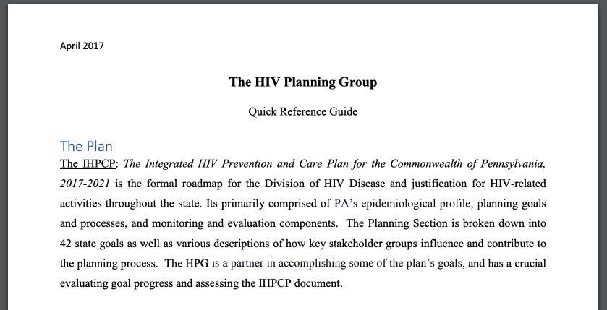
In action! Strategies to organize and prepare
Orientation and training
Pennsylvania developed orientation
materials for Integrated Plan development
Communication strategies – get on the same page
Create a common or shared language guide for prevention and care
Broward County developed a shared integrated planning lexicon that was vetted and approved by the Integrated Planning team

Slide 46
-

Slide 47
Stage 2: Prioritize Activities and Develop the Plan

Slide 48
Stage 2 activities: Structure plan development process
Ensure sufficient resources and dedicated leadership for plan development
Develop realistic timelines that account for plan development, review, and revision
Reference federal guidance to verify you have all information to draft the required sections
Concurrently develop a monitoring plan to track progress and successes
When possible, use technology that allows multiple parties to simultaneously view, edit, and contribute to plan development

Slide 49
Stage 2 activities: Continue engaging stakeholders
If using an external consultant, ensure that PC/PB members are fully and meaningfully engaged throughout the process
Consult a range of stakeholders, taking note of diverse communities within a jurisdiction
Solicit feedback in a variety of venues and formats to accommodate the needs and preferences of community members
Consider community involvement burden
Geographic (rural vs. urban)
When possible, gather feedback remotely (e.g. virtual townhall, online comment submission)

Slide 50
In action! Maryland Engagement
To engage a broader community in the Integrated HIV Prevention and Care Plan development process, Maryland’s planning body sought input from advisory groups, including:
Five Regional Advisory Committees, the Baltimore Planning Council, the Anne Arundel Commission, and the Baltimore City Commission
MSM Response Team
Transgender Response Team
HIV Perinatal Team
Maryland Hepatitis Coalition
STI Community Coalition

Slide 51
Stage 2 activities: Obtain feedback on plan from PC/PB
Present key information to PC/PB in an open meeting
Ensure that key stakeholders receive copies or summaries of the plan and have an opportunity to provide feedback to the PC/PB
Public comments and feedback may be obtained formally at public hearings or through other venues such as community meetings, advisory committees, and provider forums
Review and revise the draft plan as needed
The Integrated HIV Prevention and Care Plan must be reviewed by the full PC/PB resulting in a letter of concurrence, concurrence with reservation(s), or no concurrence

Slide 52
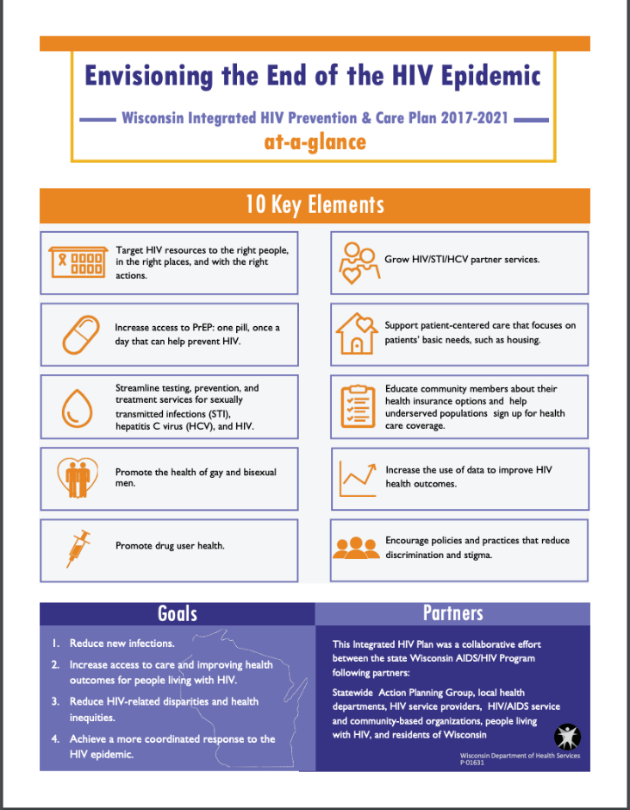
Stage 2 activities: Disseminate plan
Disseminate final plan to all key stakeholders and establish mechanisms for sharing plan updates and progress towards goals
In Action! Wisconsin developed an abbreviated version of their Integrated Plan to distill the 130-page plan into 10 pages and a one page At-A-Glance document

Slide 53
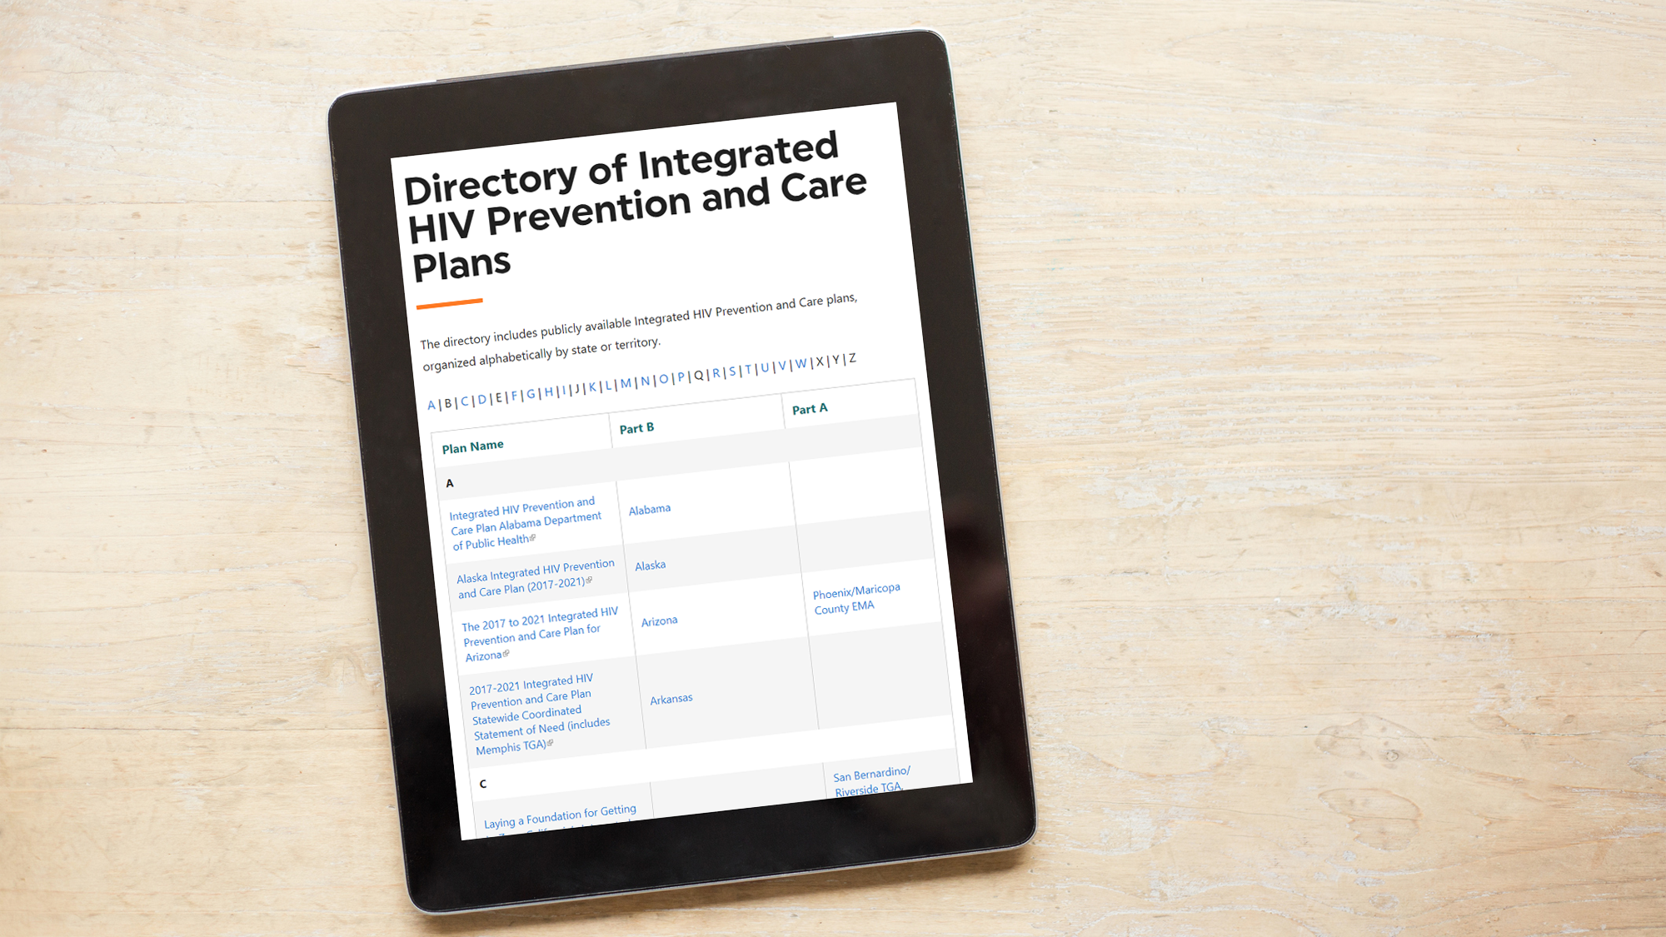
-

Slide 54
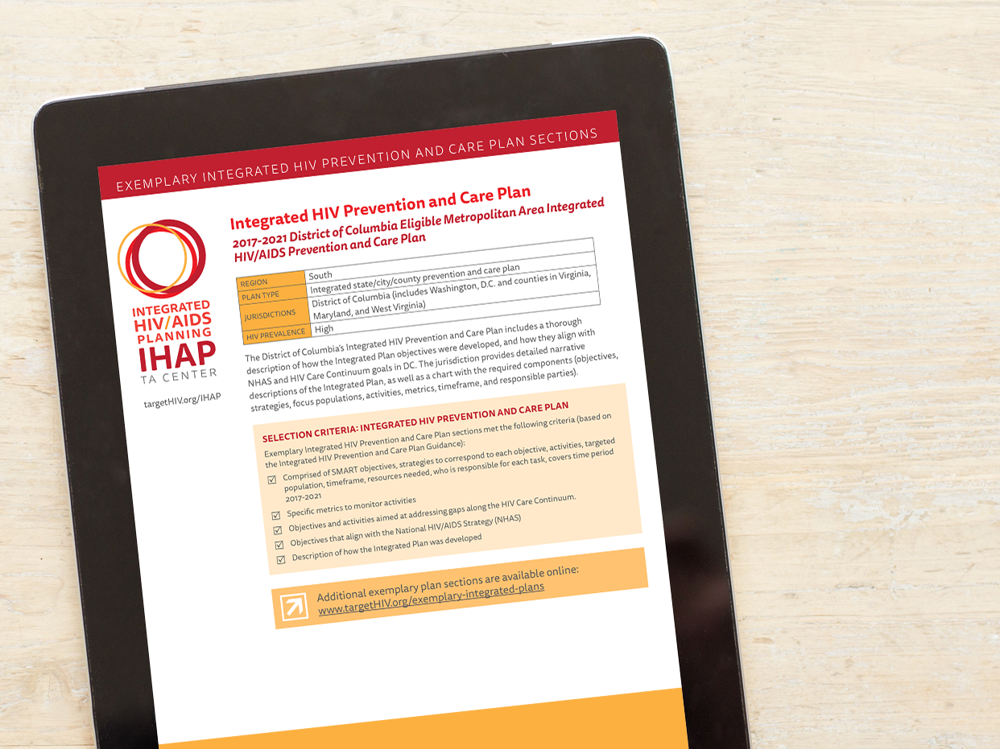
Exemplary Plans
Inventory of strong responses to joint CDC/HRSA guidance
Not exhaustive
Inform and guide development or revision of Integrated HIV Prevention and Care Plans
161 Exemplary Plan sections reviewed
34 sections highlighted

Slide 55
Stage 3: Implement Plan

Slide 56
Stage 3 activities: Document implementation processes
Document protocols to support implementation
Decision-making process
Communications to report progress and challenges
Develop a realistic work plan based on the Integrated HIV Prevention and Care Plan, including:
Roles and responsibilities for planning bodies, recipients, and sub-recipients
Timelines
Outcomes

Slide 57
Stage 3 activities: Implement plan!
Consider developing a list that includes small but important, achievable steps
Frame activities as action steps to support goals and objectives
Help to generate momentum
Provide structure for regular updates to key stakeholders

Slide 58
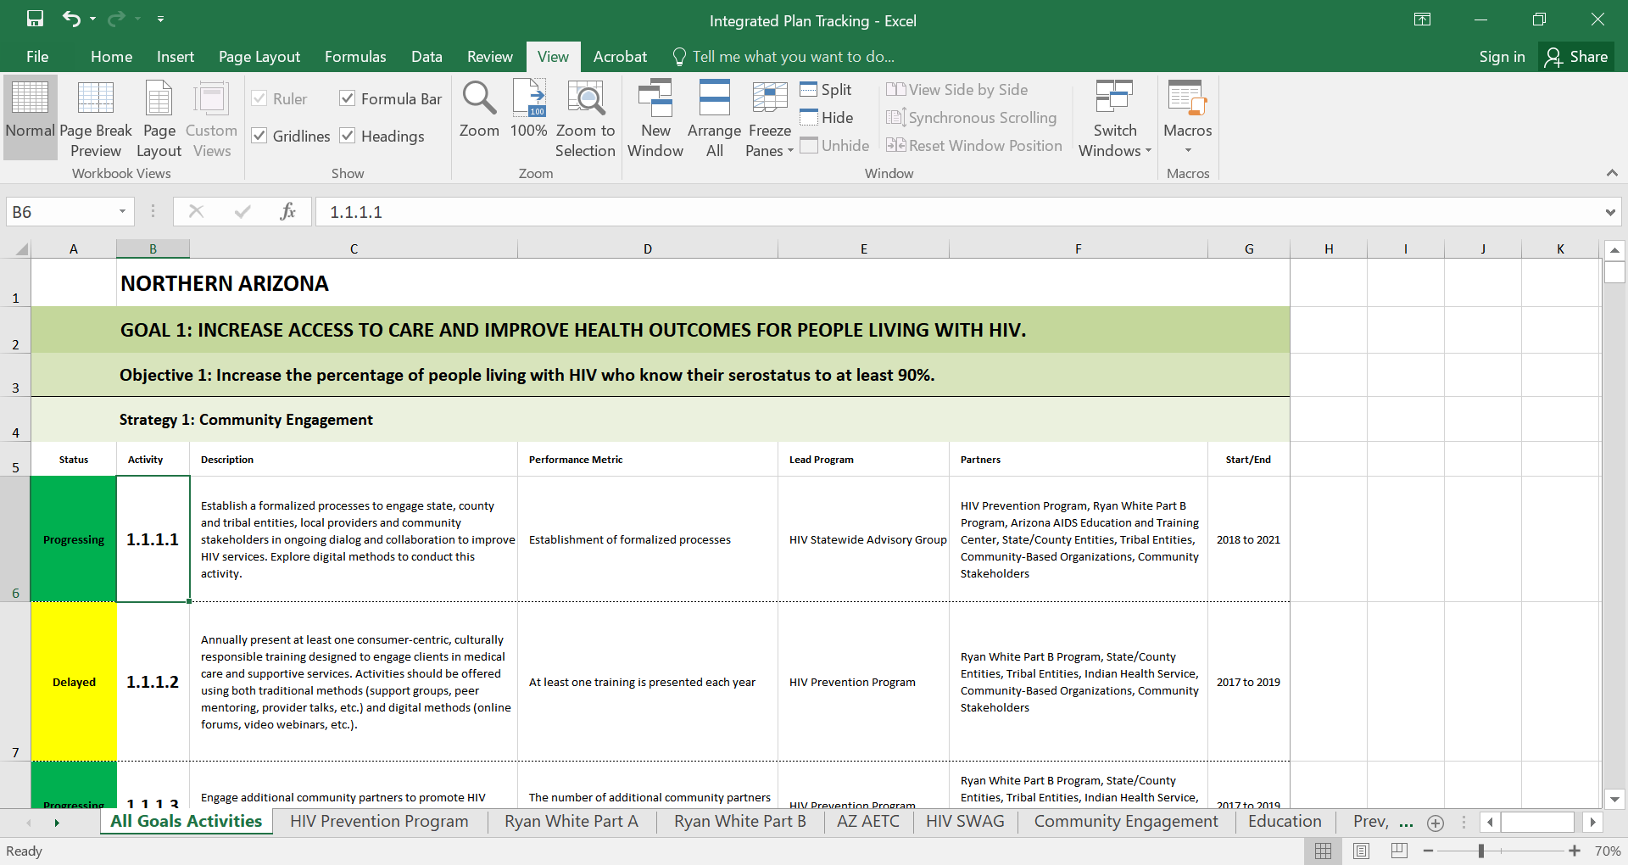
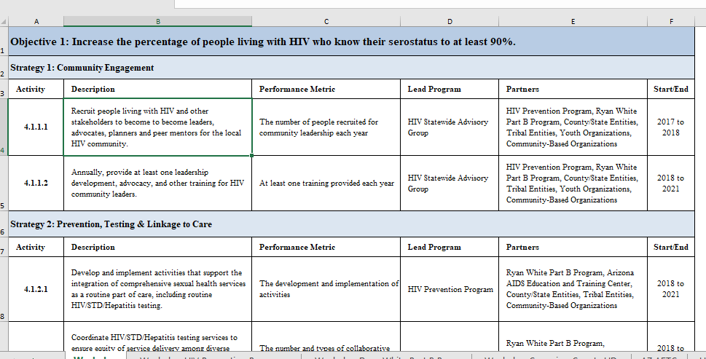
In action! Arizona’s Plan Tracking Tool

Slide 59
Stage 4: Monitor and Improve Plan

Slide 60
Stage 4 activities: Implement monitoring plan
Update the monitoring plan developed in Stage 2 to ensure effective and responsive tracking of progress and successes, including:
Measures, data sources, and data collection processes
Reporting structures and processes for reporting
Data management protocols
Ongoing quality assurance
Monitor and assess implementation of goals, SMART objectives, and projected activities

Slide 61
Stage 4 activities: Share and incorporate feedback
Update stakeholders on plan implementation
Report progress on plan implementation
Share data, as well as conclusions gleaned from partner data, in an appropriate format
Solicit feedback for plan and program improvements
Integrate feedback for improvement
Update plan to reflect feedback if necessary

Slide 62
Stage 4 activities: Use data to monitor progress
Use HIV care continuum data and real-time data dashboards to monitor jurisdictional progress in improvements in HIV prevention, care, and service delivery
Identify HIV care continuum data and sources
Determine schedule/plan to review surveillance, program, and care data
Use data to improve and measure changes to specific steps of the HIV care continuum

Slide 63
Stage 5: Communicate and Share Progress

Slide 64
Stage 5 activities: Share updates and progress
Provide updates on plan activities and progress to PB/PCs and other stakeholders
Include successes, challenges, modifications, and lessons learned
Create a progress report or activity dashboard that is updated and shared regularly according to an established schedule
Distill the Integrated Plan and its activities into a succinct visual or snapshot to promote or communicate progress

Slide 65
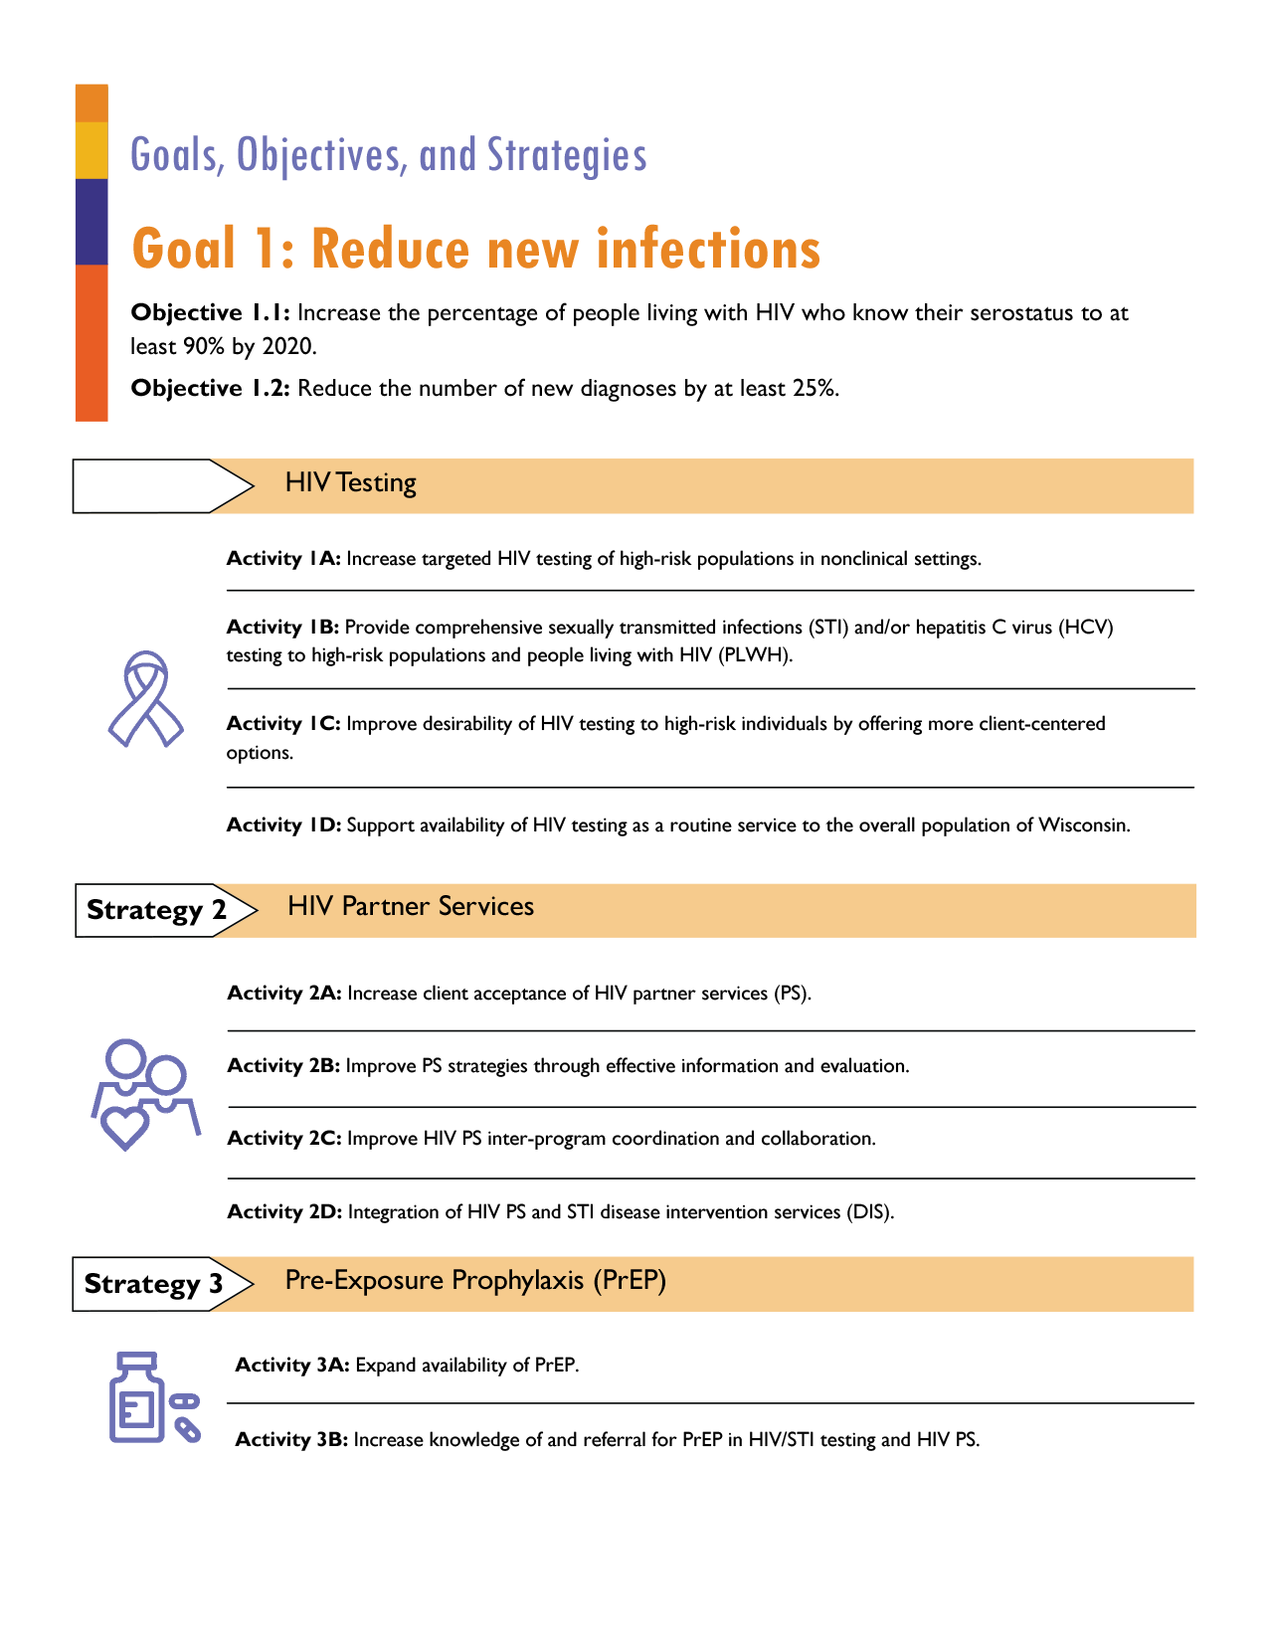
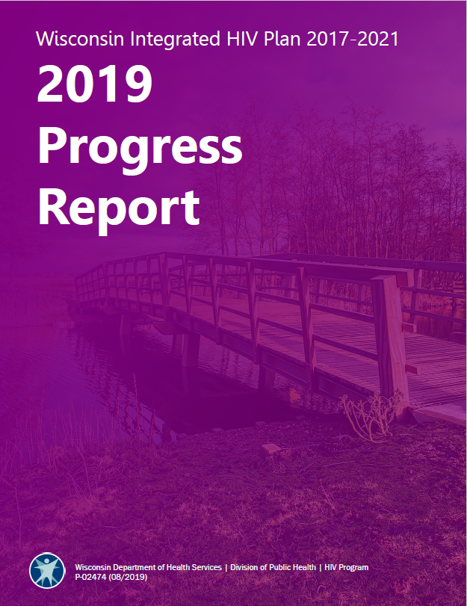
In action! Plan dissemination in Wisconsin

Slide 66
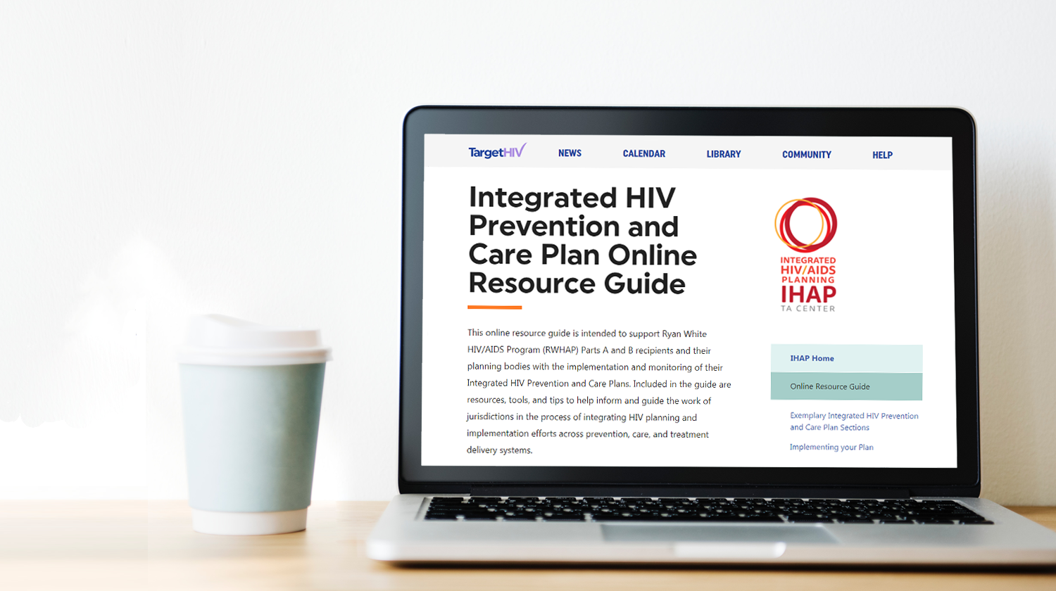
Integrated HIV Prevention and Care Plan Online Resource Guide

Slide 67
Stages of Integrated Planning Poll
What stage of integrated planning do find the most challenging?
Stage 1: Pre-Planning - organizing and preparing to plan
Stage 2: Plan Development – plan and prioritize plan activities
Stage 3: Implementation of Plan activities
Stage 4: Monitor and Improvement
Stage 5: Communication - sharing progress

Slide 68
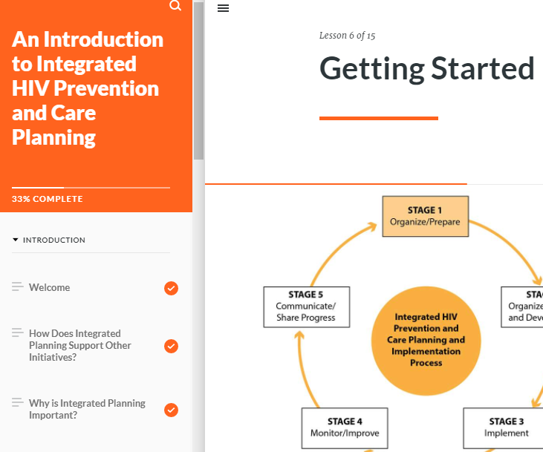
Integrated Planning 101
Integrated Planning 101 Online Curriculum
Launching Soon!
Fundamentals of integrated planning
New to integrated planning or refresher on basics

Slide 69
Questions?

Slide 70
Tell us more!
The IHAP TAC is conducting an information gathering needs assessment to better understand challenges on the ground.
The information gathered during the needs assessment will inform future TA offerings, including webinars, tools, and resources.
Launching in January, 2021!

Slide 71
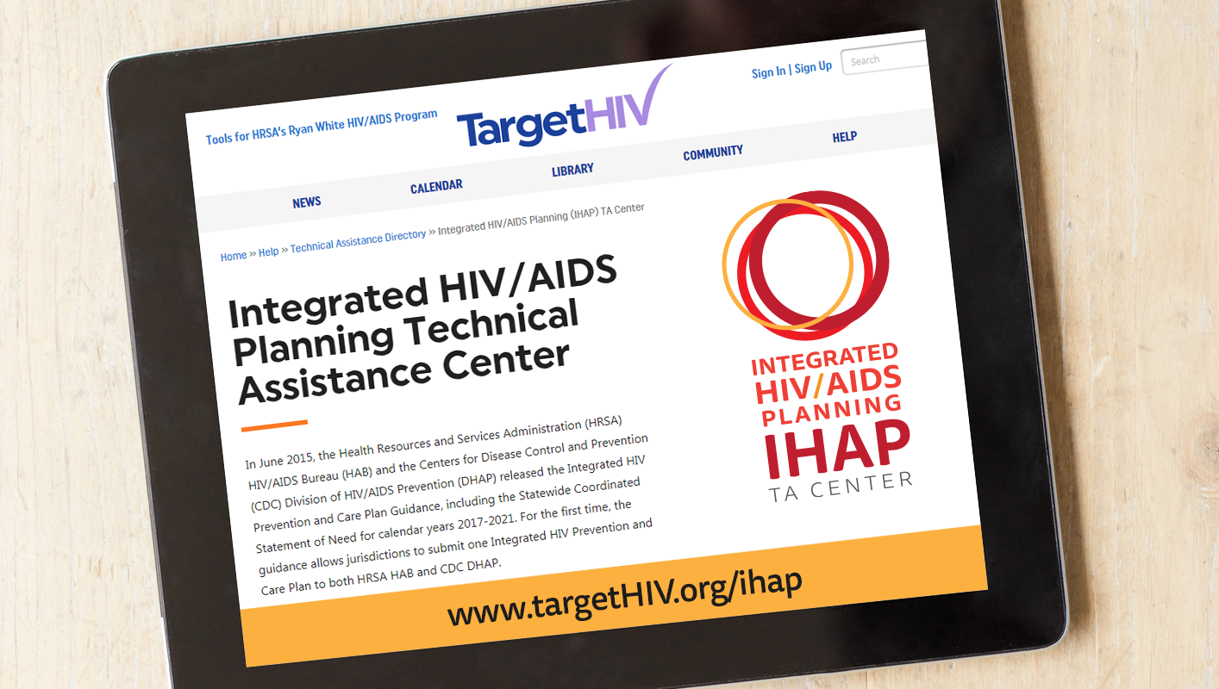
-

Slide 72
Thank you!
Contact us at ihaptac@jsi.com!
Obtain more information, join our mailing list, request TA, or share your experiences or resources.
This project is supported by the Health Resources and Services Administration (HRSA) of the U.S. Department of Health and Human Services (HHS) under grant number U69HA30144, Ryan White HIV/AIDS Program Integrated HIV Planning Implementation. This information or content and conclusions are those of the author and should not be construed as the official position or policy of, nor should any endorsements be inferred by HRSA, HHS or the U.S. Government.

