Slide 1
Roles and Responsibilities of RWHAP Part A Planning Councils/Bodies (PC/PBs) and Recipients
Slides for Module 2
Topic: Roles and Responsibilities

Slide 2
PC/PB and Recipient Roles and Responsibilities
Evolution of Roles in the Legislation and HRSA/HAB Guidance
PC/PB Roles and Responsibilities
Recipient Roles and Responsibilities
Boundaries and Separation of Roles
Similarities and Differences between Roles of Planning Councils and Planning Bodies

Slide 3
Training Objectives
Following the roles and responsibilities training, participants will be able to:
Explain how the legislation and HRSA/HAB guidance together define and explain PC/PB and recipient responsibilities
List and explain the roles and responsibilities of RWHAP Part A PC/PBs
Describe and differentiate the roles and responsibilities of the recipient/administrative agency and those of the PC/PB
Ensure understanding of how PC/PB support staff and recipient staff work with PC/PBs
Identify 2 key similarities and 2 important differences between a RWHAP Part A planning council and a RWHAP Part A planning body

Slide 4
Legislation and Guidance
Legislation specifies duties of RWHAP Part A planning councils and activities in which they must not be involved, to prevent conflict of interest [§2602(b)(4) and (5)]
HRSA/HAB/DMHAP provides ongoing guidance to clarify PC/PB roles and responsibilities and how they fit into RWHAP Part A, through such means as:
The RWHAP Part A Manual
Policy Clarification Notices (PCNs) and Program Letters
Annual Notice of Funding Opportunity (NOFO)
Notice of Award (including Conditions of Award)
Project Officer calls and guidance
Training and technical assistance

Slide 5
Differences between Planning Councils and Planning Bodies
RWHAP Part A planning councils have:
Clearly defined legislative roles and responsibilities
Legislatively required membership categories
Additional guidance from HRSA/HAB
Other Part A planning bodies have:
A legislative requirement for obtaining “community input (particularly from those with HIV)…for formulating the overall plan for priority setting and allocating funds from the grant” [§2609(d)(1)(A)]
No legislatively required membership categories or responsibilities for appointment

Slide 6
Differences between Planning Councils and Planning Bodies (cont. 1)
PCs decide how services are prioritized and how funding is allocated to those services
PBs make recommendations to the recipient about priorities and allocations

Slide 7
Differences between Planning Councils and Planning Bodies (cont. 2)
In spite of these differences:
HRSA/HAB strongly encourages PBs to look and act as much like PCs as possible, in terms of:
Membership
Roles and responsibilities
TGAs with PBs must meet the same application requirements as those with PCs, including expectations for community planning and consumer input

Slide 8
Recipient and Planning Council Roles and Responsibilities
Recipient and planning council are two independent entities, both with legislative authority and roles
Some roles belong to one entity and some are shared
Effectiveness requires clear understanding of the roles and responsibilities of each entity, plus:
Frequent communications, information sharing, and collaboration between the recipient, planning council, and planning council support (PCS) staff
Ongoing consumer and community involvement

Slide 9
Planning Council/Planning Body, Recipient, & CEO Roles & Responsibilities¹
Task | CEO | Recipient | PC/PB
Establishment of Planning Council/Planning Body* | ✓
Appointment of PC/PB Members* | ✓
Needs Assessment |  |  | 
Integrated/Comprehensive Planning |  |  | 
Priority Setting* |  |  | 
Resource Allocation* |  |  | 
Directives* |  |  | 
Procurement of Services* |  | 
Contract Monitoring* |  | 
Coordination of Services |  |  | 
Evaluation of Services |  |  | Optional
Development of Service Standards |  |  | 
Clinical Quality Management |  |  | Contributes
Assessment of Efficiency of the Administrative Mechanism* |  |  | 
PC/PB Operations & Support |  |  | 
*Sole responsibility of one entity 1: required for a PC; sound practice for a PB functioning like a PC

Slide 10
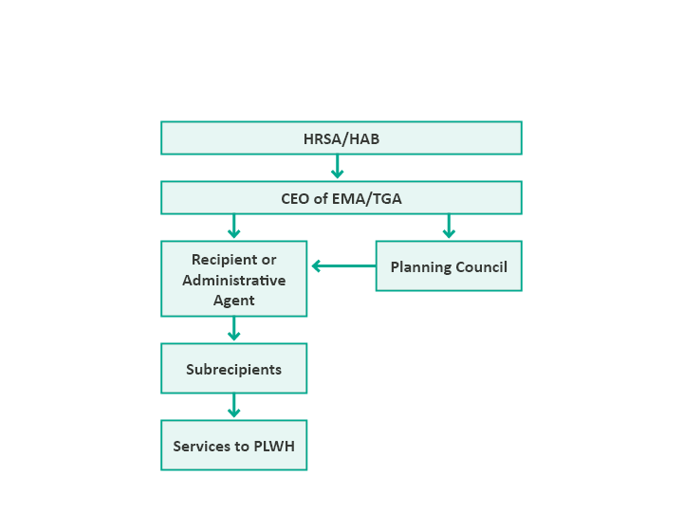
Flow of RWHAP Part A Decision Making & Funds
Planning council sets priorities, allocates resources, and gives directives to recipient on how best to meet these priorities

Slide 11
Planning Council Formation and Membership
Chief Elected Official (CEO) establishes the PC/PB
For a PC, CEO appoints all members from applicants provided through the PC’s open nominations process
Membership must meet legislative requirements:
Representation (legislatively required categories)
33% unaffiliated consumers of RWHAP Part A services
Reflectiveness of the epidemic in the EMA/TGA
Recipient not involved in membership selection
Bylaws may call for a recipient representative on the PC/PB
A PC may not be chaired solely by an employee of the recipient
Varied approaches used for establishing and appointing PB members

Slide 12
Expectations: Needs Assessment
Determine what services are needed, what services are being provided, and what service gaps exist, overall and for particular populations, both in and out of care
Includes obtaining PLWH input on service needs and gaps

Slide 13
Components of Needs Assessment
Epi profile of HIV and AIDS cases and trends
Estimate & characteristics of PLWH with unmet need – PLWH who know their status but are not in care
Estimate & characteristics of individuals with HIV who are unaware of their status
Service needs & barriers for PLWH in and out of care
Existing system of care including a resource inventory and profile of provider capacity & capability
Assessment of service needs, gaps, and disparities in access to services, based on all needs assessment data

Slide 14
Needs Assessment
PC has primary responsibility and “ownership” – design, direct work or oversight of consultants or volunteers
Recipient provides support but not leadership – data, help in hiring a consultant if one is needed, staff assistance
Active community involvement needed – especially consumers and providers
Need a multi-year plan for assessing needs of PLWH in and out of care
Presentation of findings in user-friendly formats as input to decision-making, especially priority setting and resource allocation

Slide 15
Integrated/Comprehensive Planning
Legislation requires Ryan White Part A and Part B programs to prepare comprehensive plans that set goals and objectives and guide the annual planning cycle
All RWHAP Parts expected to participate in the Statewide Coordinated Statement of Need (SCSN) process, which is led by Part B
Part A and Part B recipients prepared 5-year HRSA/CDC Integrated HIV Prevention and Care Plans based on a combined guidance from CDC and HRSA
Plans for 2017-2022 submitted in September 2016

Slide 16
Integrated/Comprehensive Planning (cont.)
Combined guidance designed to help reach the national goals to end the epidemic and improve performance along the HIV care continuum
Programs expected to review Plan progress regularly and refine objectives and strategies as needed
Collaborative plan implementation and monitoring by prevention and care (and between Part A and Part B) encouraged

Slide 17
Priority Setting and Resource Allocation (PSRA)
Most important legislative responsibility—planning councils decide, planning bodies recommend:
Priority setting: determining what service categories are most important for PLWH in the EMA or TGA
Resource allocation: specifying how much RWHAP Part A program funding should go to each prioritized service (best done in both dollars and percent)
Directives to the recipient on how best to meet these priorities – e.g., what service models for what populations in what geographic areas
Reallocation of funds during the program year to ensure that all funds are expended on needed services

Slide 18
Priority Setting
Means determining what service categories are most important for PLWH in the EMA or TGA – unrelated to who provides the funding for these services
Recipient provides information – especially service utilization data – and offers advice
Requires a sound, fair process to ensure that priorities are data-based and address the needs of diverse PLWH
All needed service categories should be prioritized even though some may not be funded, in case needs change or reallocation permits funds for a previously unfunded category during the program year

Slide 19
Directives
Guidance to recipient on how best to meet the priorities and other factors to consider in procurement of services
Often specify use of a particular service model, address geographic access to services or require services appropriate for specific PLWH subpopulations
Must not limit procurement by making only a few providers eligible
Recipient must follow PC directives in procurement and contracting (but cannot always guarantee full success)

Slide 20
Examples of Directives
Funded outpatient ambulatory health services (OAHS) must offer services at least 1 evening a week or 1 weekend a month
Medical case management must be offered at a site in a particular geographic area (e.g., an outlying county)
At least one substance abuse treatment provider must offer services appropriate for pregnant women and mothers with young children

Slide 21
Resource Allocation
Planning council responsibility: recipient provides data and advice, but has no decision-making role
Process of deciding how much funding to allocate to each priority service category or sub-category
At least 75% of service dollars must go to core services (unless program has a waiver from HRSA/HAB)
Up to 25% of funds can be used for support services needed for achieving medical outcomes
Need a fair, data-based process that manages conflict of interest
Consider other funding streams, cost per client, plans for bringing people into care (some highly ranked service categories may receive little or no funding)

Slide 22
Reallocation
Planning council role: must approve any reallocation of funds among service categories
Recipient provides expenditure data by service category to PC, usually monthly
Some recipients do regular “sweeps” or request reallocation permission at set times each year
Rapid reallocations process needed to avoid unobligated (unused) funds and ensure available funds are used to address priority service needs

Slide 23
Coordination of Services
Shared responsibility of recipient and PC/PB
Focus on ensuring that RWHAP Part A funds fill gaps, do not duplicate other services, and make RWHAP the payor of last resort
Involves coordination in planning, funding, and service delivery
PC/PB reviews other funding streams as input to resource allocation
Recipient ensures that subrecipients have linkage agreements and use other funding where possible – for example, help clients apply for entitlements like Medicaid

Slide 24
Procurement
Recipient role – no PC/PB involvement
Involves:
Publicizing the availability of funds
Writing Requests for Proposals (RFPs)
Using a fair and impartial review process to choose subrecipients (service providers)
Contracting with providers – and requiring that they follow service standards and meet reporting and clinical quality management (CQM) requirements
Contract amounts and use of funds by service category or sub-category must be consistent with PC allocations and directives

Slide 25
Contract Monitoring
Recipient role – no PC/PB involvement
Involves site visits and document review for monitoring of:
Program quality and level of services
Finances/fiscal management, including expenditure patterns and adherence to HRSA/HAB and local regulations in use of funds
Aggregate findings (by service category or across categories) shared with the PC/PB as input to decision making

Slide 26
Legislative Requirements to Prevent PC Conflict of Interest
Planning council:
“May not be directly involved in the administration of a grant”
“May not designate (or otherwise be involved in the selection of) particular entities” as funded providers
Individual members affiliated with an entity seeking funds may not “participate (directly or in an advisory capacity) in the process of selecting entities” for funding
[§2602(b)(5)]

Slide 27
Clinical Quality Management
Recipient responsibility – some PC/PBs contribute
Involves the coordination of activities aimed at improving service access, patient care, health outcomes, and patient satisfaction
Used to ensure that:
Services meet clinical guidelines and local service standards
Supportive services are linked to positive medical outcomes
Recipient monitors providers based on quality standards, and recommends improvements
PC establishes service standards used in CQM and uses findings by or across service categories in decision making
Sometimes consumers participate in CQM

Slide 28
Cost-Effectiveness and Outcomes Evaluation
Recipient assesses performance, clinical outcomes, and cost effectiveness of services
PC/PB has the option of assessing the effectiveness of services offered – usually best done in coordination with recipient
Major focus on performance along the HIV care continuum
Findings used by recipient in selecting and monitoring providers
Findings used by PC/PB in priority setting, resource allocation, and improving service system

Slide 29
Assessment of the Efficiency of the Administrative Mechanism
PC must “assess the efficiency of the administrative mechanism in rapidly allocating funds to the areas of greatest need within the eligible area” [Legislation, §2602(b)(4)(E)]
Done annually
Assesses recipient procurement, disbursement of funds, support for the PC’s planning process, and adherence to PC priorities and allocations
Written report goes to recipient, which indicates actions it will take to address any identified problem areas, and summarizes this in the annual application
Planning bodies usually do not perform this role

Slide 30
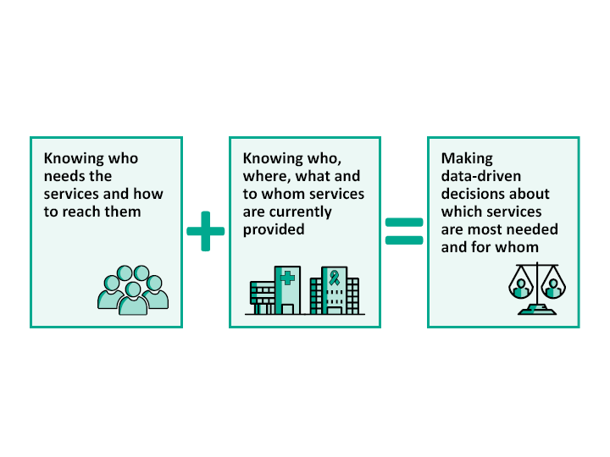
Purpose of the Planning Cycle: Putting the Pieces Together

Slide 31
PC/PB Operations
Develop bylaws, policies and procedures to ensure fair, efficient operations
Establish grievance procedures
Manage conflict of interest
Major attention to new member recruitment including an open nominations process, orientation, and training
PCs expected to provide training for members at least annually
Much of PC/PB’s work is done in committees
Assistance from PC/PB support staff

Slide 32
Role of PC/PB Support Staff
Help the PC/PB carry out its responsibilities and operate effectively
Typical roles:
Staff committees and full meetings
Provide expert advice on RWHAP legislative requirements and HRSA/HAB regulations & expectations
Oversee a training program for members
Encourage member involvement and retention, with special focus on consumers
Serve as liaison with the recipient
Help the PC/PB manage its budget
PBs may have assigned staff or be staffed by recipient

Slide 33
Recipient Staff Roles with PC/PBs
Typical roles with PC:
Attend and make a recipient report at meetings
Regularly provide agreed-upon reports and data (e.g., costs and service utilization, CQM performance data)
Provide advice on areas of expertise without unduly influencing discussions or decisions
Assign staff to attend most committees regularly
Collaborate on shared roles
Carry out joint efforts such as task forces and special analyses consistent with roles and resources
Roles with PBs similar, but with more staff leadership and direction since PB is advisory

Slide 34
Separation of PC/PB and Recipient Roles
Division of roles between recipient and PC/PB helps prevent actual or perceived conflict of interest
Recipient chooses and manages RWHAP Part A service providers with no PC/PB involvement
Data on subrecipients – e.g., funding, expenditures, performance – provided to PC/PB by service category only, without provider names
PC/PB should not discuss individual providers or refer to funded providers by name names in its work – focus should be on services and service categories

Slide 35
Recipient and PC/PB as Partners
Joint efforts of PC and recipient necessary to provide needed care and maximize positive clinical outcomes for PLWH
PC should work closely with the recipient but as an independent body with its own staff, structure, & roles
Recipient provides information and advice to the PC while supporting its decision-making role
HRSA/HAB encourages use of a Memorandum of Understanding (MOU) to clarify roles, relationship, and data sharing
Ideally, relationship of recipient and non-PC planning body is similar to PC-recipient relationship

Slide 36
Sum-Up
Planning councils are decision-making bodies; planning bodies are advisory
PC roles are determined by the legislation, with additional guidance from HRSA/HAB/DMHAP
PBs encouraged to look and act as much like PCs as possible
Many tasks shared with the recipient
Legislation forbids PC involvement in activities related to procurement and contract administration/monitoring
Programs and clients benefit when PC and recipient work together as mutually respectful partners

Slide 37
Optional Slides for Activities

Slide 38
Quick Activities to Apply Knowledge
Following are 4 quick scenarios and discussions to increase interaction during your presentation/lecturette and help participants apply what they are learning to practical situations. Revise them if needed to fit your situation, and use them in small groups or pairs, or in the full group. Following is the title of each activity and where you may want to insert it:
Insert Scenario A: Needs Assessment after slide 14
Insert Discussion B: Integrated/Comprehensive Planning after slide 16
Insert Scenario C: Reallocation after slide 22
Insert Scenario D: Boundaries after slide 35

Slide 39
Quick Scenario A: Needs Assessment
Your PC/PB has done a lot of needs assessment activities, but not a comprehensive needs assessment, including all components. Several members of the Committee want to do a comprehensive needs assessment with every component next program year, to “catch up,” then begin a multi-year cycle. Others say no, it is best to just start a three-year cycle next year.
Which is the better idea? Why?
Is there another approach you think would work better than these options? If so, explain.
Notes:
Quick Activity: Compendium for Planning Council Support (PCS) Staff, Section 3a. PC Orientation PowerPoint, slide 61

Slide 40
Quick Discussion B: Integrated/Comprehensive Planning
Discuss the following, asking PC/PB leadership or support staff for any needed background information:
What kind of integrated/comprehensive plan did your EMA/TGA submit last time – did it include just Part A and CDC prevention, or was it a joint plan with Part B?
What are some specific ways in which this kind of 5-year plan can help improve HIV services and outcomes and move the EMA/TGA toward ending the epidemic?
What do you see as the greatest challenges of developing an integrated plan with prevention and with Part B?
What are the challenges of implementing an integrated plan?
Notes:
Quick Activity: Compendium for Planning Council Support (PCS) Staff, Section 3a. PC Orientation PowerPoint, slide 61

Slide 41
Quick Scenario C: Reallocation
Your PC/PB has clear procedures for PSRA, but not for reallocation. The new Executive Committee suggests the following as steps to improve reallocation decisions:
During resource allocation, identify and document service categories the PC/PB would like to see receive more funds
Identify proposed directives not adopted because of the costs of implementation and ask the recipient to estimate those costs
Have the responsible committee carefully review expenditure data with the recipient each month
Work with the recipient on a thorough review of utilization data for the first quarter to identify service issues that might be addressed through reallocation
Are these appropriate approaches?
What other steps might the PC/PB take to improve reallocation?
Notes:
Quick Activity: Compendium for Planning Council Support (PCS) Staff, Section 3a. PC Orientation PowerPoint, slide 61

Slide 42
Quick Scenario D: Boundaries
A PC/PB member who runs a subrecipient agency that also has Part C funding reports to the PC/PB each month about Part C activities. He also discusses why his agency needs more funding, complains about the amount of time it takes to prepare for Part A and HRSA/HAB Part C monitoring visits, and talks about late reimbursements or other challenges the agency is facing. PC/PB members sometimes ask questions that lead to more of this.
You are a PC/PB Co-Chair, and you know that the PC/PB should not discuss contracting or monitoring issues or issues related to a specific agency, but you aren’t sure how to deal with this situation, since the members like the updates.
What should be done? How can the PC/PB receive useful information about Part C without overstepping boundaries?
Notes:
Quick Activity: Compendium for Planning Council Support (PCS) Staff, Section 3a. PC Orientation PowerPoint, slide 61

Slide 43
Pre-Training Quiz
Please complete the quiz individually
Circle the number of any questions you can’t answer or aren’t sure you answered correctly
Keep the quiz for use at the end of the session

Slide 44
Post-Training Quiz
Please take out your quiz as completed before the training
Review your answers
Add and revise your answers based on what you learned during the training
Count the number of answers you added or revised
Identify any questions that you still aren’t sure how to answer
Be ready to discuss the quiz with other participants

Slide 45
Scenarios on PC/PB Roles and Responsibilities
Work in your small group, choosing a facilitator, recorder, and reporter
Assume you are members of the PC/PB or a specific committee, and need to decide how to address your assigned scenario – you have 15 minutes
Have your recorder summarize your work on easel pad paper for sharing
If you have time, read the scenarios assigned to other groups
Your reporter will share your work, focusing on what you recommend and why

Slide 46
Review of Matrix
As a review of the training on the roles and responsibilities of the CEO, recipient, and PC/PB:
Using the blank Roles and Responsibilities Matrix provided, fill in the duties of each entity
Indicate which roles are shared, and which are the responsibility of just one entity
Be prepared to discuss the Matrix

Slide 47
Planning Council/Planning Body, Recipient, & CEO Roles & Responsibilities¹ Matrix
Task | CEO | Recipient | PC/PB
Establishment of Planning Council/Planning Body*
Appointment of PC/PB Members*
Needs Assessment
Integrated/Comprehensive Planning
Priority Setting*
Resource Allocation*
Directives*
Procurement of Services*
Contract Monitoring*
Coordination of Services
Evaluation of Services
Development of Service Standards
Clinical Quality Management
Assessment of Efficiency of the Administrative Mechanism*
PC/PB Operations & Support
*Sole responsibility of one entity 1: required for a PC; sound practice for a PB functioning like a PC

