Slide 2
Oral Health Engagement:
How Partnerships, Access, and Education Improve Retention and Viral Suppression
Mark Schweizer, DDS MPH
David Reznick, DDS
Helene Bednarsh, RDH MPH
Christine Farrell, RDH MPA

Slide 3
Objectives
Identify the importance and components of health professional and patient educational programs in improving HIV health outcomes
Gain a greater understanding of how medical/dental integration can lead to improved retention in care and viral suppression
Describe the partnership between the Michigan Dental Program and third-party administrator and how it is improving access to care

Slide 4
Disclosure
The speakers will not discuss any off-label use or investigational product during the program.
This slide set has been peer-reviewed to ensure that there are no conflicts of interest represented in the presentation
Neither I or my Family have financial and/or commercial interest to disclose relating to the content of this presentation

Slide 5
Mark Schweizer, DDS MPH
Director of Special Projects
Associate Professor
Nova Southeastern University College of Dental Medicine
Project Director Community Based Dental Partnership Program Part F
Program Director Ryan White Dental Programs
Dental Director Southeast AIDS Education and Training Center

Slide 6
The Program
Care provided to over 2000 unduplicated clients living with HIV each year
Twenty-five dental operatories providing Oral Health Care five days per week including evening and Saturday hours
Oral Health Care provided by Dentists and Senior Dental Students
Comprehensive educational program provided through the Southeast AIDS Education and Training Center including interprofessional education from Dentists, Clinical Pharmacologists, Physicians, Case Managers, Mental Health Providers
Comprehensive patient educational programs

Slide 7
Program Demographics
The program is located in Broward County, Florida which is the epicentre of new infections in the United States.
Broward County has experienced among the highest rates of new HIV and AIDS cases in the United States. Disproportionately impacted groups include Men Who Have Sex with Men (MSM) of all races and ethnicities and Women of Color.
The program serves a large number of Black and African-American clients who are disproportionally affected by the increase in new infections.
Community Partner population is 60% Black or African American.
A majority of the clients are at or below the Federal poverty level.
The focus of the program is on preventive care and health education to promote healthier lifestyles and improving health outcomes in the communities the program serves

Slide 8
Provider Educational Program
Minimum of live onsite 20 hours of HIV related education
Access to online HIV training materials
Webinars in multiple languages
Education is interprofessional
Pre and post training evaluations

Slide 9
Provider Educational Program
Topics covered:
Oral manifestations of HIV and their significance
Antiretroviral Therapy and medication side effects
Post exposure prophylaxis (PEP)
PrEP
U=U
Test and Treat
Cultural Competence and Diversity
HPV/HCV
Preceptorships

Slide 10
Patient Educational Program
Each patient meets with Program Manager to explain program as well as policies and procedures and to address any barriers to care
Providers review medications at each visit
Providers review pertinent lab values at each visit
Smoking cessation, Nutritional Counseling, Oral Health Education, Onsite Mental Health Professionals
Onsite food bank
Providers review transmission prevention techniques and distribute products
Providers provide positive reinforcement

Slide 11
Motivational Interviewing
Motivational interviewing is a counseling method that helps people resolve ambivalent feelings and insecurities to find the internal motivation they need to change their behavior. It is a practical, empathetic, and short-term process that takes into consideration how difficult it is to make life changes

Slide 12
Motivational Interviewing
Affirmations: Statements made by health professionals in response to what people have said. They help to increase peoples confidence in their ability to change.
“You showed and lot of strength and courage by doing that”
“ It is clear you are really trying to change (insert behavior)
“ In spite of your visit last time, your coming back today reflects that you are concerned about changing your (insert behavior)
https://www.nova.edu/gsc/forms/mi-techniques-skills.pdf
Sobel and Sobel 2011, A motivational cognitive behavior approach

Slide 13
Motivational Interviewing
For people that do not want information:
“I get the sense that you are not ready to change (behavior) today. We can discuss this at a later time if your change your mind.”
Asking Permission: People are more likely to discuss change when asked, then when told.
Normalizing: Normalizing is intended to communicate that having difficulties changing is not uncommon.
Open-Ended Questions: Open-ended questions let people tell their stories and do most of the talking. “What brought you here today?
“What was that like for you?
https://www.nova.edu/gsc/forms/mi-techniques-skills.pdf
Sobel and Sobel 2011, A motivational cognitive behavior approach

Slide 14
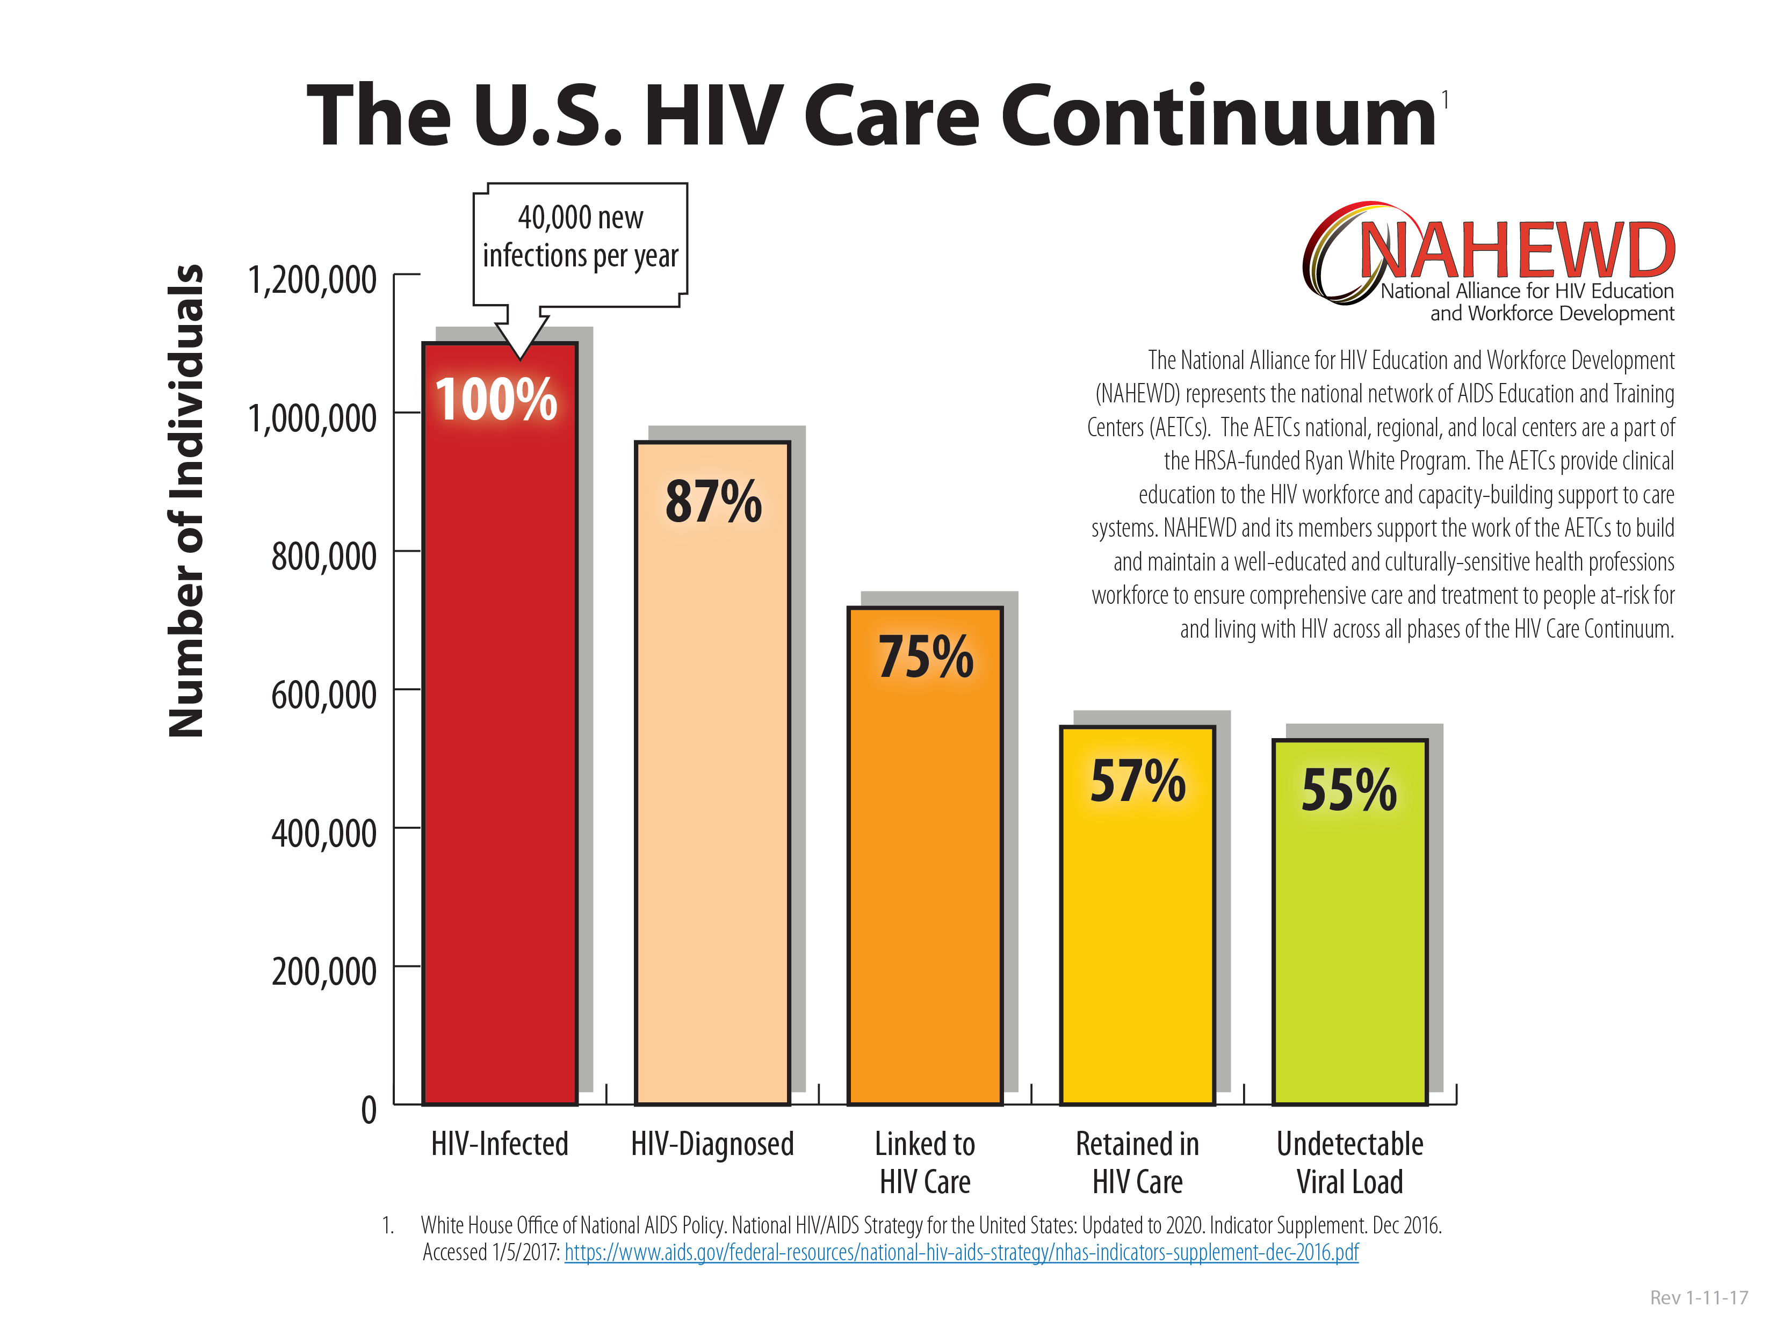
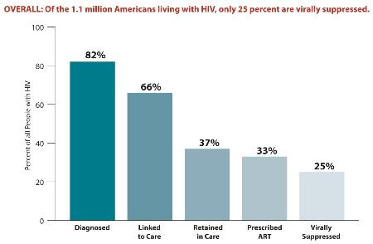
Program Outcomes
Engaged in Selected Stages of the Continuum of HIV Care
Florida Oral Health Care
95%
94%
85%
OO
OO
OO

Slide 15
Best Practices
The most unique practice of the program is to provide a total continuum of care for all patients in a diverse and culturally sensitive and welcoming environment.
An emphasis is placed on both diagnosis of new HIV cases, medication adherence, and retention in care and viral load suppression through collaborative partnerships with multiple providers.
Medical model of care
Clients lost to care are aggressively addressed.
Students providers, community health care professionals, and clients are engaged in an ongoing multidisciplinary educational program stressing the importance of medication adherence, retention in care, viral load suppression, and a health lifestyle.
The outcomes of the program reflect the dedication and unique collaboration of both patients and providers with retention rates and viral suppression rates that exceed national statistics.

Slide 16
Case Presentation
44 year old Female/Haitian
Denies any history of HIV/AIDS
Current Medication List:
Singular
Proair
Pantoprazole Sodium 40mg (GERD)
Fluticasone propriate (allergies)
Hydroxyzine Hcl 25mg (anxiety)

Slide 17
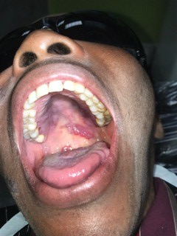
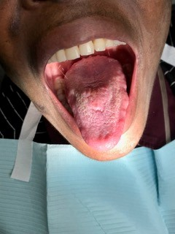
Case Presentation
Lesions observed upon presentation for routine dental visit
Differential Diagnosis: Kaposi Sarcoma, Melanoma, Squamous Cell Carcinoma, HPV

Slide 18
Case Presentation
Patient referred to Nova Southeastern University for Evaluation
Consulted with physician and ordered full lab panel including HIV test, CD4, Viral Load
Referred to Oral Surgery for Biopsy
Linkage to Case Manager/Mental Health Services

Slide 19
Case Presentation
Mode of Transmission/Heterosexual
Date of Diagnosis 1/1/2011
On antiviral therapy in 2013 during pregnancy/child born HIV- then discontinued
Date new antiretroviral therapy started 1/20/2018
CD4 10
Viral load 79,500
Current Medication
Singular, Proair, Genvoya, Bactrim DS 800, Azithromycin 600mg, Pantoprazole Sodium 40mg (GERD),Amoxicillin 875, Fluticasone propriate (allergies), hydroxyzine Hcl 25mg (anxiety),Permethrin 5% (scabies,lice)

Slide 20
Michigan Dental Program
Christine Farrell, RDH, MPA and Pam Manning, RDH, BAS
Michigan Department of Health and Human Services
Oral Health Program

Slide 21
What is the Michigan Dental Program?
A comprehensive dental access program for persons living with HIV/AIDS residing in the State of Michigan
Administered through Michigan Department of Health and Human Services (MDHHS)
Three staff within Oral Health Program
Program coordinator, eligibility specialist and CAREWARE reporting and financial analyst
Dental Benefits Manager is Delta Dental Plan of Michigan

Slide 22
Contract provisions with Delta Dental Plan
Developed Request For Proposal (RFP) and solicited bids in 2015
Awarded the contract to Delta Dental Plan early 2016
GO LIVE DATE was August 1, 2016
Three-year contract with two one year extensions allowed
Uses the Delta Dental PPO Network of general dentists and dental specialists
Approximately 2,000 dentists in network statewide
BONUS: Clients have access to a member dentist less than 20 miles from their home,

Slide 23
Eligibility and Enrollment Process
Meet Income Eligibility Requirements
Cannot have any private dental insurance
Must apply for Medicaid and Healthy Michigan Plan, if eligible
Clients can have both Medicaid and Michigan Dental Program
Michigan Dental Program is payor of last resort
Applications and verification forms are available in three languages, English, Arabic and Spanish
Applications are found on the Oral Health Webpage
www.michigan.gov/oralhealth

Slide 24
MDP enrollment of Men, Women, and Transgender individuals in 2016 (left) and 2017 (right).
August 2016, the MDP hired Delta Dental to become the dental benefits manager. Data shows a steady increase in enrollment after this partnership.

Slide 25
MDP Metrics
Oral Health Metric: Applications received and processed within 10 days.
Metric has been 98%-100% each month.
Ryan White Part B Metric: Percentage of MDP members who received services in 2017.
Total enrollment 1,955 members, 50% received services.
Dental bills paid by Medicaid are not reflected in these numbers.
Ryan White Part B Metric: Viral Load Suppression of MDP members.
Total enrollment 1,955 members, 90% achieved viral load suppression.

Slide 26
Utilization

Slide 27
Highest utilization is diagnostic services of exams and x-rays.
Second highest utilization is restorative or fillings and crowns.
Third most utilized services are preventive or (regular) cleanings and fluoride treatments.
Fourth is treatment and maintenance of periodontal disease (deep cleanings).

Slide 28
MDP paid $363,918.40 covering 3,413 procedures from Aug.-December.
2017 MDP paid $889,574.32 covering 7,981 procedures.

Slide 29
2,449 providers at 1,721 locations statewide

Slide 30
Results MDP Member Satisfaction Survey
September 2017, a MDP Member Satisfaction Survey was mailed to 1,387 enrolled members.
Total of 344 responses were received.
Response rate of 24.8%.
Survey consisted of 17 multiple choice questions.
Question #18 was open ended to allow members to write in comments or feedback.
Over all satisfaction with the MDP is 91%.

Slide 31
Future Goals
OH epi time is now 20% towards the Michigan Dental Program. Goal is for her to review data, analyze and develop picture of MDP impact via fact sheets and surveillance briefs.
Work with the MDHHS Health Equity Steering Committee to create a health equity lens for the Michigan Dental Program.
Encourage members to utilize case managers, so they can be connected to additional resources.
Develop a Dental HIV Symposium in Michigan to offer a day of Continuing Education Credits (CEU’s) for dental professionals.
Implement a Quality Improvement project with the Quality Management team.

Slide 32
Grady Infectious Disease Program
David A Reznik, DDS
Chief, Dental Medicine
Grady Health System - Atlanta
341 Ponce de Leon Ave, Atlanta, GA 30308

Slide 33
Grady’s Legacy of Care
The Ponce Clinic is one of the largest, most comprehensive programs in the U.S. for people living with HIV disease
Almost 2/3 of patients have advanced, symptomatic HIV disease
Grady treats 1 out of 4 persons living
with AIDS in Georgia.
Notes:
Dr. Reznik to touch upon Grady’s legacy of care in this community
Since 1993, Grady’s Infectious Disease Program (IDP) has been housed here in the Ponce Clinic. Located in the heart of the city, the Ponce Clinic is one of the largest, most comprehensive programs for the treatment of advanced HIV in the United States.
More than 60% of people served at the Ponce Clinic have advanced, symptomatic HIV disease. (64%)
The Ponce Clinic is Atlanta’s major provider of care for adults, adolescents and children living with HIV/AIDS – in fact, Grady treats one of our four persons living with AIDS in Georgia.

Slide 34
Who are the IDP patients?
71% Male, 28% Female, <1% Transgender
84% Black/African American, 9% White, 5% Latino/Hispanic
14% <= 24, 35% 25-44, 51% >=45 years of age
32% < FPL, 60% < 2X FPL
42% uninsured, 26% Medicaid, 21% Medicare
64% Stage 3 (AIDS)

Slide 35
Medical Services
Primary Care Clinics | Specialty Services
Adult Clinic | Cancer Care (Hematology/Oncology) including chemotherapy
Women, Family and Youth Clinic | Hepatitis Treatment
Mental Health, Substance Use and Wellness Center | Pulmonary
Oral Health Center | Neurology
Nurse Adherence Education | Ophthalmology
Evening Hours/Walk-In services | Palliative Care
 | Coming soon: Dermatology

Slide 36
Critical Additional Services (Care Completion)
Financial Counseling | Laboratory
Health Education and Peer counseling | Pharmacy including Mail-Order/Specialty Options
Patient Navigation | Radiology
Rapid Entry | Nutritionist
Chaplaincy | Physical Therapy
Translation Services | Medical Transportation
Babysitting | On-site Community Services (Legal Aid, Project Open Hand, The Living Room)

Slide 37
OHC Patient Demographics compared to the IDP
IDP ~ 6,250 | OHC ~ 2,000
28% Female | 25% Female
71% Male | 75% Male
84% Black/African American | 81% Black/African American
9% White | 13% White
5% Latino/Hispanic | 6% Latino/Hispanic

Slide 38
Age Demographics Comparison IDP and OHC
Age | IDP | OHC
24 and younger | 14% | 3%
25-44 | 35% | 28%
45 and over | 51% | 69%

Slide 39
Poor Oral and Mental Health Are Related in PLWH
HIV Is Independently Linked to Poorer Mental Health*
The longer people in a British study had been living with diagnosed HIV, the more likely they were to have depression and anxiety.
ASTRA (+) and AURAH (-) International AIDS Conference in Amsterdam (AIDS 2018).
Poor Oral and Mental Health Are Related in People With HIV**
Depressed participants, compared with those without depression, had worse oral-health indicators, both in terms of their DFMT index score and average number of missing teeth.
The depressed individuals also had lower health-related quality-of-life scores in almost all the domains investigated in the SF-36, such as bodily pain, general health, vitality and social functioning
Oral health and health-related quality of life in HIV patients. BMC Oral Health. 2018 Aug 29;18(1):151.
People with HIV who have depression, the study authors concluded, deserve particularly close attention to their health-related quality of life and their oral health

Slide 40
HAB Core Measure: HIV Viral Load Suppression

Slide 41
HAB Core Measure: Retention in HIV Medical Care

Slide 42
Helene Bednarsh, RDH, MPH, Director Ryan White Dental Program Boston Public Health Commission Infectious Disease Bureau Dental Director NEAETC

Slide 43
Program Description
Services funded are recruitment of dentists and preventive, diagnostic and therapeutic services rendered by licensed dentists and dental hygienists. Currently 185 dental practices work with RWDP.
RWDP also provides education and outreach for clients, consumers, case managers and providers.
Since the beginning of the program we have served approximately 16,500 clients. From August 01, 2016 to July 31,2018 we provided 16,073 units of service to 2,974 unduplicated clients.
Funding is from the Boston EMA Part A and the MDPH
Notes:
This FY $1,518,327 from Part A, 2/3 is for oral health care
MDPH $102,408 69% is for oral health care

Slide 44
Demographic of PLWH Using Oral Health Services 8/1/16 – 7/31/18
Notes:
Age 0% is actually less than 13, 13-19 =.1%
The percent 45 and older closely matches national statistics.

Slide 45
Demographic of PLWH Using Oral Health Services 8/1/16 – 7/31/18
Notes:
Blood product as other
Race other = Asian and Native American

Slide 46
Infographic references can be found here: http://www.aidsetc.org/toolkit/aging/infographic
Notes:
For clients residing in MA Part B and not Boston EMA 2/3 are over 50

Slide 47
Health Outcomes Among Ryan White Part A Clients in the Boston EMA
Notes:
90% of Dental Clients were also enrolled in Medical Case Management Programs
Definitions:
Dental Clients: Any client who received Ryan White Part A ‘Oral Health Services’ and had outcomes recorded from 8/1/16-7/31/18
Non Dental Clients: Any Client who received any Ryan White Part A service except ‘Oral Health’ and had outcomes recorded from 8/1/16-7/31/18
Medication Adherence:
Numerator: Any client from denominator who had an outcome of ‘Excellent Medication adherence’
Denominator: Any Client who had a recorded Medication Adherence Outcome in E2Boston
**Options for medication adherence were ‘In Crisis’, ‘Poor’, ‘Fair/Good’ or ‘Excellent’
Retention in Care:
Numerator: Any client who had a visit with a medical provider in the last six months
Denominator: Sum of any client who had a visit with a medical provider in the last six months AND anyone who did not have a visit with a medical provider in the last six months
Viral Load Suppression:
Numerator: Any client from denominator who had an undetectable viral load (<75 copies)
Denominator: Any client who had a recorded viral load in the measurement period

Slide 48
Retention
Each member of the healthcare team has the opportunity to advise patients of the importance of retention in healthcare
Adherence
The oral healthcare team has a unique opportunity during a health history intake or update to discuss a patient’s HIV care, including medications
The oral healthcare provider can encourage patients to adhere to treatment regimens and discuss how these promote sound oral health
With consent to contact the medical and support teams, we can alert them to oral issues and concerns

Slide 49
Role(s) of the Non-Dental Health Care Provider
Integrating oral health with systemic health
Screening the oral cavity as part of the head and neck examination
Promoting basic oral health and referring for clinical care
Providing preventive and palliative oral health care when indicated
Facilitating referrals for emergent disease of the hard and soft tissues of the oral cavity
Ensuring medically complex patients who may be scheduled for chemo, radiation, infusion, transplants, etc have an infection free oral cavity prior to treatment

Slide 50
Best Practices
Client
Collaboration with medical case managers on enrollment, engagement and updates (generated by client activity).
Client referral based on expressed need and location.
We encourage client communication between medical and dental providers.
Dental Provider
Assist with retention in care and for new referrals to the RWDP.
Clients must be active at the time of service; dental providers are encouraged to check eligibly prior to appointments.
The RWDP Provider manual includes all information on client status, updates, enrollment, scope of service and more.

Slide 51
Best Practices
Medical/Case Manager Model
Goal is to influence those who assist PLWHs entry into oral health care
Include recognition of importance of oral health care as part of primary care and basics of client assessment by asking clients about dental
Include information for referral to oral healthcare
MCMs assist in updating client records every 6 months. Attestation form is available if no changes in client status once annually.
The Boston EMA MCM training program now includes a webinar by the RWDP on how to access our services.

Slide 52
Best Practices
Education and Outreach to Providers and Clients
Providers are sent materials regarding HIV oral health and infection control. Presentations to dental societies and educational institutions. Annual exhibit at the Yankee Dental Congress to educate the broader dental community.
Presentations at PLWH events such as health fairs at AIDS Service Organizations.
Active participation in oral health and HIV advocacy coalitions.
Linkage to Part F
Active referral with Part F programs, which is critical for specialty care but may be limited by institutions due to low reimbursement by Health Resources and Services Administration (HRSA)

Slide 53
Challenges
Oral health literacy and cultural norms may affect a client’s adherence to oral health treatment.
Our client population is aging, medically complex and may present with co-morbidities.
Many clients have not engaged in dental care and present with treatment needs which may be very costly to the program. This can be reduced when medical providers and MCMs refer to the RWDP.
Dental specialists are needed, but few participate in the program due to low reimbursement required by grant criteria. This barrier has been reduced by collaboration with Part F programs.
Ensuring clients are active at the time of dental care – this barrier has been reduced by the attestation form
Notes:
David already noted OHQOL and mental health

Slide 54
Lessons Learned
Our model is innovative, sustainable and replicable. Versions of it have been used in other areas. This model could be adapted for use with other vulnerable populations.
MCM are important for keeping clients engaged with the program and being retained in oral health care.
Dental offices can assist with client retention and provide a source for new clients referrals to the RWDP.
It is critically important to monitor Medicaid and other health safety nets in case of financial or service changes. The program must be prepared to make adjustments should they become necessary.
Notes:
As we experienced in 2010 due to cuts in adult medicaid

Slide 55
Collaboration is Key!
There are many opportunities for dental and medical teams to collaborate to ensure patients with HIV are linked to medical and dental care, retained in care and adhere to care. All of these actions promote better health outcomes and demonstrate the importance of oral systemic associations. We should look at this as a shared responsibility for the health of the clients we serve.
As primary oral healthcare providers please consider the major role you can play in your patient’s health.

Slide 56
Acknowledgements
Thank You to:
Anthony Silva, RWDP, BPHC
Katherine D’Onfro, HASD, BPHC
Contact Information:
Helene Bednarsh, BS, RDH, MPH
Director RWDP, Dental Director NEAETC, VP hivdent.org Boston Public Health Commission 1010 Mass Ave Boston, MA 02118 617-534-2344 fax 617-534-2819 hbednarsh@BPHC.org

Slide 57
Obtaining CME/CE Credit
If you would like to receive continuing education credit for this activity, please visit:
http://ryanwhite.cds.pesgce.com

Slide 58
